Slide 1
Statistical Debugging
Ben Liblit, University of Wisconsin–Madison
Notes:
Copyright © 2007, Benjamin Liblit. All rights reserved.

Slide 2
What’s This All About?
Statistical Debugging & Cooperative Bug Isolation
  Observe deployed software in the hands of real end users
  Build statistical models of success & failure
  Guide programmers to the root causes of bugs
  Make software suck less
Lecture plan
  Motivation for post-deployment debugging
  Instrumentation and feedback
  Statistical modeling and (some) program analysis
  Crazy hacks, cool tricks, & practical considerations

Slide 3
Credit Where Credit is Due
Alex Aiken
David Andrzejewski
Piramanayagam Arumuga Nainar
Ting Chen
Greg Cooksey
Evan Driscoll
Jason Fletchall
Michael Jordan
Anne Mulhern
Garrett Kolpin
Akash Lal
Junghee Lim
Mayur Naik
Jake Rosin
Umair Saeed
Alice Zheng
Xiaojin Zhu
… and an anonymous cast of thousands!
  Or maybe just hundreds?
  I don’t really know

Slide 4
Motivations: Software
Quality in the Real World

Slide 5
Bill Gates, quoted in FOCUS Magazine
“There are no significant
bugs in our released software
that any significant number
of users want fixed.”

Slide 6
A Caricature of Software Development
Requirements
Architecture & Design
Implementation
Testing & Verification
Maintenance

Slide 7
A Caricature of Software Development
Requirements
Architecture & Design
Implementation
Testing & Verification
Maintenance
Release!

Slide 8
Software Releases in the Real World
[Disclaimer: this may also be a caricature.]

Slide 9
Software Releases in the Real World
Coders & testers in tight feedback loop
  Detailed monitoring, high repeatability
  Testing approximates reality
Testers & management declare “Ship it!”
  Perfection is not an option
  Developers don’t decide when to ship

Slide 10
Software Releases in the Real World
Everyone goes on vacation
  Congratulate yourselves on a job well done!
  What could possibly go wrong?
Upon return, hide from tech support
  Much can go wrong, and you know it
  Users define reality, and it’s not pretty
    Where “not pretty” means “badly approximated by testing”

Slide 11
Testing as Approximation of Reality
Microsoft’s Watson error reporting system
  Crash reports from 500,000 separate programs
  x% of software errors cause 50% of user crashes
  Care to guess what x is?
1% of software errors cause 50% of user crashes
Small mismatch ➔ big problems (sometimes)
Big mismatch ➔ small problems? (sometimes!)
  Perfection is usually not an economically viable option

Slide 12
Always One More Bug
Imperfect world with imperfect software
  Ship with known bugs
  Users find new bugs
Bug fixing is a matter of triage + guesswork
  Limited resources: time, money, people
  Little or no systematic feedback from field
Our goal: reality-directed debugging
  Fix bugs that afflict many users

Slide 13
The Good News: Users Can Help
Important bugs happen often, to many users
  User communities are big and growing fast
  User runs  testing runs
  Users are networked
We can do better, with help from users!
  Users know define what bugs matter most
Common gripe: “Software companies treat their users like beta testers”
  OK, let’s make them better beta testers

Slide 14
Measure Reality and Respond
Software quality as an empirical science
  Observed trends rather than absolute proofs
  Biologists do pretty well, even without source code
Observational science requires … observation!
  7,600 Ad-Aware 2007 downloads during today’s lecture
  500,000,000 Halo 2 games in 20 months
  Plenty to observe, provided we can get at the data

Slide 15
Bug and Crash Reporting Systems
Snapshot of Mozilla’s Bugzilla bug database
  Entire history of Mozilla; all products and versions
  60,866 open bug reports
  109,756 additional reports marked as duplicates
Snapshot of Mozilla’s Talkback crash reporter
  Firefox 2.0.0.4 for the last ten days
  101,812 unique users
  183,066 crash reports
  6,736,697 hours of user-driven “testing”

Slide 16
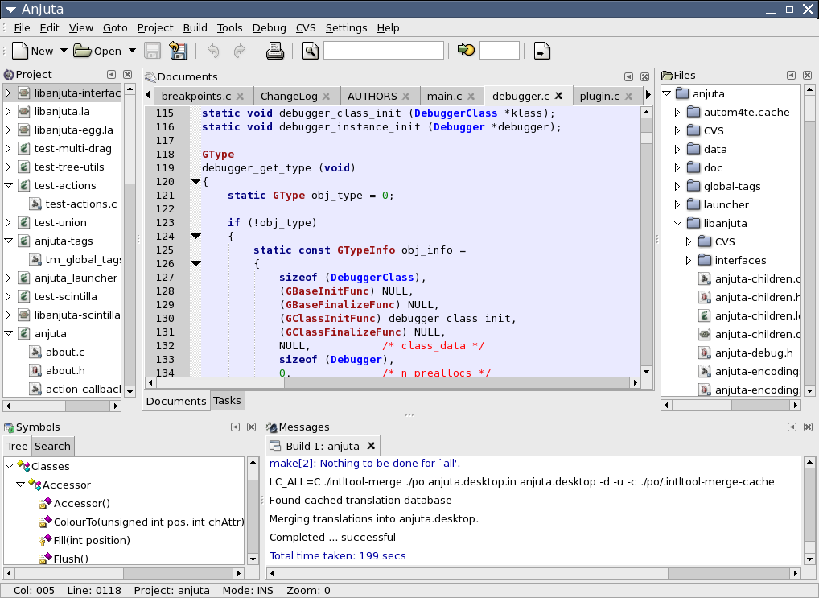



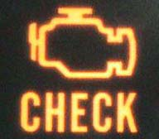
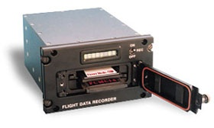
Real Engineers Measure Things;
Are Software Engineers Real Engineers?

Slide 17
Real Engineering Constraints
Millions of lines of code
Loose semantics of buggy programs
Limited performance overhead
Limited disk, network bandwidth
Incomplete & inconsistent information
Mix of controlled, uncontrolled code
Threads
Privacy and security

Slide 18
High-Level Approach
Guess “potentially interesting” behaviors
  Compile-time instrumentation
Collect sparse, fair subset of complete info
  Generic sampling transformation
  Feedback profile + outcome label
Find behavioral changes in good/bad runs
  Statistical debugging

Slide 19
Instrumentation Framework

Slide 20
Douglas Adams, Mostly Harmless
“The major difference between a thing that might go wrong and a thing that cannot possibly go wrong is that when a thing that cannot possibly go wrong goes wrong, it usually turns out to be impossible to get at or repair.”

Slide 21
Bug Isolation Architecture
Predicates
Shipping
Application
Program
Source
Sampler

Compiler
€
ƒ
‚
ƒ
€
Statistical
Debugging

Top bugs with
likely causes
Counts
& J/L

Slide 22
Our Model of Behavior
Each behavior is expressed as
a predicate P on program state
at a particular program point.
Count how often “P observed true”
and “P observed” using sparse but fair random samples of complete behavior.

Slide 23
Predicate Injection:
Guessing What’s Interesting
Predicates
Shipping
Application
Program
Source
Sampler

Compiler
€
ƒ
‚
ƒ
€
Statistical
Debugging

Top bugs with
likely causes
Counts
& J/L

Slide 24
Branch Predicates Are Interesting
if (p)
…
else
…

Slide 25
Branch Predicate Counts
if (p)
// p was true (nonzero)
else
// p was false (zero)
Syntax yields instrumentation site
Site yields predicates on program behavior
Exactly one predicate true per visit to site

Slide 26
Returned Values Are Interesting
n = fprintf(…);
Did you know that fprintf() returns a value?
Do you know what the return value means?
Do you remember to check it?

Slide 27
Returned Value Predicate Counts
n = fprintf(…);
// return value < 0 ?
// return value == 0 ?
// return value > 0 ?
Syntax yields instrumentation site
Site yields predicates on program behavior
Exactly one predicate true per visit to site

Slide 28
Pair Relationships Are Interesting
int i, j, k;
…
i = …;

Slide 29
Pair Relationship Predicate Counts
int i, j, k;
…
i = …;
// compare new value of i with…
// other vars: j, k, …
// old value of i
// “important” constants

Slide 30
Many Other Behaviors of Interest
Assert statements
  Perhaps automatically introduced, e.g. by CCured
Unusual floating point values
  Did you know there are nine kinds?
Coverage of modules, functions, basic blocks, …
Reference counts: negative, zero, positive, invalid
  I use the GNOME desktop, but it terrifies me!
Kinds of pointer: stack, heap, null, …
Temporal relationships: x before/after y
More ideas? Toss them all into the mix!

Slide 31
Summarization and Reporting
Observation stream ➔ observation count
  How often is each predicate observed true?
  Removes time dimension, for good or ill
Bump exactly one counter per observation
  Infer additional predicates (e.g. ≤, ≠, ≥) offline
Feedback report is:
  Vector of predicate counters
  Success/failure outcome label
Still quite a lot to measure
  What about performance?

Slide 32
Fair Sampling Transformation
Predicates
Shipping
Application
Program
Source
Sampler

Compiler
€
ƒ
‚
ƒ
€
Statistical
Debugging

Top bugs with
likely causes
Counts
& J/L

Slide 33
Sampling the Bernoulli Way
Decide to examine or ignore each site…
  Randomly
  Independently
  Dynamically
Cannot use clock interrupt: no context
Cannot be periodic: unfair temporal aliasing
Cannot toss coin at each site: too slow

Slide 34
Amortized Coin Tossing
Randomized global countdown
  Small countdown ➔ upcoming sample
Selected from geometric distribution
  Inter-arrival time for biased coin toss
  How many tails before next head?
  Mean sampling rate is tunable parameter

Slide 35
Geometric Distribution
D = mean of distribution
= expected sample density

Slide 36
Weighing Acyclic Regions
4
Break CFG into acyclic regions
Each region has:
  Finite number of paths
  Finite max number of instrumentation sites
Compute max weight in bottom-up pass
3
1
2
1
2
1
1

Slide 37
Weighing Acyclic Regions
Clone acyclic regions
  “Fast” variant
  “Slow” variant
Choose at run time
Retain decrements on fast path for now
  Stay tuned…
>4?

Slide 38
Optimizations I
Identify and ignore “weightless” functions
Identify and ignore “weightless” cycles
Cache global countdown in local variable
  Global → local at function entry & after each call
  Local → global at function exit & before each call

Slide 39
Optimizations II
Avoid cloning
  Instrumentation-free prefix or suffix
  Weightless or singleton regions
Static branch prediction at region heads
Partition sites among several binaries
Many additional possibilities…

Slide 40
Path Balancing Optimization
4
Decrements on fast path are a bummer
  Goal: batch them up
  But some paths are shorter than others
Idea: add extra “ghost” instrumentation sites
  Pad out shorter paths
  All paths now equal
3
1
2
1
2
1
1

Slide 41
Path Balancing Optimization
4
Fast path is faster
  One bulk counter decrement on entry
  Instrumentation sites have no code at all
Slow path is slower
  More decrements
Consume more randomness
3
1
2
1
2
1
1

Slide 42
Variations on Next-Sample Countdown
Fixed reset value
  Biased, but useful for benchmarking
Skip sampling transformation entirely
  Observe every site every time
  Used for controlled, in-house experiments
  Can simulate arbitrary sampling rates offline
Non-uniform sampling
  Decrement countdown more than once
  Multiple countdowns at different rates

Slide 43
What Does This Give Us?
Absolutely certain of what we do see
  Subset of dynamic behavior
  Success/failure label for entire run
Uncertain of what we don’t see
Given enough runs, samples ≈ reality
  Common events seen most often
  Rare events seen at proportionate rate

Slide 44
Statistical Debugging Basics

Slide 45
Penn Jillette
“What is luck?
Luck is probability taken personally.
It is the excitement of bad math.”

Slide 46
Playing the Numbers Game
Predicates
Shipping
Application
Program
Source
Sampler

Compiler
€
ƒ
‚
ƒ
€
Statistical
Debugging

Top bugs with
likely causes
Counts
& J/L

Slide 47
Find Causes of Bugs
Gather information about many predicates
  298,482 predicates in bc
  857,384 predicates in Rhythmbox
Vast majority not related to any particular bug ☹
How do we find the useful bug predictors?
  Data is incomplete, noisy, irreproducible, …

Slide 48
Sharing the Cost of Assertions
What to sample: assert() statements
Look for assertions which sometimes fail on bad runs, but always succeed on good runs
Overhead in assertion-dense CCured code
  Unconditional: 55% average, 181% max
  ¹/₁₀₀ sampling: 17% average, 46% max
  ¹/₁₀₀₀ sampling: 10% average, 26% max

Slide 49
Isolating a Deterministic Bug
Hunt for crashing bug in ccrypt-1.2
Sample function return values
  Triple of counters per call site: < 0, == 0, > 0
Use process of elimination
  Look for predicates true on some bad runs,
  but never true on any good run

Slide 50
Winnowing Down the Culprits
1710 counters
  3 × 570 call sites
1569 zero on all runs
  141 remain
139 nonzero on at least one successful run
Not much left!
  file_exists() > 0
  xreadline() == 0

