Slide 1
Scalable Defect Detection
Manuvir Das, Zhe Yang, Daniel Wang
Center for Software Excellence
Microsoft Corporation

Slide 2
Part III
Lightweight Specifications for Win32 APIs
Center for Software Excellence
daniwang@microsoft.com

Slide 3
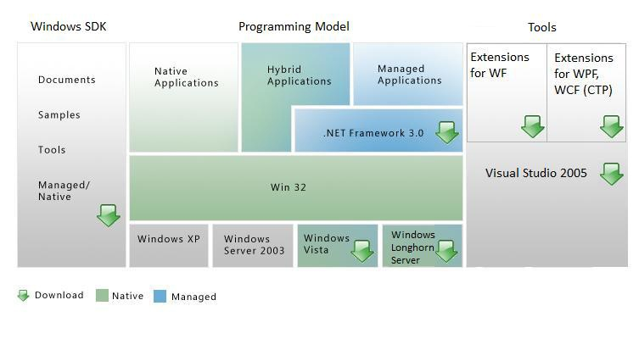
The Win32 API
Win32 API is the layer on which all modern Windows applications are built
.NET is built on top, and contains many managed classes that wrap Win32 functionality

Slide 4
Business Goals
Significantly reduce the number of exploitable buffer overruns in Windows Vista
Change development process so products after Vista are more secure

Slide 5
Standard Annotation Language
Created in summer June 2002 joint effort with product groups and CSE
Specifies programmer intent which leads to:
  Better coverage (reduce false negatives)
  Reduced noise (reduce false positives)
  Ecosystem of tools
  High impact results

Slide 6
Measured Outcomes
#include<tchar.h>
#include<windows.h>
#include<wincrypt.h>
#include<wininet.h>
#include<shlwapi.h>
#include<shlobj.h>
int _tmain(…)
{
return 0;
}
 | Mutable String Arguments | Functions
Total | 1096 | 20,928
Annotated | 1031 | 6,918
Headers for toy application only expose 1/5th of all Win32 APIs
Developers did more than the minimum required for security!

Slide 7
How We Got There!
Manual
Annotation
Lock in progress!
Code
SALInfer
SAL
MIDL Compiler
espX, IO, MSRC, Prefast,
Prefix, Truscan, …
Drive these to zero!
Warnings
Triage Warnings
Code Fixes
SAL Fixes

Slide 8
Focus of This Talk
Manual
Annotation
Code
SALInfer
SAL
MIDL Compiler
espX, IO, MSRC, Prefast,
Prefix, Truscan, …
Warnings
Triage Warnings
Code Fixes
SAL Fixes

Slide 9
Technical Design Goals
Improves coverage and accuracy of static tools
Locks in progress for the future
Usable by an average windows developer
Cannot break existing Win32 public APIs or force changes in data-structures (i.e. no fat pointers)

Slide 10
Technical Design Non-Goals
No need to guarantee safety
No need to be efficiently checked as part of normal foreground “edit-debug-compile” loop
No need to handle all the corner cases
No need to be “pretty”

Slide 11
Take a Peek Yourself!
For MSDN documented Win32 APIs start here
http://msdn2.microsoft.com/en-us/library/aa139672.aspx
or Google “Live Search” for them
Annotated headers can be download from
Vista SDK
first search hit for “Vista SDK”

Slide 12
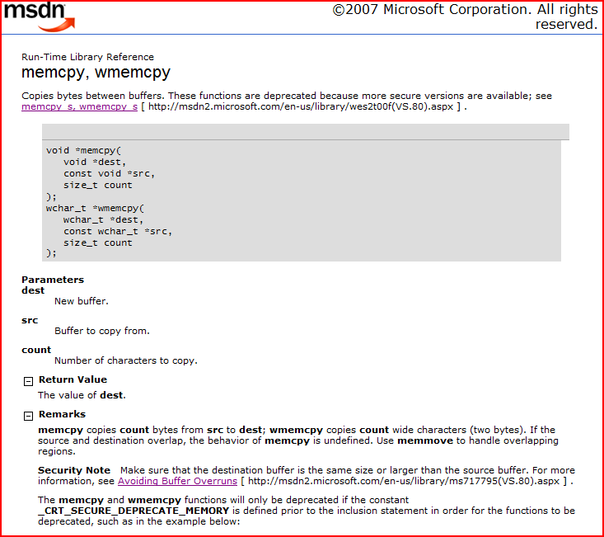
MSDN Documentation for an API

Slide 13
memcpy, wmemcpy, (cont)
For every API there’s usually a wide version.
Many errors are confusing “byte” versus “element” counts
Not all the information is relevant to buffer overruns.
Just say “No” to bad APIs.

Slide 14
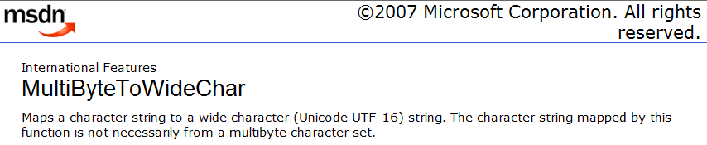
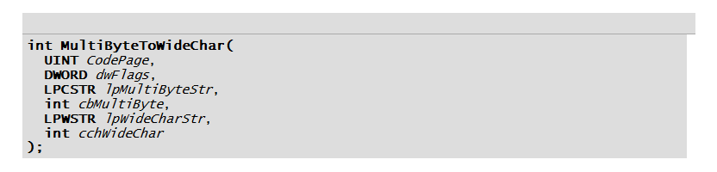
This unfortunately is a typical Win32 API

Slide 15
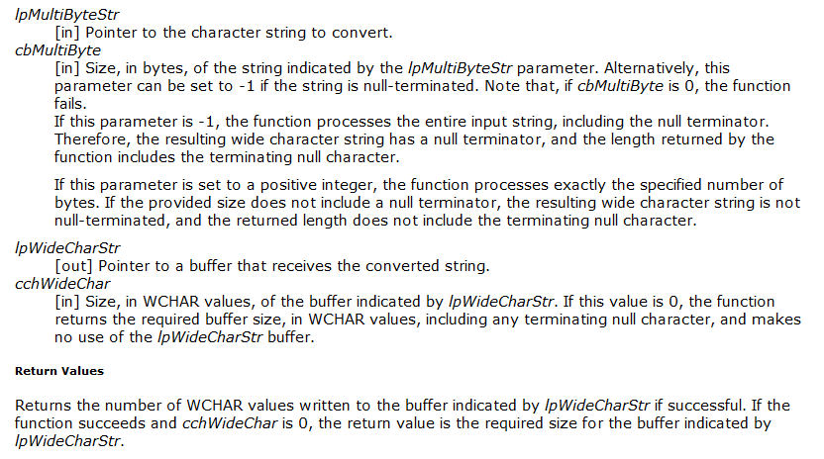
Not so common pattern
A common pattern

Slide 16
How to Solve a Problem like MultiByteToWideChar?
Start with an approximate specification
See how much noise and real bugs you find
Power up the tools and refine until you find the next thing to worry about
Need conditional null termination to handle case when cbMultiByte is -1
Buffer size weakening handles cbMultiByte 0 case

Slide 17
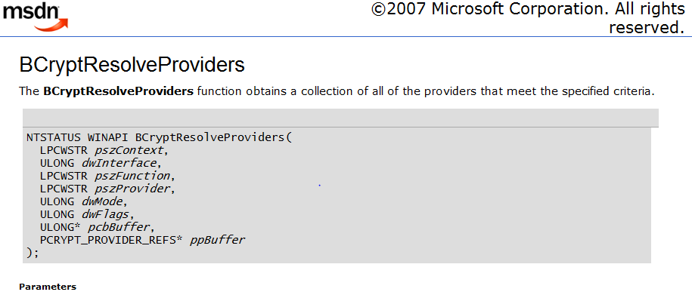

Slide 18
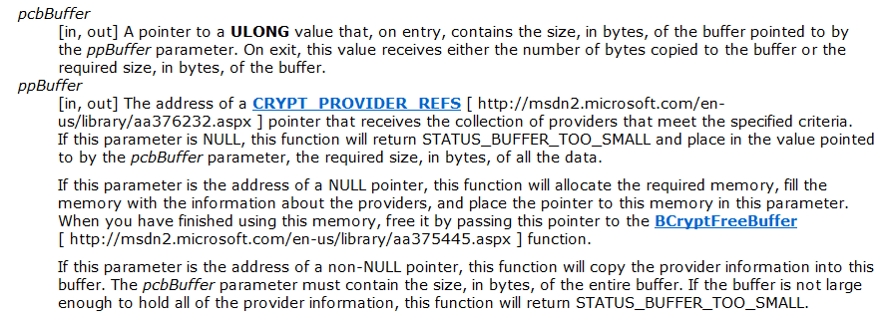

Optional reference argument!
Optional buffer!
A common pattern to communicate buffer sizes to callee

Slide 19
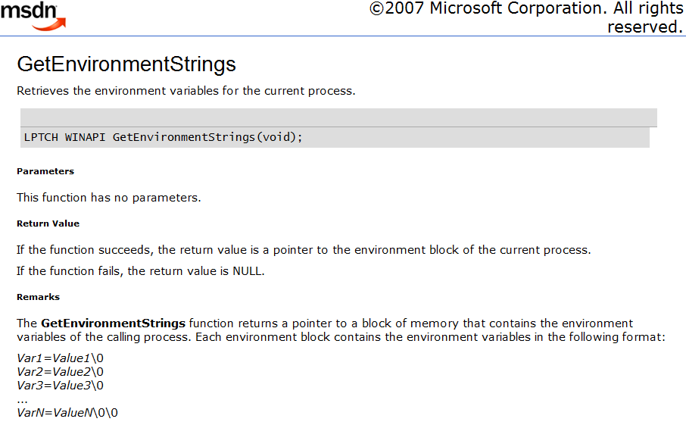
Double null termination!

Slide 20

Does Your Head Hurt Yet?

Slide 21
Does Your Head Hurt Yet?
If only C had exceptions, garbage collection, and a better string type the Win32 APIs would be much simpler!

Slide 22
Does Your Head Hurt Yet?
I WISH IT DID!

Slide 23
The Next Best Thing
Use the .NET Win32 bindings until it does!

Slide 24
The Next Best Thing
So when are they going to rewrite Vista in C#?

Slide 25
So That’s Why It Took Five Years!
Read up about the "Longhorn Reset"
http://en.wikipedia.org/wiki/Development_of_Windows_Vista

Slide 26
So That’s Why It Took Five Years!
Intel and AMD will solve this problem eventually! Until then we have SAL.

Slide 27
MultiByteToWideChar
WINBASEAPI
int
WINAPI
MultiByteToWideChar(
__in UINT CodePage,
__in DWORD dwFlags,
__in_bcount(cbMultiByte) LPCSTR lpMultiByteStr,
__in int cbMultiByte,
__out_ecount_opt(cchWideChar) LPWSTR lpWideCharStr,
__in int cchWideChar);

Slide 28
BCryptResolveProvider
NTSTATUS WINAPI
BCryptResolveProviders(
__in_opt LPCWSTR pszContext,
__in_opt ULONG dwInterface,
__in_opt LPCWSTR pszFunction,
__in_opt LPCWSTR pszProvider,
__in ULONG dwMode,
__in ULONG dwFlags,
__inout ULONG* pcbBuffer,
__deref_opt_inout_bcount_part_opt(*pcbBuffer, *pcbBuffer)
PCRYPT_PROVIDER_REFS *ppBuffer);

Slide 29
GetEnvironmentStrings
WINBASEAPI
__out
__nullnullterminated
LPCH
WINAPI
GetEnvironmentStrings(
VOID
);

Slide 30
End of Section A
Questions?

Slide 31
From Types to Program Logics a Recipe for SAL
A story inspired by true events

Slide 32
A Recipe for SAL
Start with a simple Cyclone like type system
Slowly shape it into a powerful program logic for describing common Win32 APIs
Add some syntactic sugar and abstraction facilities
Mix in a lot of developer feedback
Bake it until it’s properly done!
It’s getting there but still needs some cooking!

Slide 33
Types vs Program Logic
Types are used to describe the representation of a value in a given program state
Program Logic describe transitions between program states
Aside: Each execution step in a type-safe imperative languages preserves types so types by themselves are sufficient to establish a wide class of properties without the need for program logic

Slide 34
Concrete Values
Scalars
Cells
'\0',..,'a','b','c', …
?
'a'
1
…,-2,-1,0, 1, 2, …
Pointers
Extent
'H'
'e'
'l'
'l'
'o'
'\0'
?

Slide 35
Abstract Values
Some Scalar
Some Cell
A,B, … ,X,Y,Z
Some Pointer
Some Extent
…
…
…
n

Slide 36
Program State
Roots
Store
x →
'a'
y →
1
1
p →

Slide 37
Well-Typed Program State
Roots
Store
char x →
'a'
int y →
1
1
int* p →

Slide 38
Well-Typed Program State
Roots
Store
char x →
'a'
int y →
1
int* p →

Slide 39
Well-Typed Program States
Roots
Store
char x →
'a'
int y →
1
1
int* p →
C types not descriptive enough to avoid errors

Slide 40
Well-Typed Program States
Roots
Store
char x →
'a'
int y →
1
1
@notnull int* p →
Use Cyclone style qualifiers to be more precise!

Slide 41
Generalizing @numelts
@numelts(3) int* buf →
1
2
3
int cbuf →
N
@numelts(cbuf) int* buf →
…
…
…
What's wrong with this?
N

Slide 42
Is it Initialized or Not?
int* buf →
1
2
3
int* buf →
1
?
?
int* buf →
1
?
3

Slide 43
Define @numelts(e) as @extent(e,e)
@extent(3,3) int* buf →
1
2
3
@extent(2,3) int* buf →
1
2
?
@extent(??,3) int* buf →
1
?
3
Just give up here!

Slide 44
Refined Abstract Extent
m
Initialized count
…
…
…
where m <= n
n
Extent capacity

Slide 45
Some Special Cases
m
Fully initialized extent
…
…
…
when m == n
…
…
…
when m == 0
n
Some allocated extent

Slide 46
@extent(count,capcity)
@extent(0,3) int* buf →
?
?
?
int cbuf →
N
@extent(0,cbuf) int* buf →
…
…
…
N

Slide 47
Qualified Types Useful for Win32 APIs
t ::= int | void | char | t* | q₁ … q_{n} t
q ::= @range(e₁, e₁) | @relop(e,op)
| @notnull | @nullable | @null | @readonly
| @numelts(e) | @alloced(e) | @extent(e₁, e₂)
| @bsize(e) | @balloced(e) | @bextent(e₁, e₂)
| @zeroterm | @zerozeroterm
op ::= == | <= | >= | !=
e ::= ….

Slide 48
A Qualifed Type for memcpy
@notnull @numelts(count)
void* memcpy(
@notnull @alloced(count)
void *dest,
@readonly @notnull @numelts(count)
const void *src,
size_t count)
It seems to work? What's wrong?

Slide 49
Which One is Right?
void f(@notnull @alloced(1) int *p) {
*p = 1;
}
void f(@notnull @numelts(1) int *p) {
*p = 1;
}
Types don’t capture the state transition!

Slide 50
Program State Transitions
Pre-condition
@alloced(1) int* p →
?
f(&p);
@numelts(1) int* p →
1
Post-condition
Pre-post pair make a up a contract!

Slide 51
Contracts with Program Logics
void f( @Pre{ @notnull @alloced(1) }
@Post{ @notnull @numelts(1) }
int *p) {
*p = 1;
}

Slide 52
Contracts with Program Logics
void f( @Pre{ @notnull @alloced(1) }
@Post{ @numelts(1) }
int *p) {
*p = 1;
}
Simplify because C is call by value!

Slide 53
Contracts with Program Logics
void f( @Pre{ @notnull @alloced(1) }
@Post{ @numelts(1) }
int *p) {
*p = 1;
}
Who in their right mind is going to write that!

Slide 54
Contracts with Program Logics
#define __out \
@Pre{ @notnull @alloced(1) } \
@Post{ @numelts(1) }
void f(__out int *p) {
*p = 1;
}
C Preprocessor macros to the rescue!
Defined to empty string for compatibility.

Slide 55
Single Element Contracts
#define __in \
@Pre{ @readonly @notnull @numelts(1) }
#define __out \
@Pre{ @notnull @alloced(1) } \
@Post{ @numelts(1) }
#define __inout \
@Pre{ @notnull @numelts(1) } \
@Post{ @numelts(1) }

Slide 56
Single Element Contracts
#define __in_opt \
@Pre{ @readonly @nullable @numelts(1) }
#define __out_opt \
@Pre{ @nullable @alloced(1) } \
@Post{ @numelts(1) }
#define __inout_opt \
@Pre{ @nullable @numelts(1) } \
@Post{ @numelts(1) }

Slide 57
Contracts for Element Extents
#define __in_ecount(e) \
@Pre{ @readonly @notnull @numelts(e) }
#define __out_ecount_part(cap,count) \
@Pre{ @notnull @alloced(cap) } \
@Post{ @extent(count,cap) }
#define __inout_ecount_part(cap,count) \
@Pre{ @notnull @extent(count,cap) } \
@Post{ @extent(count,cap) }
Note order of args
Note order of args

Slide 58
Contracts for Element Extents
#define __out_ecount_full(e) \
__out_ecount_part(e,e)
#define __inout_ecount_full(e) …
/* opt versions */
#define __in_ecount_opt(e) …
#define __out_ecount_part_opt(cap,count) …
#define __inout_ecount_part_opt(cap,count) …
#define __out_ecount_full_opt(e) …
#define __inout_ecount_full_opt(e) …

Slide 59
Contracts for Byte Extents
#define __in_bcount(e) …
#define __out_bcount_part(cap,count) …
#define __inout_bcount_part(cap,count) …
#define __out_bcount_full(e) …
#define __inout_bcount_full(e) …
#define __in_bcount_opt(e) …
#define __out_bcount_part_opt(cap,count) …
#define __inout_bcount_part_opt(cap,count) …
#define __out_bcount_full_opt(e) …
#define __inout_bcount_full_opt(e) …

Slide 60
Developers can learn a small set of macros and be productive quickly
Distribution of macros used across Vista source base.

Slide 61
Contract for memcpy
__out_bcount_full(count)
void* memcpy(
__out_bcount_full(count)
void *dest,
__in_bcount(count)
const void *src,
size_t count);
Ignore meaningless pre-condition

Slide 62
What about pointers to pointers?
void f( __out (@nullable int*)* p) {
static int l = 3;
if(…) *p = NULL;
else *p = &l;
}
void f(__deref_out_opt int **p) { … }
Syntax makes applying automatically inferred annotations to legacy code tractable!

Slide 63
How We Got There!
Manual
Annotation
Inference bootstrapped everything!
Code
SALInfer
SAL
MIDL Compiler
espX, IO, MSRC, Prefast,
Prefix, Truscan, …
Warnings
Triage Warnings
Code Fixes
SAL Fixes

Slide 64
What about Nested Pointers?
#define __deref_out_opt \
@Pre{ @notnull @alloced(1) } \
@Deref @Post { @nullable @numelt(1) }
Pushes context of assertion down a pointer level

Slide 65
Annotated Types for Win32 APIs
Annotated type split into annotations and type,
Not mixed in as type qualifiers
t ::= int | char | void | t* | t
at ::= a₁ … a_{n} t
p ::= @range(e₁, e₁) | … | @zerozeroterm
a ::= @Deref a| @Pre { p₁ … p_{n} } | @Post { p₁ … p_{n} } | p
op ::= …
e ::= ….
Actual primitive syntax is different. Just use the macros! Your code will be non-portable if you don't!

Slide 66
What About This Case?
bool f(__out_opt int *p) {
if(p != NULL) {
*p = 1;
return true;
}
return false
}
Need to introduce conditional contracts!

Slide 67
Adding __success(cond)
Most conditional behavior is related to error handling protocols (i.e. exceptions via return codes)
Introduce specialized construct for this case
  __success(expr) f(…); means Post-conditions only hold when "expr" is true (non-zero) on return of function.
Full conditional support on the roadmap!

Slide 68
Using Success
__success(return == true)
bool f(__out_opt int *p) {
if(p != NULL) {
*p = 1;
return true;
}
return false
}
Is _opt the right thing?

Slide 69
Using Success Correctly!
__success(return == true)
bool f(__out int *p) {
if(p != NULL) {
*p = 1;
return true;
}
return false
}
Annotate for successful case!

Slide 70
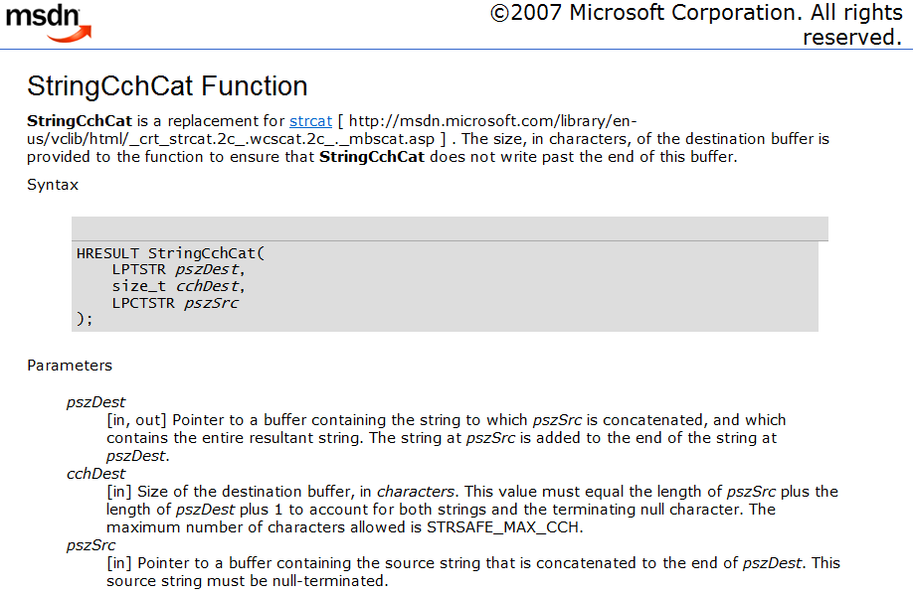

Slide 71
Contracts For StringCchCat
HRESULT StringCchCat(
__post __nullterminated __out
LPTSTR pszDect,
__range(0,STRSAFE_MAX_CCH)
size_t cchDest,
__nullterminated __in
LPCTSTR pszSrc);
Much more verbose than we'd like!

Slide 72
Types with Contracts For StringCchCat
typedef __nullterminated TCHAR* LPSTR;
typedef const LPSTR LPCSTR;
typedef __range(0,STRSAFE_MAX_CCH) size_t
STRSIZE;
HRESULT StringCchCat(
__out LPTSTR pszDect,
__in STRSIZE cchDest,
__in LPCTSTR pszSrc);
Must mean null terminated only in post condition!

Slide 73
New primitive @valid
typedef @zeroterm TCHAR* LPSTR;
void f( @Pre{@notnull @alloced(1)}
@Post{@valid @numelts(1)}
LPSTR s) {
s[0]='\0';
}
Annotations associated with types only happen when an extent is "valid"

Slide 74
Memory Semantics Revisited
Can be written to but nothing is known about its contents
?
Allocated
The contents are in a known state
Initialized
Type specific properties hold
Valid

Slide 75
Lifecycle of a LPTSTR
Allocated
@alloced(3) LPTSTR s →
?
?
?
Initialized
@extent(1,3) LPTSTR s →
'a'
?
?
Valid
@valid @extent(2,3) LPTSTR s →
'a'
'\0'
?

Slide 76
Validity: Related Work
Validity is a lot like the Boogie methodology used in Spec#
  Not as general since validity is just baked into macros
  Many things are conditionally valid because of __success
  Full conditional pre/post will allow more flexibility
Even without it we can do some interesting with Objects
  Treat them like structs!
  Added in a few defaults

Slide 77
Structure Annotations
Describes properties of buffers embedded in structs/classes
Three scenarios supported
  Outlined structure buffers
  Structs with inline buffers
  Header structs
Structure descriptions interact with __in, __out, and __inout to determine pre/post rules for functions using structure buffers

Slide 78
struct buf {
int n;
__field_ecount(n)
int *data;
};
n
…
…
n
struct ibuf {
int n;
__field_ecount(n)
int data[1];
};
…
n
…
n
__struct_bcount(n * sizeof(int))
struct hbuf {
int n;
int data[1];
};
…
n
…
n

Slide 79
Zero Sized Buffers and NULL
struct buf {
int n;
__field_ecount(n)
int *data;
};
0
n
…
…
n
_opt versions available but generally not needed

Slide 80
SAL Annotations for Classes
class Stack {
public:
Stack(int max); // Stack(__out Stack *this,int max);
int Pop(); // int Pop(__inout Stack *this);
void Push(int v); // void Push(__inout Stack *this,int v);
~Stack(); // treated specially
private:
int m_max;
int m_top;
__field_ecount_part(m_max,m_top)
int *m_buf;
};

Slide 81
Conclusions
Developers will accept the use of appropriate light weight specifications!
But must understand the problem and tailor custom solutions
Generic recipe:
  Write the problem down.
  Think real hard.
  Write the solution down.
  Repeat!

Slide 82
Questions?

Slide 83

http://www.microsoft.com/cse
© 2007 Microsoft Corporation. All rights reserved.
This presentation is for informational purposes only.
MICROSOFT MAKES NO WARRANTIES, EXPRESS OR IMPLIED, IN THIS SUMMARY.

