Slide 1
Trinocular: Understanding Internet Reliability Through Adaptive Probing
Lin Quan, John Heidemann, Yuri Pradkin
USC/Information Sciences Institute

Slide 2
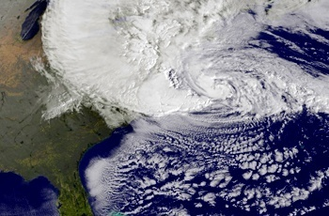
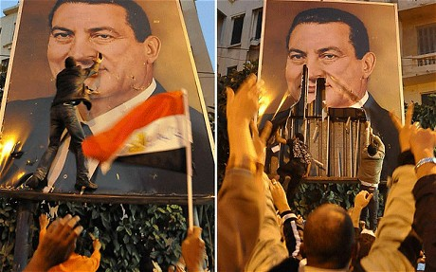
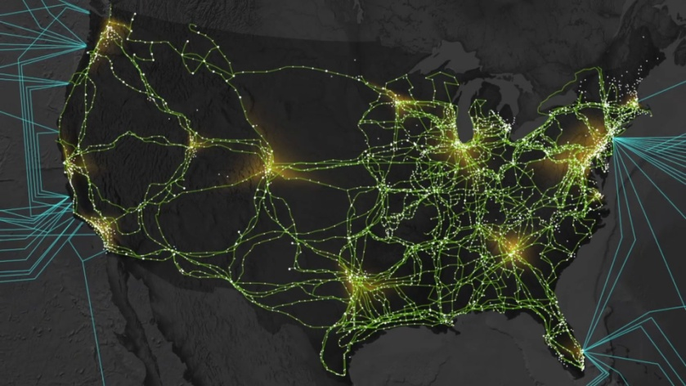
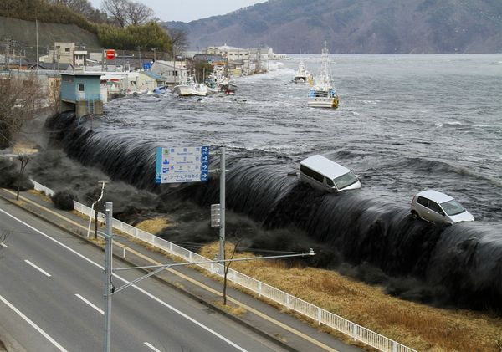
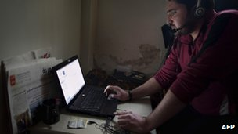
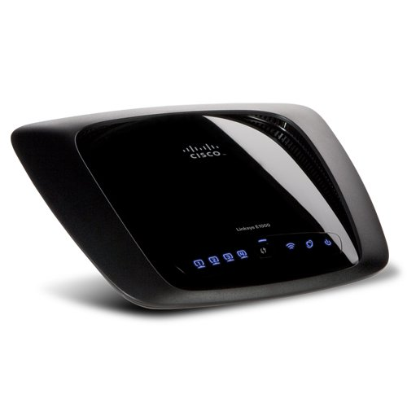
Why Study Internet Outages?
Hurricane Sandy, Oct 2012
Egypt Internet shutdown, Jan 2012
link failures
natural weather events and disasters
political events
network infrastructure problems
Syria Internet shutdown, May 2013
Japan Earthquake, Mar 2011
Home router down

Slide 3
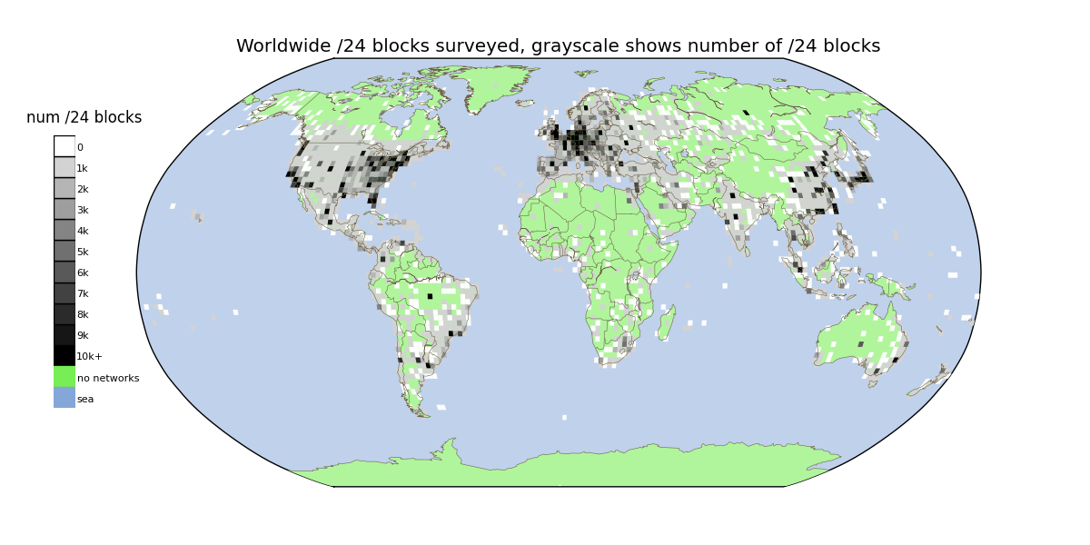
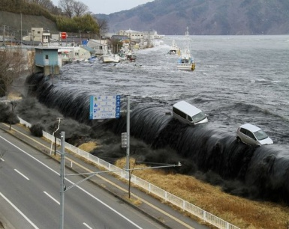
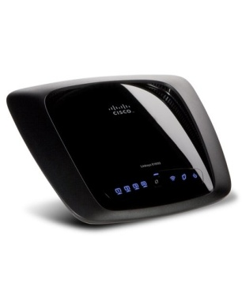
Our Goal: Track All Outages, for All Internet, All The Time
3.4M ping-responsive IPv4 /24 blocks
Hurricane Sandy, Oct 2012
Egypt Internet shutdown, Jan 2012
natural weather events and disasters
political events
link failures
Japan Earthquake, Mar 2011
Syria Internet shutdown, May 2013
network infrastructure problems
Home router down

Slide 4
Why Study Internet Reliability?
Internet Users
am I getting the reliability I pay for?
which ISP is most reliable?
Network Operators
is my ISP more reliable?
Researchers
is Internet health improving?
do correlated events that affect multiple ISPs?

Slide 5
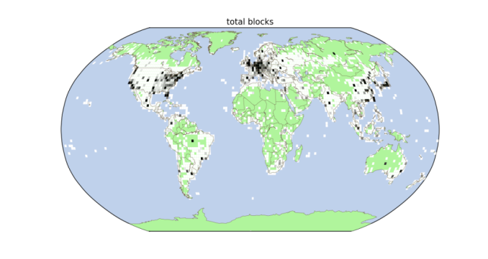
How Is Our Goal Different?
Our goal: track all Internet outages
all ping-responsive IPv4 /24 blocks
all the time
with known precision
Prior work is less complete or less precise
focus on BGP prefixes ([Hubble, NSDI’08], [iPlane, OSDI’06], etc.)
or on-demand study of small sample ([Thunderping, IMC’11])
or based primarily on passive analysis ([Dainotti et al., IMC’11])

Slide 6
Why Is Outage Detection Hard?
challenges
CPU constraints on prober
14.5M allocated /24 blocks
5.6M reply to pings
CPU tops @ 30k probes/s per core
Traffic on target blocks
benchmark: “background radiation” (Wustrow, IMC ‘10): 2-3.3k probes/hour to each /24
we want to be innocuous: us <1% of background radiation
prober ISP goodwill
traffic => complaints
must moderate complaints
goals
precision
must probe frequently
accuracy
must probe many addresses per block
full coverage
must probe many blocks

Slide 7
Trinocular
Trinocular: active ping probes to study reliability in Internet edge
principled: probe only when needed (informed by Bayesian inference)
model who will reply, and how likely
precise: outage duration ±330s (half of probing interval)
parsimonious: only +0.7% background radiation (at target /24, per Trinocular instance)

Slide 8
Trinocular
Trinocular: active ping probes to study reliability in Internet edge
principled: probe only when needed (informed by Bayesian inference)
model who will reply, and how likely
precise: outage duration ±330s (half of probing interval)
parsimonious: only +0.7% background radiation (at target /24, per Trinocular instance)
principled: probe only when needed (informed by Bayesian inference)
model who will reply, and how likely

Slide 9
Pings Tell You Something
But Not Everything
time
negative replies are ambiguous
positive:
block is up
negative:
block is down
or
computer crashed
laptop suspended
computer address reassigned
probe or reply lost
firewall enabled

Slide 10
Pinging Whole Blocks Tells More
time
Probing whole blocks resolves ambiguity
but much traffic:
draws complaints at target
expensive at prober
a.0
a.1
space
a.2
a.3

Slide 11
Probe Less with Simple Model + Bayesian Inference
Probing whole block is correct but wasteful (most probes duplicate info)
Key idea: adaptive probing
Who: use simple block model (outage-centric)
When: guided by Bayesian Inference
=> Minimum necessary probing per block

Slide 12
Adaptive Probing: Probe Just Enough
time
positive responses => block is up
but don’t need all 4 to learn
a.0
a.1
1. instead: probe one by one
2. find one is up
space
=> stop early
a.2
3. if try is down
=> try again
=> stop less early
a.3
4. several fail
=> block down

Slide 13
Ever-active: who will respond
E(b) is who will respond (derived from 3 years of censuses)
E(b) are addresses that ever respond (in plots: green at any time)
sparse
space (0..255 addrs)
time (2 weeks)
|E(b)|=39
medium
|E(b)|=141
dense
|E(b)|=234

Slide 14
Availability: how likely they respond
A(E(b)) is how likely E(b) responds
(from 3 years of censuses; checked at runtime)
consistent
A(E(b))=0.992
medium
A(E(b))=0.637
A(E(b)) is the fraction of time an E(b) address responds (plots: % time green)
intermittent
A(E(b))=0.241

Slide 15
Bayesian Inference: Probe Just Enough to Establish Belief
Belief (B) of block state evolves over time
after positive response
similarly for negative response
stop probing when belief is definitive
down if B(U)<0.1
up if B(U)>0.9
too many probes? declare unknown

Slide 16
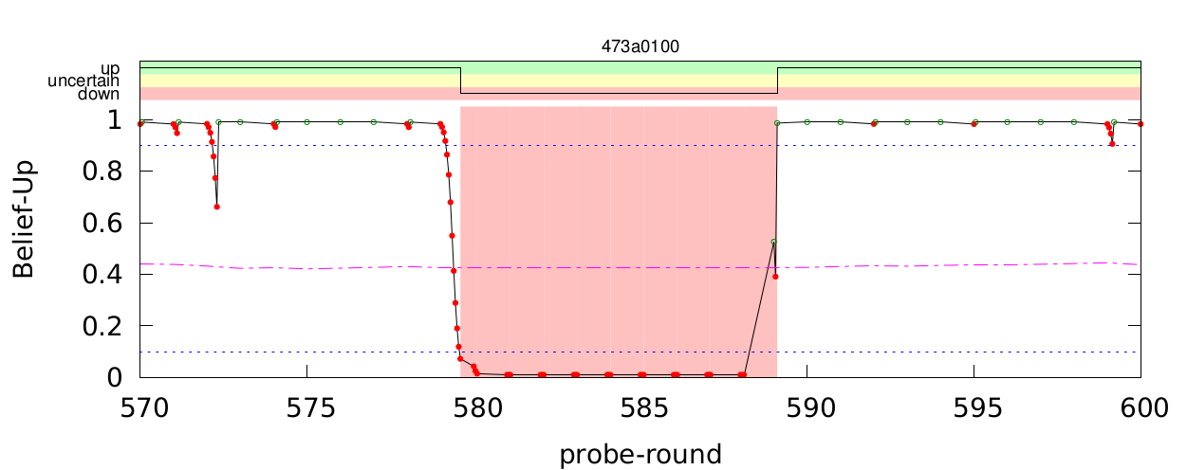
Bayesian Inference Decides: How Many Probes Are Needed
model: every responding |E(b)|=111, active A(E(b))=0.515
this block is sparse but consistent, so only a few probes needed
1 3 1 1 1 2
15
15 probes to confirm down
a few probes
confirm block is still up
ground truth
(data for complete /24)
16

Slide 17
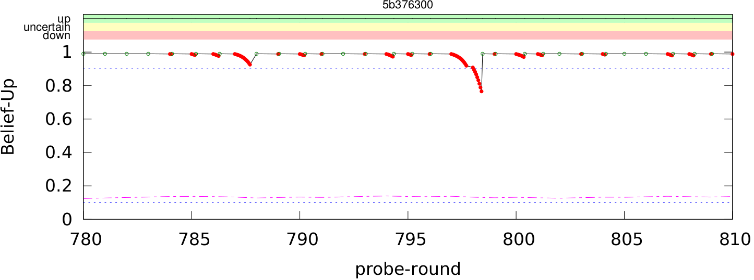
More Intermittent Block
model: every responding |E(b)|=234, active A(E(b))=0.241
this block is dense but intermittent, so sometimes need more probes
2 4 3 2 15 10 2 4 3 1
sometimes need several probes to establish confidence
17

Slide 18
Trinocular’s Probing Types
Periodic probing => guarantees freshness
fixed interval: 11 minutes
Adaptive probing => guarantees accuracy
probes to resolve uncertainty of block state
at short time scale, usually 3s apart
Bayesian inference determines need
Recovery probing => guarantees correctness
special case to handle down-to-up transition
because non-response is ambiguous in intermittent blocks
model determines number required
Details in paper Section 4

Slide 19
Trinocular Instances and Outage Scope
local:
t1≠>d1
t2=>d1
Multiple Trinoculars can separate
local from global outages
(future work: study where and
how many instances are needed)
t1
1 Trinocular instance sees 2 outages:
t1 ≠> d1
t1 ≠> d2
d1
t2
d2
2 instances distinguish local from global:
t1 ≠> d1 BUT t2 => d1 => local to t1
t1 ≠> d2 AND t2 ≠> d2 => “global”
global:
t1≠>d2
t2≠>d2

Slide 20
Trinocular
Trinocular: active ping probes to study reliability in Internet edge
principled: probe only when needed (informed by Bayesian inference)
model who will reply, and how likely
precise: outage duration ±330s (half of probing interval)
parsimonious: only +0.7% background radiation (at target /24, per Trinocular instance)
precise: outage duration ±330s (half of probing interval)
parsimonious: only +0.7% background radiation (at target /24, per Trinocular instance)

Slide 21
Precision and Parsimony
Validation: does Trinocular work?
correctness: next
precision: within ±330s, half of probing interval
probe rate: next
Comparison: why probe /24s?
(details in paper sections 5 and 6)

Slide 22
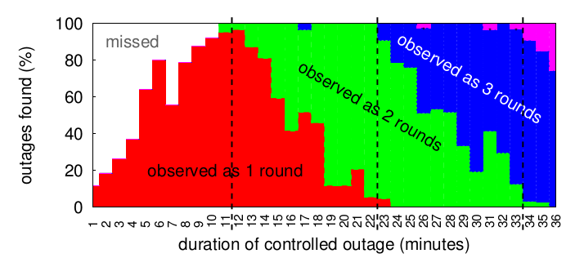
Precise: Detect All Outages?
Controlled outages (random duration, 1 to 36 minutes) in test block, measured from 3 different sites (2 in US, 1 in Japan).
We detect all outages longer than 11 minutes (the probing interval)

Slide 23
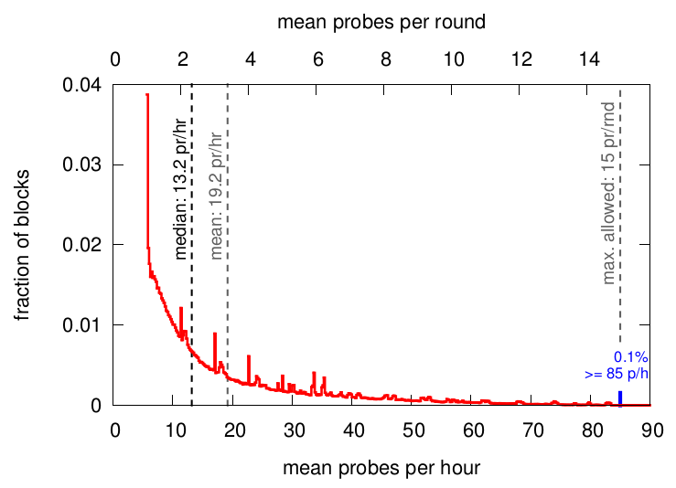
Parsimonious: Probing Rate
post-facto analysis of 48 hours operation
1% of background radiation
(1% = 20-33 pkts/hour)
most blocks are probed with very little traffic
our mean probe rate is less than 1% of background traffic

Slide 24
What Probing Granularity?
What size block should we look at?
routable prefixes (most prior work: [Hubble, NSDI’08], [iPlane, OSDI’06], etc.)
large regions [Dainotti et al., IMC’11]
individual addresses [Thunderping, IMC’11]
Huge performance advantage for bigger
418k routable prefixes vs. 3.4M analyzable /24s (8x more work!)
But what about accuracy and precision?
[Bush et al., IMC ‘09]: reachability ≠ routable prefixes

Slide 25
Coverage: What’s Theoretically Possible
the IPv4 address space
(shown on hilbert curve)
1D:
0 1 2 3 4 5 6 7…
etc.
2D:
0 1 14 15
3 2 13 12
4 7 8 11
5 6 9 10
green: what is routed black: not routed
But active probing requires targets that respond…

Slide 26
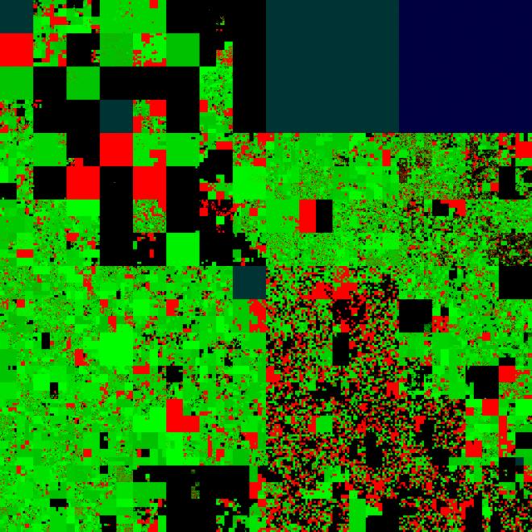
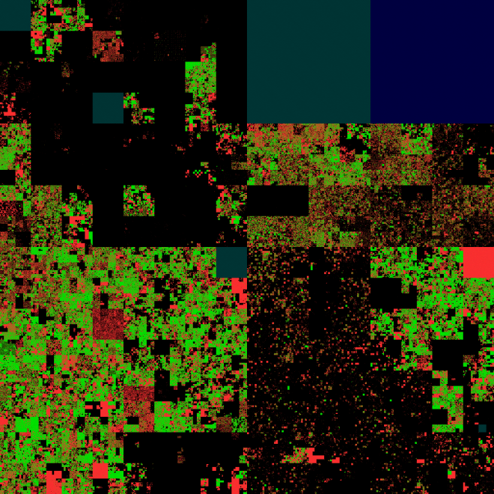
Coverage: What’s Actually Possible
prefix-based
/24 block-based
green: possible
not possible:
red : not measurable
black: not routed
green: has a some .1 that responds
red: no .1 responding
black: not routed
green: >20 address respond
red: <20 address respond
black: not routed
(stricter than Trinocular requires)

Slide 27
Coverage: What’s Actually Possible
very different number of targets (yellow dots)
approaches trade-off:
precision: what could they see? what precision?
accuracy: what do they see correctly?
prefix-based
/24 block-based

Slide 28
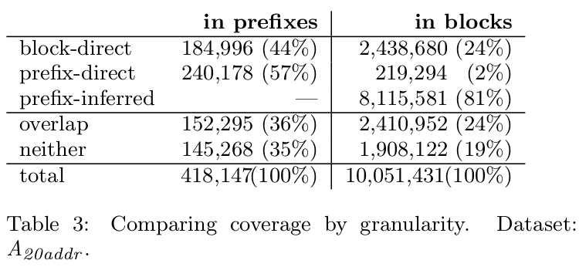
Coverage: Granularity and Precision
measure coverage in two sizes:
routable prefixes /24 blocks
we directly cover more blocks (more yellow dots)

Slide 29
Coverage: Granularity and Precision
measure coverage in two sizes:
routable prefixes /24 blocks
we directly cover more blocks (more yellow dots)
prefix infers many more blocks (more green area)
but is the larger coverage of prefix-based correct?

Slide 30
Coverage: Coarser Granularity => Poorer Accuracy
prefix-based
/24 block-based
prefix-level missed 37% of outages (undercounts)
iPlane will correct with additional traceroutes
truth
under-count outages
prefix-based over-counts 25% of outages:
current approaches will miss partial availability
over-count outages
=> even though prefix-based cover more blocks through inference, this coverage has poorer accuracy

Slide 31
Trinocular
Trinocular: active ping probes to study reliability in Internet edge
principled: probe only when needed (informed by Bayesian inference)
model who will reply, and how likely
precise: outage duration ±330s (half of probing interval)
parsimonious: only +0.7% background radiation (at target /24, per Trinocular instance)
what does Trinocular say?

Slide 32
Observations about the Internet
local vs. global outages
notable outages: Hurricane Sandy, Egypt, Libya, Japan
Internet availability as a whole: 99.3%
(more in paper section 7)

Slide 33
Do Different Sites See Differently?
Prior work shows different sites see different outages
local outages: seen at one
global outages: seen at all
(and in between)
We compare 3 sites
w: ISI-west (Marina del Rey)
c: Colorado State University (Ft. Collins, Colorado)
j: Japan (WIDE at Keio University, near Tokyo, Japan)
Merge outage observations to find overlap

Slide 34
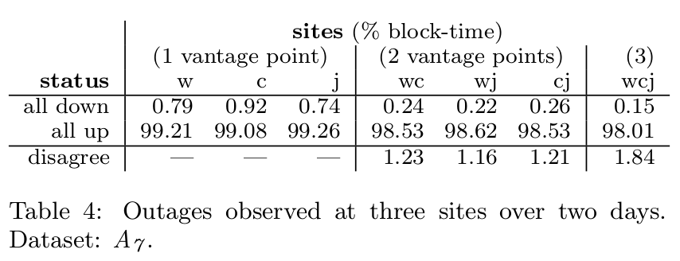
Local vs. Global Outages
many outages are local (near one vantage point)
some outages affect all, estimate 15% are global
(future work: systematically evaluate how number of vantage points affect global outage rate)

Slide 35
Hurricane Sandy: why and how
Can Trinocular see large events?
we next look at Hurricane Sandy
paper covers Egypt, Libya, Japan, etc.
Methodology: reanalyze of existing full-probing survey data
data not driven by Trinocular
reuse existing frequent probing (every 2.6s) of every address
but we apply Trinocular-style analysis
E(b) = all addresses
Dataset: internet_address_survey_reprobing_it51j-20121217

Slide 36
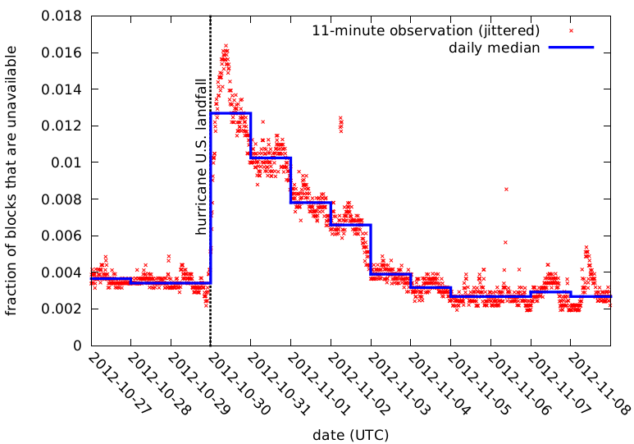
Hurricane Sandy: overall outage rate
after Sandy:
U.S.-level of outages tripled to about 1.2%
(compare daily median, blue line, before and after)
always some outages in US:
about 0.4%
(each red X is amount of U.S. outage for 11 minutes)
gradually back to baseline after about 4 days

Slide 37
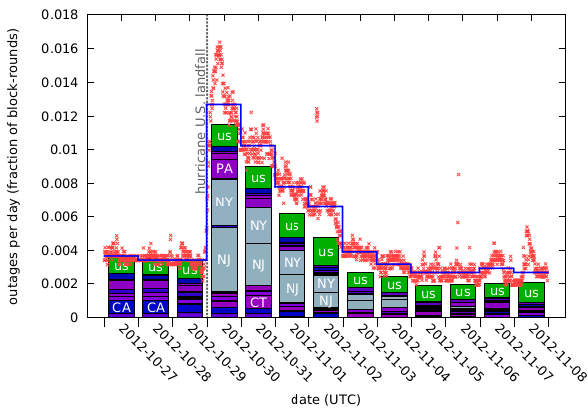
Hurricane Sandy: outages in NY/NJ
geolocation shows outage increase due from New York/New Jersey

Slide 38
Ongoing Work
Current work assumes accurate availability
paper detect and discards cases where low A(E(b)) would result in false outages
Work-in-progress
estimate A(E(b)) as side-effect of outage detection (careful: they are coupled)
Then: long-term study of global outages

Slide 39
Conclusion
We can now measure outages
for the whole Internet edge (continuous probes to 3.5M /24 blocks)
with known precision
single prober is <1% of background radiation
Data is available
http://www.isi.edu/ant/traces/internet_outages
come verify or extend our results

