Slide 1

Wisdom In The Social Crowd: An Analysis Of Quora
Gang Wang, Konark Gill, Manish Mohanlal,
Haitao Zheng and Ben Y. Zhao
University of California at Santa Barbara
gangw@cs.ucsb.edu

Slide 2

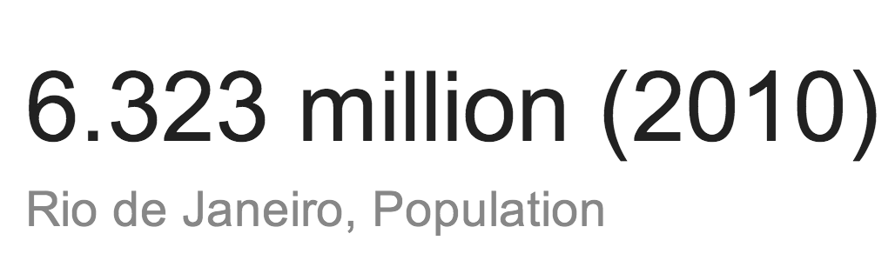


Asking Questions on the Internet
Systems to answer user questions on the Internet
  Google - general information
  Wikipedia - factual knowledge
But we often have questions that require…
  Domain-specific knowledge
  First-hand life experiences
Q: What is the population of Rio?
Q: What is the most interesting souvenir you can buy in Rio?

Slide 3





Online Q&A Services Today
Question and Answer (Q&A) sites
  Web services where people ask and answer questions
  A crowd-sourced way to search information
Large online knowledge repositories
As the Q&A systems grow to massive scales…
  More difficult for users to locate useful answers
  or interesting questions
  Low-value questions (spam) overwhelm the system
  300+ Million questions
  1+ Billion answers
  3.5+ Million questions
  6.8+ Million answers

Slide 4
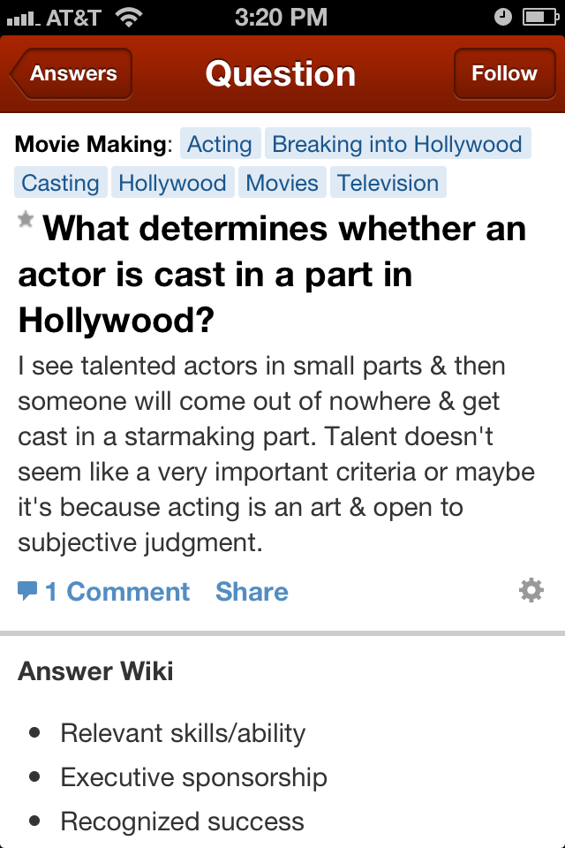
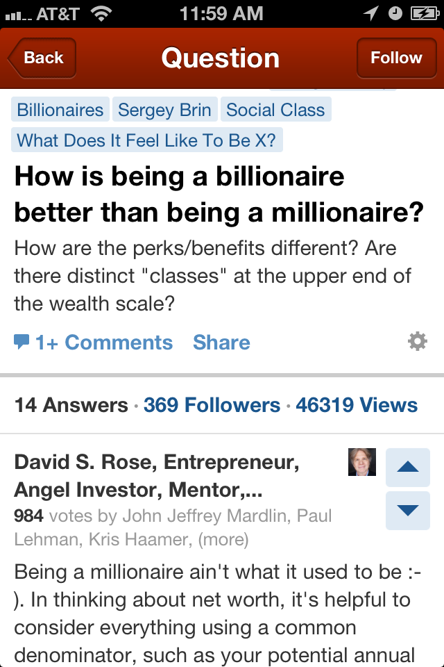
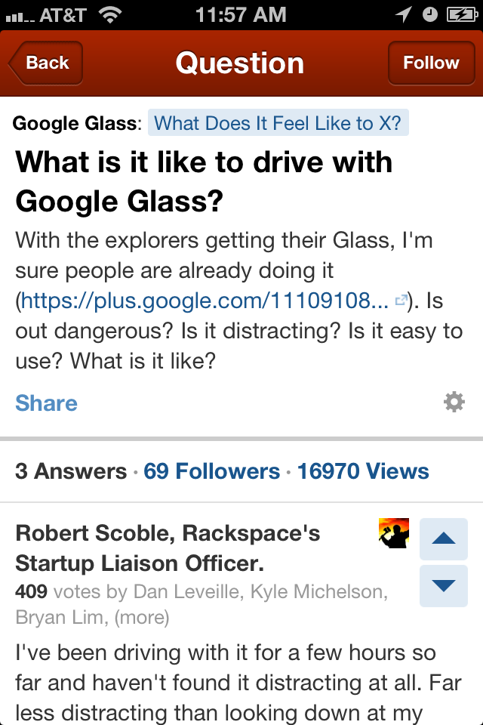
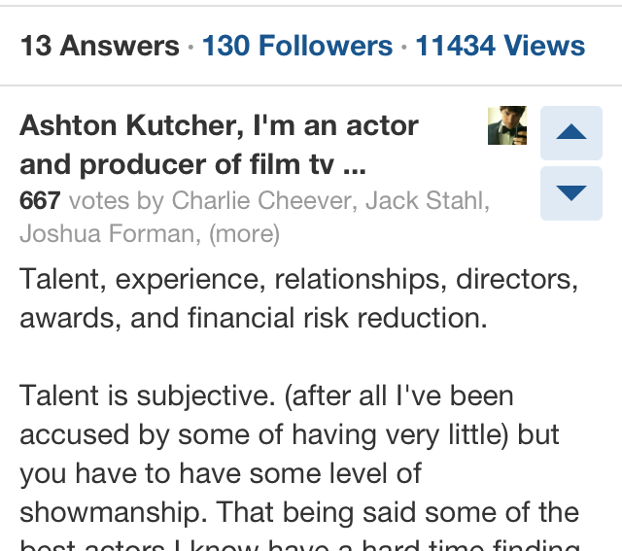
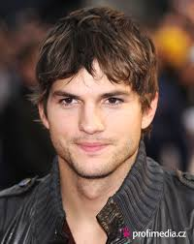
Quora - Social Q&A
“Hottest” (most successful) today
  First social network based Q&A
  350% traffic growth in 2012
  Many answers are returned
  as top answers to Google queries
Quora’s advantages
  High-quality questions and answers
  True domain experts participation
  politicians, actors, startup founders, etc.
How does Quora’s internal structures contribute to its success?

Slide 5

A Measurement Study of Quora
Limited understanding of Quora
  Size of site (questions, users), growth rate
  Mechanisms for content discovery, quality control
Questions we asked in our study
  How does Quora grow over time?
  What’s the impact of social graph on Q&A activities?
  How does Quora direct users to the valuable content?
  Match experts w/ questions, and seekers w/ answers

Slide 6
Outline
Introduction
Characterizing Quora
Analyzing Graph Structures
Implications

Slide 7
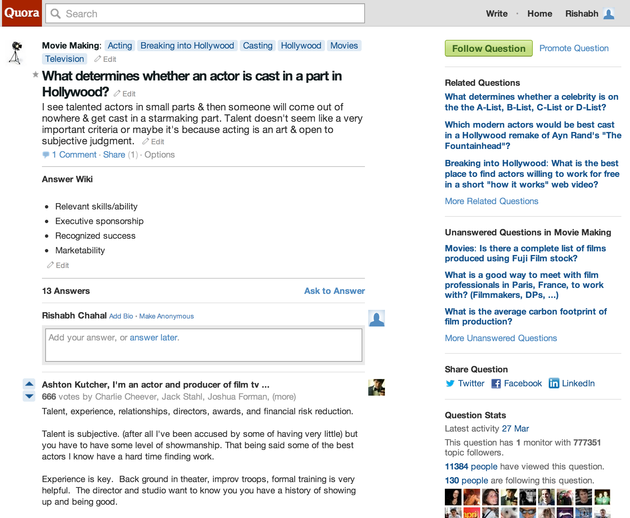
A Typical Question Page
Topics
Related Questions
Question
Votes
Answer

Slide 8


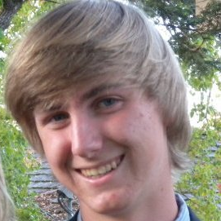

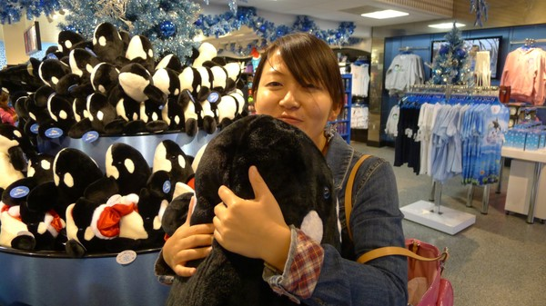

Graphs, Graphs, More Graphs
User-topic graph: user following topics
Social graph: user following other users
Related question graph: connecting related questions
Topics
Q
Q
Q
Q
A
A
A
Q

Slide 9

Data Collection
Website | Data Since | Total Questions | Total Topics | Total Users | Total Answers | Question Coverage
Quora | Oct. 2009 | 437K | 56K | 264K | 979K | 58%
StackOverflow | Jun. 2008 | 3.45M | 22K | 1.3M | 6.86M | 100%
Crawling Quora
  Snowball-crawled related question graph (August 2012)
  Obtained the largest connected component
  Slow speed, minor impact to the site
Using the dataset of StackOverflow as a comparison

Slide 10
Growth Over Time
761K
Total # of questions estimated by Qid
Number of Questions
437K (58%)
Similar growth trend with StackOverflow
2008/7 2009/5 2010/3 2011/1 2011/11 2012/7

Slide 11
Outline
Introduction
Characterizing Quora
Analyzing Graph Structures
  Social Graph
  Related Question Graph
Implications
Details on User-Topic Graph in the paper!

Slide 12
How do social ties impact Q&A activities?

Slide 13
Social Graph Structure
Users can follow other users to build social connections
  Asymmetric social graph
  Users receive items in their newsfeed from people they follow
Social degree has power-law distribution

Slide 14
Is the Social Graph Meaningful?
More answers or high-quality answers == more followers
Social structure could indicate content quality
Correlation between user’s # of followers and
  # of total answers the user wrote
  # of votes the user ever received

Slide 15
Using Social Ties to Attract Answers
Would social ties help to attract answers?
Defining “super-users”
  Top 5% users sorted by # of followers
Social ties have no effect on attracting answers

Slide 16
How does Quora direct users to
“interesting” questions?

Slide 17
Related Question Graph
Q
Q
Q
Related question feature
  Allows users to browse a series of related questions
Related question graph
  Questions as nodes, edges indicates “related” relationships
Graph properties
  Power-law structure
  A small set of “core” questions
  inside each topic
Q

Slide 18
Impact of Question Degree
Strong correlation between question degree and user’s attention on the question
Question graph drives users to “core” questions

Slide 19
User Attention on Similar Questions
Similar questions in Quora
  Questions around very close (same) subjects
  Redundant questions asked by different users
Do users pay equal attention to similar questions?
Locating similar questions by partitioning question graph
  METIS, produce clusters, each contains similar questions
Q
Q
Q
Q
Q
Q
Q
Q
Q
Q

Slide 20
Equal Attention on Similar Questions?
Is user attention evenly distributed in each cluster?
  Gini coefficient (G): evaluate the uniformity of distribution
    G=0: perfect equality
    G~1: extremely skewed distribution
User attention is highly skewed in each cluster
Excellent! users are not distracted by similar questions
G=0
G=0.4
G=0.9

Slide 21
Implication and Conclusion
Implication for crowdsourcing content sites
  Q&A sites
    Users attention is “skewed” to top questions
    Avoid distraction, encourage contribution
  Other sites such as Yelp, TripAdvisor
    Drive enough reviews to key venues
    Ensure reliable rating
The first large-scale measurement study on Quora
Graph structures contribute to effective content discovery
  Social graph indicates content quality
  Question graph focuses user attention

Slide 22
Thank you!
Questions?

