Slide 1
Observing common spam in tweets and email
Cristian Lumezanu Nick Feamster

Slide 2
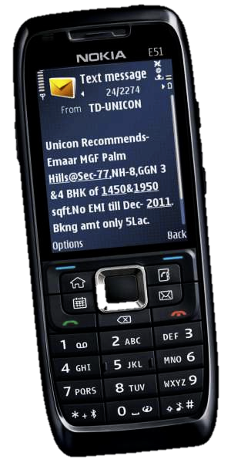
Spam is everywhere
Notes:
It’s a truism: spam is pervasive:
email: 90% of trillions of emails is spam
Social networks: facebook, twitter, 8% of tweets with URLs
IM
Blogs, forums (in comments)
SMS

Slide 3
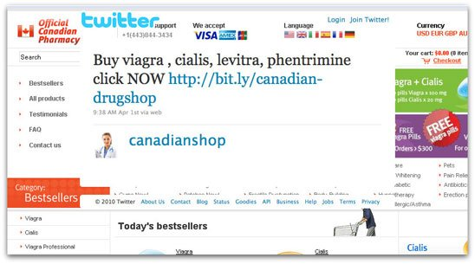
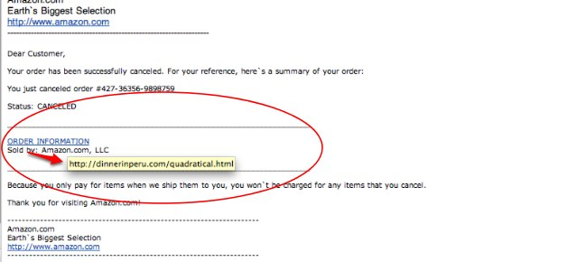
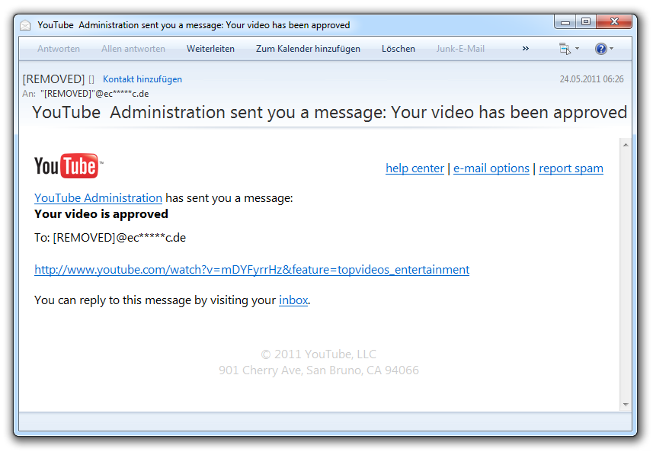
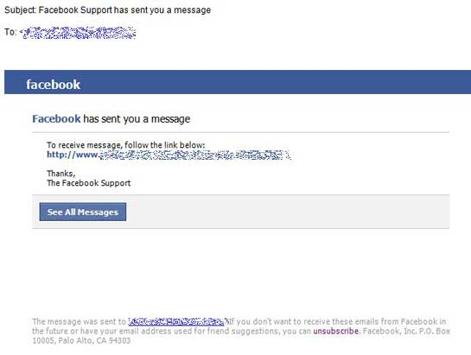
Spam is common
Email
Twitter
Facebook
YouTube
Notes:
To reach more users and maximize their financial gains, spammers are using multiple platforms to disseminate spam.
Here is an example of spam pointing users to a canadian pharmacy shop, carried over four different meda: email, twitter, facebook, youtube
Email helps target a lot of users, OSNs help give focus to the targetting by exploiting the social relationships
There are many spam fighting solutions for each of these platforms but with a few exceptions, they do not work together and collaborate

Slide 4
Fight together!
Notes:
Our long-term vision: fight together! Leverage information about spam across multiple platforms:
help design better filters

Slide 5
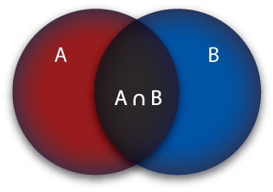
This paper: understand common spam
common?
effective?
Notes:
First step: understand more about the spam that is sent over multiple platforms (email and tweet)
presence: how much spam is there?
effectiveness: will sending on multiple platforms increase the effectiveness of spam?

Slide 6
Data sets
290M emails with URLs
5M tweets with URLs
Notes:
We use two data sets:
Yahoo: all incoming emails to yahoo servers
Twitter: public tweets
Important:
Same period
Around 1%
Steps:
Filtered the messages that did not have URLs
What is spam:
- A message with an URL that points to a malicious website (scam, malware, phishing)

Slide 7
Problem: uneven filtering
Notes:
The data that we have is not perfect: it is not filtered equally
Yahoo emails are raw and have not passed through Yahoo’s filters, while tweets have passed through Twitter’s filter
What does it mean? Tweets have less impurities and there is less common spam than our data sets show. So we cannot provide absolute numbers. A better interpretation of this study would be more from the perspective of email: what common spam does an email filter see if it has access to a public twitter feed.

Slide 8
Common spam
(emails or tweets containing spam domains that appear on both platforms)
740
common spam domains
49M spam emails
(55% “common” with Twitter)
199K spam tweets
(99% “common” with Yahoo)
Notes:
Let’s how much common spam is there in our data sets.
We define common spam as messages that contain spam domains that appear on both platforms.
There are 740 such domains but, in reality there may have been more if we consider the unfiltered tweet feed

Slide 9
Common spam senders
1
0.5
networks that do NOT
send common spam
networks that
send common spam
fraction of
networks
0 0.5 1
spam domain ratio
Notes:
Who sends the common spam? Is there something special about the senders?
We have information about the IP address from which every email was sent. We extract the /24 and for each network we compute the spam domain ratio which is the fraction of spam domains to the total number of domains that originate from this domain. We show the CDF of networks.

Slide 10
Common spam senders
1
0.5
networks that
send common spam
fraction of
networks
send (relatively) more spam
than
networks that do NOT
send common spam
0 0.5 1
spam domain ratio
Notes:
The tendency is that networks that send common spam send more spam than networks that do not. What this means: if a network sends a common spam it is more likely that that network is a heavier spammers. This could help quickly pinpoint the heavier spammers.

Slide 11
Data sets
49M spam emails
199K spam tweets
.com and .net lookup information
Notes:
No let’s look at the effectiveness of common spam vs that of spam on one platform. To measure the effectiveness, we use DNS lookup information. We obtained a data set from Verisign containing lookup for com and net during the same period. It contains information about the /24 recursive resolvers that looked up the spam domains in our data sets. Since some domains do not end in com or net we don’t have info for them.

Slide 12
Effectiveness
1
0.5
0
common
Yahoo only
fraction of
domains
10x
more networks lookup common spam than email only spam
1 10 100 1000 1000000
avg number of lookups per day

Slide 13
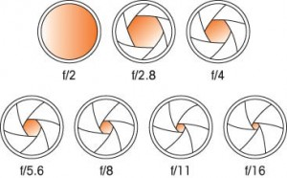
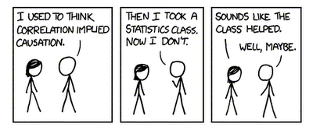
Common spam (now)
better exposure
heavy spammers

Slide 14
Common spam (future)
multiple platform spam fighting

