Slide 1
On the behavior of deviant communities in Online Social Networks
Mauro Coletto, Luca Maria Aiello Claudio Lucchese, Fabrizio Silvestri
Notes:
Thank you for the introduction. Hello everyone. My name is Mauro Coletto and I am a Ph.D. student. This is a joint work with Luca Aiello & Fabrizio Silvestri from Yahoo and Claudio Lucchese from CNR.

Slide 2
ICWSM 2016
On the Behaviour of Deviant Communities in Online Social Networks
Mauro Coletto, Luca Maria Aiello, Claudio Lucchese, Fabrizio Silvestri
http://www.aaai.org/ocs/index.php/ICWSM/ICWSM16/paper/view/13059

Slide 3
Notes:
In social networks, communities naturally emerge around different topics. In particular some groups are centered on matters that are not commonly discussed by the general public because of the embarrassment, discomfort, or shock they may cause. This is the case of what are usually referred to as deviant behaviors.

Slide 4
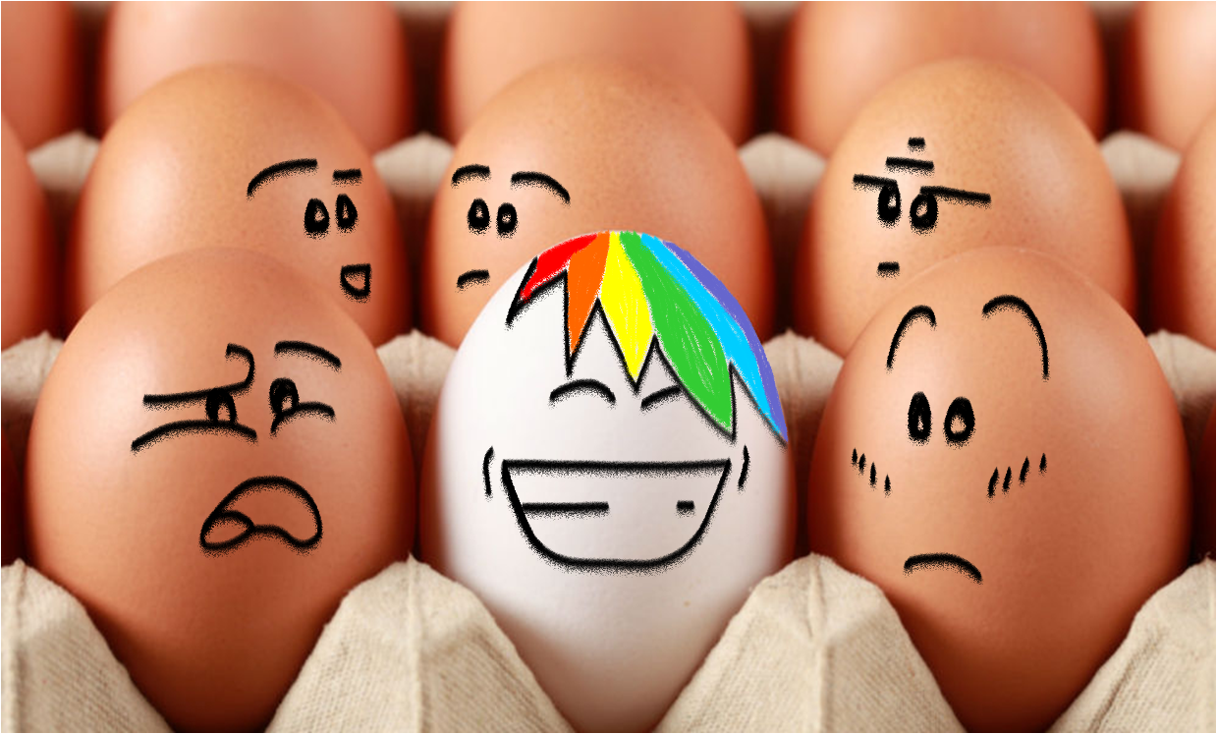
Deviant Behavior
Conducts that are considered inappropriate with respect to the society’s norms or moral standards.
Notes:
Deviant Behaviors are then conducts that are commonly considered inappropriate with respect to the society’s norms or moral standards.

Slide 7
For the first time, we study the interactions of deviant communities with the rest of the social network.
Notes:
In reality, things might be more mixed. People are not segregated. In general-purpose online social networks, people could take part to a deviant community and, at the same time, to other communities that discuss mainstream topics.
For the first time, we study the interaction of deviant communities with the rest of the social network.

Slide 9
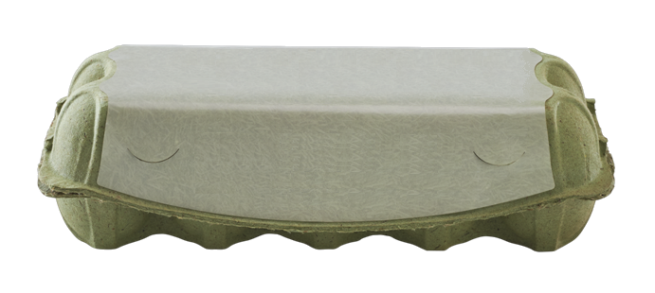
Data
146 M queries
Adult dictionary
Adult blogs: 76 K
Reblog network (1 month) 14 M nodes, 472 M edges
Follow network 130 M nodes, 7 B edges
http://github.com/hpclab/DevCommunities
Notes:
To answer these questions we considered a popular, general-purpose social blogging platform: Tumblr.
We first identify blogs that contain pornographic material using 146M search query log entries and an adult query dictionary. We label as adult all the 76K blogs that are hit by a large portion of adult queries. We also collect a large sample of the Tumblr follow and reblog network in which these adult blogs are included, which covers the vast majority of active users in the social network.

Slide 10
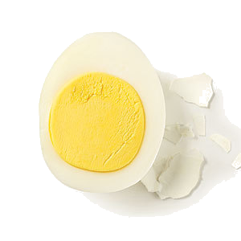
Q1: What is the structure of the deviant community?
Notes:
Let’s analyze the structure of the deviant community.

Slide 16
Q2: How does its content spread in the social network?
Notes:
The deviant community is not isolated but is is small small in comparison with the whole graph. So one might think that even though the deviant network is not isolated, the content spreads only to a few neighboring nodes. Is this true?

Slide 18
Majority illusion:
More than 71% of nodes reblog less deviant content than the average of their friends.
Notes:
Moreover we find that more than 71% of nodes reblogs less deviant content than the average of their friends. Meaning that even the internal perception of the spreading of adult content is high.

Slide 19
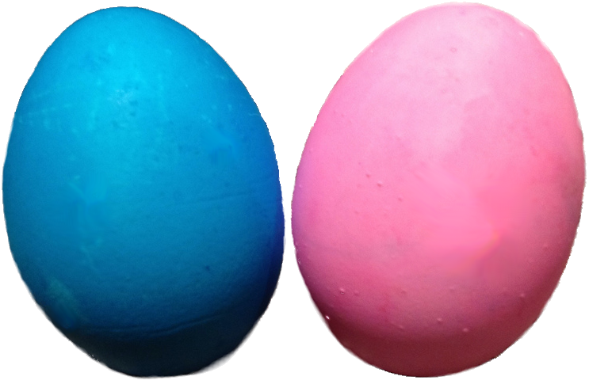
Q3: Who are the actors involved in the process?
Demographic data about 1.7 M users
Notes:
Last we look at age and gender data. Studying the demographics of people involved in producing and spreading deviant content is crucial for sociological and psychological studies. Most of the studies done so far rely on small surveys. Here we consider data about 1.7 M people.

Slide 20
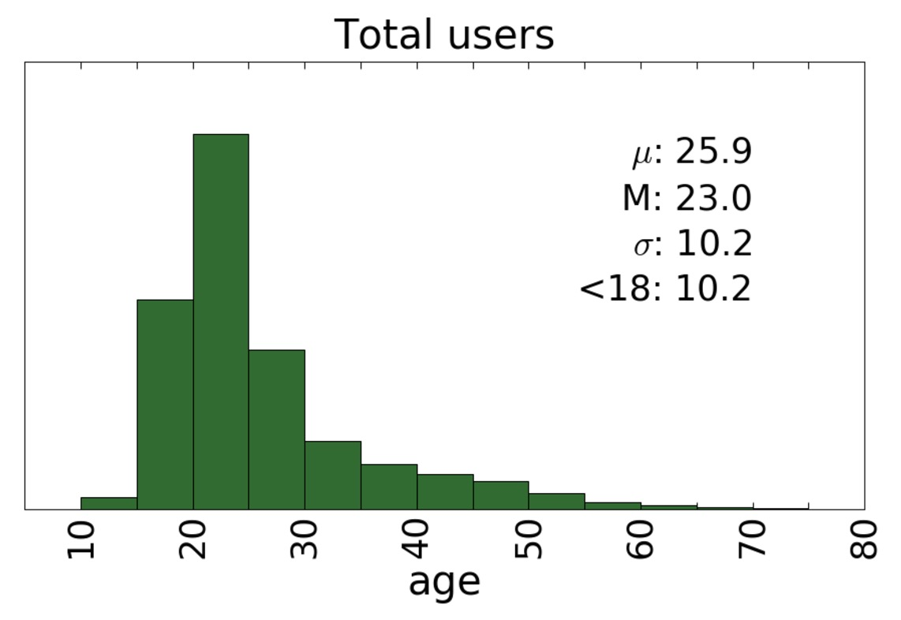
Notes:
This figure shows the distribution of age in Tumblr. Tumblr is a young platform with an average user age of 26 y.

Slide 21
Notes:
We compare this distribution with the age of people in the different classes.
Consumers have a age distribution similar to the overall. It is not the case for producers.
Producers are 12 years older on average, with an higher variance. Moreover the percentage of underage consumers ranges from 9 up to 13 %. On one hand this is a worrying fact..

Slide 22
Targeted intervention
Notes:
On the other hand we see that underage exposure can be drastically contained.
By obscuring the content of the 200 most active deviant blogs the number of exposed minors drop to zero.

Slide 23
TUMBLR USERS:
72%
28 %
Notes:
What about gender? There are more female than male users in Tumblr.

Slide 24
USERS:
72% ♀
28% ♂
PRODUCERS:
18% ♀
82% ♂
CONSUMERS:
68% ♀
32% ♂
Notes:
However if we consider the adult producers we see the opposite: male users are 82%. Among consumers results are more in line with the overall gender distribution

Slide 25
AVG NUM OF PEOPLE PER INTERVAL (5 years): 25K (M), 49K (F)
Notes:
Previous studies have also hypothesized that the IMPACT of age on pornography consumption depends on the gender. We looked at the proportion of male and female who consume adult content by age. Values are max-min normalized by gender. The curve for men shows an increasing trend (maximum in the range of age 35 to 55.) In contrast, women have their peak in their 20s.
The results we showed are consistent with previous survey-based sociological studies.
MIN NUM OF PEOPLE PER INTERVAL (5 years): 1.3K (M), 0.6K (F)

Slide 26
We hope that our work will motivate researchers
who study deviant behaviors to consider them in context.
Notes:
In summary, this is the first large-scale study on the consumption of adult content in a general-purpose online social network (To make sure that the results are not platform-dependent we have also studied the same phenomenon in Flickr and obtained comparable results.) We find that deviant content can spread all over the network: even nodes that reside far away can be exposed. However, the spreading can be easily limited with targeted intervention on very few nodes.
This is only the first step to the study of deviant behaviors in context. We hope that our work will motivate researchers who study all types of deviant behaviors to consider them in context.

Slide 27
Thank you for your attention.
Contact:
mauro.coletto@imtlucca.it
Notes:
Thank you for your attention.

