Slide 1
An Analysis of the Privacy and Security Risks of Android VPN Permission-enabled Apps
Muhammad Ikram (UNSW, Data61, CSIRO)
Narseo Vallina-Rodriguez (ICSI, IMDEA Networks)
Suranga Seneviratne (Data61, CSIRO)
Mohamed Ali Kaafar (Data61, CSIRO)
Vern Paxson(UC Berkeley, ICSI)

Slide 2
Typical VPN Use Cases
VPN Tunnel
Geo-filtered content
Anti-surveillance
Censorship
Untrusted networks
Privacy and Security Risks of Android VPN Permission-enabled Apps | Muhammad Ikram

Slide 3
Android VPN API
Available since Android ≧ 4.0 (Ice Cream Sandwich)
Highly sensitive API
Protected by BIND_VPN_SERVICE
Requires user’s direct action
Users may not understand VPN technology
Lack of apps’ vetting process
Privacy and Security Risks of Android VPN Permission-enabled Apps | Muhammad Ikram

Slide 4
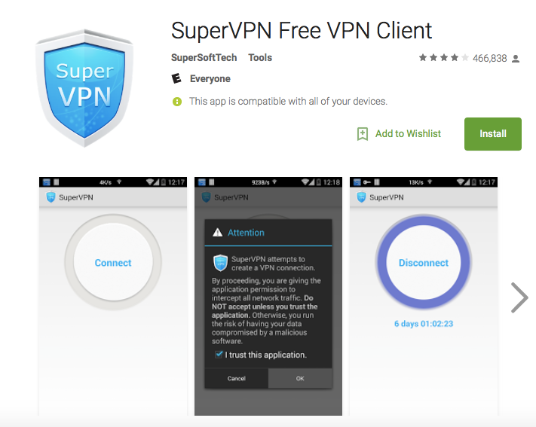
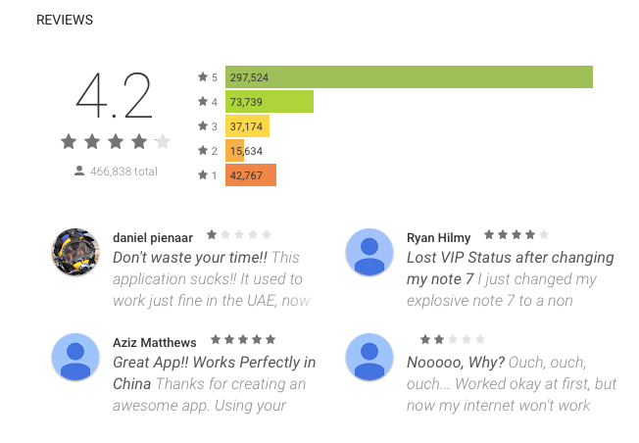
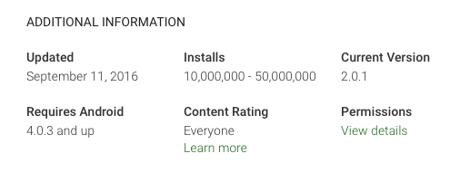
Privacy and Security Risks of Android VPN Permission-enabled Apps | Muhammad Ikram

Slide 5
Are VPN Android apps trustworthy?
Privacy and Security Risks of Android VPN Permission-enabled Apps | Muhammad Ikram

Slide 6
Approach
1. Static Analysis
2. Network Measurements
Privacy and Security Risks of Android VPN Permission-enabled Apps | Muhammad Ikram

Slide 7
Some salient results
Malware presence
Traffic leak
Javascript injection and TLS interception
38% of VPN apps have malware presence (VirusTotal)
18% of VPN apps do not use encrypted tunnels
84% leak IPv6 traffic
66% leak DNS traffic
2 apps inject JavaScript code
4 apps implement TLS interception
Privacy and Security Risks of Android VPN Permission-enabled Apps | Muhammad Ikram

Slide 8
Agenda
VPN App Detection and Methodology
Passive Analysis
Network Measurements
Summary
Developer’s feedback
Privacy and Security Risks of Android VPN Permission-enabled Apps | Muhammad Ikram

Slide 9
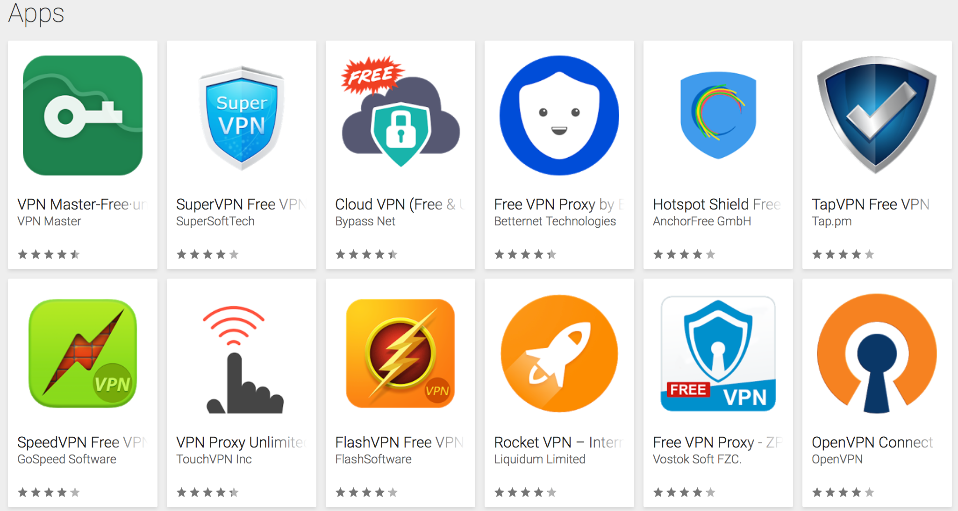
Methodology
Google Play Crawl
(1.4M+ Apps)
Static Analysis
Network Measurements
VPN App
Detection and Classification
Executables and metadata
(apps description, reviews, etc)
Privacy and Security Risks of Android VPN Permission-enabled Apps | Muhammad Ikram

Slide 10
Identified VPN App
App Category | # of apps found (N = 283)
Free VPN apps with Free services | 130
Free VPN apps with Premium services | 153
Privacy and Security Risks of Android VPN Permission-enabled Apps | Muhammad Ikram

Slide 11
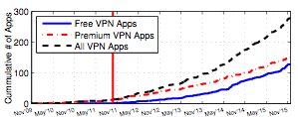
Analyzed VPN Apps - Evolution
Android 4.0 release date
Estimated Release Date
Privacy and Security Risks of Android VPN Permission-enabled Apps | Muhammad Ikram

Slide 12
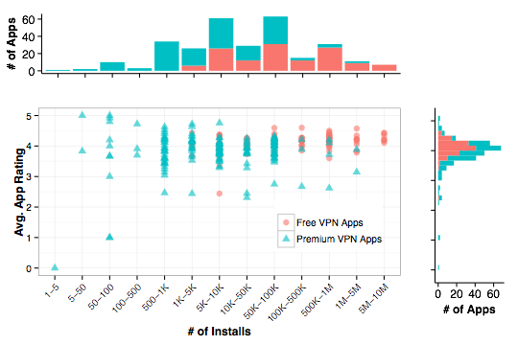
User installs and ratings
37% of apps > 500K installs
55% of apps > 4-star rating
Privacy and Security Risks of Android VPN Permission-enabled Apps | Muhammad Ikram

Slide 13
Static Analysis
Privacy and Security Risks of Android VPN Permission-enabled Apps | Muhammad Ikram

Slide 14
67% of Android VPN apps claim privacy and security enhancement features
Privacy and Security Risks of Android VPN Permission-enabled Apps | Muhammad Ikram

Slide 15
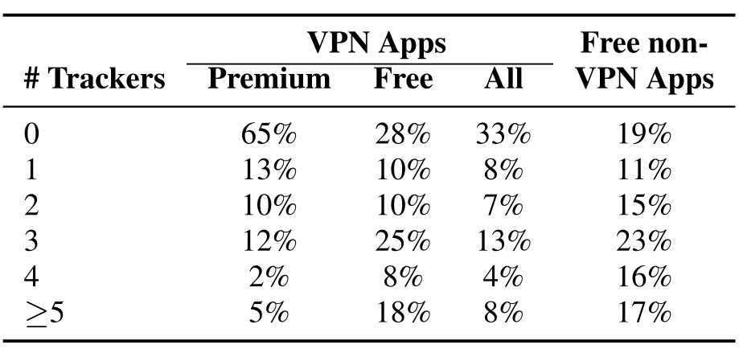
3rd-party Tracking Libraries
67% of VPN apps include 3rd-party tracking libraries
Privacy and Security Risks of Android VPN Permission-enabled Apps | Muhammad Ikram

Slide 16
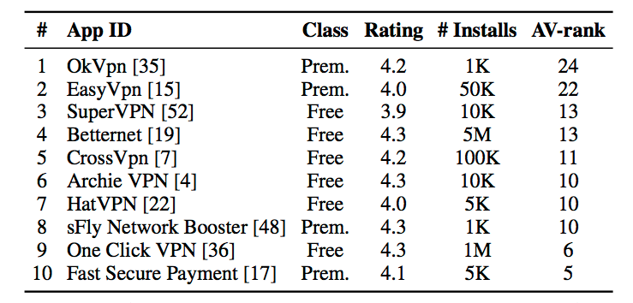
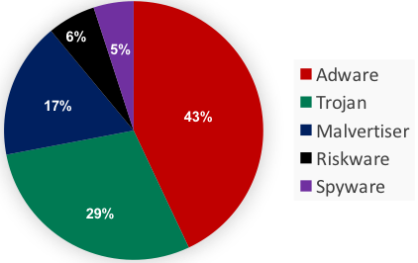
Malware Presence
Scanner: VirusTotal aggregator
AV-rank: number of AV tools reporting malware
38% of VPN apps contain malware with 4% have AV-rank ≧ 5
Privacy and Security Risks of Android VPN Permission-enabled Apps | Muhammad Ikram

Slide 17
Network Measurements
Privacy and Security Risks of Android VPN Permission-enabled Apps | Muhammad Ikram

Slide 18
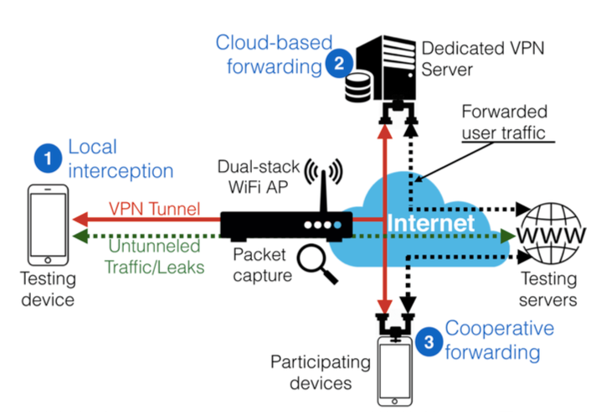
Testbed
Traffic manipulations
Privacy and Security Risks of Android VPN Permission-enabled Apps | Muhammad Ikram
Notes:
SITUATION: Normally, all static code analyses do not fully convey behavioral (or runtime) issues of Android apps. We aim to analyze runtime behavior and networking functionalities of VPN apps to further illuminate on security and privacy issues.
ACTION: POINT 1 - To this end, we devised a test, as you can seen in the figure, that consist of testing device connects VPN endpoints (and internet) via dual WiFI AP. POINT 2 – To measure VPN app’s behavior and networking function, we collect data on testing device (DNS setting, TUN, original and changed IP addresses of testing device), VPN app ON and OFF scenarios, and WiFI AP (tcpdump). We also used Netalyzr for Android for network analysis of VPN apps. Using the the testbed, we performed more than 700 VPN apps installs and 5340 tests (connected to 5340 endpoints).
RESULTS Our testbed revealed several interesting privacy and security related insights, grouped as: traffic interception and forwarding mechanisms, apps vulnerabilities/misconfigurations, traffic manipulation, and TLS-interceptions. [That I will explain in the next slides one by one.]

Slide 19
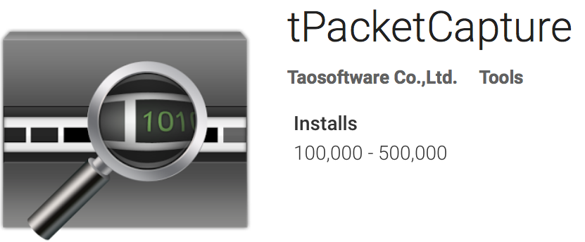
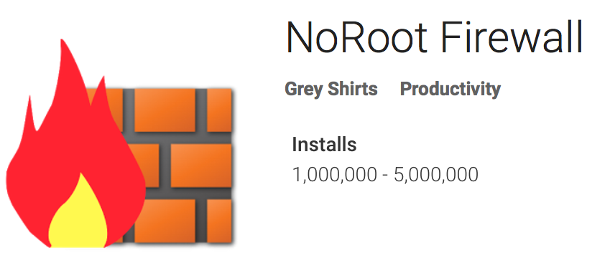
Forwarding models
Tested manually each vantage point reported in the app
18% of apps do not inform about the terminating end-point
4% of VPN apps intercept traffic on localhost
16% use vantage points hosted on residential networks (Spamhaus PBL)
1lt.su
Privacy and Security Risks of Android VPN Permission-enabled Apps | Muhammad Ikram

Slide 20
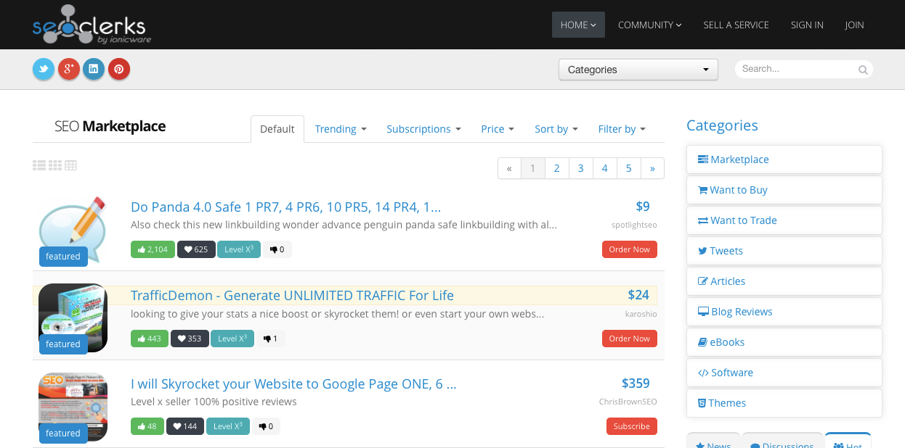
USERS HAVE NO CONTROL! maxhane.com
qudosteam.com
Privacy and Security Risks of Android VPN Permission-enabled Apps | Muhammad Ikram

Slide 21
Traffic leak
18% of apps do not use encrypted tunnels
84% of VPN apps leak IPv6 traffic
66% of VPN apps leaks DNS queries
Users can be potentially subject to in-path modification, profiling, redirection, and censorship.
Privacy and Security Risks of Android VPN Permission-enabled Apps | Muhammad Ikram
Notes:
SITUATION: To provide security and privacy, VPN apps resolve DNS traffic on their servers and modify host’s routing tables to enroute user traffic to its VPN servers. However, VPN developers may have miss-configuration and loop-holes in their source code. In other words, they may not fully enforce policies on host’s DNS resolution and routing tables thus exposing/leaking IPv6 and DNS traffic. We aim to illuminate on those leakages.
ACTION: To this end, we tested each with our testbed. In the figure when VPN app is ON, an attacker (an open WiFi AP at Starbuck/airport or in this case our instrumented WiFi AP acts like passive man-in-the-middle) enforces DNS resolution and over-writes host’s VPN app DNS settings.
RESULTS: [After explaining the third and fourth bullet] and explain that such leakage could expose user traffic to modification, user-profiling, and even to censorship.

Slide 22
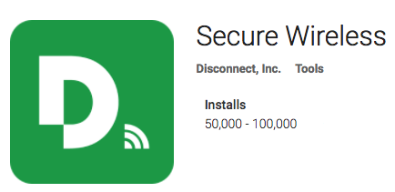
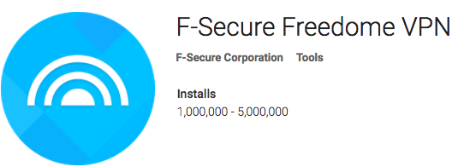
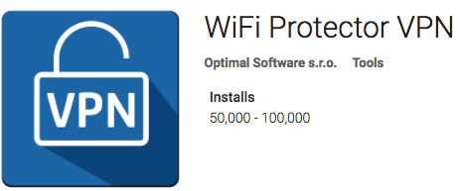
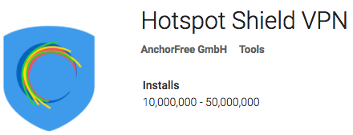
Adblocking and JavaScript Injection
DOM-based analysis
Top 30 Alexa sites, reference website and seven e-commerce sites
Privacy and Security Risks of Android VPN Permission-enabled Apps | Muhammad Ikram
Notes:
SITUATION: VPN apps may actively modify user traffic either by injecting or blocking content. We aim to detect VPN apps performing active traffic modifications – specifically JavaScript injection and adblocking.
ACTION: [Very clear from the first three bullets]
RESULTS: POINT 1 – Two apps, point to Secure Wireless and F-Secure Freedome VPN, blocks advertisements and analytics networks such as DoubleClick and Google Analytics. As we pointed out in our paper that their black list based approach result in usability issues – due to F-Secure Freedome VPN blocking of TagServices useful content such videos were not accessible on Nytimes.
POINT 2 – From our analysis, we found out that two VPN apps, WiFi Protector and Hotspot Shield VPN, are injecting JavaScripts for tracking and advertisements purposes. Hotspot Shield VPN also use JavaScripts to redirect users to its affiliate ad-networks that we reported in our paper, in detail.

Slide 23
TLS Interception
Analysed certificates from 60 websites/domains
Apps compromise root store
Domain(port) | Neopard | DashVPN | DashNet | Packet Capture
amazon.com | ❌ | ✅ | ❌ | ✅
gmail.com | ✅ | ✅ | ✅ | ✅
orcart.facebook.com (8883) | ✅ | ❌ | ❌ | ✅
bankofamerica.com | ✅ | ✅ | ✅ | ✅
hsbc.com | ❌ | ✅ | ❌ | ✅
Privacy and Security Risks of Android VPN Permission-enabled Apps | Muhammad Ikram
Notes:
SITUATION: VPN apps may target user HTTPS traffic for extensive user profiling or provision of specialized services such traffic acceleration and compression. We aim to identify all such apps. We are also interested to figure out whether these apps target perform TLS interception for all user traffic or aiming at some specific services such as Banks, IM, Emails or social networks.
ACTION: For each analyzed VPN apps, we use OpenSSL and customized scripts to access 60 different websites/domains consist of OSN, banks, emails, and news services (detailed in our paper) from our testing device. For each website/domain, our customized scripts and OpenSSL result in SSL certificate chain that we analyzed with ICSI Notary to check the validity of certificate chain.
RESULT: We found 4 apps are performing TLS interception. Packet Capture intercepting all HTTPS traffic whilst all other 3 VPN apps are focusing on shopping, banks, and social media traffic. Upon our enquires, Neopard’s developer confirmed that they are performing TLS interception for traffic acceleration and MARKET research – selling aggregate statistical data.
[There are more interesting insights and we encourage you to read our paper.]

Slide 24
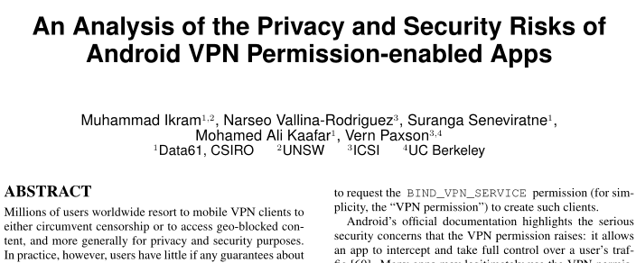
More details:
Privacy and Security Risks of Android VPN Permission-enabled Apps | Muhammad Ikram

Slide 25
“And isn’t it ironic?”
Do users care or know?
Manually analysed negative reviews (4.5K) (1- and 2-Stars)
< 1% of the negative reviews raised privacy and security concerns
Privacy and Security Risks of Android VPN Permission-enabled Apps | Muhammad Ikram

Slide 26
Summary
38% of apps have malware presence
67% of apps have at least one third-party tracking library
66% of VPN apps have DNS leakages and 84% have IPv6 Leakages
2 VPN apps perform JS-injection for ads, tracking, and redirections
4 VPN apps perform TLS interception
Privacy and Security Risks of Android VPN Permission-enabled Apps | Muhammad Ikram

Slide 27
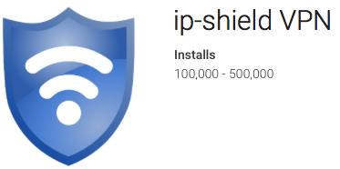
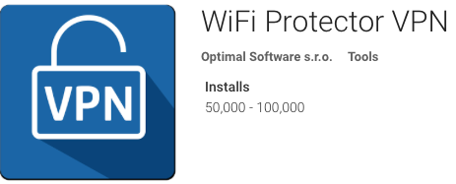
Developer Feedback and Reactions
“… Appflood [third-party library] was the best choice to monetize the app”.
Now: ads- and tracking free app
Confirmed JS-Injections for tracking users and showing their own advertisements
Now: status quo
Privacy and Security Risks of Android VPN Permission-enabled Apps | Muhammad Ikram
Notes:
SITUATION: Did our study impact on VPN apps ecosystem?
ACTION: We shared our results with all the developers whose apps were explicitly discussed in the paper. We shared our findings and explained that presence certain intentional features or errors undermine user privacy and security. From 21st to 25th of October, we selectively tested VPN apps to confirm whether the developer made changes or not.
RESULT: ip-shield VPN acknowledged that they used Appflood, a third-party tracking library, to maximize their revenue from targeted advertisements. They promised to stop this to ensure user privacy. We found out that the developer removed all third-party tracking and advertisement libraries from ip-shield VPN source code.
Whilst WiFi Protector VPN also acknowledged our finding however still injecting JS for tracking and advertisement purposes.

Slide 28
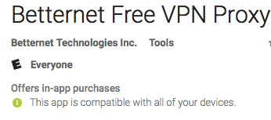
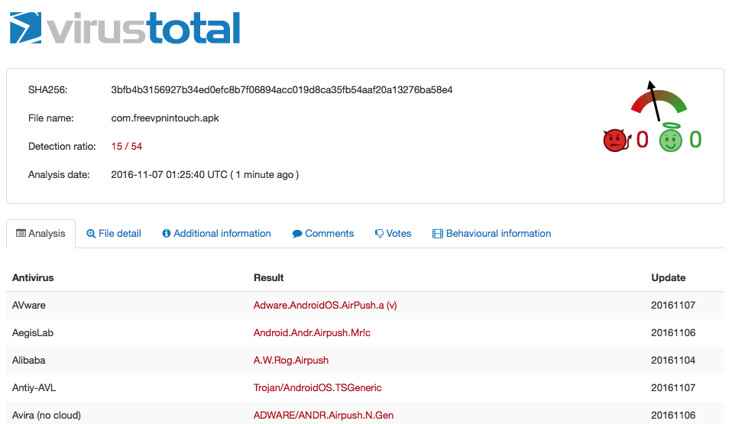
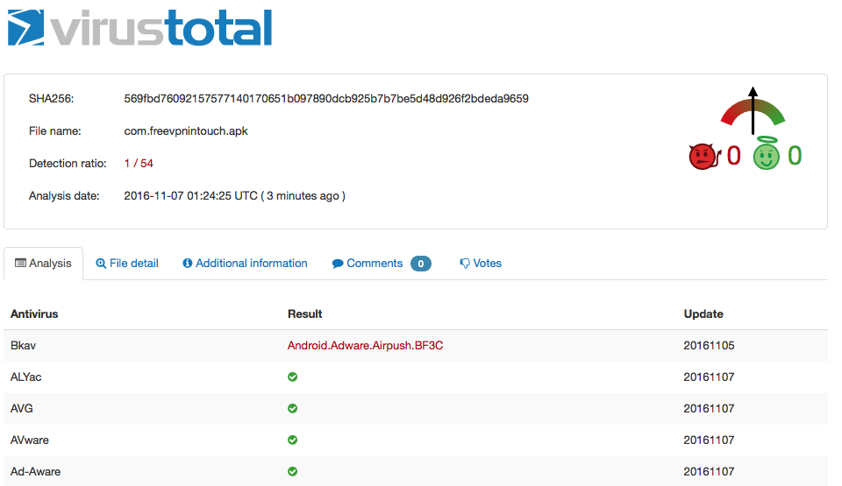
Developer Feedback and Reactions
“… we will promise these problems never occur again.”
15 AV-RANK
1 AV-RANK
November 2015
October 2016
Privacy and Security Risks of Android VPN Permission-enabled Apps | Muhammad Ikram
Notes:
SITUATION: Did our study impact on VPN apps ecosystem?
ACTION: We shared our results with all the developers whose apps were explicitly discussed in the paper. We shared our findings and explained that presence certain intentional features or errors undermine user privacy and security. On 7th of November, we tested VPN apps that have some malware in the source code to confirm whether the developer made changes or not.
Figure on the left : VirusTotal Scan, dated on 7th November 2016, of the Betternet Free VPN’s APK that we analyzed in our paper
Figure on the right : VirusTotal Scan, dated on 7th November 2016, of the Betternet Free VPN’s APK that we downloaded 22nd October, 2016.
RESULT: Only one VPN developer took action and fulfilled promise to remove malware from its VPN app source code.

Slide 29
Thanks Q&A
Muhammad Ikram
muhammad.ikram@data61.csiro.au

