Slide 1
Emotions, Demographics and Sociability in Twitter Interactions
@meghaarora42
Kristina Lerman, Megha Arora, Luciano Gallegos, Ponnurangam Kumaraguru (PK), David Garcia
Session V: Users, Opinions and Attitudes 1 @ ICWSM’16
19th May 2016
Notes:
Hi everyone! I am Megha Arora and am here to present my paper titled ‘Emotions, Demographics and Sociability in Twitter Interactions’. Prof.PK and David, co-authors of the paper are also in the room (point out)

Slide 2
Who am I?
A proud alumna of
Going to join for MSCS, with a specialization in data science
Started working with Dr. Lerman at
Have been a part of for last 3 years

Slide 3
Notes:
Remember the last time you went to a formal gathering… Apart from judging people on the basis of what they are wearing and what car they came it, we end up noticing more subtle things. We pay attention to their social interactions. If the person is standing in one corner throughout, or interacting with just a couple of others. Then there are those who interact with a lot of other people.. frequently referred to as the ‘life of a party’.. We often perceive them as happy beings, which is based on the intuition that structure of our social interactions shapes individual fitness and well being..

Slide 4
Motivation
Structure of social interactions shapes individual fitness and well-being
What factors affect social interactions?
Cognitive factors: emotions
Socio-economic factors: income, education, demographics
Can we empirically validate for online social interactions?
*Glyphicons taken from http://www.flaticon.com/
Notes:
Which is actually true. Extensive research has shown that there are many factors that impact our social interactions. Psychologists have studied cognitive factors like emotions - how the structure of social interactions of happy people is different from that of sad ones.. Other socio-economic factors like income, education and demographics have also been found to impact social interactions.
The question we had in front of us was if these factors also impact our online social interactions and if there was a way to empirically validate it. Is it that you talk to your friends any differently on Facebook or Twitter if you are happy or sad, or rich or poor...

Slide 5
Motivation
Structure of social interactions shapes individual fitness and well-being
What factors affect social interactions?
Cognitive factors: emotions
Socio-economic factors: income, education, demographics
Can we empirically validate for online social interactions?
*Glyphicons taken from http://www.flaticon.com/
Notes:
Which is actually true. Extensive research has shown that there are many factors that impact our social interactions. Psychologists have studied cognitive factors like emotions - how the structure of social interactions of happy people is different from that of sad ones.. Other socio-economic factors like income, education and demographics have also been found to impact social interactions.
The question we had in front of us was if these factors also impact our online social interactions and if there was a way to empirically validate it. Is it that you talk to your friends any differently on Facebook or Twitter if you are happy or sad, or rich or poor...

Slide 6
What we need?
Methodology
Results
Conclusions
Notes:
Hi everyone! I am Megha Arora and am here to present my paper titled ‘Emotions, Demographics and Sociability in Twitter Interactions’. Prof.PK and David, co-authors of the paper are also in the room (point out)

Slide 7
What We Need
What does the structure of social interactions look like?
Social Tie strength and Mobility analysis from Twitter
How happy, how anxious, how powerful people feel?
Emotions
How much they earn; what are their education levels, their ethnicities?
Socio-economic characteristics
Notes:
So, what do we need to conduct a study of this sort? First, we need the structure of these online interactions. Online Social Interactions happen at unprecedented spatial and temporal resolution and how do you capture these?
Then we need to understand how sad , happy, powerful, excited, tensed these people feel, for which we did emotion analysis.
Finally, we need information about their socio-economic characteristics - how much do they earn, if they have a bachelors degree, their age, and so on so forth..

Slide 8
What We Need
What does the structure of social interactions look like?
Social Tie strength and Mobility analysis from Twitter
How happy, how anxious, how powerful people feel?
Emotions
How much they earn; what are their education levels, their ethnicities?
Socio-economic characteristics
Notes:
So, what do we need to conduct a study of this sort? First, we need the structure of these online interactions. Online Social Interactions happen at unprecedented spatial and temporal resolution and how do you capture these?
Then we need to understand how sad , happy, powerful, excited, tensed these people feel, for which we did emotion analysis.
Finally, we need information about their socio-economic characteristics - how much do they earn, if they have a bachelors degree, their age, and so on so forth..

Slide 9
What We Need
What does the structure of social interactions look like?
Social Tie strength and Mobility analysis from Twitter
How happy, how anxious, how powerful people feel?
Emotions
How much they earn; what are their education levels, their ethnicities?
Socio-economic characteristics
Notes:
So, what do we need to conduct a study of this sort? First, we need the structure of these online interactions. Online Social Interactions happen at unprecedented spatial and temporal resolution and how do you capture these?
Then we need to understand how sad , happy, powerful, excited, tensed these people feel, for which we did emotion analysis.
Finally, we need information about their socio-economic characteristics - how much do they earn, if they have a bachelors degree, their age, and so on so forth..

Slide 10
What we need?
Methodology
Results
Conclusions
Notes:
Hi everyone! I am Megha Arora and am here to present my paper titled ‘Emotions, Demographics and Sociability in Twitter Interactions’. Prof.PK and David, co-authors of the paper are also in the room (point out)

Slide 11
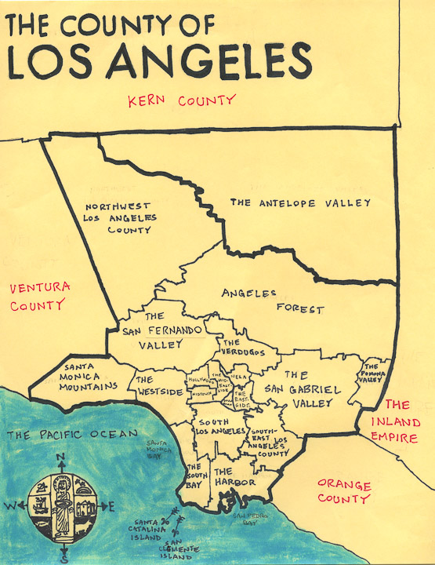
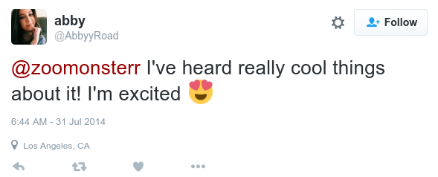
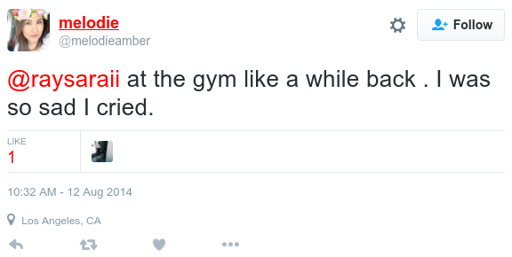
Data Collection
6M geo-tagged tweets posted from around Los Angeles County
340K users
2.6M mentions
Notes:
We did an advanced search using the Twitter Search API to collect geo-tagged tweets from the Los angeles county for a period of 4 months starting July’14. In all, we collected 6M geo-tagged tweets posted from around the LA county, posted by 340K users. This is an example of a tweet from our data-set with user mentions, one twitter user mentioning two others, which is actually a form of online social interaction. In all, we had 2.6M mentions in the tweets we had collected. (on avg, 38% of tweets per tract have mentions)

Slide 12
Demographics Data
Obtained socioeconomic characteristics for all Los Angeles County tracts from the 2012 US Census.
Income | Education | Ethnicity
hsp
Notes:
To obtain socio-economic characteristics, we used the data from 2012 US census. We collected information like mean income of population, percentage of population with a bachelor's degree or above, and ethnicity related information like percentage of hispanic population. This was obtained for each tract. Tracts are relatively homogeneous regions with respect to population characteristics, economic status, and living conditions, census tracts average about 4,000 inhabitants. Homogeneity ensures that whatever value holds for the tract can be safely assumed for every resident in the tract. Because we had geo-tagged tweets, we know which tract people are posting from, hence we could get their socio-economic characteristics.

Slide 13
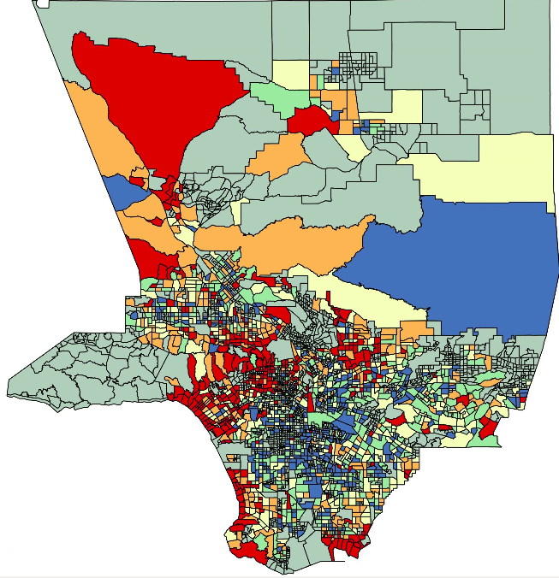
What is a Tract?
Relatively homogeneous units with respect to population characteristics, economic status, and living conditions.
All tracts in the Los Angeles County
Notes:
To obtain socio-economic characteristics, we used the data from 2012 US census. We collected information like mean income of population, percentage of population with a bachelor's degree or above, and ethnicity related information like percentage of hispanic population. This was obtained for each tract. Tracts are relatively homogeneous regions with respect to population characteristics, economic status, and living conditions, census tracts average about 4,000 inhabitants. Homogeneity ensures that whatever value holds for the tract can be safely assumed for every resident in the tract. Because we had geo-tagged tweets, we know which tract people are posting from, hence we could get their socio-economic characteristics.

Slide 14
Emotion Analysis
Analyze text of tweets to measure emotions
SentiStrength to measure
Negativity | Positivity
-5 -1 +1 +5
Notes:
Next we did emotion analysis on the tweets we had collected. First, we used a tool called SentiStrength to measure how positive or negative was the content in the tweet. SentiStrength gives negativity on a scale of -1 to -5 and positivity on +1 to +5. We wanted to go beyond these polar measure of emotions so we used Warriner’s lexicon to do a 3-D analysis on the tweet text to calculate valence, which quantifies pleasure and happiness, arousal, which refers to a heightened sense of physiological activity - marked by increased heart rate, sweating and excitement at times, and finally dominance, a level of subjective power, to approximately measure how powerful the person, who wrote the tweet, feels.

Slide 15
Emotion Analysis
Analyze text of tweets to measure emotions
WKB (Warriner et al.) lexicon to measure
Valence | Arousal | Dominance
Notes:
Next we did emotion analysis on the tweets we had collected. First, we used a tool called SentiStrength to measure how positive or negative was the content in the tweet. SentiStrength gives negativity on a scale of -1 to -5 and positivity on +1 to +5. We wanted to go beyond these polar measure of emotions so we used Warriner’s lexicon to do a 3-D analysis on the tweet text to calculate valence, which quantifies pleasure and happiness, arousal, which refers to a heightened sense of physiological activity - marked by increased heart rate, sweating and excitement at times, and finally dominance, a level of subjective power, to approximately measure how powerful the person, who wrote the tweet, feels.

Slide 16
Emotion Analysis
Analyze text of tweets to measure emotions
WKB (Warriner et al.) lexicon to measure
Valence | Arousal | Dominance
Quantifies the level of pleasure or pleasantness expressed by a word → Happiness
Notes:
Next we did emotion analysis on the tweets we had collected. First, we used a tool called SentiStrength to measure how positive or negative was the content in the tweet. SentiStrength gives negativity on a scale of -1 to -5 and positivity on +1 to +5. We wanted to go beyond these polar measure of emotions so we used Warriner’s lexicon to do a 3-D analysis on the tweet text to calculate valence, which quantifies pleasure and happiness, arousal, which refers to a heightened sense of physiological activity - marked by increased heart rate, sweating and excitement at times, and finally dominance, a level of subjective power, to approximately measure how powerful the person, who wrote the tweet, feels.

Slide 17
Emotion Analysis
Analyze text of tweets to measure emotions
WKB (Warriner et al.) lexicon to measure
Valence | Arousal | Dominance
Quantifies the level of activity induced by the emotions associated with a word
Notes:
Next we did emotion analysis on the tweets we had collected. First, we used a tool called SentiStrength to measure how positive or negative was the content in the tweet. SentiStrength gives negativity on a scale of -1 to -5 and positivity on +1 to +5. We wanted to go beyond these polar measure of emotions so we used Warriner’s lexicon to do a 3-D analysis on the tweet text to calculate valence, which quantifies pleasure and happiness, arousal, which refers to a heightened sense of physiological activity - marked by increased heart rate, sweating and excitement at times, and finally dominance, a level of subjective power, to approximately measure how powerful the person, who wrote the tweet, feels.

Slide 18
Emotion Analysis
Analyze text of tweets to measure emotions
WKB (Warriner et al.) lexicon to measure
Valence | Arousal | Dominance
Quantifies the level of subjective power
associated with an emotional word
Notes:
Next we did emotion analysis on the tweets we had collected. First, we used a tool called SentiStrength to measure how positive or negative was the content in the tweet. SentiStrength gives negativity on a scale of -1 to -5 and positivity on +1 to +5. We wanted to go beyond these polar measure of emotions so we used Warriner’s lexicon to do a 3-D analysis on the tweet text to calculate valence, which quantifies pleasure and happiness, arousal, which refers to a heightened sense of physiological activity - marked by increased heart rate, sweating and excitement at times, and finally dominance, a level of subjective power, to approximately measure how powerful the person, who wrote the tweet, feels.

Slide 19
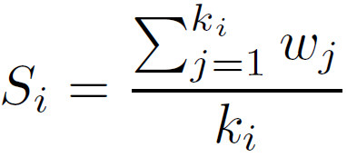
Social Interactions Analysis
Social Tie Strength of tract i: how much do people there interact with others?
S_{i} : average social tie strength for tract i
w_{j} : is the weight of the j^{th} edge (number of times a user mentions another), and
k_{i} : number of distinct users mentioned in tract i
Notes:
Next, we needed to quantify the structure of these social interactions. We used the concept of strength of ties. We obtained the mention graphs for each tract, which have users as nodes and mentions as connections/edges. The number of mentions become the edge weights. So, to measure the strength of ties for a particular tract we sum up all these edge weights in the mention graph and divide that by the number of users.

Slide 20
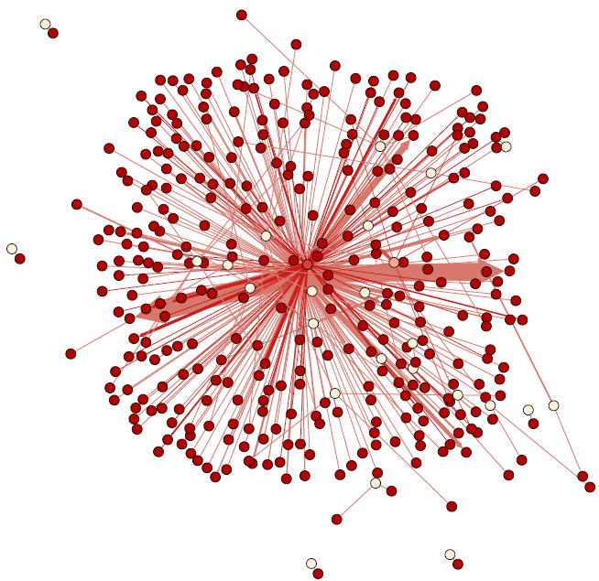
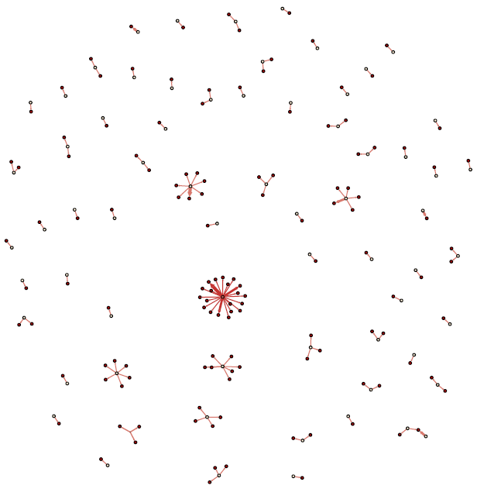
Social Interactions Analysis
Tie Strength
tract1 tract2
S_{i} = 7.33 (Strong Ties)
S_{i} = 1.08 (Weak Ties)
Notes:
To make this measure more intuitive, here we have the mention graphs for two tracts. Tract 1 on left has the strength of ties value 7.33 which is very high. These strong ties are marked by a dense graph. On left, we have tract 2 with strength of ties value 1.08. Weak ties are associated with a sparse mention graph. Strong ties represent people have higher number of interactions with a restricted few people, while weak ties means are associated with connections with more number of people but reduced intensity naturally because you are talking to more number of people. Research has shown that weak ties are more beneficial because being connected with more people corresponds to more incoming information and access to opportunities.

Slide 21
Mobility Analysis
Spatial Diversity of tract i: how many other places do people tweet from?
n_{i} : number of tracts from which users who tweeted from tract i also tweeted from, and
p_{ij} : proportion of tweets posted by these users from tract j
Notes:
There is another measure we came up with for quantifying social interactions, which is spatial diversity or inter tract mobility. We wanted to capture - users who are tweeting from a tract, how much are these people moving around and tweeting from other places (in our case, tracts). We have used Shannon’s entropy to calculate this, some basic maths there..

Slide 22
What we need?
Methodology
Results
Conclusions
Notes:
Hi everyone! I am Megha Arora and am here to present my paper titled ‘Emotions, Demographics and Sociability in Twitter Interactions’. Prof.PK and David, co-authors of the paper are also in the room (point out)

Slide 23
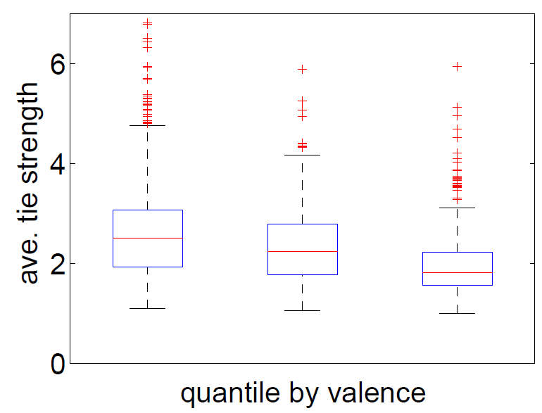
Weaker Ties → more Happiness
… also
Stronger ties are associated with more Negativity
-0.36***
*p < 0.05, **p < 0.01, ***p < 0.001
Notes:
We found out that weaker ties are associated with more happiness. We divided the tracts into tertiles, the leftmost one having lowest value for valence, representing tracts from where less positive - sadder tweets were posted from, and the rightmost one representing happier ones. We see that strength of ties is much weaker for this happier tract (highest valence). Conversely, stronger ties are associated with more negativity. All these differences are significant. One take away we have from here is that happier people have more diverse social relationships (that is what weak ties are associated with) and sad people are interacting with a restricted number of people with greater intensity i.e. stronger ties.

Slide 24
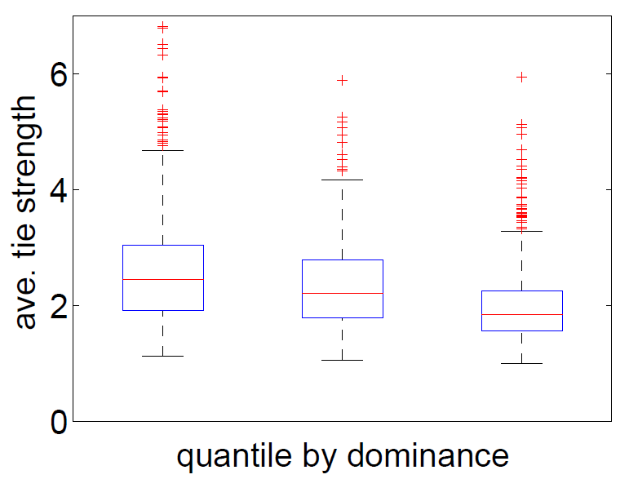
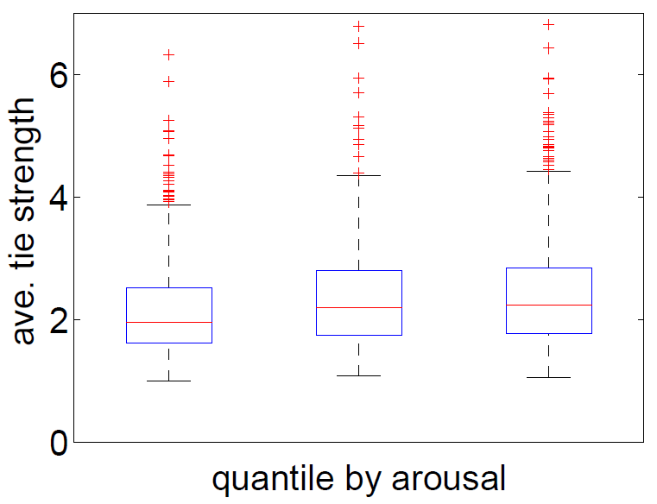
Weaker Ties → lower Arousal and higher Dominance
-0.36***
-0.31***
0.14***
*p < 0.05, **p < 0.01, ***p < 0.001
Notes:
When we look at the other two measures - arousal and dominance. Tracts from where users post tweets expressing higher arousal tend to have slightly stronger ties although only the difference between mean tie strength of the mid and top tertiles are significant (p < 0.05). In contrast, tracts associated with tweets expressing higher dominance, are associated with significantly weaker social ties (p < 0.01). So adding to what we learnt earlier - we were able to validate that weaker ties i.e. having diverse social relationships is associated with more happiness, stronger feeling of power and lower arousal.

Slide 25
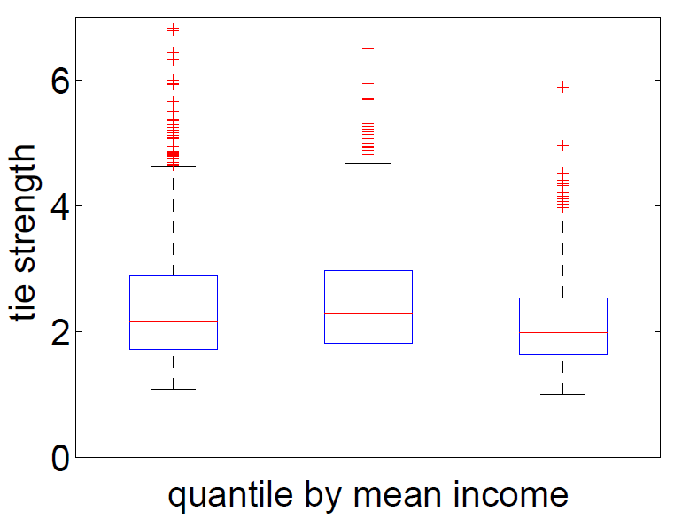
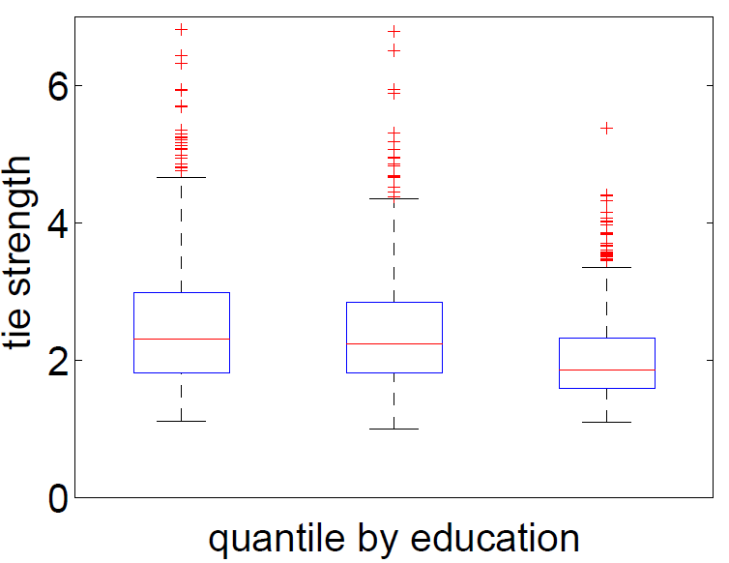
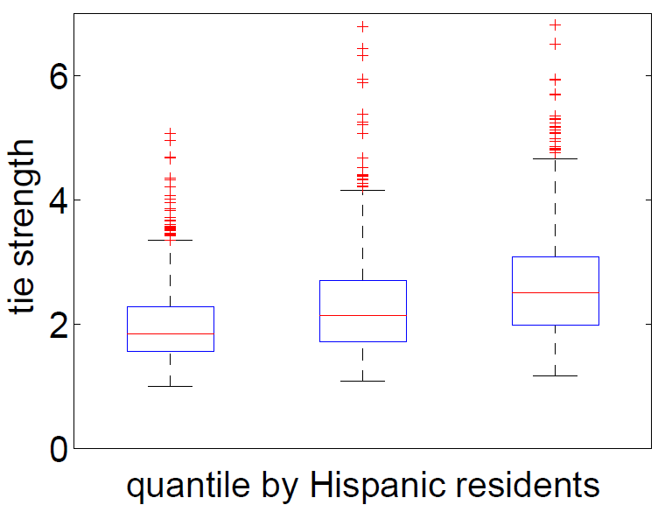
Weaker Ties → more Education, more Income, fewer Hispanics
-0.12***
-0.27***
0.35***
*p < 0.05, **p < 0.01, ***p < 0.001
Notes:
Understanding the connection between strength of ties and socioeconomic characteristics. Divides tracts by mean income - lowest-earning, mid-earning, and highest-earning tertiles; only the top income and education tertiles have significantly weaker social ties than the other two tertiles. However, when tracts are divided into tertiles according to the number of Hispanic residents, the differences between the mean tie strengths of all tertiles are significant (p < 0.01). This result highlights the social component of culture: Research has shown that Hispanic cultures focus more on sociability values and are less individualist. This provides an explanation for the stronger ties in tracts with higher number of Hispanic residents, as their online network structures reflect their shared values.

Slide 26
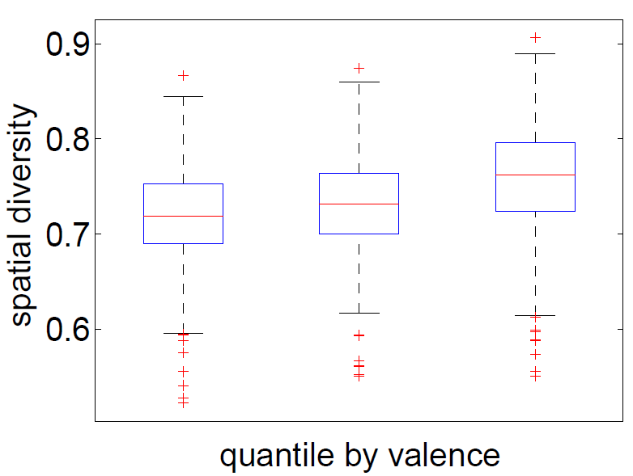
Higher Mobility → more Happiness
0.32***
*p < 0.05, **p < 0.01, ***p < 0.001
Notes:
Now we come to the second measure we used to quantify interactions, which is inter-tract mobility or spatial diversity. Tracts with more positive tweets have significantly higher spatial diversity than tracts with less positive tweets (p < 0.001). This suggests that people expressing happier emotions move (and tweet from) a larger number of different places than people expressing more negative emotions, whose movements are confined to a smaller set of tracts.

Slide 27
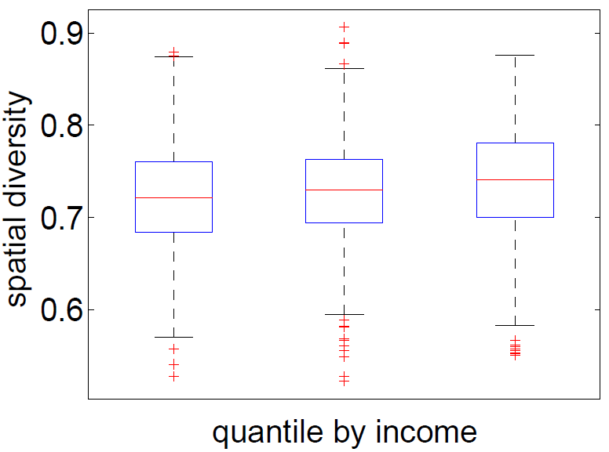
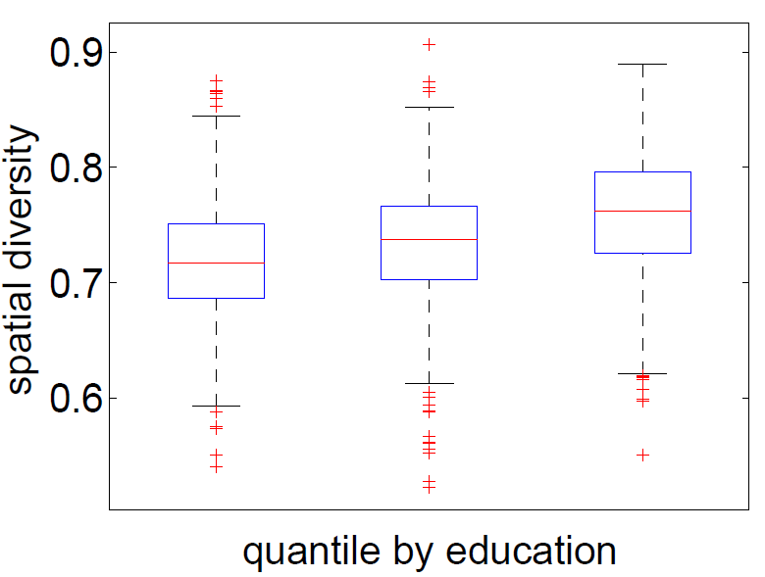
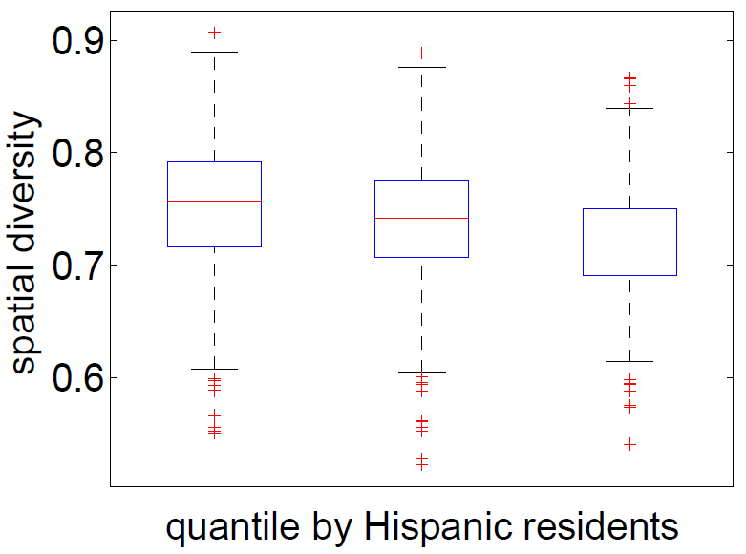
Higher Mobility → more Income, more Education, fewer Hispanics
0.08**
0.35***
-0.27***
*p < 0.05, **p < 0.01, ***p < 0.001
Notes:
Looking at the association between inter-tract mobility and demographic characteristics. Income does not appear to significantly affect spatial diversity: only the top tertile has a significantly higher spatial diversity (p < 0.001) from the other two tertiles. Education, however, has a stronger dependence: tracts with better-educated residents also have significantly higher (p < 0.001) spatial diversity than tracts with fewer educated residents. Ethnicity also appears to be a factor. Tracts with larger Hispanic population have significantly lower spatial diversity (p < 0.01) than other tracts. Again, linking to the fact that hispanic residents are more confined to a small set of tracts. So, inter-tract mobility is higher in case of tracts with higher-earning, more educated residents and having lower fraction of hispanic residents.

Slide 28
What we need?
Methodology
Results
Conclusions
Notes:
Hi everyone! I am Megha Arora and am here to present my paper titled ‘Emotions, Demographics and Sociability in Twitter Interactions’. Prof.PK and David, co-authors of the paper are also in the room (point out)

Slide 29
Conclusions
Cognitive factors (emotions) and demographics of places affect the quality of online social interactions
Places with better educated, younger and higher-earning population are associated with weaker social ties and greater mobility (spatial diversity)
These Twitter users express happier, more positive emotions
Notes:
To conclude, we were successfully able to understand and unobtrusively monitor online social structures at a macroscopic level.. We validated that...

Slide 30
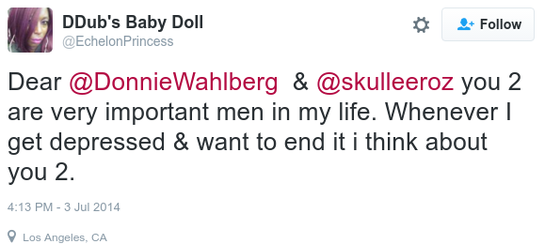
Conclusions
Places with more Hispanic residents are associated with stronger social ties and lower mobility (spatial diversity)
People also express less positive, sadder emotions in these areas
Notes:
Since weak ties are believed to play an important role in delivering strategic, novel information, our work also identified a social inequity, wherein the already privileged ones (more affluent, better educated, happier) are in network positions that potentially allow them greater access to novel information.

Slide 31
Thank You!
@meghaarora42
marora@andrew.cmu.edu
Questions?

