Slide 1
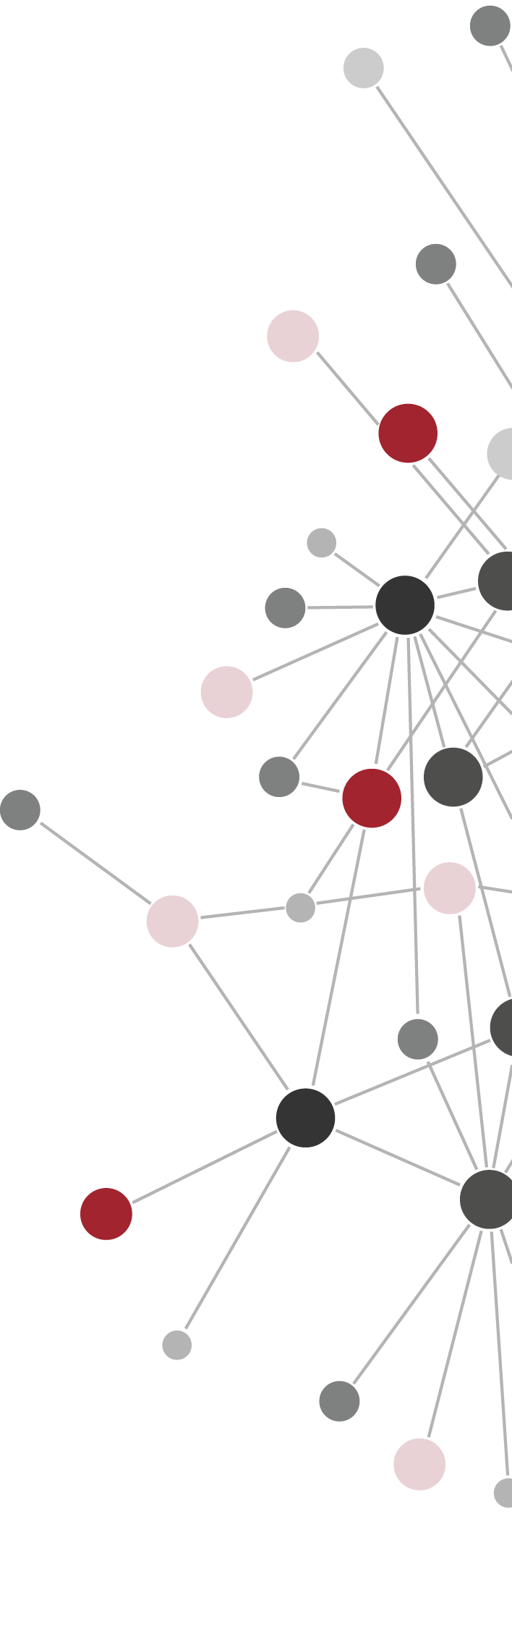

Extracting Health-related
Social Structures from Conversations in Twitter
Abduljaleel Al Rubaye
Dr. Ronaldo Menezes
BioComplex Lab
Florida Institute of Technology
Melbourne, Fl

Slide 2

Outlines / Thesis Structure
Health &
Social Communities
Collecting Data
Filtering Process
Building Networks
Time Window
Analyzing the Networks
Degree Distribution
Average Path Length
Clustering Coefficient

Slide 3

Motivation
Health is an important aspect in one’s live.
Quality of health defines our general wellbeing.
In order to be healthy, most of us try to be informed about the latest developments, medical practices, treatments, drugs, etc.

Slide 4
Motivation
The acquisition of knowledge is more prominent with individuals who are already suffering from serious health conditions, particularly the ones that may lead to death.
People who have been diagnosed with serious health conditions may suffer the symptoms of their condition for a considerable period of time.
These people naturally form support groups to share their feelings as well as share their daily experiences through. (like contributing to social communities)

Slide 5

Social Communities
The benefits of being in a social community :
help to get support
prevent the loneliness
eliminate behavioral risks
help to exchange and share the experiences
can improve the knowledge and health education faster

Slide 6

Online Social Networks
Many ways to communicate with social.
A common way is using Online Social Networks.
They become part of our lives
Easy to access
Ease the process of finding and connecting individuals that have the same interest

Slide 7

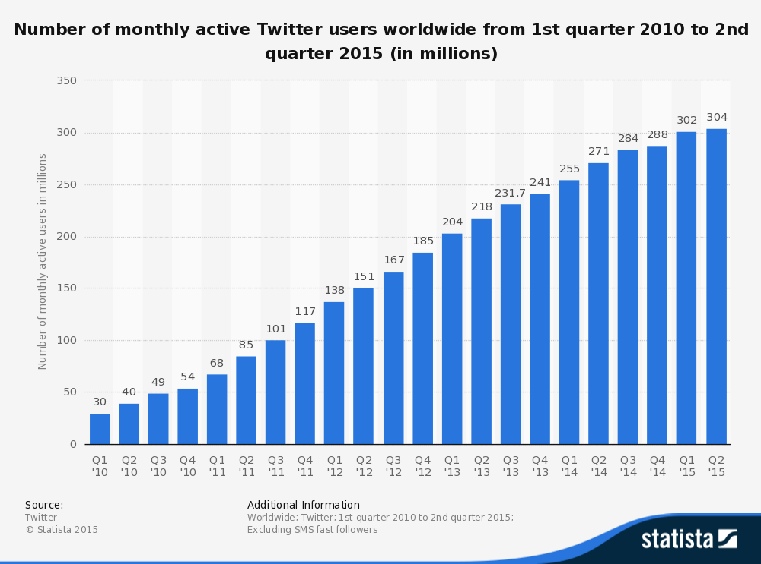
Twitter
One of the most popular social networking applications
Last statistic : 316 million active users by the 3rd quarter of 2015

Slide 8
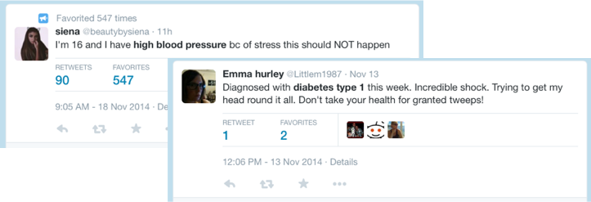
The Goal
In this work we tried to collect the tweets that mentioned one of the top leading causes of death in the U.S.
Generating networks from term co-occurrence in Twitter to form social communities related to top causes of death in the USA.
We reconstruct the structures using the concept of time window.
- Ferreira et al. “The small world of seismic events”
- Meng et al. “Systematic dynamic and heterogeneous analysis of rich social network data”

Slide 9
The Goal
Retrieving networks out of conversations between Twitter users; Even where users are not talking directly.
Finding if these networks have social networks characteristic.
Is the time window a good tool to unveil social structures from Twitter timeline conversations ?
Find if there is any specific time window’s length at which the tweet conversations better appear to be a typical social network conversations.

Slide 10

Health Conditions
An official updated list was provided by the Center for Diseases Control
and Prevention (CDC).
The list includes 113 causes of death in the US.
CDC focused more on top 15 causes of death.
The causes included 13 health conditions that lead to death
  Heart Diseases
  Malignant Neoplasms (Cancer)
  Chronic Lower Respiratory Diseases (CLRD)
  Cerebrovascular Diseases (Stroke)
  Alzheimer’s disease
  Diabetes mellitus
  Influenza and pneumonia
  Kidney diseases
  Septicemia
  Chronic Liver Diseases (CLD)
  Hypertension (High blood pressure)
  Parkinson’s Disease
  Pneumonitis due to solids and liquids.

Slide 11
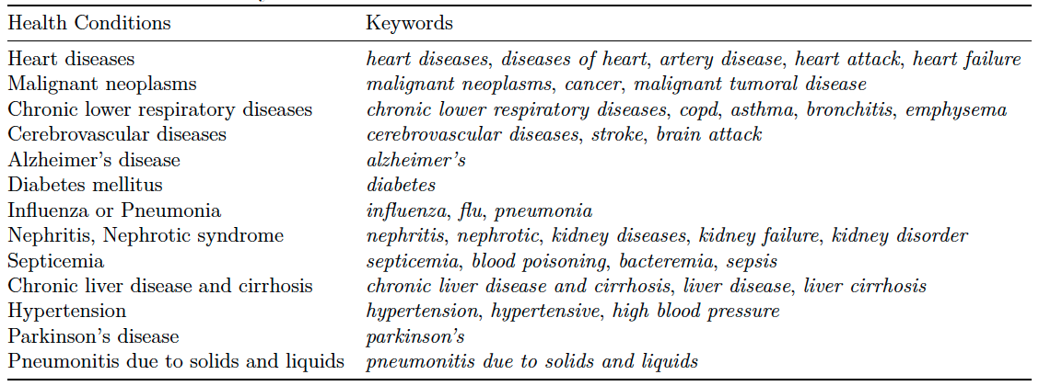
Collecting Data
In order to track tweets we used the keywords below:

Slide 12
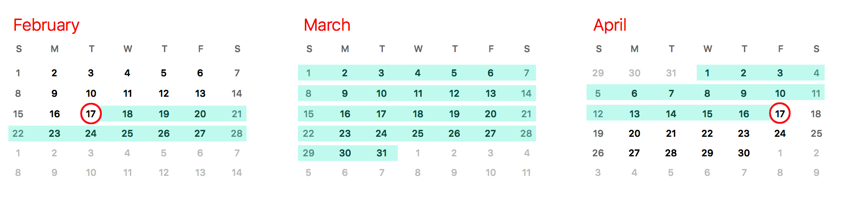
Tweets Tracker
The Twitter crawler was coded using Python 2.7
Tracks data in a period of 60 days:
From Feb 17th to April 17th 2015
In collecting data we used the following tools :
Twitter streaming API
Mongo DB
PyMongo

Slide 13
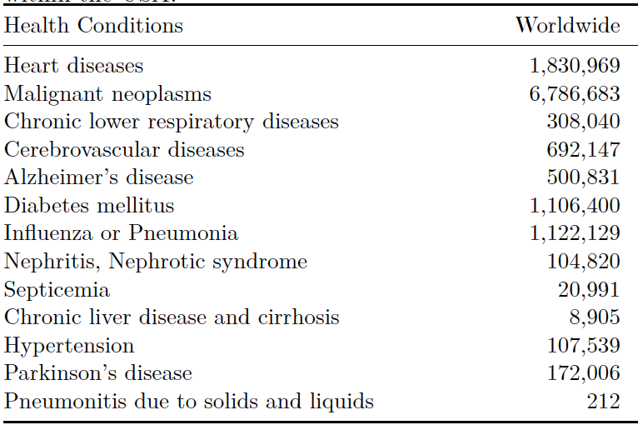
Statistics (before filtration)
Collected Tweets Worldwide: 12,518,372
Number of times that a health condition was mentioned in the total tweets :

Slide 14
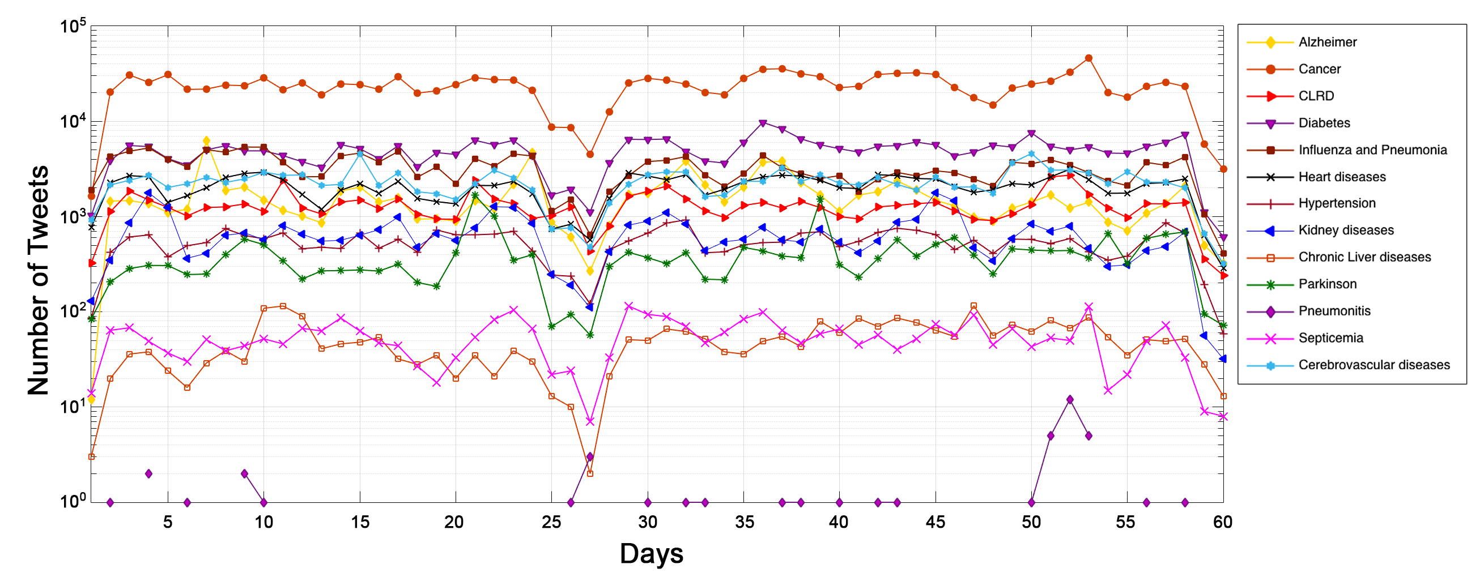
Statistics (before filtration)
Tweet distribution per day
Due to a disruption in accessing the global tweet stream on day 27, the process of collecting tweets stopped for a while.

Slide 15
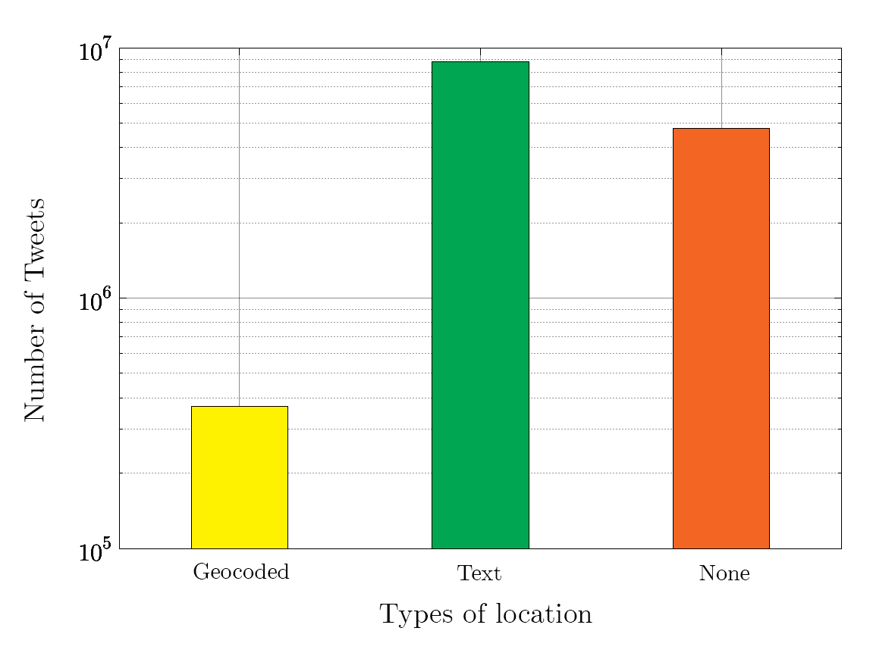
Filtration Process / Location Type
Number of geocoded tweets: 370,376 (about 3% of total number of tweets)
Tweets that only include textual location: 8,785,834 (70%)
No location included: 4,750,895 (37%)

Slide 16
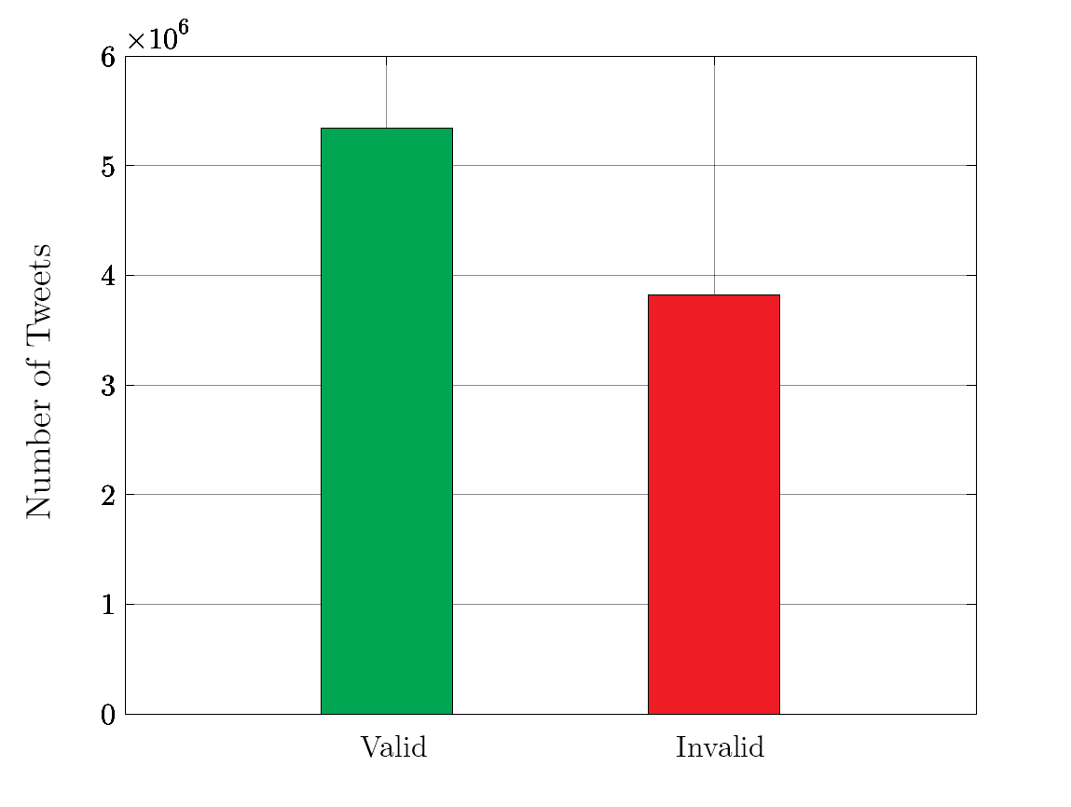
Filtration Process
The geocoding system Geopy was used to retrieve a readable address out of information we have.
Geopy uses several different geo-location services (Google maps, Bing maps, Open Street, … etc.)
Due to time limitation we used the geocoder service Open Street Map Nominatim that responds to one request per second.
Examples:
- Valid readable address:
Input: (North of Chicago) output: (Chicago, Cook County, Illinois, United States of America)
- Invalid readable address:
Input: (Behind the tears of a clown) output: (Error)
We retrieved 5,338,448 (61%) valid address out of textual information.

Slide 17
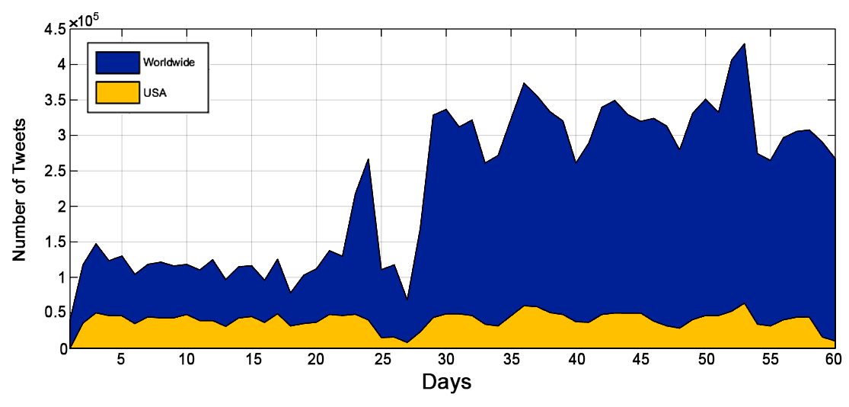
Statistics (after filtration)
Number of Tweets originated from the US : 2,351,991
Due to a disruption in accessing the global tweet stream on day 27, the process of collecting tweets stopped for a while.

Slide 18
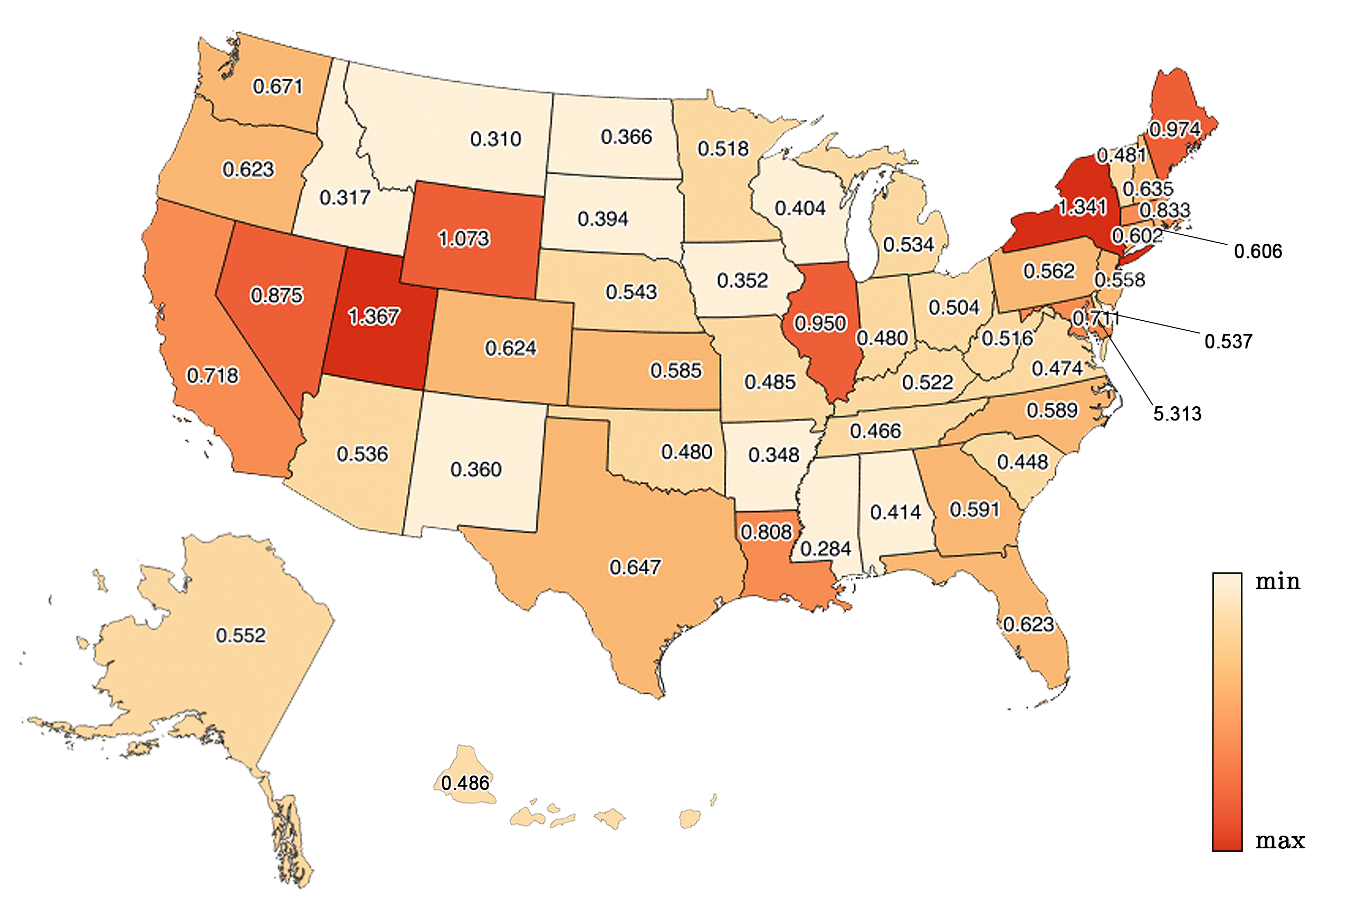
Statistics (after filtration)
# tweets
California: (278,771 tweets) North Dakota: (2,703 tweets)
Health conditions
Cancer: (1,395,590 tweets) (59%)
Pneumonitis due to liquids and solids: (44 tweets)
Normalized the total collected tweets by state’s census population to visualize the distribution.
Why? According to S.Burton et. al. (right time, right place; health communication on twitter) the number of Twitter users per state is correlated to the state’s population.

Slide 19
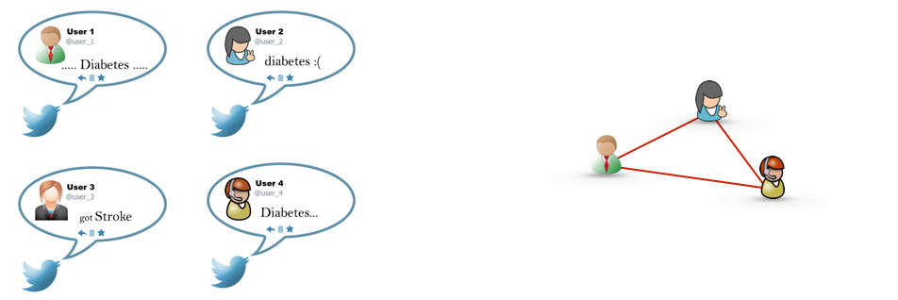
Building Networks
Nodes: users of the same US state
Links: two users will have a link in between if both mentioned the same health condition
According to the definition, users who mentioned the same health conditions will be related to each other.
To construct a network of a specific health condition if we consider all tweets in the collecting period of 60 day, the network will be too densely connected.

Slide 20
Time Window
Is a predefined period of time.
Restricts defining relations among entities in that limited interval.
Two issues should be addressed before utilizing the time window concept:
1) The size of the time window:
If the size is too large or too small might not get useful information
A very large time window’s size results in having fully connected clusters connected to each other.
    - if we assign the highest possible size to the time window we will have one big clique.
A very small length may lead us to generate networks that most probably have many of disconnected nodes.
Hence we assigned 12 different lengths (1,2,3,4,…12) hours, to define the relations among Twitter users related to the same health condition.
That means we will have 12 different structures representing the same data set.

Slide 21
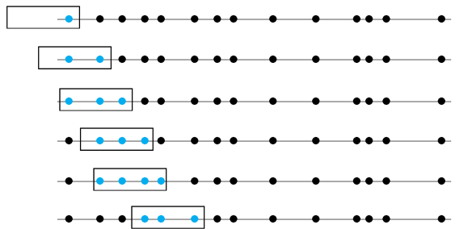
Time Window
2) How to move the time window over the data set ?
The simplest way is to move the time window event by event (tweet by tweet)
Step 1
Step 2
Step 3
Step 4
Step 5
Step 6
. . .

Slide 22
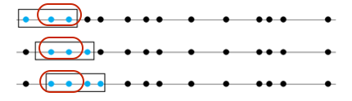
Weighted Networks
Due to using time window, we’ll have weighted networks
Some tweets could be exist in the time window many times. That makes the link weighted.
As much as the two tweets be closer to each other (in time) they could appear in the time window for more than one iteration.
Some tweets might be in the time window only few times. The links’ weights are less.
Some other never happen to be in the same time window. That means no link in between.

Slide 23
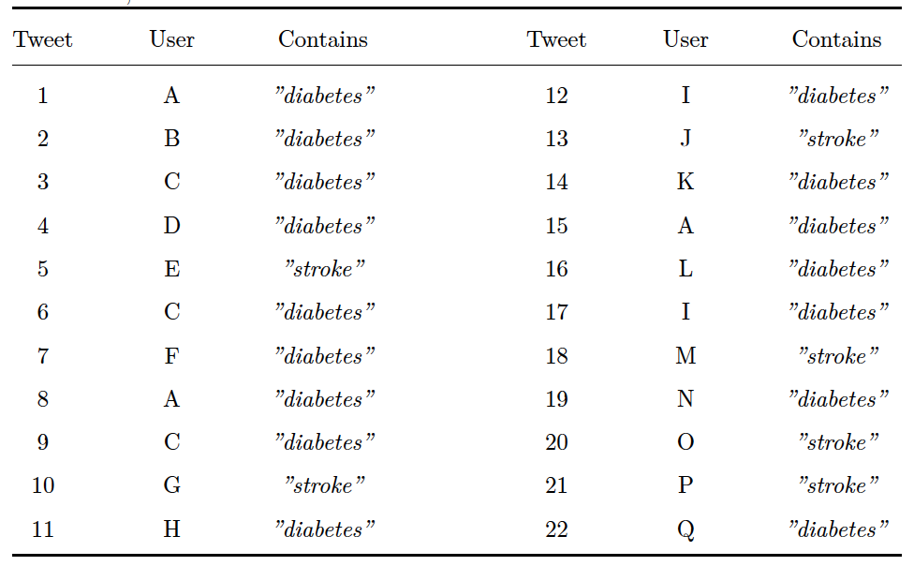
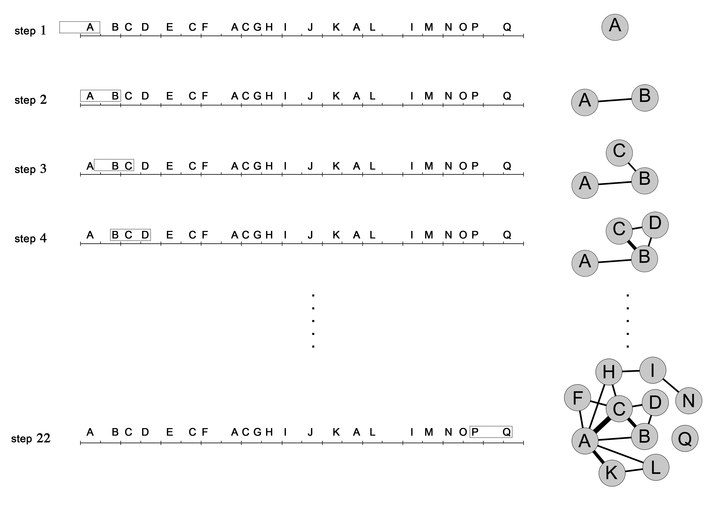
An Example

Slide 24
Results
Due to very small amount of collected tweets, the health condition Pneumonitis due to solids and liquids was not considered in the analytical work.
At the end of network building process we end up with 7344 constructed networks.
(51 states × 12 time windows × 12 health condition)

Slide 25
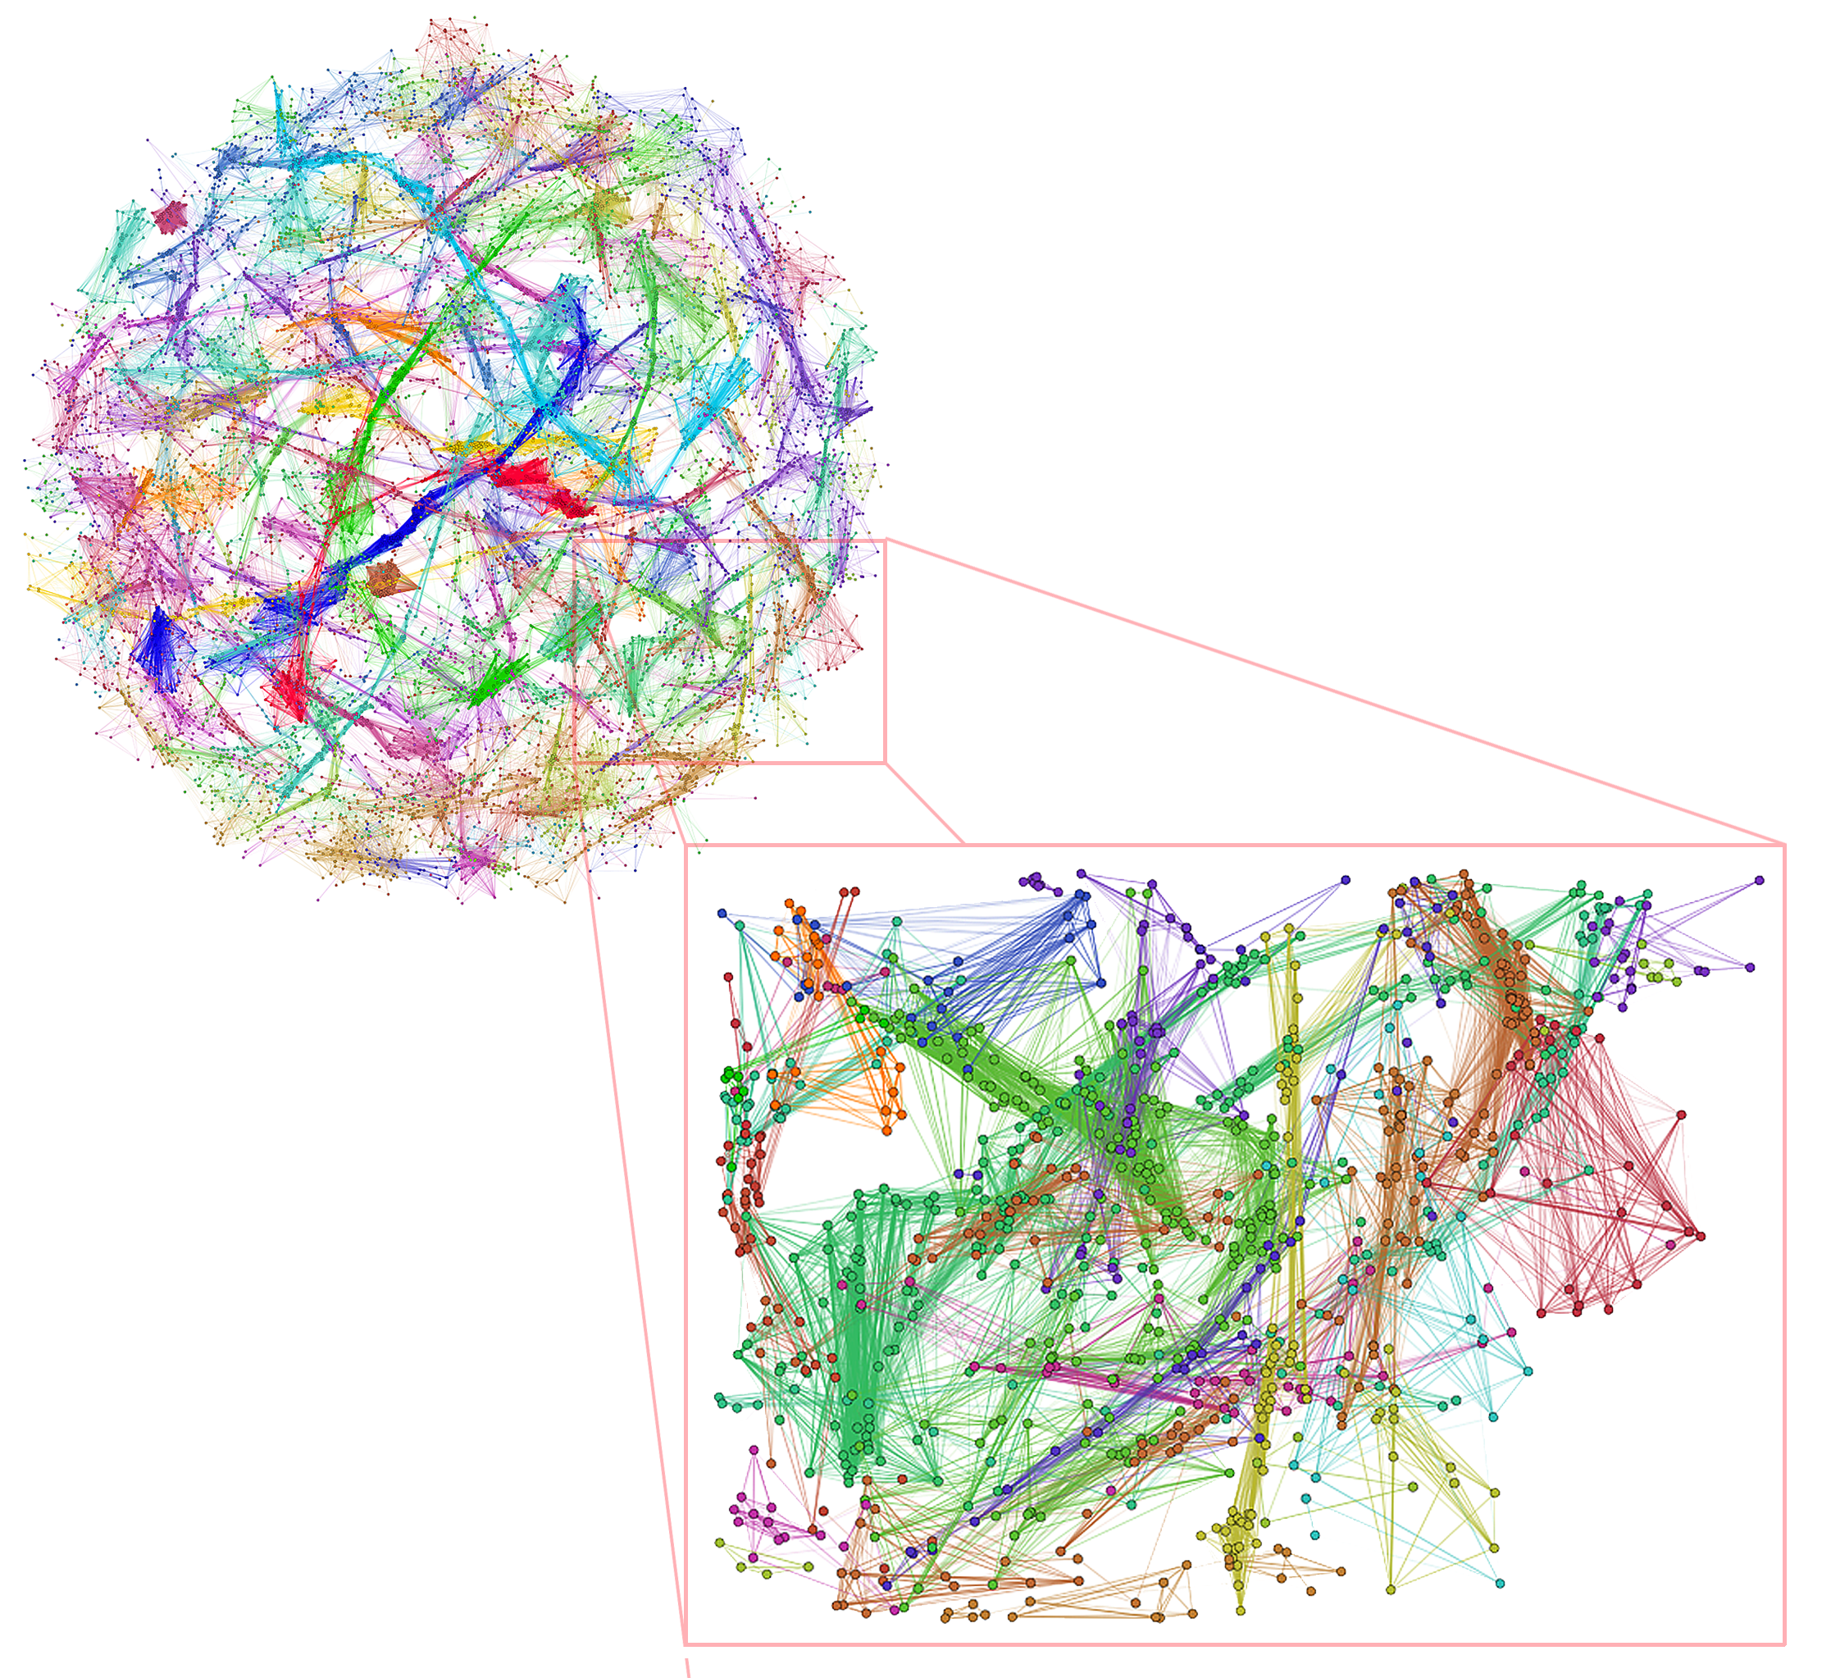
Samples of the Generated Networks
A sample of the networks the we generated.
State: Florida
Health condition: Diabetes
TW Size: 1 hour
11,760 nodes & 160,664 edges
Tools that was used:
  NetworkX (Python Library)
  Gephi (Network Visualization Tool)

Slide 26
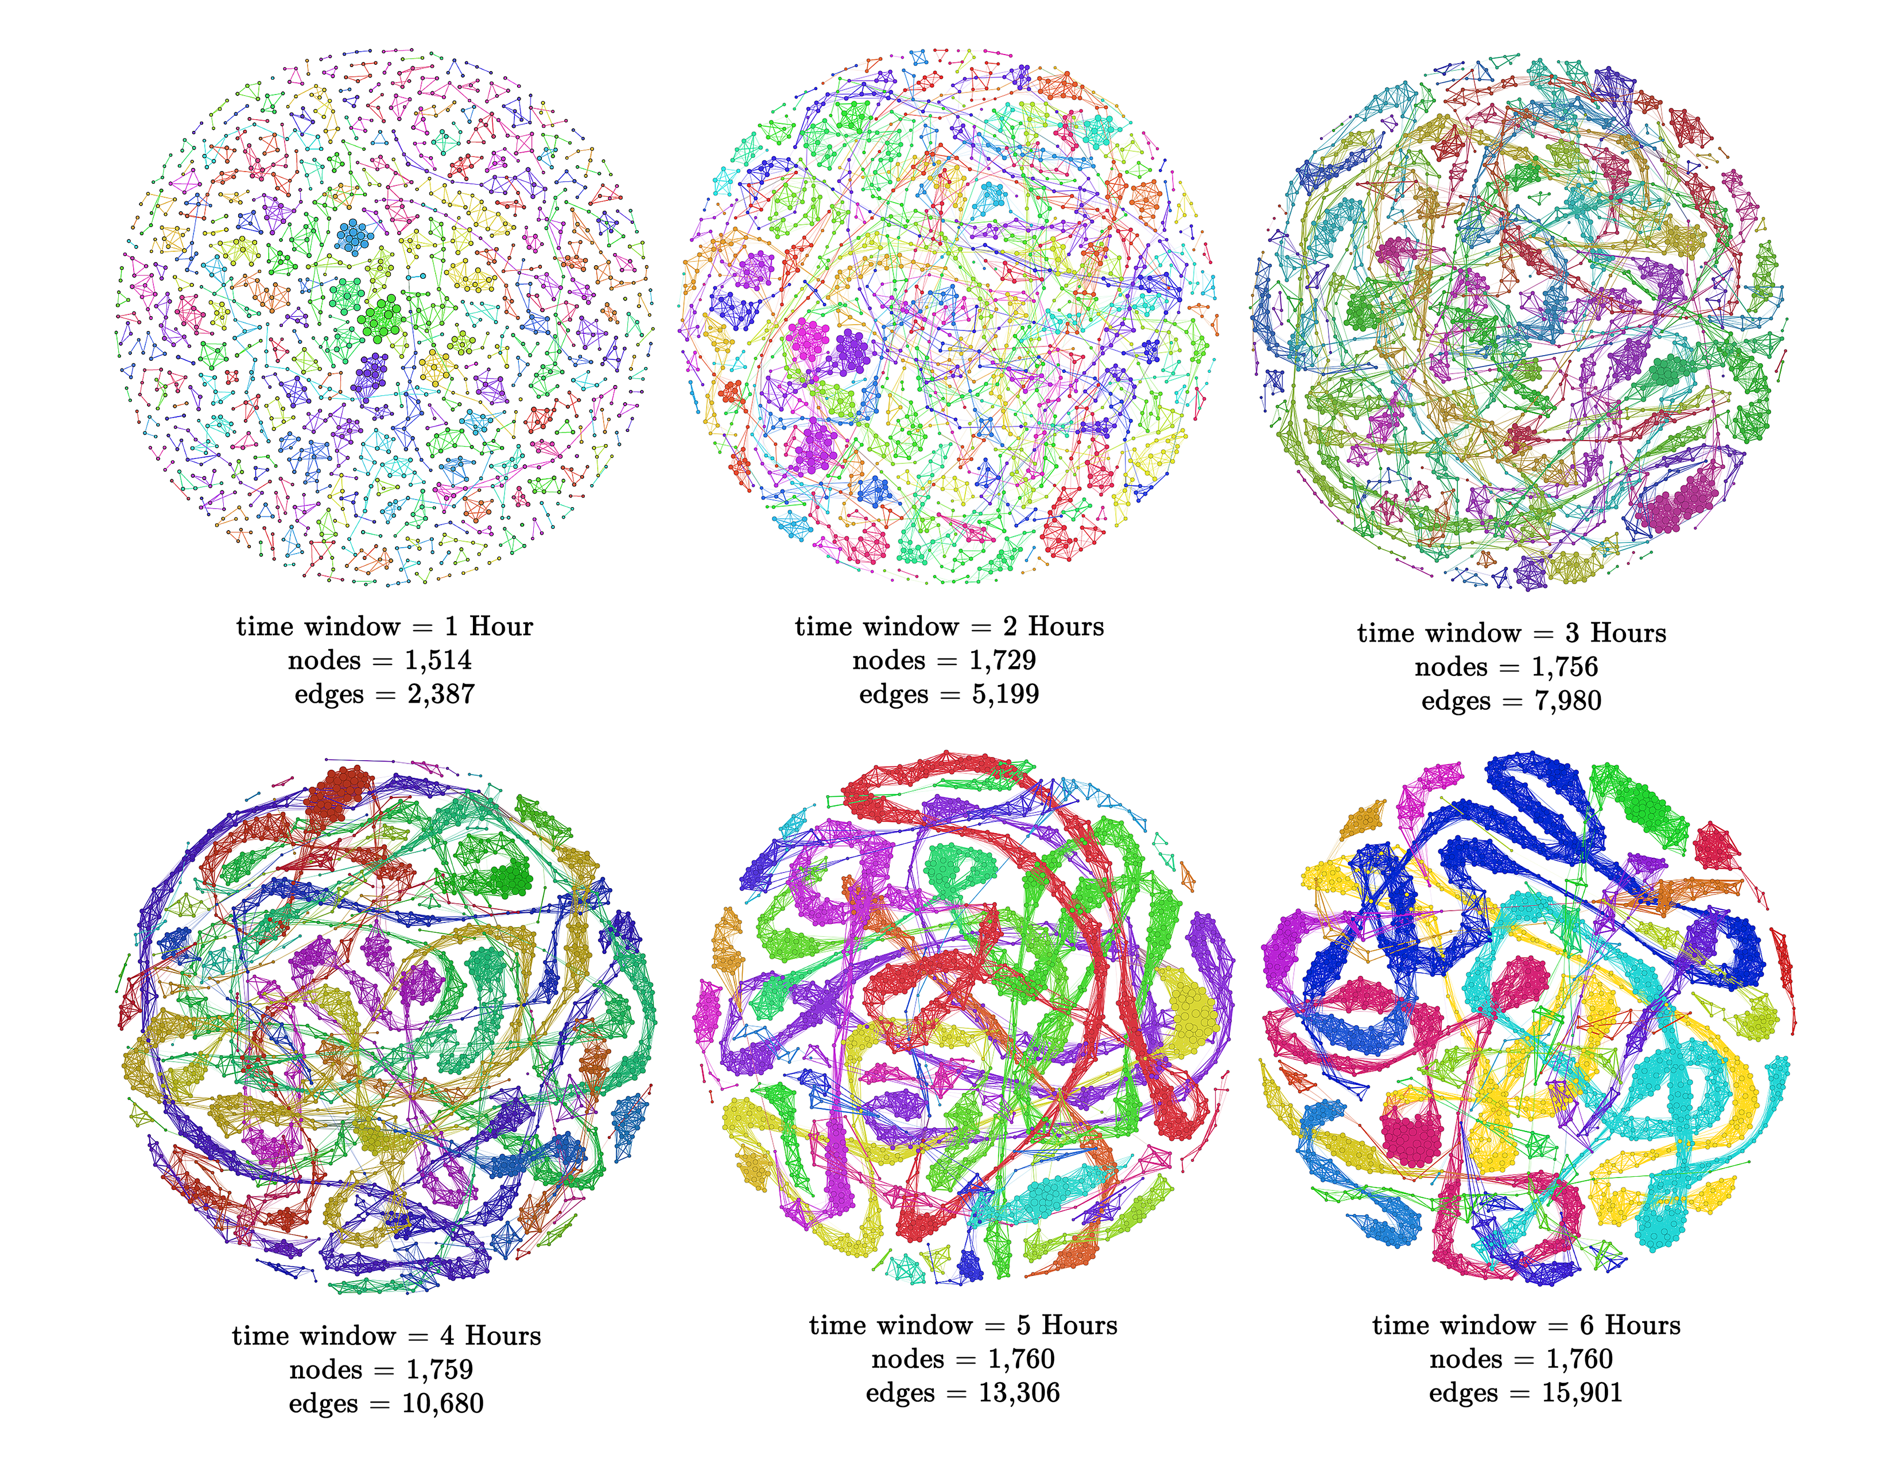
Samples of the Generated Networks
Alabama – Heart Diseases

Slide 27
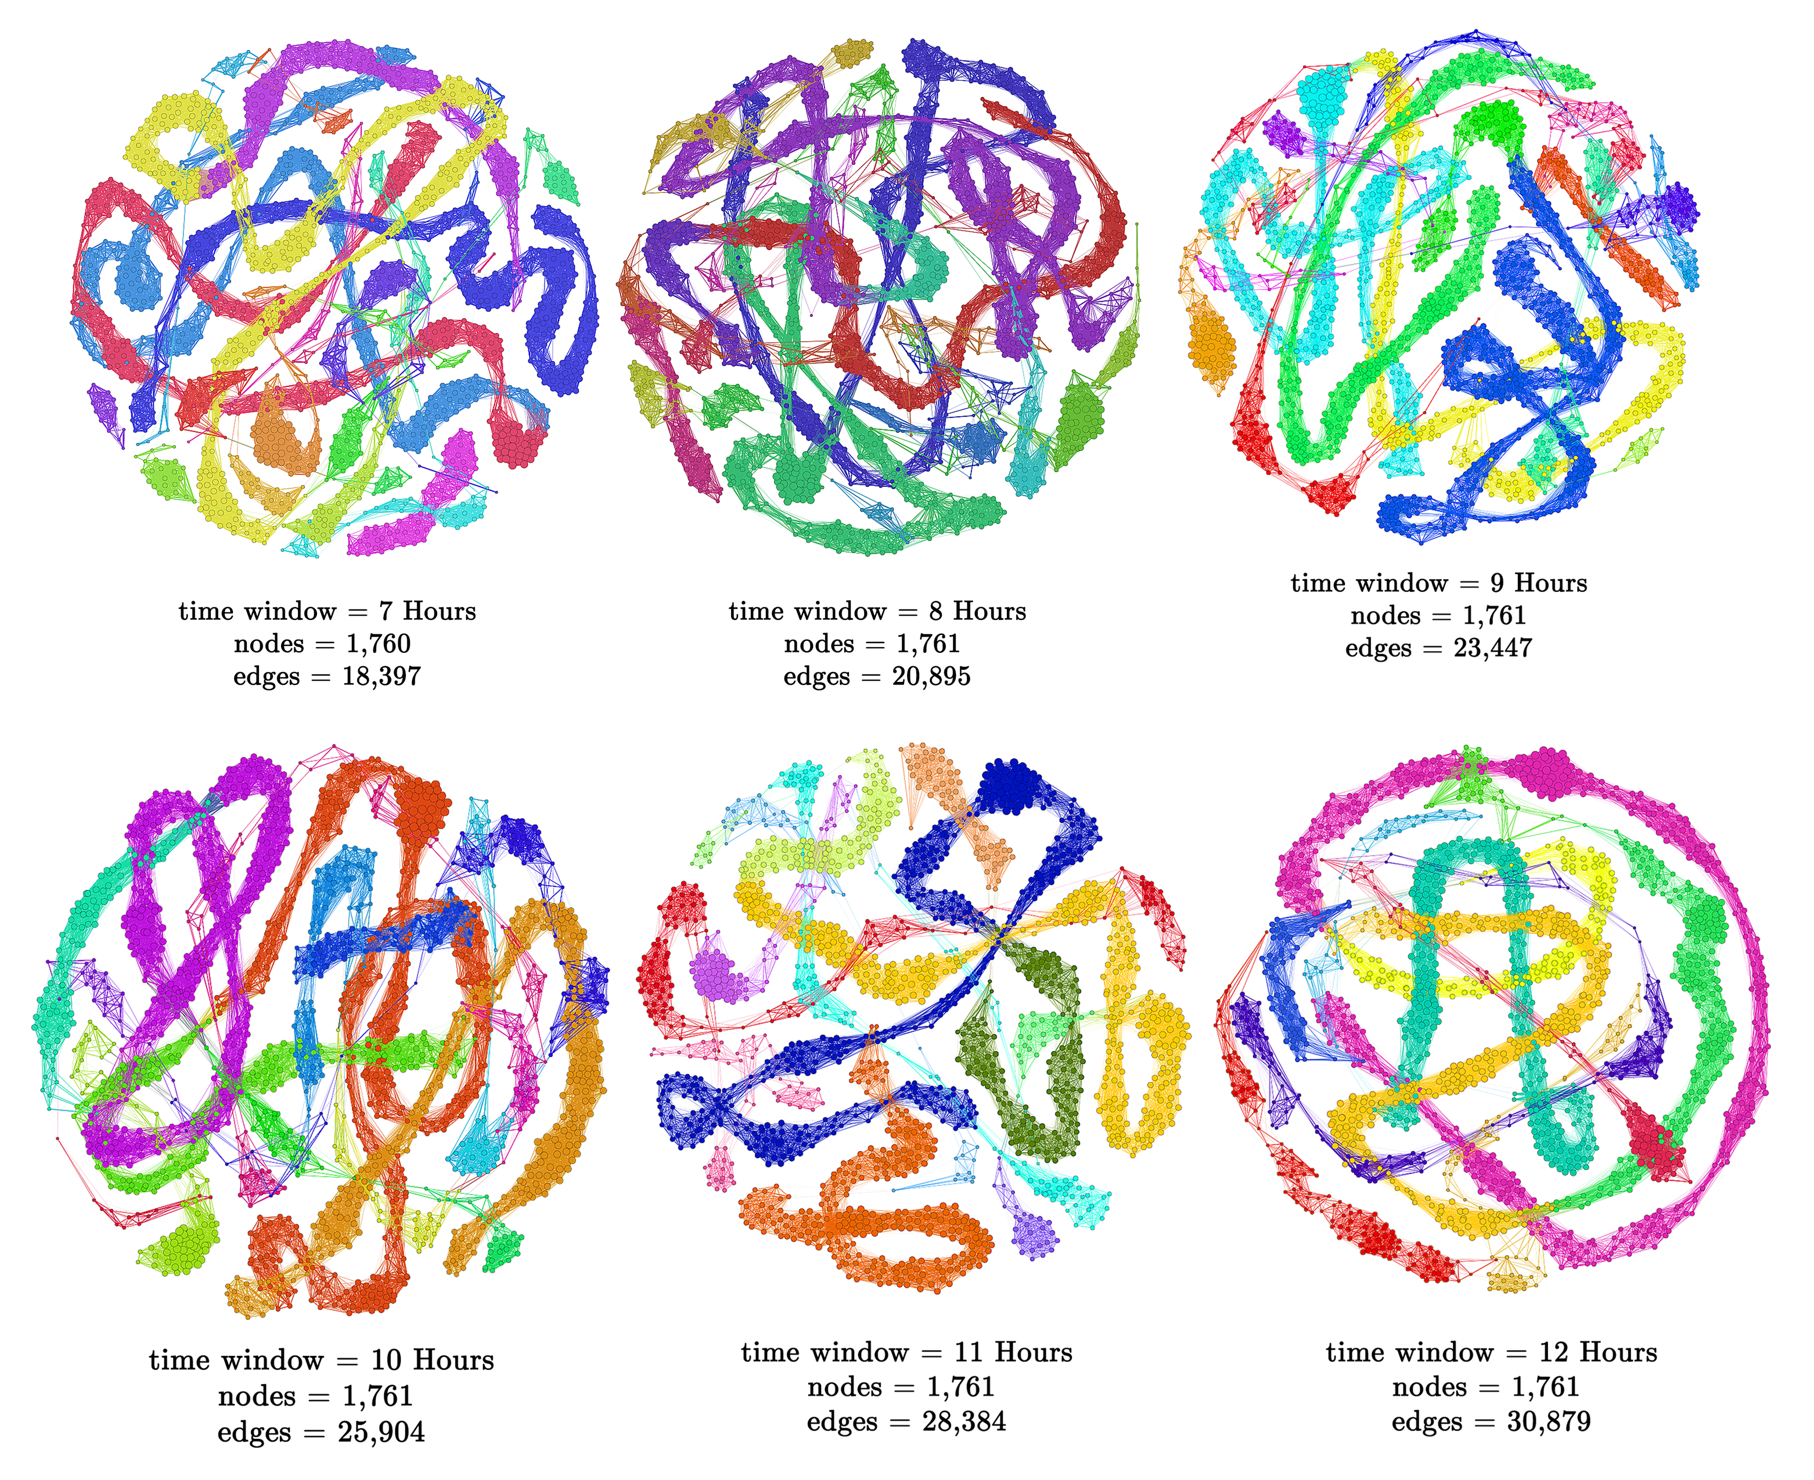
Samples of the Generated Networks
Alabama – Heart Diseases

Slide 28
Network Analysis
Networks were analyzed using three general properties of networks:
  Degree Distribution
  Average Path Length
  Clustering Coefficient

Slide 29
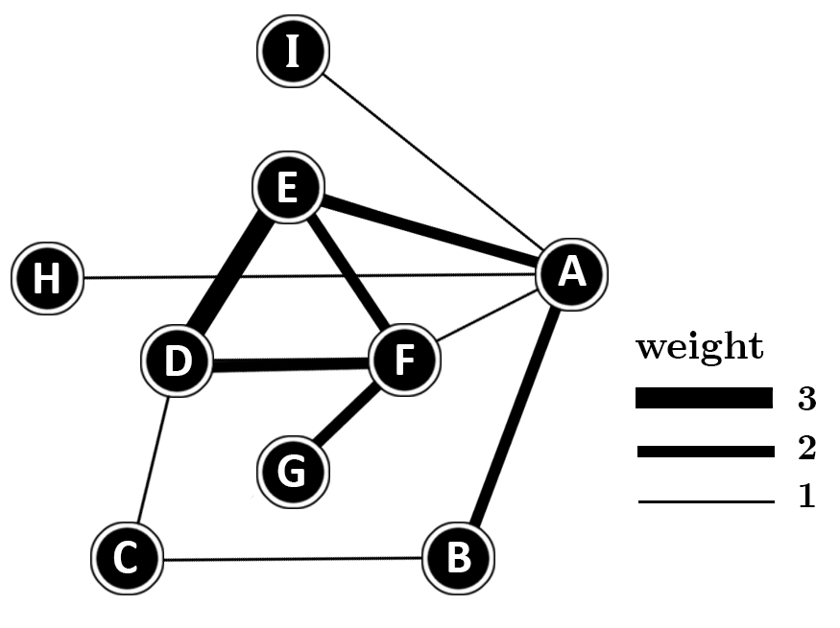
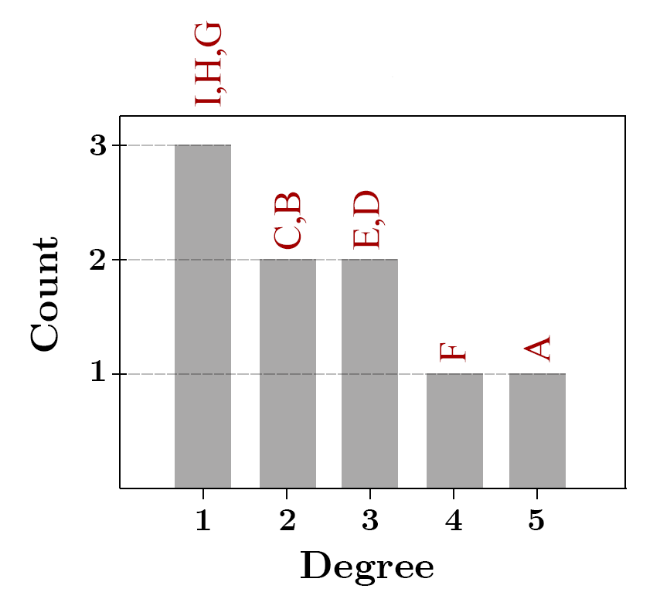
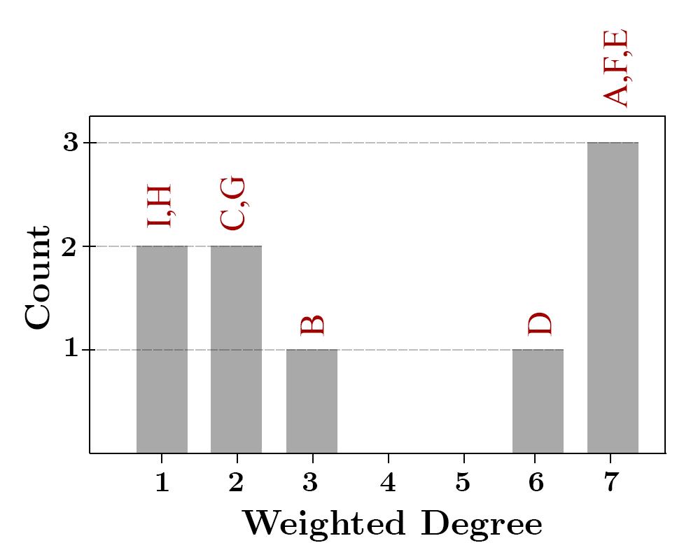
Degree Distribution Analysis
Scale free networks :
Degree distribution :
The probability of having nodes with a certain degree.
Since the networks are weighted, considering the weighted degrees can capture more information about the structures of the networks.

Slide 30
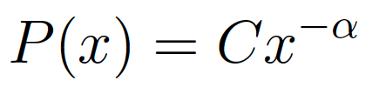
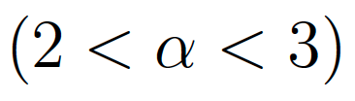
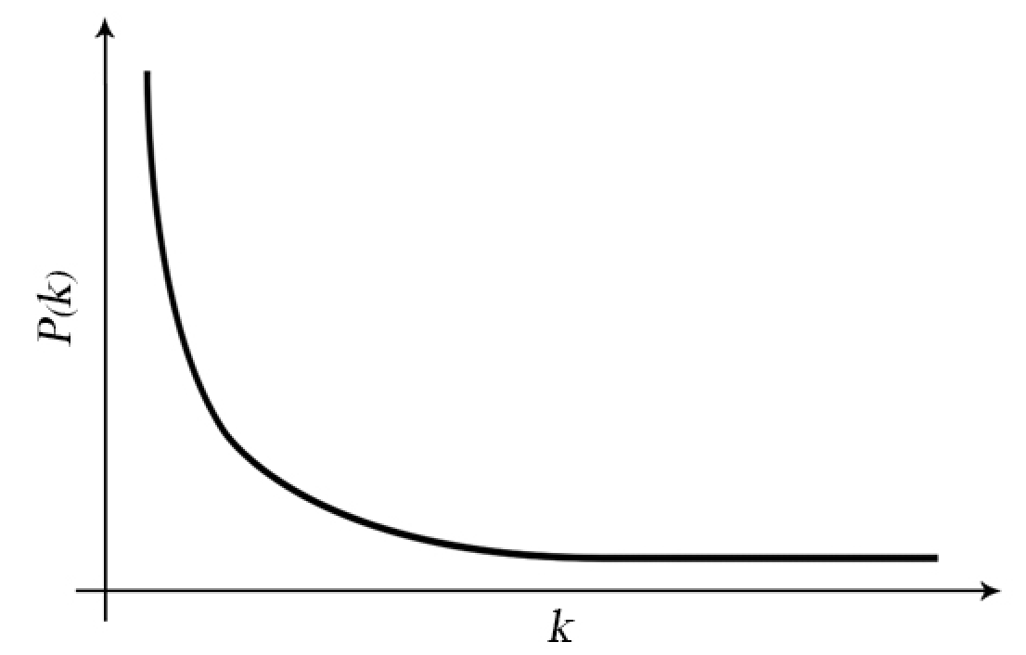
Degree Distribution Analysis
In scale-free networks the degree distribution of nodes is a power-law distribution and follows the function:
where the exponent value (alpha) in most cases falls in the range
A few number of nodes are highly connected (hubs)
A large number of nodes have low degrees

Slide 31
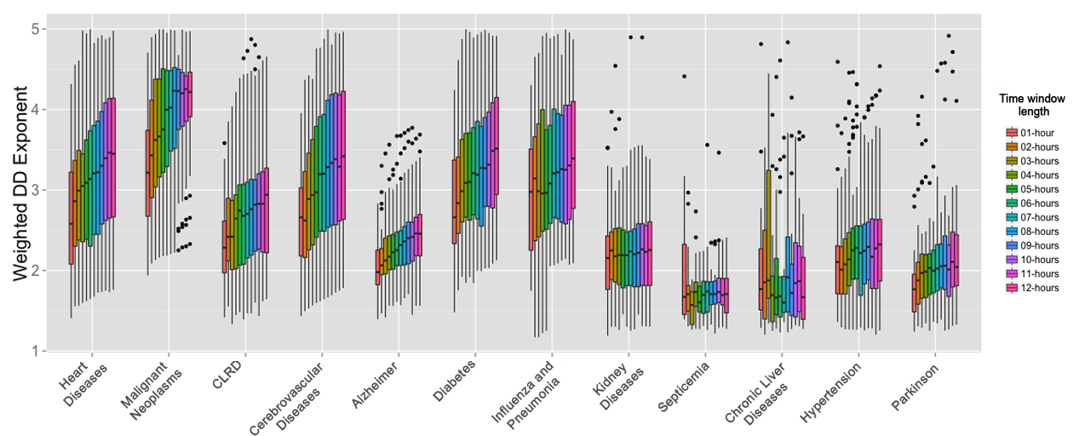
Degree Distribution Analysis
The distribution is displayed as a box plot.
Each box plot shows the distributions of the weighted degree distribution’s exponent of all the networks related to one health condition and generated using the same time window size.

Slide 32
Degree Distribution Analysis
However, in our networks, the exponent might be between 2 and 3, but it does not mean that the correspondent degree distribution is a power law.
According to Clauset et al. (2009) “Power law Distribution in empirical data” Due to occurring fluctuations in the degree distributions, the power law behavior is not easy to be understood.
Clauset et al. introduced an approach to compare between the power law and other distributions.

Slide 33

Degree Distribution Analysis
Using the package power-law performed comparison between power law and :
  exponential distribution
  log normal distribution
  truncated power law distribution
By having the process of comparison done, we retrieved the values R and p :
  distribution_compare ( ’dist_1’ , ’dist_2’ )
  if (R > 0) & (p was significant; p < 0.05) => the distribution behaves more as the first
  distribution.
  if (R < 0 ) & ( p was significant; p < 0.05) => the second distribution is favored.
  else the behavior of the distribution is unclear.
R : the likelihood ratio between
the distributions
p: represents how much the result
is significant
$$⟹$$

Slide 34
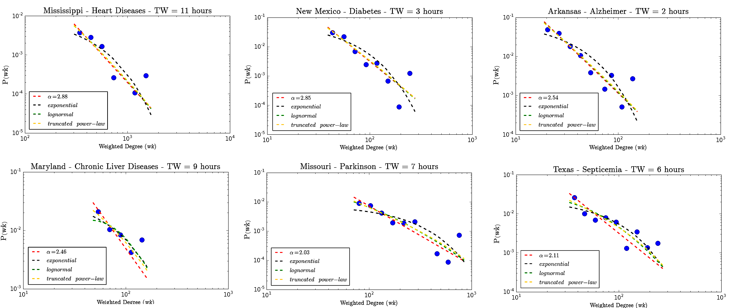
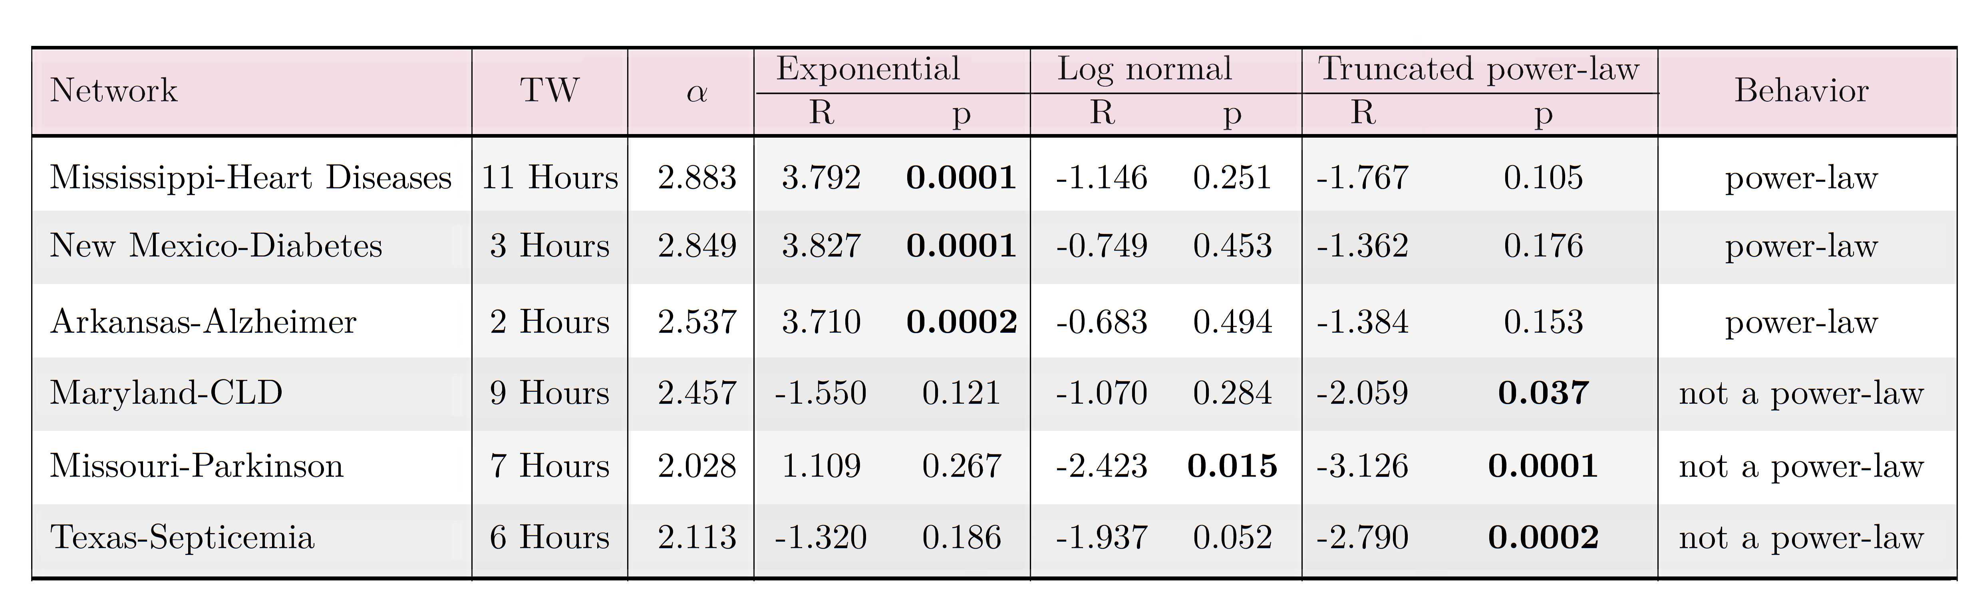
Example of Comparison between different distributions

Slide 35
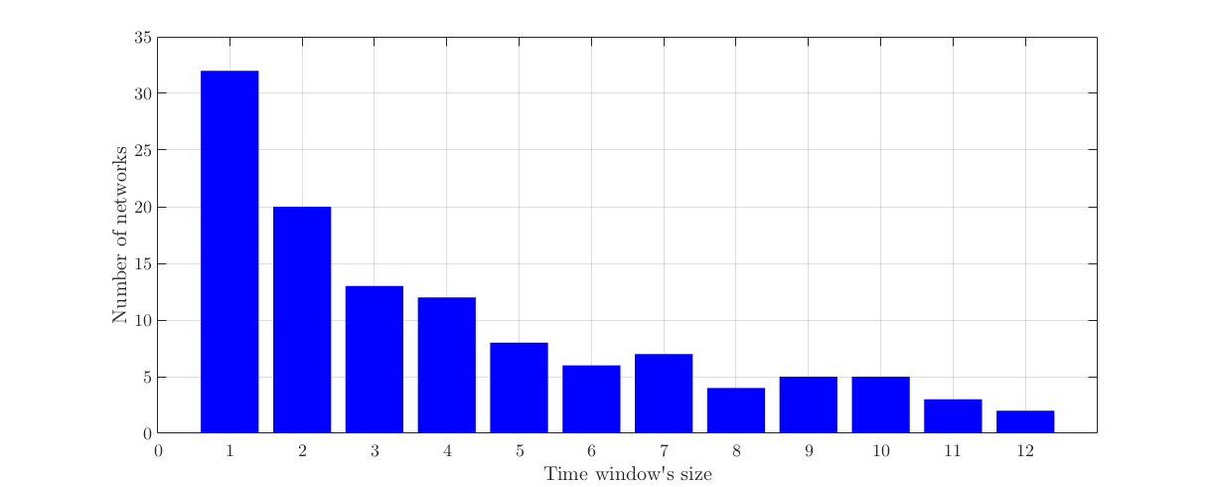
Degree Distribution Analysis
Only 117 out of 7344 Networks have a power-law distribution. (2.3% of all the networks)
Among the 117 networks that follow a power-law, the number of networks that was generated using the time window of one hour was larger than the other networks.

Slide 36
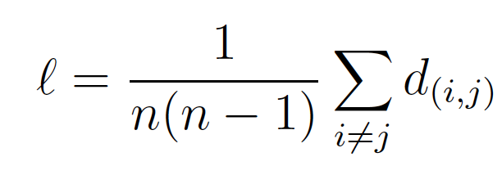
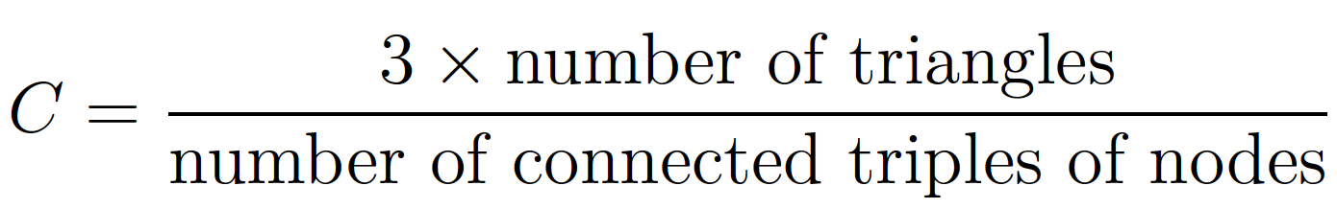
Network Analysis
Small – World :
Average path length:
  - determines the average number of hops between a pair of nodes.
  - defined as follows:
  - d (i,j) is the shortest path between nodes i and j
Clustering coefficient :
  - measures how tightly the nodes are connected to each other.
- defined as follows:
- it calculates the tendency of nodes to cluster with each other.
In small world networks average path length is low and clustering coefficient is high.

Slide 37
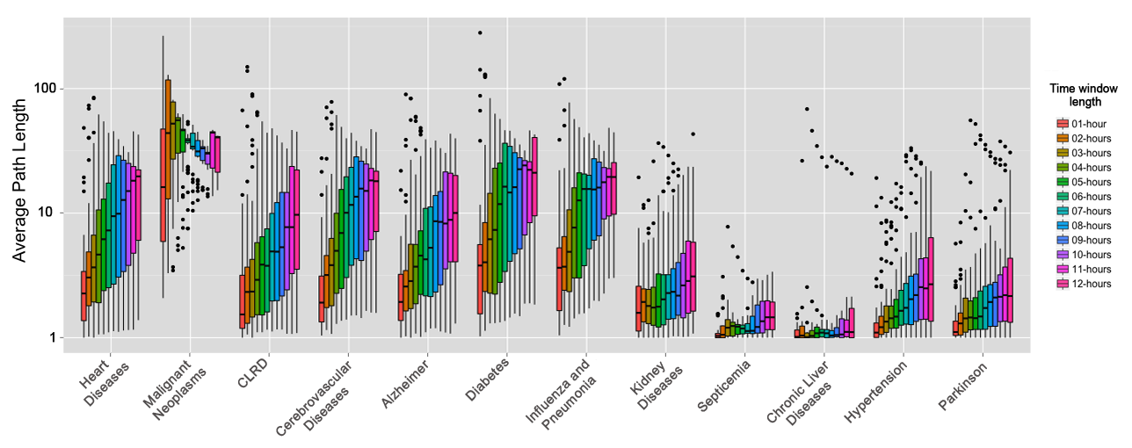
Average Path Length Evaluation
The distributions of the Networks’ Average Path Length

Slide 38
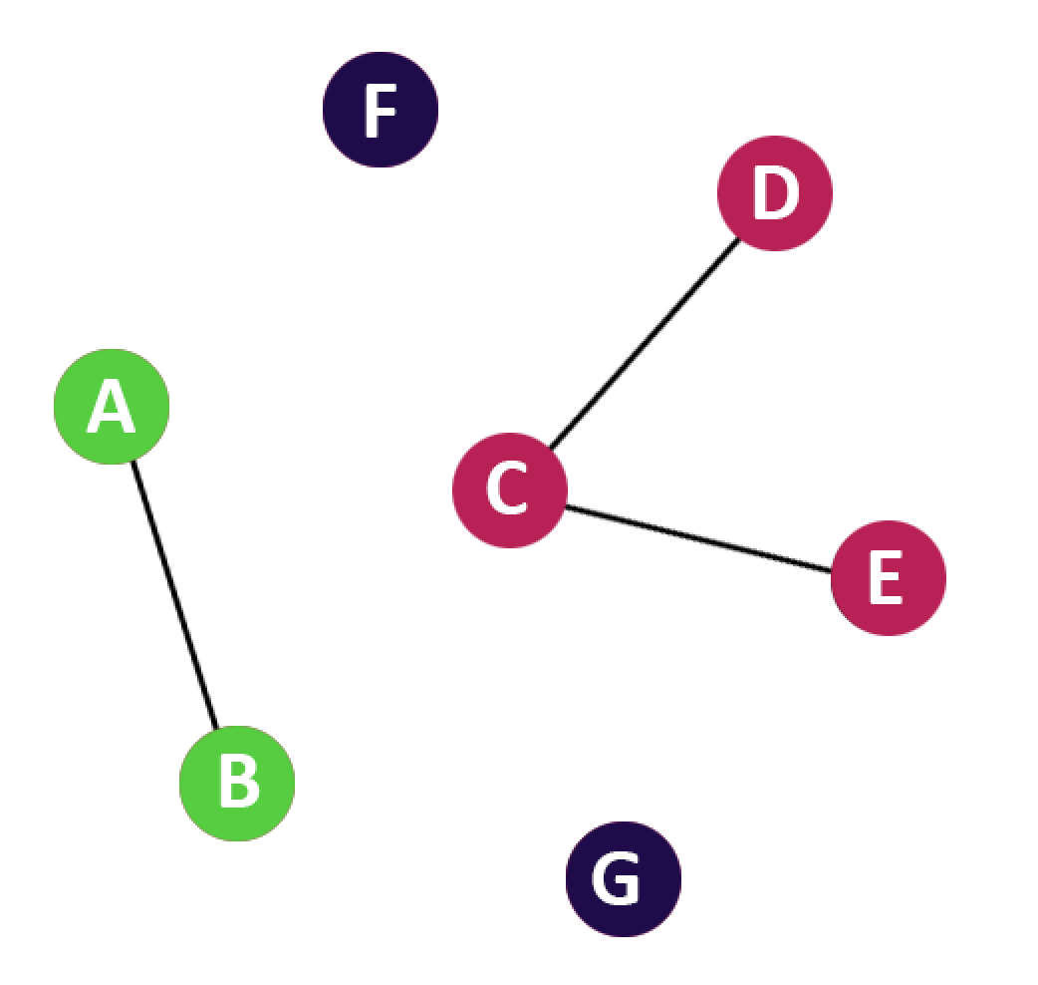
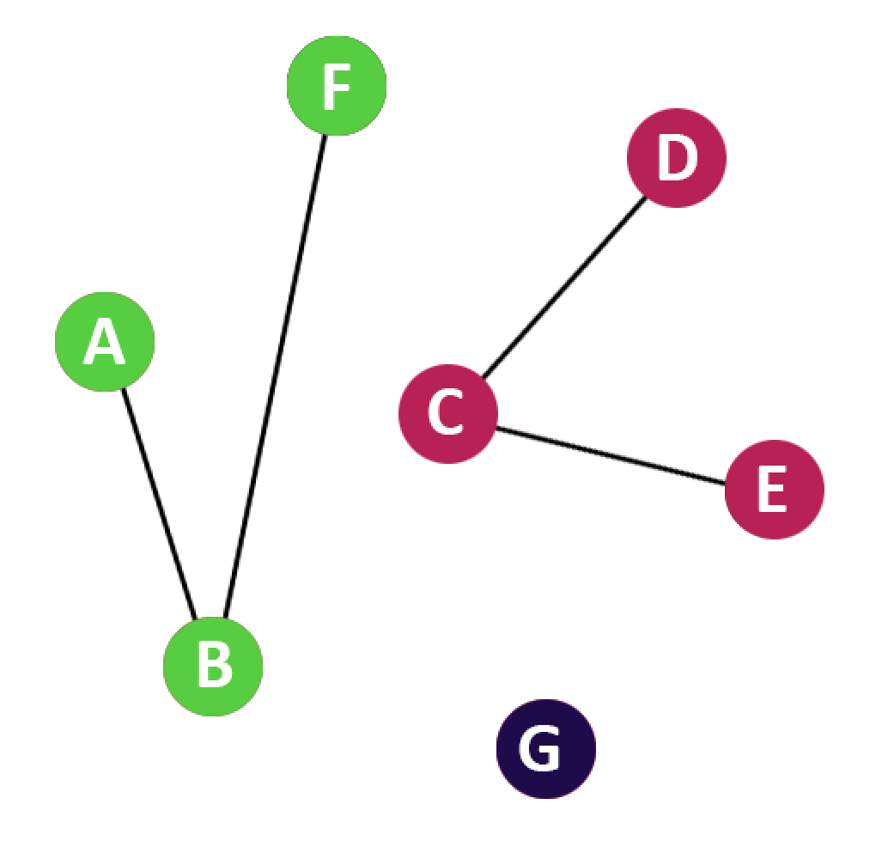
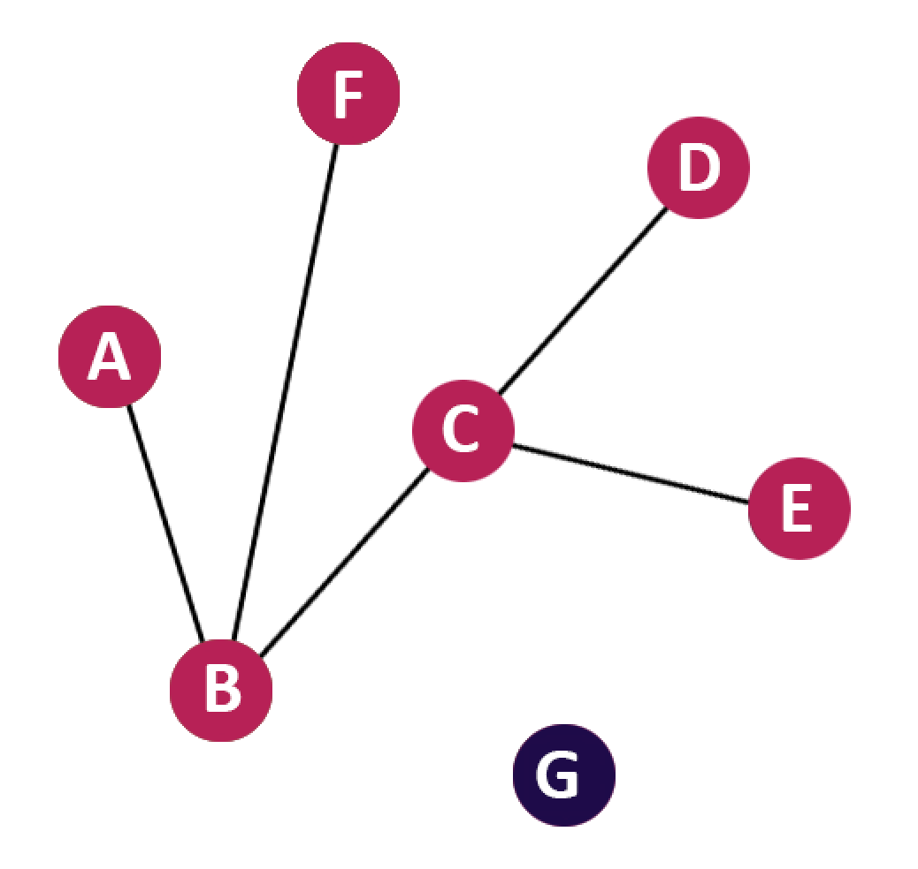


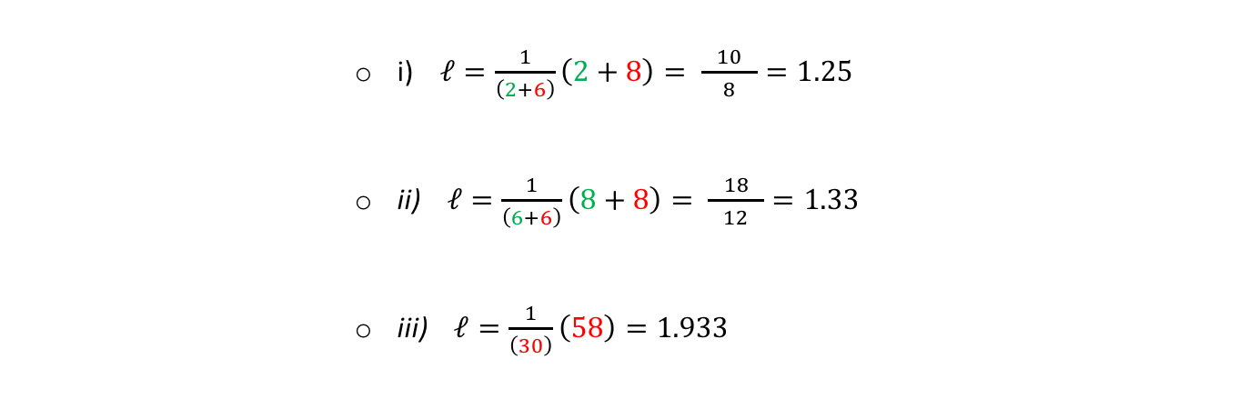
Average Path Length
Why do we observe that by increasing the time window the average path length is also increasing ?
    i ii iii
            $$ℓ=\frac{1}{3\left(2\right)}\left(1+1+1+2+1+2\right)$$
            $$ℓ=\frac{1}{2\left(1\right)}\left(1+1\right)$$
            i) $ℓ=\frac{1}{\left(2+6\right)}\left(2+8\right)= \frac{ 10 }{8}=1.25$
            ii) $ℓ=\frac{1}{\left(6+6\right)}\left(8+8\right)= \frac{ 18 }{12}=1.33$
            iii) $ℓ=\frac{1}{\left(30\right)}\left(58\right)=1.933$

Slide 39
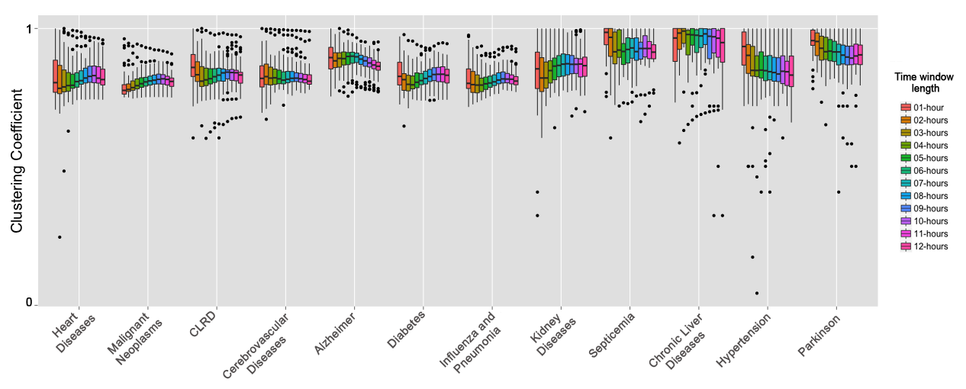
Clustering Coefficients Evaluation
The distributions of the Networks’ Clustering Coefficients

Slide 40
Conclusion
  Since only 2.3% of the networks’ WDD follow power-law; the majority of the generated networks do not have characteristics of scale-free networks.
  However, a power-law DD is not a necessary condition in social networks.
  The networks that were generated using the time window of one hour have the lower value of average path length.
  Despite the time window’s size, the majority of the networks have a high clustering coefficient.
  The TW approach retrieved the properties of small-world networks in which the average path length is low and the clustering coefficient is high.
  The level of awareness about the diseases does not lead to having more clustered networks.

Slide 41
Thanks
Thank you

