Slide 1
Performance Evaluation of GPU-accelerated HPC and AI applications using HPCToolkit, TAU, and ParaTools Pro for E4STM
Sameer Shende
Research Professor, University of Oregon
President and Director
ParaTools, Inc.
Presentation at EnergyHPC conference, Rice U., Houston
February 27, 2025
https://tinyurl.com/e4stut

Slide 2
ECP’s holistic approach uses co-design and integration to achieve exascale computing
Performant mission and science applications at scale
Aggressive
RD&D project
Mission apps; integrated S/W stack
Deployment to DOE HPC Facilities
Hardware
technology advances
Application Development (AD)
Software Technology (ST)
Hardware and Integration (HI)
Develop and enhance the predictive capability of applications critical to DOE
24 applications
National security, energy,
Earth systems, economic security, materials, data
6 Co-Design Centers
Machine learning, graph analytics, mesh refinement, PDE discretization, particles, online data analytics
Deliver expanded and vertically integrated software stack to achieve full potential of exascale computing
71 unique software products spanning programming models and run times,
math libraries,
data and visualization
Integrated delivery of ECP products on targeted systems at leading DOE HPC facilities
6 US HPC vendors
focused on exascale node and system design; application integration and software deployment to Facilities

Slide 3
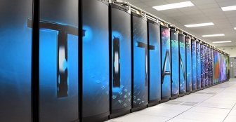
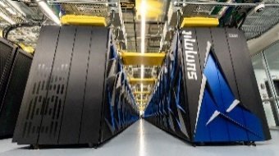

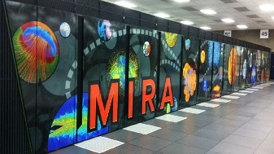
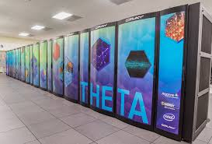

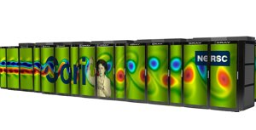
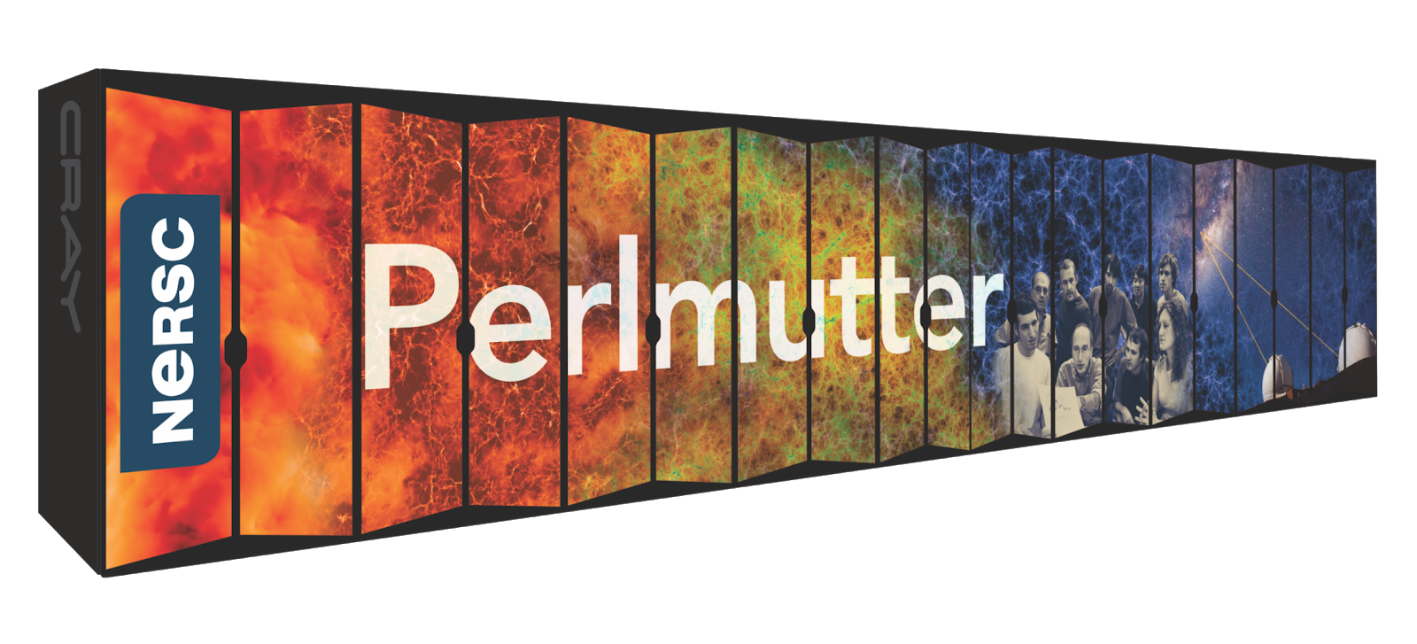
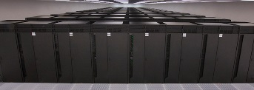
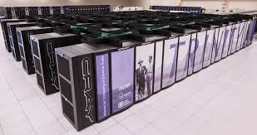



US DOE HPC Roadmap to Exascale Systems
2012-2020
2021-2025
Exascale
Systems
Titan
Summit
ORNL
Cray/AMD/NVIDIA
ORNL
IBM/NVIDIA
ORNL
HPE/AMD
Aurora
Mira
Theta
ANL
Intel/HPE
decommissioned
ANL
IBM BG/Q
ANL
Cray/Intel KNL
Cori
LBNL
Cray/Intel Xeon/KNL
LBNL
HPE/AMD/NVIDIA
Sequoia
LLNL
IBM BG/Q
Trinity
Sierra
LANL/SNL
Cray/Intel Xeon/KNL
LLNL
IBM/NVIDIA
LANL/SNL
HPE/Intel
LLNL
HPE/AMD

Slide 4
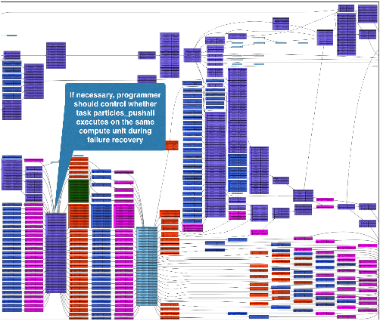
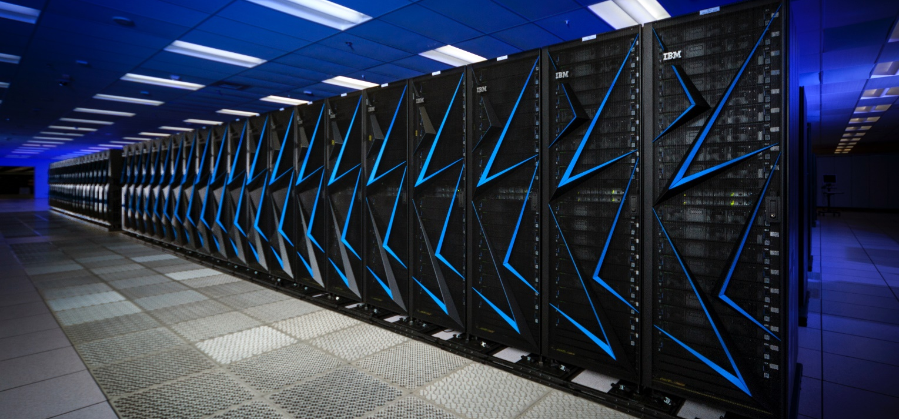
ECP Software Technology (ST)
Goal
Build a comprehensive, coherent software stack that enables application developers to
productively develop highly
parallel applications
that effectively target
diverse exascale
architectures
Prepare SW stack for scalability with massive on-node parallelism
Extend existing capabilities when possible, develop new when not
Guide, and complement, and integrate with vendor efforts
Develop and deliver high-quality and robust software products

Slide 5












E4S: Extreme-scale Scientific Software Stack
About E4S
https://e4s.io
E4S is a community effort to provide open-source software packages for developing, deploying and running scientific applications on HPC platforms.
E4S has built a comprehensive, coherent software stack that enables application developers to productively develop highly parallel applications that effectively target diverse exascale architectures.
E4S provides a curated, Spack based software distribution of 120+ HPC (OpenFOAM, Gromacs, Nek5000, LAMMPS), EDA (e.g., Xyce), and AI/ML packages (e.g., NVIDIA NeMoTM, HuggingFace Hub, TensorFlow, PyTorch, TorchBraid, Scikit-Learn, Pandas, JAX, Horovod, LBANN with support for GPUs).
Base images and full featured containers (with GPU support) and DOE LLVM containers.
Commercial support for E4S through ParaTools, Inc. for installation, maintaining an issue tracker, and ECP AD engagement.
E4S for commercial cloud platforms: Adaptive Computing’s ODDC with ParaTools Pro for E4STM image for AWS, GCP, Azure.
With E4S Spack binary build caches, E4S supports both bare-metal and containerized deployment for GPU based platforms.
  X86_64, ppc64le (IBM Power 10), aarch64 (ARM64) with support for GPUs from NVIDIA, AMD, and Intel
  HPC and AI/ML packages are optimized for GPUs and CPUs.
    Container images on DockerHub and E4S website of pre-built binaries of ECP ST products.
e4s-chain-spack.sh to chain two Spack instances allows us to install new packages in home directory and use other tools.
e4s-cl container launch tool allows binary distribution of applications by swapping MPI in the containerized app w/ system MPI.
e4s-alc is an à la carte tool to customize container images by adding system and Spack packages to an existing image.
Notes:
LOCAL LAB POC: Michael Heroux (maherou@sandia.gov)
TALKING POINTS:
PESO is a five-year post-ECP software-ecosystem stewardship and advancement project. In partnership with the Consortium for the Advancement of Scientific Software (CASS), PESO will establish and steward a sustainable scientific software ecosystem comprising libraries and tools that deliver the latest high-performance algorithms and capabilities for DOE mission-critical applications.
PESO will enable applications to realize 100X improvement in both high-end capabilities and energy efficiency by leveraging accelerator devices
PESO will emphasize software product quality, the continued fostering of software product communities, and the delivery of products, working with CASS
METADATA:
Name of the associated awarded project:
PI name(s): Michael Heroux (Sandia), Lois Curfman McInnes (Argonne)
Name of the program manager: William Spotz, Software Stewardship and Advancement
CITATIONS:
The notes section should also include full citations (including the DOI) to any important and associated publications, datasets or code developed as part this work.
N/A
AWARDS:
N/A
REPRODUCIBILITY:
N/A.
BACKGROUND AND CONTEXT INFORMATION:
N/A

Slide 6
Reproducibility of scientific results using E4S containers
E4S has built and distributed container images on DockerHub and E4S website of pre-built binaries of ECP ST products.
Base images and full featured containers (with GPU support) and DOE LLVM containers.
e4s-alc is an à-la-carte tool to customize container images by adding system and Spack packages to an existing image.
e4s-chain-spack.sh to chain two Spack instances allows us to install new packages in home directory and use other tools.
e4s-cl container launch tool allows binary distribution of applications by swapping MPI in the containerized app with system MPI.
Using containers to take a snapshot of a working scientific model for reproducibility.
Hands-on exercises on building a working container with MPI and using it on an HPC system.
https://e4s.io

Slide 7
E4S 24.11: What’s New?
E4S includes 132+ HPC packages on ARM, x86_64, and ppc64le platforms, 132K+ binaries in E4S build Cache.
E4S improves support for a cross-platform AI/ML software stack including packages like NVIDIA NeMoTM, Huggingface_hub, DeepHyper, Google.generativeai (Gemini API), OpenAI (API), TorchBraid, Pandas, Scikit-Learn, JAX, PyTorch, TensorFlow, Horovod, OpenCV, and LBANN with support for GPUs.
Support for new architecture: AMD MI300A/MI300X (gfx942).
New language and runtime: Chapel
New applications: NWChem, WRF, FFTX
E4S DocPortal updated with AI/ML tools.
CUDA upgraded from to 12.6 (aarch64), ROCm upgraded to 6.2.1, oneAPI upgraded to 2024.2.0.
Adaptive Computing’s HPC Cloud on demand data center (ODDC) web-based platform for multi-user, multi-node ParaTools Pro for E4STM images on AWS, Azure, and Google Cloud Marketplace with NVIDIA GPUs with VNC based remote desktop and Torque (qsub) and SLURM (sbatch) for multi-node execution:
    https://adaptivecomputing.com/
    https://paratoolspro.com

Slide 8

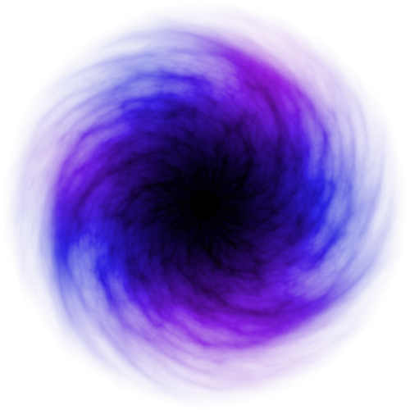







E4S: Better quality, documentation, testing, integration, delivery, building & use
Delivering HPC software to facilities, vendors, agencies, industry, international partners in a brand-new way
Quality Commitment
Community policies, improvement
DocPortal
Single portal to all E4S product info
Portfolio testing
Especially leadership platforms
Curated collection
The end of dependency hell
Quarterly releases Release 24.11 – November
Build caches
10X build time improvement
Turnkey stack
A new user experience
https://e4s.io
E4S Strategy Group
US agencies, industry, international

Slide 9


Extreme-scale Scientific Software Stack (E4S)
E4S: HPC Software Ecosystem – a curated software portfolio
A Spack-based distribution of software tested for interoperability and portability to multiple architectures with support for GPUs from NVIDIA, AMD, and Intel in each release
Available from source, containers, cloud, binary caches
Leverages and enhances SDK interoperability thrust
Not a commercial product – an open resource for all
Oct 2018: E4S 0.1 - 24 full, 24 partial release products
Jan 2019: E4S 0.2 - 37 full, 10 partial release products
Nov 2019: E4S 1.0 - 50 full, 5 partial release products
Feb 2020: E4S 1.1 - 61 full release products
Nov 2020: E4S 1.2 (aka, 20.10) - 67 full release products
Feb 2021: E4S 21.02 - 67 full release, 4 partial release
May 2021: E4S 21.05 - 76 full release products
Aug 2021: E4S 21.08 - 88 full release products
Nov 2021: E4S 21.11 - 91 full release products
Feb 2022: E4S 22.02 – 100 full release products
May 2022: E4S 22.05 – 101 full release products
August 2022: E4S 22.08 – 102 full release products
November 2022: E4S 22.11 – 103 full release products
February 2023: E4S 23.02 – 106 full release products
May 2023: E4S 23.05 – 109 full release products
Aug 2023: E4S 23.08 – 115 full release products
Nov 2023: E4S 23.11 – 120 full release products
Feb 2024: E4S 24.02 – 122 full release products
May 9, 2024: E4S 24.11 – 125 full release products
Nov 15, 2024: E4S 24.11 – 132 full release products
https://e4s.io
Lead: Sameer Shende
(U Oregon)
Also include other products .e.g.,
AI: NVIDIA NeMoTM, DeepHyper, TorchBraid, Scikit-Learn, JAX, PyTorch, TensorFlow, Horovod, LBANN
Co-Design: AMReX, Cabana, MFEM
EDA: Xyce

Slide 10
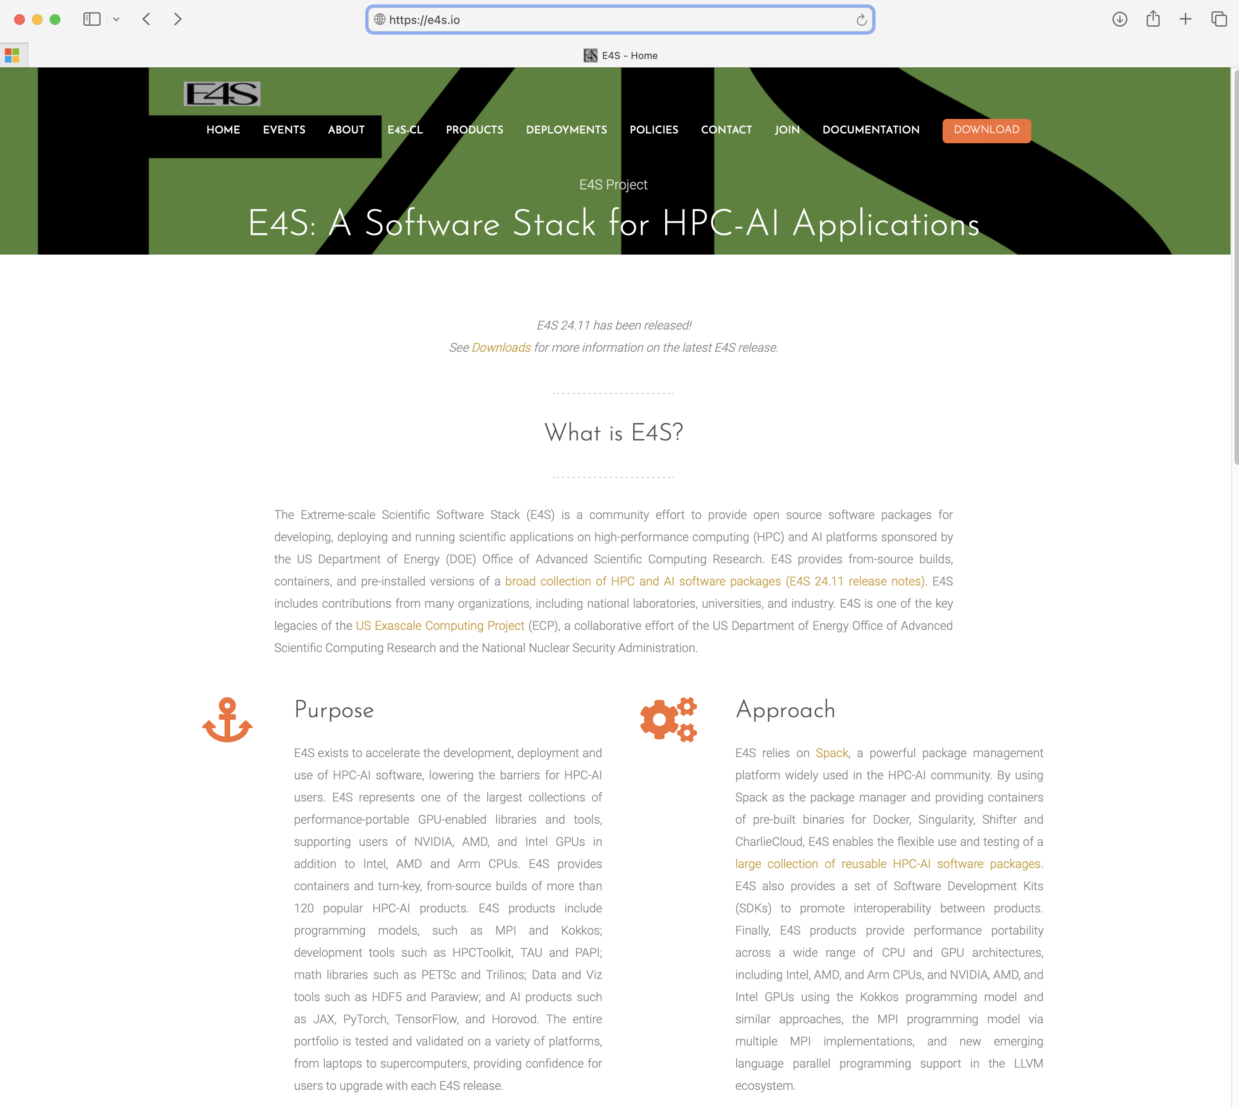
E4S Download from https://e4s.io

Slide 11
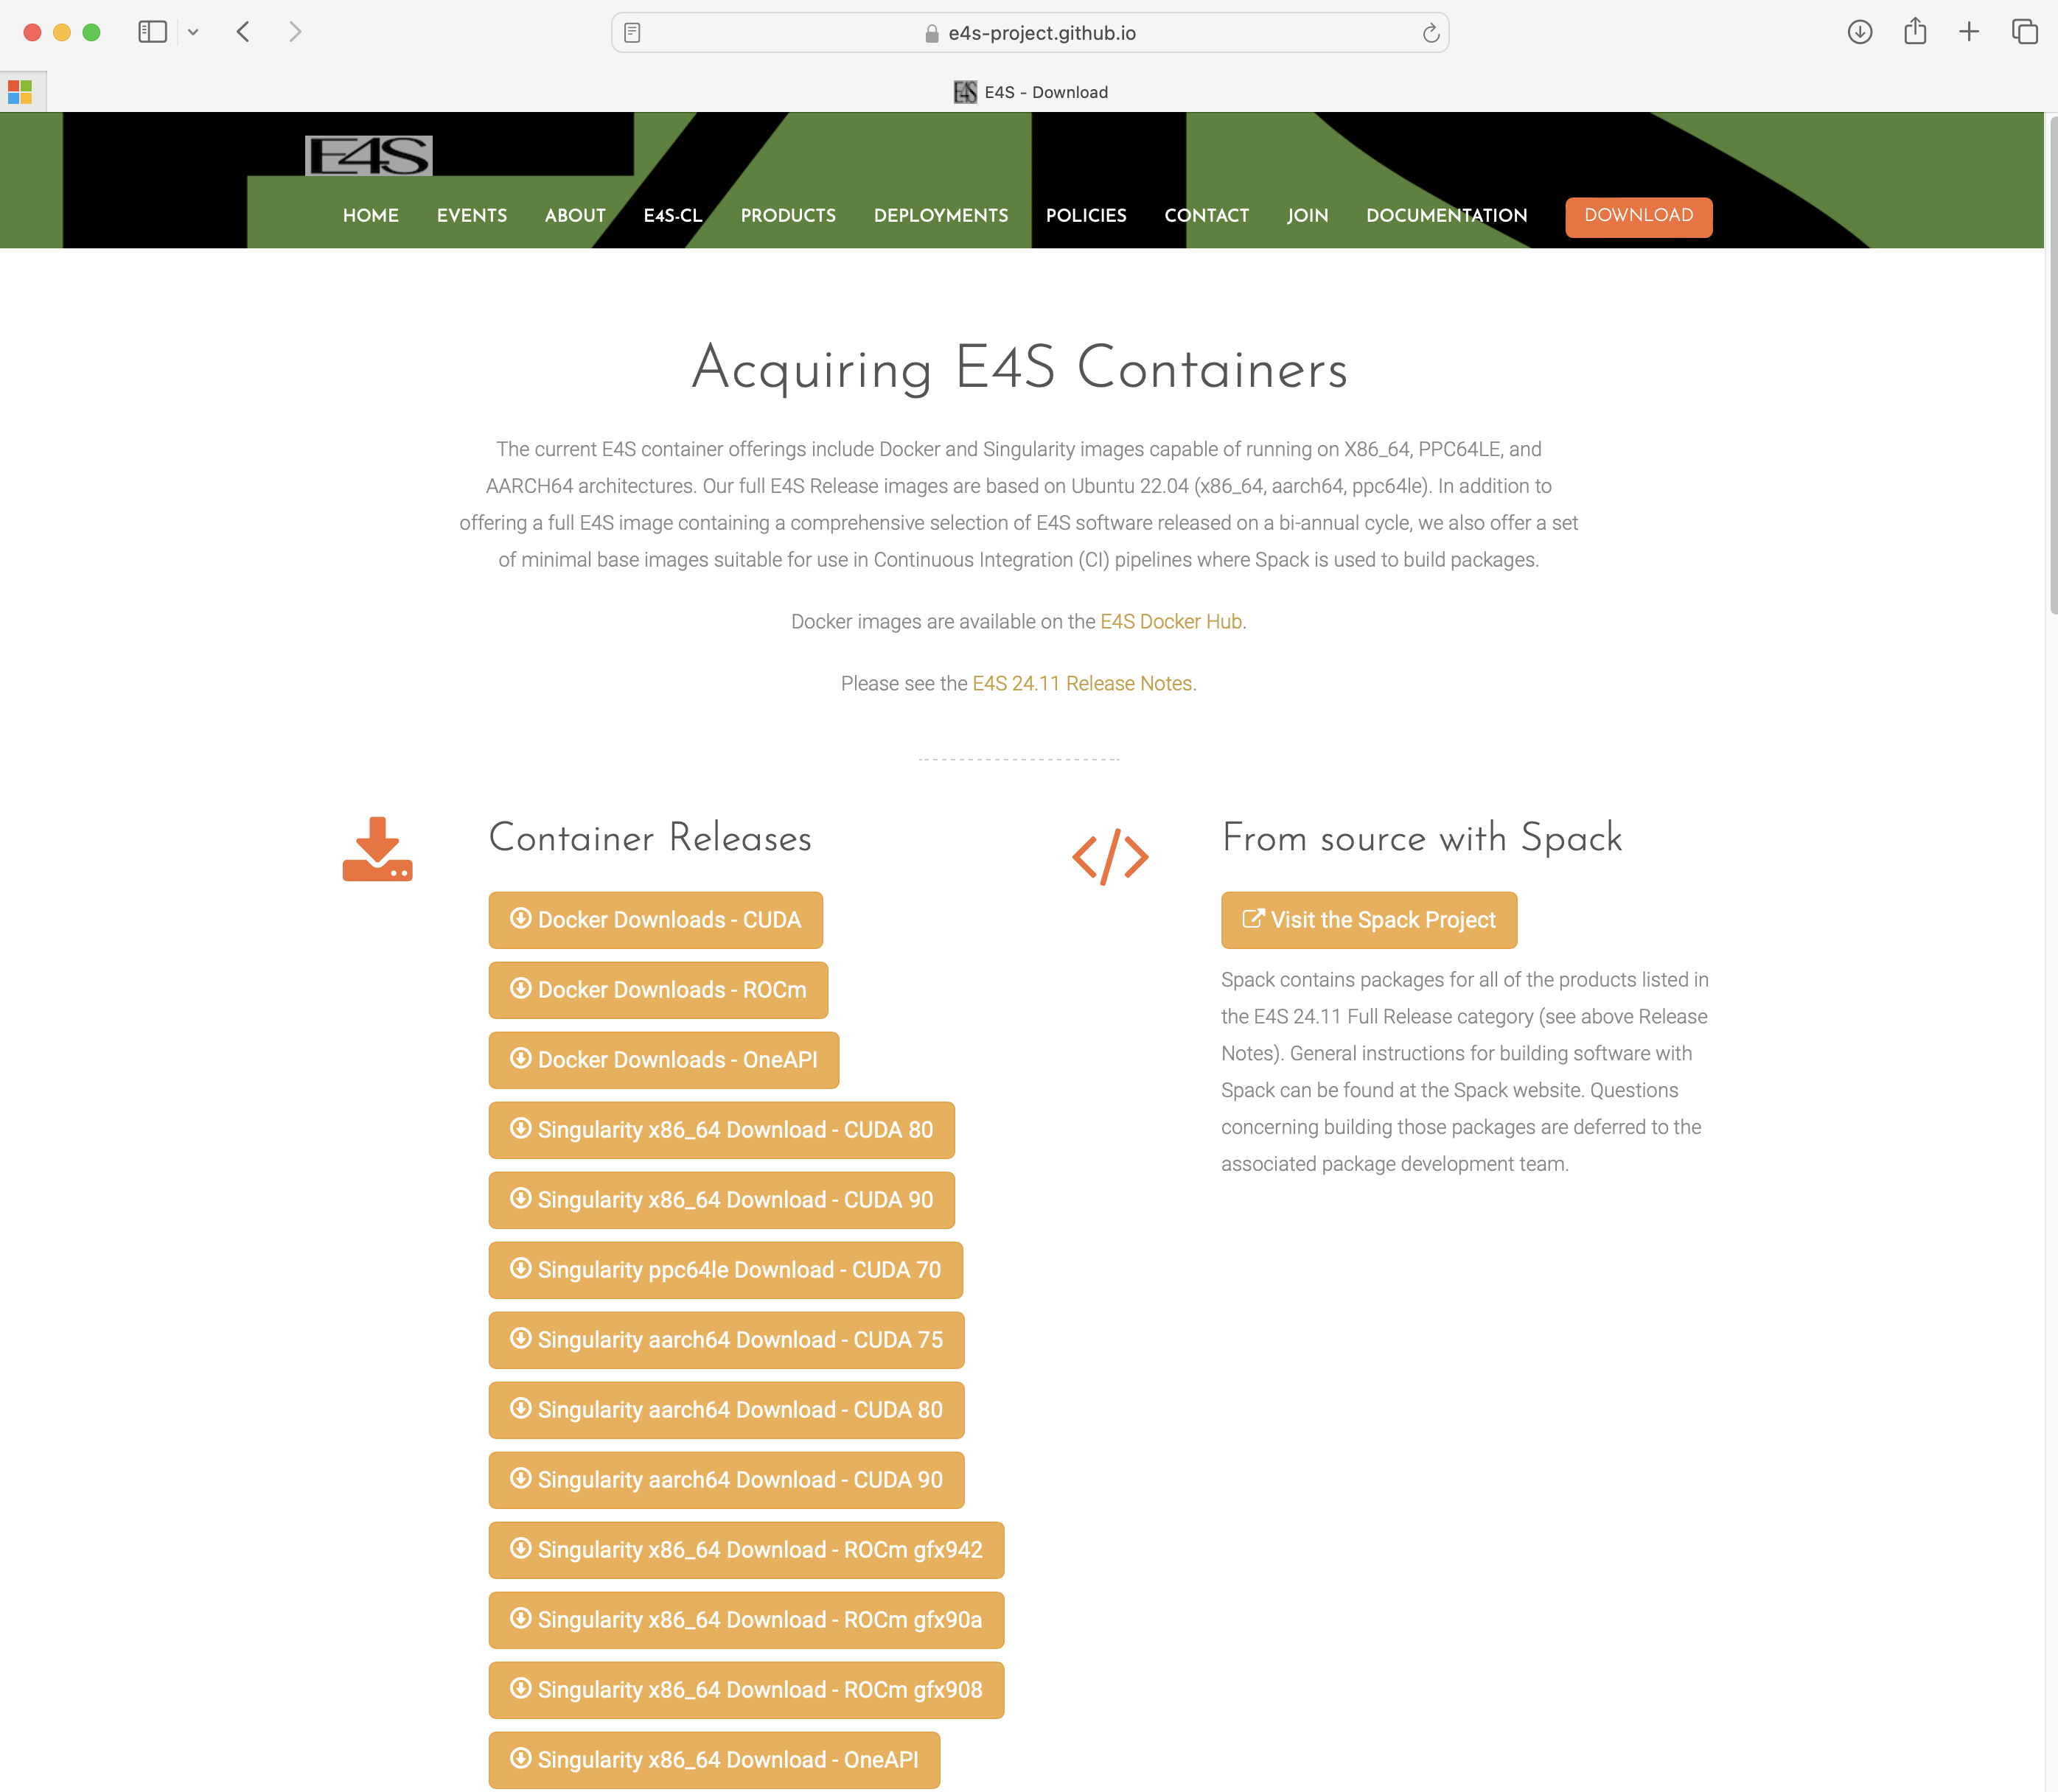
E4S Container Download from https://e4s.io
Separate full featured Singularity images for 3 GPU architectures
GPU full featured images for
  x86_64 (Intel, AMD, NVIDIA)
  ppc64le (NVIDIA)
  aarch64 (NVIDIA)
Full featured images available
on Dockerhub
132+ products on 3 architectures

Slide 12
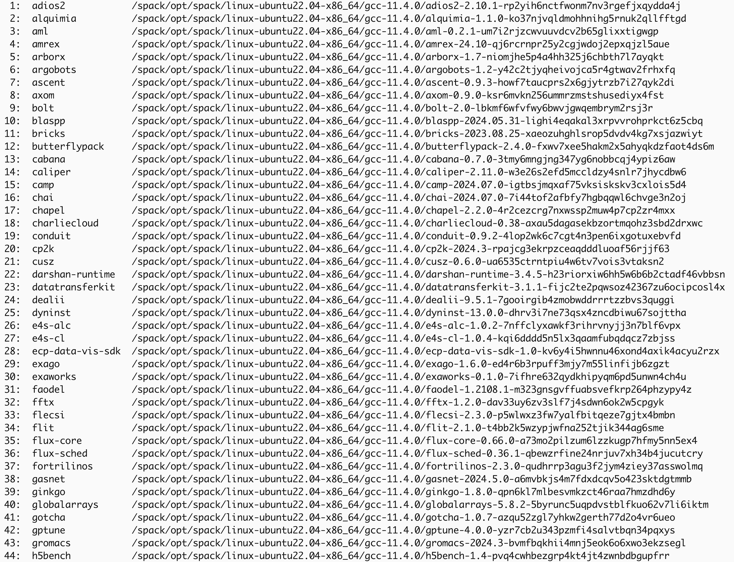
24.11 Release: 132+ Official Products + dependencies (gcc,x86_64)
GPU runtimes
AMD (ROCm)
  6.2.1
NVIDIA (CUDA)
  12.2
NVHPC
  24.9
Intel oneAPI
  2024.2.0

Slide 13
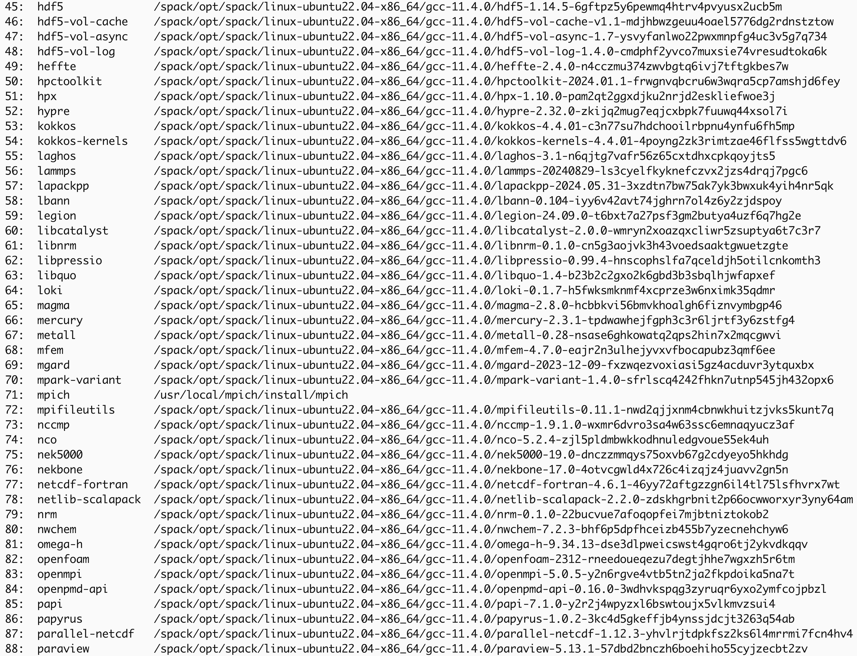
24.11 Release: 132+ Official Products + dependencies (gcc, x86_64)

Slide 14
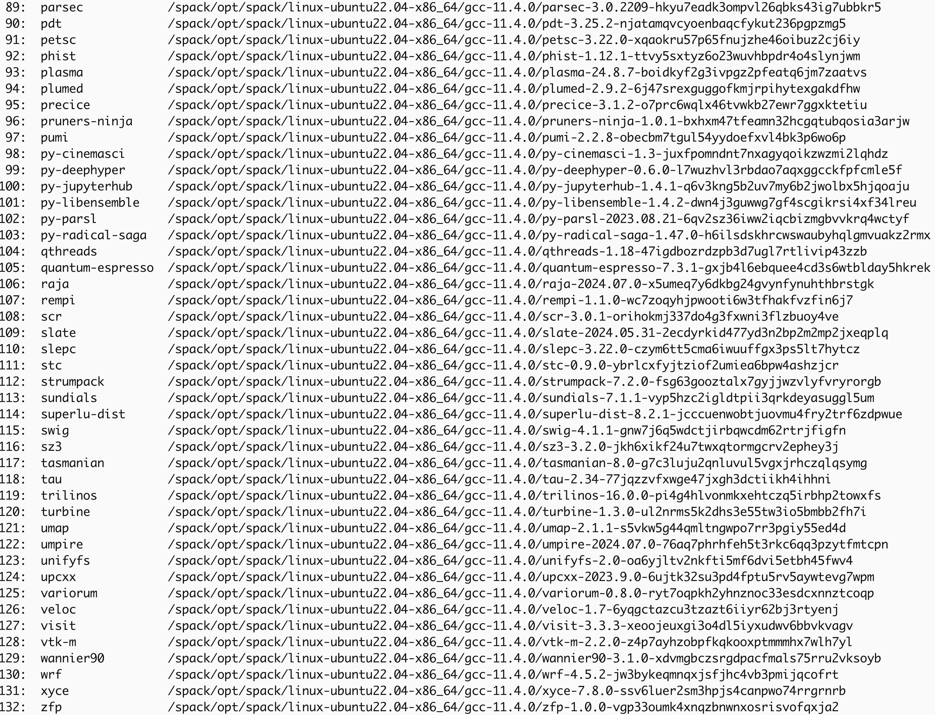
24.11 Release: 132+ Official Products + dependencies (gcc,x86_64)
Languages:
Chapel, Rust
Julia with support for MPI, and CUDA
Python
AI products
NVIDIA NeMoTM
TensorBraid
DeepHyper
OpenAI
Tensorflow
Pytorch
JAX
Horovod
LBANN
EDA Tools:
Xyce
3D Visualization
Paraview
VisIt
TAU’s paraprof
Jupyter notebook …

Slide 15
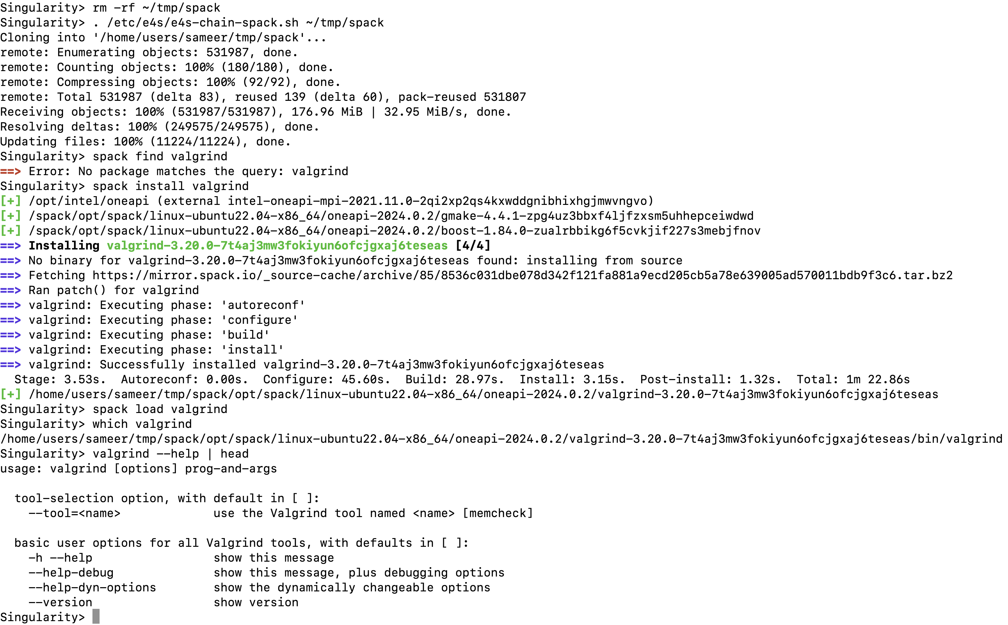
E4S Tools: e4s-chain-spack.sh
e4s-chain-spack.sh allows a user to extend and add new tools to an existing Spack
installation in a read-only filesystem in a container and chain both Spack installations!

Slide 16
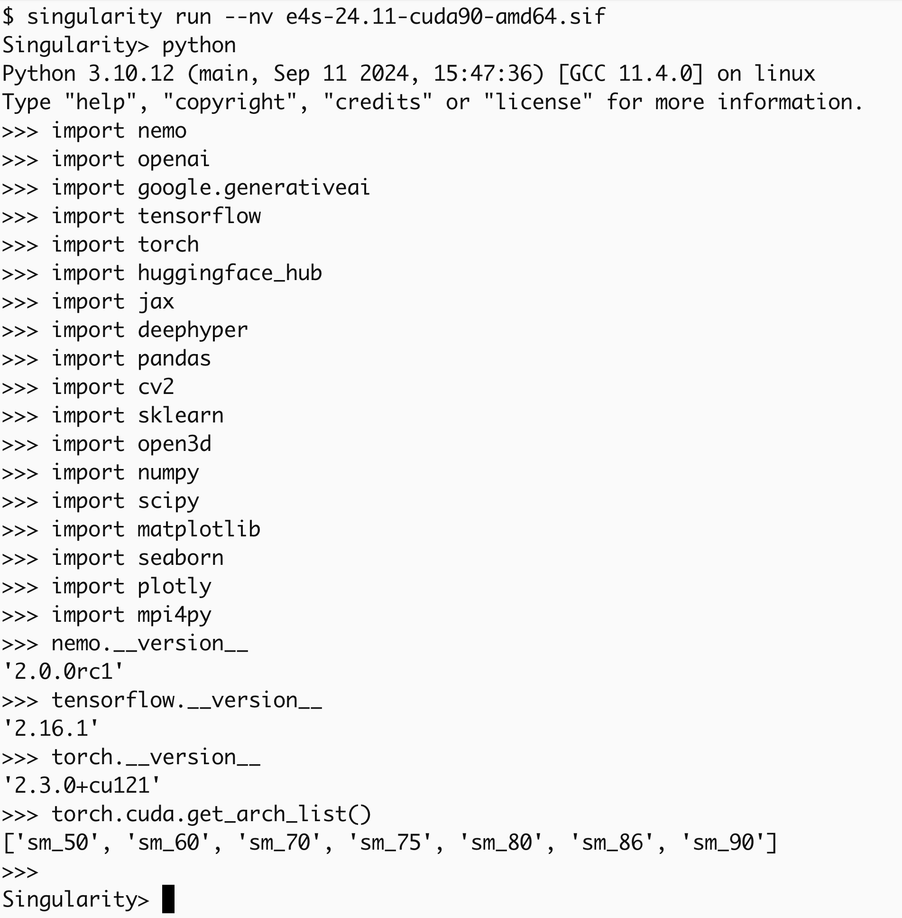
E4S Support for AI/ML and Python tools
Updated:
Tensorflow: 2.16.1
PyTorch: 2.3.0
NVIDIA NeMoTM: 2.0.0rc1
NVHPC 24.9
CUDA 12.2.2
CuDNN 8.9.7.29, 9.5.0
NCCL 2.20.3
TensorRT 8.6.1.6

Slide 17
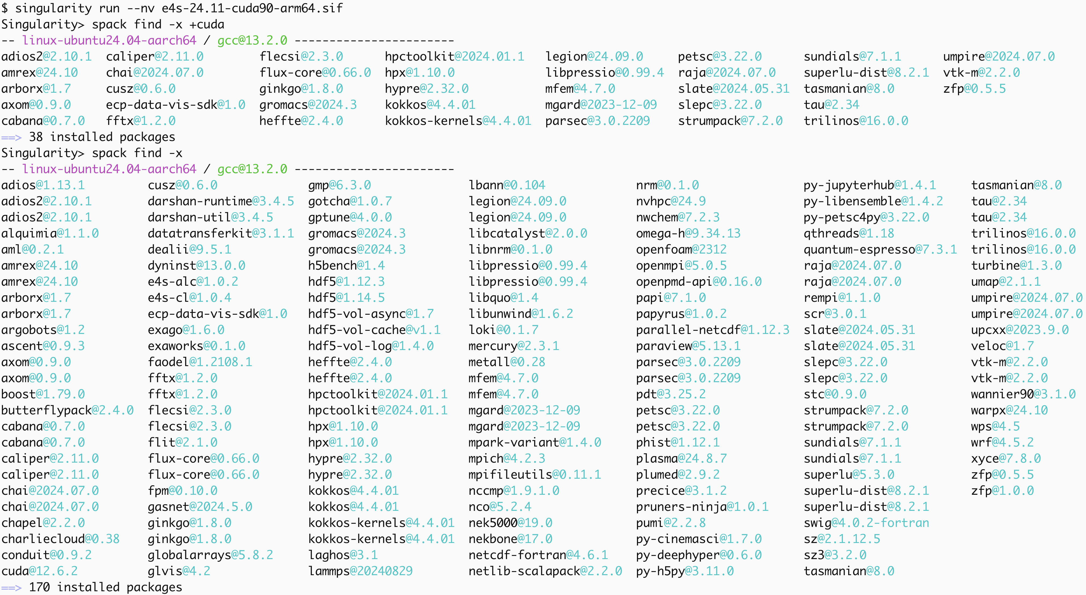
E4S 24.11 Support for GPUs: NVIDIA

Slide 18
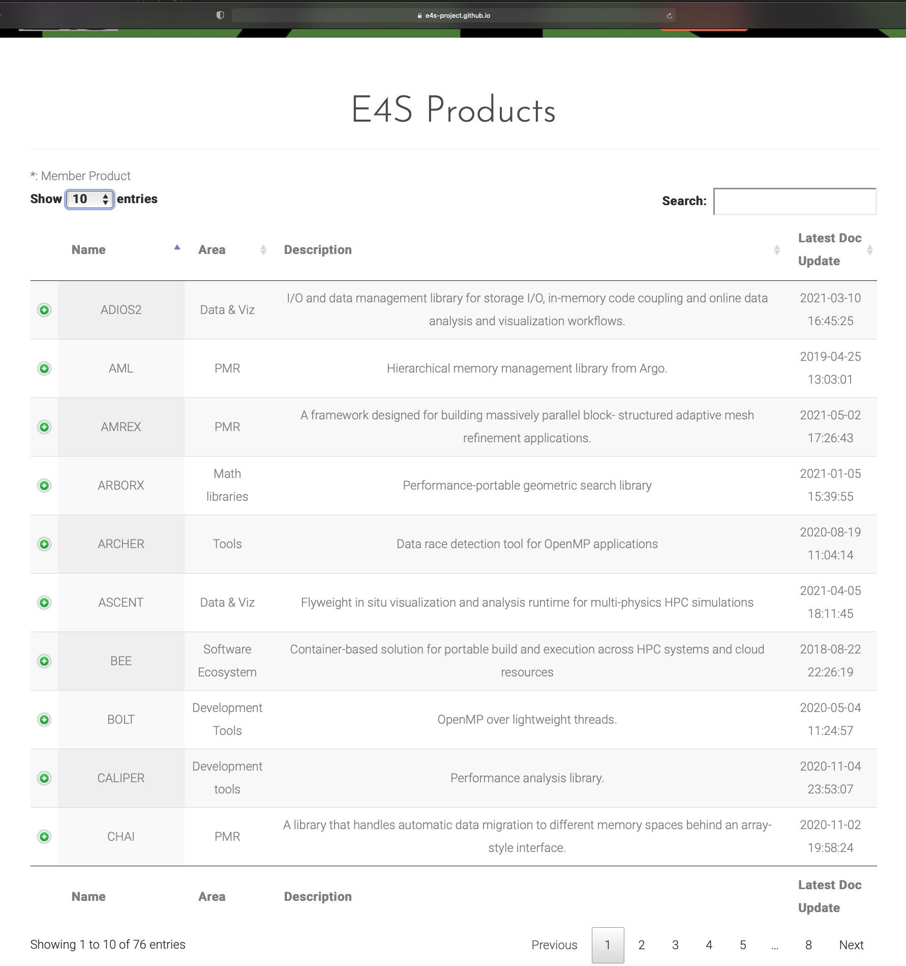
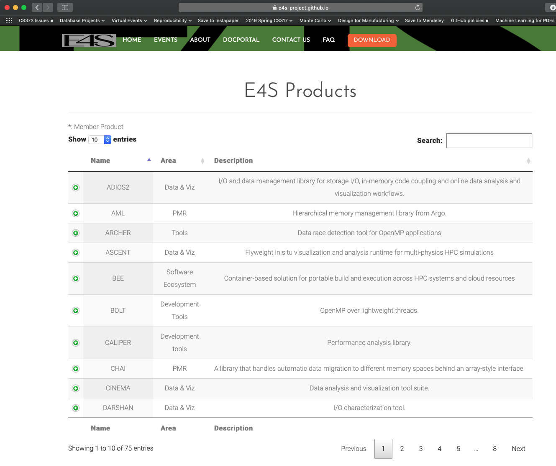
E4S DocPortal
Single point of access
All E4S products
Summary Info
  Name
  Functional Area
  Description
  License
Searchable
Sortable
Rendered daily from repos
https://e4s-project.github.io/DocPortal.html
Notes:
quick run through - what ECP ST is working on

Slide 19
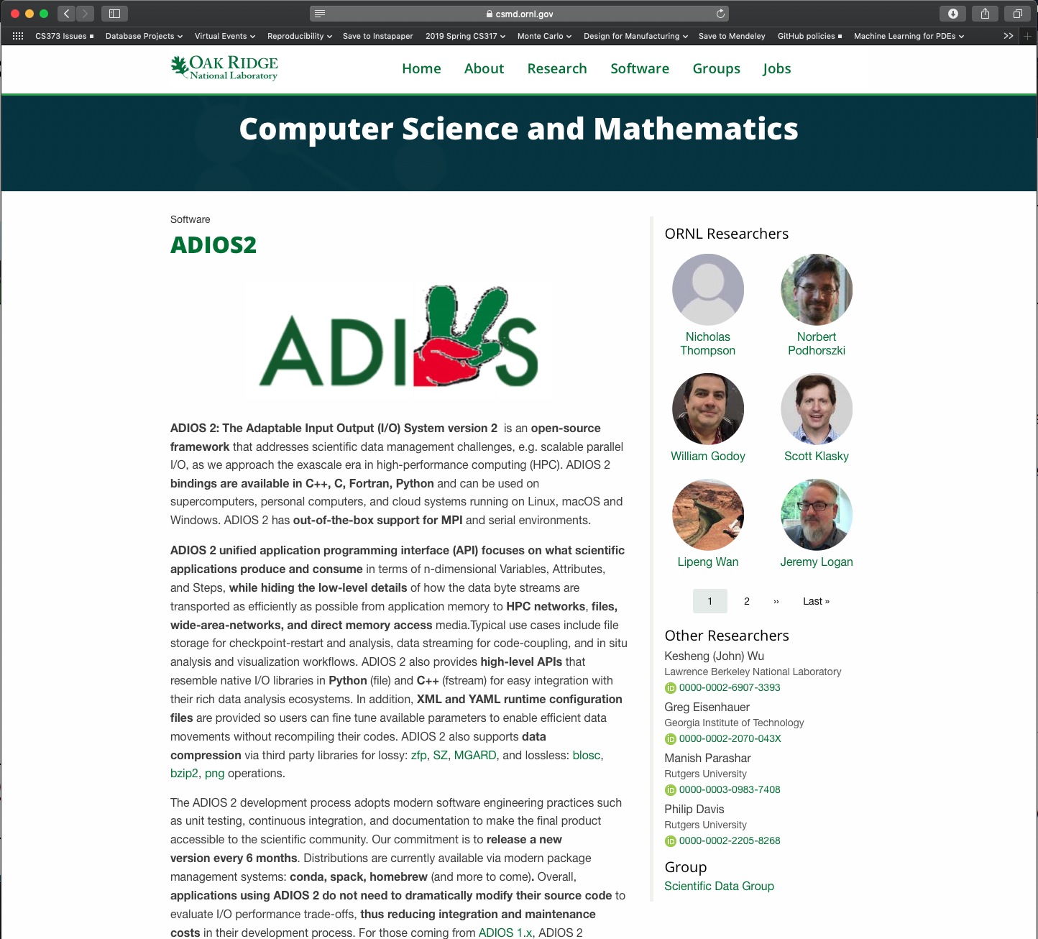
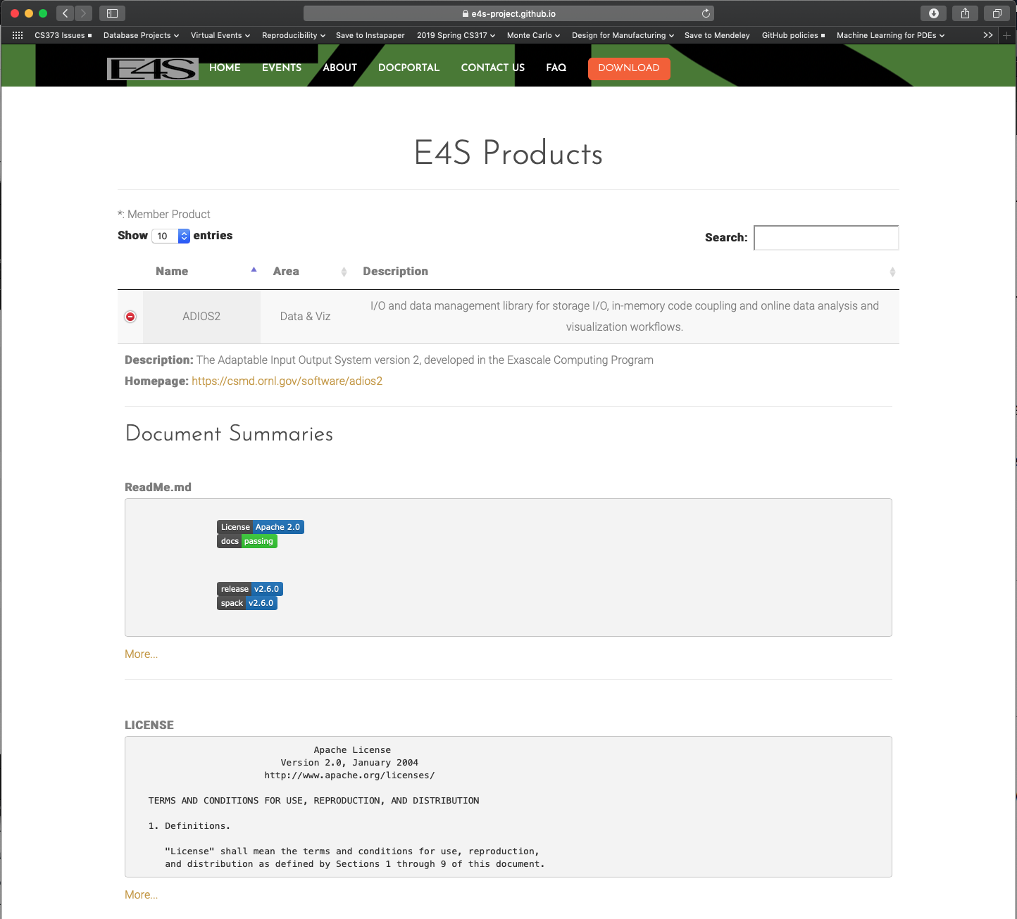
Goal: All E4S product documentation accessible from single portal on E4S.io (working mock webpage below)
https://e4s-project.github.io/DocPortal.html

Slide 20
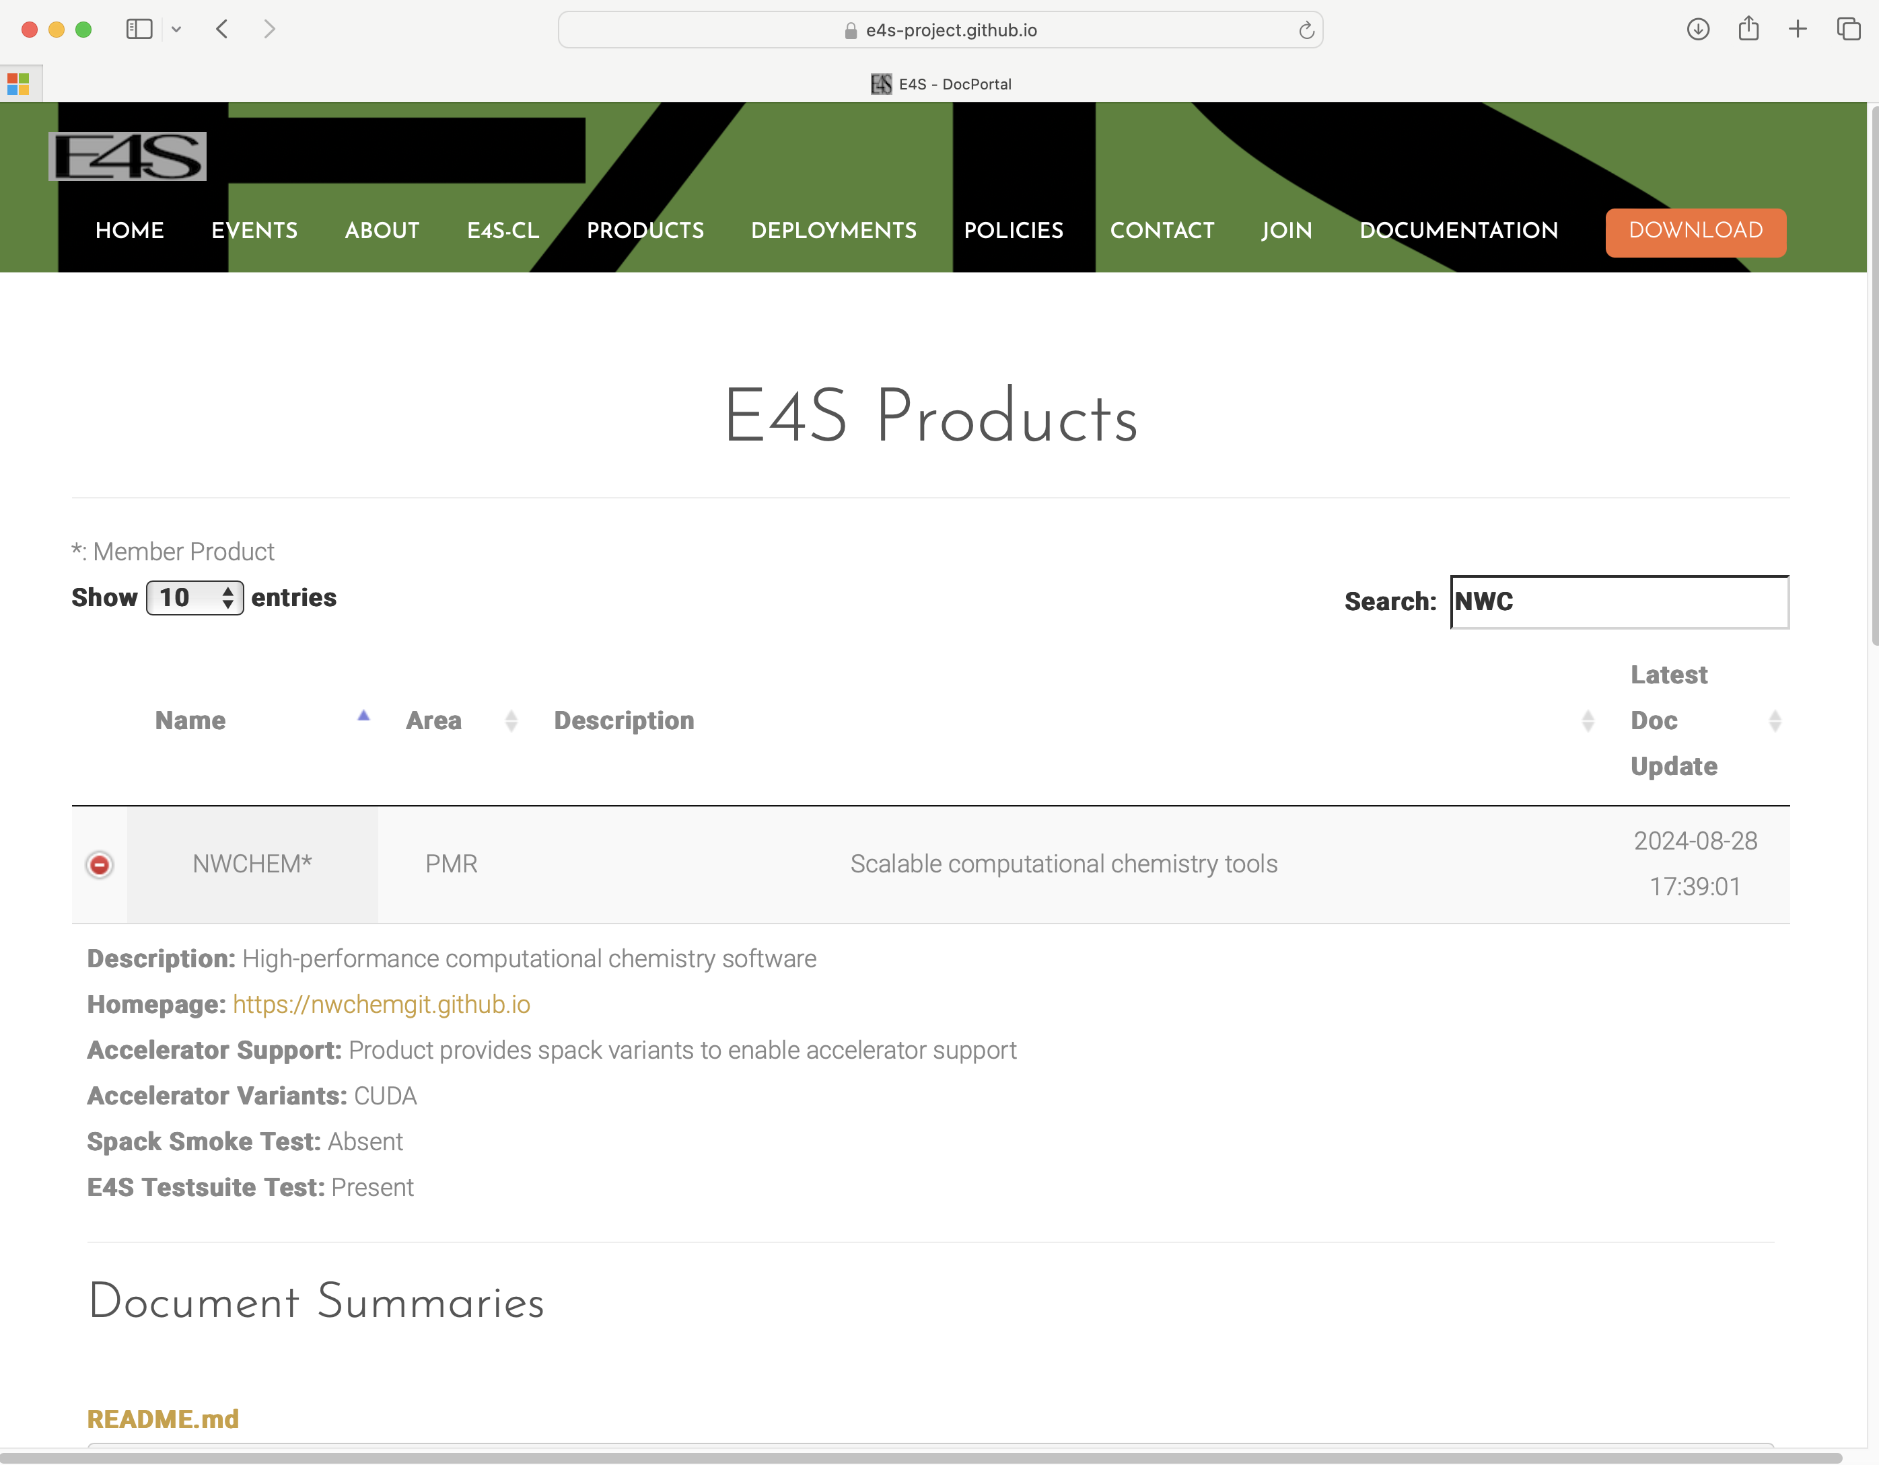
E4S DocPortal updated with new applications and AI/ML tools
Notes:
quick run through - what ECP ST is working on

Slide 21

e4s-cl: A tool to simplify the launch of MPI jobs in E4S containers
E4S containers support replacement of MPI libraries using MPICH ABI compatibility layer and Wi4MPI [CEA] for OpenMPI replacement.
Applications binaries built using E4S can be launched with Singularity using MPI library substitution for efficient inter-node communications.
e4s-cl is a new tool that simplifies the launch and MPI replacement.
  e4s-cl init --backend [singularity|shifter|docker] --image <file> --source <startup_cmds.sh>
  e4s-cl mpirun -np <N> <command>
Usage:
  e4s-cl init --backend singularity --image ~/images/e4s-gpu-x86.sif --source ~/source.sh
  cat ~/source.sh
. /spack/share/spack/setup-env.sh
spack load trilinos@13.0.1
  e4s-cl mpirun -np 4 ./a.out
https://github.com/E4S-Project/e4s-cl
Notes:
quick run through - what ECP ST is working on

Slide 22
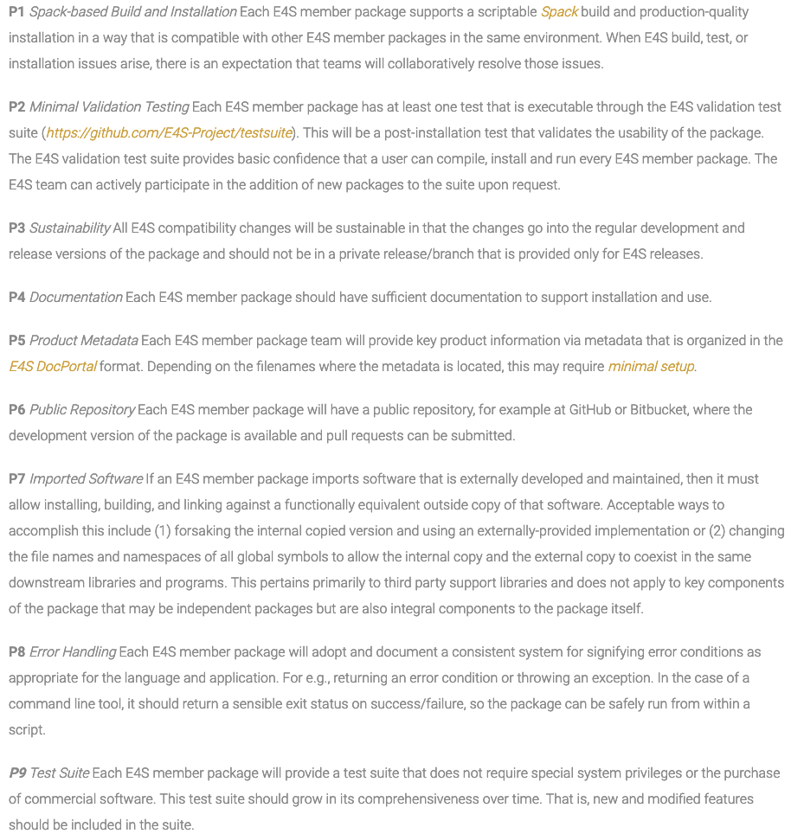
E4S Community Policies Version 1
A Commitment to Quality Improvement
Will serve as membership criteria for E4S
  Membership is not required for inclusion in E4S
  Also includes forward-looking draft policies
Purpose: enhance sustainability and interoperability
Topics cover building, testing, documentation, accessibility, error handling and more
Multi-year effort led by SDK team
  Included representation from across ST
  Multiple rounds of feedback incorporated from ST leadership and membership
Modeled after xSDK Community Policies
https://e4s-project.github.io/policies.html

Slide 23
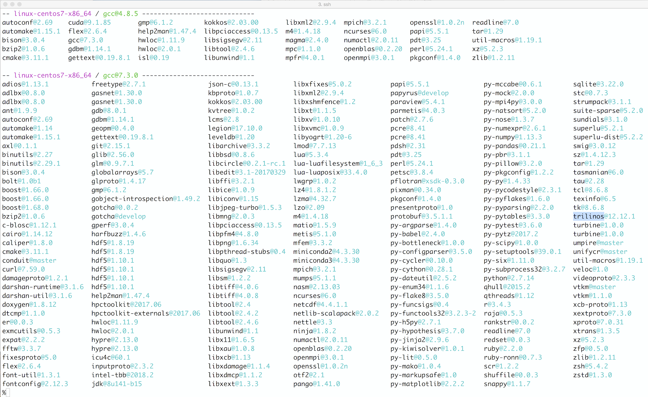
Spack
E4S uses the Spack package manager for software delivery
Spack provides the ability to specify versions of software packages that are and are not interoperable.
Spack is a build layer for not only E4S software, but also a large collection of software tools and libraries outside of ECP ST.
Spack supports achieving and maintaining interoperability between ST software packages.

Slide 24
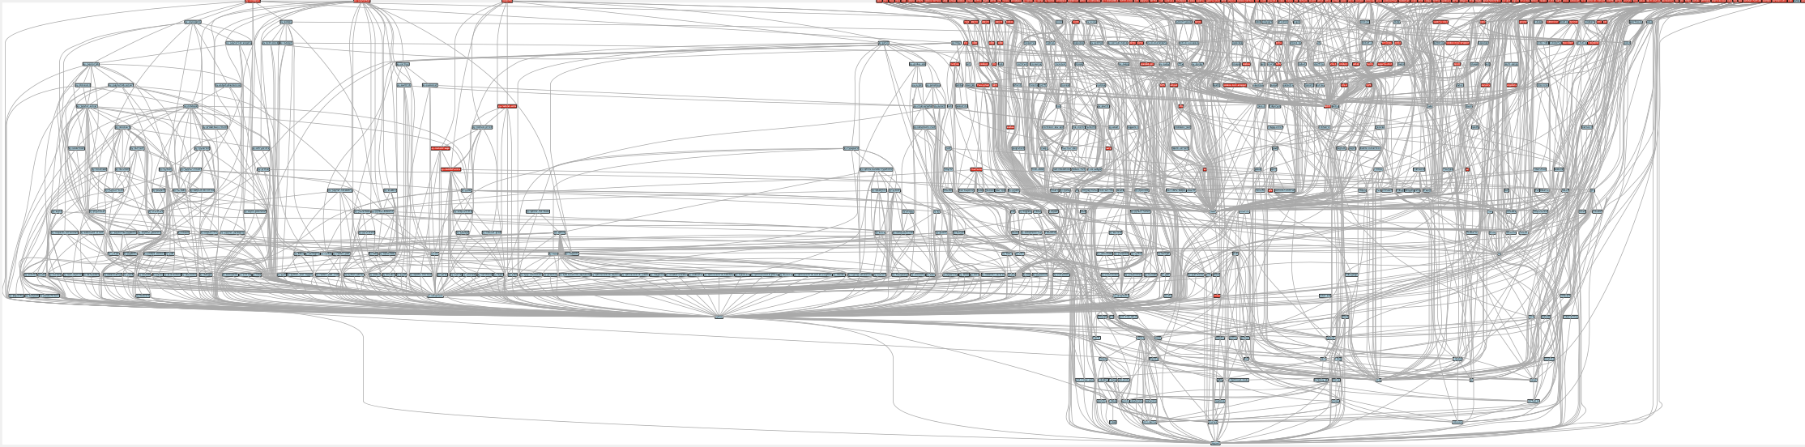
Managing large software installations: E4S
Red boxes are the packages in it (about 100)
Blue boxes are what else you need to build it (about 600)
It’s infeasible to build and integrate all of this manually

Slide 25
Spack enables software distribution for HPC
No installation required: clone and go
$ git clone https://github.com/spack/spack
$ source spack/share/spack/setup-env.sh
$ spack compiler find
$ spack external find
$ spack install tau unconstrained
$ spack install tau@2.34 @ custom version
$ spack install tau@2.34 %gcc@11.2.0 % custom compiler
$ spack install tau@2.34 %gcc@11.2.0 +mpi+python+pthreads +/- build option
$ spack install tau@2.34 %gcc@11.2.0 +mpi ^mvapich2@2.3~wrapperrpath ^ dependency information
Each expression is a spec for a particular configuration
  Each clause adds a constraint to the spec
  Constraints are optional – specify only what you need.
  Customize install on the command line!
Spec syntax is recursive
  Full control over the combinatorial build space
github.com/spack/spack

Slide 26

The Spack community is growing rapidly
Spack simplifies HPC software for:
  Users
  Developers
  Cluster installations
  The largest HPC facilities
Spack is central to ECP’s software strategy
  Enable software reuse for developers and users
  Allow the facilities to consume the entire ECP stack
The roadmap is packed with new features:
  Building the ECP software distribution
  Better workflows for building containers
  Stacks for facilities
  Chains for rapid dev workflow
  Optimized binaries
  Better dependency resolution
Visit spack.io
github.com/spack/spack
@spackpm

Slide 27
ParaTools Pro for E4STM: Using E4S on Cloud Platforms

Slide 28
Considerations while deploying HPC/AI workloads to the cloud
Which cloud provider?
  AWS, OCI, GCP, Azure, …
  Why not all?
HPC and AI/ML workloads need low latency, high bandwidth
  Which MPI?
Which image?
  Remote desktop accelerated by GPU, integration with batch schedulers (SLURM, Torque)
  Base Ubuntu without HPC tools or libraries? Too steep a learning curve
Provisioning and building the image on different cloud providers
  Command line interfaces can be cumbersome to use
Bursting to the cloud from on-prem clusters using batch submission scripts?
Notes:
quick run through - what ECP ST is working on

Slide 29
Key considerations for cloud-based deployment for E4S
MPI - the core inter-node communication library has several implementations
  Intel MPI, MVAPICH2-X, OpenMPI
  Interfacing MPI with the job scheduling package (MOAB, Torque, SLURM)
Cloud providers have different inter-node network adapters:
  Elastic Fabric Adapter (EFA) on AWS
  Infiniband on Azure
  Mellanox Connect-X 5 Ethernet (ROCE) on Oracle Cloud Infrastructure (OCI)
  IPU on Google Cloud (GCP)
Intra-node communication with XPMEM (driver and kernel module support is critical)
GPU Direct Async (GDR) support for communication between GPUs in MVPICH-Plus release
ParaTools, Inc. building E4S optimized with MVAPICH-Plus for AWS, OCI, GCP, and Azure
Using Adaptive Computing, Inc.’s ODDC interface to launch E4S jobs on multiple cloud providers!
Notes:
quick run through - what ECP ST is working on

Slide 30
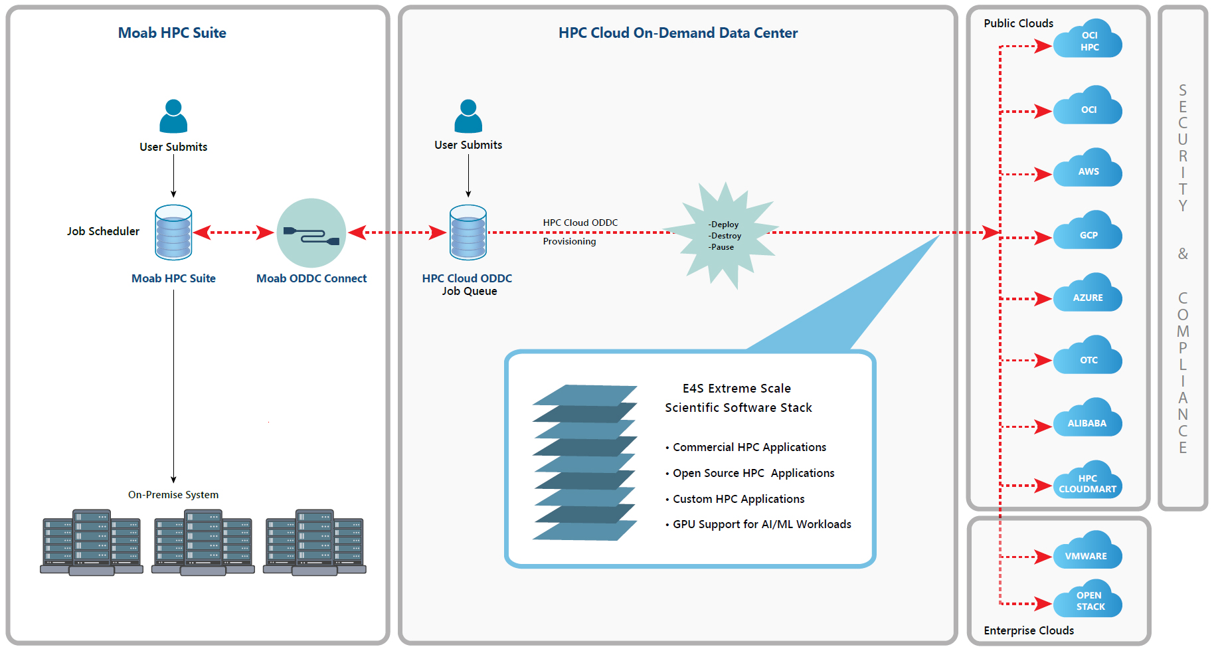
Adaptive Computing’s ODDC with ParaTools Pro for E4STM
Notes:
quick run through - what ECP ST is working on

Slide 31
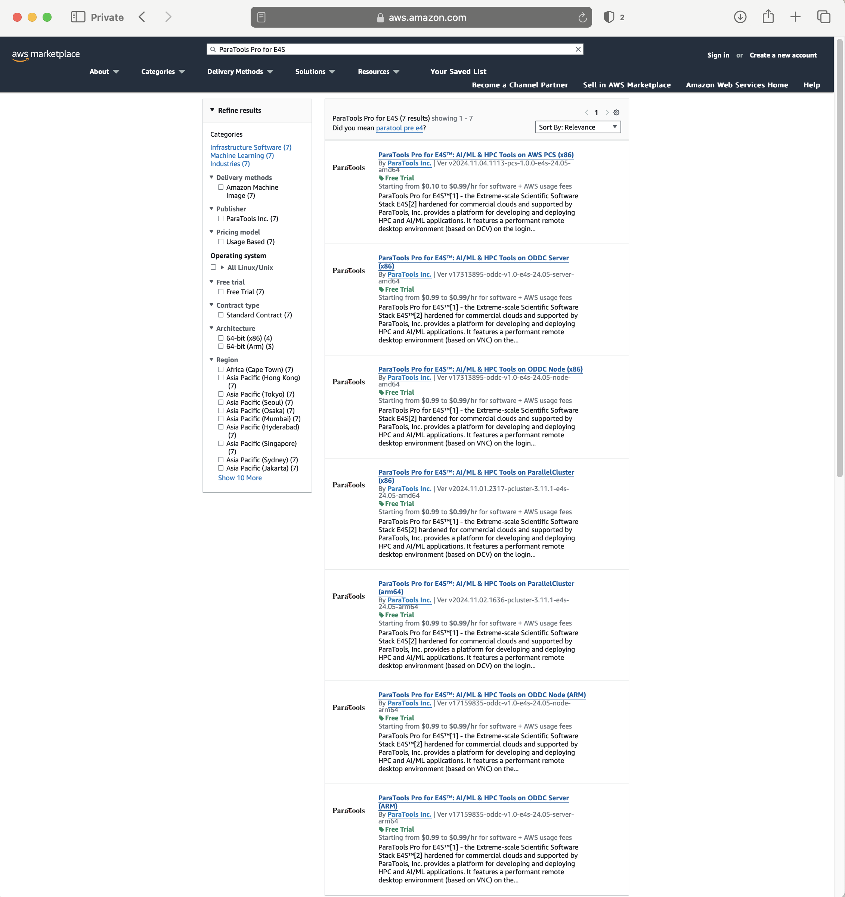
ParaTools Pro for E4S^{TM*}: Available in AWS, Google Cloud, Azure
AWS Marketplace listing
Support for SLURM and Torque
GPU accelerated remote desktop
Compute nodes with GPUs
Commercial image with support
* Supported by DOE SBIR Phase I and II
DE-SC0022502

Slide 32
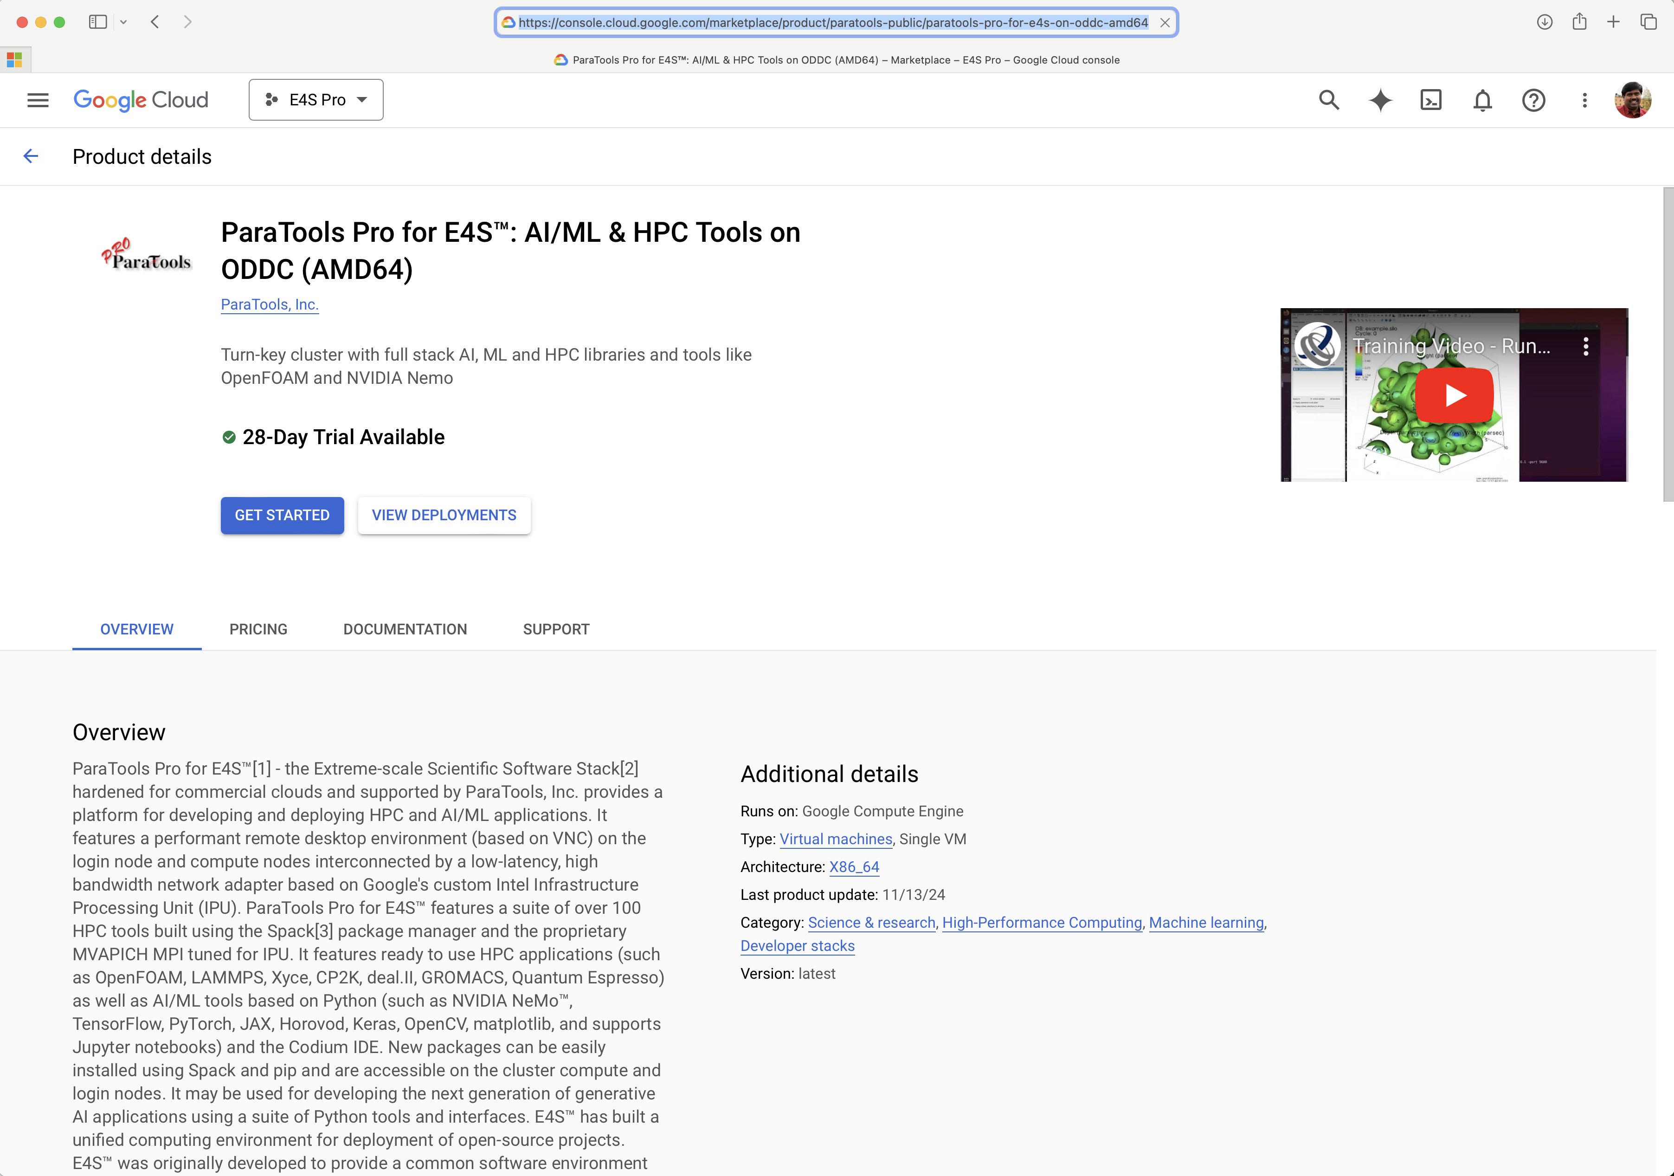
ParaTools Pro for E4STM: Available in AWS, Google Cloud, Azure
Google Cloud Marketplace

Slide 33
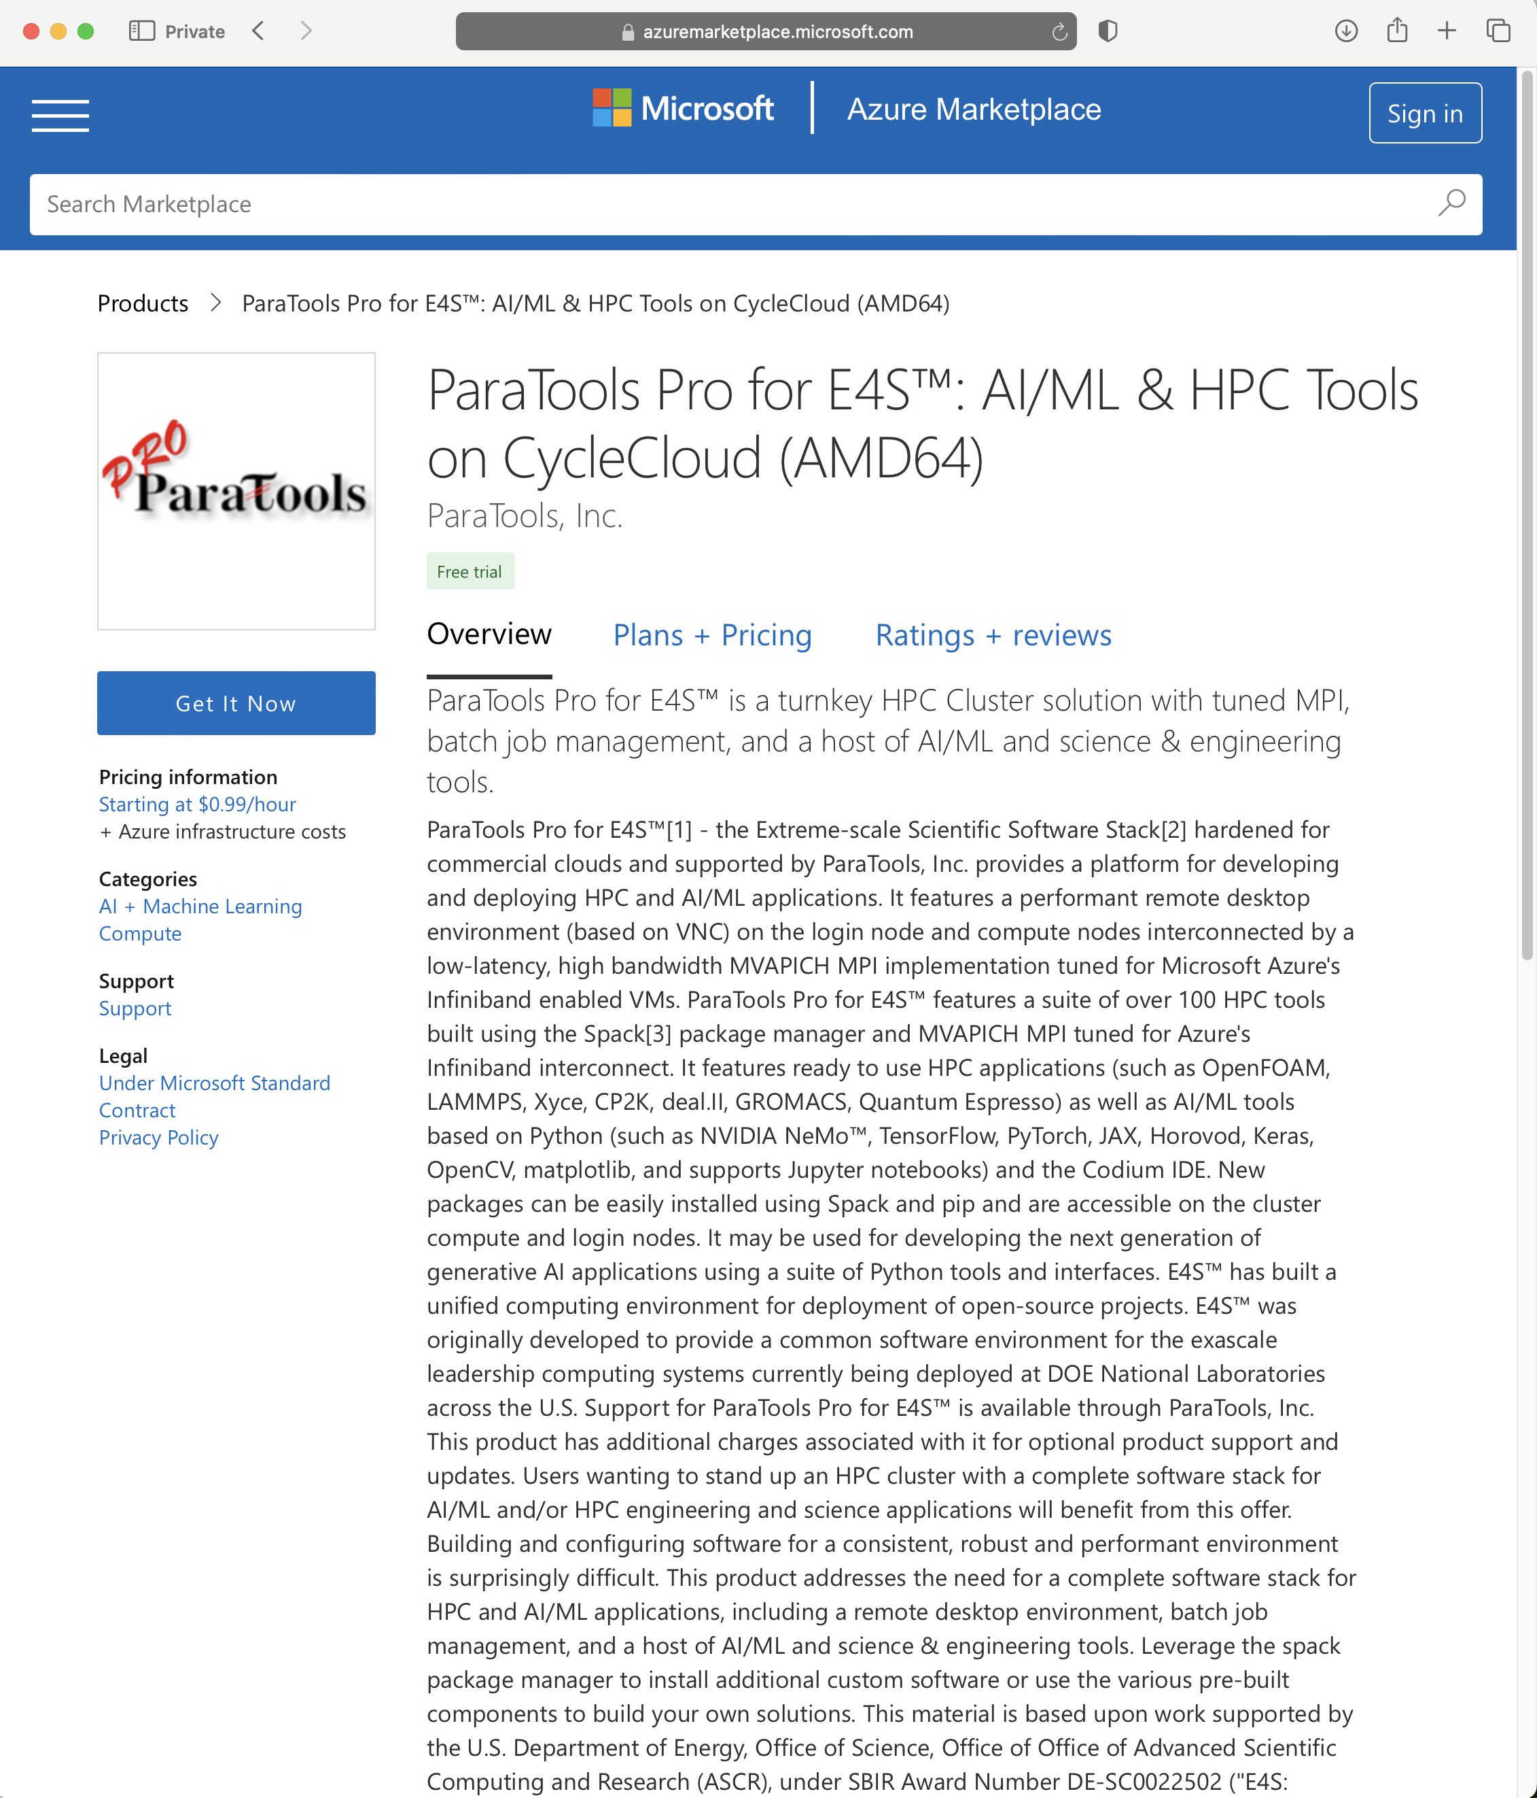
ParaTools Pro for E4STM: Available in AWS, Google Cloud, Azure
Azure Marketplace listing

Slide 34
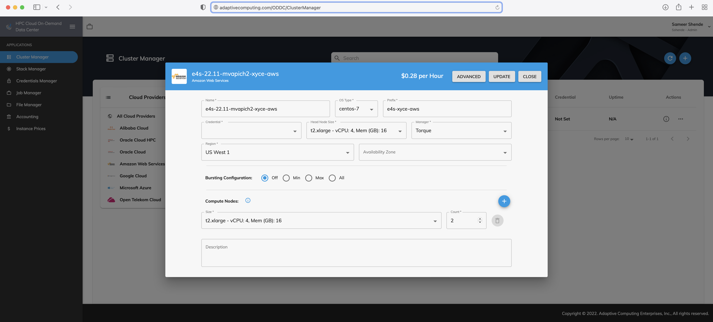
Choosing an instance on AWS to run the image using Heidi
Notes:
quick run through - what ECP ST is working on

Slide 35
Using ParaTools Pro for E4S image on AWS with Adaptive Computing’s Heidi Workshops (ODDC)
STEP 1: Click on Student tab at:
https://paratools.adaptivecomputing.com
Firefox recommended.

Slide 36
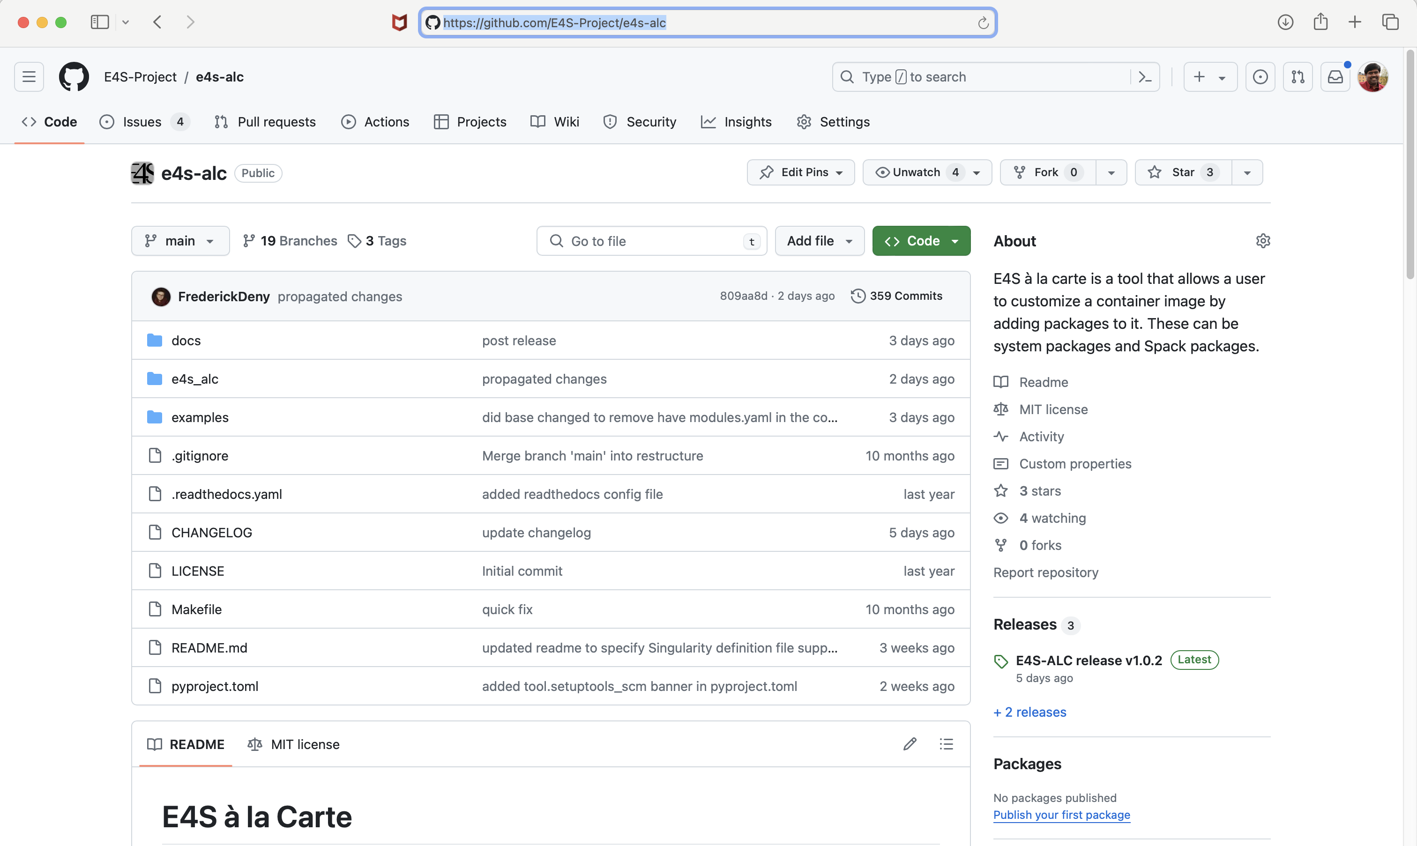
e4s-alc: a tool to customize container images. Version 1.0.2
Add to a base image:
Spack packages
OS packages
Tarballs
Can create a Dockerfile
Can create Singularity
definition file
https://github.com/E4S-Project/e4s-alc
Notes:
quick run through - what ECP ST is working on

Slide 37
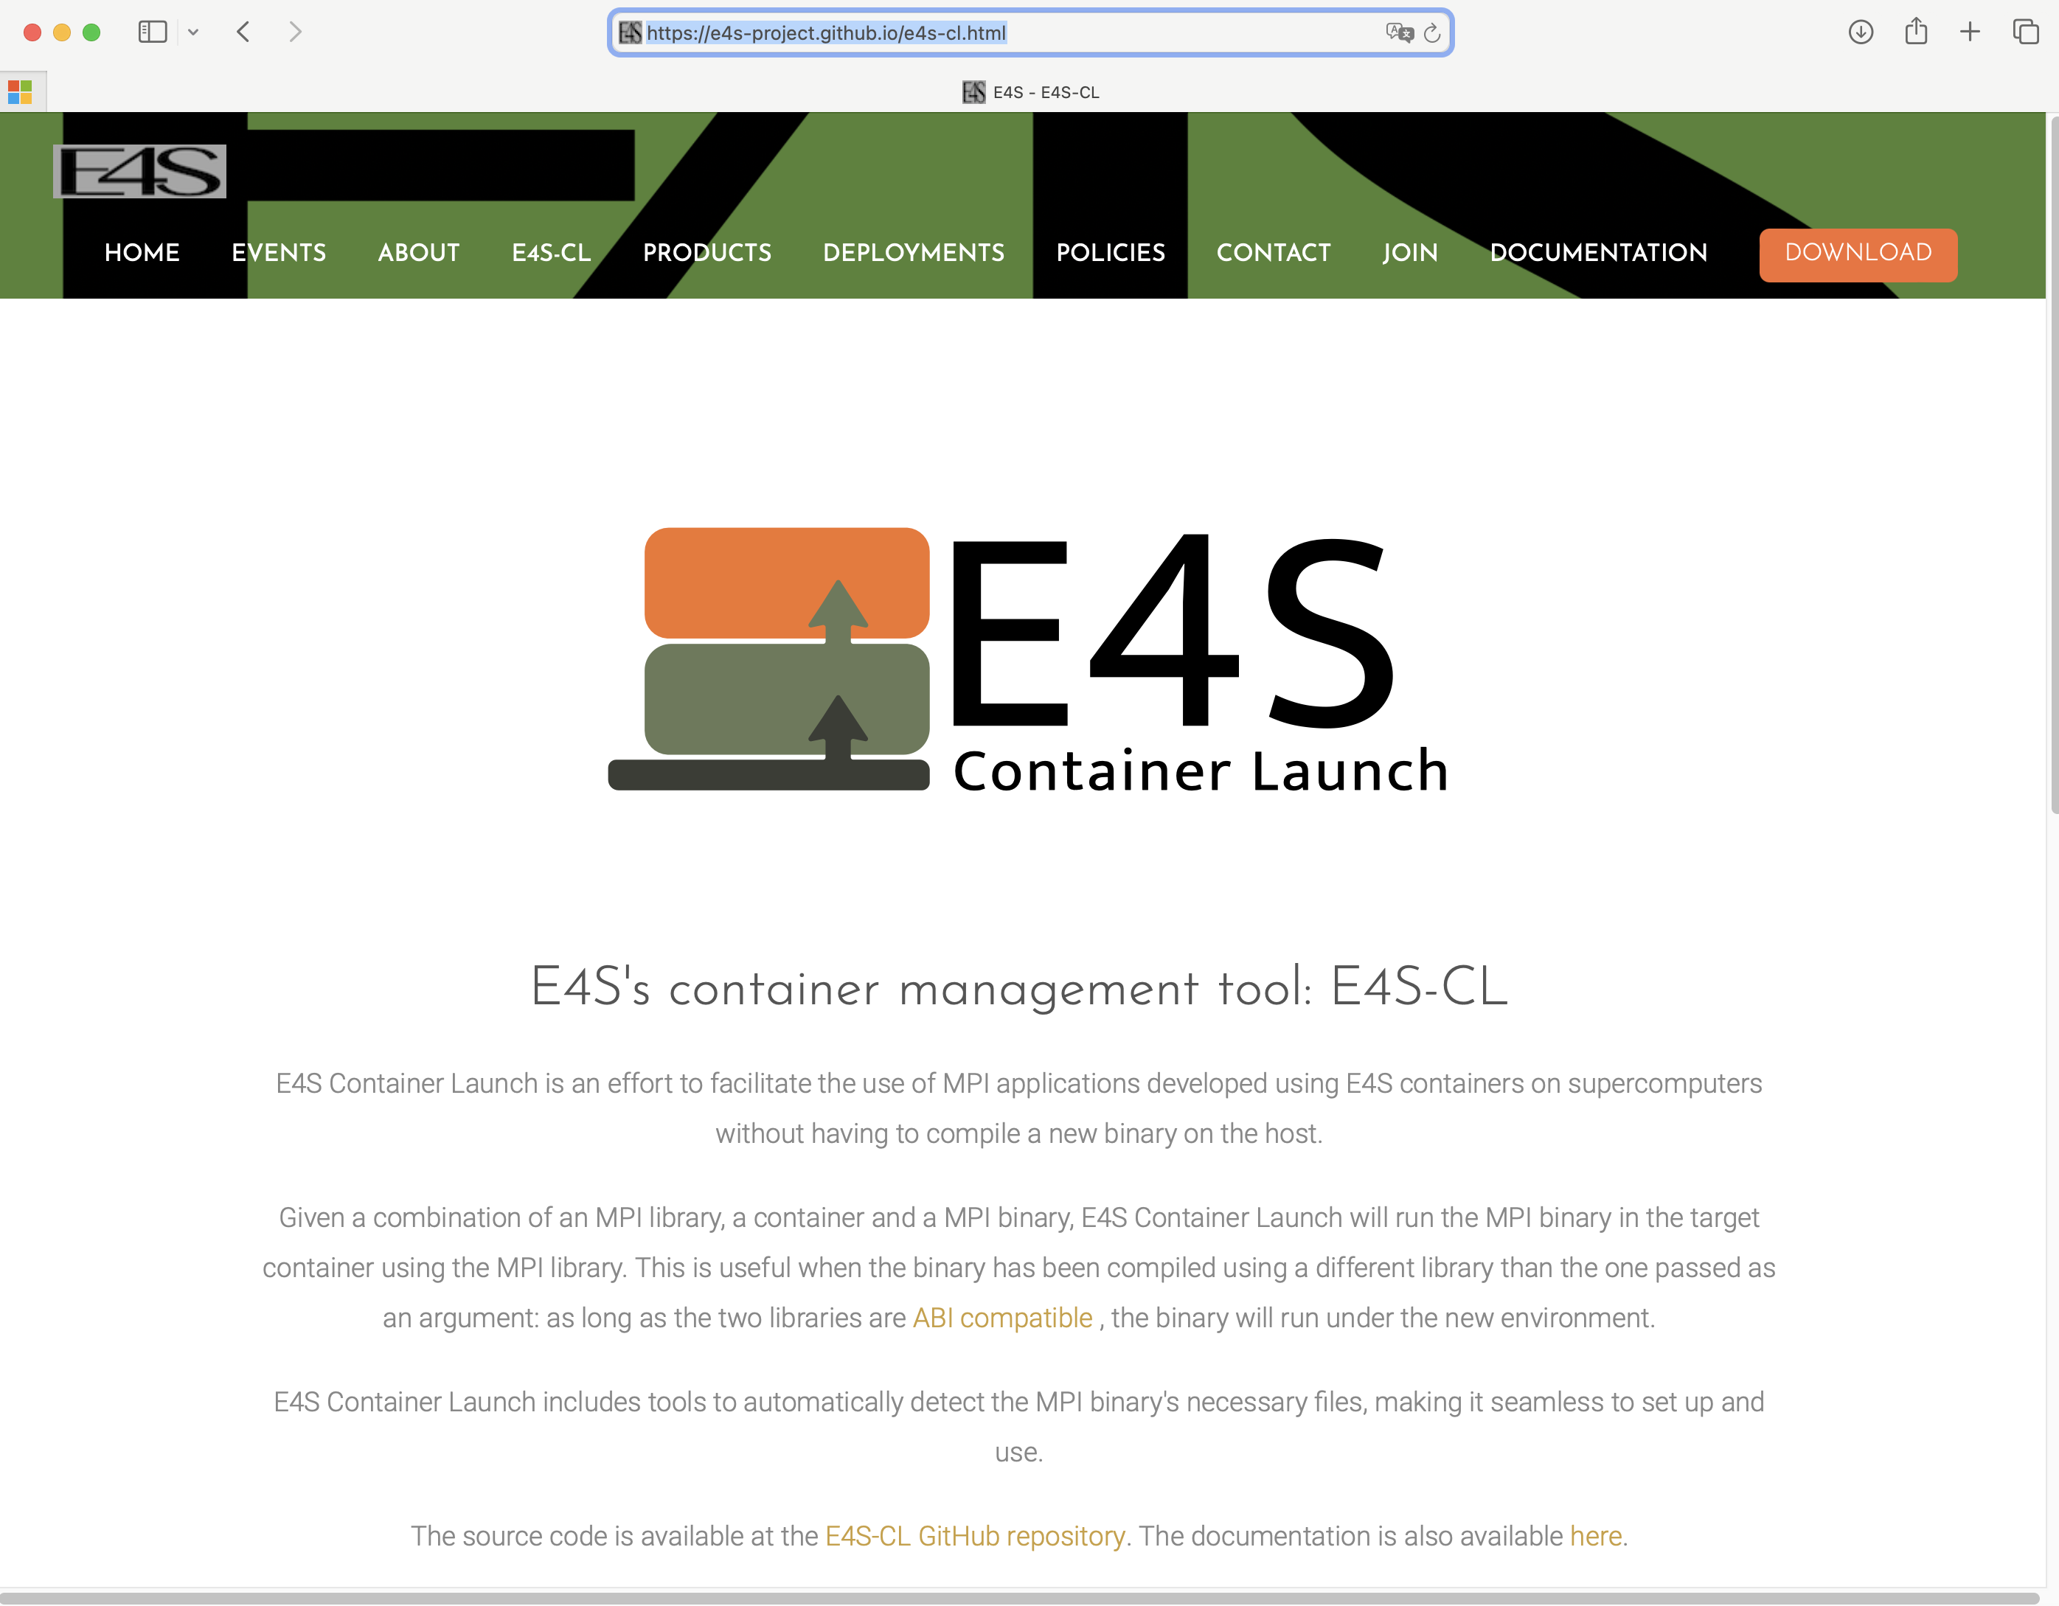
E4S Container Launch tool: e4s-cl
https://github.com/E4S-Project/e4s-cl
Notes:
quick run through - what ECP ST is working on

Slide 38
e4s-cl: A tool to simplify the launch of MPI jobs in E4S containers
E4S containers support replacement of MPI libraries using MPICH ABI compatibility layer and Wi4MPI [CEA] for OpenMPI replacement.
Applications binaries built using E4S can be launched with Singularity using MPI library substitution for efficient inter-node communications.
e4s-cl is a new tool that simplifies the launch and MPI replacement.
  e4s-cl init --backend [singularity|shifter|docker] --image <file> --source <startup_cmds.sh>
  e4s-cl mpirun -np <N> <command>
Usage:
  % e4s-cl init --backend singularity --image ~/images/e4s-gpu-x86.sif --source ~/source.sh
  % cat ~/source.sh
. /spack/share/spack/setup-env.sh
spack load trilinos+cuda cuda_arch=80
  % e4s-cl mpirun -np 4 ./a.out
https://github.com/E4S-Project/e4s-cl
Notes:
quick run through - what ECP ST is working on

Slide 39
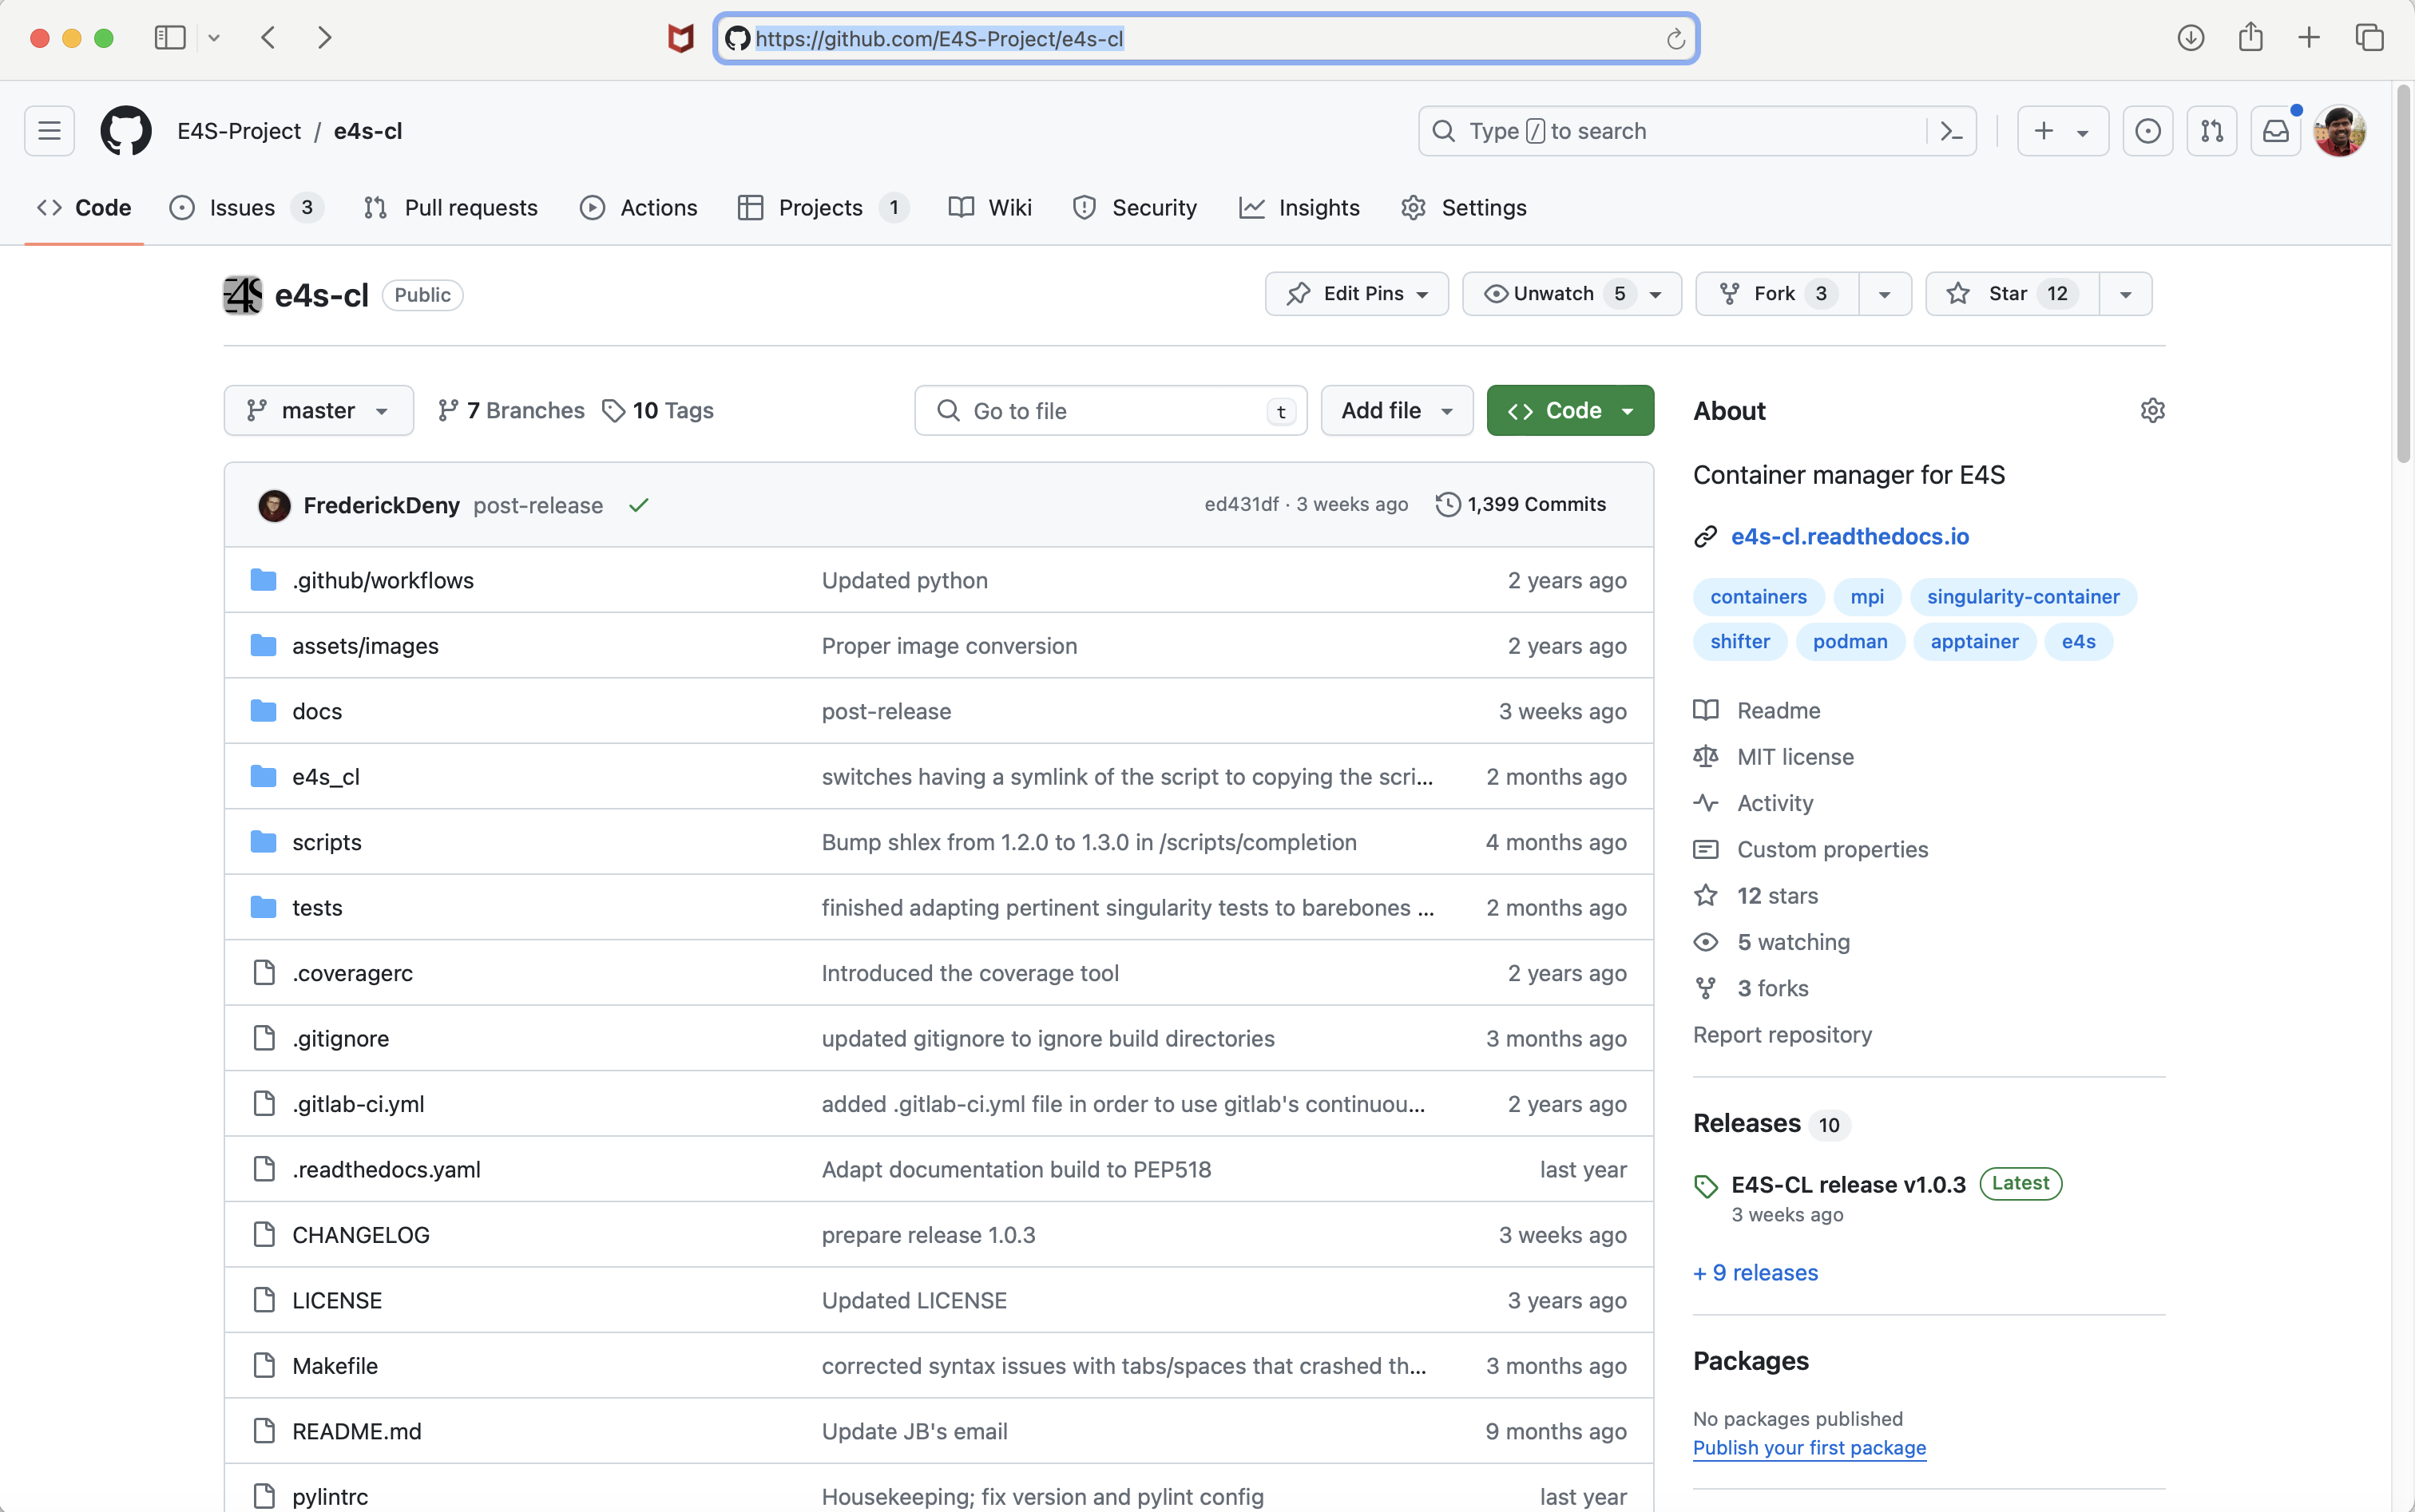
Release of e4s-cl on GitHub
https://github.com/E4S-Project/e4s-cl
Notes:
quick run through - what ECP ST is working on

Slide 40
Using your own AWS credentials with ODDC

Slide 41
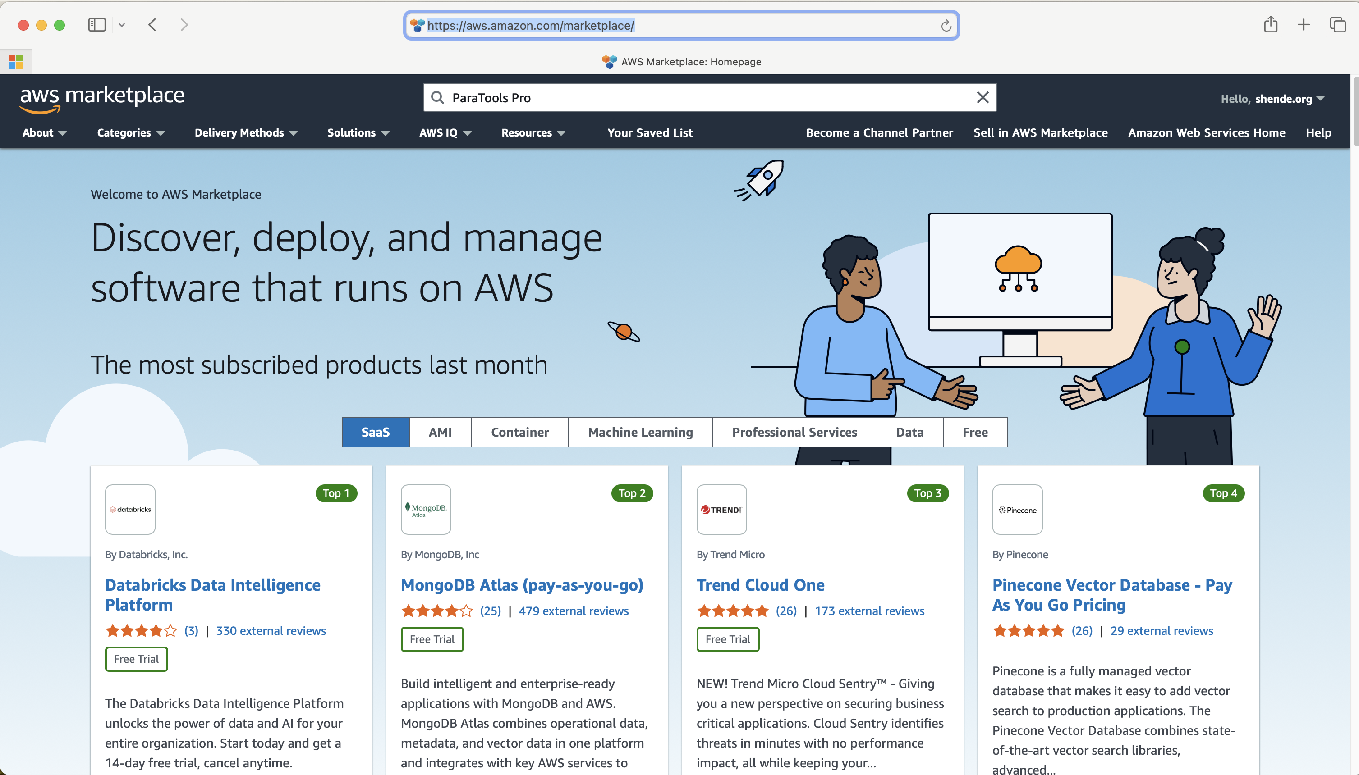
STEP 1: Subscribe to ParaTools Pro for E4S image on AWS Marketplace
Go to https://aws.amazon.com/marketplace
Login, then search for ParaTools Pro

Slide 42
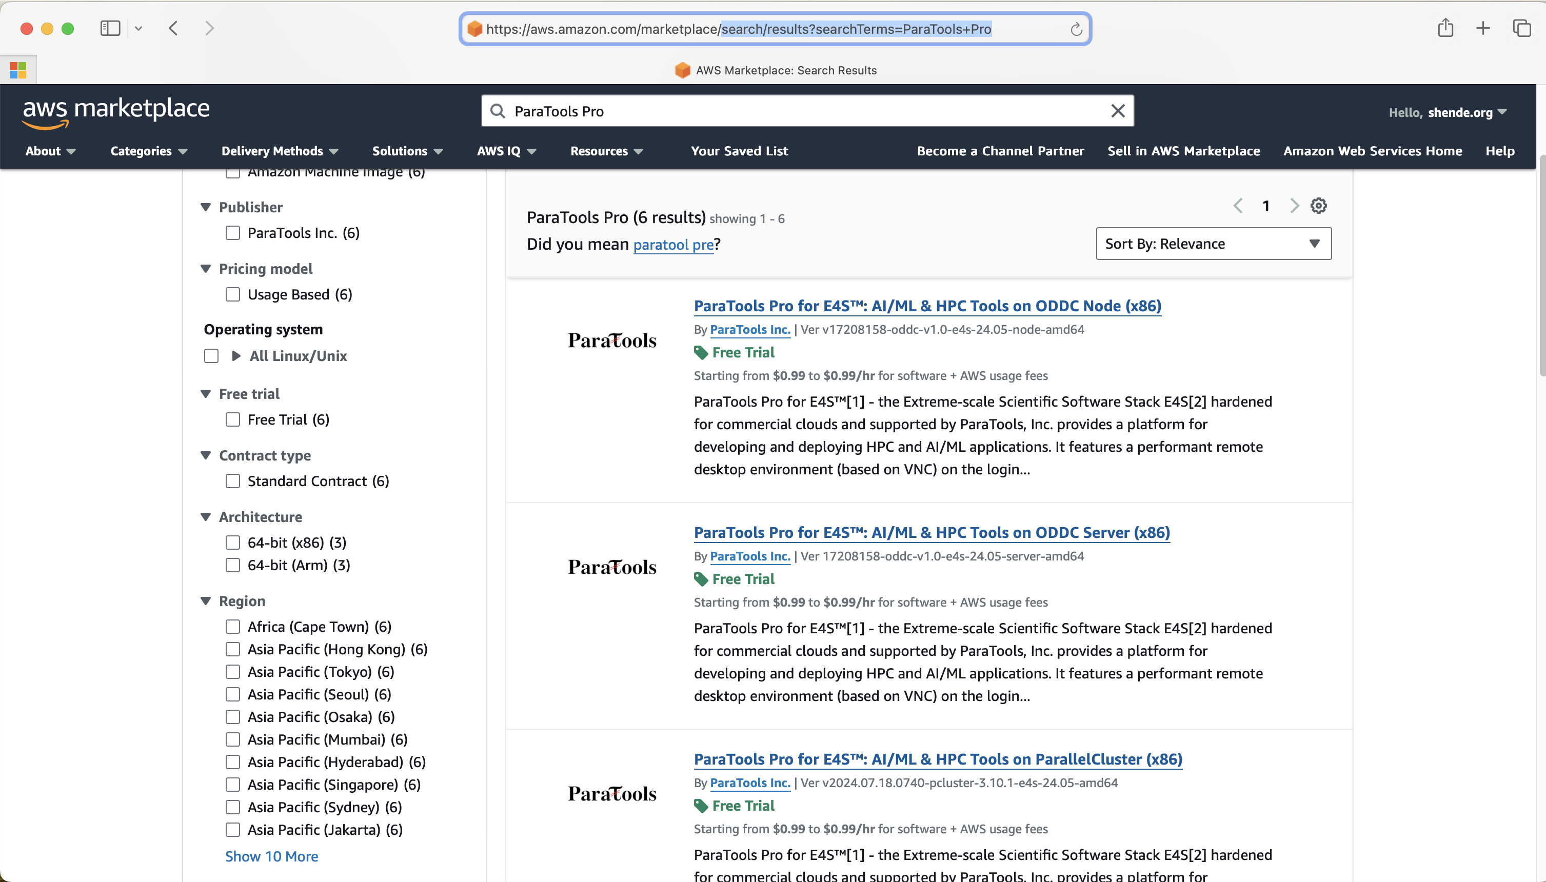
STEP 1: Subscribe to ParaTools Pro for E4S image on AWS Marketplace
Free trial for
31 days!
Click on ODDC Server (x86) click subscribe
Click on ODDC Node (x86) click subscribe

Slide 43
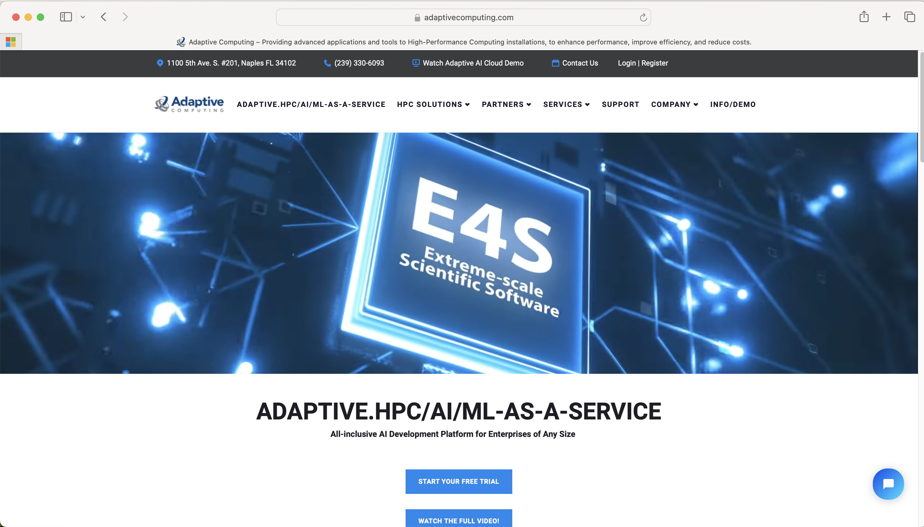
STEP 2: Subscribe for a free trial at AdaptiveComputing.com for E4S
Go to https://adaptivecomputing.com
Click on “Start your free trial”

Slide 44
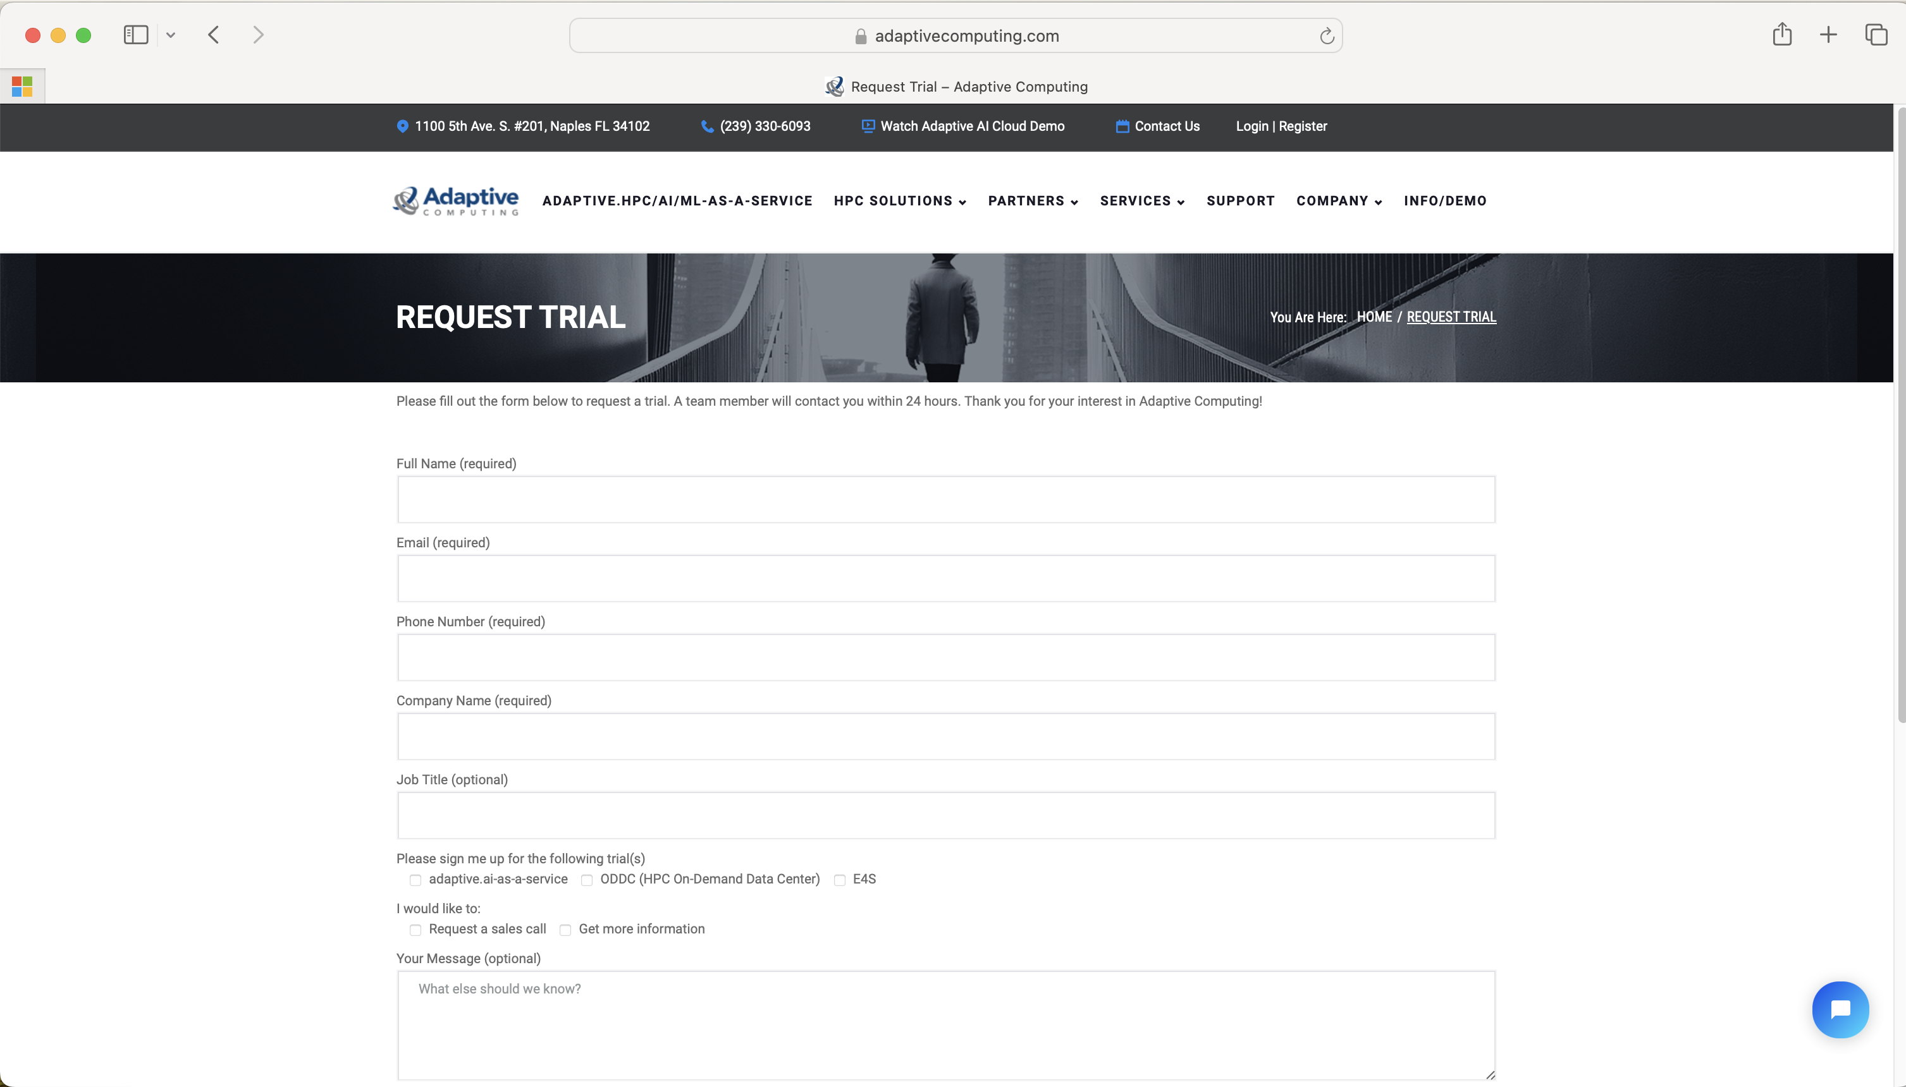
STEP 2: Subscribe for a free trial on Adaptive Computing for E4S
Fill out the form and check the E4S box

Slide 45
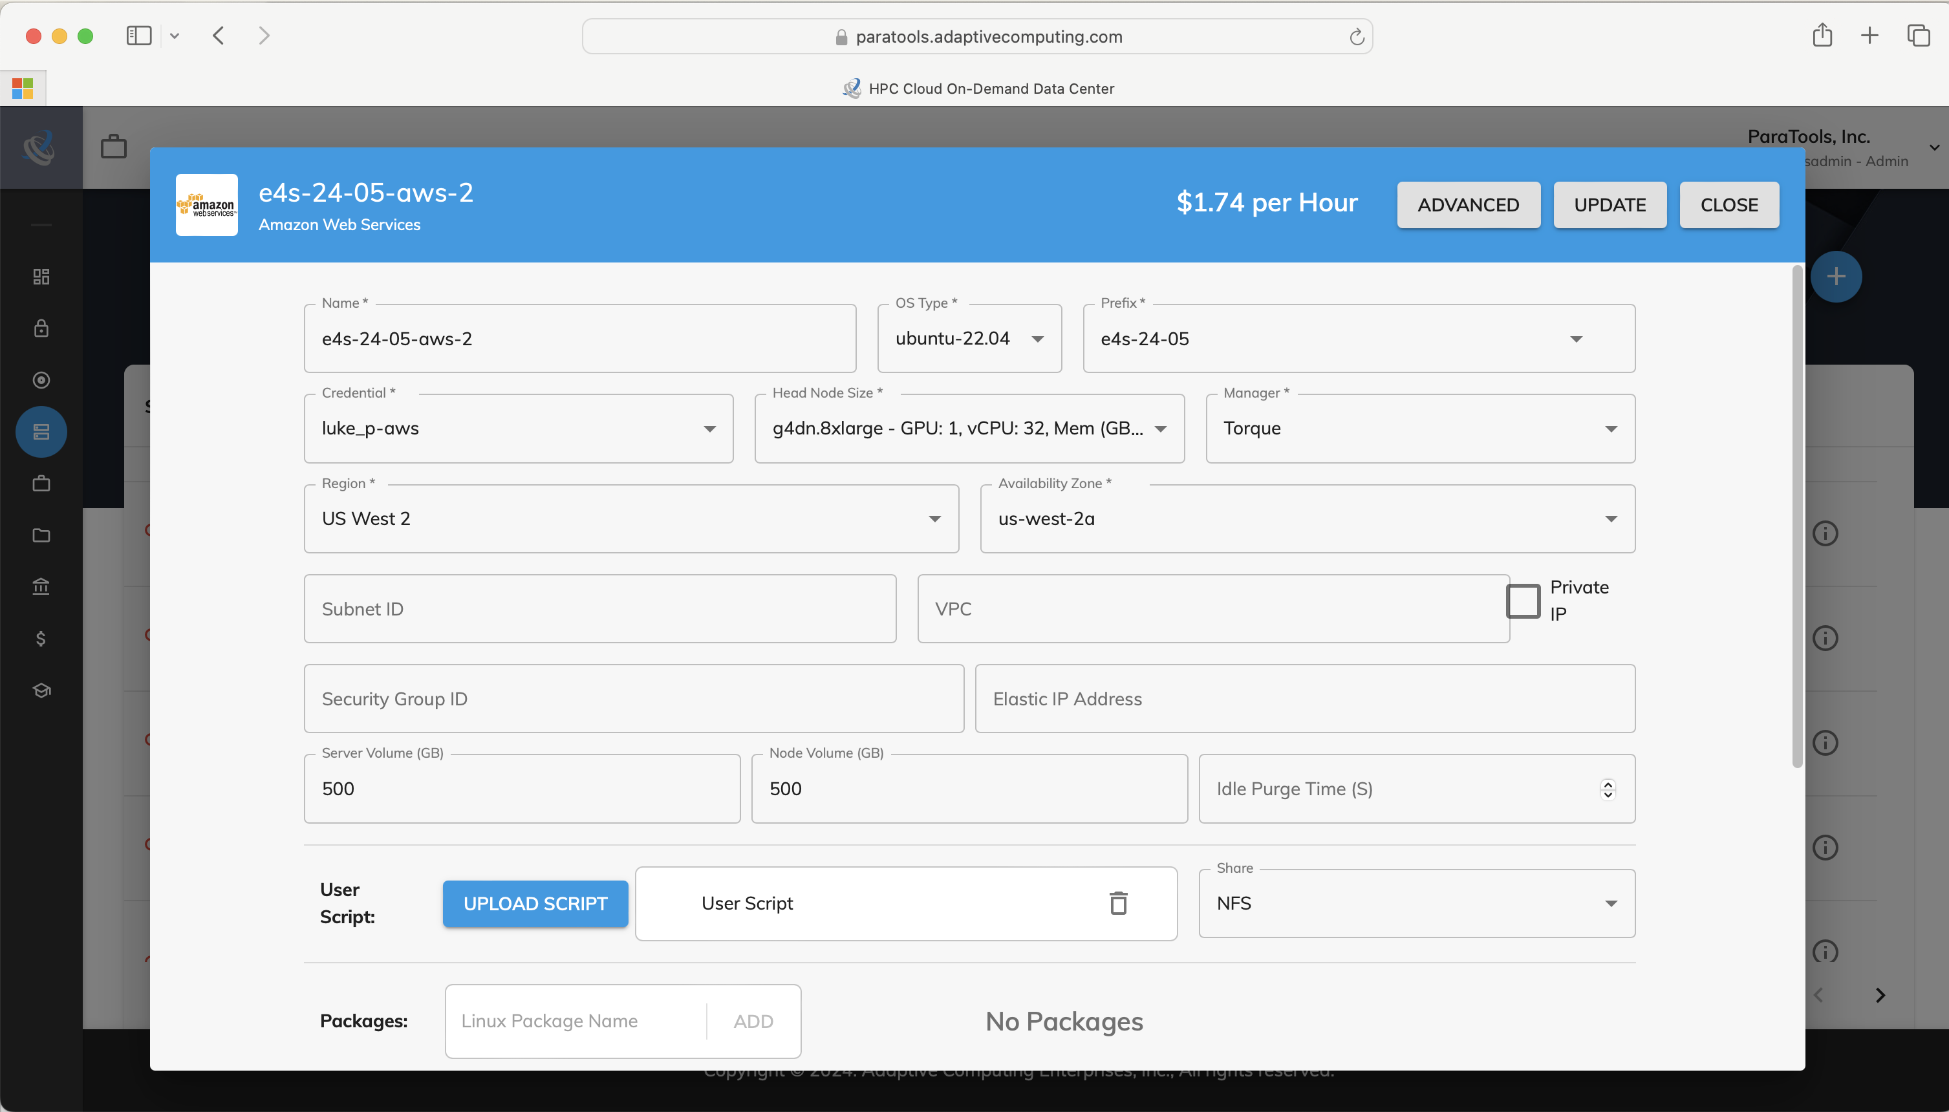
STEP 3: Choose cluster configuration settings (GPU, EFA, memory, nodes, shape)
Once login is setup with their help, go
to cluster configuration and edit cluster

Slide 46
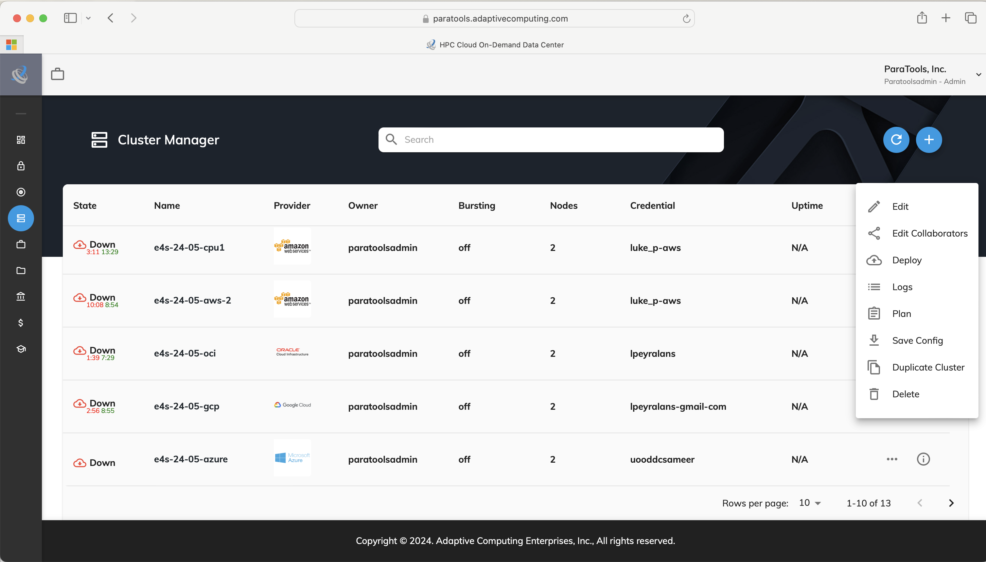
STEP 4: Deploy cluster from ODDC!
Right click on the cluster, edit collaborators
and then click Deploy, click on deployed cluster

Slide 47
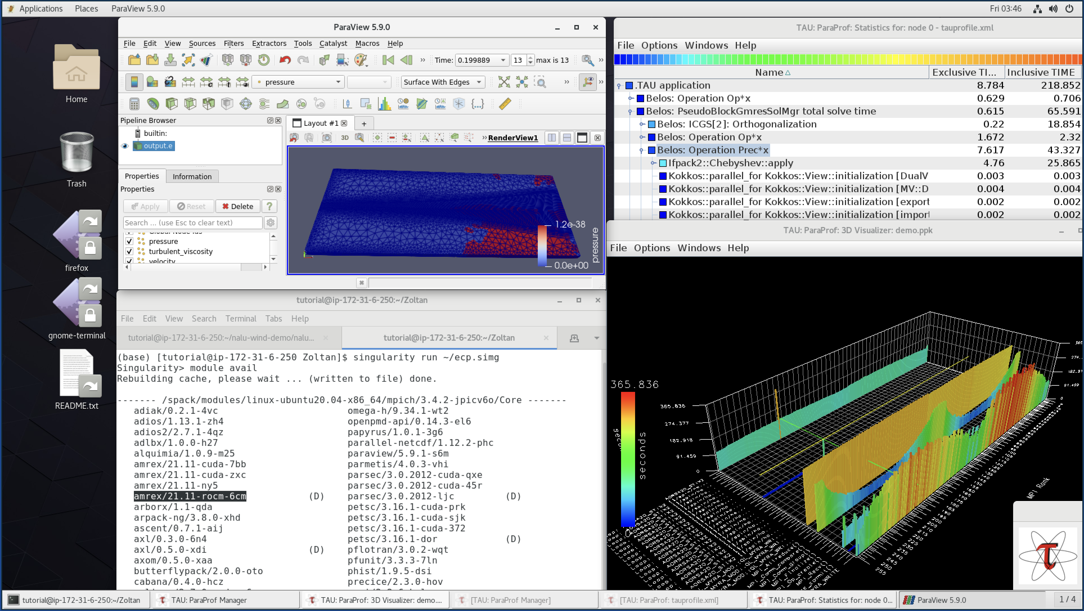
E4S 24.11 AWS image: US-West2 (OR)
E4S 24.11 AWS
Intel oneAPI
CUDA
NVHPC
ROCm
AWS DCV
Spack Build Cache
ECP: Nalu-Wind
Trilinos 13.4.0
OpenFOAM
ParaView
TAU
Docker
Shifter
Charliecloud
E4S Singularity
EDA tools…

Slide 48
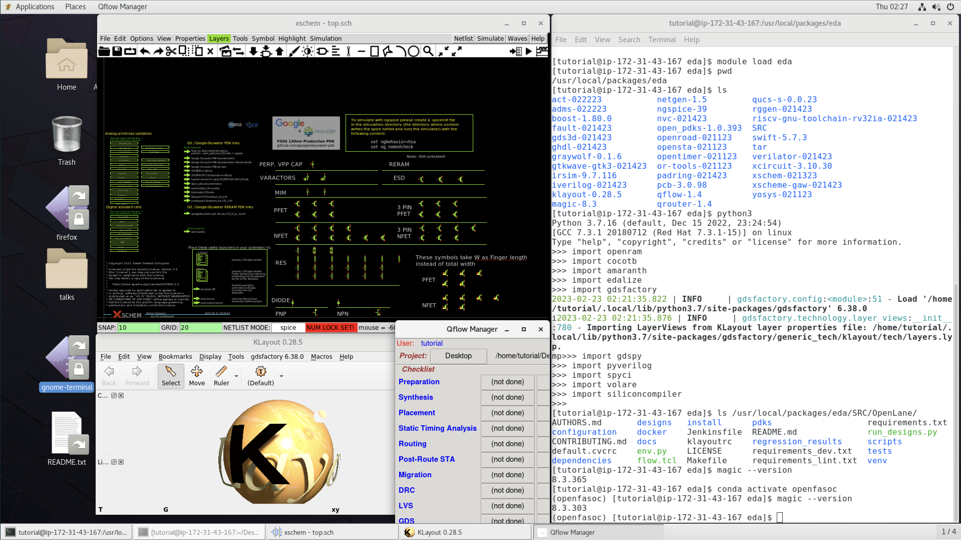
E4S for Commercial Cloud Platforms for EDA on AWS
E4S EDA on AWS
Magic
ACT
Klayout
Qflow
Xschem
Xcircuit
Yosys
Volator
OpenROAD
OpenLane
OpenFASOC
iVerilog
Gtkwave
Irsim
Qrouter
Fault
GDS3D
Rggen
Python tools
  Cocotb
  Amaranth
  Edalize
  Gdsfactory
  Gdspy
  OpenRAM
  Gdstk
  Silicon
  compiler
  Volare …
PDKs
  GF
  Skywater
E4S: HPC Software Ecosystem – a curated software portfolio for Electronic Design Automation
Free to use public AMI on AWS: ami-0e752117cfa13cb9b in the US-West-2 (Oregon) region

Slide 49
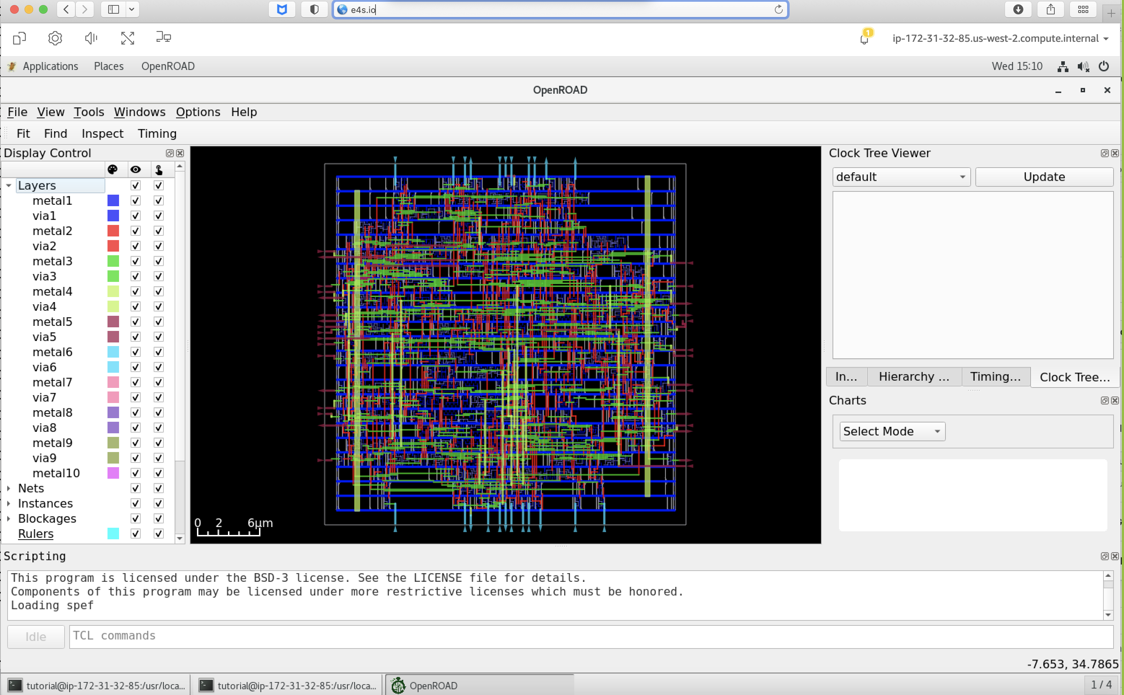
E4S for Commercial Cloud Platforms for EDA on AWS
E4S EDA on AWS
Magic
ACT
Klayout
Qflow
Xschem
Xcircuit
Yosys
Volator
OpenROAD
OpenLane
OpenFASOC
iVerilog
Gtkwave
Irsim
Qrouter
Fault
GDS3D
Rggen
Python tools
  Cocotb
  Amaranth
  Edalize
  Gdsfactory
  Gdspy
  OpenRAM
  Gdstk
  Silicon
  compiler
  Volare …
PDKs
  GF
  Skywater
E4S: HPC Software Ecosystem – a curated software portfolio for Electronic Design Automation
OpenROAD
Free to use public AMI on AWS: ami-0e752117cfa13cb9b in the US-West-2 (Oregon) region

Slide 50
E4S for Commercial Cloud Platforms for EDA on AWS
E4S: HPC Software Ecosystem – a curated software portfolio for Electronic Design Automation
# | Packages currently in E4S | URL
1 | Magic | http://opencircuitdesign.com/magic/
2 | Xyce | https://xyce.sandia.gov
3 | NGSPICE | https://ngspice.sourceforge.io
4 | KLayout | https://www.klayout.de
5 | Qflow | http://opencircuitdesign.com/qflow
6 | OR-Tools | https://developers.google.com/optimization
7 | IRSIM | http://opencircuitdesign.com/irsim/
8 | OpenROAD | https://github.com/The-OpenROAD-Project/OpenROAD
9 | OpenLane | https://openlane.readthedocs.io/
10 | OpenFASOC | https://openfasoc.readthedocs.io/
11 | Open_PDKs | http://opencircuitdesign.com/open_pdks/
12 | Netgen | http://opencircuitdesign.com/netgen/
# | Packages currently in E4S | URL
13 | Yosys | https://github.com/YosysHQ/yosys
14 | Xcircuit | http://opencircuitdesign.com/xcircuit/
15 | Graywolf | https://github.com/rubund/graywolf
16 | OpenSTA | https://github.com/The-OpenROAD-Project/OpenSTA
17 | OpenTimer | https://github.com/OpenTimer/OpenTimer
18 | Qrouter | http://opencircuitdesign.com/qrouter/
19 | Xschem | https://github.com/silicon-vlsi-org/eda-xschem
20 | RISC-V GNU Toolchain | https://github.com/riscv-collab/riscv-gnu-toolchain
21 | Fault: Design for Test | https://github.com/AUCOHL/Fault
22 | NVC | https://github.com/nickg/nvc
23 | Amaranth | https://github.com/amaranth-lang/amaranth
24 | Cocotb | https://github.com/cocotb/cocotb

Slide 51
E4S for Commercial Cloud Platforms for EDA on AWS
E4S: HPC Software Ecosystem – a curated software portfolio for Electronic Design Automation
# | Packages currently in E4S | URL
25 | Covered | https://github.com/hpretl/verilog-covered
26 | Edalize | https://github.com/olofk/edalize
27 | Gaw3-xschem | https://github.com/StefanSchippers/xschem-gaw.git
28 | GDSFactory | https://github.com/gdsfactory/gdsfactory
29 | GDSPy | https://github.com/heitzmann/gdspy
30 | GDS3D | https://github.com/trilomix/GDS3D
31 | Ghdl | https://github.com/ghdl/ghdl
32 | Gtkwave | https://github.com/gtkwave/gtkwave
33 | iic-osic | https://github.com/hpretl/iic-osic.git
34 | Iverilog | https://github.com/steveicarus/iverilog.git
35 | Netlistsvg | https://github.com/nturley/netlistsvg
36 | Ngspyce | https://github.com/ignamv/ngspyce
# | Packages currently in E4S | URL
37 | Padring | https://github.com/donn/padring
38 | Pyverilog | https://github.com/PyHDI/Pyverilog
39 | OpenRAM | https://github.com/VLSIDA/OpenRAM
40 | Rggen | https://github.com/rggen/rggen
41 | Spyci | https://github.com/gmagno/spyci
42 | Volare | https://github.com/efabless/volare
43 | Siliconcompiler | https://github.com/siliconcompiler/siliconcompiler
44 | Verilator | https://github.com/verilator/verilator
45 | Sky130 | SkyWater Technologies 130nm CMOS PDK
46 | Actflow | https://github.com/asyncvlsi/actflow.git
47 | Qucs-s | https://github.com/Qucs
48 | ADMS | https://github.com/Qucs/ADMS.git
49 | Gdstk | https://heitzmann.github.io/gdstk/
50 | xcell | https://github.com/asyncvlsi/xcell.git
https://e4s.io

Slide 52





















Support Acknowledgements
US Department of Energy (DOE)
  ANL
  Office of Science contracts, ECP
  SciDAC, LBL contracts
  LLNL-LANL-SNL ASC/NNSA contract
  Battelle, PNNL and ORNL contract
NASA SBIR
Department of Defense (DoD)
  PETTT, HPCMP
National Science Foundation (NSF)
  SI2-SSI, Glassbox
CEA, France
Industry: AWS, AMD, IBM, ARM, Intel, NVIDIA
Partners:
  University of Oregon
  The Ohio State University
  ParaTools, Inc.
  University of Tennessee, Knoxville
  T.U. Dresden, GWT
  Jülich Supercomputing Center

Slide 53

Acknowledgment
This material is based upon work supported by the U.S. Department of Energy, Office of Science, Office of Advanced Scientific Computing Research, Next-Generation Scientific Software Technologies program, under contract number DE-AC02-06CH11357. DOE SBIR DE-SC0022502.
https://science.osti.gov/ascr
https://pesoproject.org
https://ascr-step.org
https://hpsf.io
https://www.energy.gov/technologytransitions/sbirsttr

Slide 54
Thank you
https://www.exascaleproject.org
This research was supported by the Exascale Computing Project (17-SC-20-SC), a joint project of the U.S. Department of Energy’s Office of Science and National Nuclear Security Administration, responsible for delivering a capable exascale ecosystem, including software, applications, and hardware technology, to support the nation’s exascale computing imperative.
Thank you to all collaborators in the ECP and broader computational science communities. The work discussed in this presentation represents creative contributions of many people who are passionately working toward next-generation computational science.

Slide 55


