Slide 1
Performance Evaluation of GPU-accelerated HPC and AI applications using HPCToolkit, TAU, and ParaTools Pro for E4STM
Sameer Shende
Research Professor, University of Oregon
President and Director
ParaTools, Inc.
Presentation at EnergyHPC conference, Rice U., Houston
February 27, 2025
https://tinyurl.com/e4stut

Slide 2
Using Adaptive Computing’s Heidi Workshops (aka ODDC)
Go to https://tinyurl.com/e4stut for slides
STEP 1: Click on Students tab at:
https://paratools.adaptivecomputing.com
Firefox recommended.

Slide 3
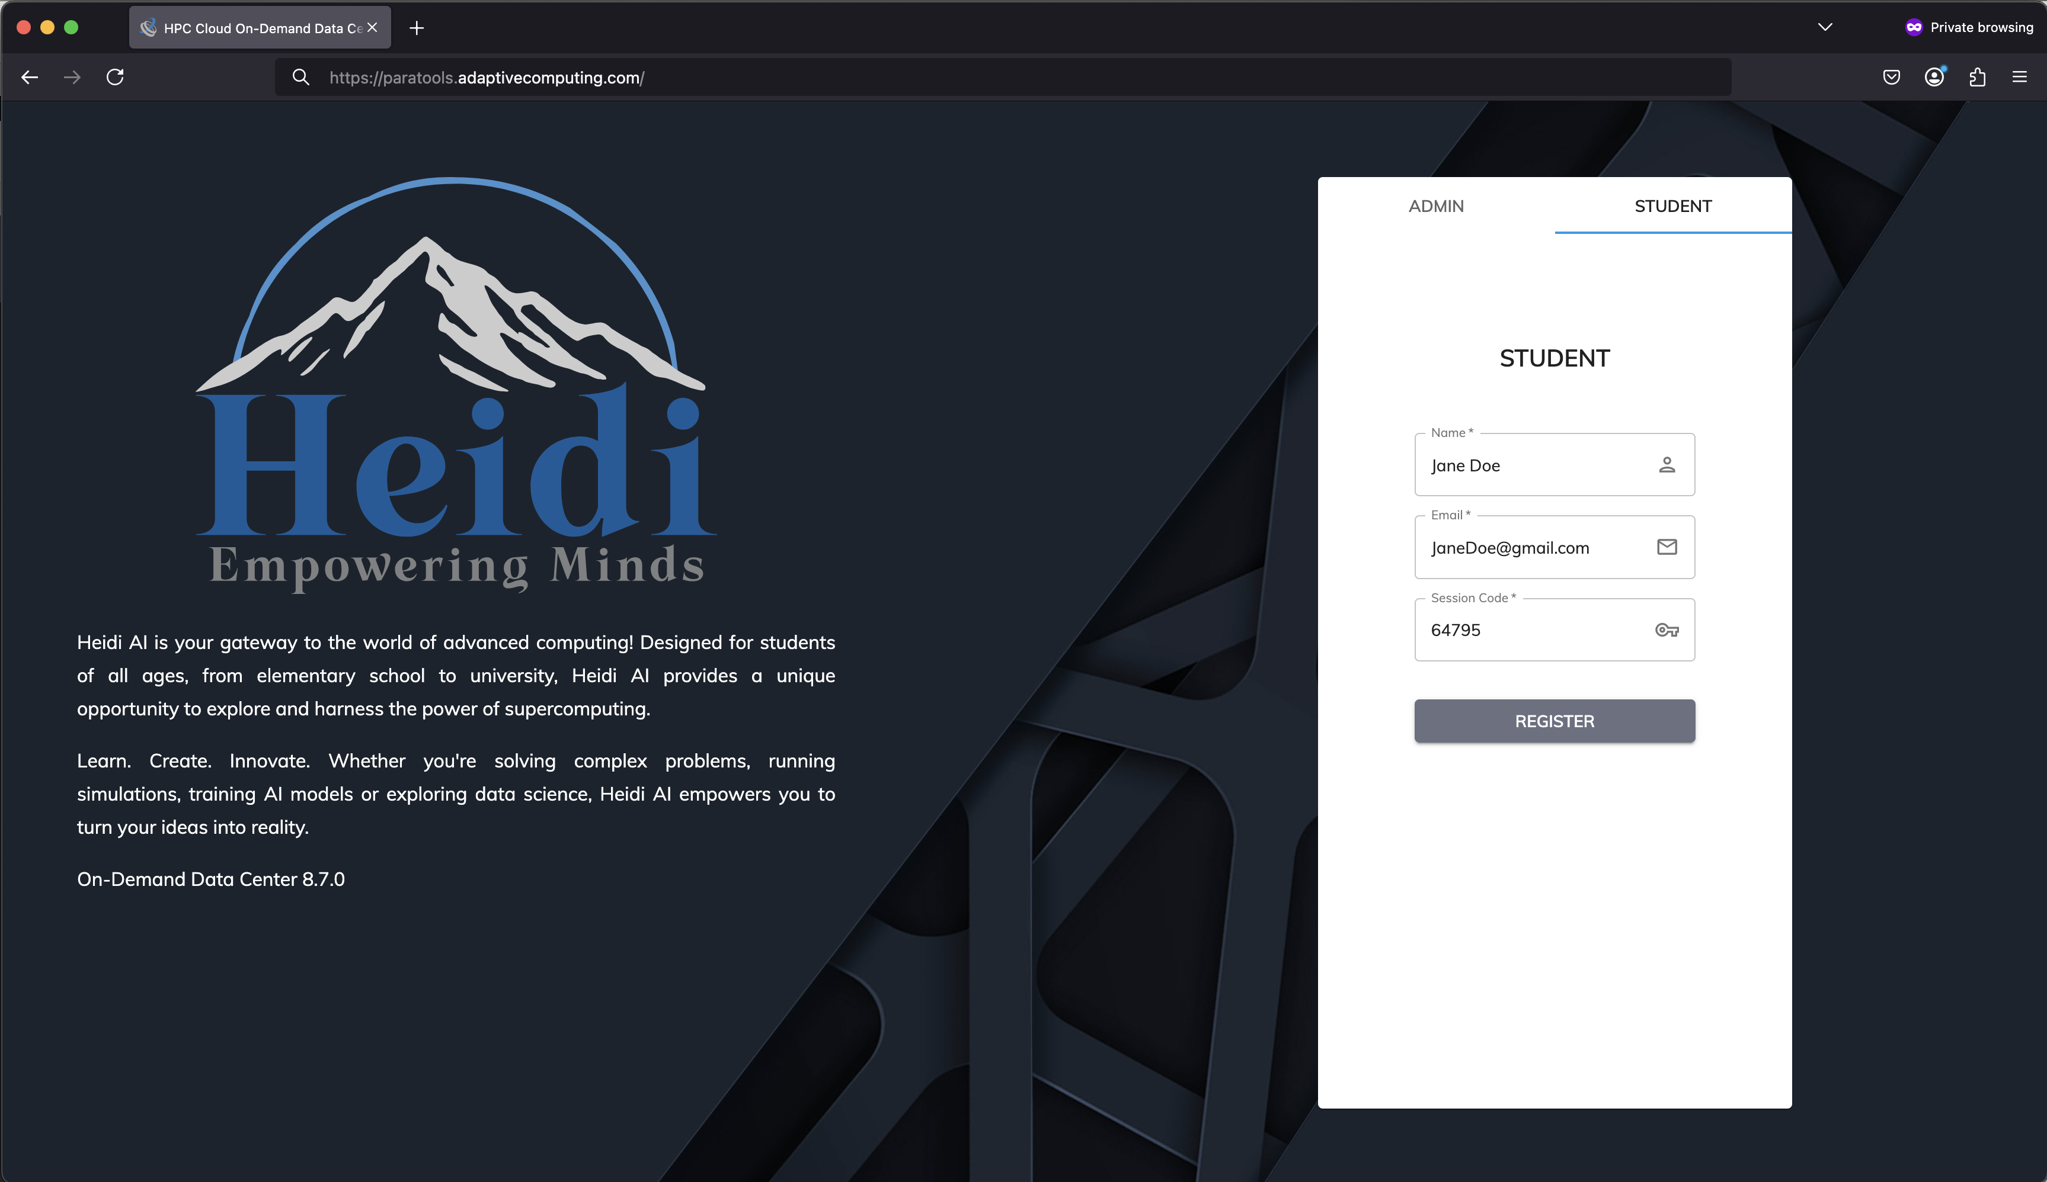
Adaptive Computing’s Heidi: Go to STUDENT tab and enter Name, Email and enter the session code 64795
Click on
Student
tab
Enter name, email
And 64795 session
code
https://tinyurl.com/e4stut. https://paratools.adaptivecomputing.com

Slide 4
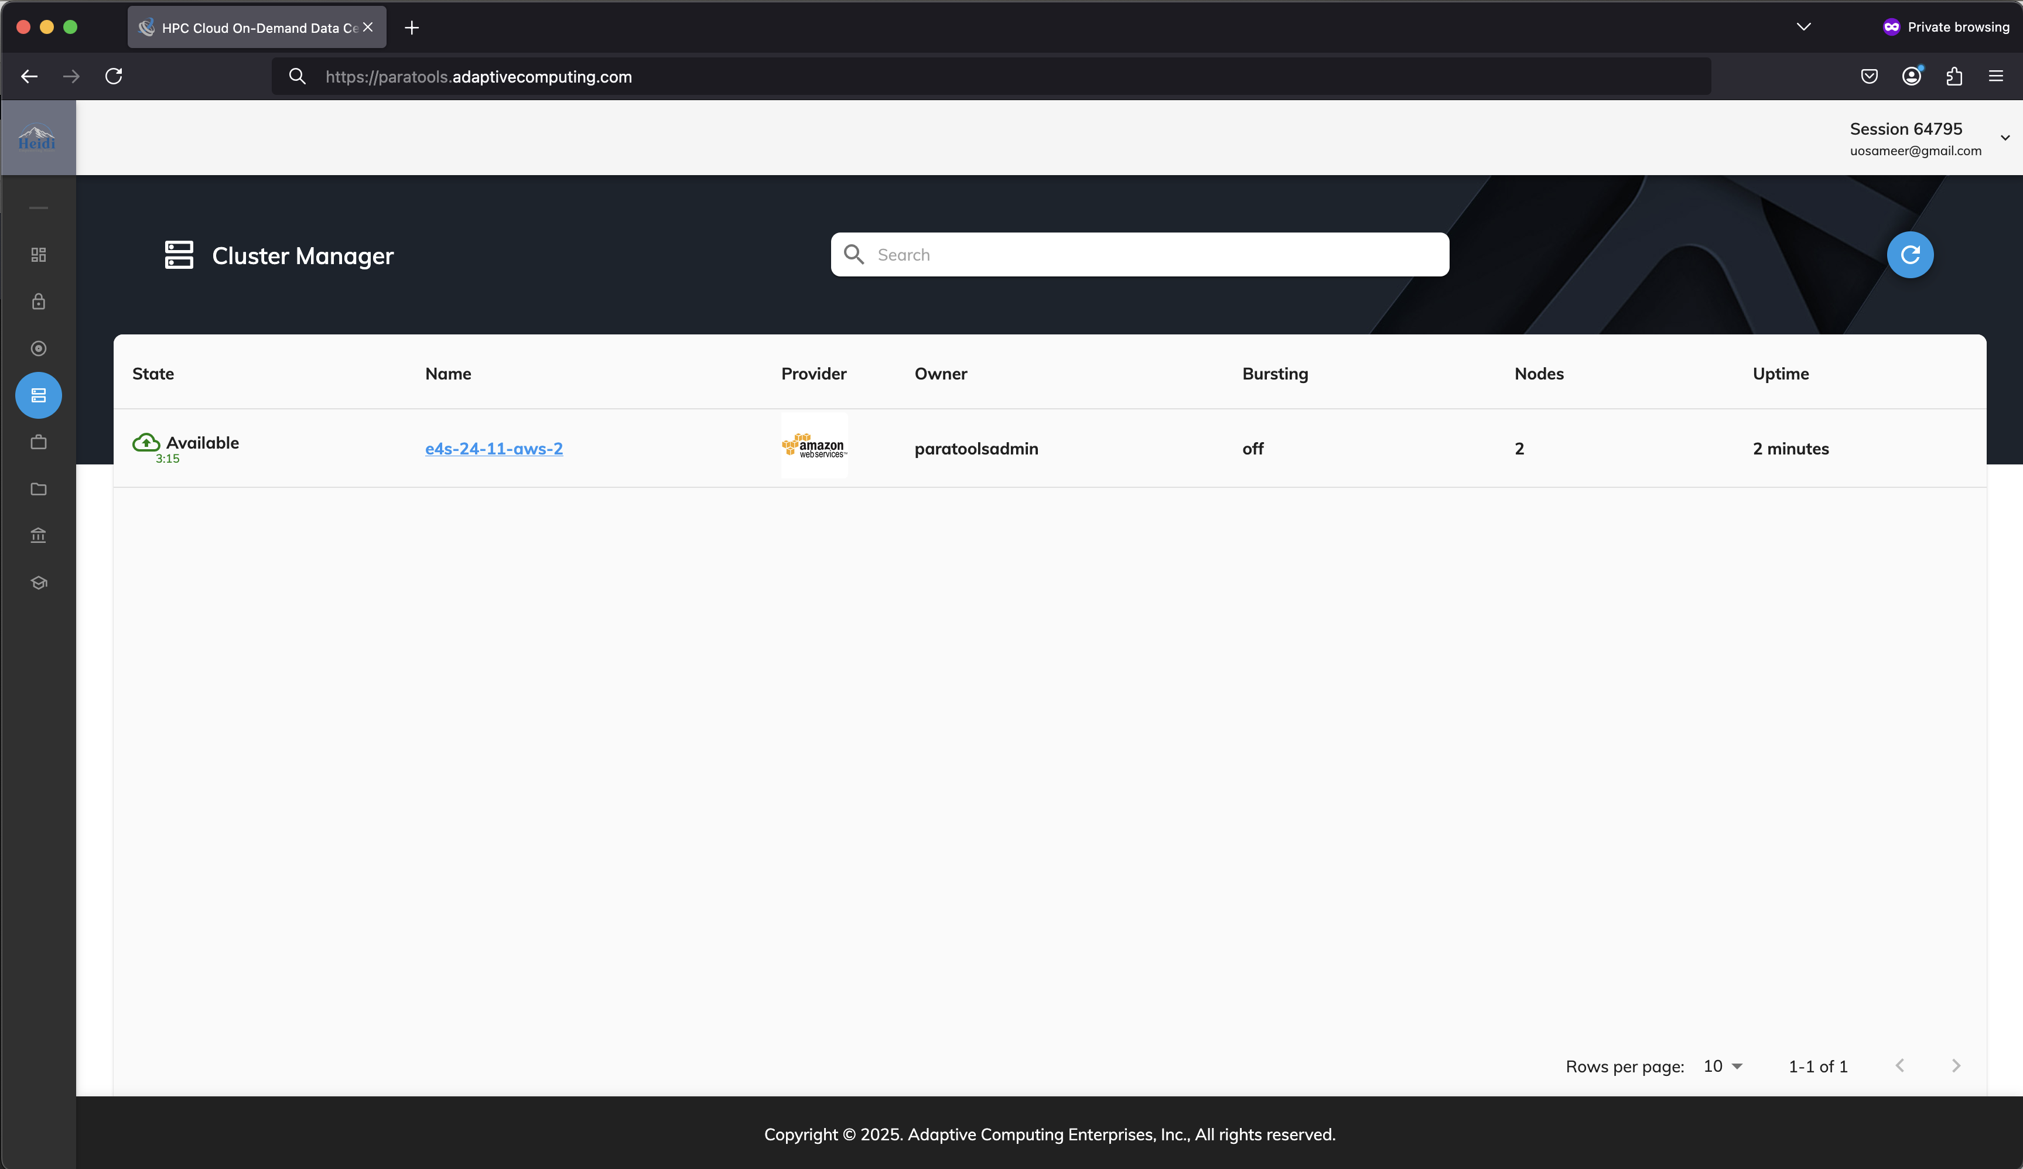
Launch VNC Viewer from Heidi’s Configuration Tab
Click here

Slide 5
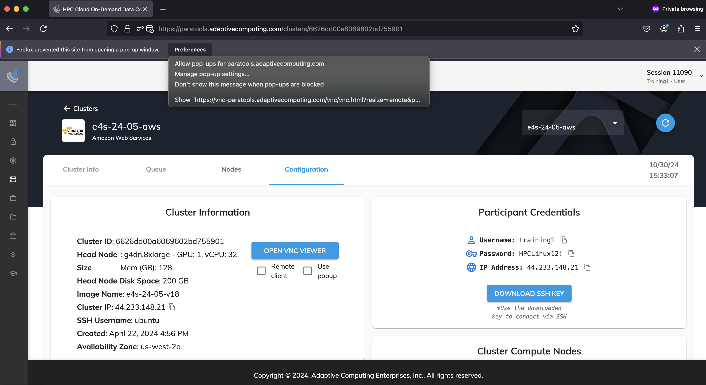
Launch VNC Viewer from ODDC and allow popups
Click here

Slide 6
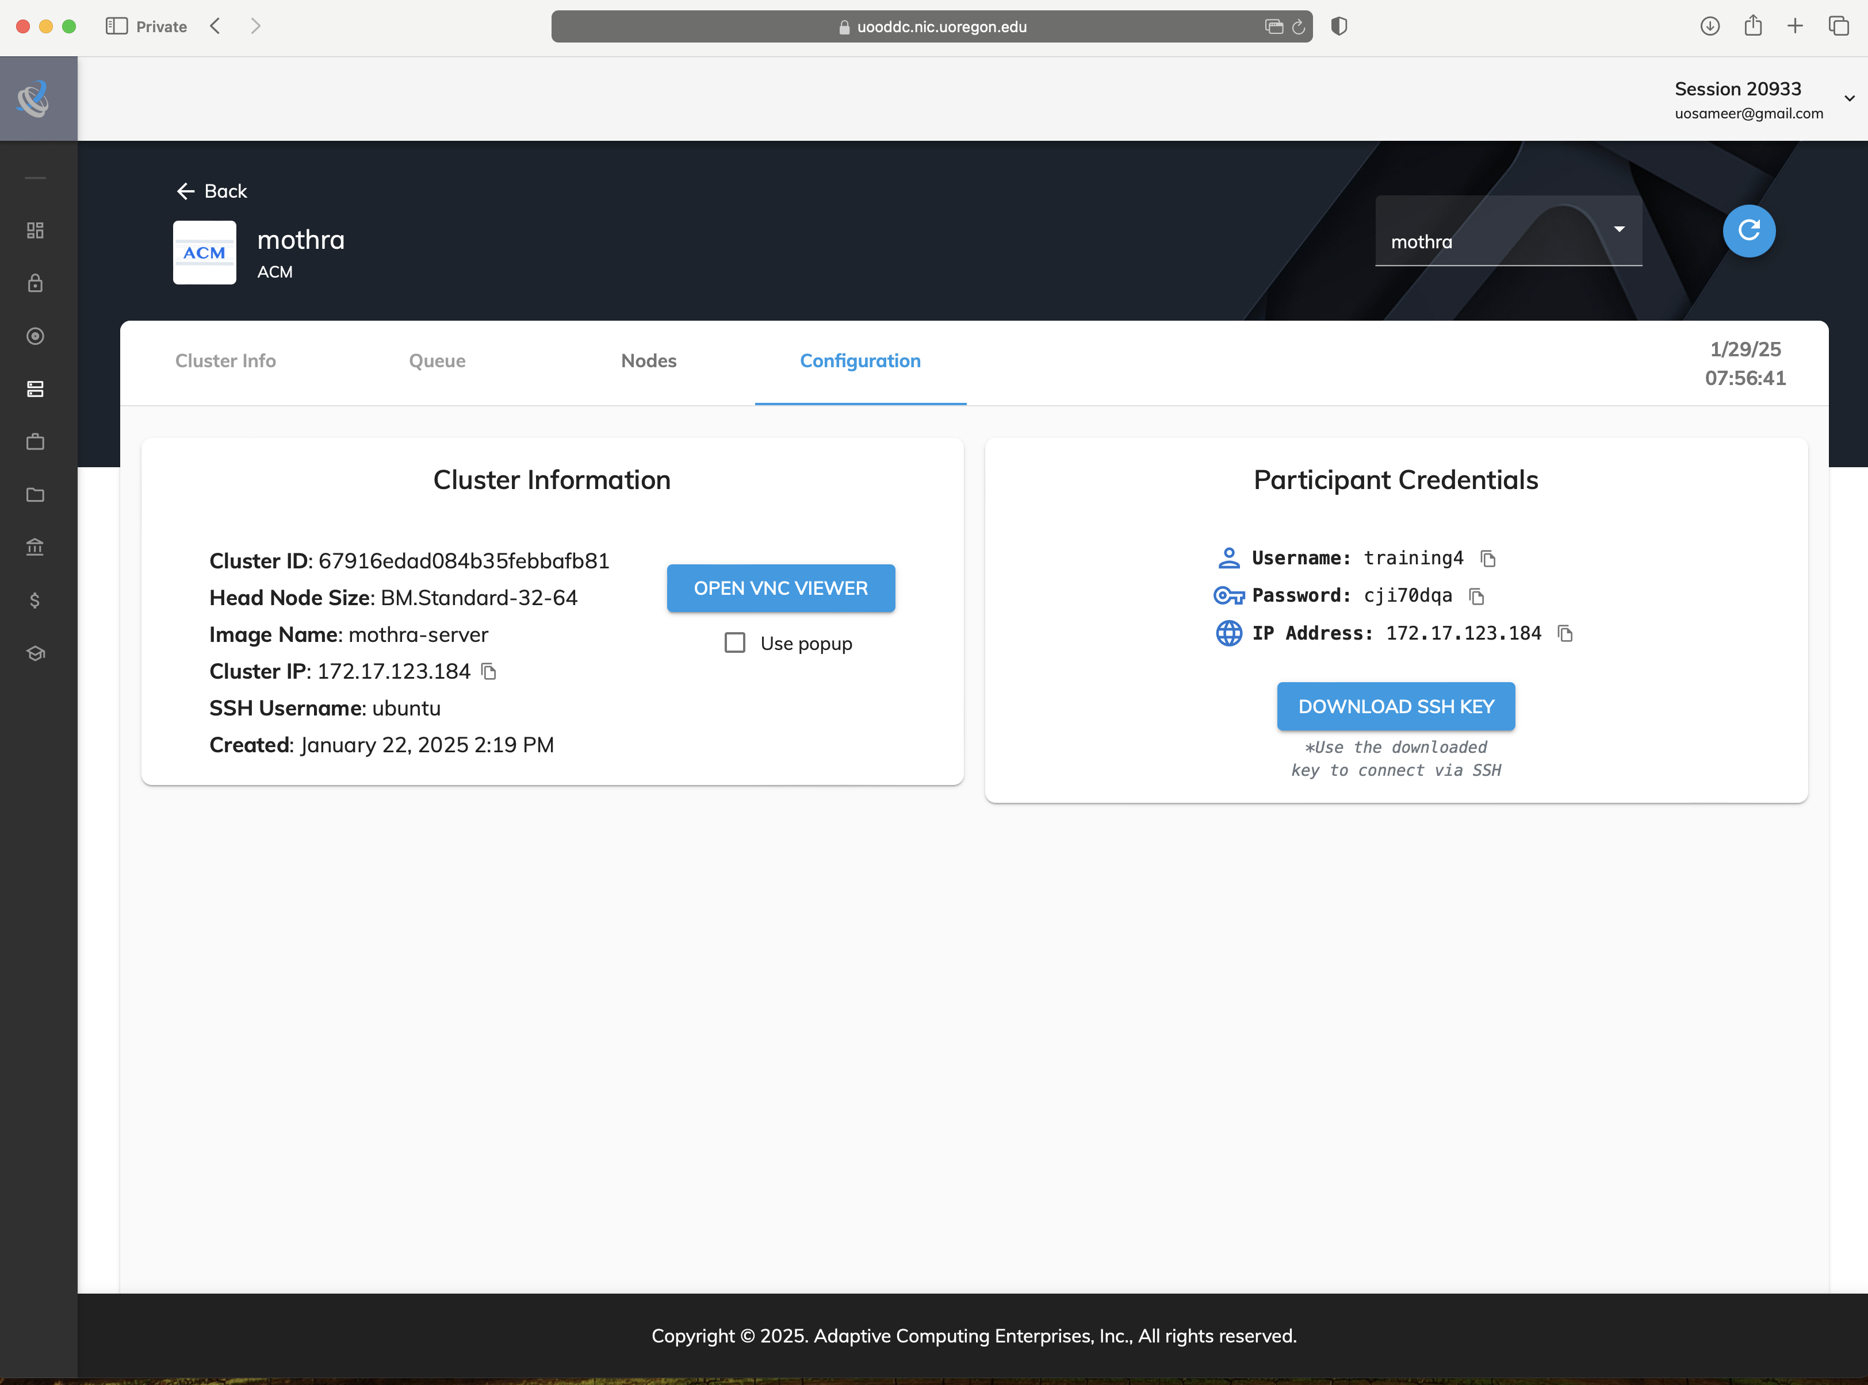
Allow Popups by clicking on popup window in Safari
Click here
to open popup window in Safari

Slide 7
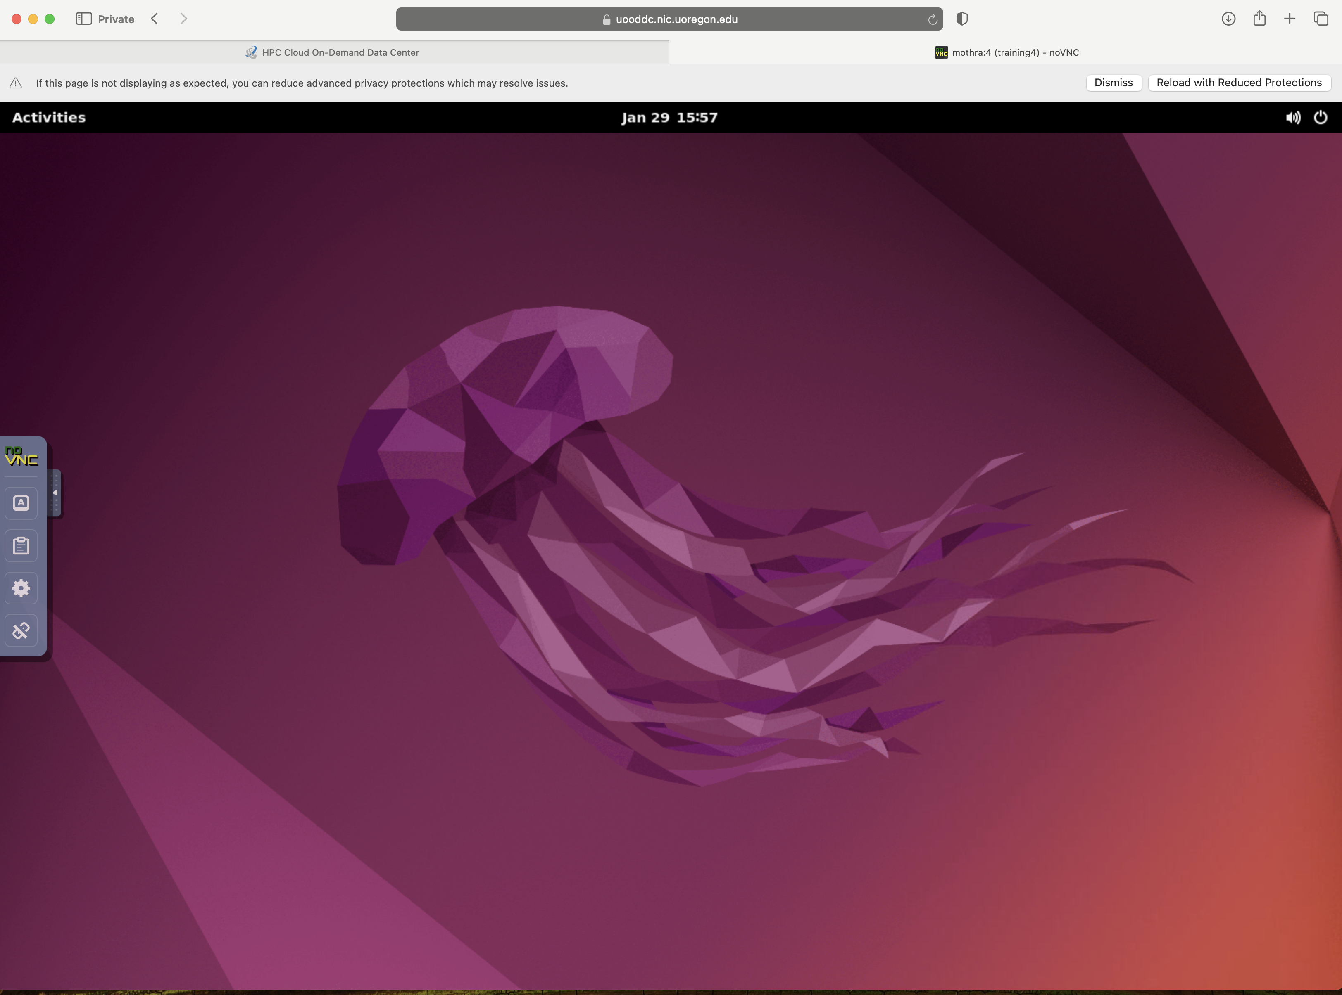
Launch Activities and Terminal Window
Click here
To cut and paste to windows in Heidi

Slide 8
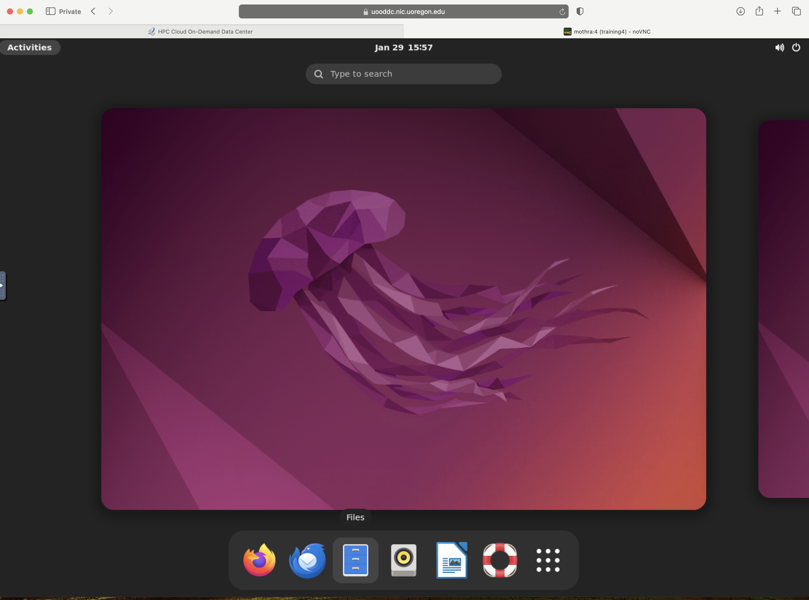
Launch Terminal Application from the desktop
Click here

Slide 9
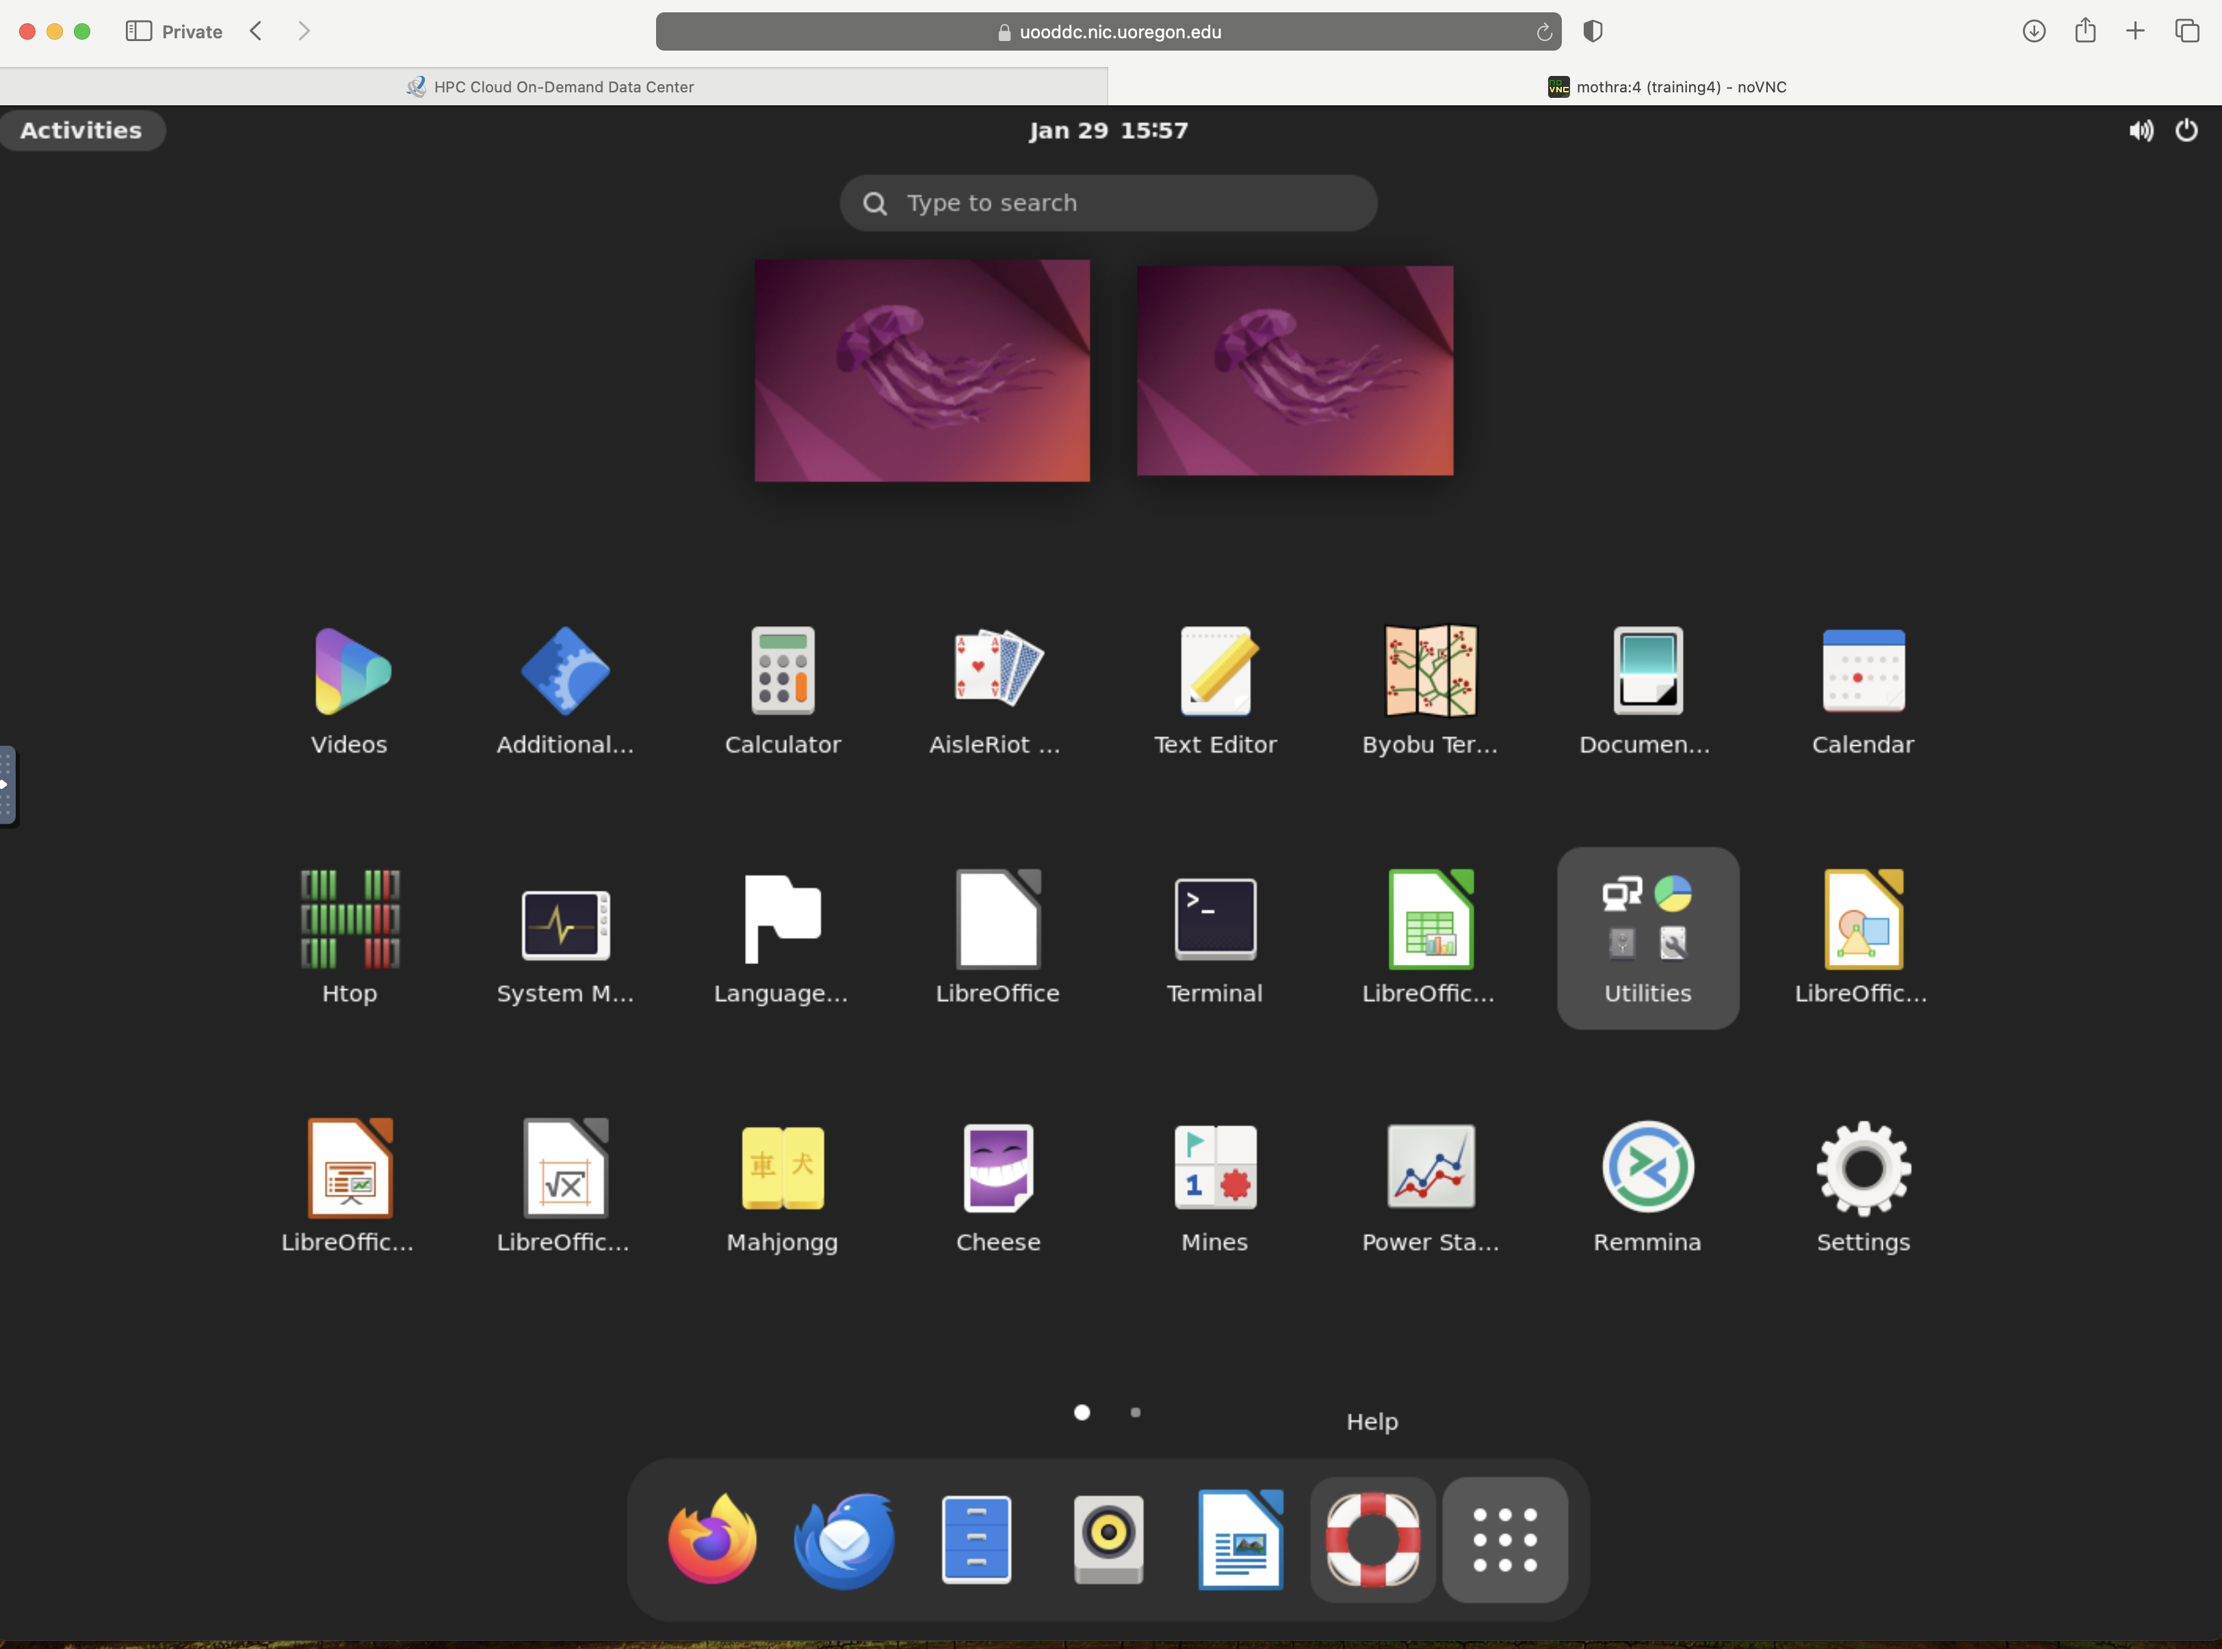
Launch Terminal from Applications
Click here

Slide 10
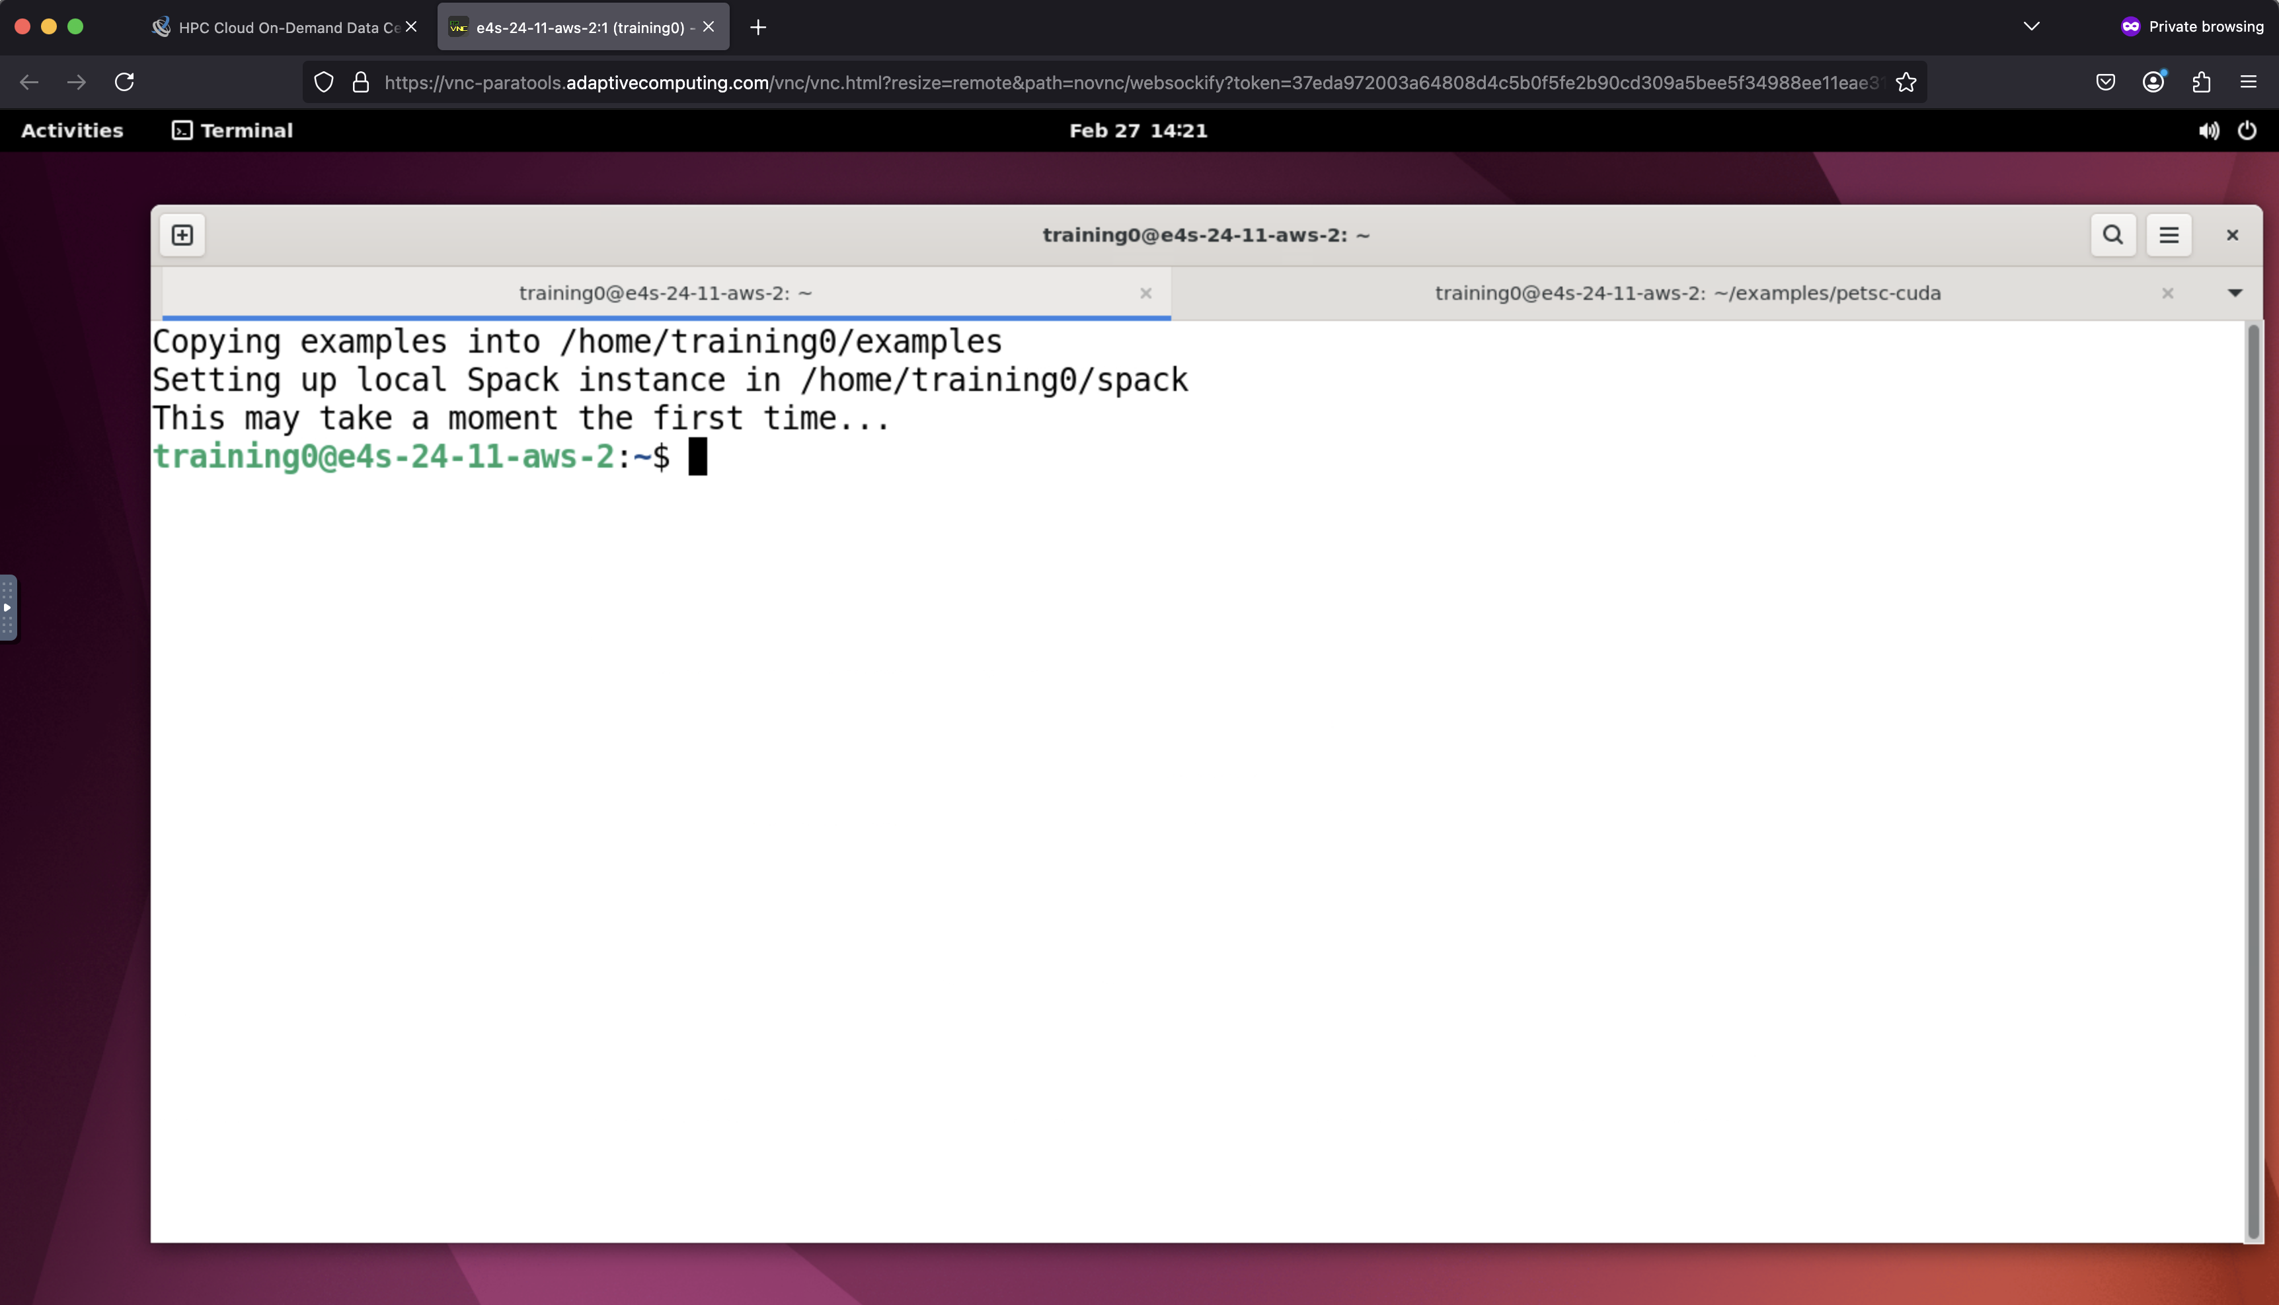
Launch Terminal from Applications

Slide 11
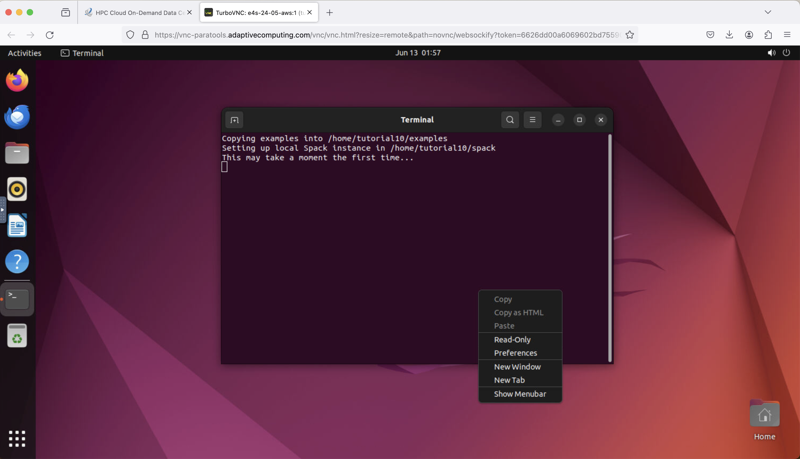
To increase font size right click and choose preferences

Slide 12
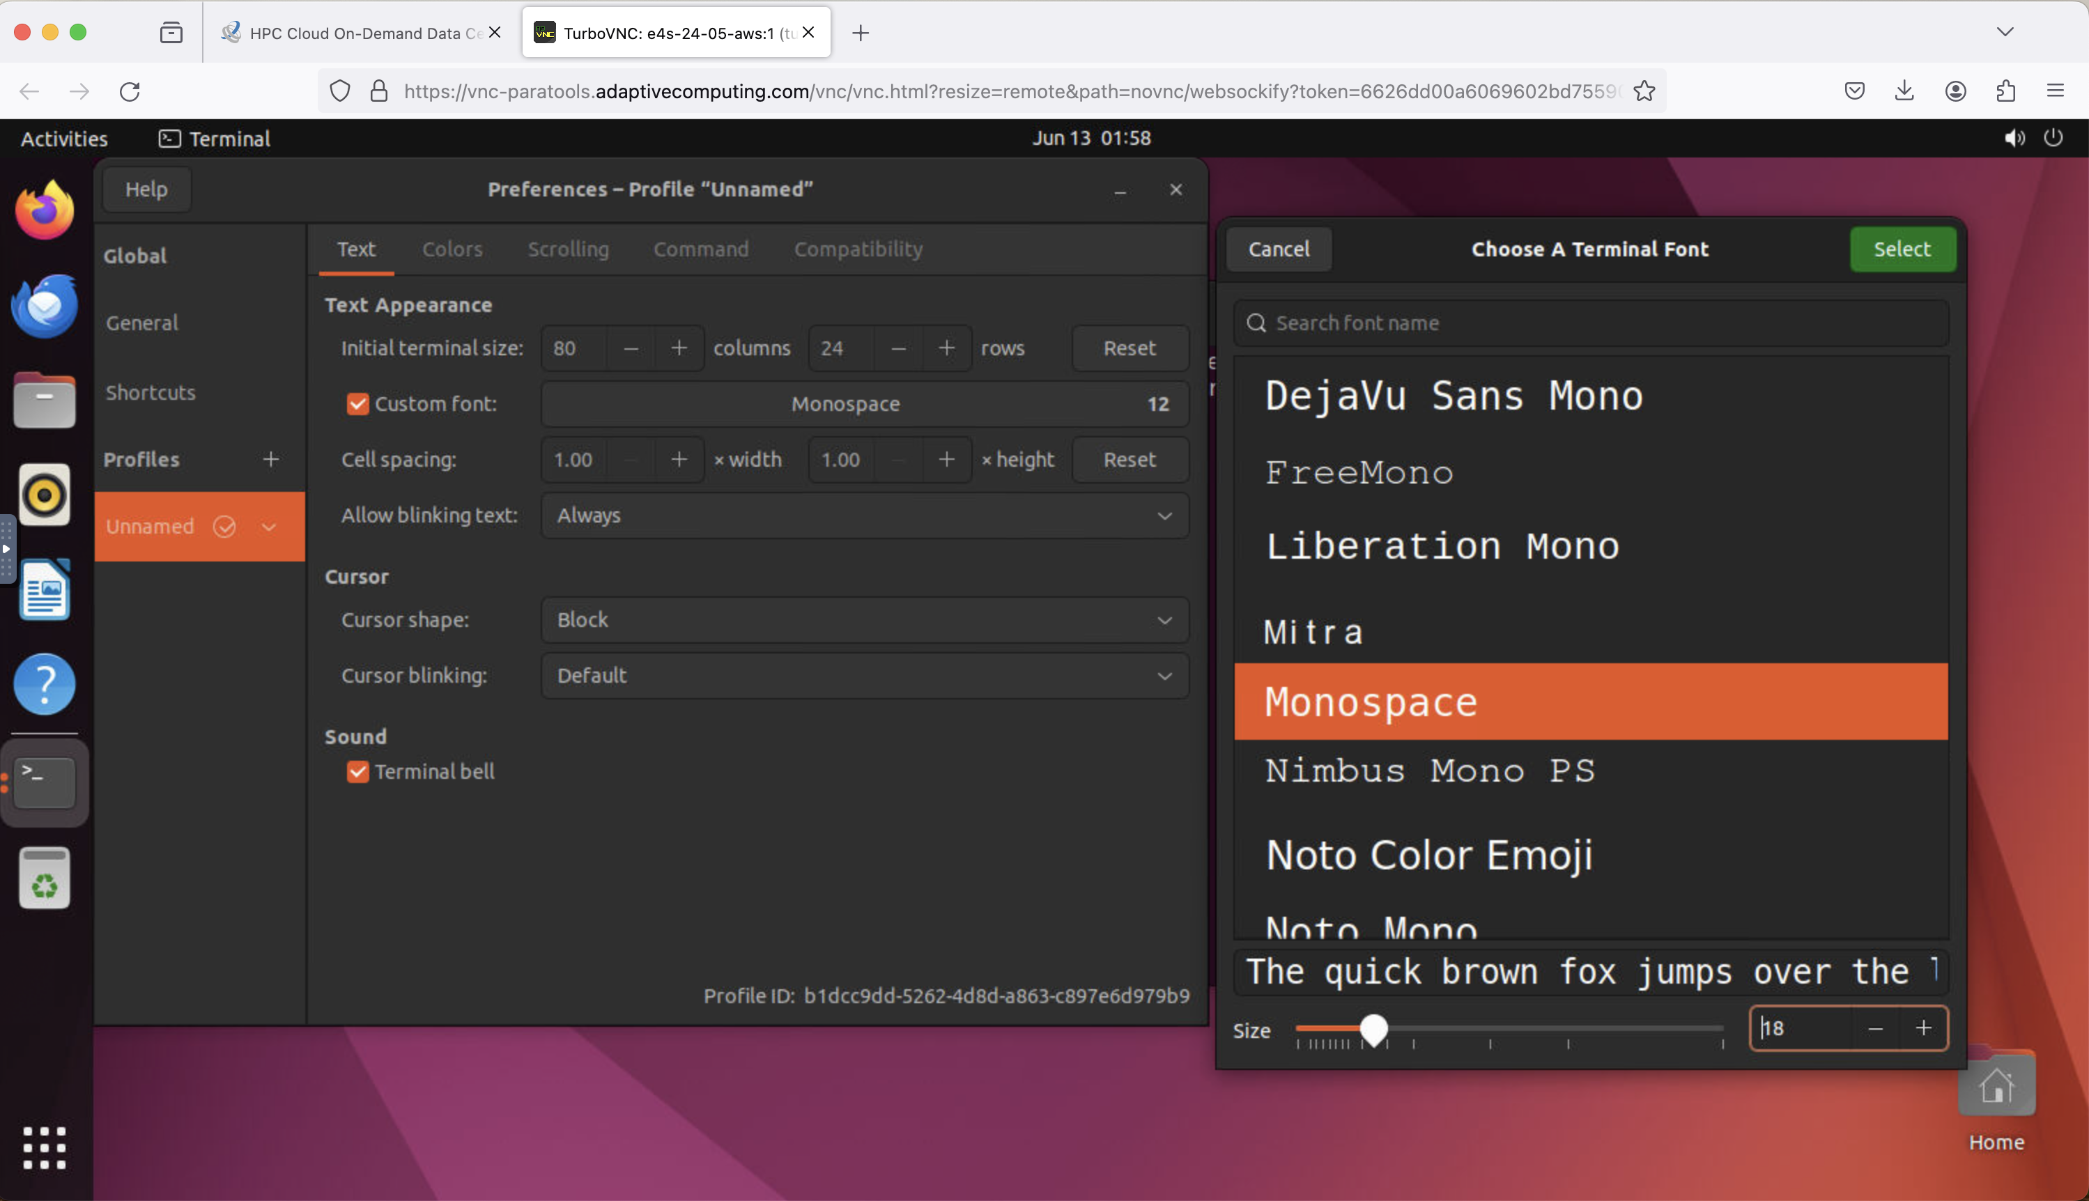
Choose font size after clicking Custom Font for Terminal

Slide 13
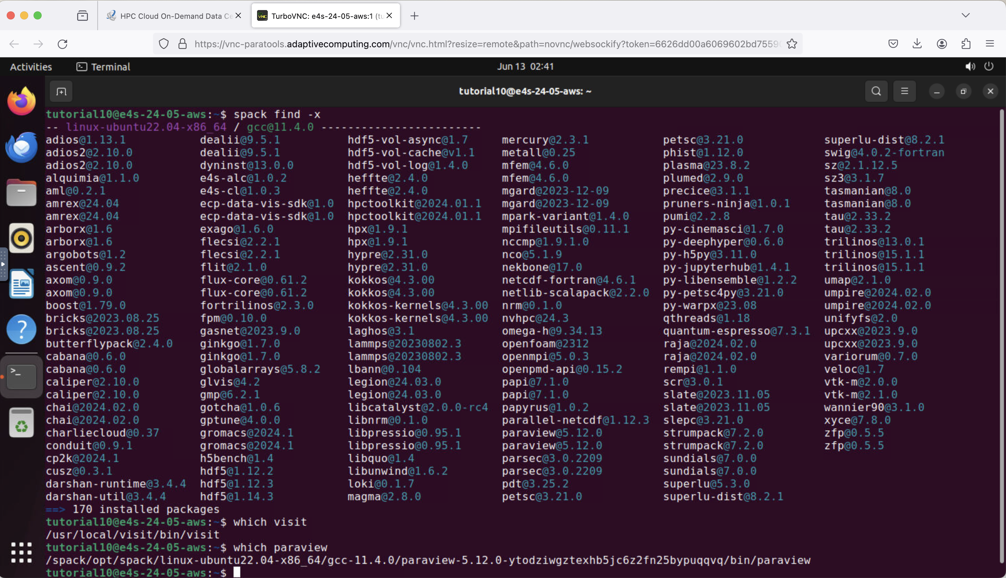
Spack package manager [https://spack.io]
spack find –x
spack find
module avail

Slide 14
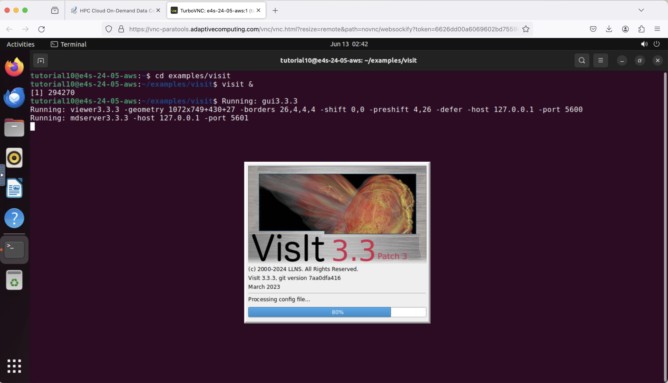
VisIt visualizer: 3D graphics on remote desktop
cd ~/examples/visit
visit &

Slide 15
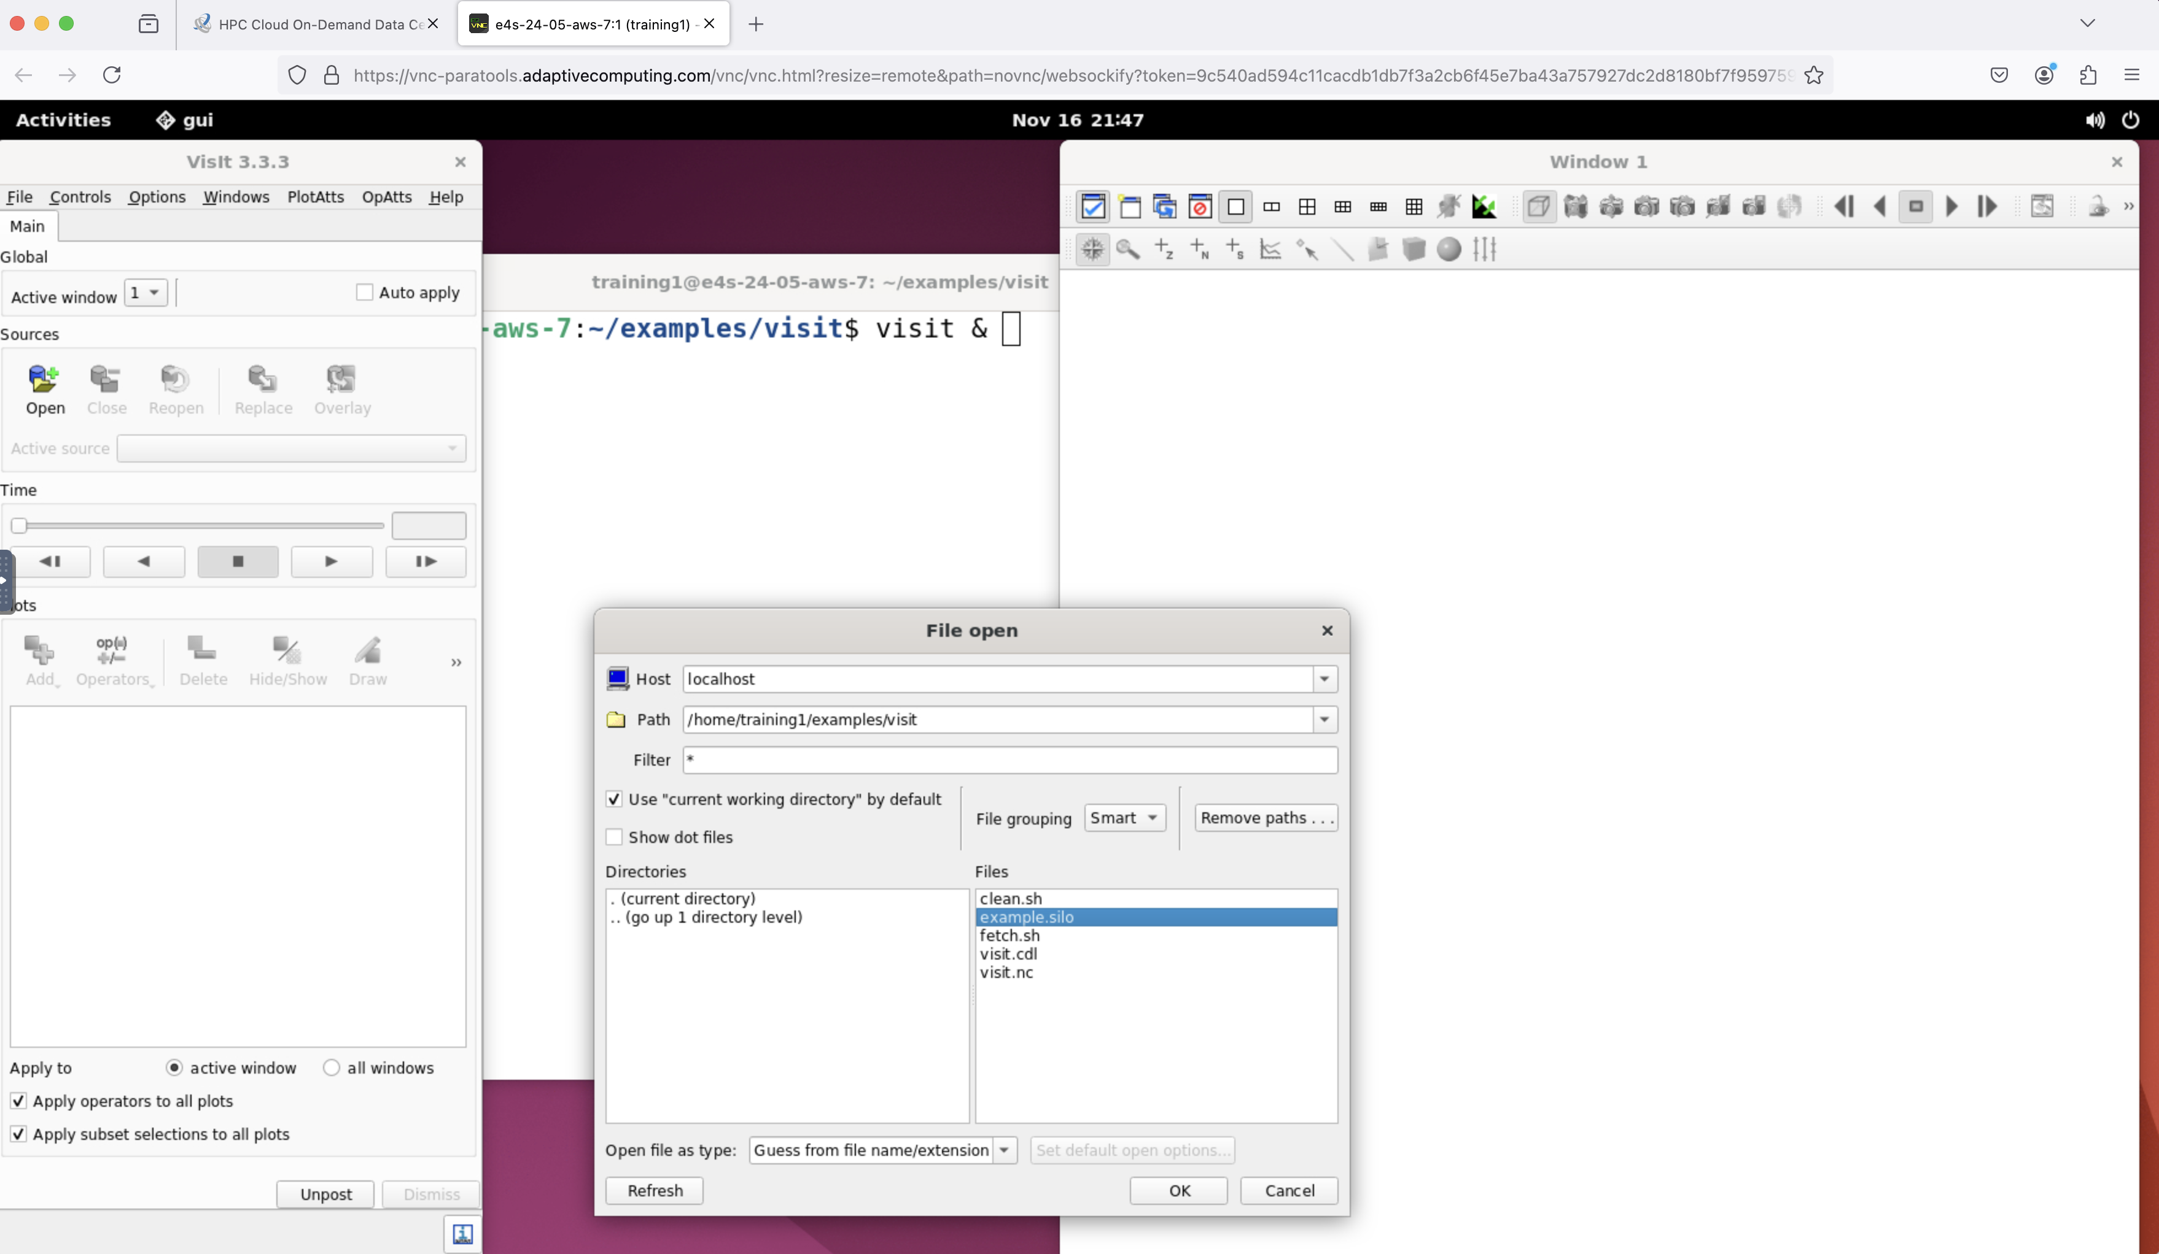
VisIt visualizer: 3D graphics on remote desktop
cd ~/examples/visit
visit &
Open example.silo

Slide 16
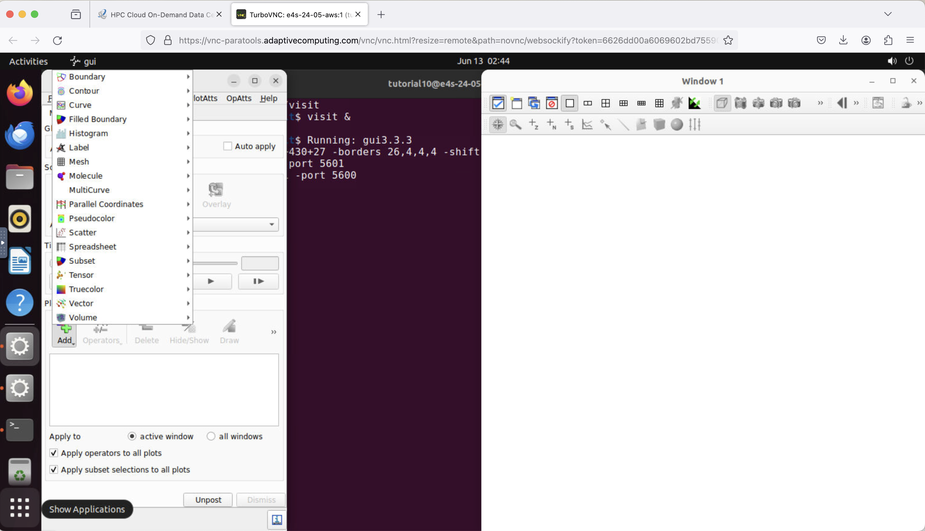
VisIt visualizer
Click Add
Add Pseudocolor ->
Pressure
Click Draw

Slide 17
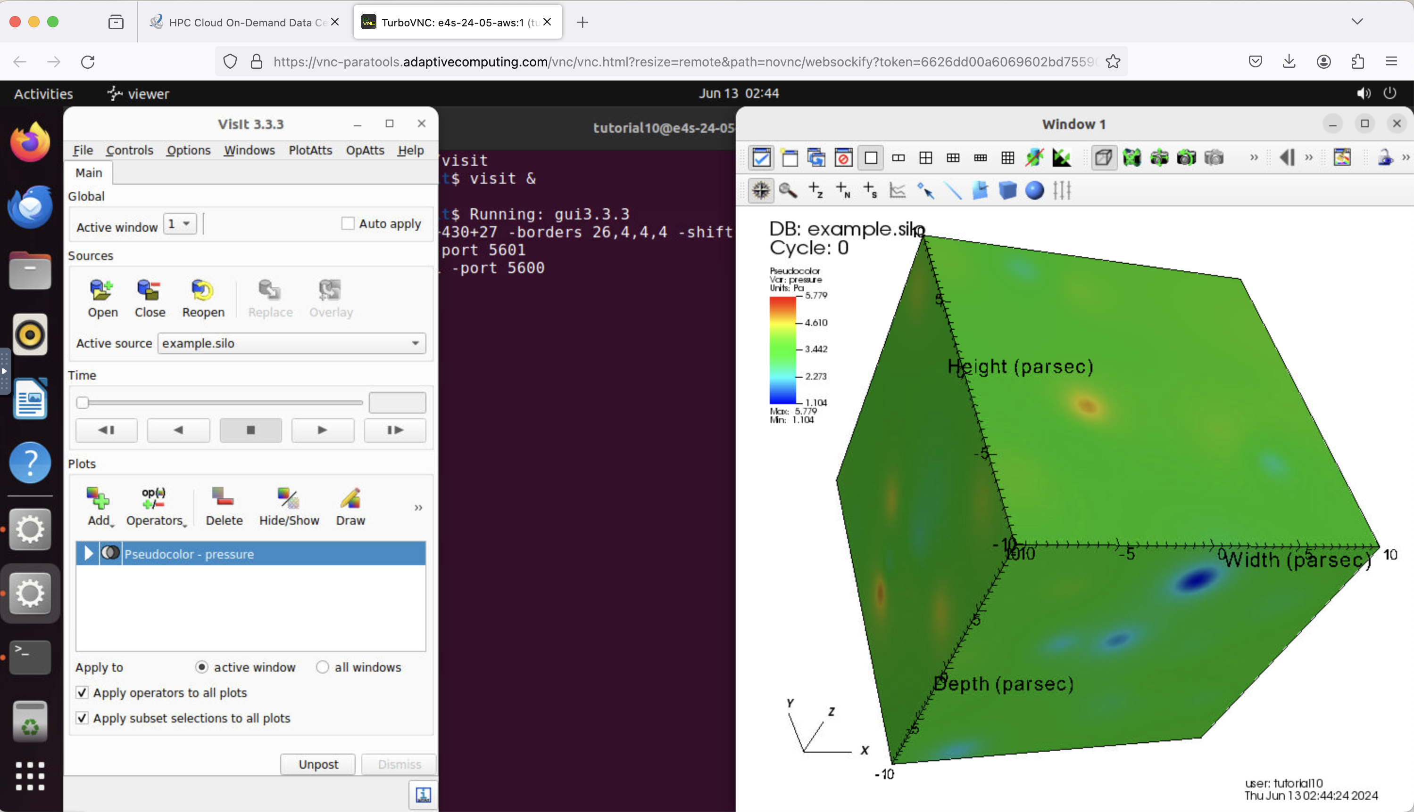
VisIt visualizer
Add Pseudocolor ->
Pressure
Click Draw
Rotate image

Slide 18
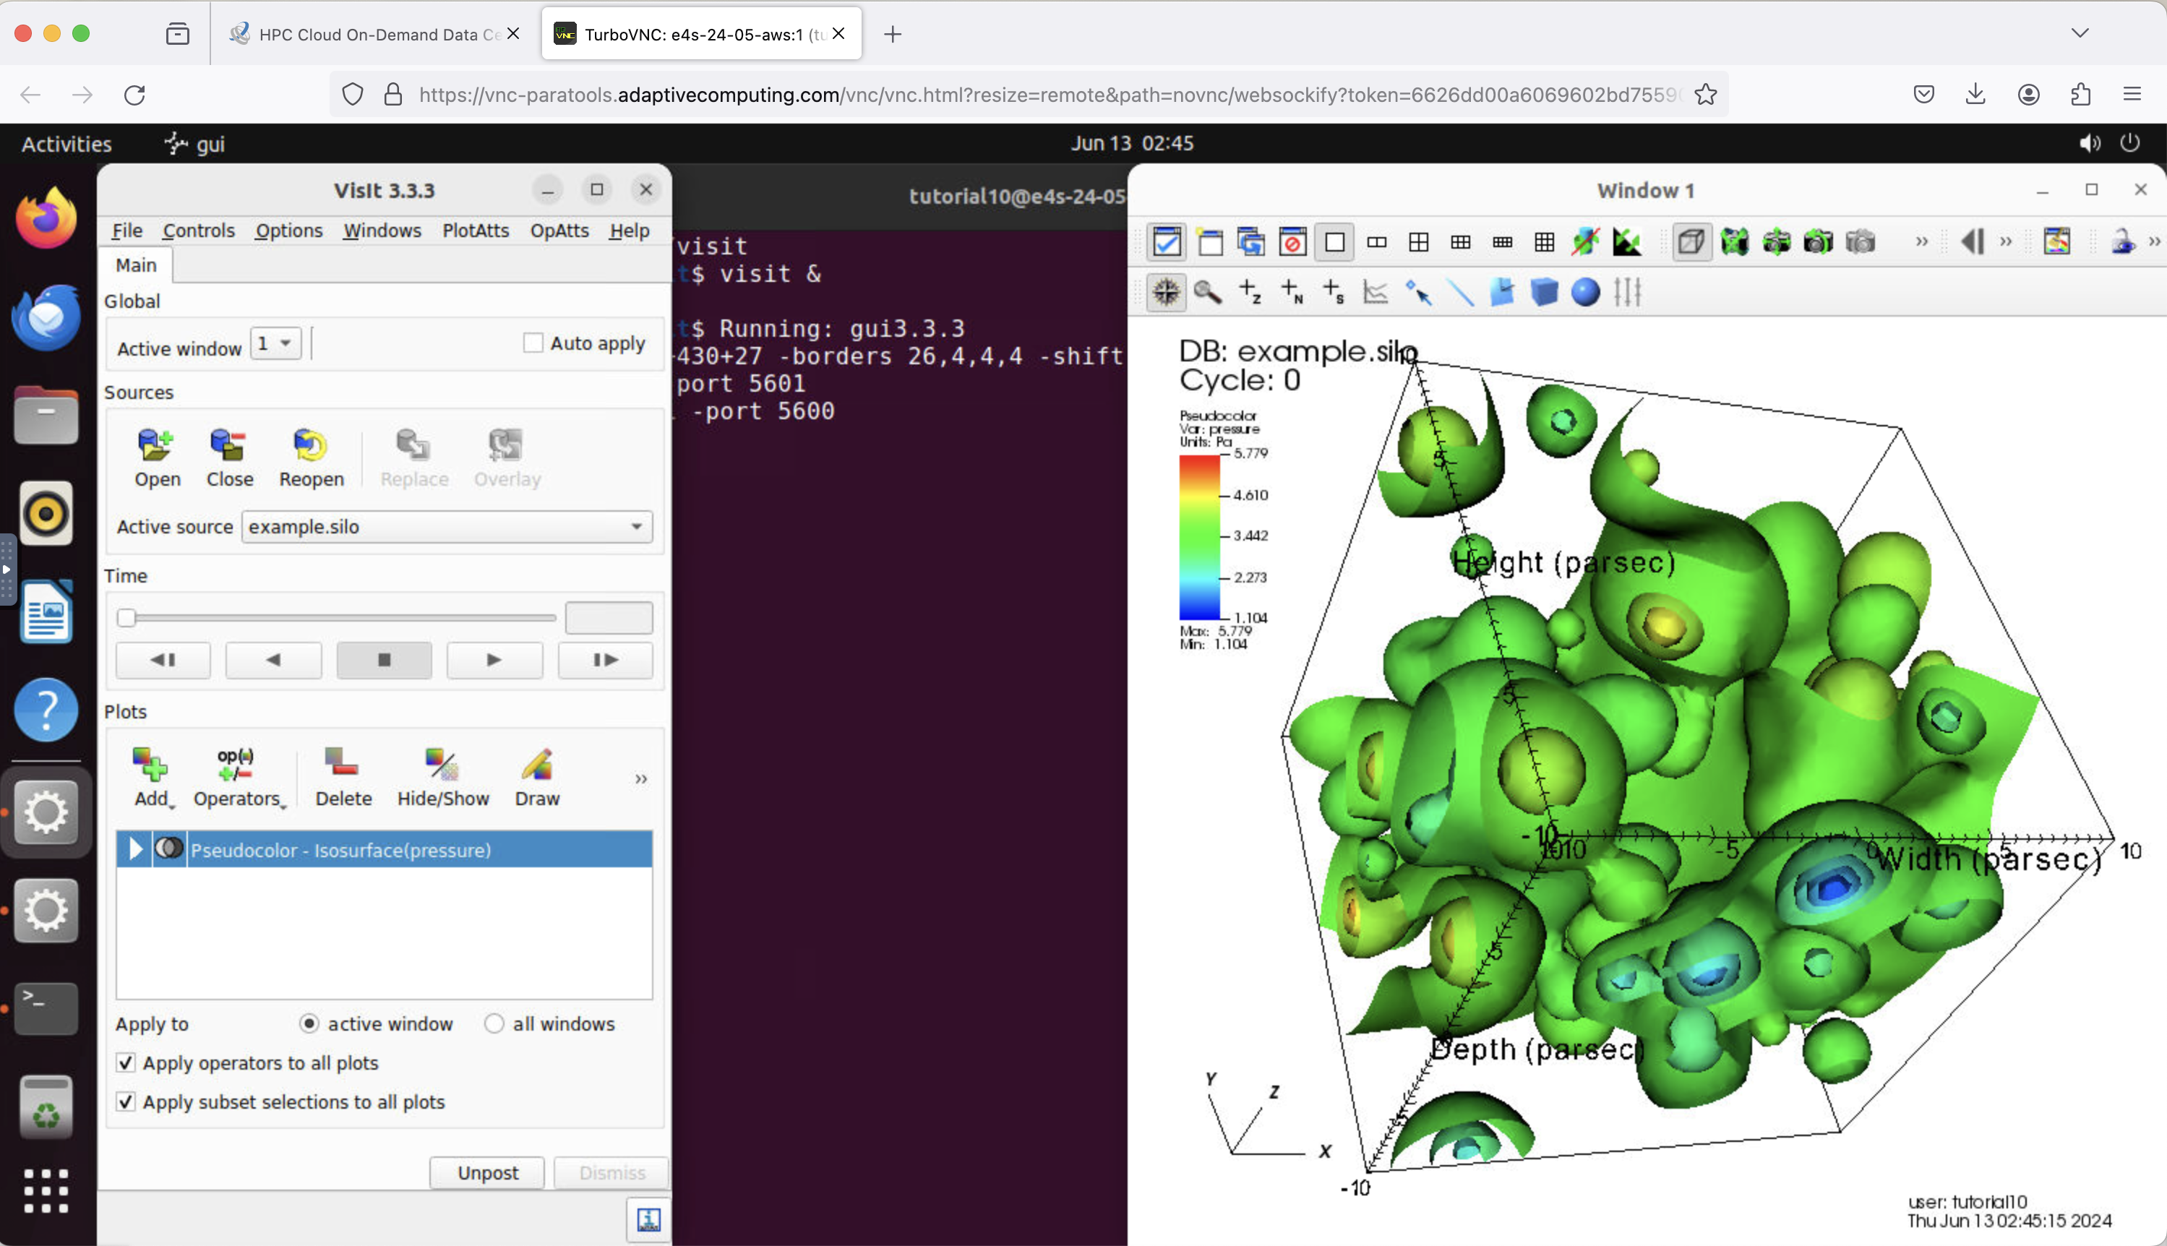
VisIt visualizer
Add Operators ->
Isosurface
Click Draw
Rotate image

Slide 19
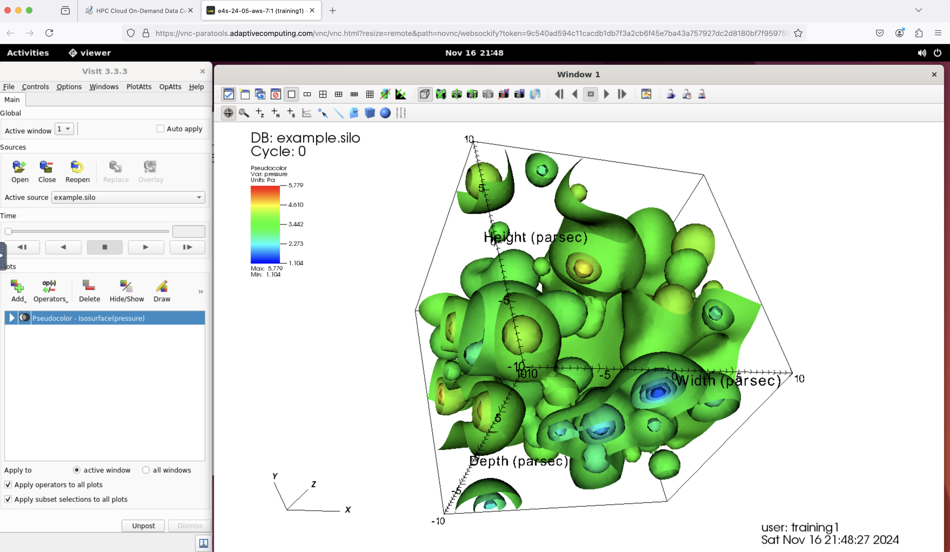
VisIt visualizer: 3D graphics check

Slide 20

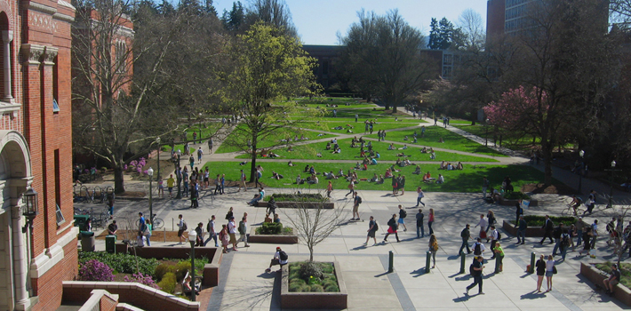
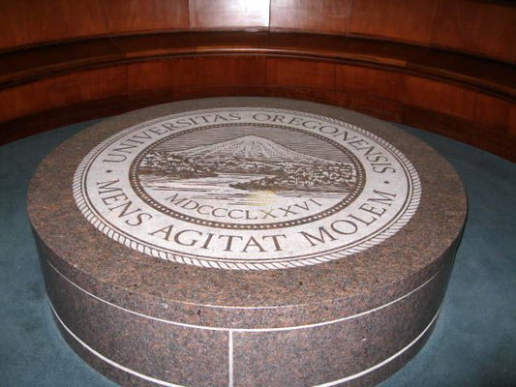
Performance Research Laboratory, OACISS, University of Oregon
www.uoregon.edu

Slide 21





















Support Acknowledgements
US Department of Energy (DOE)
  ANL
  Office of Science contracts, ECP
  SciDAC, LBL contracts
  LLNL-LANL-SNL ASC/NNSA contract
  Battelle, PNNL and ORNL contract
NASA SBIR
Department of Defense (DoD)
  PETTT, HPCMP
National Science Foundation (NSF)
  SI2-SSI, Glassbox
CEA, France
Industry: AWS, AMD, IBM, ARM, Intel, NVIDIA
Partners:
  University of Oregon
  The Ohio State University
  ParaTools, Inc.
  University of Tennessee, Knoxville
  T.U. Dresden, GWT
  Jülich Supercomputing Center

Slide 22

Acknowledgment
This material is based upon work supported by the U.S. Department of Energy, Office of Science, Office of Advanced Scientific Computing Research, Next-Generation Scientific Software Technologies program, under contract number DE-AC02-06CH11357. DOE SBIR DE-SC0022502.
https://science.osti.gov/ascr
https://pesoproject.org
https://ascr-step.org
https://hpsf.io
https://www.energy.gov/technologytransitions/sbirsttr

Slide 23
Thank you
https://www.exascaleproject.org
This research was supported by the Exascale Computing Project (17-SC-20-SC), a joint project of the U.S. Department of Energy’s Office of Science and National Nuclear Security Administration, responsible for delivering a capable exascale ecosystem, including software, applications, and hardware technology, to support the nation’s exascale computing imperative.
Thank you to all collaborators in the ECP and broader computational science communities. The work discussed in this presentation represents creative contributions of many people who are passionately working toward next-generation computational science.

Slide 24


