Slide 1


Performance Evaluation of GPU-accelerated HPC and AI applications using HPCToolkit, TAU, and ParaTools Pro for E4STM
Sameer Shende
Research Professor, University of Oregon
President and Director
ParaTools, Inc.
Presentation at EnergyHPC conference, Rice U., Houston
February 27, 2025
https://tinyurl.com/e4stut

Slide 2

TAU Performance System®
Versatile profiling and tracing toolkit that supports:
  MPI, ROCm, CUDA, DPC++/SYCL (Level Zero), OpenCL, and
  OpenMP (OpenMP Tools Interface for Target Offload), OpenACC
Scalable, portable, performance evaluation toolkit for HPC and AI/ML workloads that supports:
  C++/C/DPC++, Fortran, Python
Interfaces with Program Database Toolkit (PDT) and SALT-FM for instrumentation of source code.
Supports PAPI, Likwid for hardware performance counter information
Instrumentation includes support for PETSc (Perfstubs), XGC (CAMTIMERS), Kokkos, MPI, pthread, event-based sampling, GPU runtimes
A single tool (tau_exec) is used to launch un-instrumented, un-modified binaries
TAU’s paraprof, pprof, perfexplorer for profile analysis; Vampir, Jumpshot, Perfetto.dev for traces
http://tau.uoregon.edu

Slide 3
Using TAU’s Runtime Preloading Tool: tau_exec
Preload a wrapper that intercepts the runtime system call and substitutes with another
    MPI
    OpenMP
    POSIX I/O
    Memory allocation/deallocation routines
    Wrapper library for an external package
No modification to the binary executable!
Enable other TAU options (communication matrix, OTF2, event-based sampling)

Slide 4
TAU: Quickstart Guide
Profiling:
MPI: % mpirun -np 16 tau_exec -ebs ./a.out
Pthread: % mpirun -np 16 tau_exec –T mpi,pthread –ebs ./a.out
CUDA: % mpirun –np 16 tau_exec –T cupti –cupti ./a.out
ROCM: % mpirun –np 16 tau_exec –rocm ./a.out
Analysis: % pprof –a –m | more; % paraprof (GUI)
Tracing:
Vampir: MPI: % export TAU_TRACE=1; export TAU_TRACE_FORMAT=otf2
% mpirun -np 16 tau_exec ./a.out; vampir traces.otf2 &
Chrome/Jumpshot: % export TAU_TRACE=1; mpirun -np 64 tau_exec ./a.out
% tau_treemerge.pl;
Chrome: % tau_trace2json tau.trc tau.edf –chrome –ignoreatomic –o app.json
Chrome browser: chrome://tracing (Load -> app.json) or Perfetto.dev
Jumpshot: tau2slog2 tau.trc tau.edf –o app.slog2; jumpshot app.slog2

Slide 5
TAU Execution Command (tau_exec)
Uninstrumented execution
  % mpirun -np 256 ./a.out
Track GPU operations
  % mpirun -np 256 tau_exec –rocm ./a.out
  % mpirun -np 256 tau_exec –cupti ./a.out
  % mpirun -np 256 tau_exec –cupti -um ./a.out (for Unified Memory)
  % mpirun –np 256 tau_exec –l0 ./a.out
  % mpirun –np 256 tau_exec –opencl ./a.out
  % mpirun –np 256 tau_exec –openacc ./a.out
Track MPI performance
  % mpirun -np 256 tau_exec ./a.out
Track I/O, and MPI performance (MPI enabled by default)
  % mpirun -np 256 tau_exec -io ./a.out
Track OpenMP and MPI execution (using OMPT for Intel v19+ or Clang 8+)
  % export TAU_OMPT_SUPPORT_LEVEL=full;
  % mpirun –np 256 tau_exec –T ompt,mpi -ompt ./a.out
Track memory operations
  % export TAU_TRACK_MEMORY_LEAKS=1
  % mpirun –np 256 tau_exec –memory_debug ./a.out (bounds check)
Use event based sampling (compile with –g)
  % mpirun –np 256 tau_exec –ebs ./a.out
  Also export TAU_METRICS=TIME,PAPI_L1_DCM… -ebs_resolution=<file | function | line>

Slide 6
Advanced Instrumentation Features of TAU

Slide 7
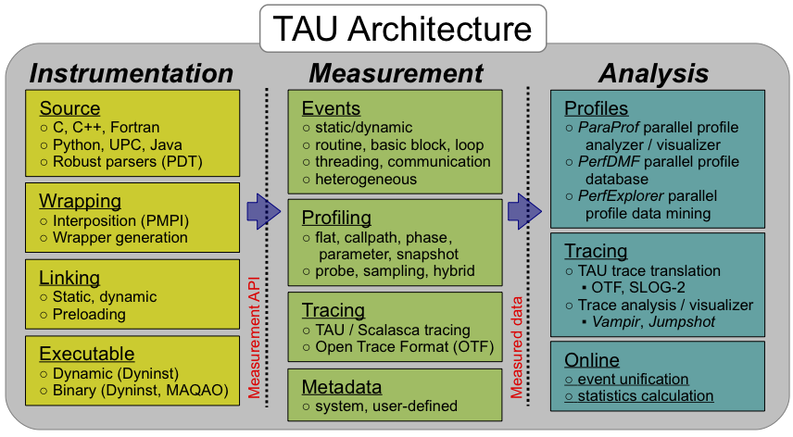
TAU Performance System®
Parallel performance framework and toolkit
  Supports all HPC platforms, compilers, runtime system
  Provides portable instrumentation, measurement, analysis

Slide 8
Application Performance Engineering using TAU
How much time is spent in each application routine and outer loops? Within loops, what is the contribution of each statement? What is the time spent in OpenMP loops? In kernels on GPUs. How long did it take to transfer data between host and device (GPU)?
How many instructions are executed in these code regions?
Floating point, Level 1 and 2 data cache misses, hits, branches taken? What is the extent of vectorization for loops?
How much time did my application spend waiting at a barrier in MPI collective operations?
What is the memory usage of the code? When and where is memory allocated/de-allocated? Are there any memory leaks? What is the memory footprint of the application? What is the memory high water mark?
How much energy does the application use in Joules? What is the peak power usage?
What are the I/O characteristics of the code? What is the peak read and write bandwidth of individual calls, total volume?
How does the application scale? What is the efficiency, runtime breakdown of performance across different core counts?

Slide 9
Instrumentation
Direct and indirect performance observation
  Instrumentation invokes performance measurement
  Direct measurement with probes
  Indirect measurement with periodic sampling or hardware performance counter overflow interrupts
  Events measure performance data, metadata, context, etc.
User-defined events
  Interval (start/stop) events to measure exclusive & inclusive duration
  Atomic events take measurements at a single point
      Measures total, samples, min/max/mean/std. deviation statistics
  Context events are atomic events with executing context
      Measures above statistics for a given calling path

Slide 10
Instrumentation
Add hooks in the code to perform measurements
Source instrumentation using a preprocessor
  Add timer start/stop calls in a copy of the source code.
  Use SALT-FM or Program Database Toolkit (PDT) for parsing source code.
  Requires recompiling the code using TAU shell scripts (tau_cc.sh, tau_f90.sh)
  Selective instrumentation (filter file) can reduce runtime overhead and narrow instrumentation focus.
Compiler-based instrumentation
  Use system compiler to add a special flag to insert hooks at routine entry/exit.
  TAU LLVM plugin for selective instrumentation at the LLVM IR level before codegen.
  Requires recompiling using TAU compiler scripts (tau_cc.sh, tau_f90.sh…)
Runtime preloading of TAU’s Dynamic Shared Object (DSO)
  No need to recompile code! Use mpirun tau_exec ./app with options.

Slide 11
Using Instrumentation of Source Code in TAU using PDT
TAU supports several measurement and thread options
  Phase profiling, profiling with hardware counters, MPI library, CUDA…
  Each measurement configuration of TAU corresponds to a unique stub makefile and library that is generated when you configure it
To instrument source code automatically using PDT
  Choose an appropriate TAU stub makefile in <arch>/lib:
  (or module load tau… )
  % export TAU_MAKEFILE=$TAU/Makefile.tau-papi-mpi-pdt
  % export TAU_OPTIONS=‘-optVerbose …’ (see tau_compiler.sh )
  % export PATH=$TAUDIR/x86_64/bin:$PATH
  Use tau_f90.sh, tau_cxx.sh, tau_upc.sh, or tau_cc.sh as F90, C++, UPC, or C compilers respectively:
  % mpif90 foo.f90 changes to
  % tau_f90.sh foo.f90
Set runtime environment variables, execute application and analyze performance data:
  % pprof (for text based profile display)
  % paraprof (for GUI)

Slide 12
TAU Configurations available
% module load tau
% ls $TAU/Makefile*
/packages/tau-2.34/x86_64/lib/Makefile.tau-intel-papi-mpi-pthread-pdt
/packages/tau-2.34/x86_64/lib/Makefile.tau-intel-papi-ompt-mpi-pdt-openmp
/packages/tau-2.34/x86_64/lib/Makefile.tau-papi-mpi-pdt
/packages/tau-2.34/x86_64/lib/Makefile.tau-papi-pdt
/packages/tau-2.34/x86_64/lib/Makefile.tau-papi-pthread-pdt
/packages/tau-2.34/x86_64/lib/Makefile.tau-papi-tbb-pdt
For an uninstrumented binary:
% mpirun –np 16 tau_exec –T mpi,papi,pdt ./a.out
Picks the configuration represented by
/packages/tau-2.34/x86_64/lib/Makefile.tau-intel-papi-mpi-pdt
To use OpenMP instrumentation:
% export TAU_OMPT_SUPPORT_LEVEL=full
% export OMP_NUM_THREADS=<N>
% mpirun –np 16 tau_exec –T ompt,mpi –ompt –ebs ./a.out
To use TAU’s source code instrumentation:
% export TAU_MAKEFILE=/packages/tau-2.34/x86_64/lib/Makefile.tau-intel-papi-mpi-pdt
% make CC=tau_cc.sh F90=tau_f90.sh CXX=tau_cxx.sh ; mpirun –np 16 ./a.out
% pprof –a | more
% paraprof
% paraprof --pack foo.ppk
# Copy it to your local machine and launch: % paraprof foo.ppk

Slide 13
TAU’s Legacy Static Analysis System:
Program Database Toolkit (PDT)
Closed source C/C++ parser based on obsolete version of Edison Design Group compiler
Application
/ Library
C / C++
parser
Fortran parser
F77/90/95
Based on an old, modified version of GFortran.
GFortran’s non-modular design makes use as a library difficult and does not support modern Fortran
IL
IL
C / C++
IL analyzer
Fortran
IL analyzer
.
.
.
Program
Database
Files
Automatic source
instrumentation
TAU
instrumentor
DUCTAPE
Text-based database files enumerating all functions, statements, types

Slide 14
Automatic Source Instrumentation using PDT
TAU source
analyzer
Application
source
Parsed
program
Instrumented
copy of source
tau_instrumentor
Instrumentation
specification file

Slide 15
Problems with PDT
PDT has usability issues
  Not compatible with any C++ features beyond C++11
  Closed source — so have to ship large binary blobs to end users
  PDB file requirement to serialize all types to textual description presents problems with modern C++ with deeply-templated types (large number of types with long description length)
PDT has maintainability issues
  Closed source – developers must sign NDA, limits number of developers involved
  PDT instrumentor mixes EDG parser and PDT client code in same codebase — difficult to upgrade to new versions
  Difficult to support for new C++ features
  Major EDG release makes numerous breaking changes to API, which would require a from-scratch rewrite to adopt
Fortran support
  Based on older GFortran parser that does not support modern Fortran features

Slide 16
Flang-based Instrumentation
flang
flang -fc1
LLVM assembler
Parser
Semantics
Lower to FIR
Lower to MLIR
Lower to LLVM IR
SALT is implemented as a Flang Frontend Plugin which receives the Fortran parse tree from flang –fc1 after parse tree generation and before the semantics stage.

Slide 17
SALT plugin for Flang: NASA SBIR Phase I
Phase I proof-of-concept implements instrumentation for performance monitoring.
SALT Visitor visits each node of parse tree
  Identifies programs/subprograms for instrumentation
  Identifies source locations for inserting variable declarations and timer start/stop code for TAU timers
    Not all parse tree node types in Flang have associated source position data.
    Scans into children of a given node to find source position data in subnodes.
Phase I focused specifically on instrumentation.

Slide 18
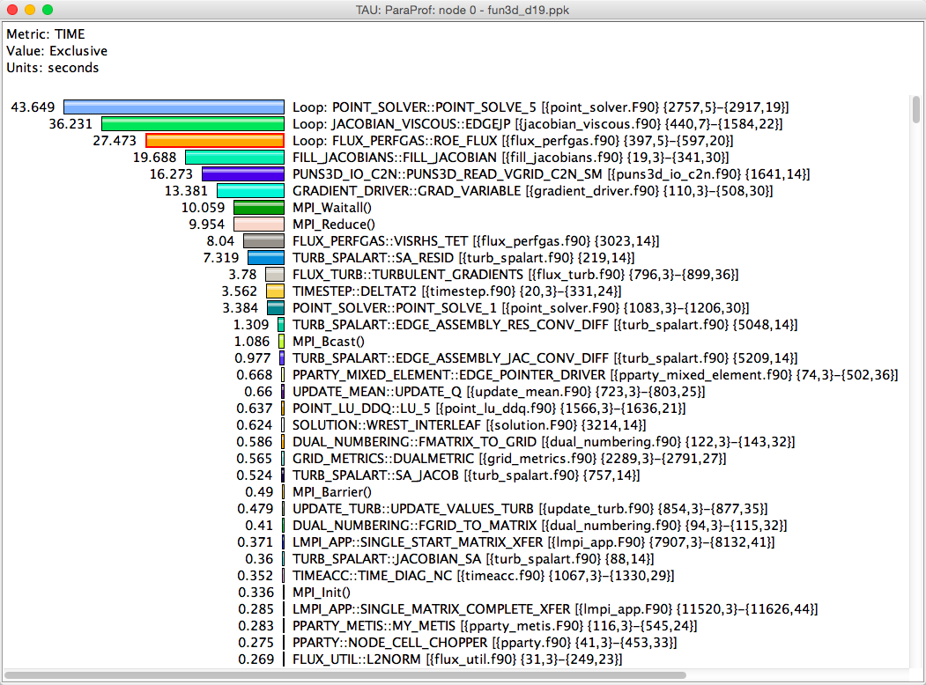
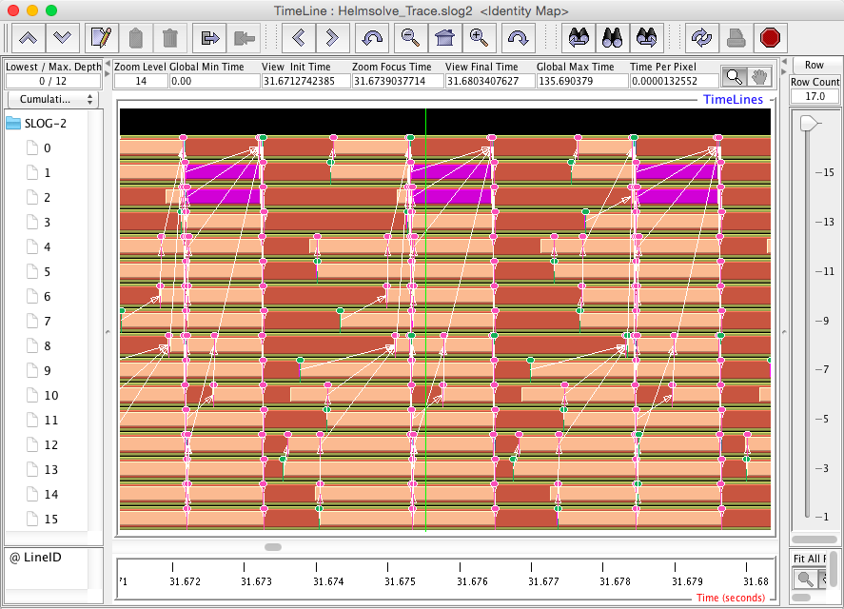
Profiling and Tracing
Profiling
Tracing
Profiling shows you how much (total) time was spent in each routine
Tracing shows you when the events take place on a timeline
Profiling and tracing
  Profiling shows you how much (total) time was spent in each routine
  Tracing shows you when the events take place on a timeline

Slide 19
Inclusive vs. Exclusive values
Inclusive
  Information of all sub-elements aggregated into single value
Exclusive
  Information cannot be subdivided further
int foo()
{
int a;
a = 1 + 1;
bar();
a = a + 1;
return a;
}
Inclusive
Exclusive

Slide 20
How much data do you want?
Limited
Profile
Loop
Profile
Callpath
Profile
O(KB)
O(TB)
Flat
Profile
Callsite
Profile
Trace

Slide 21
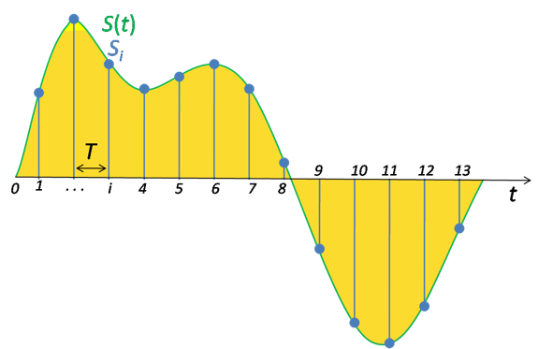
Performance Data Measurement
Direct via Probes
Indirect via Sampling
Call START(‘potential’)
// code
Call STOP(‘potential’)
Exact measurement
Fine-grain control
Calls inserted into code
No code modification
Minimal effort
Relies on debug symbols (-g)

Slide 22
Sampling
t₁
t₂
t₃
t₄
t₅
t₆
t₇
t₈
t₉
Time
main
foo(0)
foo(1)
foo(2)
Measurement
int main()
{
int i;
for (i=0; i < 3; i++)
foo(i);
return 0;
}
void foo(int i)
{
if (i > 0)
foo(i – 1);
}
Running program is periodically interrupted to take measurement
  Timer interrupt, OS signal, or HWC overflow
  Service routine examines return-address stack
  Addresses are mapped to routines using symbol table information
Statistical inference of program behavior
  Not very detailed information on highly volatile metrics
  Requires long-running applications
Works with unmodified executables

Slide 23
Instrumentation
t₁
t₂
t₃
t₄
t₅
t₆
t₇
t₈
t₉
t₁₀
t₁₁
t₁₂
t₁₃
t₁₄
Time
Time
main
foo(0)
foo(1)
foo(2)
Measurement
int main()
{
int i;
for (i=0; i < 3; i++)
foo(i);
return 0;
}
void foo(int i)
{
if (i > 0)
foo(i – 1);
}
Measurement code is inserted such that every event of interest is captured directly
  Can be done in various ways
Advantage:
  Much more detailed information
Disadvantage:
  Processing of source-code / executable
  necessary
  Large relative overheads for small functions
TAU_START(“main”);
TAU_STOP(“main”);
TAU_START(“foo”);
TAU_STOP(“foo”);

Slide 24
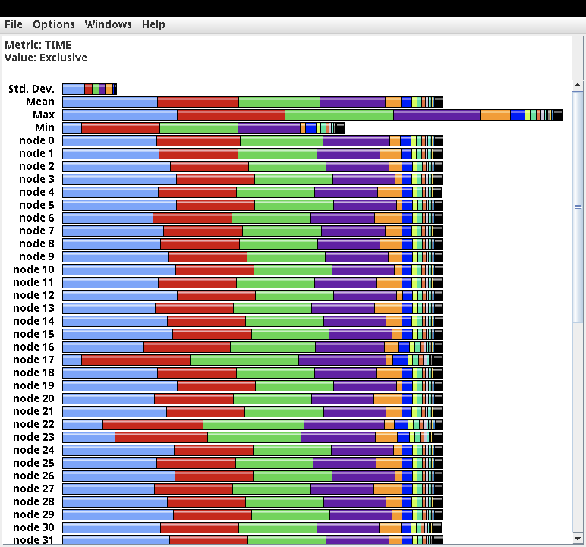
ParaProf Profile Browser
% paraprof

Slide 25
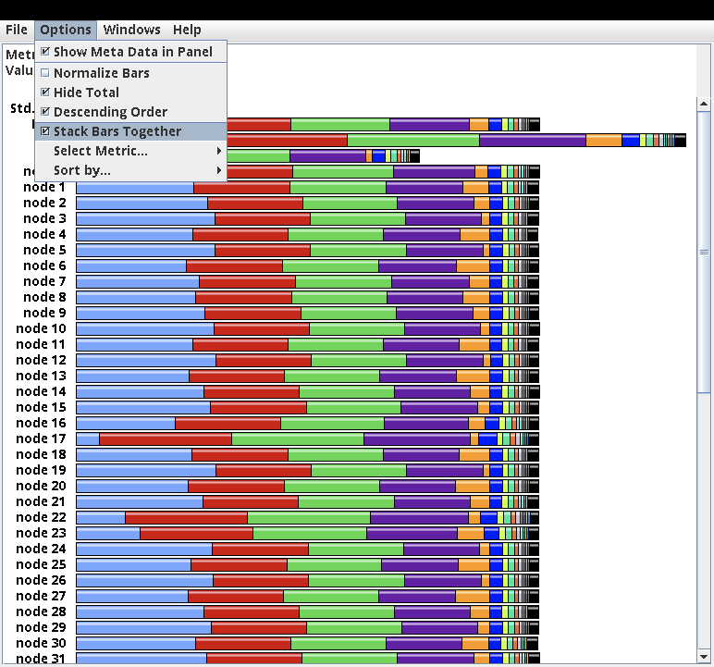
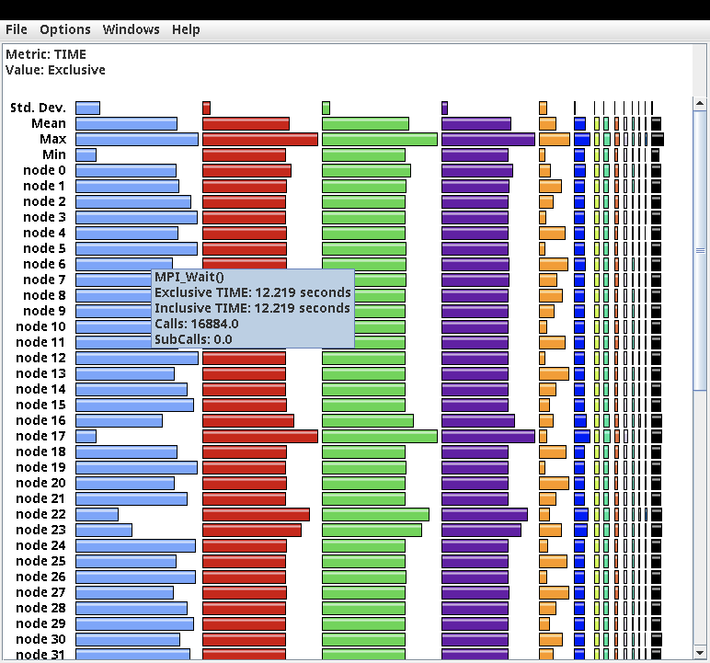
ParaProf Profile Browser

Slide 26
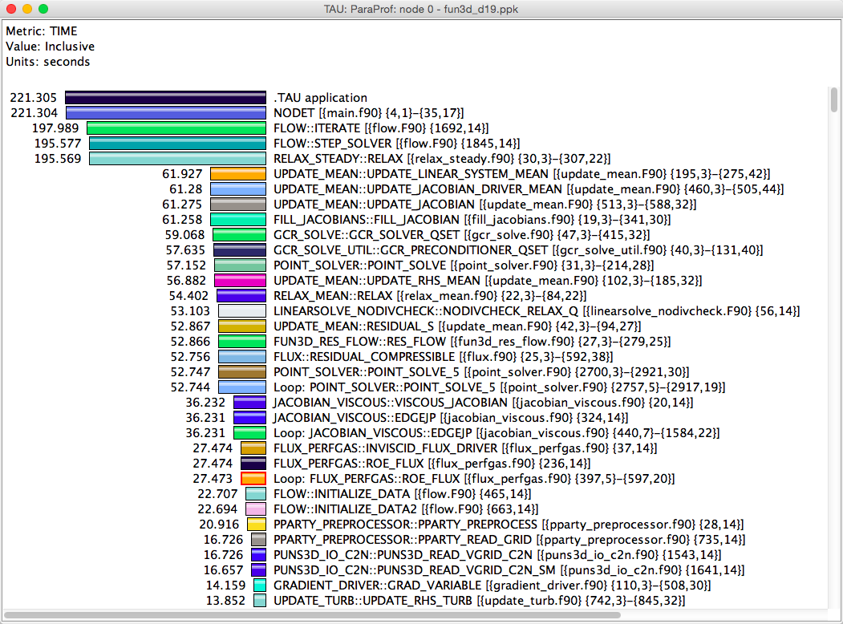
Inclusive Measurements

Slide 27
Exclusive Time

Slide 28
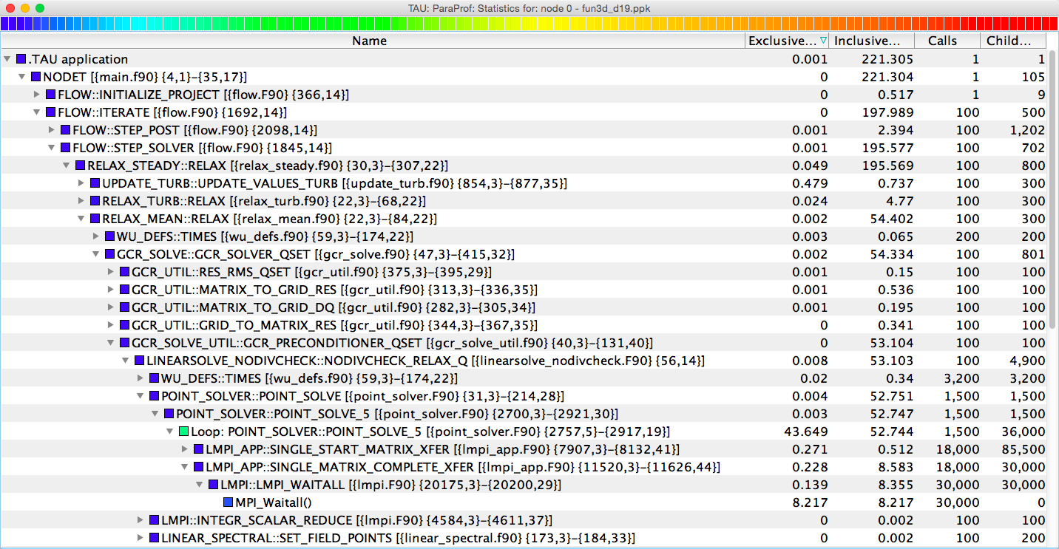
Callpath Profiling
% export TAU_CALLPATH=1
% export TAU_CALLPATH_DEPTH=100

Slide 29
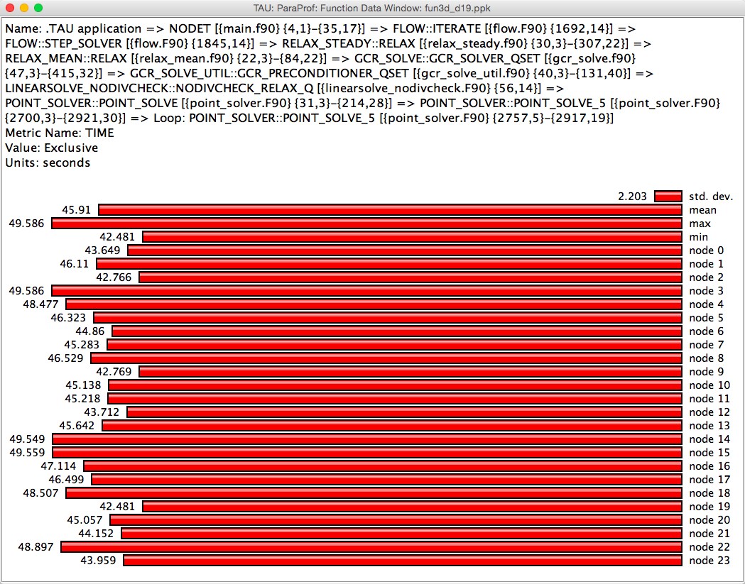
ParaProf Function Window

Slide 30
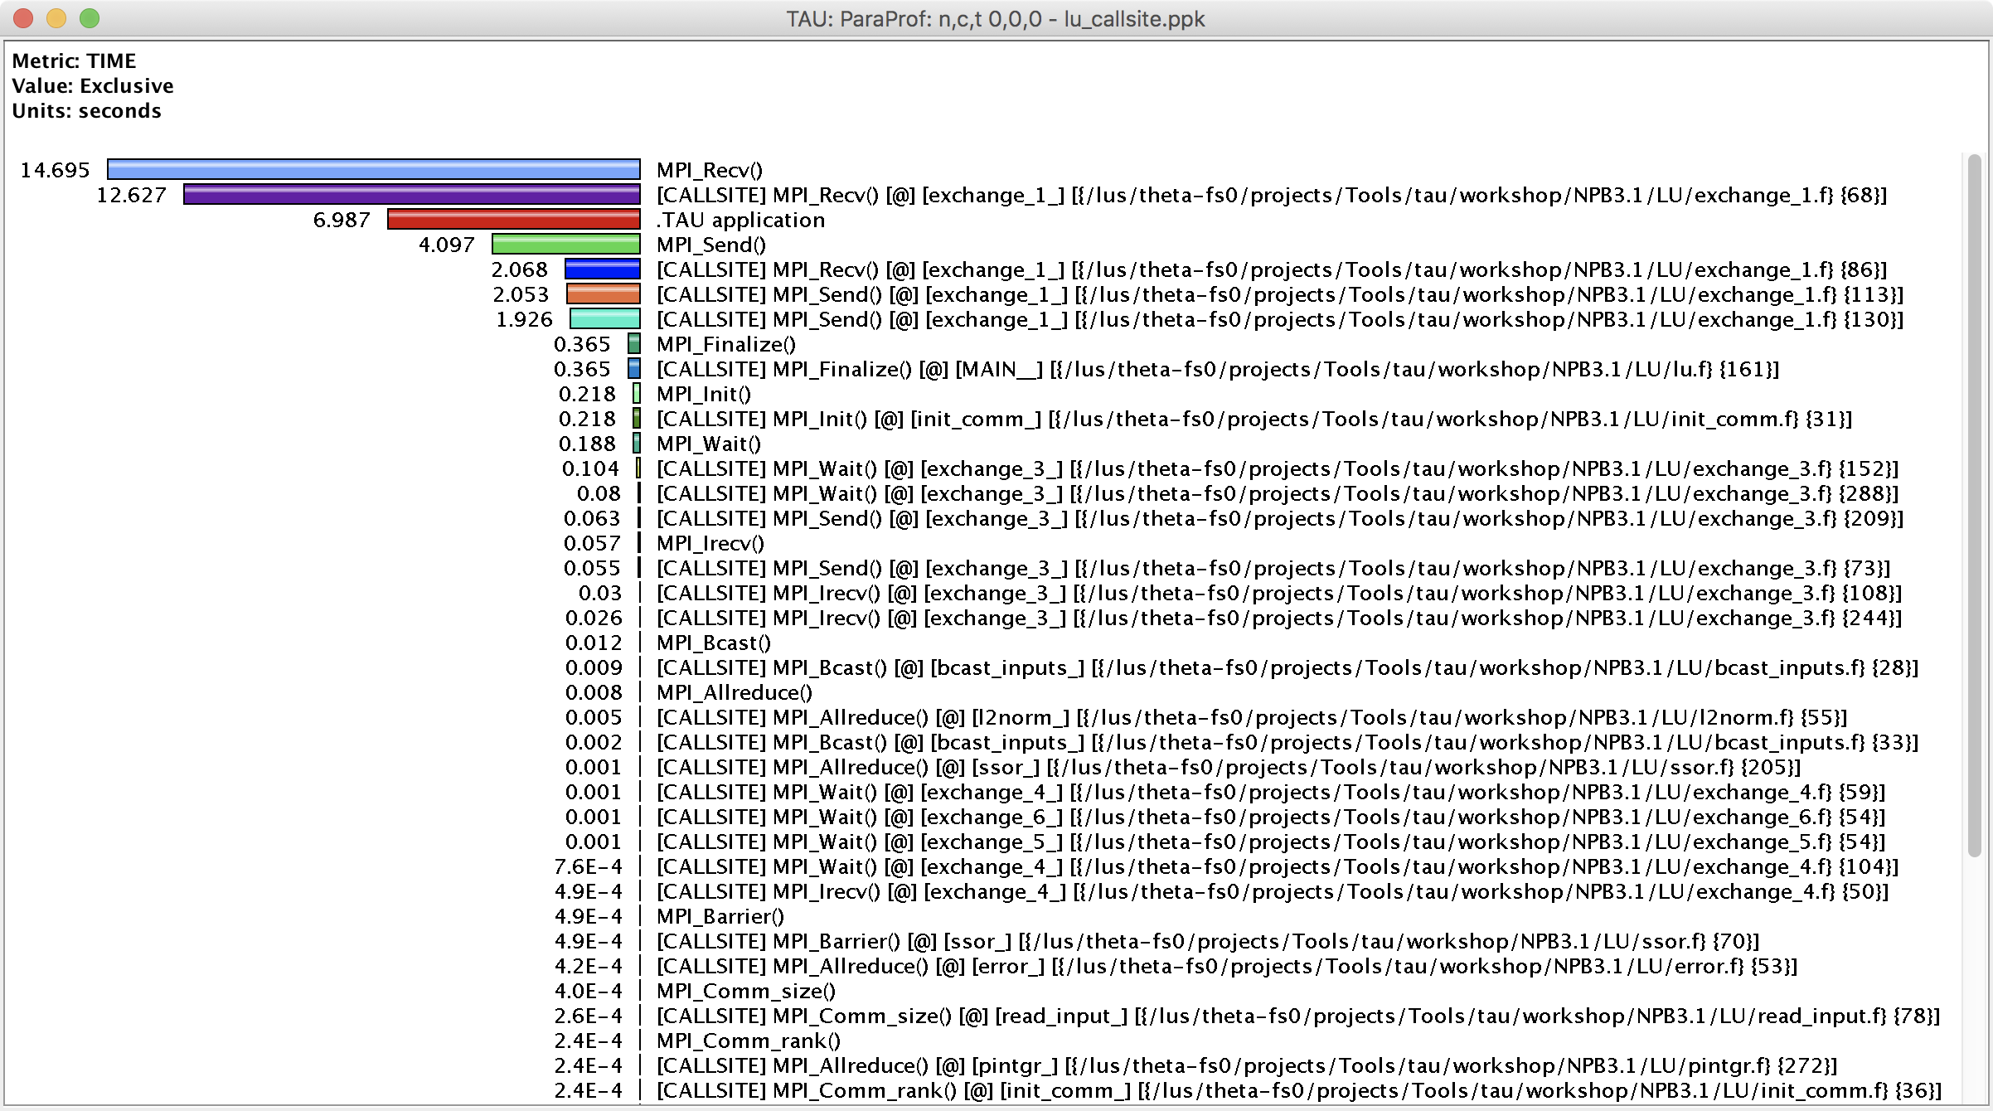
Callsite Profiling and Tracing
% export TAU_CALLSITE=1

Slide 31
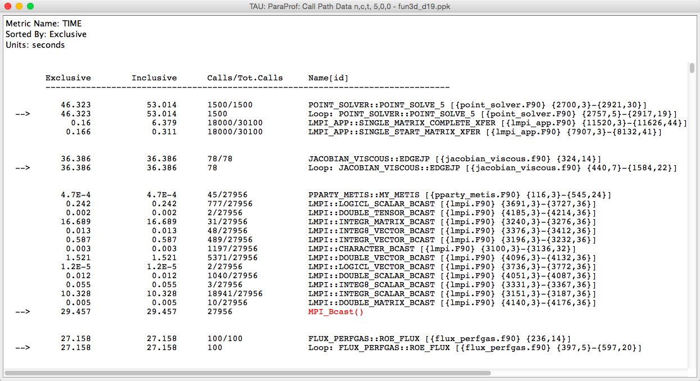
ParaProf Callpath Thread Relations Window
Shows the contribution of parents and children for each routine (marked by an arrow)

Slide 32
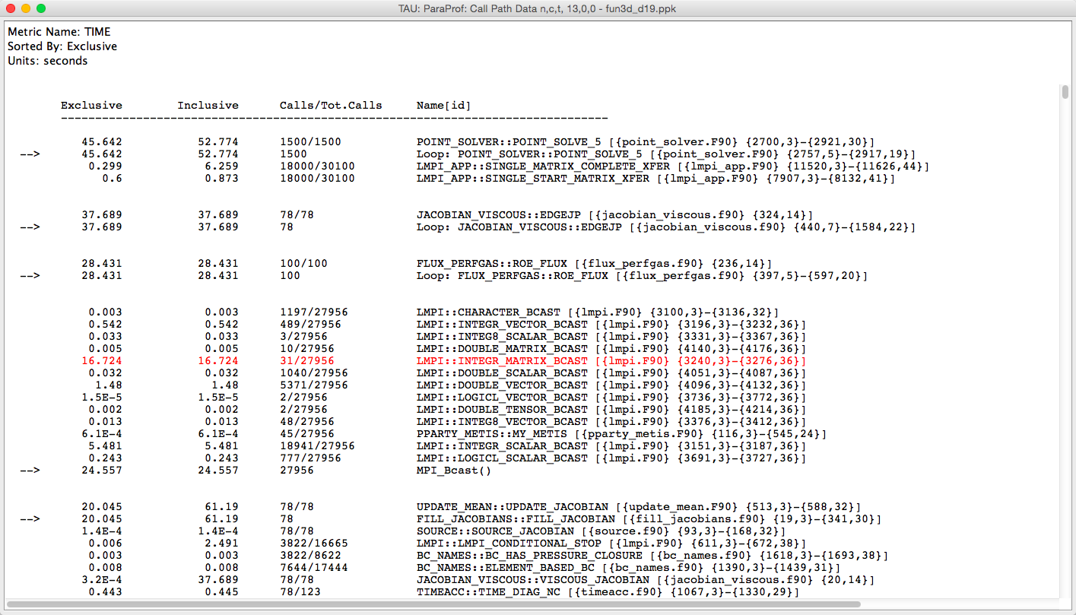
ParaProf Callpath Thread Relations Window

Slide 33
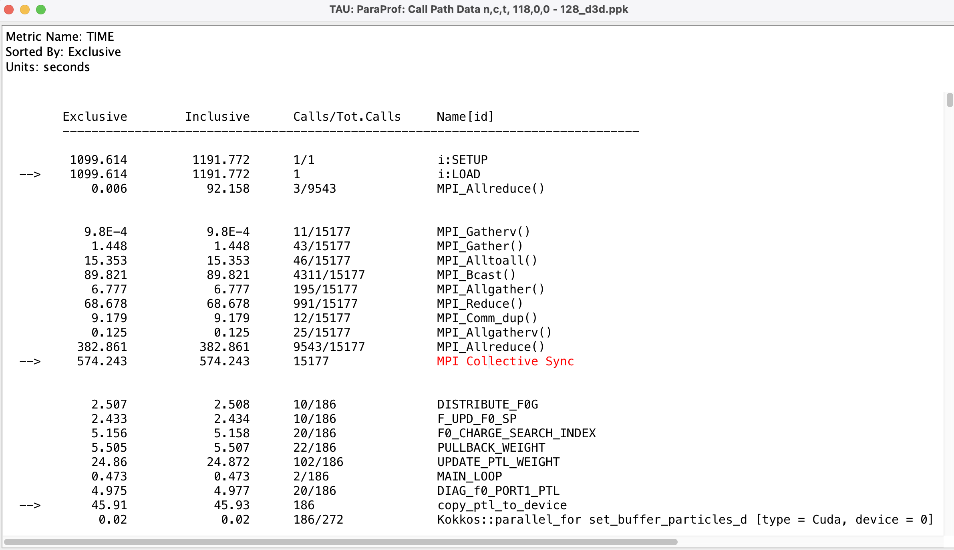
Identifying Collective Wait States: Thread Callpath Relations Window
MPI Collective Sync is the time spent in a barrier operation inside a collective

Slide 34
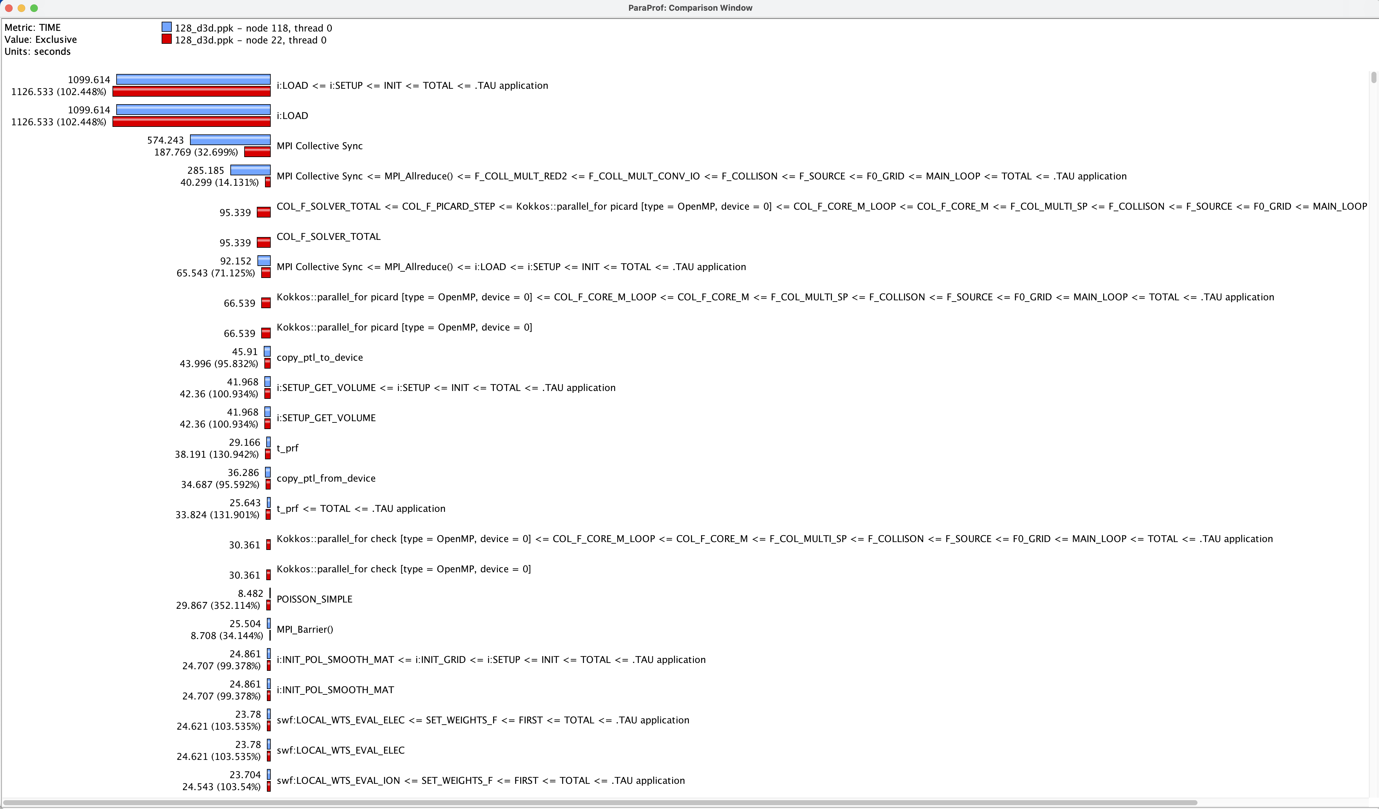
ParaProf Thread Comparison Window
Comparing Rank 118 with 22.
Right click on “node 118” -> Add node to comparison window

Slide 35
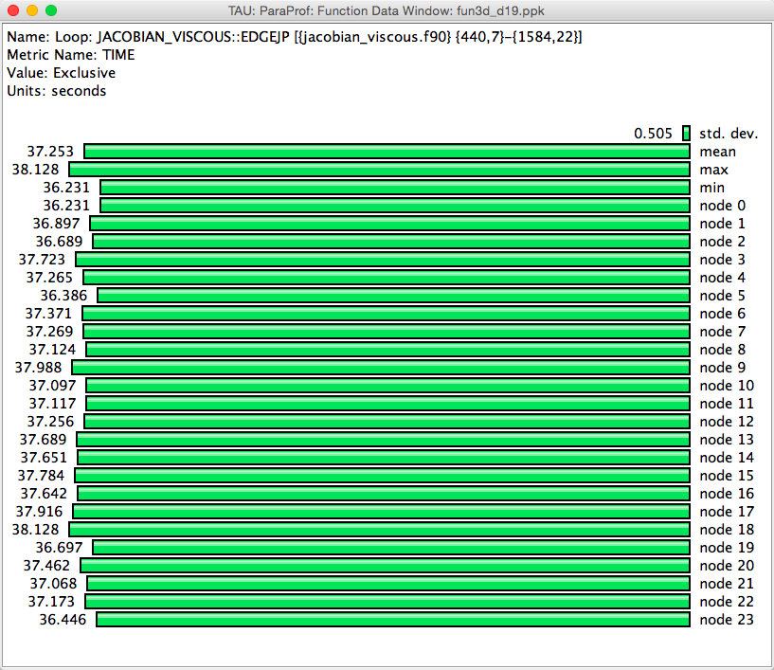
ParaProf Function Window

Slide 36
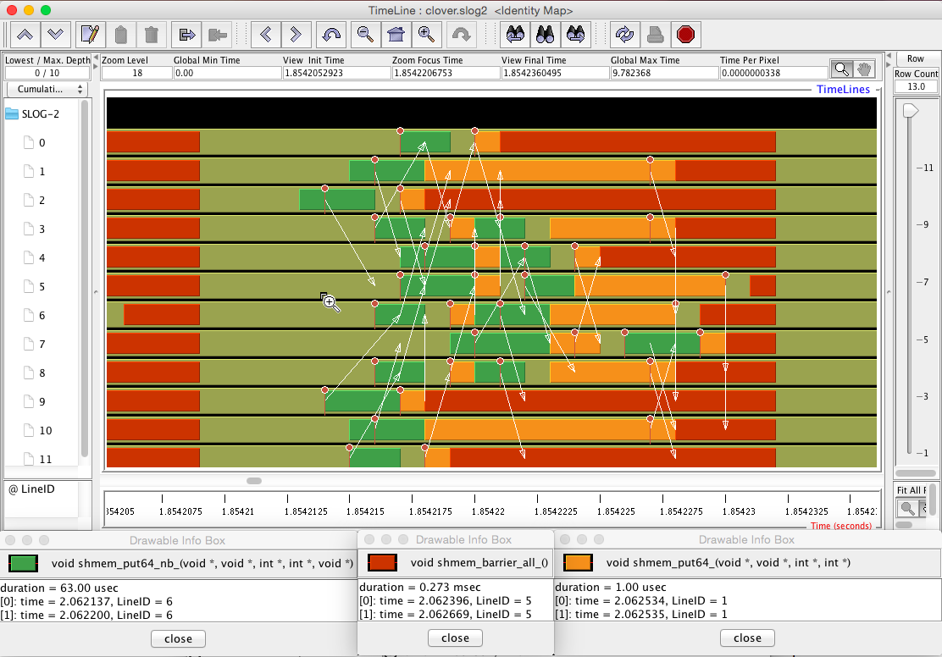
Tracing: Jumpshot (ships with TAU)
% export TAU_TRACE=1; mpirun –np 256 tau_exec ./a.out
% tau_treemerge.pl; tau2slog2 tau.trc tau.edf –o app.slog2
% jumpshot app.slog2

Slide 37
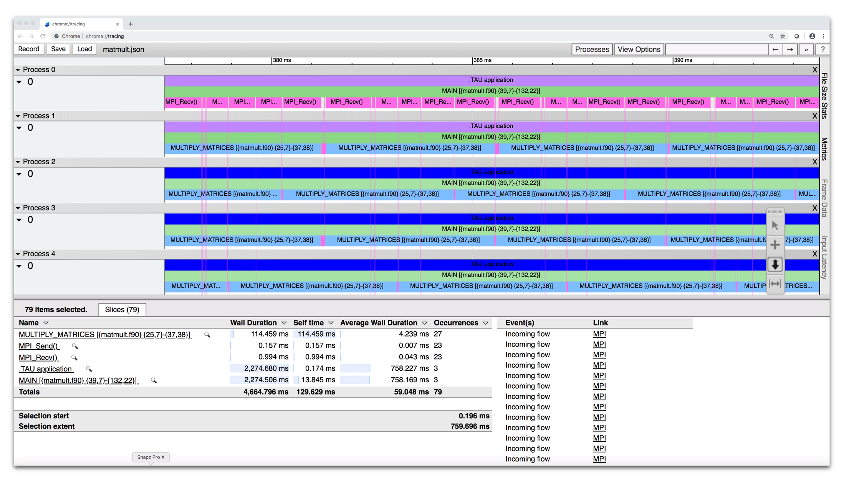
Tracing: Chrome Browser or Perfetto.dev
% export TAU_TRACE=1
% mpirun –np 256 tau_exec ./a.out
% tau_treemerge.pl; tau_trace2json tau.trc tau.edf –chrome –ignoreatomic –o app.json
Chrome browser: chrome://tracing (Load -> app.json)
Perfetto.dev (open the UI)
Notes:
37

Slide 38
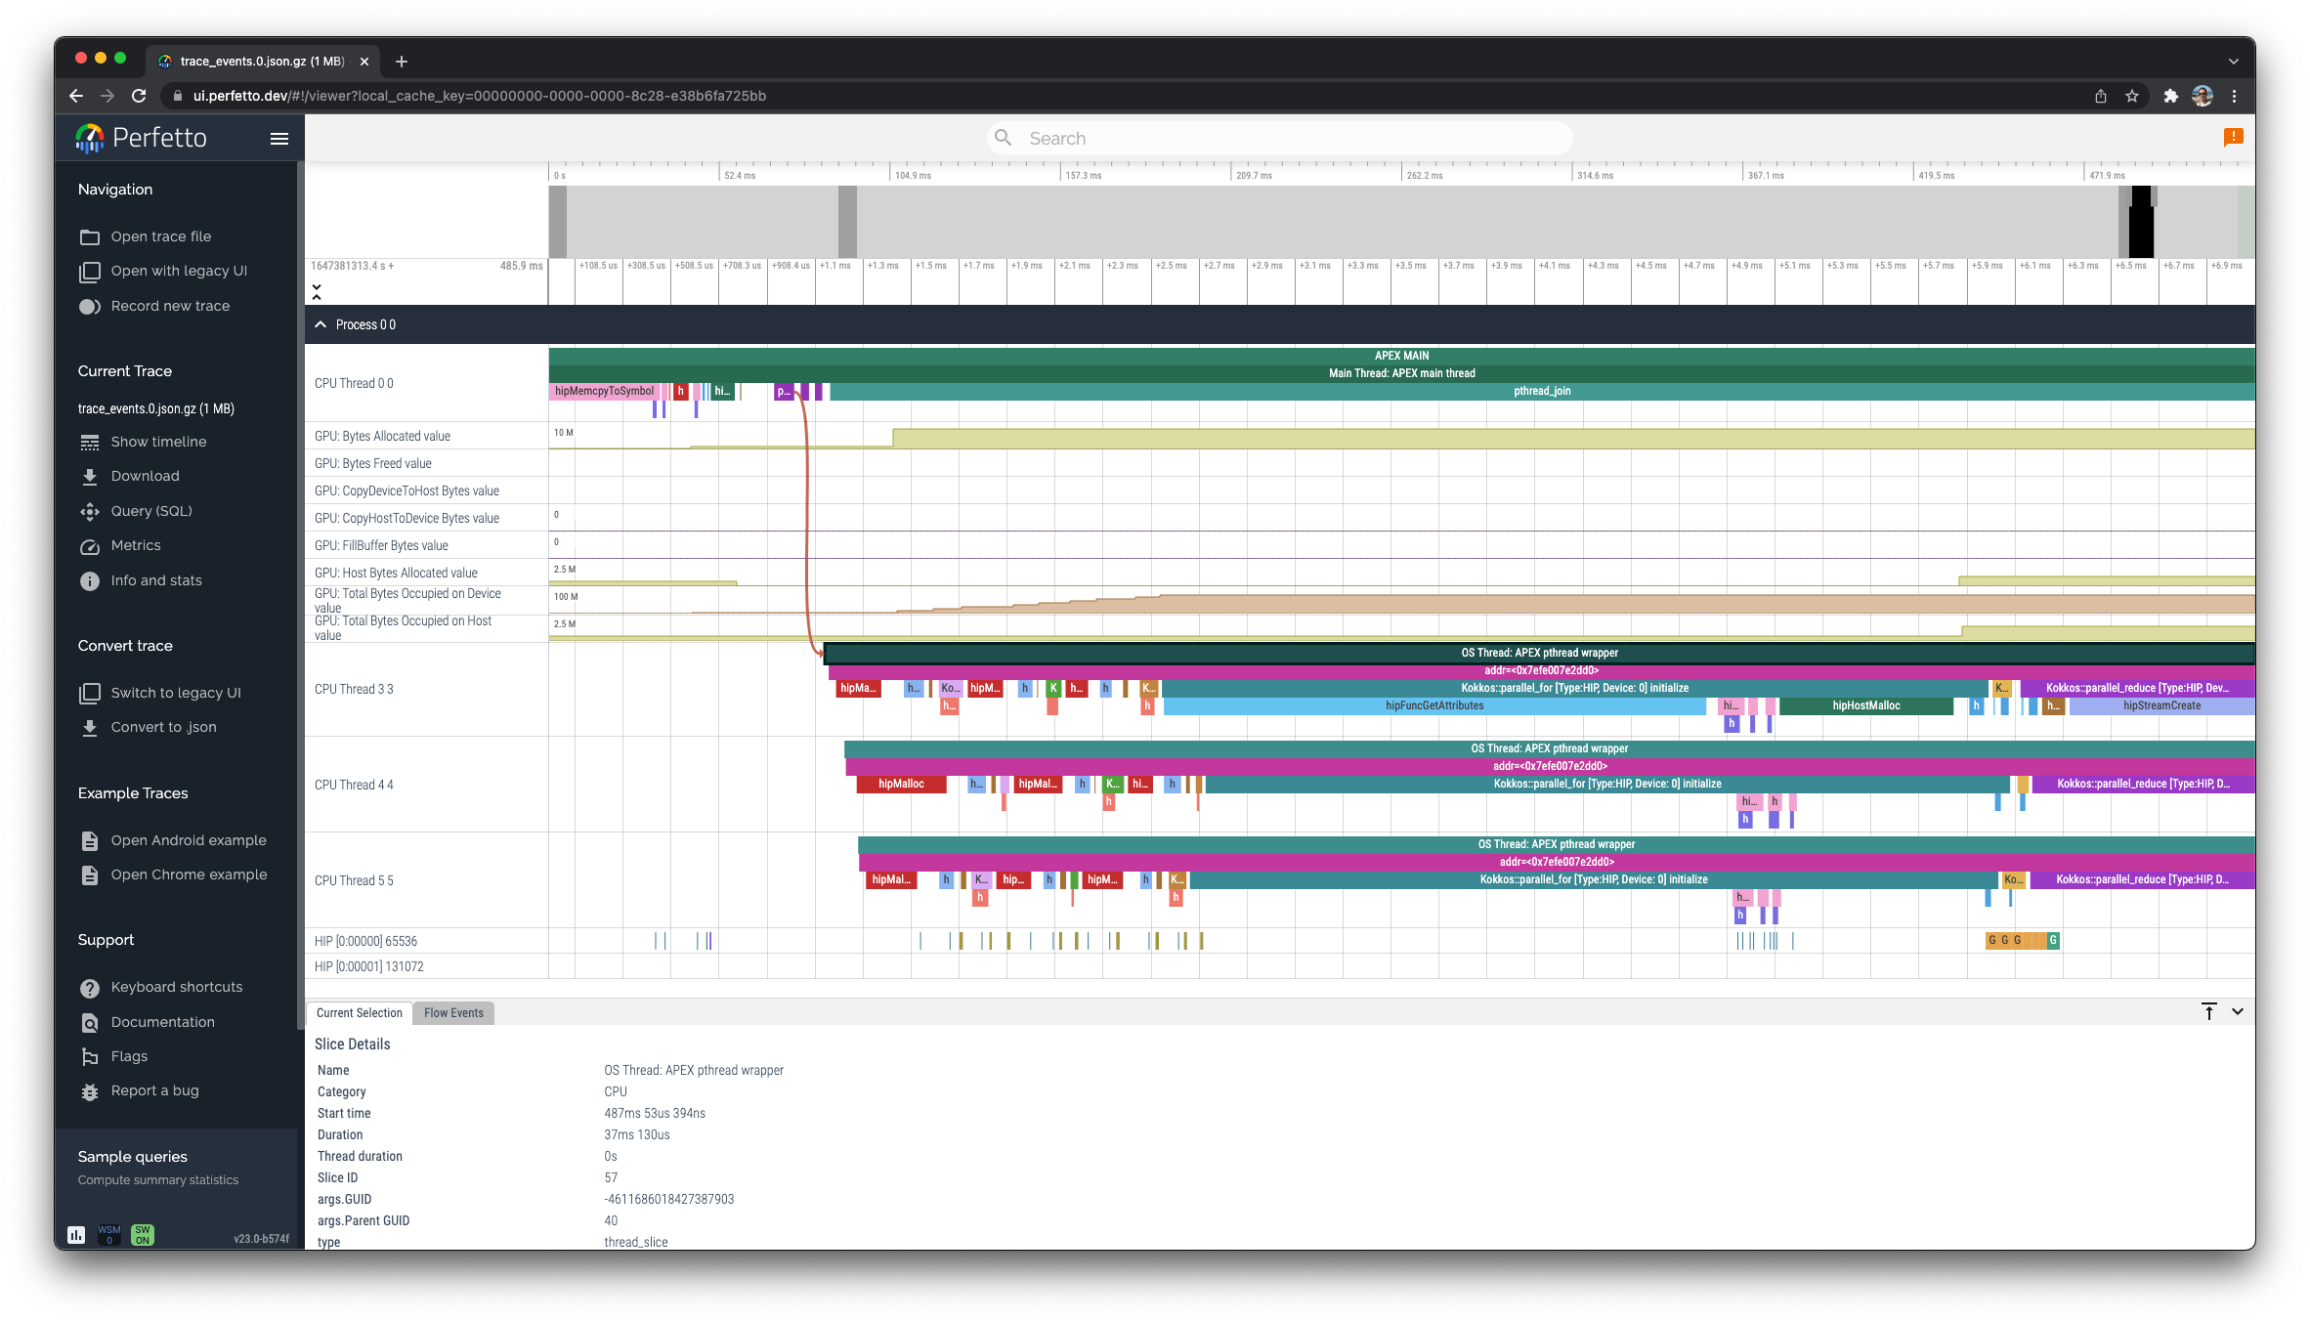
Perfetto.dev Trace Browser: Kokkos
% export TAU_TRACE=1; mpirun –np 64 tau_exec –rocm ./a.out;
% tau_treemerge.pl;
% tau_trace2json tau.trc tau.edf –chrome –ignoreatomic –o app.json

Slide 39
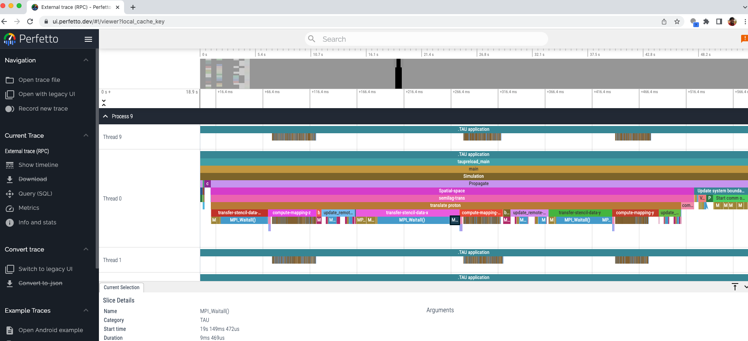
Perfetto.dev

Slide 40
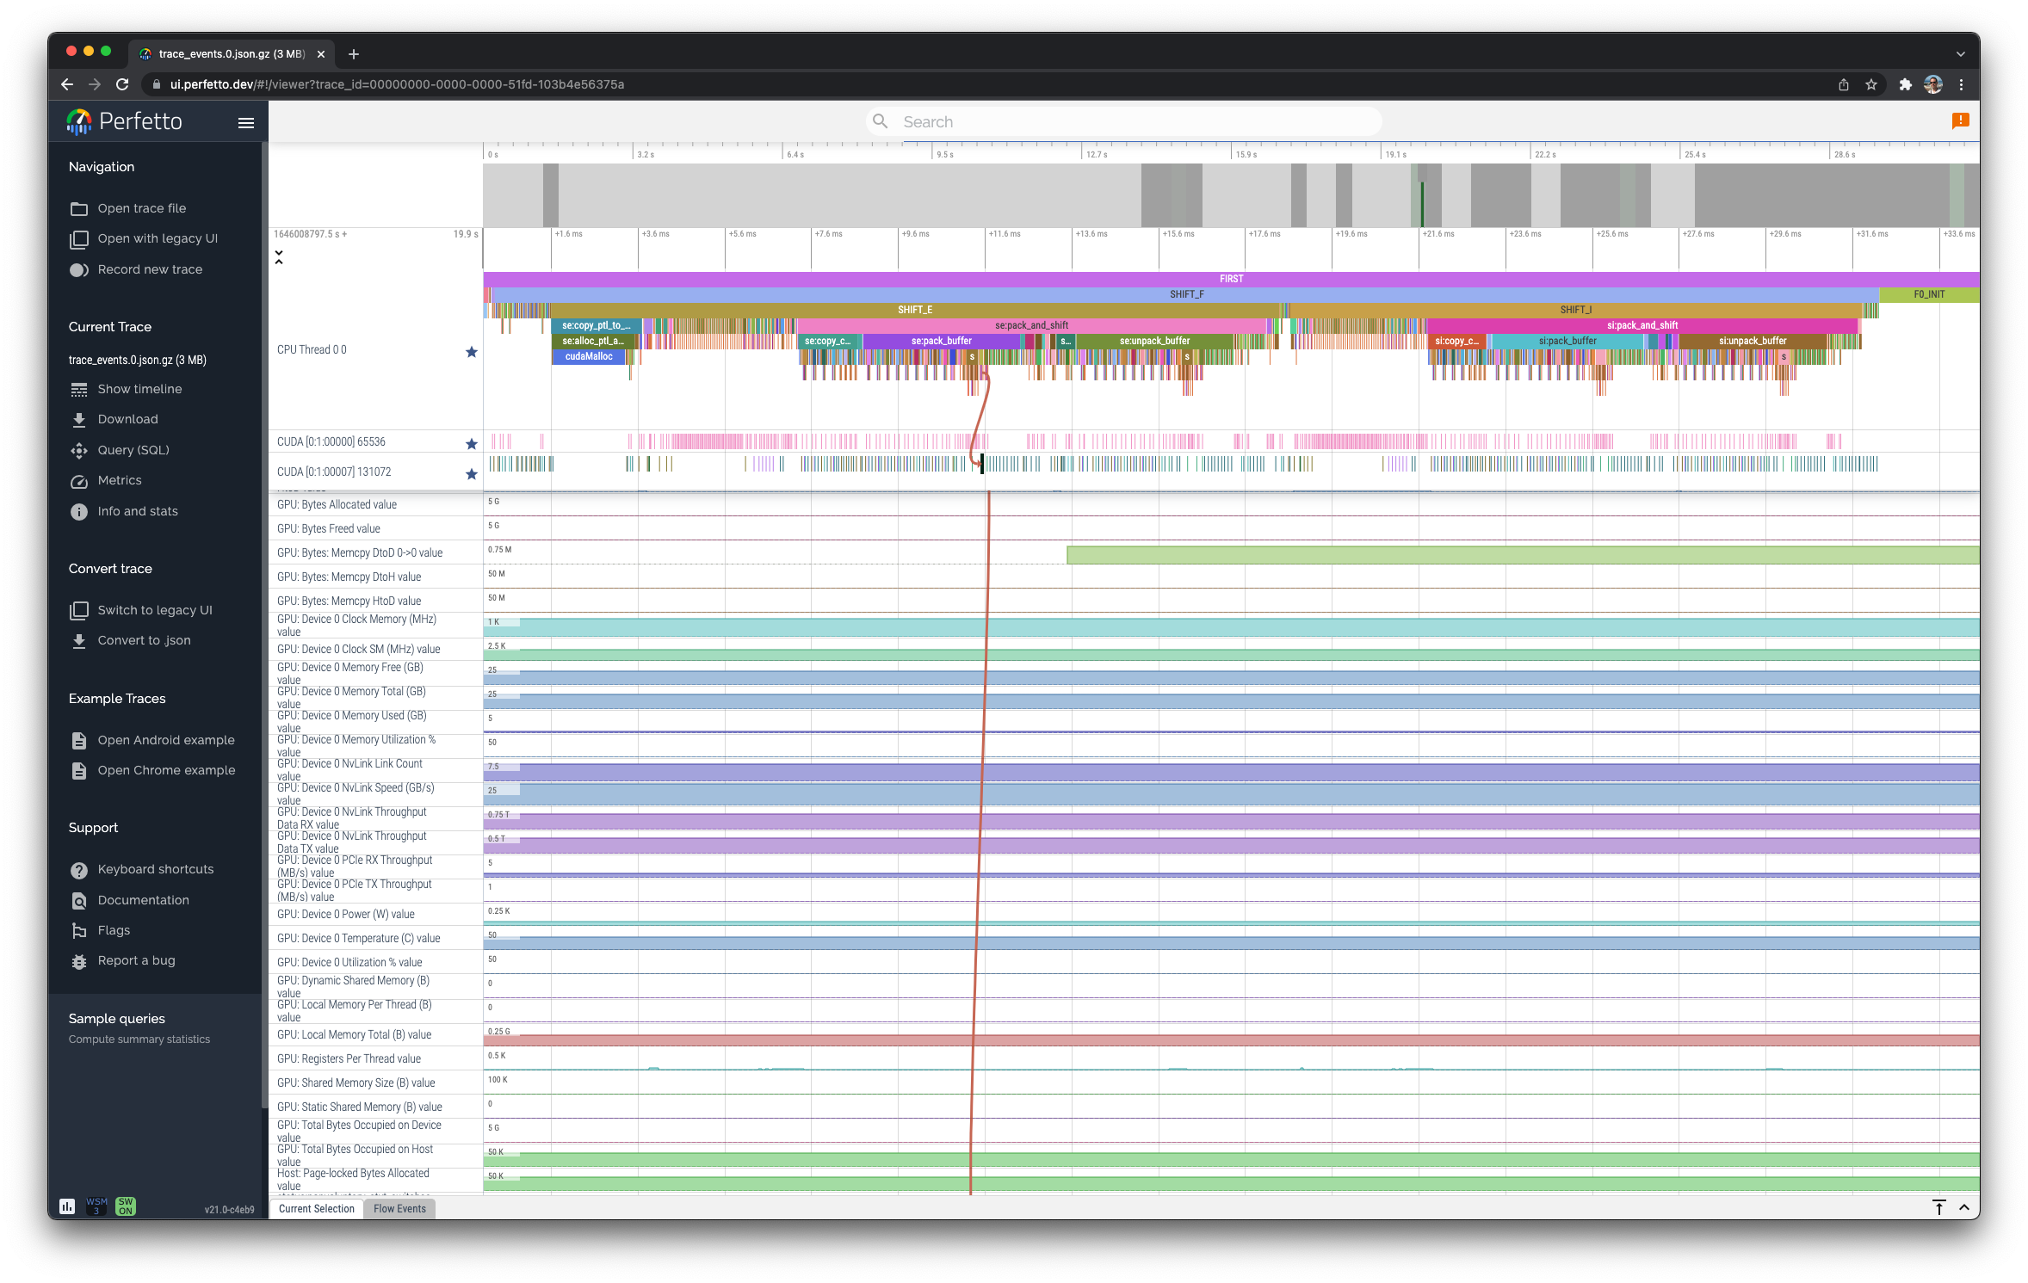
Perfetto.dev Trace Browser
CUDA streams
Flow Events

Slide 41
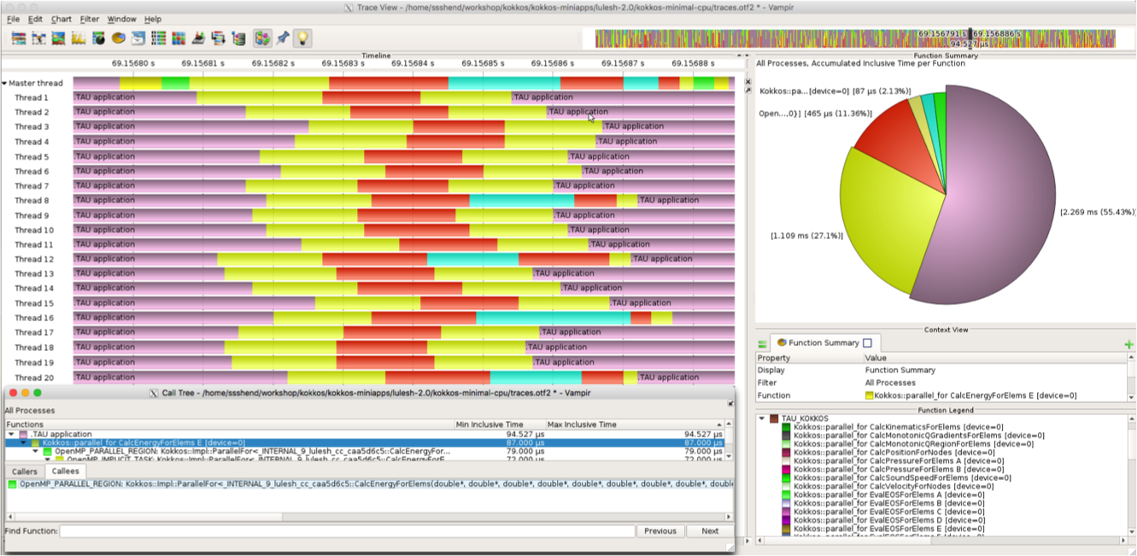
Vampir [TU Dresden] Timeline: Kokkos
% export TAU_TRACE=1; export TAU_TRACE_FORMAT=otf2
% tau_exec -T ompt –ompt ./a.out
% vampir traces.otf2 &

Slide 42
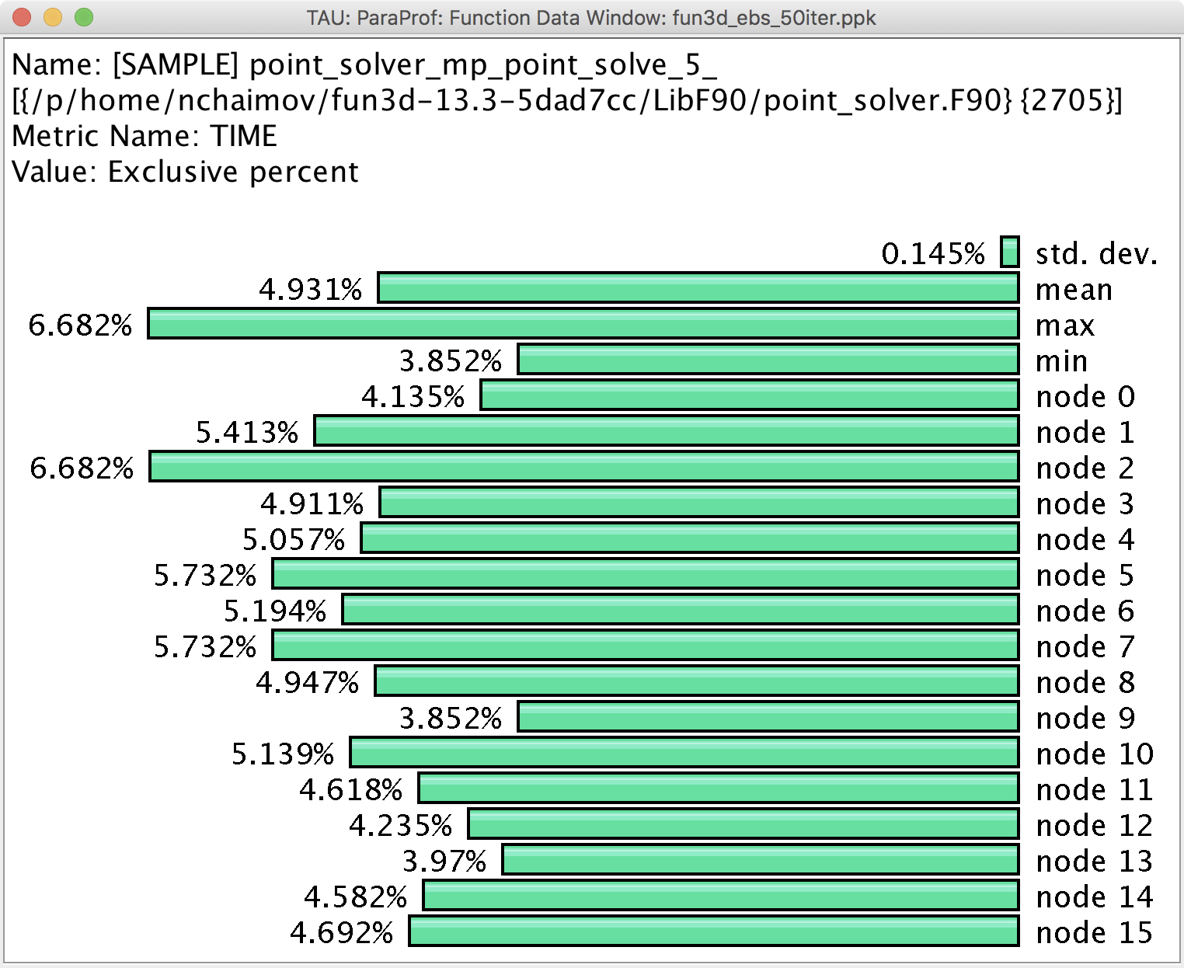
Event Based Sampling (EBS)
File: point_solver.F90
Line: 2705
Uninstrumented!
% mpirun -n 16 tau_exec –ebs a.out

Slide 43
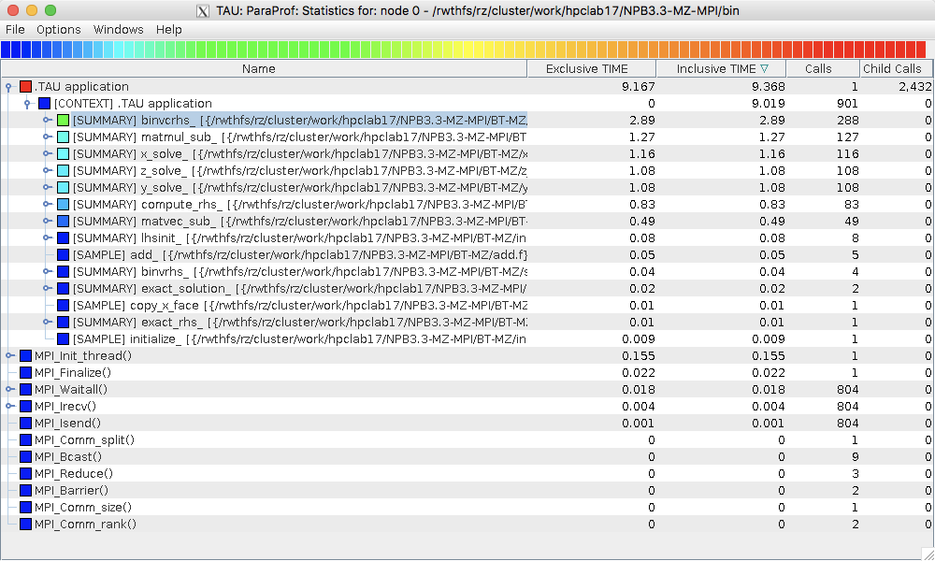
ParaProf
Click on Columns:
to sort by incl time
Open binvcrhs
Click on Sample
% export TAU_SAMPLING=1

Slide 44
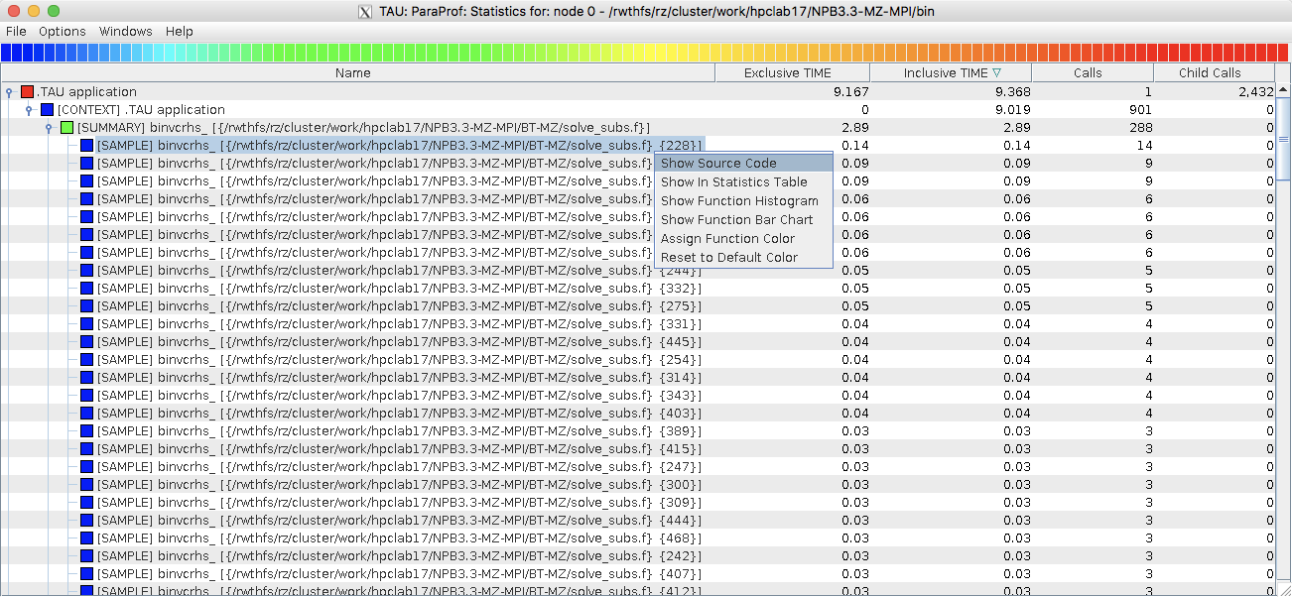
ParaProf

Slide 45
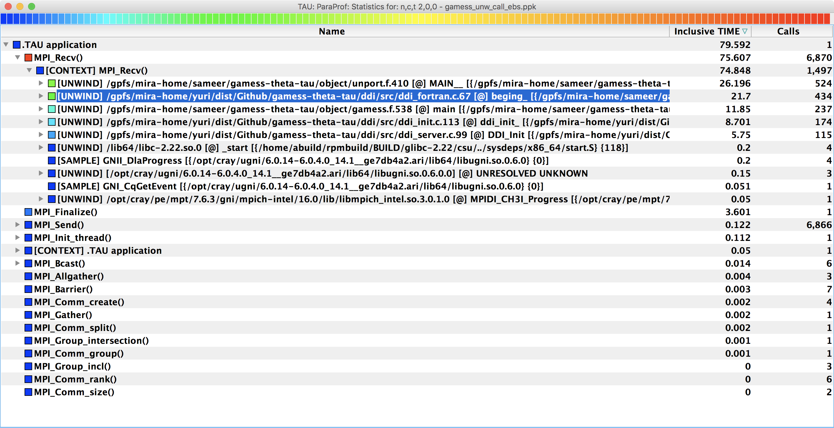
Callstack Sampling in TAU
% export TAU_SAMPLING=1; export TAU_EBS_UNWIND=1

Slide 46
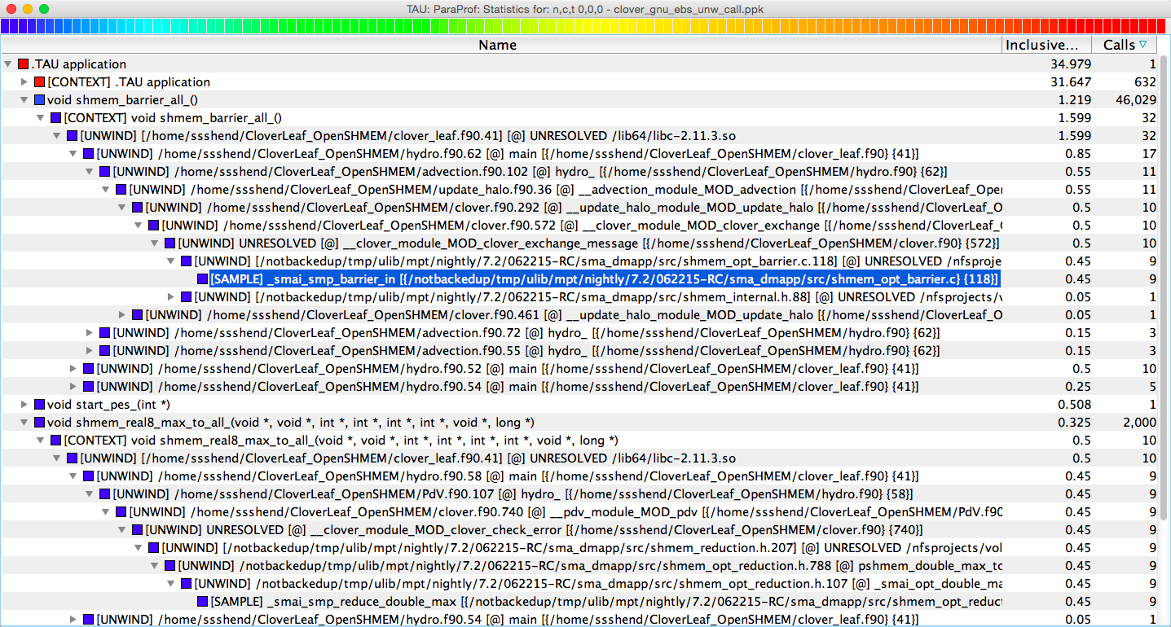
TAU – Callstack Sampling
% export TAU_SAMPLING=1; export TAU_EBS_UNWIND=1

Slide 47
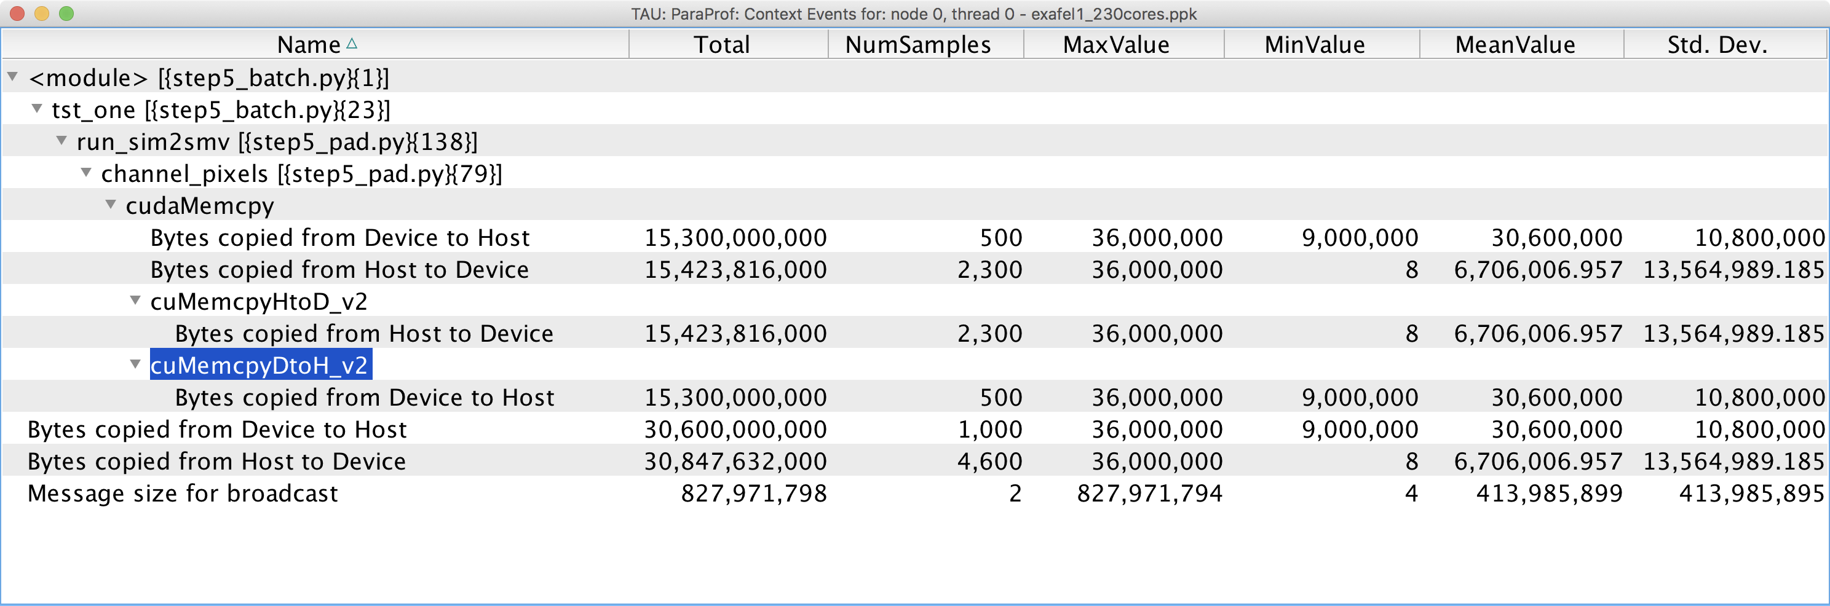
TAU Context Event Window
TAU tracks the data transfers between the host and the GPU.

Slide 48
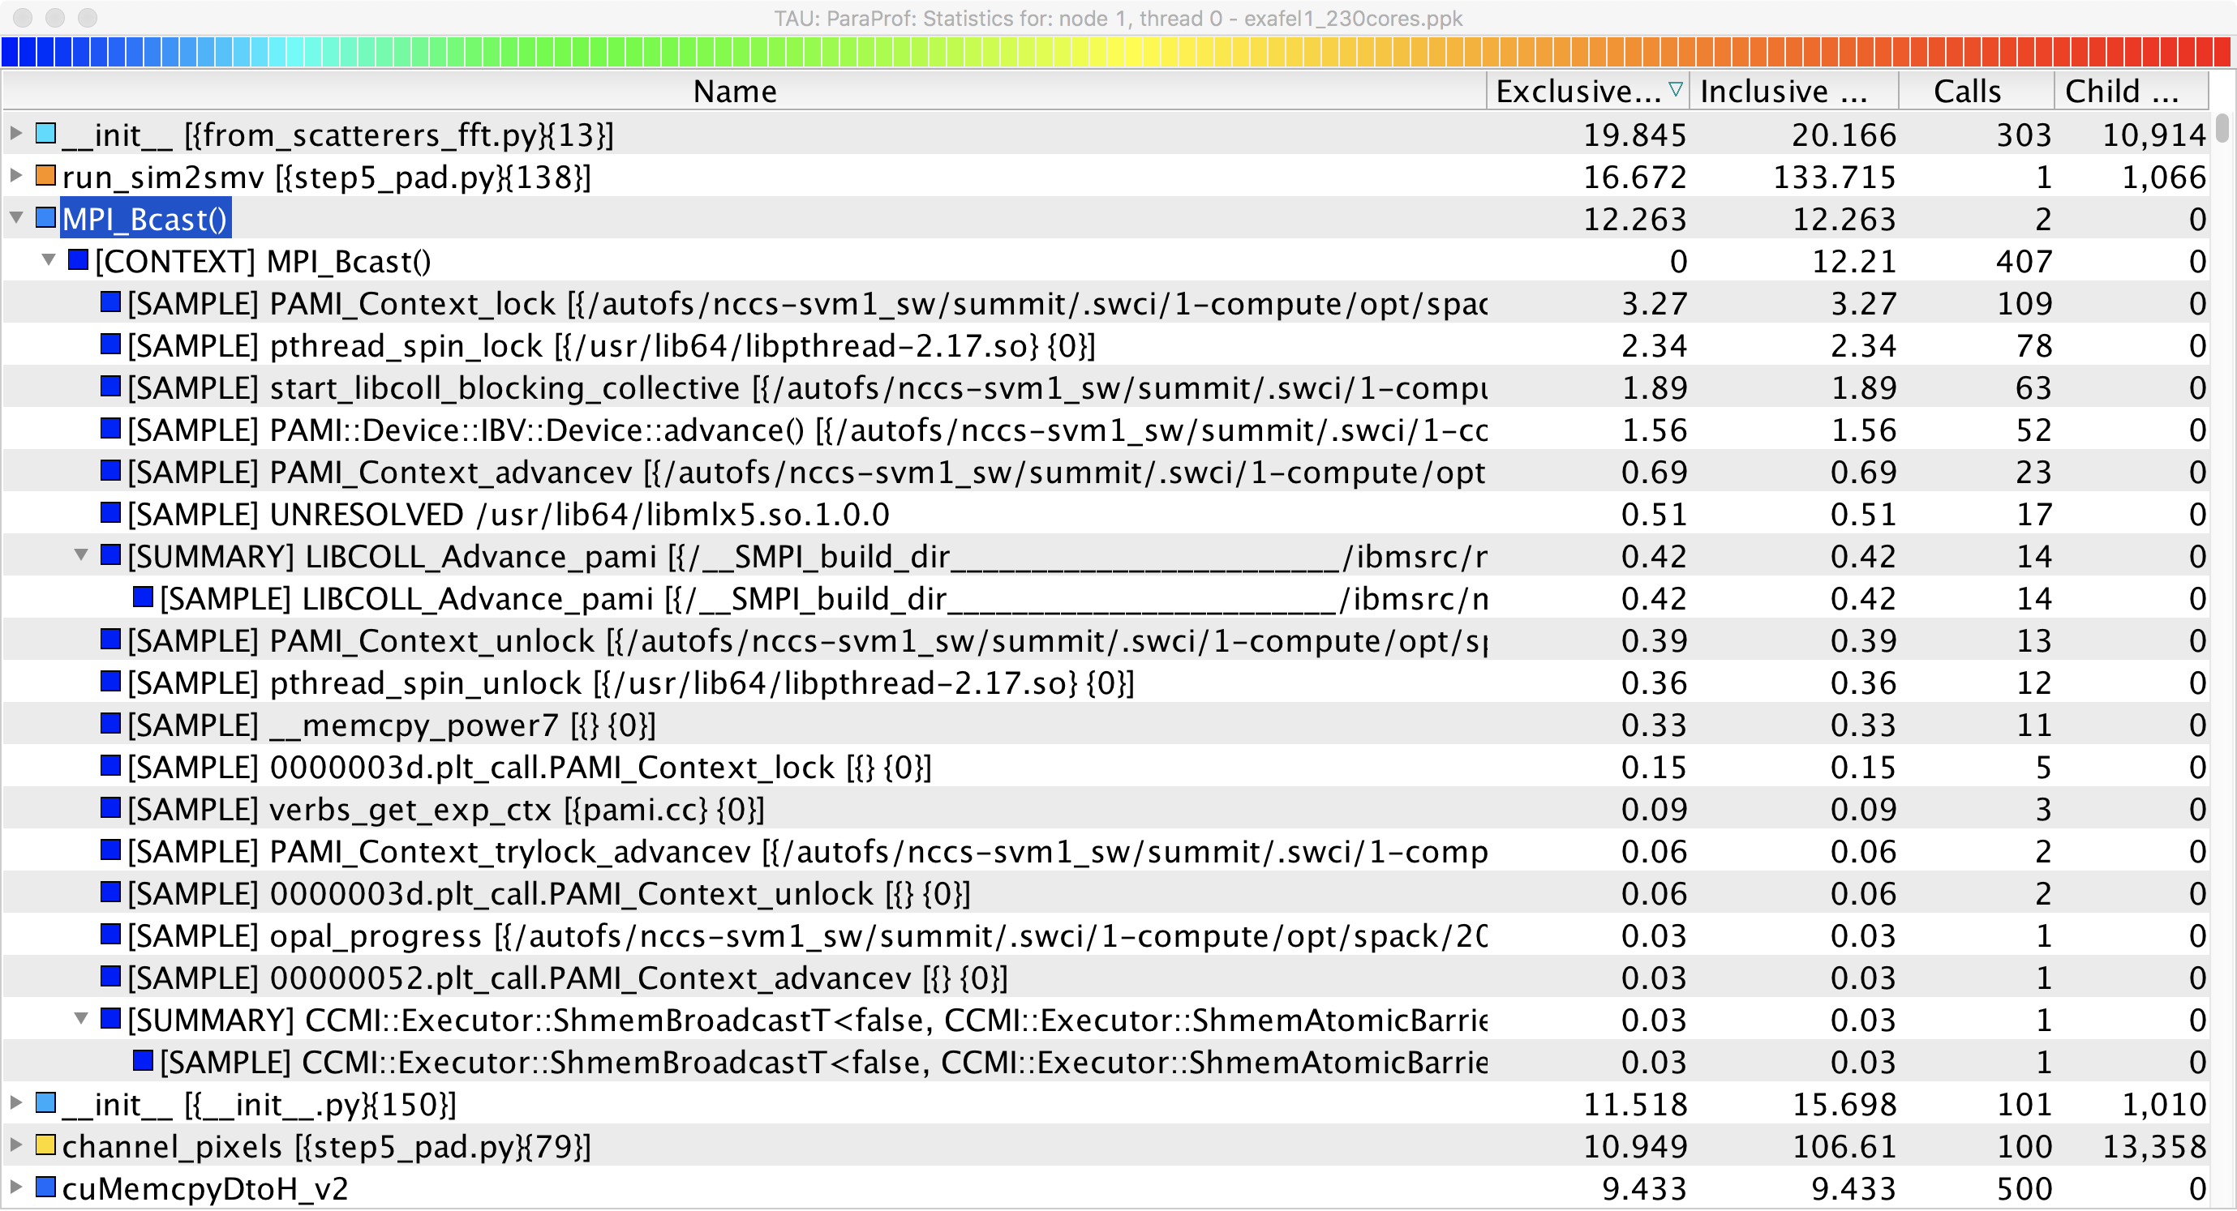
TAU’s tracking of Python and MPI
TAU can observe events in closed-source vendor libraries (e.g., in MPI_Bcast)!

Slide 49
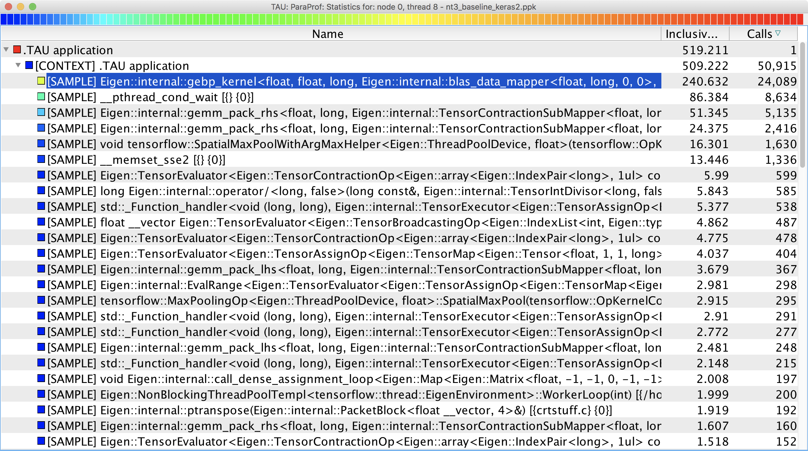
Deep Learning: Tensorflow
% tau_python –ebs nt3_baseline_keras2.py (CANDLE)

Slide 50
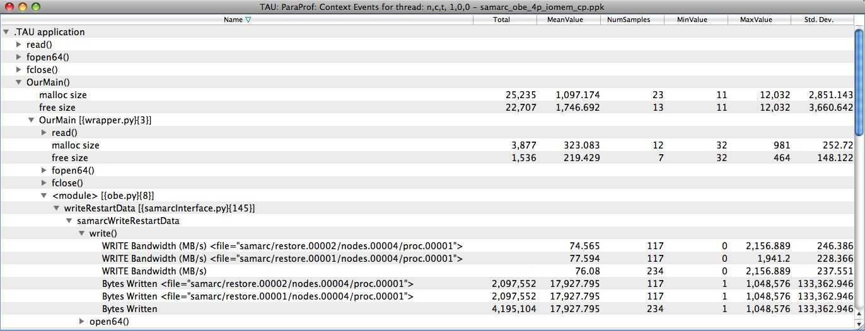
TAU – Context Events
Write bandwidth per file
Bytes written to each file
% mpirun –np 16 tau_python -io ./foo.py

Slide 51
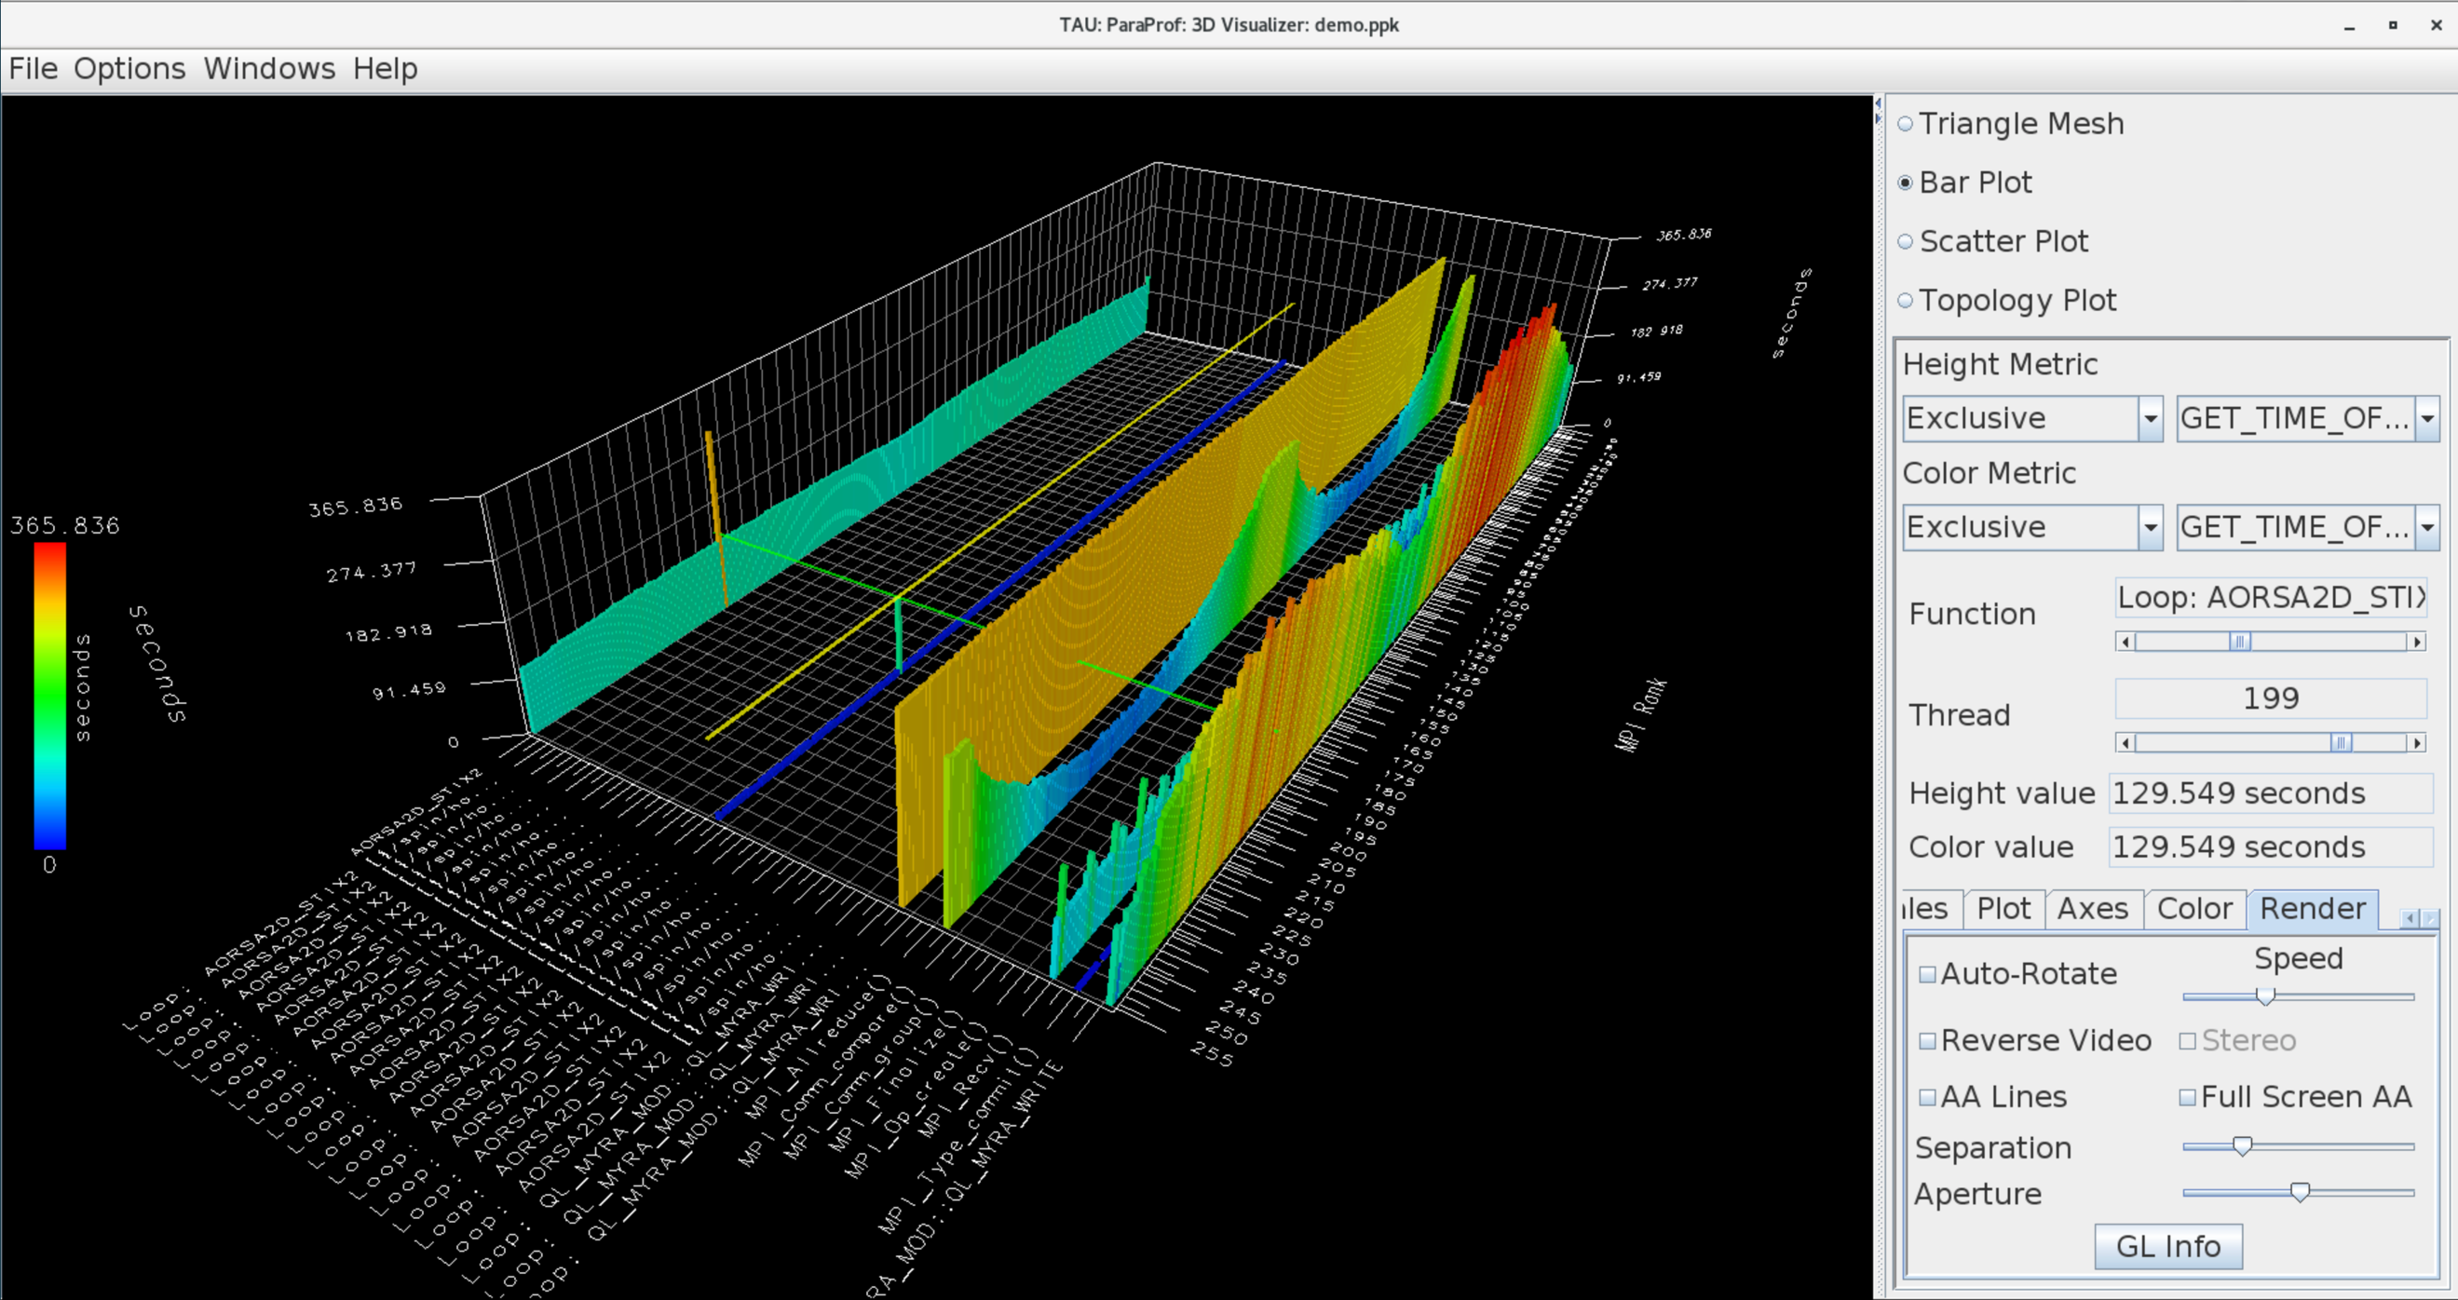
ParaProf 3D Profile Browser

Slide 52
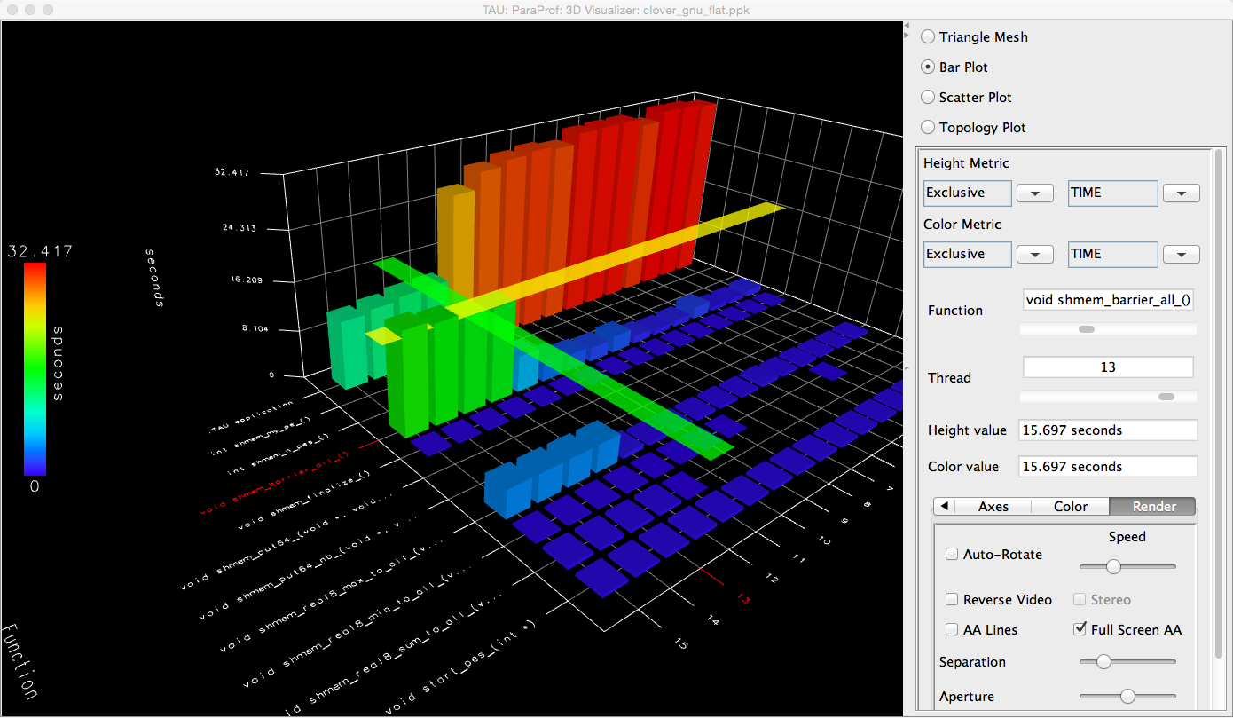
TAU – ParaProf 3D Visualization
% paraprof app.ppk
Windows -> 3D Visualization -> Bar Plot (right pane)

Slide 53
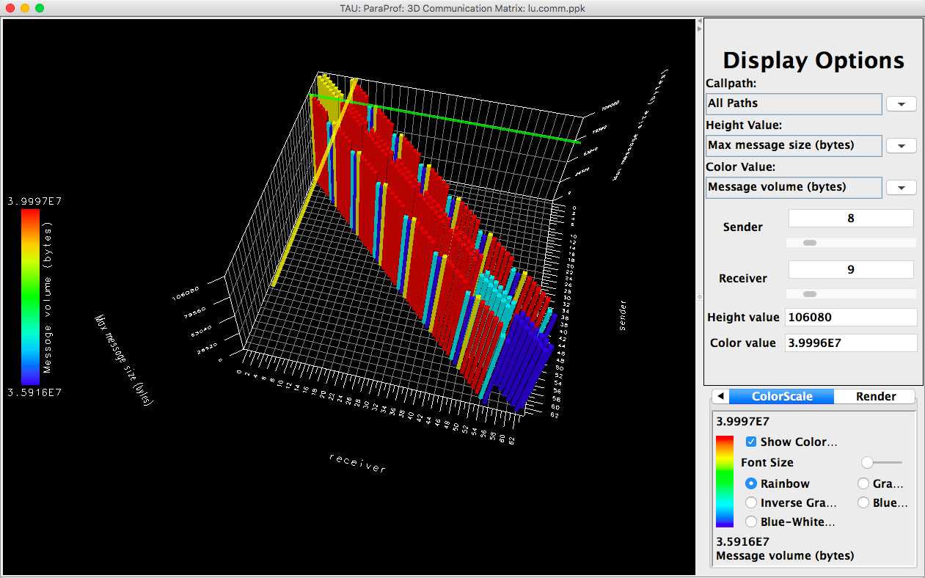
TAU – 3D Communication Window
% export TAU_COMM_MATRIX=1; mpirun … tau_exec ./a.out
% paraprof ; Windows -> 3D Communication Matrix

Slide 54
TAU’s Support for Runtime Systems
MPI
  PMPI profiling interface
  MPI_T tools interface using performance and control variables
Pthread
  Captures time spent in routines per thread of execution
OpenMP
  OMPT tools interface to track salient OpenMP runtime events
  Opari source rewriter
  Preloading wrapper OpenMP runtime library when OMPT is not supported
OpenACC
  OpenACC instrumentation API
  Track data transfers between host and device (per-variable)
  Track time spent in kernels

Slide 55
TAU’s Support for Runtime Systems (contd.)
OpenCL
  OpenCL profiling interface
  Track timings of kernels
Intel® OneAPI
  Level Zero
  Track time spent in kernels executing on GPU
  Track time spent in OneAPI runtime calls
CUDA
  Cuda Profiling Tools Interface (CUPTI)
  Track data transfers between host and GPU
  Track access to uniform shared memory between host and GPU
ROCm
  Rocprofiler and Roctracer instrumentation interfaces
  Track data transfers and kernel execution between host and GPU
Kokkos
  Kokkos profiling API
  Push/pop interface for region, kernel execution interface
Python
  Python interpreter instrumentation API
  Tracks Python routine transitions as well as Python to C transitions
Notes:
Collect basic routine-level timing profile to determine where most time is being spent
Collect routine-level hardware counter data to determine types of performance problems
Collect callpath profiles to determine sequence of events causing performance problems
Conduct finer-grained profiling and/or tracing to pinpoint performance bottlenecks
Loop-level profiling with hardware counters
Tracing of communication operations

Slide 56
Examples of Multi-Level Instrumentation
MPI + OpenMP
  MPI_T + PMPI + OMPT may be used to track MPI and OpenMP
MPI + HIP
  PMPI + Roctracer interfaces
ROCprofiler+ MPI
  ROCm Rocprofiler+ PMPI MPI interface
Kokkos + OpenMP
  Kokkos profiling API + OMPT to transparently track events
Kokkos + pthread + MPI
  Kokkos + pthread wrapper interposition library + PMPI layer
Python + ROCTracer + MPI
  Python + ROCm Roctracer + MPI profiling interface
MPI + OpenCL
  PMPI + OpenCL profiling interfaces

Slide 57
Binary instrumentation of libraries: Work in progress
% tau_run a.out –o a.inst
instruments a binary. Other flags –T <tags>, -f <selective instrumentation file>
% tau_run -l /path/to/libhdf5.so.310 –o libhdf5.so.310
instruments a DSO
% tau_exec ./a.out
executes the uninstrumented application with the instrumented shared object.
Works on x86_64. Issues with aarch64:
https://github.com/dyninst/dyninst/issues/1708 and https://github.com/dyninst/dyninst/pull/1712
To use with DyninstAPI 13 on x86_64:
1. Load spack: spack/share/spack/setup-env.sh
2. Install dyninst: spack install dyninst@13 %gcc@11
3. Configure tau with dyninst:
3.1 spack find -p dyninst boost tbb elfutils
3.2 Copy the paths for each package into the configure line
3.3 ./configure -bfd=download -dyninst=<dir> -tbb=<dir> -boost=<dir> -elf=<dir>; <set paths>; make install

Slide 58

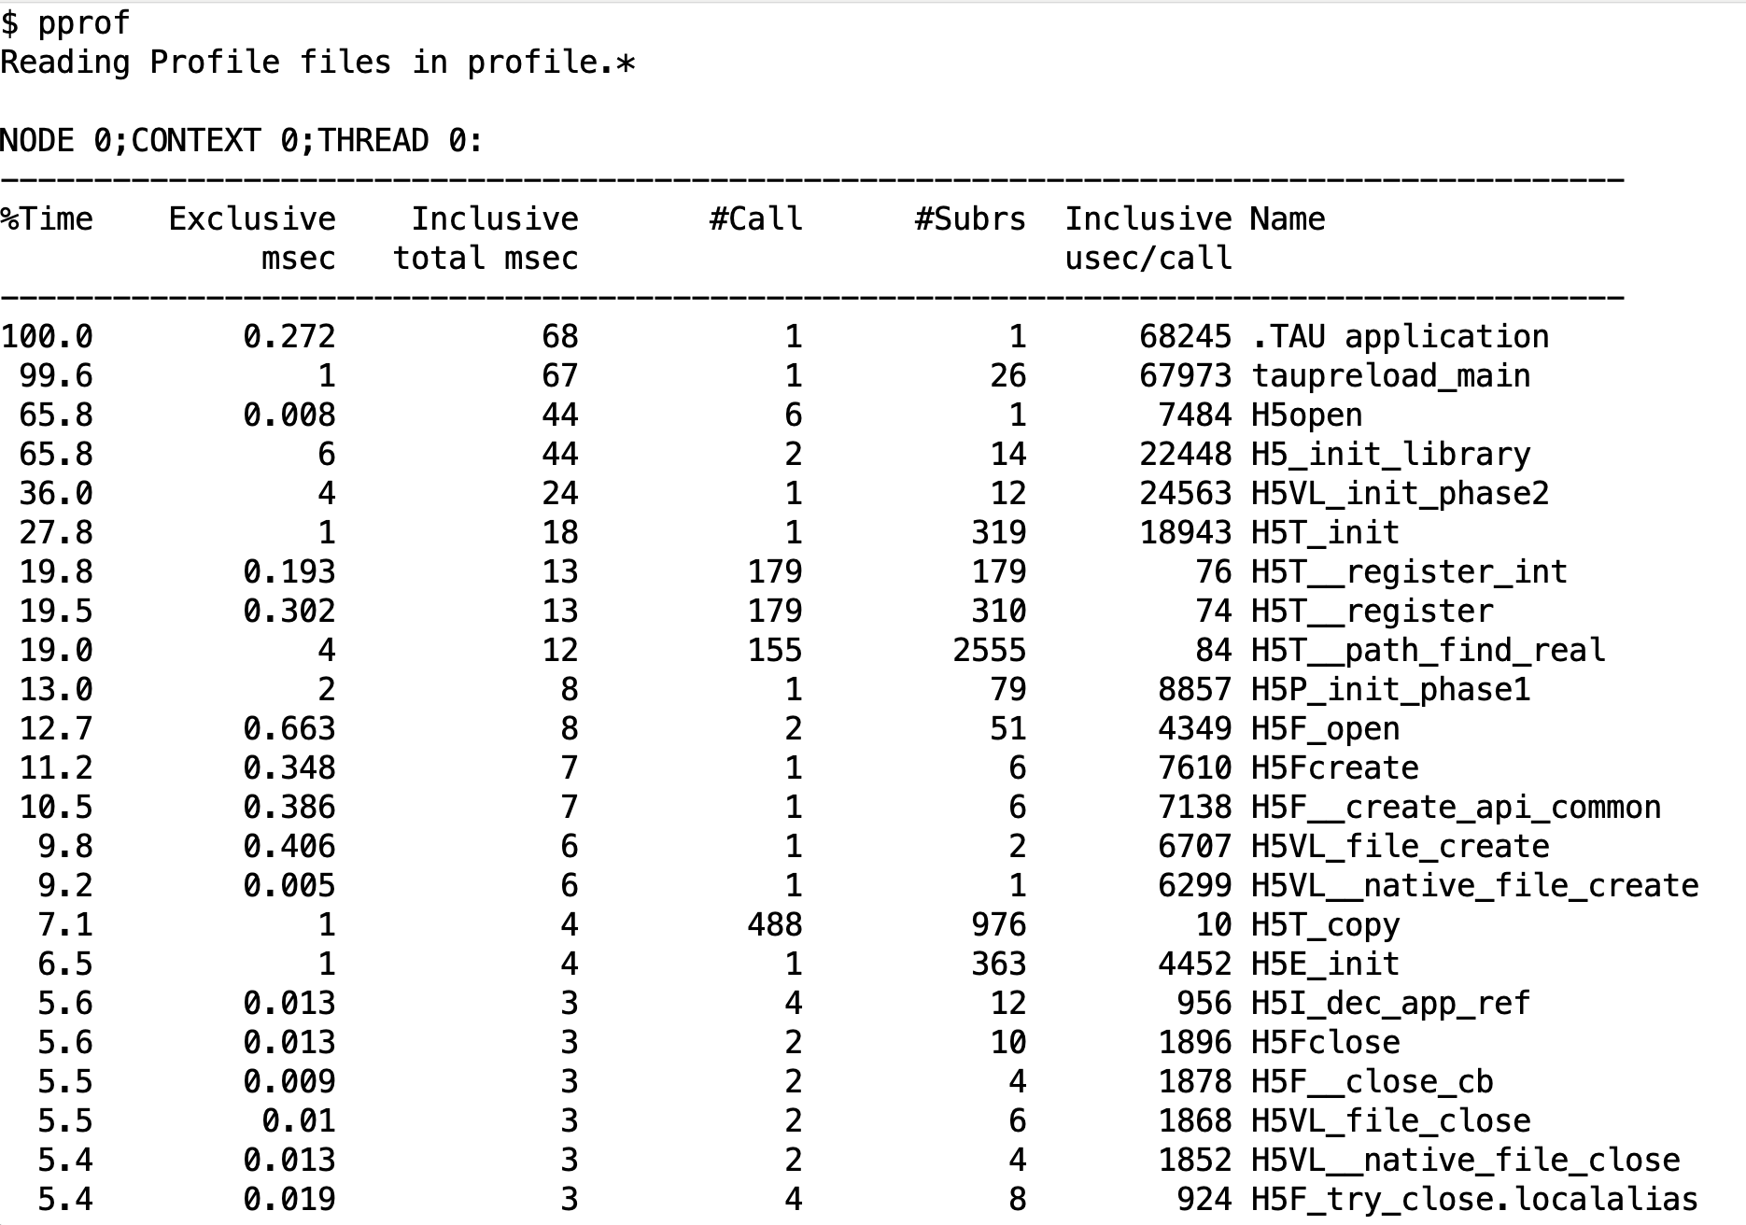
Binary instrumentation of libraries: HDF5

Slide 59
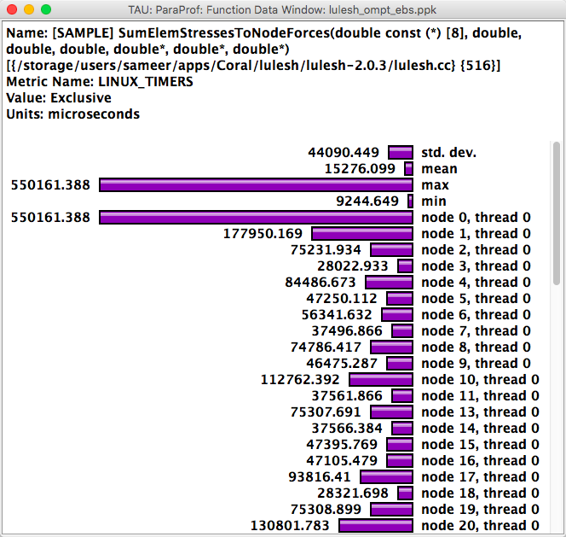
TAU – Event Based Sampling (EBS)
% export TAU_SAMPLING=1

Slide 60
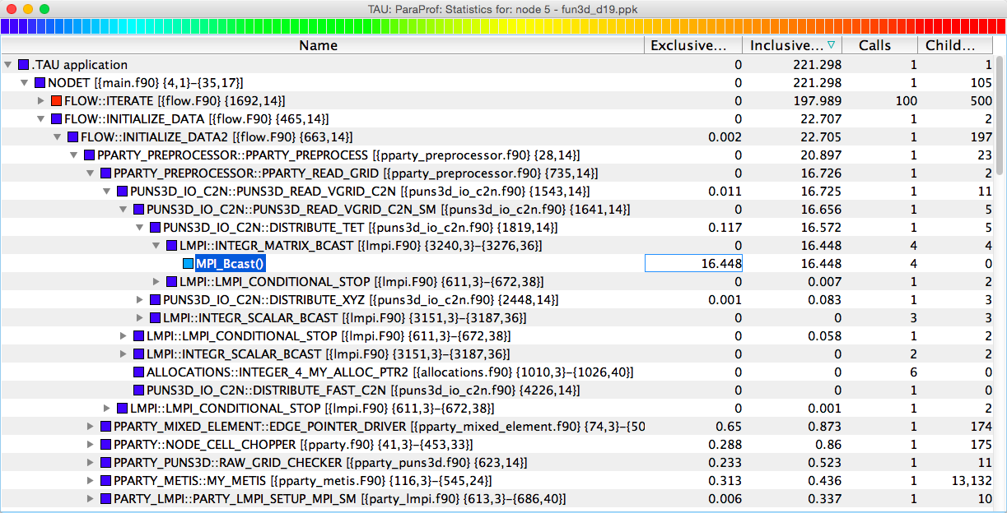
TAU – Callpath Profiling
% export TAU_CALLPATH=1; export TAU_CALLPATH_DEPTH=100

Slide 61
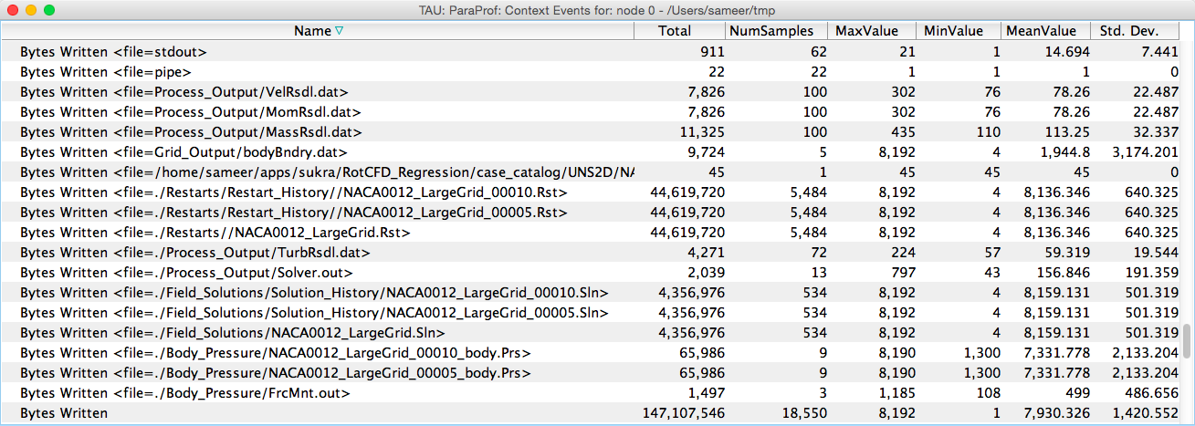
TAU Atomic Events

Slide 62
TAU – Context Events
Write bandwidth per file
Bytes written to each file

Slide 63
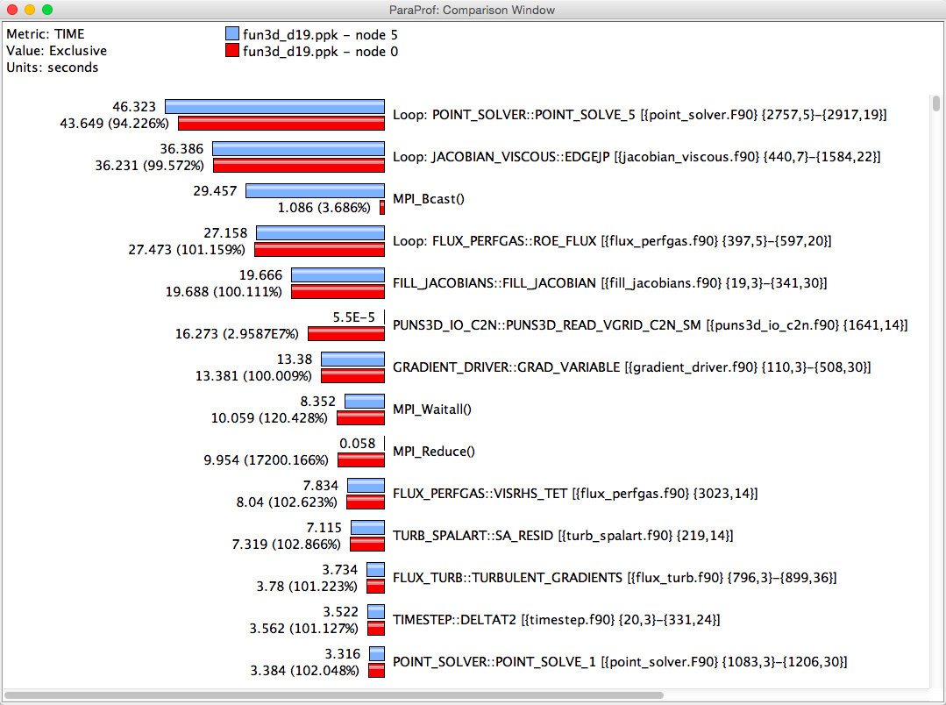
ParaProf Comparison Window
Comparing Rank 0 with 5.
Right click on “node 5” -> Add node to comparison window

Slide 64
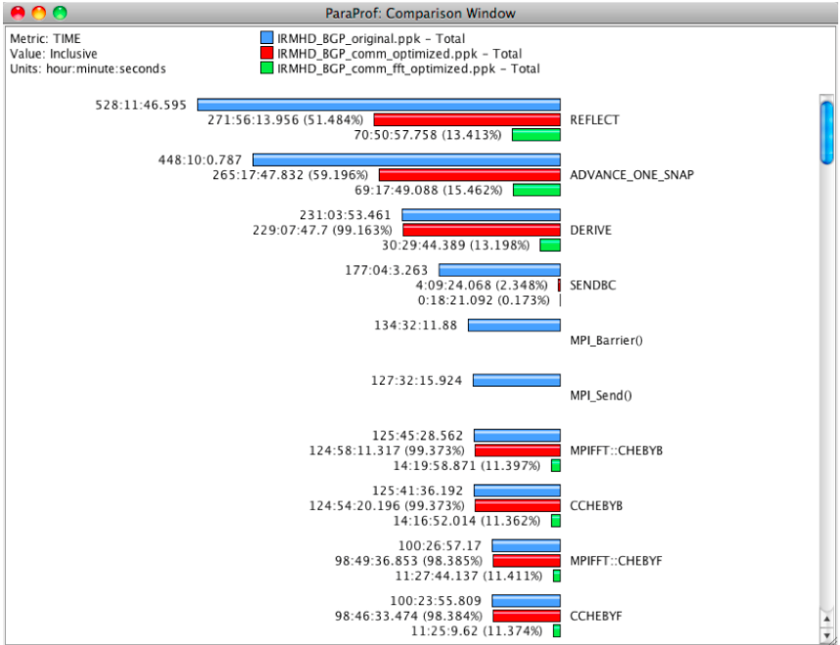
ParaProf Comparison Window

Slide 65
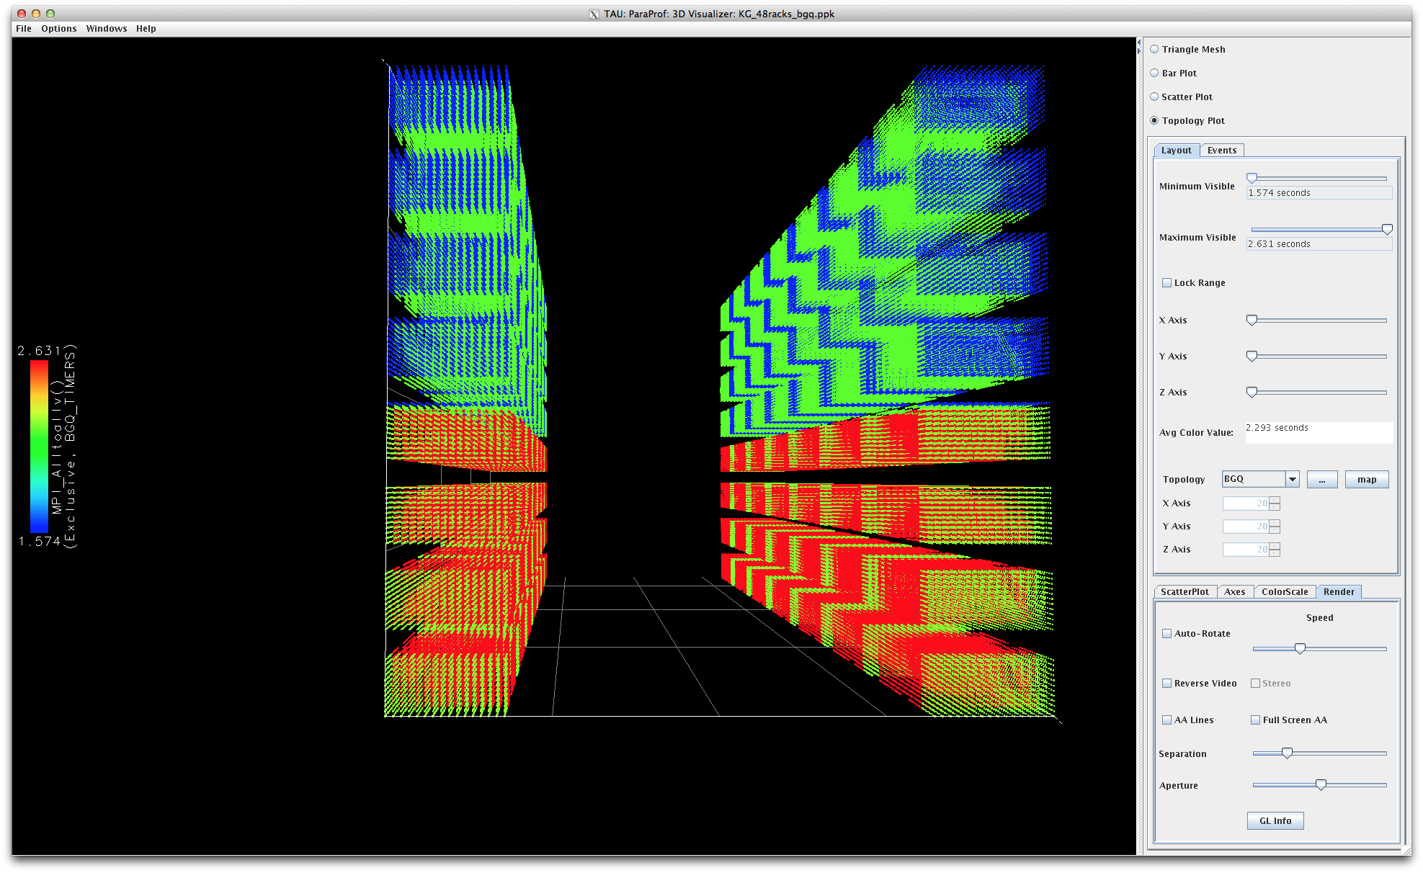
ParaProf’s Topology Display Window

Slide 66
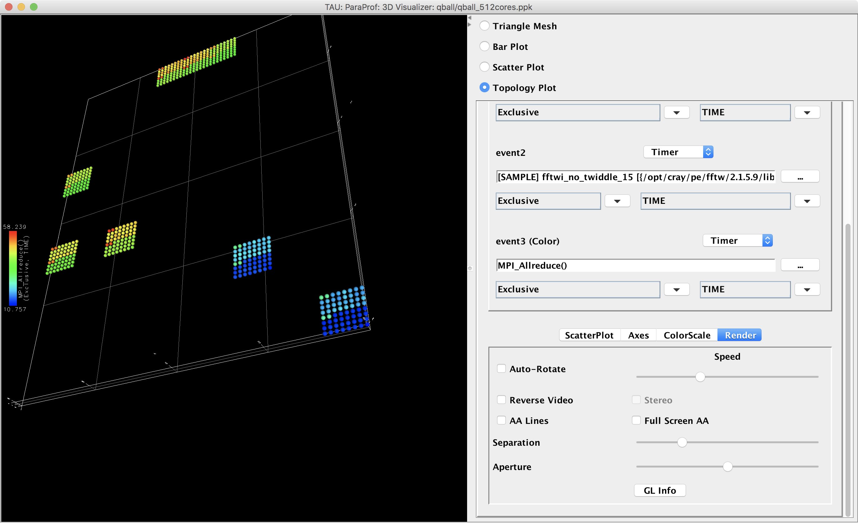
ParaProf Topology Display

Slide 67
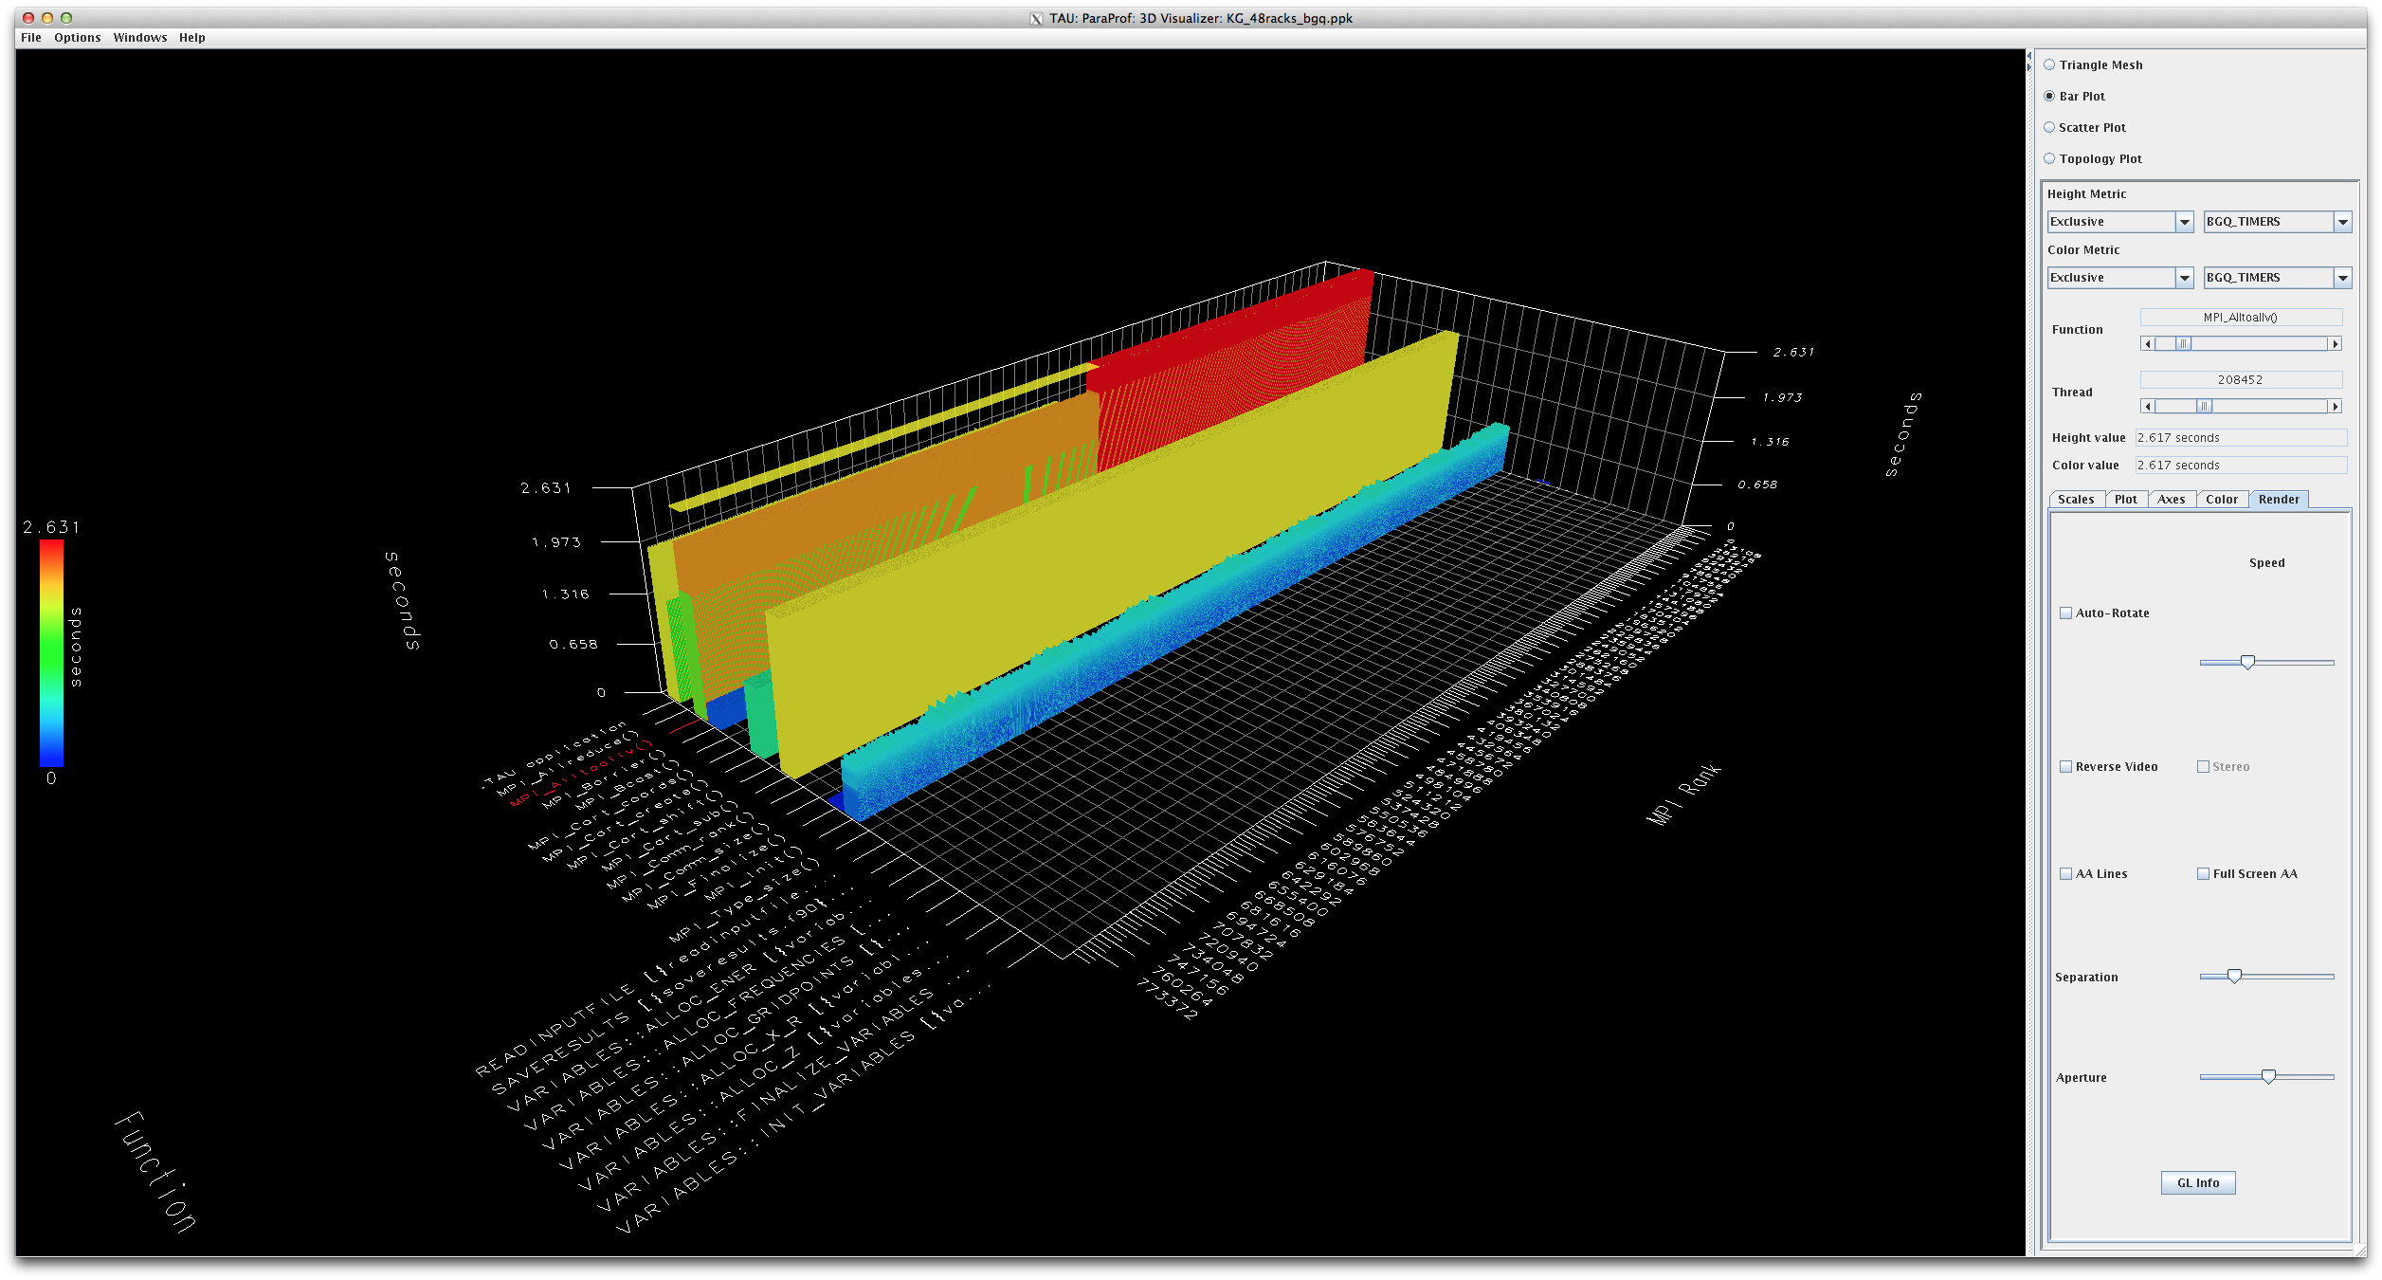
ParaProf’s Scalable 3D Visualization
786,432 ranks

Slide 68
TAU Hands-On

Slide 69
TAU Exercise #1:
Event Based Sampling (EBS)

Slide 70
Using ParaTools Pro for E4S image on AWS with Adaptive Computing’s On-Demand Data Center (ODDC)
STEP 1: Go to https://tinyurl.com/e4stut
STEP 2: Reserve an instance and login to:
https://paratools.adaptivecomputing.com
with the credentials. Firefox recommended.

Slide 71
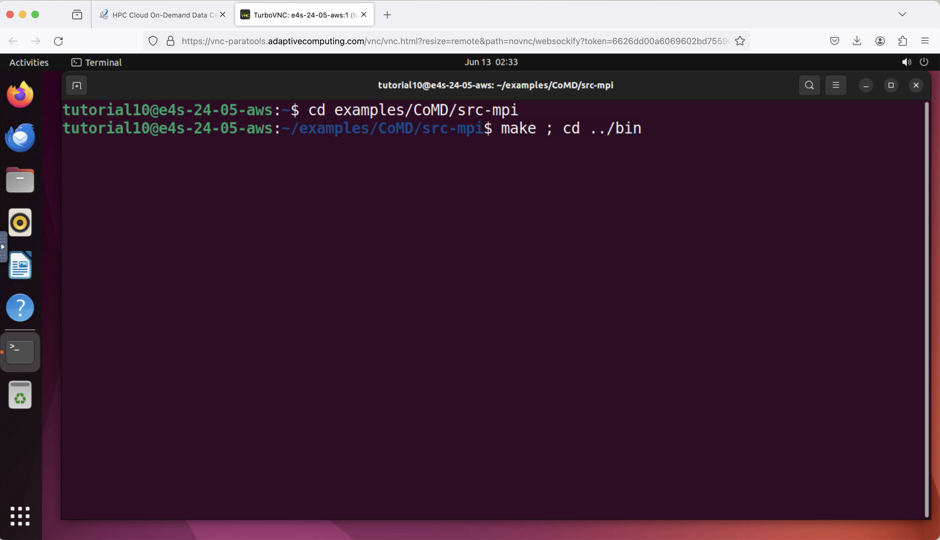
CoMD: TAU with event-based sampling (EBS)
% cd examples/CoMD/src-mpi
% make; cd ../bin

Slide 72
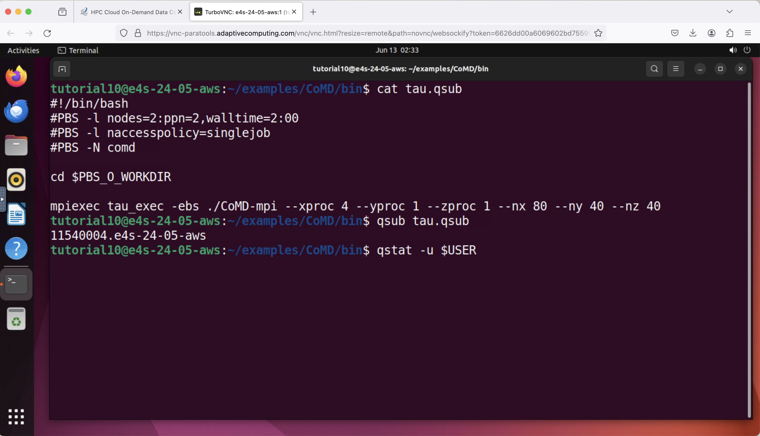
CoMD: TAU with event-based sampling (EBS)
% qsub comd.qsub
% qstat –u $USER
% qsub tau.qsub
% qstat –u $USER

Slide 73
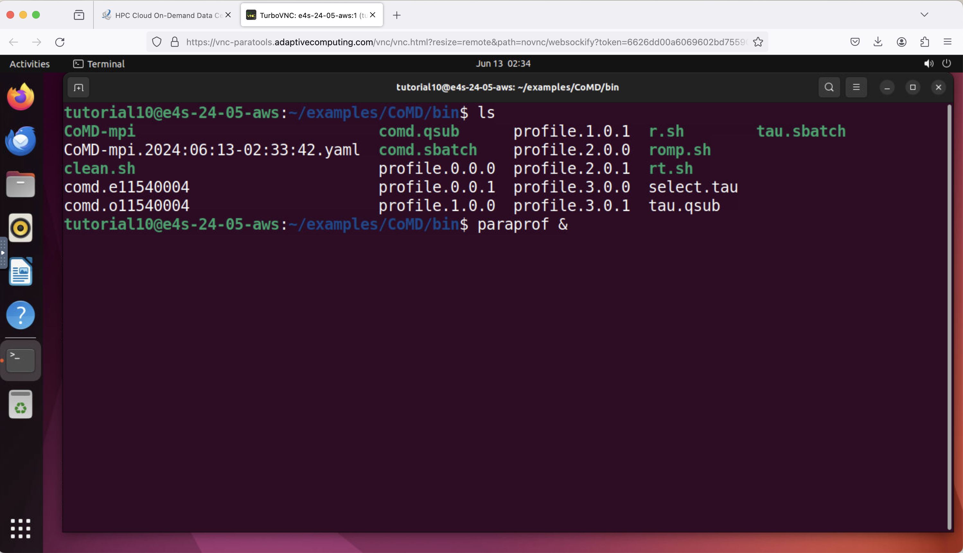
CoMD: TAU’s paraprof visualizer
% paraprof &

Slide 74
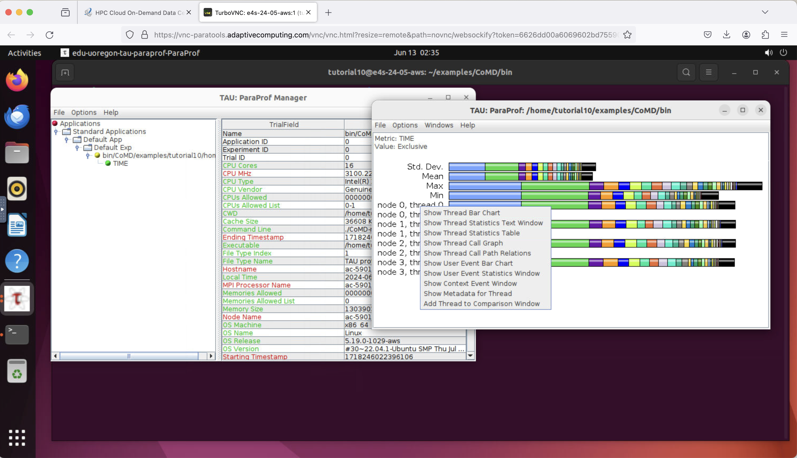
CoMD: TAU’s paraprof visualizer
Right click on Node 0, Thread 0 and choose Show Thread Statistics Table (third option)

Slide 75
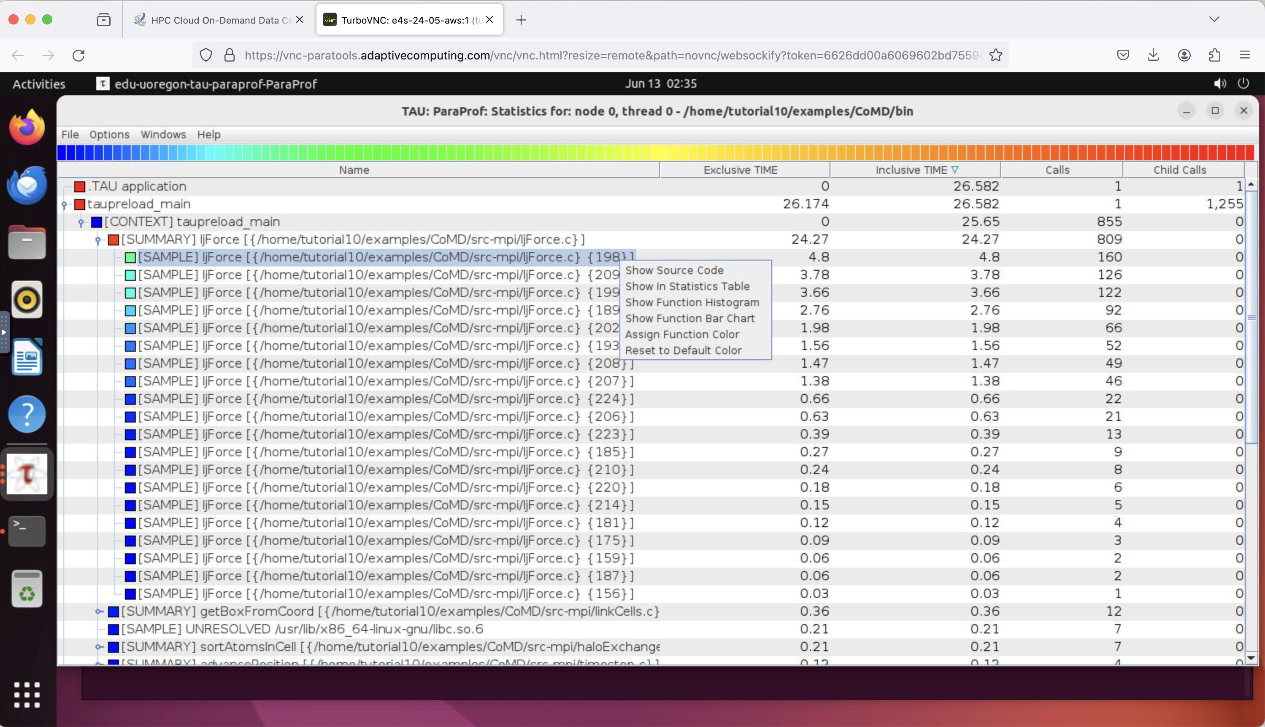
TAU’s ParaProf Profile Browser: Thread Statistics Table
Click on columns to sort (e.g., Inclusive)
Expand nodes and right click on a sample and
Select “Show Source Code”

Slide 76
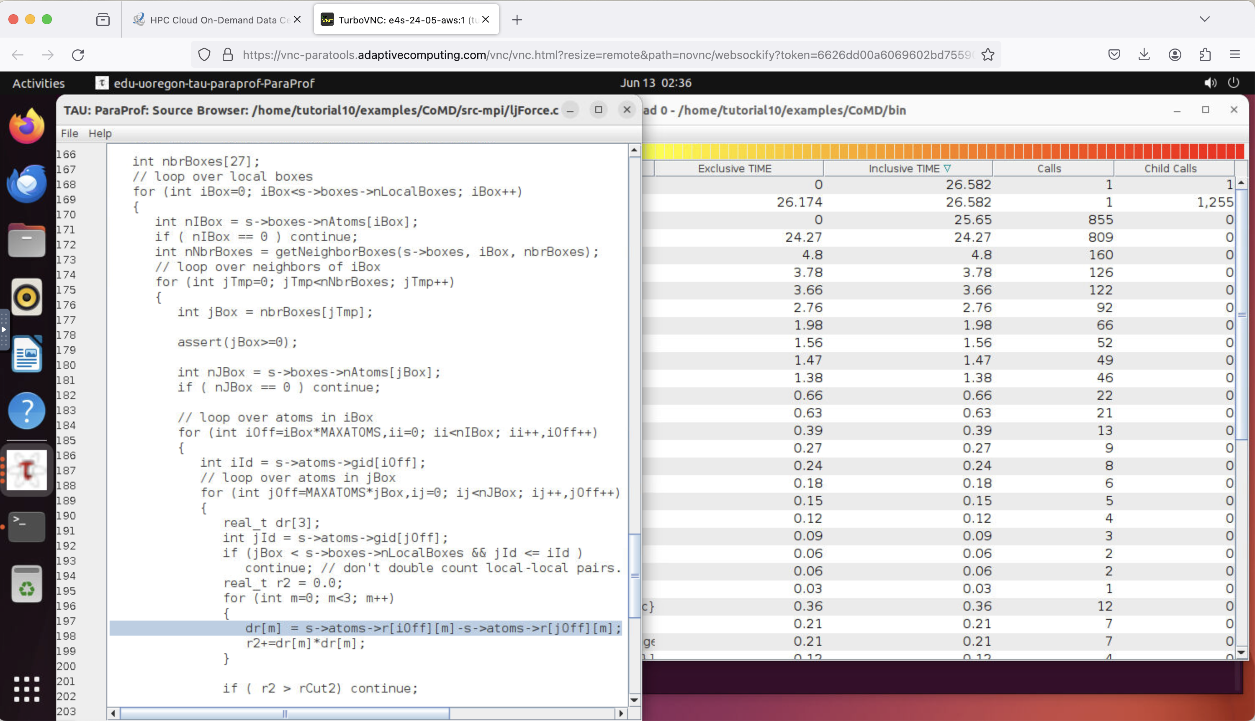
TAU’s ParaProf Profile Browser: Source Code Browser
The application spent
4.8 seconds at line 198 in ljForce.c in MPI rank 0. TAU collected 160 samples at this line of code.
It is within five levels of for loops!
There was no change to
source code,
build system, or the
application binary!

Slide 77
TAU Exercise #2:
Instrumenting PETSc application using TAU’s Perfstubs interface

Slide 78
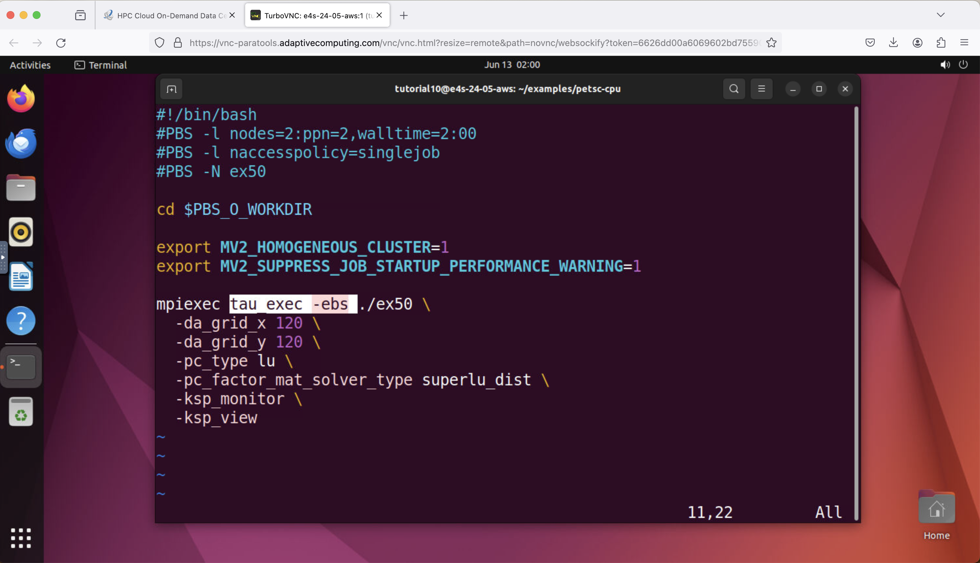
Launching the binary using tau_exec –ebs
cd ~/examples/petsc-cpu
./compile.sh
qsub tau.qsub
qstat
After it completes:
paraprof &

Slide 79

TAU’s ParaProf Profile Browser: Source Code Browser
qsub tau.qsub
qstat -u $USER
# After it completes
ls
paraprof &

Slide 80

TAU’s paraprof browser with PETSc performance profile
paraprof
Choose
Show thread statistics table by right clicking on
node 0, thread 0.

Slide 81

Using pprof: TAU’s text based profile browser
pprof –a | more
Here we see PETSc timers translated into TAU timers using the Perfstubs library.
No modification to the source, build system, or the binary!

Slide 82
Generating Traces
% cp /tmp/trace.qsub .
% ./compile.sh
% qsub trace.qsub
% qstat
% firefox https://perfetto.dev &
Click -> Trace Viewer -> Open the UI ->
Open Trace File -> navigate to app.json
Open the four trace rows (one for each rank)
Use wasd keys to widen/shrink/left/right
scroll

Slide 83
What it was doing
# cd ~/examples/petsc-cuda; vi ex50.qsub
# Comment out previous CALLPATH options
export TAU_TRACE=1
% qsub ex50.qsub
% tau_treemerge.pl
% tau_trace2json tau.trc tau.edf –chrome \
-ignoreatomic –o app.json
Open Firefox, load Perfetto.dev
trace visualizer and open app.json
wasd keys to widen/shrink/left/right

Slide 84

Visualizing Traces with https://Perfetto.dev
wasd
W = widen
S = Shrink
A = Left
D = Right

Slide 85
Generating Traces with Vampir
% cp /tmp/vampir.qsub .
% ./compile.sh (only needs to be done once)
% qsub vampir.qsub
% export PATH=/tmp/vampir/bin:$PATH
% vampir traces.otf2 &
(No need to merge or convert traces)

Slide 86

Vampir [TU Dresden]

Slide 87
Generating callpath profiles
Edit tau.qsub
# add
export TAU_CALLPATH=1
export TAU_CALLPATH_DEPTH=100
export TAU_PROFILE_FORMAT=merged
mpirun …
% qsub tau.qsub
% qstat
% paraprof tauprofile.xml

Slide 88
Generating Traces
# Edit tau.qsub
# Comment out previous CALLPATH options
export TAU_TRACE=1
export TAU_TRACE_FORMAT=otf2
% qsub tau.qsub
% export PATH=/tmp/vampir/bin:$PATH
% vampir traces.otf2 &
(No need to merge or convert traces)

Slide 89
TAU Exercise #5:
CUDA instrumentation using CUPTI
(CUDA Profiling Tools Interface)

Slide 90
PETSc CUDA
% cd ~/examples/petsc-cuda
% cp /tmp/cupti.qsub .
% qsub cupti.qsub
% qstat
After it completes:
% paraprof tauprofile.xml &

Slide 91
PETSc CUDA: What it was doing
% cd ~/examples/petsc-cuda
% ./compile.sh
Edit the qsub file:
spack load tau+cuda
export TAU_PROFILE_FORMAT=merged
mpiexec tau_exec –T cupti,mpi –cupti –ebs ./ksp…
% qsub *.qsub
% paraprof tauprofile.xml &

Slide 92
Generating Traces
% cp /tmp/trace-cuda.qsub .
% qsub trace-cuda.qsub
% qstat
% firefox https://perfetto.dev &
Click -> Trace Viewer -> Open the UI ->
Open Trace File -> navigate to app.json
Open the four trace rows (one for each rank)
Use wasd keys to widen/shrink/left/right
scroll

Slide 93

Visualizing Traces with https://Perfetto.dev
wasd
W = widen
S = Shrink
A = Left
D = Right

Slide 94
TAU Exercise #6:
paraprof 3D display

Slide 95

TAU paraprof
cd ~/examples/tau
paraprof demo.ppk &
Choose 3D Visualization

Slide 96

TAU paraprof 3D visualization
Choose Bar Plot and move
Function and Thread
Sliders
First mouse button to rotate
Second mouse button to
translate (left to right)
Scroll wheel (or +/- keys) to
zoom in.
Try Scatter plot next

Slide 97

TAU paraprof: 3D Scatter Plot

Slide 98
Reference

Slide 99
Installing and Configuring TAU
Installing PDT:
  wget tau.uoregon.edu/pdt_lite.tgz
  ./configure –prefix=<dir>; make ; make install
Installing TAU:
  wget tau.uoregon.edu/tau.tgz; tar zxf tau.tgz; cd tau-2.<ver>
  wget http://tau.uoregon.edu/ext.tgz ; tar xf ext.tgz
  ./configure -bfd=download -pdt=<dir> -papi=<dir> -mpi
  –pthread –c++=mpicxx –cc=mpicc –fortran=mpif90
  –dwarf=download –unwind=download –otf=download
  –iowrapper –papi=<dir>
  make install
Using TAU:
  export TAU_MAKEFILE=<taudir>/x86_64/lib/Makefile.tau-<TAGS>
  make CC=tau_cc.sh CXX=tau_cxx.sh F90=tau_f90.sh

Slide 100
Compile-Time Options
Optional parameters for the TAU_OPTIONS environment variable:
% tau_compiler.sh
  -optVerbose Turn on verbose debugging messages
  -optCompInst Use compiler based instrumentation
  -optNoCompInst Do not revert to compiler instrumentation if source instrumentation fails.
  ﻿-optTrackIO Wrap POSIX I/O call and calculates vol/bw of I/O operations (Requires TAU to be configured with –iowrapper)
  ﻿-optTrackGOMP Enable tracking GNU OpenMP runtime layer (used without –opari)
  ﻿-optMemDbg Enable runtime bounds checking (see TAU_MEMDBG_* env vars)
  -optKeepFiles Does not remove intermediate .pdb and .inst.* files
  -optPreProcess Preprocess sources (OpenMP, Fortran) before instrumentation
  -optTauSelectFile=”<file>" Specify selective instrumentation file for tau_instrumentor
  -optTauWrapFile=”<file>" Specify path to link_options.tau generated by tau_gen_wrapper
  -optHeaderInst Enable Instrumentation of headers
  -optTrackUPCR Track UPC runtime layer routines (used with tau_upc.sh)
  -optLinking="" Options passed to the linker. Typically
  $(TAU_MPI_FLIBS) $(TAU_LIBS) $(TAU_CXXLIBS)
  -optCompile="" Options passed to the compiler. Typically
  $(TAU_MPI_INCLUDE) $(TAU_INCLUDE) $(TAU_DEFS)
  -optPdtF95Opts="" Add options for Fortran parser in PDT (f95parse/gfparse) …

Slide 101
Compile-Time Options (contd.)
Optional parameters for the TAU_OPTIONS environment variable:
% tau_compiler.sh
  -optShared Use TAU’s shared library (libTAU.so) instead of static library (default)
  ﻿-optPdtCxxOpts=“” Options for C++ parser in PDT (cxxparse).
  ﻿-optPdtF90Parser=“” Specify a different Fortran parser
  ﻿-optPdtCleanscapeParser Specify the Cleanscape Fortran parser instead of GNU gfparser
  -optTau=“” Specify options to the tau_instrumentor
  -optTrackDMAPP Enable instrumentation of low-level DMAPP API calls on Cray
  -optTrackPthread Enable instrumentation of pthread calls
  See tau_compiler.sh for a full list of TAU_OPTIONS.
  …

Slide 102
TAU’s Runtime Environment Variables
Environment Variable | Default | Description
TAU_TRACE | 0 | Setting to 1 turns on tracing
TAU_CALLPATH | 0 | Setting to 1 turns on callpath profiling
TAU_TRACK_MEMORY_FOOTPRINT | 0 | Setting to 1 turns on tracking memory usage by sampling periodically the resident set size and high water mark of memory usage
TAU_TRACK_POWER | 0 | Tracks power usage by sampling periodically.
TAU_CALLPATH_DEPTH | 2 | Specifies depth of callpath. Setting to 0 generates no callpath or routine information, setting to 1 generates flat profile and context events have just parent information (e.g., Heap Entry: foo)
TAU_SAMPLING | 1 | Setting to 1 enables event-based sampling.
TAU_TRACK_SIGNALS | 0 | Setting to 1 generate debugging callstack info when a program crashes
TAU_COMM_MATRIX | 0 | Setting to 1 generates communication matrix display using context events
TAU_THROTTLE | 1 | Setting to 0 turns off throttling. Throttles instrumentation in lightweight routines that are called frequently
TAU_THROTTLE_NUMCALLS | 100000 | Specifies the number of calls before testing for throttling
TAU_THROTTLE_PERCALL | 10 | Specifies value in microseconds. Throttle a routine if it is called over 100000 times and takes less than 10 usec of inclusive time per call
TAU_CALLSITE | 0 | Setting to 1 enables callsite profiling that shows where an instrumented function was called. Also compatible with tracing.
TAU_PROFILE_FORMAT | Profile | Setting to “merged” generates a single file. “snapshot” generates xml format
TAU_METRICS | TIME | Setting to a comma separated list generates other metrics. (e.g., ENERGY,TIME,P_VIRTUAL_TIME,PAPI_FP_INS,PAPI_NATIVE_<event>:<subevent>)

Slide 103
Runtime Environment Variables
Environment Variable | Default | Description
TAU_TRACE | 0 | Setting to 1 turns on tracing
TAU_TRACE_FORMAT | Default | Setting to “otf2” turns on TAU’s native OTF2 trace generation (configure with –otf=download)
TAU_EBS_UNWIND | 0 | Setting to 1 turns on unwinding the callstack during sampling (use with tau_exec –ebs or TAU_SAMPLING=1)
TAU_EBS_RESOLUTION | line | Setting to “function” or “file” changes the sampling resolution to function or file level respectively.
TAU_TRACK_LOAD | 0 | Setting to 1 tracks system load on the node
TAU_SELECT_FILE | Default | Setting to a file name, enables selective instrumentation based on exclude/include lists specified in the file.
TAU_OMPT_SUPPORT_LEVEL | basic | Setting to “full” improves resolution of OMPT TR6 regions on threads 1.. N-1. Also, “lowoverhead” option is available.
TAU_OMPT_RESOLVE_ADDRESS_EAGERLY | 1 | Setting to 1 is necessary for event based sampling to resolve addresses with OMPT. Setting to 0 allows the user to do offline address translation.

Slide 104
Runtime Environment Variables
Environment Variable | Default | Description
TAU_TRACK_MEMORY_LEAKS | 0 | Tracks allocates that were not de-allocated (needs –optMemDbg or tau_exec –memory)
TAU_EBS_SOURCE | TIME | Allows using PAPI hardware counters for periodic interrupts for EBS (e.g., TAU_EBS_SOURCE=PAPI_TOT_INS when TAU_SAMPLING=1)
TAU_EBS_PERIOD | 100000 | Specifies the overflow count for interrupts
TAU_MEMDBG_ALLOC_MIN/MAX | 0 | Byte size minimum and maximum subject to bounds checking (used with TAU_MEMDBG_PROTECT_*)
TAU_MEMDBG_OVERHEAD | 0 | Specifies the number of bytes for TAU’s memory overhead for memory debugging.
TAU_MEMDBG_PROTECT_BELOW/ABOVE | 0 | Setting to 1 enables tracking runtime bounds checking below or above the array bounds (requires –optMemDbg while building or tau_exec –memory)
TAU_MEMDBG_ZERO_MALLOC | 0 | Setting to 1 enables tracking zero byte allocations as invalid memory allocations.
TAU_MEMDBG_PROTECT_FREE | 0 | Setting to 1 detects invalid accesses to deallocated memory that should not be referenced until it is reallocated (requires –optMemDbg or tau_exec –memory)
TAU_MEMDBG_ATTEMPT_CONTINUE | 0 | Setting to 1 allows TAU to record and continue execution when a memory error occurs at runtime.
TAU_MEMDBG_FILL_GAP | Undefined | Initial value for gap bytes
TAU_MEMDBG_ALINGMENT | Sizeof(int) | Byte alignment for memory allocations
TAU_EVENT_THRESHOLD | 0.5 | Define a threshold value (e.g., .25 is 25%) to trigger marker events for min/max

Slide 105


















Support Acknowledgements
US Department of Energy (DOE)
  ANL
  Office of Science contracts, ECP
  SciDAC, LBL contracts
  LLNL-LANL-SNL ASC/NNSA contract
  Battelle, PNNL and ORNL contract
NASA SBIR
Department of Defense (DoD)
  PETTT, HPCMP
National Science Foundation (NSF)
  SI2-SSI, Glassbox
CEA, France
Industry: AWS, AMD, IBM, ARM, Intel, NVIDIA
Partners:
  University of Oregon
  The Ohio State University
  ParaTools, Inc.
  University of Tennessee, Knoxville
  T.U. Dresden, GWT
  Jülich Supercomputing Center

Slide 106

Acknowledgment
This material is based upon work supported by the U.S. Department of Energy, Office of Science, Office of Advanced Scientific Computing Research, Next-Generation Scientific Software Technologies program, under contract number DE-AC02-06CH11357. DOE SBIR DE-SC0022502.
https://science.osti.gov/ascr
https://pesoproject.org
https://ascr-step.org
https://hpsf.io
https://www.energy.gov/technologytransitions/sbirsttr

Slide 107
Thank you
https://www.exascaleproject.org
This research was supported by the Exascale Computing Project (17-SC-20-SC), a joint project of the U.S. Department of Energy’s Office of Science and National Nuclear Security Administration, responsible for delivering a capable exascale ecosystem, including software, applications, and hardware technology, to support the nation’s exascale computing imperative.
Thank you to all collaborators in the ECP and broader computational science communities. The work discussed in this presentation represents creative contributions of many people who are passionately working toward next-generation computational science.

Slide 108


