Slide 1

Using POINT Performance Tools
(PAPI, PerfSuite, TAU, Scalasca and Vampir) to Understand and Optimize Multicore Codes
Sameer Shende University of Oregon sameer@cs.uoregon.edu | David Cronk Innovative Computing Laboratory University of Tennessee cronk@eecs.utk.edu
Rui Liu National Center for Supercomputing Applications ruiliu@ncsa.illinois.edu | Nick Nystrom Pittsburgh Supercomputing Center nystrom@psc.edu
LCI 2010, Pittsburgh, March 8, 2010

Slide 2
Tutorial Agenda
Time | Topic | Speaker
8:30 – 8:45 | Introduction to POINT | Nick Nystrom
8:45 – 9:00 | Multicore Processors: Resource Contention & Performance | David Cronk
9:00 – 9:45 | Introduction to Performance Engineering | Sameer Shende
9:45 – 10:00 | POINT LiveDVD | All
10:00 – 10:30 | Break
10:30 – 11:15 | PAPI | David Cronk
11:15 – 12:00 | PerfSuite | Rui Liu
12:00 – 1:00 | Lunch
1:00 – 3:00 | TAU | Sameer Shende
3:00 – 3:30 | Break
3:30 – 4:00 | Vampir | Sameer Shende
4:00 – 4:30 | Scalasca | David Cronk
4:30 – 5:00 | Application Case Studies | Nick Nystrom

Slide 3
IntroDUCTION to POINT
Nick Nystrom
Pittsburgh Supercomputing Center
Allen D. Malony
Performance Research Laboratory, University of Oregon

Slide 4
POINT Project
  Petascale Productivity from Open, Integrated Tools
“High-Productivity Performance Engineering (Tools, Methods, Training) for NSF HPC Applications”
  NSF SDCI, Software Improvement and Support
  University of Oregon, University of Tennessee,
  National Center for Supercomputing Applications, Pittsburgh Supercomputing Center
  http://www.nic.uoregon.edu/point

Slide 5
Motivation
Promise of HPC through scalable scientific and engineering applications
Performance optimization through effective performance engineering methods
  Performance analysis / tuning “best practices”
Productive petascale HPC will require
  Robust parallel performance tools
  Training good performance problem solvers

Slide 6
Objectives
Robust parallel performance environment
  Uniformly available across NSF HPC platforms
Promote performance engineering
  Training in performance tools and methods
  Leverage NSF TeraGrid EOT
Work with petascale applications teams
Community building

Slide 7
Challenges
Consistent performance tool environment
  Tool integration, interoperation, and scalability
  Uniform deployment across NSF HPC platforms
Useful evaluation metrics and process
  Make part of code development routine
  Recording performance engineering history
Develop performance engineering culture
  Proceed beyond “hand holding” engagements

Slide 8
Performance Engineering Levels
Target different performance tool users
  Different levels of expertise
  Different performance problem solving needs
Level 0 (entry)
  Simpler tool use, limited performance data
Level 1 (intermediate)
  More tool sophistication, increased information
Level 2 (advanced)
  Access to powerful performance techniques

Slide 9
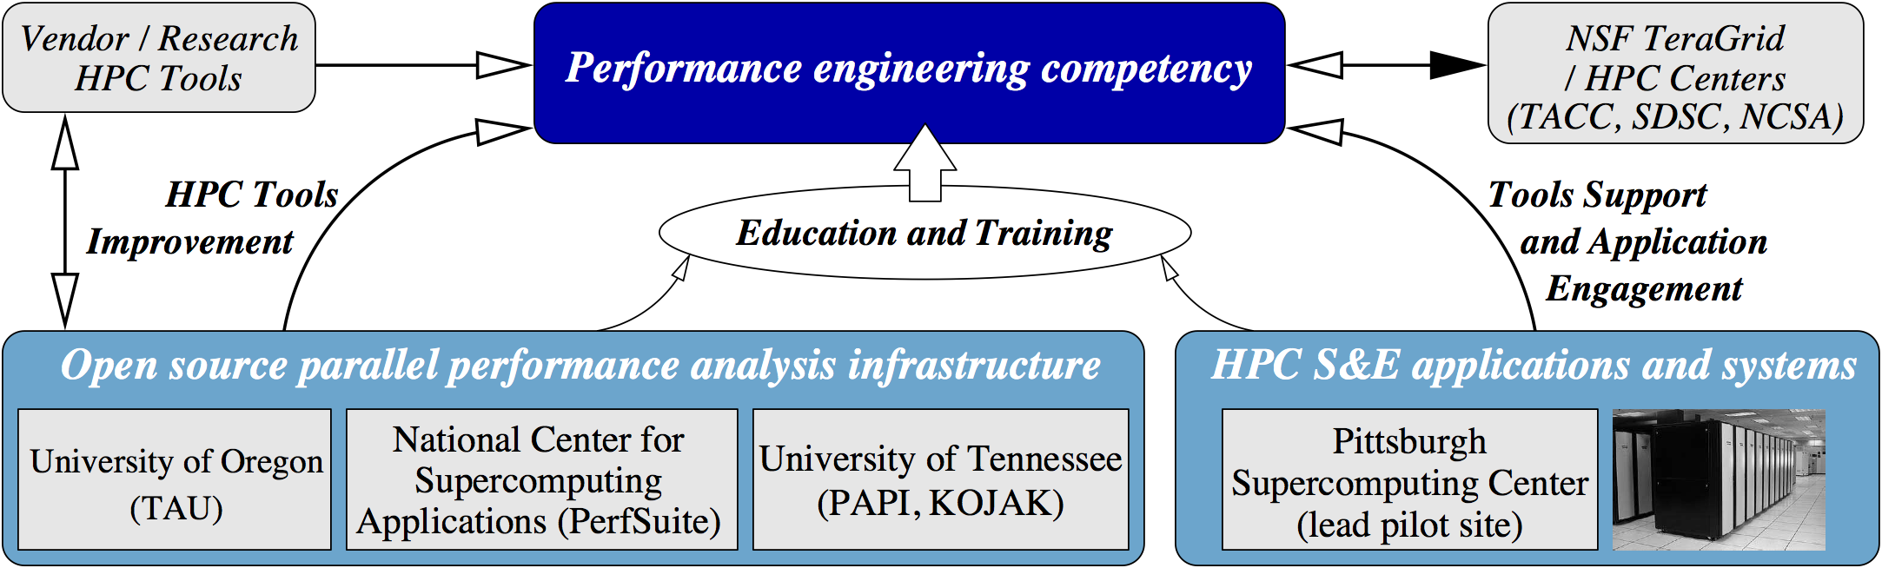
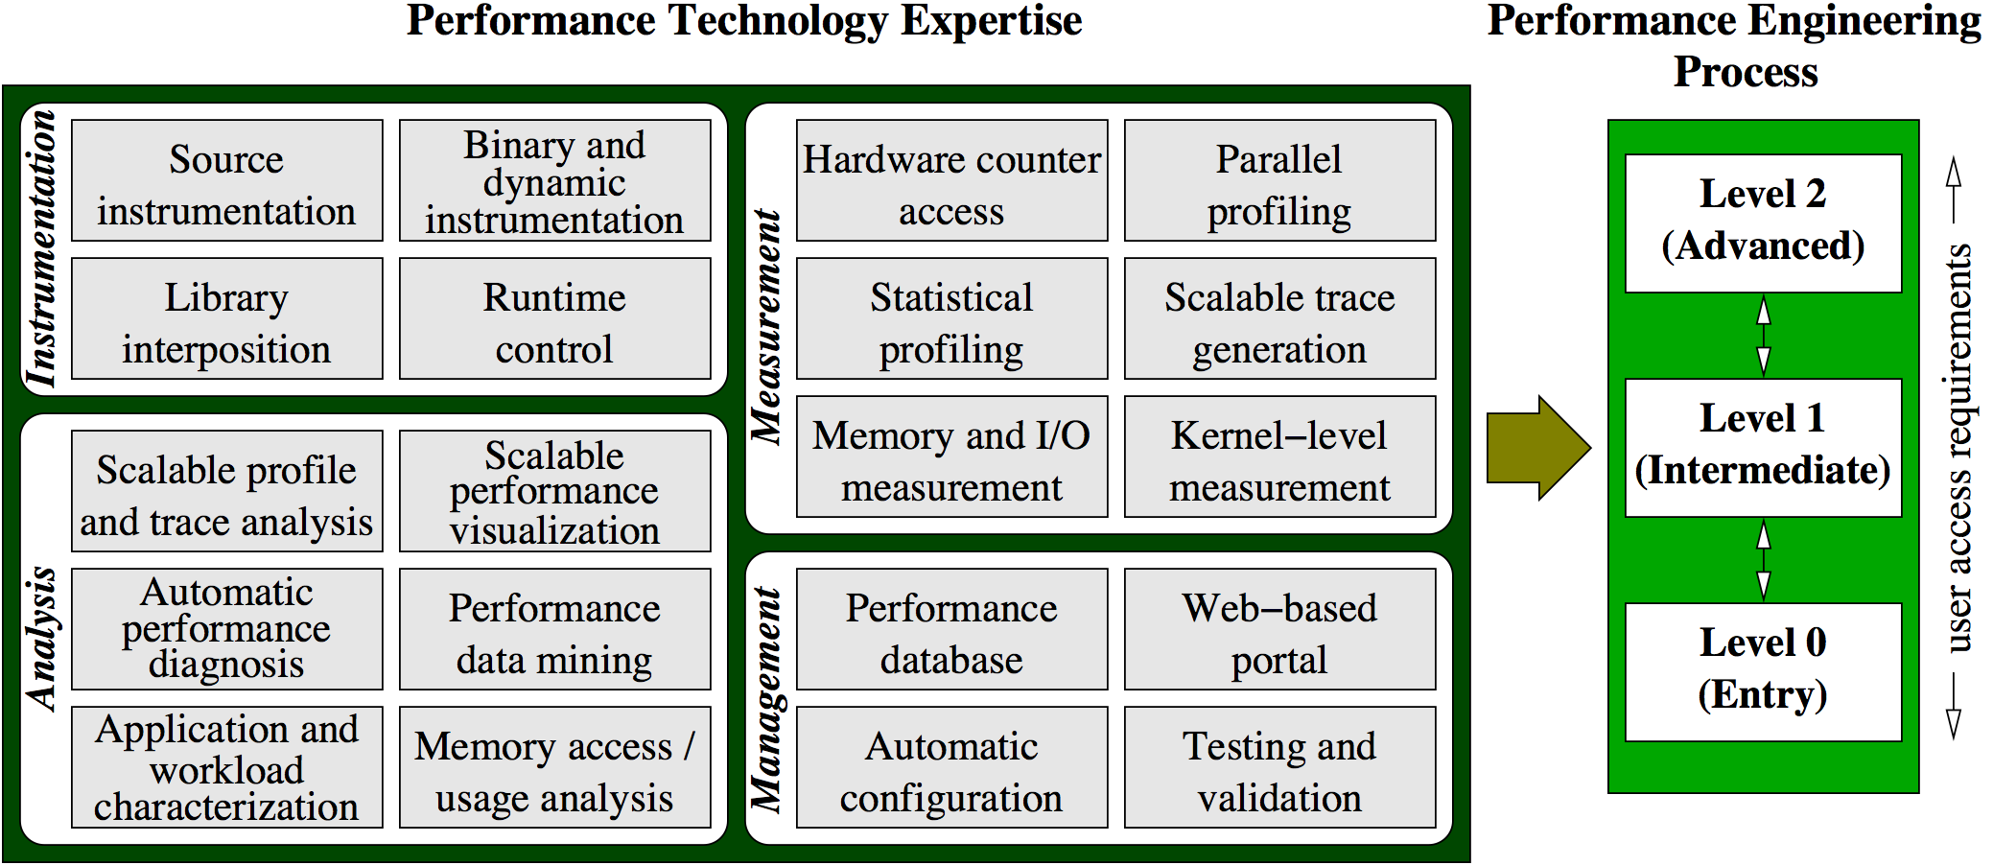
POINT Project Organization
Testbed Apps
ENZO
NAMD
NEMO3D
UNRES
ARPS

Slide 10






Parallel Performance Technology
PAPI
  University of Tennessee, Knoxville
PerfSuite
  National Center for Supercomputing Applications
TAU Performance System
  University of Oregon
Kojak / Scalasca
  Research Centre Juelich
Vampir and VampirTrace
  T.U. Dresden

Slide 11


Parallel Engineering Training
User engagement
User support in TeraGrid
Training workshops
Quantify tool impact
POINT lead pilot site
  Pittsburgh Supercomputing Center
  NSF TeraGrid site

Slide 12
Testbed Applications
ENZO
  Adaptive mesh refinement (AMR), grid-based hybrid code (hydro+Nbody) designed to do simulations of cosmological structure formation
NAMD
  Mature community parallel molecular dynamics application deployed for research in large-scale biomolecular systems
NEMO3D
  Quantum mechanical based simulation tool created to provide quantitative predictions for nanometer-scale semiconductor devices

Slide 13

Virtual Institute – High Productivity Supercomputing
Goal: Improve the quality and accelerate the development process of complex simulation codes running on highly-parallel computer systems
Funded by Helmholtz Association
of German Research Centres
Activities
  Development and integration of HPC programming tools
    Correctness checking & performance analysis
  Training workshops
  Service
    Support email lists
    Application engagement
  Academic workshops
  www.vi-hps.org

Slide 14


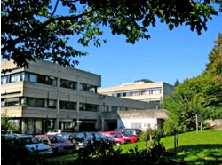



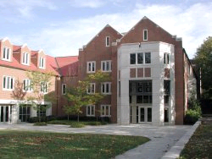

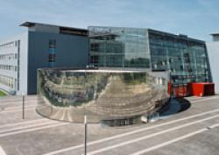



Partners
Forschungszentrum Jülich
  Jülich Supercomputing Centre
RWTH Aachen University
  Centre for Computing and Communication
Technical University of Dresden
  Centre for Information Services and HPC
University of Tennessee (Knoxville)
  Innovative Computing Laboratory
Technical University of Munich
  Chair for Computer Architecture
University of Stuttgart
  High Performance Computing Centre

Slide 15
Productivity tools
Marmot
  Free MPI correctness checking tool
PAPI
  Free library interfacing to hardware performance counters
Scalasca
  Open-source toolset for analysing the performance behaviour of parallel applications to automatically identify inefficiencies
Vampir
  Commercial framework and graphical analysis tool to display and analyse event traces
VampirTrace
  Open-source tool generating event traces for analysis and visualization by Vampir
[Tutorial Live-DVD contains latest tools releases]

Slide 16
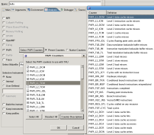
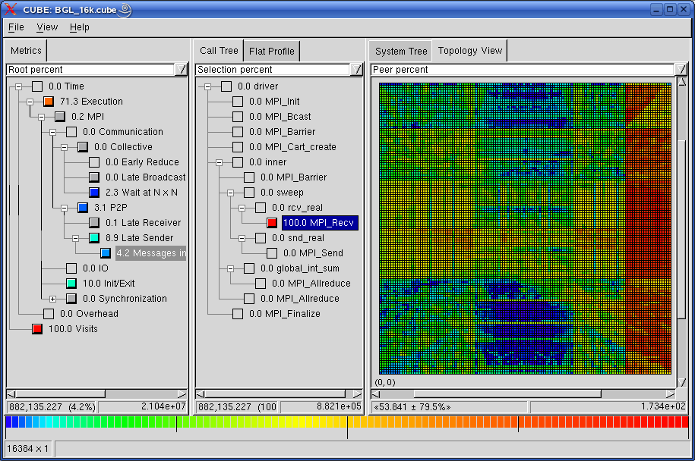


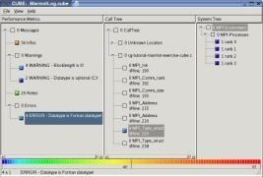
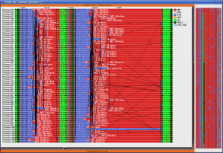

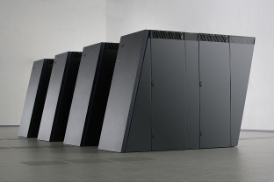
Technologies and their integration
PAPI
SCALASCA
Hardware
monitoring
Automatic
trace
analysis
MARMOT
VAMPIR
Error
correction
Visual trace
analysis
Execution
Optimization

Slide 17
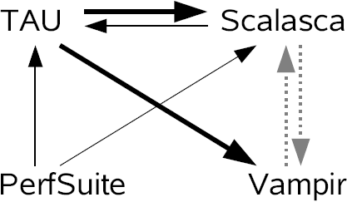
POINT/VI-HPS tool interoperability
PerfSuite can generate reports in CUBE format
TAU can use Scalasca & VampirTrace measurement libs and can present reports in PerfSuite & CUBE formats
TAU & Vampir use OPARI to instrument OpenMP sources, and Scalasca can use TAU source instrumenter
Scalasca & Vampir traces can be inter-converted

Slide 18
Multicore processors: resource contention and Performance
David Cronk
Innovative Computing Lab
University of Tennessee, Knoxville

Slide 19
Introduction
The number of cores on a chip is only going to continue to increase
  Chips with 4 cores per socket are common today
  Chips with 6 or 8 cores per socket are available
    Chips with 16, 32, 64, etc cores per chip are on their way
Many believe we cannot scale past 8 cores per socket and continue to see performance improvement
  Cache coherency adds overhead
  Multi-core causes contention for shared resources
  This contention causes performance degradation
    In extreme cases, this performance degradation can cause execution times to increase when using multiple cores

Slide 20
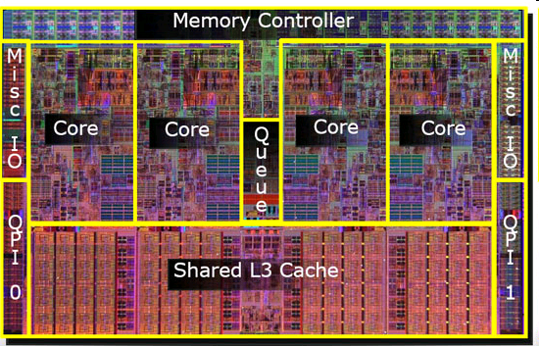
Intel Core i7 (Nehalem)

Slide 21
Shared Resources
Main memory
Last Level Cache (LLC)
Memory controller
Pre-fetch hardware

Slide 22
Performance Issues
Thread/process allocation
  Threads accessing the same data should be within the same socket
  Minimize cross-socket communication
Hyperthreading
Cache coherency
False sharing
  Causes thrashing
Memory contention

Slide 23
Thread/process allocation
If two threads share some data, being within the same socket can increase performance
  However, cache coherency mechanisms can have a negative affect
If two processes communicate with each other, communicating across sockets is more costly than within a socket

Slide 24
Hyperthreading
Many modern microarchitectures offer hyperthreading
  Allows for more threads than cores
    Sun UltraSPARC – 8 threads per core
    Intel i7 – 2 threads per core
  Basically allows multiple pipelines. As long as the pipelines don’t converge, concurrency is possible
  The hardware reports as if there are more cores than physically exist

Slide 25
Cache Coherency
If two threads share data, even if that data is in cache there can be performance problems
  If the data is only read, no problems
  If one or more writes to the data, then updates must be reflected in both caches, resulting in contention for the memory bus and/or memory controller

Slide 26
False Sharing
Generally, cores have private level one cache; sometimes private level two
If each core stays in local cache, there should be little contention
However, if two cores have the same cache line in their local cache, updates in one must be reflected in the other, even if the data being updated is different
This can cause thrashing

Slide 27
Memory Contention
If two cores have frequent private cache misses, then they must access the LLC. This causes contention for this resource, which slows response time.
Contention for the LLC can also increase the eviction rate, leading to more frequent accesses to main memory.
If two cores are competing for the same main memory, contention for the memory bus and memory controller results in slower response time.
Aggressive prefetching can put additional pressure on the LLC.

Slide 28
Possible solutions/ideas
Try to ensure that most frequently communicating threads reside on cores within the same socket
If threads must share data, ensure they reside on cores within the same socket
  If possible, minimize data sharing. Let each thread have its own private copy of data and aggregate when necessary
Pad or control alignment to avoid false sharing
Write local cache friendly code
  Tiling can help

Slide 29
Possible solutions/ideas
Make use of hyper threading when appropriate
  This may include using different numbers of threads at different locations of the code
  Separate tasks into compute intensive and memory intensive portions
  Maybe have MPI operations handled by a separate thread/process (mostly integer instructions, should not intefer with compute intensive portions)
Experiment to see what number of threads is best
  It is possible that leaving one or more cores idle may result in better performance

Slide 30
Conclusions
Getting the best performance out of your code is difficult for sequential, single core systems
It has always been difficult to tune your parallel application
The arrival of multi-core systems only makes the task that much harder
There are techniques that can help lead to better performance
There are tools available to help you out

Slide 31
INTRODUCTION TO PERFORMANCE ENGINEERING
Sameer Shende and Allen D. Malony
Performance Research Laboratory
University of Oregon

Slide 32
Performance Engineering
Optimization process
Effective use of performance technology
Performance
Tuning
Performance
Technology
Performance
Technology
hypotheses
Data mining
Models
Expert systems
Performance
Diagnosis
Experiment
management
Performance
storage
properties
Performance
Technology
Performance
Experimentation
Instrumentation
Measurement
Analysis
Visualization
characterization
Performance
Observation

Slide 33
Performance Optimization Cycle
Instrumentation
Expose factors
Collect performance data
Calculate metrics
Analyze results
Visualize results
Identify problems
Tune performance
Measurement
Analysis
Presentation
Optimization

Slide 34
Parallel Performance Properties
Parallel code performance is influenced by both sequential and parallel factors?
Sequential factors
  Computation and memory use
  Input / output
Parallel factors
  Thread / process interactions
  Communication and synchronization

Slide 35
Performance Observation
Understanding performance requires observation of performance properties
Performance tools and methodologies are primarily distinguished by what observations are made and how
  What aspects of performance factors are seen
  What performance data is obtained
Tools and methods cover broad range

Slide 36
Metrics and Measurement
Observability depends on measurement
A metric represents a type of measured data
  Count, time, hardware counters
A measurement records performance data
  Associates with program execution aspects
Derived metrics are computed
  Rates (e.g., flops)
Metrics / measurements decided by need

Slide 37
Execution Time
Wall-clock time
  Based on realtime clock
Virtual process time
  Time when process is executing
    User time and system time
  Does not include time when process is stalled
Parallel execution time
  Runs whenever any parallel part is executing
  Global time basis

Slide 38
Direct Performance Observation
Execution actions exposed as events
  In general, actions reflect some execution state
    presence at a code location or change in data
    occurrence in parallelism context (thread of execution)
  Events encode actions for observation
Observation is direct
  Direct instrumentation of program code (probes)
  Instrumentation invokes performance measurement
  Event measurement = performance data + context
Performance experiment
  Actual events + performance measurements

Slide 39
Indirect Performance Observation
Program code instrumentation is not used
Performance is observed indirectly
  Execution is interrupted
    can be triggered by different events
  Execution state is queried (sampled)
    different performance data measured
  Event-based sampling (EBS)
Performance attribution is inferred
  Determined by execution context (state)
  Observation resolution determined by interrupt period
  Performance data associated with context for period

Slide 40
Direct Observation: Events
Event types
  Interval events (begin/end events)
    measures performance between begin and end
    metrics monotonically increase
  Atomic events
    used to capture performance data state
Code events
  Routines, classes, templates
  Statement-level blocks, loops
User-defined events
  Specified by the user
Abstract mapping events

Slide 41
Direct Observation: Instrumentation
Events defined by instrumentation access
Instrumentation levels
  Source code – Library code
  Object code – Executable code
  Runtime system – Operating system
Different levels provide different information
Different tools needed for each level
Levels can have different granularity

Slide 42
Direct Observation: Techniques
Static instrumentation
  Program instrumented prior to execution
Dynamic instrumentation
  Program instrumented at runtime
Manual and automatic mechanisms
Tool required for automatic support
  Source time: preprocessor, translator, compiler
  Link time: wrapper library, preload
  Execution time: binary rewrite, dynamic
Advantages / disadvantages

Slide 43
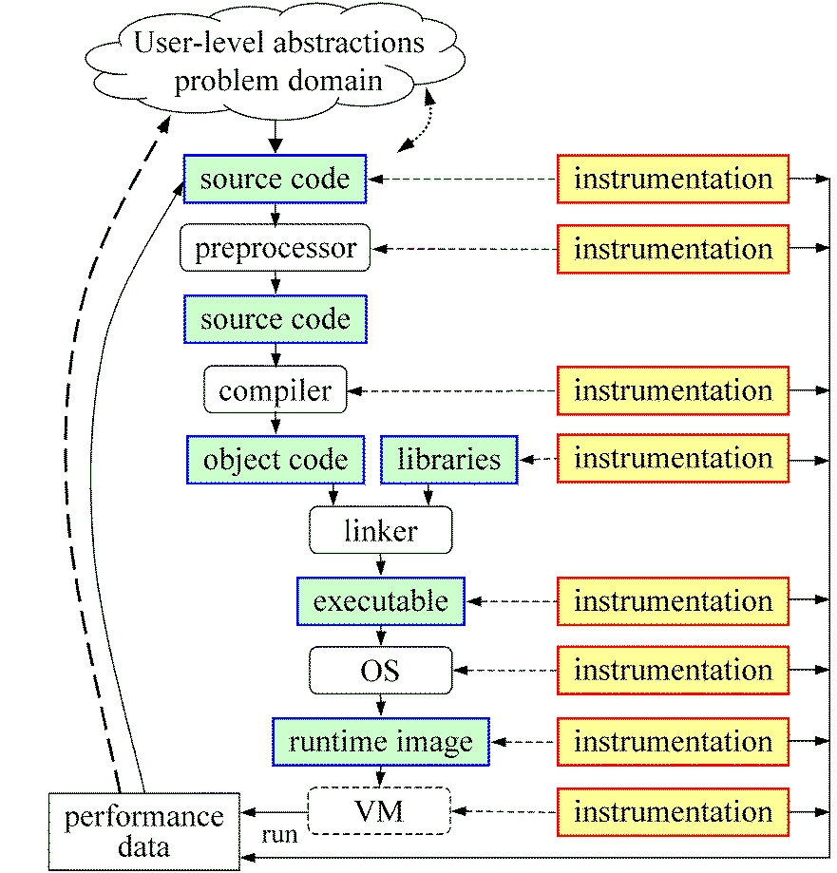
Direct Observation: Mapping
Associate performance data with high-level semantic abstractions
Abstract events at user-level provide semantic context

Slide 44
Indirect Observation: Events/Triggers
Events are actions external to program code
  Timer countdown, HW counter overflow, …
  Consequence of program execution
  Event frequency determined by:
    Type, setup, number enabled (exposed)
Triggers used to invoke measurement tool
  Traps when events occur (interrupt)
  Associated with events
  May add differentiation to events

Slide 45
Indirect Observation: Context
When events trigger, execution context determined at time of trap (interrupt)
  Access to PC from interrupt frame
  Access to information about process/thread
  Possible access to call stack
    requires call stack unwinder
Assumption is that the context was the same during the preceding period
  Between successive triggers
  Statistical approximation valid for long running programs

Slide 46
Direct / Indirect Comparison
Direct performance observation
  ☺ Measures performance data exactly
  ☺ Links performance data with application events
  😐 Requires instrumentation of code
  ☹ Measurement overhead can cause execution intrusion and possibly performance perturbation
Indirect performance observation
  ☺ Argued to have less overhead and intrusion
  ☺ Can observe finer granularity
  ☺ No code modification required (may need symbols)
  ☹ Inexact measurement and attribution

Slide 47
Measurement Techniques
When is measurement triggered?
  External agent (indirect, asynchronous)
    interrupts, hardware counter overflow, …
  Internal agent (direct, synchronous)
    through code modification
How are measurements made?
  Profiling
    summarizes performance data during execution
    per process / thread and organized with respect to context
  Tracing
    trace record with performance data and timestamp
    per process / thread

Slide 48
Measured Performance
Counts
Durations
Communication costs
Synchronization costs
Memory use
Hardware counts
System calls

Slide 49
Critical issues
Accuracy
  Timing and counting accuracy depends on resolution
  Any performance measurement generates overhead
    Execution on performance measurement code
  Measurement overhead can lead to intrusion
  Intrusion can cause perturbation
    alters program behavior
Granularity
  How many measurements are made
  How much overhead per measurement
Tradeoff (general wisdom)
  Accuracy is inversely correlated with granularity

Slide 50
Profiling
Recording of aggregated information
  Counts, time, …
… about program and system entities
  Functions, loops, basic blocks, …
  Processes, threads
Methods
  Event-based sampling (indirect, statistical)
  Direct measurement (deterministic)

Slide 51
Inclusive and Exclusive Profiles
Performance with respect to code regions
Exclusive measurements for region only
Inclusive measurements includes child regions
int foo()
{
int a;
a = a + 1;
bar();
a = a + 1;
return a;
}
inclusive
duration
exclusive
duration

Slide 52
Flat and Callpath Profiles
Static call graph
  Shows all parent-child calling relationships in a program
Dynamic call graph
  Reflects actual execution time calling relationships
Flat profile
  Performance metrics for when event is active
  Exclusive and inclusive
Callpath profile
  Performance metrics for calling path (event chain)
  Differentiate performance with respect to program execution state
  Exclusive and inclusive

Slide 53

Tracing Measurement
Process A:
trace(ENTER, 1);
trace(SEND, B);
trace(EXIT, 1);
1
master
void master {
...
send(B, tag, buf);
...
}
void master {
...
send(B, tag, buf);
...
}
2
worker
3
...
...
MONITOR
58
A
ENTER
1
60
B
ENTER
2
Process B:
62
A
SEND
B
void slave {
...
recv(A, tag, buf);
...
}
void worker {
...
recv(A, tag, buf);
...
}
trace(ENTER, 2);
trace(RECV, A);
trace(EXIT, 2);
64
A
EXIT
1
68
B
RECV
A
69
B
EXIT
2
...

Slide 54
Tracing Analysis and Visualization
1
master
main
2
worker
master
3
...
worker
...
58
A
ENTER
1
60
B
ENTER
2
A
62
A
SEND
B
64
A
EXIT
1
B
68
B
RECV
A
69
B
EXIT
2
58
60
62
64
66
68
70
...

Slide 55
Trace Formats
Different tools produce different formats
  Differ by event types supported
  Differ by ASCII and binary representations
    Vampir Trace Format (VTF)
    KOJAK (EPILOG)
    Jumpshot (SLOG-2)
    Paraver
Open Trace Format (OTF)
  Supports interoperation between tracing tools

Slide 56
Profiling / Tracing Comparison
Profiling
  ☺ Finite, bounded performance data size
  ☺ Applicable to both direct and indirect methods
  😐 Loses time dimension (not entirely)
  ☹ Lacks ability to fully describe process interaction
Tracing
  ☺ Temporal and spatial dimension to performance data
  ☺ Capture parallel dynamics and process interaction
  😐 Some inconsistencies with indirect methods
  ☹ Unbounded performance data size (large)
  ☹ Complex event buffering and clock synchronization

Slide 57
Performance Problem Solving Goals
Answer questions at multiple levels of interest
  High-level performance data spanning dimensions
    machine, applications, code revisions, data sets
    examine broad performance trends
  Data from low-level measurements
    use to predict application performance
Discover general correlations
  performance and features of external environment
  Identify primary performance factors
Benchmarking analysis for application prediction
Workload analysis for machine assessment

Slide 58
Performance Analysis Questions
How does performance vary with different compilers?
Is poor performance correlated with certain OS features?
Has a recent change caused unanticipated performance?
How does performance vary with MPI variants?
Why is one application version faster than another?
What is the reason for the observed scaling behavior?
Did two runs exhibit similar performance?
How are performance data related to application events?
Which machines will run my code the fastest and why?
Which benchmarks predict my code performance best?

Slide 59
Automatic Performance Analysis
Simple
analysis
feedback
72%
Faster!
Build
application
Execute
application
environment /
performance
data
build
information
Performance
database
Offline
analysis

Slide 60
Performance Data Management
Performance diagnosis and optimization involves multiple performance experiments
Support for common performance data management tasks augments tool use
  Performance experiment data and metadata storage
  Performance database and query
What type of performance data should be stored?
  Parallel profiles or parallel traces
  Storage size will dictate
  Experiment metadata helps in meta analysis tasks
Serves tool integration objectives

Slide 61
Metadata Collection
Integration of metadata with each parallel profile
  Separate information from performance data
Three ways to incorporate metadata
  Measured hardware/system information
    CPU speed, memory in GB, MPI node IDs, …
  Application instrumentation (application-specific)
    Application parameters, input data, domain decomposition
    Capture arbitrary name/value pair and save with experiment
  Data management tools can read additional metadata
    Compiler flags, submission scripts, input files, …
    Before or after execution
Enhances analysis capabilities

Slide 62
Performance Data Mining
Conduct parallel performance analysis in a systematic, collaborative and reusable manner
  Manage performance complexity and automate process
  Discover performance relationship and properties
  Multi-experiment performance analysis
Data mining applied to parallel performance data
  Comparative, clustering, correlation, characterization, …
  Large-scale performance data reduction
Implement extensible analysis framework
  Abstraction / automation of data mining operations
  Interface to existing analysis and data mining tools

Slide 63
How to explain performance?
Should not just re-describe performance results
Should explain performance phenomena
  What are the causes for performance observed?
  What are the factors and how do they interrelate?
  Performance analytics, forensics, and decision support
Add knowledge to do more intelligent things
  Automated analysis needs good informed feedback
  Performance model generation requires interpretation
Performance knowledge discovery framework
  Integrating meta-information
  Knowledge-based performance problem solving
Notes:
Check Dresden talk for common language for these slides

Slide 64

Metadata and Knowledge Role
Context Knowledge
You have to capture these...
Source
Code
Build Environment
Run Environment
Performance Problems
Execution
Application
Machine
Performance Knowledge
...to understand this
Performance Result

Slide 65
Performance Optimization Process
Performance characterization
  Identify major performance contributors
  Identify sources of performance inefficiency
  Utilize timing and hardware measures
Performance diagnosis (Performance Debugging)
  Look for conditions of performance problems
  Determine if conditions are met and their severity
  What and where are the performance bottlenecks
Performance tuning
  Focus on dominant performance contributors
  Eliminate main performance bottlenecks

Slide 66
HANDS-ON:
Live-DVD AND NPB-MPI BT
POINT Team

Slide 67
NPB-MPI suite
The NAS Parallel Benchmark suite (sample MPI version)
  Available from http://www.nas.nasa.gov/Software/NPB
  9 benchmarks (7 in Fortran77, 2 in C)
  Configurable for various sizes & classes
Move into the NPB3.3-MPI root directory
Subdirectories contain source code for each benchmark
  plus additional configuration and common code
The provided distribution has already been configured for the tutorial, such that it's ready to “make” one or more of the benchmarks and install them into a (tool-specific) “bin” subdirectory
% cd tutorial/NPB3.3-MPI; ls
BT/ CG/ DT/ EP/ FT/ IS/ LU/ MG/ SP/
bin/ common/ config/ Makefile README README.tutorial sys/

Slide 68
Building an NPB-MPI benchmark
Type “make” for instructions
% make
=========================================
= NAS Parallel Benchmarks 3.3 =
= MPI/F77/C =
=========================================
To make a NAS benchmark type
make <benchmark-name> NPROCS=<number> CLASS=<class>
To make a set of benchmarks, create the file config/suite.def
according to the instructions in config/suite.def.template and type
make suite
***************************************************************
* Custom build configuration is specified in config/make.def *
* Suggested tutorial benchmark specification: *
* make bt CLASS=W NPROCS=16 *
***************************************************************

Slide 69
Building an NPB benchmark
Specify the benchmark configuration
  benchmark name: bt, cg, dt, ep, ft, is, lu, mg, sp
  the number of MPI processes: NPROC=16
  the benchmark class (S, W, A, B, C, D, E): CLASS=W
% make bt NPROCS=16 CLASS=W
cd BT; make NPROCS=16 CLASS=W SUBTYPE= VERSION=
gmake: Entering directory 'BT'
cd ../sys; cc -o setparams setparams.c
../sys/setparams bt 16 W
mpif77 -c -O bt.f
...
cd ../common; mpif77 -c -O timers.f
mpif77 -c -O btio.f
mpif77 -O -o ../bin/bt_W.16 \
bt.o make_set.o initialize.o exact_solution.o exact_rhs.o \
set_constants.o adi.o define.o copy_faces.o rhs.o solve_subs.o \
x_solve.o y_solve.o z_solve.o add.o error.o verify.o setup_mpi.o \
../common/print_results.o ../common/timers.o btio.o
Built executable ../bin/bt_W.16
gmake: Leaving directory 'BT'

Slide 70
NPB-MPI BT (Block Tridiagonal solver)
What does it do?
  Solves a discretized version of unsteady, compressible Navier-Stokes equations in three spatial dimensions
  Performs 200 time-steps on a regular 3-dimensional grid
Can be configured to include various forms of parallel I/O
  e.g., MPI collective file I/O: SUBTYPE=full
Implemented in 20 or so Fortran77 source modules
Needs a square number of processes
  16 should be reasonable (decrease to 9 or 4, if necessary)
    excess processes idle when run with more than compiled
    don’t expect to see speed-up when run on a laptop!
  bt_W should run in around 5 to 12 seconds
  bt_A should take around 16-20x longer (90-100 seconds)

Slide 71
BT-MPI reference execution
Launch as an MPI application
% cd bin; mpiexec -np 16 ./bt_W.16
NAS Parallel Benchmarks 3.3 -- BT Benchmark
Size: 24x 24x 24
Iterations: 200 dt: 0.0008000
Number of active processes: 16
Time step 1
Time step 20
Time step 40
Time step 60
...
Time step 160
Time step 180
Time step 200
Verification Successful
BT Benchmark Completed.
Time in seconds = 4.70
Hint: save the benchmark output (or note the run time) to be able to refer to it later

Slide 72
Tutorial exercise steps
The tutorial steps are similar and repeated for each tool
Edit config/make.def to adjust build configuration
  Modify specification of compiler/linker: MPIF77
Make clean and build new tool-specific executable
Change to the directory containing the new executable before running it with the desired tool configuration
% make clean
% make bt CLASS=W NPROCS=16
Built executable ../bin.$(TOOL)/bt_W.16
% cd bin.$(TOOL)
% export …
% mpiexec –np 16 bt_W.16

Slide 73
NPB-MPI/BT: config/make.def
# SITE- AND/OR PLATFORM-SPECIFIC DEFINITIONS
#---------------------------------------------------------------------
# Items in this file may need to be changed for each platform.
#---------------------------------------------------------------------
...
#---------------------------------------------------------------------
# The Fortran compiler used for MPI programs
#---------------------------------------------------------------------
MPIF77 = mpif77
# Alternative variants to perform instrumentation
#MPIF77 = marmotf77
#MPIF77 = tau_f90.sh
#MPIF77 = scalasca -instrument mpif77
#MPIF77 = vtf77 -vt:f77 mpif77
# PREP is a generic preposition macro for instrumentation preparation
#MPIF77 = $(PREP) mpif77
# This links MPI Fortran programs; usually the same as ${MPIF77}
FLINK = $(MPIF77)
...
Default (no instrumentation)
Hint: uncomment one of these alternative compiler wrappers to perform instrumentation

Slide 74
PAPI
David Cronk
Innovative Computing Lab
University of Tennessee, Knoxville

Slide 75
Hardware Counters
Hardware performance counters available on most modern microprocessors can provide insight into:
  Whole program timing
  Cache behaviors
  Branch behaviors
  Memory and resource access patterns
  Pipeline stalls
  Floating point efficiency
  Instructions per cycle
  Hardware counter information can be obtained with:
  Subroutine or basic block resolution
  Process or thread attribution

Slide 76

What’s PAPI?
Middleware to provide a consistent programming interface for the performance counter hardware found in most major micro-processors.
Countable events are defined in two ways:
  Platform-neutral preset events
  Platform-dependent native events
Presets can be derived from multiple native events
All events are referenced by name and collected in EventSets for sampling
Events can be multiplexed if counters are limited
Statistical sampling implemented by:
  Hardware overflow if supported by the platform
  Software overflow with timer driven sampling

Slide 77
Where’s PAPI
PAPI runs on most modern processors and operating systems of interest to HPC:
  IBM POWER / AIX / Linux
  Blue Gene / L / P…
  Intel Pentium, Core2, Core i7, Atom / Linux
  Intel Itanium / Linux
  AMD Athlon, Opteron / Linux
  Cray XT(n) / CLE
  Altix, Sparc, Niagara …

Slide 78
PAPI Utilities: papi_cost
$ utils/papi_cost -h
This is the PAPI cost program.
It computes min / max / mean / std. deviation for PAPI start/stop pairs; for PAPI reads, and for PAPI_accums.
Usage:
cost [options] [parameters]
cost TESTS_QUIET
Options:
-b BINS set the number of bins for the graphical
distribution of costs. Default: 100
-d show a graphical distribution of costs
-h print this help message
-s show number of iterations above the first
10 std deviations
-t THRESHOLD set the threshold for the number of
iterations. Default: 100,000

Slide 79
PAPI Utilities: papi_cost
$ utils/papi_cost
Cost of execution for PAPI start/stop and PAPI read.
This test takes a while. Please be patient...
Performing start/stop test...
Total cost for PAPI_start/stop(2 counters) over 1000000 iterations
min cycles : 63
max cycles : 17991
mean cycles : 69.000000
std deviation: 34.035263
Performing start/stop test...
Performing read test...
Total cost for PAPI_read(2 counters) over 1000000 iterations
min cycles : 288
max cycles : 102429
mean cycles : 301.000000
std deviation: 144.694053
cost.c PASSED

Slide 80
PAPI Utilities: papi_cost
Cost distribution profile
63:**************************** 999969 counts ****************************
153:
243:
[…]
1863:
1953:********************
2043:
2133:********************
2223:
2313:
2403:********************
2493:********************
2583:****************************************
2673:****************************************
2763:****************************************************************************
2853:****************************************
2943:
3033:********************
3123:****************************************
3213:****************************************
3303:
3393:
3483:
3573:
3663:********************

Slide 81
PAPI Utilities: papi_avail
$ utils/papi_avail -h
Usage: utils/papi_avail [options]
Options:
General command options:
-a, --avail Display only available preset events
-d, --detail Display detailed information about all preset events
-e EVENTNAME Display detail information about specified preset or native event
-h, --help Print this help message
Event filtering options:
--br Display branch related PAPI preset events
--cache Display cache related PAPI preset events
--cnd Display conditional PAPI preset events
--fp Display Floating Point related PAPI preset events
--ins Display instruction related PAPI preset events
--idl Display Stalled or Idle PAPI preset events
--l1 Display level 1 cache related PAPI preset events
--l2 Display level 2 cache related PAPI preset events
--l3 Display level 3 cache related PAPI preset events
--mem Display memory related PAPI preset events
--msc Display miscellaneous PAPI preset events
--tlb Display Translation Lookaside Buffer PAPI preset events
This program provides information about PAPI preset and native events.
PAPI preset event filters can be combined in a logical OR.

Slide 82
PAPI Utilities: papi_avail
$ utils/papi_avail
Available events and hardware information.
--------------------------------------------------------------------------------
PAPI Version : 4.0.0.0
Vendor string and code : GenuineIntel (1)
Model string and code : Intel Core i7 (21)
CPU Revision : 5.000000
CPUID Info : Family: 6 Model: 26 Stepping: 5
CPU Megahertz : 2926.000000
CPU Clock Megahertz : 2926
Hdw Threads per core : 1
Cores per Socket : 4
NUMA Nodes : 2
CPU's per Node : 4
Total CPU's : 8
Number Hardware Counters : 7
Max Multiplex Counters : 32
--------------------------------------------------------------------------------
The following correspond to fields in the PAPI_event_info_t structure.
[MORE…]

Slide 83
PAPI Utilities: papi_avail
[CONTINUED…]
--------------------------------------------------------------------------------
The following correspond to fields in the PAPI_event_info_t structure.
Name Code Avail Deriv Description (Note)
PAPI_L1_DCM 0x80000000 No No Level 1 data cache misses
PAPI_L1_ICM 0x80000001 Yes No Level 1 instruction cache misses
PAPI_L2_DCM 0x80000002 Yes Yes Level 2 data cache misses
[…]
PAPI_VEC_SP 0x80000069 Yes No Single precision vector/SIMD instructions
PAPI_VEC_DP 0x8000006a Yes No Double precision vector/SIMD instructions
-------------------------------------------------------------------------
Of 107 possible events, 34 are available, of which 9 are derived.
avail.c PASSED

Slide 84
PAPI Utilities: papi_avail
$ utils/papi_avail -e PAPI_FP_OPS
[…]
---------------------------------------------------------------------------
The following correspond to fields in the PAPI_event_info_t structure.
Event name: PAPI_FP_OPS
Event Code: 0x80000066
Number of Native Events: 2
Short Description: |FP operations|
Long Description: |Floating point operations|
Developer's Notes: ||
Derived Type: |DERIVED_ADD|
Postfix Processing String: ||
Native Code[0]: 0x4000801b |FP_COMP_OPS_EXE:SSE_SINGLE_PRECISION|
Number of Register Values: 2
Register[ 0]: 0x0000000f |Event Selector|
Register[ 1]: 0x00004010 |Event Code|
Native Event Description: |Floating point computational micro-ops, masks:SSE* FP single precision Uops|
Native Code[1]: 0x4000081b |FP_COMP_OPS_EXE:SSE_DOUBLE_PRECISION|
Number of Register Values: 2
Register[ 0]: 0x0000000f |Event Selector|
Register[ 1]: 0x00008010 |Event Code|
Native Event Description: |Floating point computational micro-ops, masks:SSE* FP double precision Uops|
-------------------------------------------------------------------------

Slide 85
PAPI Utilities: papi_native_avail
UNIX> utils/papi_native_avail
Available native events and hardware information.
--------------------------------------------------------------------------------
[…]
Event Code Symbol | Long Description |
--------------------------------------------------------------------------------
0x40000010 BR_INST_EXEC | Branch instructions executed |
40000410 :ANY | Branch instructions executed |
40000810 :COND | Conditional branch instructions executed |
40001010 :DIRECT | Unconditional branches executed |
40002010 :DIRECT_NEAR_CALL | Unconditional call branches executed |
40004010 :INDIRECT_NEAR_CALL | Indirect call branches executed |
40008010 :INDIRECT_NON_CALL | Indirect non call branches executed |
40010010 :NEAR_CALLS | Call branches executed |
40020010 :NON_CALLS | All non call branches executed |
40040010 :RETURN_NEAR | Indirect return branches executed |
40080010 :TAKEN | Taken branches executed |
--------------------------------------------------------------------------------
0x40000011 BR_INST_RETIRED | Retired branch instructions |
40000411 :ALL_BRANCHES | Retired branch instructions (Precise Event) |
40000811 :CONDITIONAL | Retired conditional branch instructions (Precise |
| Event) |
40001011 :NEAR_CALL | Retired near call instructions (Precise Event) |
--------------------------------------------------------------------------------
[…]

Slide 86
PAPI Utilities: papi_native_avail
UNIX> utils/papi_native_avail -e DATA_CACHE_REFILLS
Available native events and hardware information.
--------------------------------------------------------------------------------
[…]
--------------------------------------------------------------------------------
The following correspond to fields in the PAPI_event_info_t structure.
Event name: DATA_CACHE_REFILLS
Event Code: 0x4000000b
Number of Register Values: 2
Description: |Data Cache Refills from L2 or System|
Register[ 0]: 0x0000000f |Event Selector|
Register[ 1]: 0x00000042 |Event Code|
Unit Masks:
Mask Info: |:SYSTEM|Refill from System|
Register[ 0]: 0x0000000f |Event Selector|
Register[ 1]: 0x00000142 |Event Code|
Mask Info: |:L2_SHARED|Shared-state line from L2|
Register[ 0]: 0x0000000f |Event Selector|
Register[ 1]: 0x00000242 |Event Code|
Mask Info: |:L2_EXCLUSIVE|Exclusive-state line from L2|
Register[ 0]: 0x0000000f |Event Selector|
Register[ 1]: 0x00000442 |Event Code|

Slide 87
PAPI Utilities: papi_event_chooser
$ utils/papi_event_chooser PRESET PAPI_FP_OPS
Event Chooser: Available events which can be added with given events.
--------------------------------------------------------------------------------
[…]
--------------------------------------------------------------------------------
Name Code Deriv Description (Note)
PAPI_L1_DCM 0x80000000 No Level 1 data cache misses
PAPI_L1_ICM 0x80000001 No Level 1 instruction cache misses
PAPI_L2_ICM 0x80000003 No Level 2 instruction cache misses
[…]
PAPI_L1_DCA 0x80000040 No Level 1 data cache accesses
PAPI_L2_DCR 0x80000044 No Level 2 data cache reads
PAPI_L2_DCW 0x80000047 No Level 2 data cache writes
PAPI_L1_ICA 0x8000004c No Level 1 instruction cache accesses
PAPI_L2_ICA 0x8000004d No Level 2 instruction cache accesses
PAPI_L2_TCA 0x80000059 No Level 2 total cache accesses
PAPI_L2_TCW 0x8000005f No Level 2 total cache writes
PAPI_FML_INS 0x80000061 No Floating point multiply instructions
PAPI_FDV_INS 0x80000063 No Floating point divide instructions
-------------------------------------------------------------------------
Total events reported: 34
event_chooser.c PASSED

Slide 88
PAPI Utilities: papi_event_chooser
$ utils/papi_event_chooser PRESET PAPI_FP_OPS PAPI_L1_DCM
Event Chooser: Available events which can be added with given events.
--------------------------------------------------------------------------------
[…]
--------------------------------------------------------------------------------
Name Code Deriv Description (Note)
PAPI_TOT_INS 0x80000032 No Instructions completed
PAPI_TOT_CYC 0x8000003b No Total cycles
-------------------------------------------------------------------------
Total events reported: 2
event_chooser.c PASSED

Slide 89
PAPI Utilities: papi_event_chooser
$ utils/papi_event_chooser NATIVE RESOURCE_STALLS:LD_ST X87_OPS_RETIRED INSTRUCTIONS_RETIRED
[…]
--------------------------------------------------------------------------------
UNHALTED_CORE_CYCLES 0x40000000
|count core clock cycles whenever the clock signal on the specific core is running (not halted). Alias to event CPU_CLK_UNHALTED:CORE_P|
|Register Value[0]: 0x20003 Event Selector|
|Register Value[1]: 0x3c Event Code|
-------------------------------------------------------------------------
UNHALTED_REFERENCE_CYCLES 0x40000002
|Unhalted reference cycles. Alias to event CPU_CLK_UNHALTED:REF|
|Register Value[0]: 0x40000 Event Selector|
|Register Value[1]: 0x13c Event Code|
-------------------------------------------------------------------------
CPU_CLK_UNHALTED 0x40000028
|Core cycles when core is not halted|
|Register Value[0]: 0x60000 Event Selector|
|Register Value[1]: 0x3c Event Code|
0x40001028 :CORE_P |Core cycles when core is not halted|
0x40008028 :NO_OTHER |Bus cycles when core is active and the other is halted|
-------------------------------------------------------------------------
Total events reported: 3
event_chooser.c PASSED

Slide 90
PAPI Utilities: papi_command_line
$ papi_command_line PAPI_FP_OPS
Successfully added: PAPI_FP_OPS
PAPI_FP_OPS : 100000000
----------------------------------
Verification: None.
This utility lets you add events from the command line interface to see if they work.
command_line.c PASSED
$ papi_command_line PAPI_FP_OPS PAPI_L1_DCA
Successfully added: PAPI_FP_OPS
Successfully added: PAPI_L1_DCA
PAPI_FP_OPS : 100000000
PAPI_L1_DCA : 120034404
----------------------------------
Verification: None.
This utility lets you add events from the command line interface to see if they work.
command_line.c PASSED

Slide 91
The Code
#define ROWS 1000 // Number of rows in each matrix
#define COLUMNS 1000 // Number of columns in each matrix
void classic_matmul()
{
// Multiply the two matrices
int i, j, k;
for (i = 0; i < ROWS; i++) {
for (j = 0; j < COLUMNS; j++) {
float sum = 0.0;
for (k = 0; k < COLUMNS; k++) {
sum +=
matrix_a[i][k] * matrix_b[k][j];
}
matrix_c[i][j] = sum;
}
}
}
void interchanged_matmul()
{
// Multiply the two matrices
int i, j, k;
for (i = 0; i < ROWS; i++) {
for (k = 0; k < COLUMNS; k++) {
for (j = 0; j < COLUMNS; j++) {
matrix_c[i][j] +=
matrix_a[i][k] * matrix_b[k][j];
}
}
}
}
// Note that the nesting of the innermost loops
// has been changed. The index variables j and k
// change the most frequently and the access
// pattern through the operand matrices is
// sequential using a small stride (one.) This
// change improves access to memory data through
// the data cache. Data translation lookaside
// buffer (DTLB) behavior is also improved.
for (j = 0; j < COLUMNS; j++) {
for (k = 0; k < COLUMNS; k++) {
for (j = 0; j < COLUMNS; j++) {
for (k = 0; k < COLUMNS; k++) {
matrix_c[i][j] +=
matrix_a[i][k] * matrix_b[k][j];
sum +=
matrix_a[i][k] * matrix_b[k][j];

Slide 92
IPC – instructions per cycle
Measurement Classic mat_mul Reordered mat_mul
============================================================================
PAPI_IPC Test (PAPI_ipc)
Real time 13.6093 sec 2.9796 sec
Processor time 13.5359 sec 2.9556 sec
IPC 0.3697 1.6936
Instructions 9007035063 9009011383
High Level IPC Test (PAPI_{start,stop}_counters)
Real time 13.6106 sec 2.9762 sec
IPC 0.3697 1.6939
PAPI_TOT_CYC 24362605525 5318626915
PAPI_TOT_INS 9007034503 9009011245
Low Level IPC Test (PAPI low level calls)
Real time 13.6113 sec 2.9772 sec
IPC 0.3697 1.6933
PAPI_TOT_CYC 24362750167 5320395138
PAPI_TOT_INS 9007034381 9009011130
All three PAPI methods consistent
Roughly 460% improvement in reordered code

Slide 93
Data Cache Access
Data Cache Misses can be considered in 3 categories:
Compulsory: Occurs on first reference to a data item.
  Prefetching
Capacity: Occurs when the working set exceeds the cache capacity.
  Spatial locality
  Smaller working set (blocking/tiling algorithms)
Conflict: Occurs when a data item is referenced after the cache line containing the item was evicted earlier.
  Temporal locality
  Data layout; memory access patterns

Slide 94
L1 Data Cache Access
Measurement Classic mat_mul Reordered mat_mul
============================================================================
DATA_CACHE_ACCESSES 2002807841 3008528961
DATA_CACHE_REFILLS:L2_MODIFIED:L2_OWNED:L2_EXCLUSIVE:L2_SHARED
205968263 60716301
DATA_CACHE_REFILLS_FROM_SYSTEM:MODIFIED:OWNED:EXCLUSIVE:SHARED
61970925 1950282
----------------------
PAPI_L1_DCA 2002808034 3008528895
PAPI_L1_DCM 268010587 62680818
Data Cache Request Rate 0.2224 req/inst 0.3339 req/inst
Data Cache Miss Rate 0.0298 miss/inst 0.0070 miss/inst
Data Cache Miss Ratio 0.1338 miss/req 0.0208 miss/req
Two techniques
  First uses native events
  Second uses PAPI presets only
~50% more requests from reordered code
1/4 as many misses per instruction
1/6 as many misses per request

Slide 95
Branching
Measurement Classic mat_mul Reordered mat_mul
============================================================================
PAPI_BR_INS 1001028240 1001006987
PAPI_BR_MSP 1028256 1006984
PAPI_BR_TKN 1000027233 1000005980
Branch Rate 0.1111 br/inst 0.1111 br/inst
Branch Miss Rate 0.0001 miss/inst 0.0001 miss/inst
Branch Miss Ratio 0.0010 miss/br 0.0010 miss/br
Branch Taken Rate 0.1110 tkn/inst 0.1110 tkn/inst
Branch Taken Ratio 0.9990 tkn/br 0.9990 tkn/br
Instr / Branch 8.9978 inst/br 8.9999 inst/br
Uses all PAPI Presets!
Branch behavior nearly identical in both codes
Roughly 1 branch every 9 instructions
1 miss per 1000 branches (remember ROWS?)
Branching and branch misses can be reduced with loop unrolling, loop fusion and function in-lining.

Slide 96
Performance Measurement Categories
Efficiency
  Instructions per cycle (IPC)
  Memory bandwidth
Caches
  Data cache misses and miss ratio
  Instruction cache misses and miss ratio
Lower level cache misses and miss ratio
Translation lookaside buffers (TLB)
  Data TLB misses and miss ratio
  Instruction TLB misses and miss ratio
Control transfers
  Branch mispredictions
  Near return mispredictions
Special cases
  Unaligned data access
  Floating point operations
  Floating point exceptions

Slide 97
Extending PAPI beyond the CPU
PAPI has historically targeted on on-processor performance counters
Several categories of off-processor counters exist
  network interfaces: Myrinet, Infiniband, GigE
  memory interfaces: Cray SeaStar, Gemini
  thermal and power interfaces: ACPI, lm-sensors
  accelerators?
CHALLENGE:
  Extend the PAPI interface to address multiple counter domains
  Preserve the PAPI calling semantics, ease of use, and platform independence for existing applications

Slide 98
Component PAPI Goals
Support simultaneous access to on- and off-processor counters
Isolate hardware dependent code in separable ‘component’ modules
Extend platform independent code to support multiple simultaneous components
Add or modify API calls to support access to any of several components
Modify build environment for easy selection and configuration of multiple available components
Notes:
98

Slide 99







Component PAPI
Low Level
User API
High Level
User API
PAPI FRAMEWORK
Developer API
Developer API
Developer API
PAPI COMPONENT
(NETWORK)
PAPI COMPONENT
(CPU)
PAPI COMPONENT
(THERMAL)
Operating System
Operating System
Operating System
Counter Hardware
Counter Hardware
Counter Hardware

Slide 100
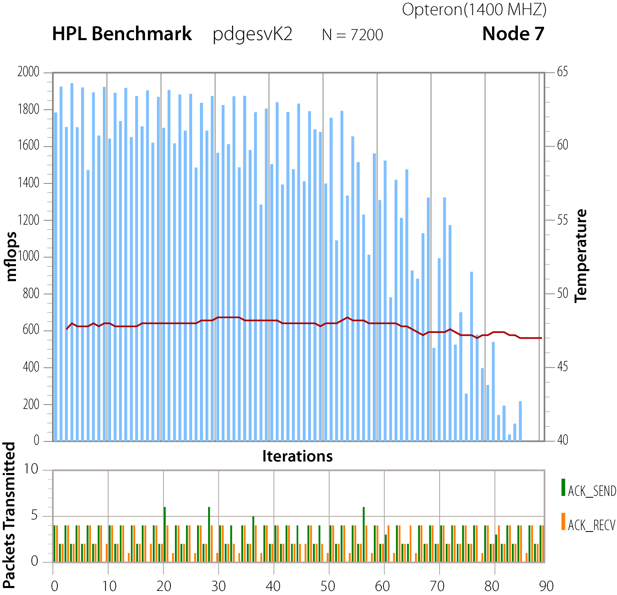
Multi Component Measurements
HPCC HPL benchmark on Opteron with 3 performance metrics:
  FLOPS; Temperature; Network Sends/Receives
    Temperature is from an on-chip thermal diode

Slide 101
For more information
PAPI Website: http://icl.cs.utk.edu/papi/
  Software
  Release notes
  Documentation
  Links to tools that use PAPI
  Mailing/discussion lists

Slide 102
PerfSuite
Rui Liu and Rick Kufrin
National Center for Supercomputing Applications
University of Illinois at Urbana-Champaign

Slide 103
Outline
Overview
PerfSuite Tools
Hands-On Exercise with LiveDVD
PerfSuite Libraries / APIs
PerfSuite and Java
Current Issues and Status

Slide 104
PerfSuite Background
Active development since Linux clusters were adopted at NCSA in 2001
  No tools then available for CPU beyond gprof
UI/NCSA Open Source license approved 2003
Targeted to users of all levels of expertise
  The intent is to provide an easy-to-use mechanism for measuring application performance, and to expose problem areas for further exploration
Low measurement overhead also important
Close collaboration/sharing with UTK from outset

Slide 105
PerfSuite and POINT
NSF SDCI program enables maintenance, enhancement, interoperability, and integration
PerfSuite fills the Level 0 (entry) role for performance measurement within POINT
  Simple (in most cases, no code change/relink needed)
  Low overhead (default case is nearly non-intrusive)
  Limited information… but still very useful and in some cases sufficient
PerfSuite has never attempted to supply sophisticated graphical/visualization or data management capabilities
  By partnering with TAU, advanced graphical tools come as a natural by-product
  PerfDMF infrastructure is mature, and well-suited for importing data collected by PerfSuite
POINT’s application and training thrust (PSC) will expose to wider user base

Slide 106
What Does PerfSuite Provide?
Overall hardware performance event counts for all or a portion of your application
Profiling with statistical sampling using either time- or event-based triggers
  Generalization of the approach used by gprof
Flexible XML-based output along with various techniques for display, manipulation, combining, transformation
Information about processor in use (type, cache/TLB specs, etc) – this “metadata” is stored along with measurement
Functionality available through easy-to-use command line tool that can be used with most applications without need for modification
Also available through several libraries for finer control

Slide 107
PerfSuite and XML
In PerfSuite, nearly all data (input, output, configuration, etc) is represented as XML (eXtensible Markup Language) documents
This provides the ability to manipulate & transform the data in many ways using standard software / skills
Machine-independent (no binary files)
  ... opens the data up to the user
There are numerous high-quality XML-aware libraries available from either compiled or interpreted languages that can make it easy to transform the data for your needs
  New in PS version 1.0.0: Java API for accessing data
The structured, well-defined nature of XML makes it natural for import into DB-driven infrastructure such as PerfDMF

Slide 108
PerfSuite Counter-Related Software
Four performance counter-related utilities:
  psconfig - configure / select performance events
  psinv - query events and machine information
  psrun - generate raw counter or statistical profiling data from an unmodified binary
  psprocess - pre- and post-process data
Three libraries (shared and static, serial and threaded)
  libperfsuite – the “core” library that can be used standalone and will be built regardless of the availability of other software
  libpshwpc – HardWare Performance Counter library, also built regardless of other software. Without counter support, will only perform time-based profiling through profil() or interval timers
  libpshwpc_mpi – a convenience library based on the MPI standard PMPI interface
PerfSuite does not require kernel patches

Slide 109
psinv: Processor Inventory
titan:~3% psinv -v
System Information -
Processors: 2
Total Memory: 2007.16 MB
System Page Size: 16.00 KB
Processor Information -
Vendor: Intel
Processor family: IPF
Model (Type): Itanium
Revision: 6
Clock Speed: 800.136 MHz
Cache and TLB Information -
Cache levels: 3
Caches/TLBs: 7
Cache Details -
Level 1:
Type: Data
Size: 16 KB
Line size: 32 bytes
Associativity: 4-way set associative
Type: Instruction
Size: 16 KB
Line size: 32 bytes
Associativity: 4-way set associative
Lists information about the characteristics of the computer
This same information is also stored in PerfSuite XML output and is useful for later generating derived metrics (or for remembering where you ran your program!)
x86/x86-64 version also shows processor features and descriptions
Lists available hardware performance events

Slide 110
psinv: PAPI Event Summary
% psinv -p
PAPI Standard Event Information -
Standard events: 43
Non-derived events: 26
Derived events: 17
PAPI Standard Event Details -
Non-derived:
PAPI_BR_INS: Branch instructions
PAPI_BR_PRC: Conditional branch instructions correctly predicted
PAPI_L1_DCA: Level 1 data cache accesses
PAPI_L1_DCM: Level 1 data cache misses
PAPI_L1_ICM: Level 1 instruction cache misses
PAPI_L2_DCA: Level 2 data cache accesses
PAPI_L2_DCR: Level 2 data cache reads
PAPI_L2_DCW: Level 2 data cache writes
PAPI_L2_ICM: Level 2 instruction cache misses
PAPI_L2_STM: Level 2 store misses
PAPI_L2_TCM: Level 2 cache misses
Derived:
PAPI_BR_MSP: Conditional branch instructions mispredicted
PAPI_BR_NTK: Conditional branch instructions not taken
PAPI_BR_TKN: Conditional branch instructions taken
PAPI_FLOPS: Floating point instructions per second
PAPI_FP_INS: Floating point instructions
PAPI_L1_DCH: Level 1 data cache hits

Slide 111
psrun: Performance Measurement
Hardware performance counting and profiling with unmodified dynamically-linked executables
Available for x86, x86-64, and ia64
POSIX threads support
Automatic multiplexing
Can be used with MPI and OpenMP
Optionally collects resource usage
Supports all PAPI standard and CPU-native events
Input/Output = XML documents (can request plain text)

Slide 112
psrun “Cookbook”
# First, be sure to set all paths properly (can do in .cshrc/.profile)
% set PSDIR=/opt/perfsuite
% source $PSDIR/bin/psenv.csh
# Use psrun on your program to generate the data,
# then use psprocess to produce an HTML file (default is plain text)
% psrun myprog
% psprocess --html myprog.12345.xml > myprog.html
# Take a look at the results
% your-web-browser myprog.html
# Second run, but this time profiling instead of counting
% psrun –C -c papi_profile_cycles.xml myprog
% psprocess -e myprog myprog.67890.xml

Slide 113
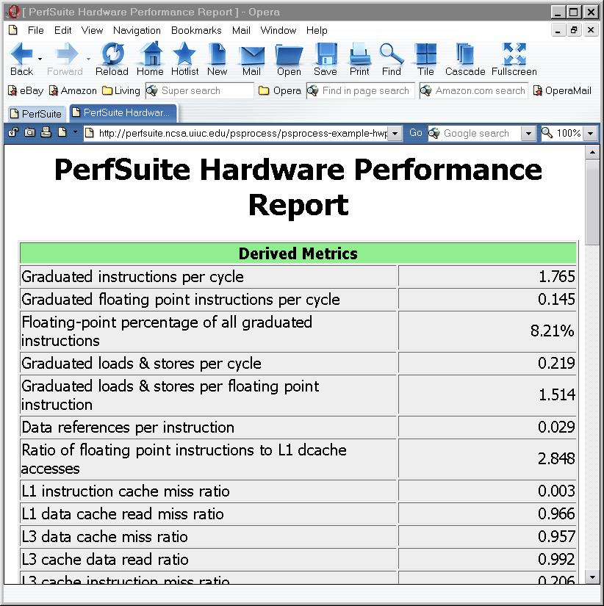
psprocess: Post-process Results
This style of output is customizable by you
By default, the information it contains and its visual appearance are based on PerfSuite-provided defaults, but these can be easily replaced to suit your preference
This output is generated by psprocess using XML Transformations. The stylesheet is in the share/perfsuite/xml/pshwpc subdirectory, with a “xsl” file extension

Slide 114
psprocess: Text Mode (default)
PerfSuite Hardware Performance Summary Report
Version : 1.0
Created : Mon Dec 30 11:31:53 AM Central Standard Time 2002
Generator : psprocess 0.5
XML Source : /u/ncsa/anyuser/performance/psrun-ia64.xml
Execution Information
===========================
Date : Sun Dec 15 21:01:20 2002
Host : user01
Processor and System Information
===========================
Node CPUs : 2
Vendor : Intel
Family : IPF
Model : Itanium
CPU Revision : 6
Clock (MHz) : 800.136
Memory (MB) : 2007.16
Pagesize (KB): 16

Slide 115
psprocess: Text Mode, cont’d
Cache Information
==========================
Cache levels : 3
--------------------------------
Level 1
Type : data
Size (KB) : 16
Linesize (B) : 32
Assoc : 4
Type : instruction
Size (KB) : 16
Linesize (B) : 32
Assoc : 4
--------------------------------
Level 2
Type : unified
Size (KB) : 96
Linesize (B) : 64
Assoc : 6
The reports (text or HTML) generated by psprocess have several sections, covering:
Report creation details
Run details
Machine information
Raw counter listings
Counter explanations and index
Derived metrics
Run annotation defined by you
Derived metrics are evaluated at run-time and can be extended (text mode only)

Slide 116
psprocess: Text Mode, cont’d
Index Description Counter Value
=================================================================
1 Conditional branch instructions mispredicted..... 4831072449
4 Floating point instructions...................... 86124489172
5 Total cycles..................................... 594547754568
6 Instructions completed........................... 1049339828741
Statistics
=================================================================
Graduated instructions per cycle................... 1.765
Graduated floating point instructions per cycle.... 0.145
Level 3 cache miss ratio (data).................... 0.957
Bandwidth used to level 3 cache (MB/s)............. 385.087
% cycles with no instruction issue................. 10.410
% cycles stalled on memory access.................. 43.139
MFLOPS (cycles).................................... 115.905
MFLOPS (wallclock)................................. 114.441

Slide 117
Configuring Your Measurement
All PerfSuite runs are configured according to an XML document that specifies what is to be measured
  if you don’t specify a custom configuration, a default is used
A custom configuration document (file) is supplied in one of two ways
  psrun option “-c filename”
  PS_HWPC_CONFIG environment variable, which can be set to filename
Creating new configuration files is easy, and can be done with either a text editor or the tool psconfig

Slide 118
Example Configuration
<?xml version="1.0" encoding="UTF-8" ?>
<ps_hwpc_eventlist class="PAPI">
<ps_hwpc_event type="preset" name="PAPI_BR_MSP" />
<ps_hwpc_event type="preset" name="PAPI_BR_PRC" />
<ps_hwpc_event type="preset" name="PAPI_BR_TKN" />
<ps_hwpc_event type="preset" name="PAPI_FP_INS" />
<ps_hwpc_event type="preset" name="PAPI_TOT_CYC" />
<ps_hwpc_event type="preset" name="PAPI_TOT_INS" />
<ps_hwpc_event type="preset" name="PAPI_L1_DCA" />
<ps_hwpc_event type="preset" name="PAPI_L1_DCM" />
<ps_hwpc_event type="preset" name="PAPI_L1_TCM" />
<ps_hwpc_event type="preset" name="PAPI_L2_DCA" />
<ps_hwpc_event type="preset" name="PAPI_L2_DCM" />
</ps_hwpc_eventlist>
You can edit this file like any text file
The XML document root element “ps_hwpc_eventlist” indicates this configuration is to be used for aggregate counting (not profiling)

Slide 119
Using Processor “Native Events”
It’s easy to work with native events in addition to PAPI standard events by modifying the configuration file slightly
Instead of using the XML attributes type=“preset” name=“PAPI_EVENTNAME”, use the attribute type=“native” and enclose the event name as the content of the element
Can be used with profiling configurations
<ps_hwpc_event type=“native”>NOPS_RETIRED</ps_hwpc_event>
<ps_hwpc_event type=“native”>BACK_END_BUBBLE_ALL</ps_hwpc_event>

Slide 120
Configuring for Profiling
Setting up for profiling is similar to counting - all you have to do is modify the XML configuration document:
The XML document “root element” is now <ps_hwpc_profile>, not <ps_hwpc_eventlist>
You can supply an optional “threshold”, or sampling rate
Only one event is allowed in the document
psconfig does not yet support profiling, need to edit by hand
<?xml version="1.0" encoding="UTF-8" ?>
<ps_hwpc_profile class="PAPI">
<ps_hwpc_event type="preset" name="PAPI_BR_MSP“ threshold="100000" />
</ps_hwpc_profile>

Slide 121
psprocess Text-Based Profiles
Profile Information
================================================================================
Class : PAPI
Version : 3.6.2
Event : PAPI_TOT_CYC (Total cycles)
Period : 100000
Samples : 200471
Domain : user
Run Time : 27.19 (seconds)
Min Self % : (all)
Module Summary
--------------------------------------------------------------------------------
Samples Self % Total % Module
186068 92.82% 92.82% /home/rkufrin/apps/aspcg/aspcg
14182 7.07% 99.89% /opt/intel/cc/9.0/lib/libguide.so
187 0.09% 99.98% /lib/ld-2.3.6.so
18 0.01% 99.99% /lib/tls/libc-2.3.6.so
15 0.01% 100.00% /lib/tls/libpthread-2.3.6.so
1 0.00% 100.00% /tmp/perfsuite/lib/libpsrun_r.so.0.0.1
File Summary
--------------------------------------------------------------------------------
Samples Self % Total % File
154346 76.99% 76.99% /home/rkufrin/apps/aspcg/pc_jac2d_blk3.f
14506 7.24% 84.23% /home/rkufrin/apps/aspcg/cg3_blk.f
14505 7.24% 91.46% ??
10185 5.08% 96.54% /home/rkufrin/apps/aspcg/matxvec2d_blk3.f
3042 1.52% 98.06% /home/rkufrin/apps/aspcg/dot_prod2d_blk3.f
2366 1.18% 99.24% /home/rkufrin/apps/aspcg/add_exchange2d_blk3.f
834 0.42% 99.66% /home/rkufrin/apps/aspcg/main3.f
687 0.34% 100.00% /home/rkufrin/apps/aspcg/cs_jac2d_blk3.f

Slide 122
Text-based profiles, cont’d
Function Summary
--------------------------------------------------------------------------------
Samples Self % Total % Function
154346 76.99% 76.99% pc_jac2d_blk3
14506 7.24% 84.23% cg3_blk
10185 5.08% 89.31% matxvec2d_blk3
6937 3.46% 92.77% __kmp_x86_pause
4711 2.35% 95.12% __kmp_wait_sleep
3042 1.52% 96.64% dot_prod2d_blk3
2366 1.18% 97.82% add_exchange2d_blk3
Function:File:Line Summary
--------------------------------------------------------------------------------
Samples Self % Total % Function:File:Line
39063 19.49% 19.49% pc_jac2d_blk3:/home/rkufrin/apps/aspcg/pc_jac2d_blk3.f:20
24134 12.04% 31.52% pc_jac2d_blk3:/home/rkufrin/apps/aspcg/pc_jac2d_blk3.f:19
15626 7.79% 39.32% pc_jac2d_blk3:/home/rkufrin/apps/aspcg/pc_jac2d_blk3.f:21
15028 7.50% 46.82% pc_jac2d_blk3:/home/rkufrin/apps/aspcg/pc_jac2d_blk3.f:33
13878 6.92% 53.74% pc_jac2d_blk3:/home/rkufrin/apps/aspcg/pc_jac2d_blk3.f:24
11880 5.93% 59.66% pc_jac2d_blk3:/home/rkufrin/apps/aspcg/pc_jac2d_blk3.f:31
8896 4.44% 64.10% pc_jac2d_blk3:/home/rkufrin/apps/aspcg/pc_jac2d_blk3.f:22
7863 3.92% 68.02% matxvec2d_blk3:/home/rkufrin/apps/aspcg/matxvec2d_blk3.f:19
7145 3.56% 71.59% pc_jac2d_blk3:/home/rkufrin/apps/aspcg/pc_jac2d_blk3.f:32

Slide 123
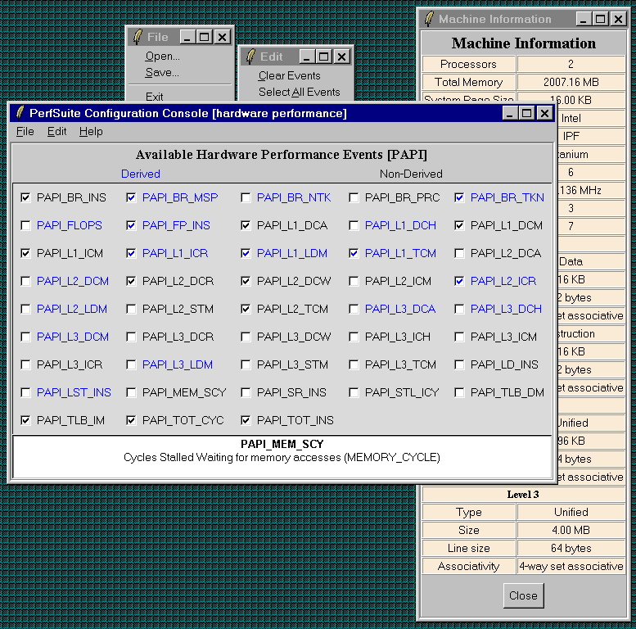
psconfig: Graphical Configuration
Graphical user interface makes it easy to select events
Can read in or write out valid XML documents to be used by psrun
Provides text description of events with mouse click
Searching capabilities
Profiling not yet supported

Slide 124
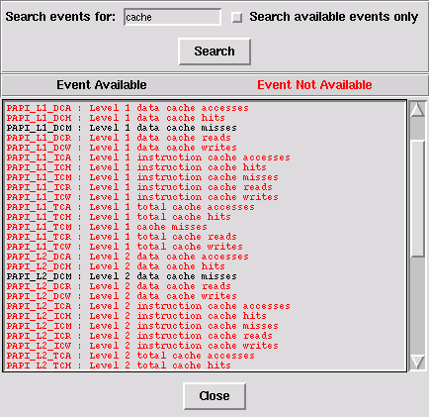
Searching Events with psconfig
Selecting “Edit”, “Search Events…” brings up a window like this that allows you to search events for keywords
Can restrict the search to only events available on your computer
The search is based on the event’s description, not its standard event name (PAPI_TOT_CYC)

Slide 125
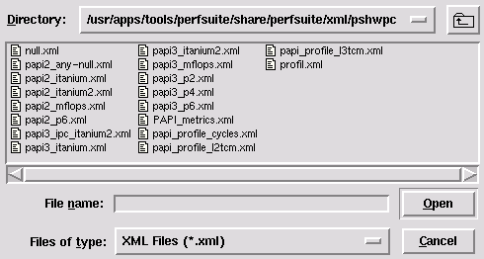
Browsing Predefined Event Configurations
Selecting “File”, “Default Hardware Event Configurations…” brings up the directory with pre-selected configuration documents
Opening one of them will show you which events will be used
You can base custom configuration files using these as a start

Slide 126
psrun: Advanced Use
psrun supports a few options that can be useful in working with shared or distributed memory programs:
-p / --pthreads
  uses a POSIX thread-aware variant of the library that captures thread creation and measures performance of each, depositing the results in an XML document with the thread ID embedded
-f / --fork
  monitors child processes that are created. Not enabled by default
-a / --annotate
  inserts an XML “element” with a user-supplied annotation (text)

Slide 127
psprocess: Advanced Use
psprocess is meant to be a “generic” processor for different XML document types generated by PerfSuite. For hardware counting, the most common type is <hwpcreport>
Individual documents can be combined into a “multi-document” with the option –c / --combine. With hardware counter data, psprocess summarizes the information contained in them with descriptive statistics (mean, max, min, sum, stddev)
-s LIST is a very useful option to be used with profiling runs. LIST is a comma-separated list of modules, files, functions, lines used to limit the amount of output
-t THRESHOLD is also helpful in limiting the output of profiling runs. THRESHOLD is a number that specifies the minimum % of samples required for a given entry to be displayed. Example: “-t 2” means “don’t show me anything that didn’t account for at least 2% of the samples collected”
psprocess help output (“-h”) lists all available options and types

Slide 128
psprocess: User-defined Metrics
psprocess allows the creation of user-defined metrics
User-defined metrics are stored in a file of your choice that contains expression templates (reminiscent of MathML)
Select via PS_HWPC_METRICS environment variable or “psprocess –m”
<?xml version="1.0" encoding="UTF-8" ?>
<psmetrics class="hwpc">
<metric namespace="PAPI" type="ratio">
<name>PS_RATIO_GINS_CYC</name>
<description lang="en_US">Graduated instructions per cycle</description>
<definition>
<apply>
<divide>
<ci>PAPI_TOT_INS</ci>
<ci>PAPI_TOT_CYC</ci>
</divide>
</apply>
</definition>
</metric>
</psmetrics>

Slide 129
PerfSuite Environment Variables
PS_HWPC: “off” or “on”, controls whether measurement takes place at all (for API)
PS_HWPC_CONFIG: set to the name of the XML event file created with psconfig or “by hand”. A default is used if not set
PS_HWPC_FILE: controls the prefix of the XML output document (default is the name of the command being measured)
PS_HWPC_ANNOTATION - adds an arbitrary “note” to the XML output
PS_HWPC_DOMAIN: controls whether counting at user or system level (or both)
PS_HWPC_THRESHOLD: sets threshold for profiling
PS_HWPC_FORMAT: “text” or “xml”, controls whether output is in an XML document or plain text (similar to a psprocess report)
PSRUN_DOFORK: if set (to anything), monitors child processes also
“psrun –h” will show a complete listing of recognized variables

Slide 130
PerfSuite’s XML Document Hierarchy
The basic per-thread XML document that is created by PerfSuite is called an “hwpcreport”
  These are in either “counting” or “profiling” mode
Logical collections of the basic documents can be grouped together using the “-c” (“combine”) option to psprocess. The result is called a “multihwpcreport”
  This is where the notion of a parallel run of arbitrary scale enters and can be applied to shared- or distributed-memory runs
  Subsequent processing with psprocess recognizes these “multi” documents and provides different statistics, more appropriate for parallel runs
The basic concept is extensible to further logical collections of one or more runs, threads, tasks, etc

Slide 131
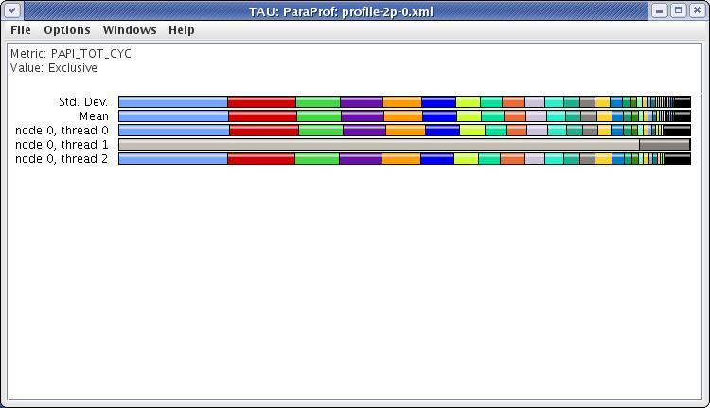
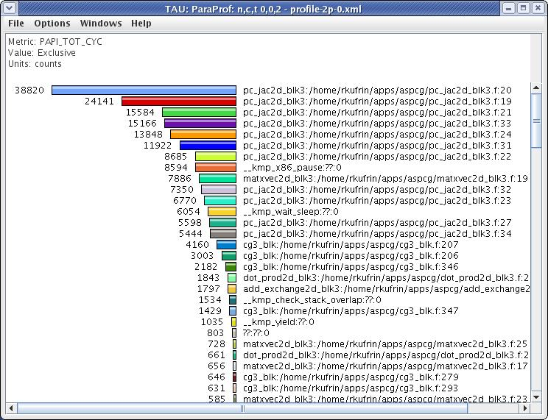
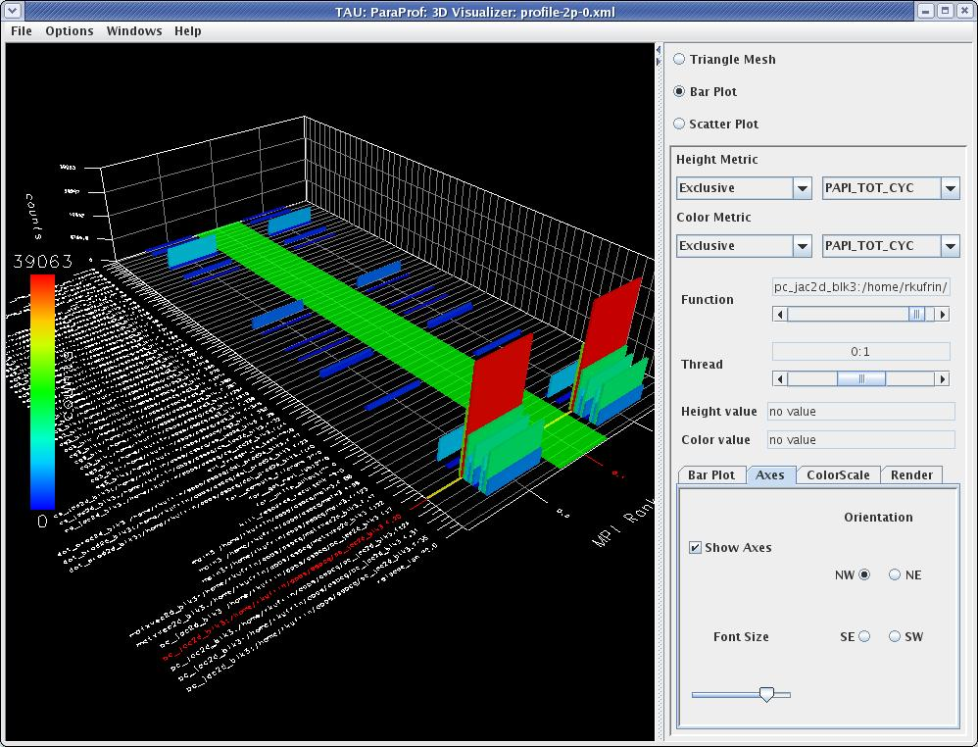
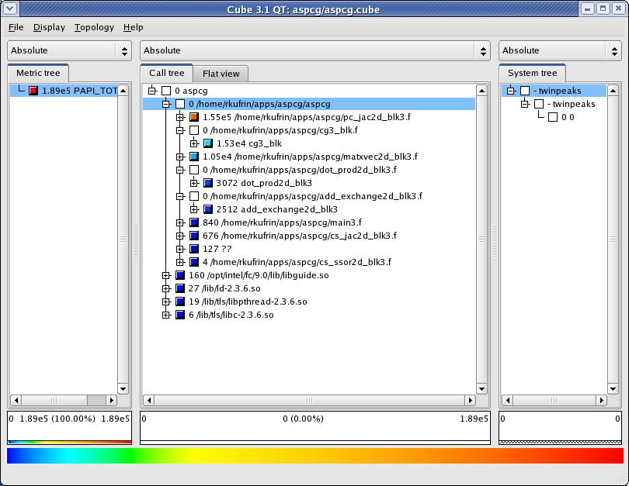
PerfSuite Profiles with ParaProf and Cube3
TAU’s ParaProf can display PerfSuite profiles after being mapped to source and stored as XML (psprocess –x)
Development version of psprocess produces Cube XML files directly

Slide 132
LiveDVD Hands-On Exercise
The goals of this exercise are to gain experience with:
  querying your computer with psinv
  collecting performance data with psrun
  examining the results with psprocess
  using PerfSuite data with other POINT/VI-HPS tools
Your environment is already set up properly to access PerfSuite after booting the LiveDVD, so no need to “source” the “psenv” file
We will use one of the NAS Parallel Benchmarks (NPB-MPI, BT), which are already on the LiveDVD

Slide 133
Querying Your System with psinv
Open a new shell (terminal), and run the psinv command, asking it to display everything it can by supplying the option –v
You will probably want to pipe the output into a pager like less
Output is broken into several logical sections:
% psinv –v | less
System/OS | Cache/TLB |  | PAPI Events
Processor Type/Speed |  | Processor Features

Slide 134
Building and Running NPB-MPI/BT
Position yourself in the source directory for the NPB-MPI benchmark, build the program, and run it without performance tools
Symbols are not included in the build by default (and they will be needed for profiling), so we request their inclusion via FFLAGS
% cd tutorial
% make bt NPROCS=4 CLASS=W FFLAGS=“-O –g”
% cd bin
% mpirun –np 4 ./bt_W.4

Slide 135
Obtaining Hardware Event Counts
Next, run the application again, but this time include psrun in the launch command:
Examine the data from one or more of the resulting XML documents with psprocess:
Combine all tasks’ data into a single document and view the aggregate statistics:
% mpirun –np 4 psrun ./bt_W.4
This is a process ID
% psprocess bt_W.4.NNNN.localhost.xml
% psprocess –c –o combined.xml bt_W*.xml
% psprocess combined.xml

Slide 136
Modifying Your Configuration
You may have to adjust the default configuration file that psrun uses, to correspond to the type of CPU you have. You can check the default configuration to be used by executing psrun -h
Use environment variable PS_HWPC_CONFIG or supply the option -c to psrun
Likely values that may work for your system:
  “papi3_core.xml” (Intel Core)
  “papi3_p4.xml” (Intel Pentium 4)
  “papi3_p6.xml” (Intel Pentium Pro, II, III)
If you find that you need to adjust the configuration:
% mpirun –np 4 psrun –C –c conf.xml ./bt_W.4

Slide 137
Obtaining A Profile
Profiling the application involves using psrun again, but using a different configuration file. We will also add the option -o, which allows us to explicitly name the output files:
Once again, use psprocess to view:
% mpirun –np 4 psrun –o bt_profile –C \
-c papi_profile_cycles.xml ./bt_W.4
% psprocess bt_profile.NNNN.xml

Slide 138
Using POINT and VI-HPS Tools
There is no built-in support within PerfSuite for working with profiles generated from parallel applications as a whole. However, you can use TAU’s ParaProf:
… and Scalasca’s Cube:
% psprocess –o pstau.xml –x –-glob ‘bt_profile*.xml’
% paraprof –f psrun pstau.xml
% psprocess –o pscube.xml –-cube –-glob ‘bt_profile*.xml’
% cube3 pscube.xml
The –-glob option provides pattern-based filename matching without exceeding shell limits. Use quotes to protect from shell interpretation/expansion!

Slide 139
PerfSuite Library Access (API)
All of the functionality is also available from within your program (C/C++/Fortran) through a small API
Same XML documents are read, same XML documents are written, small additional functionality
Why would you want to use this?
  Primarily to gain finer control over where measurements are taken in your program. For example, you might defer measurement until program initialization has completed
For complex uses, you are probably better off using an “industrial-strength” performance library
The intent of the API is to “abstract out” the process of performance measurement to a very high level

Slide 140
libperfsuite: Core Library
This library is available regardless of the presence of hardware counter support
Small number of useful routines callable from either C or FORTRAN (use “PSF_” instead of “ps_” with FORTRAN)
  int ps_cpuspeed (double *mhz);
  int ps_cpuusage (pid_t pid, ps_time_t *utime,
  ps_time_t *stime);
  int ps_dmemusage (float *total_mb, float *used_mb,
  float *free_mb);
  int ps_memusage (pid_t pid, float *vsize_mb,
  float *rss_mb);
  int ps_procstat (pid_t pid,
  ps_procstat_t *p);
  int ps_rtc (unsigned long long *rtcval);
  int ps_rtcinit (void);
  const char *ps_strerror (int code);
#include <perfsuite.h> (or “fperfsuite.h”)

Slide 141
libpshwpc: Performance Collection API
C / C++
ps_hwpc_init (void)
ps_hwpc_start (void)
ps_hwpc_read (long long *values)
ps_hwpc_suspend (void)
ps_hwpc_stop (char *prefix)
ps_hwpc_shutdown (void)
Call “init” once, call “start”, “read” and “suspend” as many times as you like. Call “stop” (supplying a file name prefix of your choice) to get the performance data XML document
Optionally, call “shutdown”
Example programs demonstrating use are installed in PerfSuite “examples” subdirectory
Additional routines ps_hwpc_numevents() and ps_hwpc_eventnames() allow querying current configuration
Fortran
call psf_hwpc_init (ierr)
call psf_hwpc_start (ierr)
call psf_hwpc_read (integer*8 values,ierr)
call psf_hwpc_suspend (ierr)
call psf_hwpc_stop (prefix, ierr)
call psf_hwpc_shutdown (ierr)

Slide 142
FORTRAN API Example
include 'fperfsuite.h'
call PSF_hwpc_init(ierr)
call PSF_hwpc_start(ierr)
do j = 1, n
do i = 1, m
do k = 1, l
c(i,j) = c(i,j) + a(i,k)*b(k,j)
end do
end do
end do
call PSF_hwpc_stop('perf', ierr)
call PSF_hwpc_shutdown(ierr)
% ifort -c matmult.f -I/opt/perfsuite/include
% ifort matmult.o -L/opt/perfsuite/lib/intel -L/opt/papi/lib
-lpshwpc -lperfsuite -lpapi

Slide 143
Java-based Performance Measurement
PerfSuite 1.0.0 provides the capability of monitoring unmodified Java applications in a manner similar to the psrun command
Implemented using the core PerfSuite C libraries and the Java Virtual Machine Tool Interface (JVMTI)
Use involves a slightly modified command line:
  java –agentlib:psjrun MyClass
Results are contained in XML documents that can be post-processed in the usual “PerfSuite way”

Slide 144
psprocess (Java version)
psprocess is being reimplemented in Java (to date, has been in Tcl). Requires Java 1.5 or newer
Motivation: long-term development and maintenance
Retains most features of Tcl version, but some infrequently-used options are deprecated:
  -h/--html generate HTML format output
  -P/--peak specify peak MFLOP rate
  --vmon generate VProf-format output
Developed using Java XML API and metric calculation API previously released

Slide 145
Java/Tcl Versions Co-exist
Plan is to have a transition period, during which both Tcl and Java versions are installed (Tcl remains default at present)
The psprocess command supports new options to select which version to use: “--tcl” and “--java”
For feature stability, continuity, and ease of debugging if issues arise
We encourage use of the Java version, feedback, bug reports, etc
  This will help accelerate full movement to the Java version, while the older Tcl prototype is deprecated

Slide 146
PerfSuite Java Performance API
PerfSuite supports a new Java-based API for performance measurement from within a Java application
Analogous to the PerfSuite C/Fortran libraries, and follows a similar model, but in Java style
import org.perfsuite.hwpc.*;
PS_hwpcThreaded hwpc = PS_hwpcThreaded.getInstance();
hwpc.start();
computeSomething();
hwpc.stop(“perfdata”);
Subclass of abstract base class PS_hwpc for threaded programs. Serial equivalent is PS_hwpcSerial

Slide 147
PerfSuite XML Java API
Provides programmatic access to the information contained in PerfSuite reports through Java
Includes detailed Javadoc documentation:
  $PREFIX/share/perfsuite/doc/javadoc
Supports all PerfSuite XML reports; parses all elements in them and places the data in Java objects that can be accessed via “getter” methods
  $ JARFILE=$PREFIX/share/perfsuite/javalib/perfsuite.jar
  $ javac -classpath $JARFILE MyClass.java
  $ java –classpath $JARFILE:. MyClass <arguments>

Slide 148
Example Use of the PS XML Java API
import java.util.*;
import org.perfsuite.xml.*;
// The “newInstance” method is used to parse any supported type of XML
// document that PerfSuite generates. It accepts the name of the
// file to parse and a flag to indicate whether XML validation is done.
PS_Report report0 = PS_Report.newInstance (filename, false);
// Use “instanceof” to determine the type of report that was parsed.
// This example shows how to handle a report with event totals.
if (report0 instanceof PS_HwpcCountingReport) {
PS_HwpcCountingReport report = (PS_HwpcCountingReport) report0;
Map<String, PS_HwpcEvent> eventMap = report.getEvents();
for (Iterator it = eventMap.entrySet().iterator(); it.hasNext(); ) {
Map.Entry entry = (Map.Entry) it.next();
PS_HwpcEvent event = (PS_HwpcEvent) entry.getValue();
System.out.println ("Event: " + event.getName() +
", Count: " + event.getCount() +
", Type: " + event.getType() +
", Derived: " + event.getDerived());
}
}
SC ‘09: Productive Performance Engineering of Petascale Applications with POINT and VI-HPS
148

Slide 149
PerfSuite Java Metrics API
Provides calculation of metrics for a given PerfSuite counting report, and a user metric definition object created by the PS XML Java API
The calculated metrics are stored in a map where the keys are the metric descriptions and the associated values are the metric values
Supports internationalization and localization in the description strings of the metrics (as in the Tcl version)
Includes detailed Javadoc documentation

Slide 150
Example Use of the PS Java Metrics API
import org.perfsuite.xml.*;
import org.perfsuite.metrics.PS_MetricCalculator;
// Use the PerfSuite XML API to parse data
PS_Report report = PS_Report.newInstance (xmlFileName, false);
// First create a metric definition object which is then used to
// obtain derived metric calculations, given an input report.
// Note: “metDef” can be reused with additional input reports
PS_MetricDefinition metDef =
new PS_MetricDefinition (metricFileName, true);
Map<String,Double> metResult =
PS_MetricCalculator.calculate (report, metDef);
System.out.println ("Calculated metric values:");
for (Map.Entry<String,Double> entry : metResult.entrySet()) {
System.out.println (String.format
("%-64s: %15.3f", entry.getKey(), entry.getValue()));
}

Slide 151
Issues at Higher Scales of Parallelism
How well can PerfSuite be expected to scale to extreme levels of parallelism?
  All monitoring is contained within the context of a single core/processor/thread. No communication or synchronization required between threads as measurement proceeds, so not impacted
  Currently, results/output are written to local disk files; PerfSuite enforces serialized output from multithreaded programs to minimize filesystem contention. Not an issue to date, but warrants rethinking
  PC-to-source code mapping (for profiling runs) is currently done through the psprocess command, and can consume significant times for large programs at high levels of parallelism
While PerfSuite has been used successfully on core counts of hundreds to thousands, further work needs to be done to improve existing barriers to scalability. These issues are a key piece of work ongoing under the POINT collaboration

Slide 152
Recent and Upcoming in PerfSuite
Current stable release is version 0.6.2
  Provides nearly all of the features covered in this presentation
Version 1.0 is now in alpha release state
  Alpha releases are for incorporating new features, major modifications
  Much new functionality and reengineering on the roadmap:
    Highlights of current alpha:
      New Java API for user access to PerfSuite XML documents (do what you like with the data PerfSuite collects)
      New Java API for derived metric calculation
      New support for Cube3 output
      New support for collecting performance data from Java applications (using either an API or a new JVMTI agent)
      New Java-based implementation of psprocess
    For later releases:
      Enhanced profiling capabilities, including substantial reduction in memory requirements for profiling runs
      Improved scalability of profiling output and post-processing for parallel runs
  Current and potential users’ feedback, bug reports, encouraged

Slide 153
For More Information and Downloads
PerfSuite web sites:
  http://perfsuite.ncsa.uiuc.edu/
  http://www.sf.net/projects/perfsuite/
Notes:
153

Slide 154
TAU PERFORMANCE SYSTEM
Sameer Shende
Alan Morris, Wyatt Spear, Scott Biersdorff
Performance Research Lab
Allen D. Malony, Suzanne Millstein
Department of Computer and Information Science
University of Oregon

Slide 155

TAU Performance System®
Tuning and Analysis Utilities (15+ year project)
Performance problem solving framework for HPC
  Integrated, scalable, flexible, portable
  Target all parallel programming / execution paradigms
Integrated performance toolkit (open source)
  Instrumentation, measurement, analysis, visualization
  Widely-ported performance profiling / tracing system
  Performance data management and data mining
Broad application use (NSF, DOE, DOD, …)

Slide 156
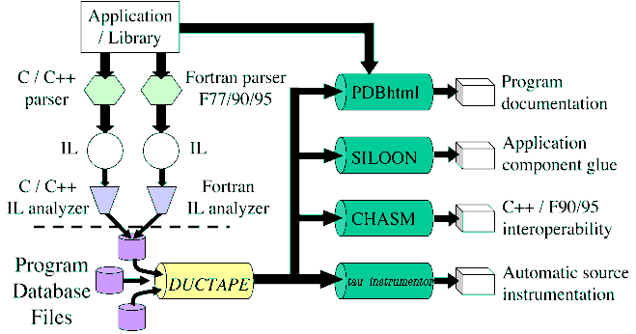
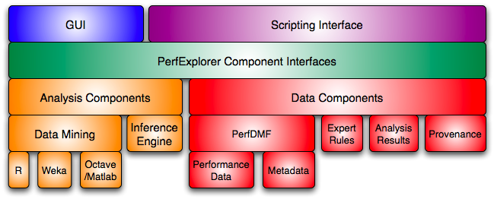
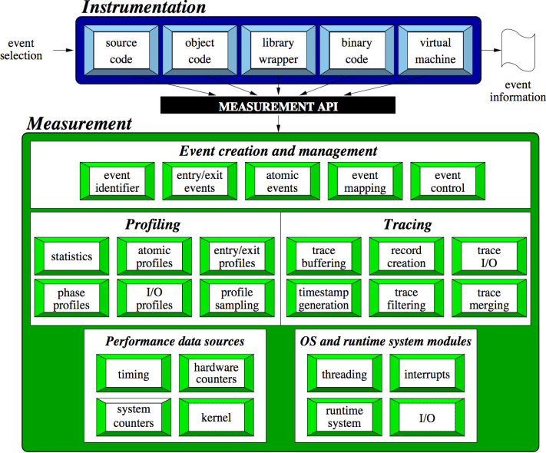
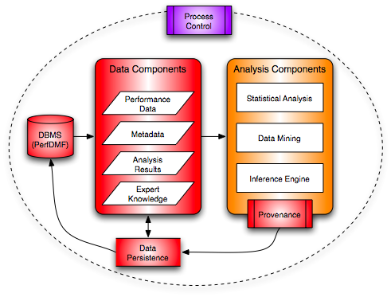
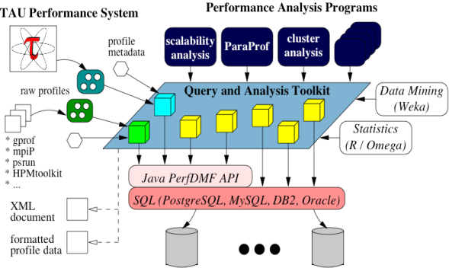
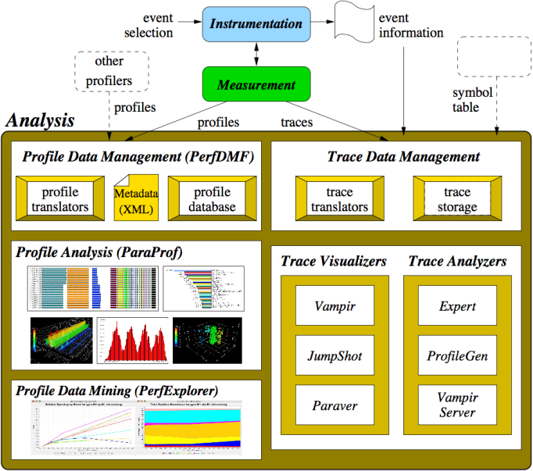
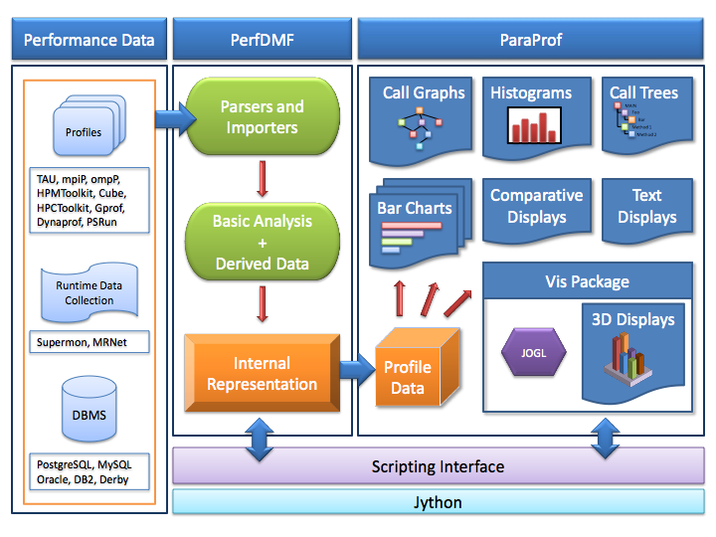
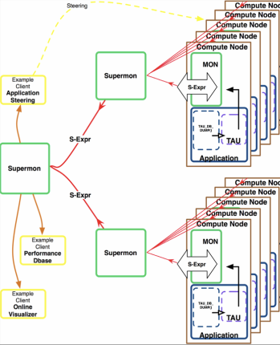
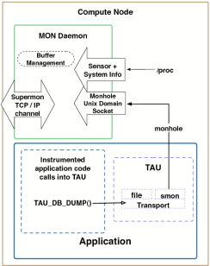
TAU Performance System Components
TAU Architecture
Program Analysis
Performance Data Mining
PDT
PerfExplorer
Parallel Profile Analysis
PerfDMF
Performance Monitoring
ParaProf
TAUoverSupermon

Slide 157
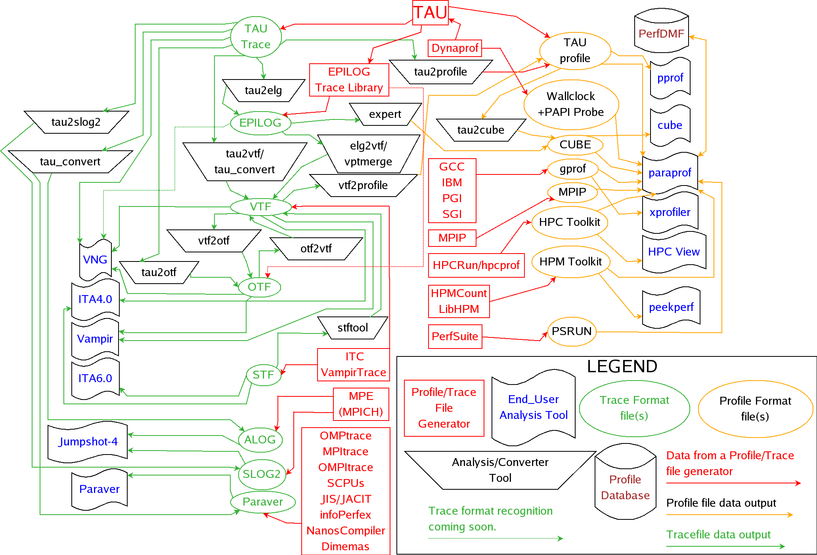
Building Bridges to Other Tools

Slide 158
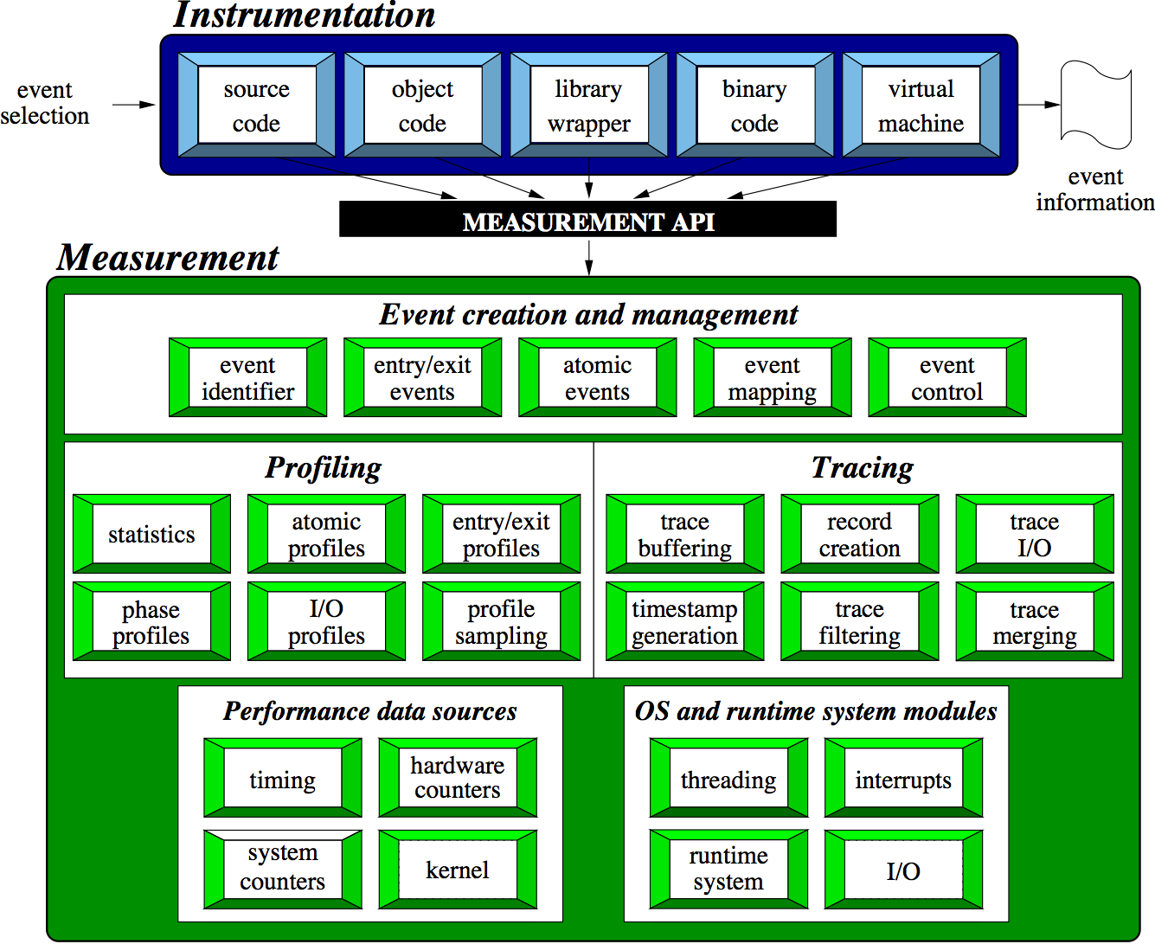
TAU Instrumentation / Measurement

Slide 159
Direct Performance Observation
Execution actions of interest exposed as events
  In general, actions reflect some execution state
    presence at a code location or change in data
    occurrence in parallelism context (thread of execution)
  Events encode actions for performance system to observe
Observation is direct
  Direct instrumentation of program (system) code (probes)
  Instrumentation invokes performance measurement
  Event measurement: performance data, meta-data, context
Performance experiment
  Actual events + performance measurements
Contrast with (indirect) event-based sampling

Slide 160
TAU Instrumentation Approach
Support for standard program events
  Routines, classes and templates
  Statement-level blocks
  Begin/End events (Interval events)
Support for user-defined events
  Begin/End events specified by user
  Atomic events (e.g., size of memory allocated/freed)
  Flexible selection of event statistics
Provides static events and dynamic events
Enables “semantic” mapping
Specification of event groups (aggregation, selection)
Instrumentation optimization

Slide 161
TAU Event Interface
Events have a type, a group association, and a name
TAU events names are character strings
  Powerful way to encode event information
  Inefficient way to communicate each event occurrence
TAU maps a new event name to an event ID
  Done when event is first encountered (get event handle)
  Event ID is used for subsequent event occurrences
  Assigning a uniform event ID a priori is problematic
A new event is identified by a new event name in TAU
  Can create new event names at runtime
  Allows for dynamic events (TAU renames events)
  Allows for context-based, parameter-based, phase events

Slide 162
TAU Instrumentation Mechanisms
Source code
  Manual (TAU API, TAU component API)
  Automatic (robust)
    C, C++, F77/90/95 (Program Database Toolkit (PDT))
    OpenMP (directive rewriting (Opari), POMP2 spec)
    Library header wrapping
Object code
  Pre-instrumented libraries (e.g., MPI using PMPI)
  Statically- and dynamically-linked (with LD_PRELOAD)
Executable code
  Binary and dynamic instrumentation (Dyninst)
  Virtual machine instrumentation (e.g., Java using JVMPI)
TAU_COMPILER to automate instrumentation process

Slide 163
Automatic Source-level Instrumentation

Slide 164
Program Database Toolkit (PDT)
Application
/ Library
C / C++
parser
Fortran parser
F77/90/95
IL
IL
C / C++
IL analyzer
Fortran
IL analyzer
.
.
.
Program
Database
Files
Automatic source
instrumentation
TAU
instrumentor
DUCTAPE

Slide 165
MPI Wrapper Interposition Library
Uses standard MPI Profiling Interface
  Provides name shifted interface
    MPI_Send = PMPI_Send
    Weak bindings
Create TAU instrumented MPI library
  Interpose between MPI and TAU
  Done during program link
    -lmpi replaced by –lTauMpi –lpmpi –lmpi
  No change to the source code!
  Just re-link application to generate performance data

Slide 166
MPI Shared Library Instrumentation
Interpose the MPI wrapper library for applications that have already been compiled
  Avoid re-compilation or re-linking
Requires shared library MPI
  Uses LD_PRELOAD for Linux
  On AIX use MPI_EUILIB / MPI_EUILIBPATH
  Does not work on XT3
Approach will work with other shared libraries
Use TAU tauex
  % mpirun -np 4 tauex a.out

Slide 167
Selective Instrumentation File
Specify a list of events to exclude or include
# is a wildcard in a routine name
BEGIN_EXCLUDE_LIST
Foo
Bar
D#EMM
END_EXCLUDE_LIST
BEGIN_INCLUDE_LIST
int main(int, char **)
F1
F3
END_INCLUDE_LIST

Slide 168
Selective Instrumentation File
Optionally specify a list of files
* and ? may be used as wildcard characters
  BEGIN_FILE_EXCLUDE_LIST
  f*.f90
  Foo?.cpp
  END_FILE_EXCLUDE_LIST
  BEGIN_FILE_INCLUDE_LIST
  main.cpp
  foo.f90
  END_FILE_INCLUDE_LIST

Slide 169
Selective Instrumentation File
User instrumentation commands
  Placed in INSTRUMENT section
  Routine entry/exit
  Arbitrary code insertion
  Outer-loop level instrumentation
  BEGIN_INSTRUMENT_SECTION
  loops file=“foo.f90” routine=“matrix#”
  memory file=“foo.f90” routine=“#”
  io routine=“matrix#”
  [static/dynamic] phase routine=“MULTIPLY”
  dynamic [phase/timer] name=“foo” file=“foo.cpp” line=22 to line=35
  file=“foo.f90” line = 123 code = " print *, \" Inside foo\""
  exit routine = “int foo()” code = "cout <<\"exiting foo\"<<endl;”
  END_INSTRUMENT_SECTION

Slide 170
TAU Measurement Approach
Portable and scalable parallel profiling solution
  Multiple profiling types and options
  Event selection and control (enabling/disabling, throttling)
  Online profile access and sampling
  Online performance profile overhead compensation
Portable and scalable parallel tracing solution
  Trace translation to OTF, EPILOG, Paraver, and SLOG2
  Trace streams (OTF) and hierarchical trace merging
Robust timing and hardware performance support
Multiple counters (hardware, user-defined, system)
Performance measurement of I/O and Linux kernel

Slide 171
TAU Measurement Mechanisms
Parallel profiling
  Function-level, block-level, statement-level
  Supports user-defined events and mapping events
  Support for flat, callgraph/callpath, phase profiling
  Support for parameter and context profiling
  Support for tracking I/O and memory (library wrappers)
  Parallel profile stored (dumped, shapshot) during execution
Tracing
  All profile-level events
  Inter-process communication events
  Inclusion of multiple counter data in traced events

Slide 172
Types of Parallel Performance Profiling
Flat profiles
  Metric (e.g., time) spent in an event (callgraph nodes)
  Exclusive/inclusive, # of calls, child calls
Callpath profiles (Calldepth profiles)
  Time spent along a calling path (edges in callgraph)
  “main=> f1 => f2 => MPI_Send” (event name)
  TAU_CALLPATH_DEPTH environment variable
Phase profiles
  Flat profiles under a phase (nested phases are allowed)
  Default “main” phase
  Supports static or dynamic (per-iteration) phases
  Phase profiles may be generated from full callpath profiles in paraprof by choosing events as phases

Slide 173

TAU Analysis

Slide 174
Performance Analysis
Analysis of parallel profile and trace measurement
Parallel profile analysis (ParaProf)
  Java-based analysis and visualization tool
  Support for large-scale parallel profiles
Performance data management framework (PerfDMF)
Parallel trace analysis
  Translation to VTF (V3.0), EPILOG, OTF formats
  Integration with Vampir / Vampir Server (TU Dresden)
  Profile generation from trace data
Online parallel analysis and visualization
Integration with CUBE browser (Scalasca, UTK / FZJ)

Slide 175
ParaProf Profile Analysis Framework

Slide 176
Performance Data Management
Provide an open, flexible framework to support common data management tasks
  Foster multi-experiment performance evaluation
Extensible toolkit to promote integration and reuse across available performance tools (PerfDMF)
  Originally designed to address critical TAU requirements
  Supported profile formats:
  TAU, CUBE (Scalasca), HPC Toolkit (Rice), HPM Toolkit (IBM), gprof, mpiP, psrun (PerfSuite), Open|SpeedShop, …
  Supported DBMS:
  PostgreSQL, MySQL, Oracle, DB2, Derby/Cloudscape
  Profile query and analysis API
Reference implementation for PERI-DB project

Slide 177
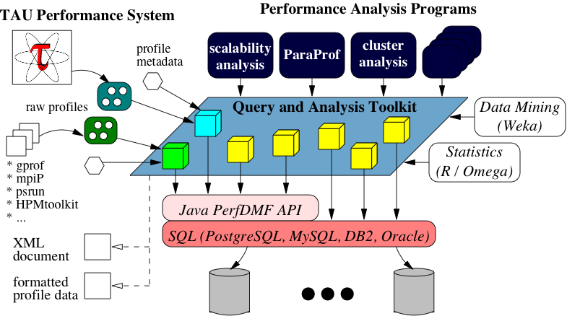
PerfDMF Architecture

Slide 178
Metadata Collection
Integration of XML metadata for each parallel profile
Three ways to incorporate metadata
  Measured hardware/system information (TAU, PERI-DB)
    CPU speed, memory in GB, MPI node IDs, …
  Application instrumentation (application-specific)
    TAU_METADATA() used to insert any name/value pair
    Application parameters, input data, domain decomposition
  PerfDMF data management tools can incorporate an XML file of additional metadata
    Compiler flags, submission scripts, input files, …
Metadata can be imported from / exported to PERI-DB

Slide 179
Performance Data Mining / Analytics
Conduct systematic and scalable analysis process
  Multi-experiment performance analysis
  Support automation, collaboration, and reuse
Performance knowledge discovery framework
  Data mining analysis applied to parallel performance data
    comparative, clustering, correlation, dimension reduction, …
  Use the existing TAU infrastructure
PerfExplorer v1 performance data mining framework
  Multiple experiments and parametric studies
  Integrate available statistics and data mining packages
    Weka, R, Matlab / Octave
  Apply data mining operations in interactive enviroment

Slide 180
How to explain performance?
Should not just redescribe the performance results
Should explain performance phenomena
  What are the causes for performance observed?
  What are the factors and how do they interrelate?
  Performance analytics, forensics, and decision support
Need to add knowledge to do more intelligent things
  Automated analysis needs good informed feedback
    iterative tuning, performance regression testing
  Performance model generation requires interpretation
We need better methods and tools for
  Integrating meta-information
  Knowledge-based performance problem solving
Notes:
Check Dresden talk for common language for these slides

Slide 181
Role of Metadata and Knowledge Role
Context Knowledge
You have to capture these...
Source
Code
Build Environment
Run Environment
Performance Problems
Execution
Application
Machine
Performance Knowledge
...to understand this
Performance Result

Slide 182
PerfExplorer v2 – Requirements
Component-based analysis process
  Analysis operations implemented as modules
  Linked together in analysis process and workflow
Scripting
  Provides process/workflow development and automation
Metadata input, management, and access
Inference engine
  Reasoning about causes of performance phenomena
  Analysis knowledge captured in expert rules
Persistence of intermediate analysis results
Provenance
  Provides historical record of analysis results
Notes:
Notes for what these features specifically address problem wise

Slide 183
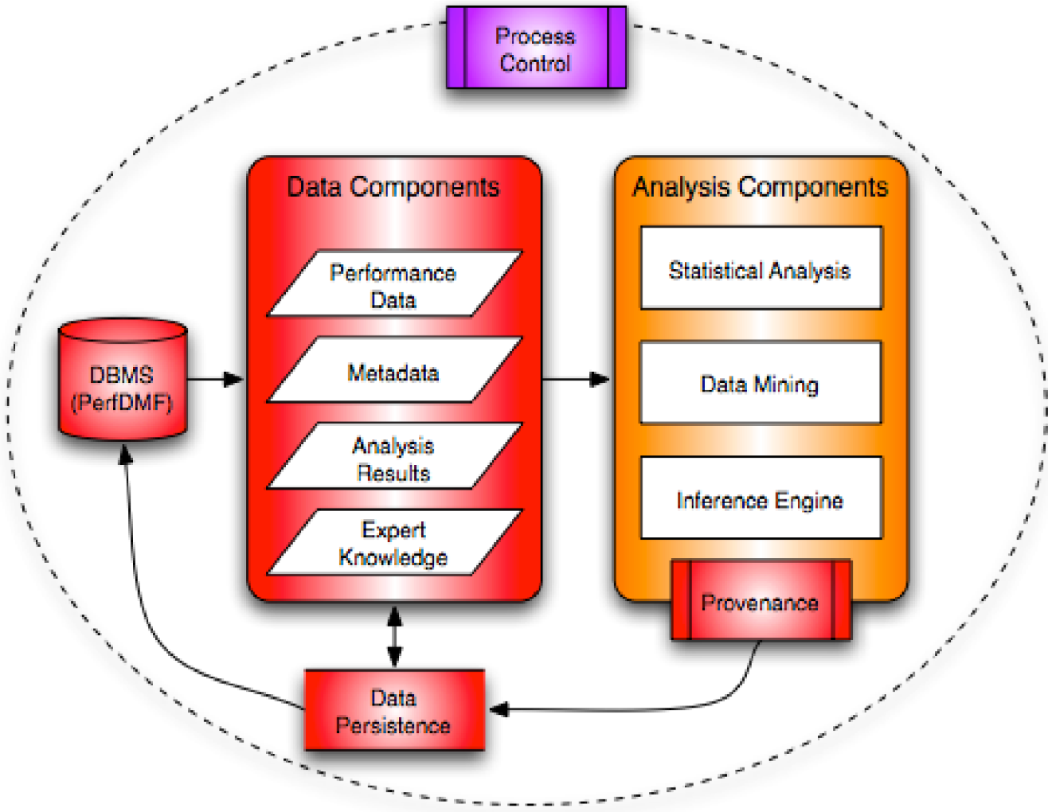
PerfExplorer v2 Architecture

Slide 184
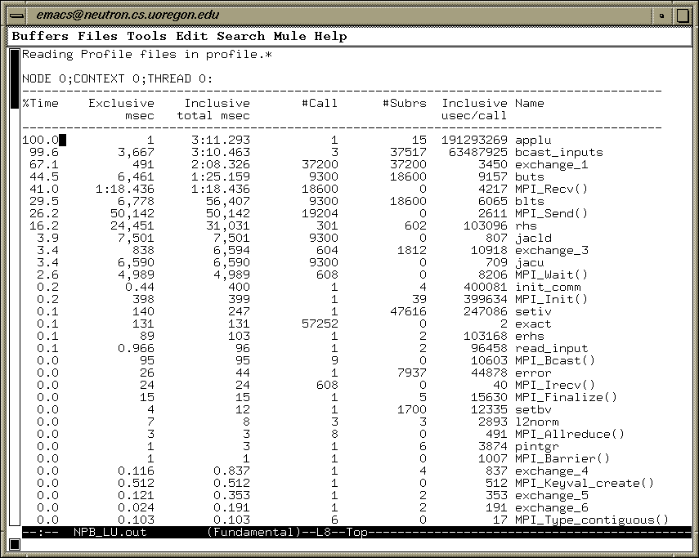
Parallel Profile Analysis – pprof

Slide 185
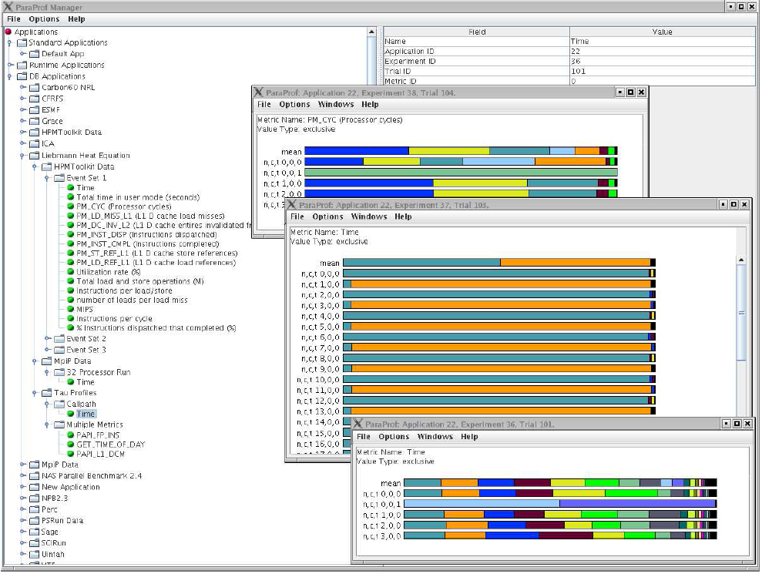
Parallel Profile Analysis – ParaProf
Raw files
HPMToolkit
PerfDMF
managed
(database)
Metadata
MpiP
Application
Experiment
Trial
TAU

Slide 186
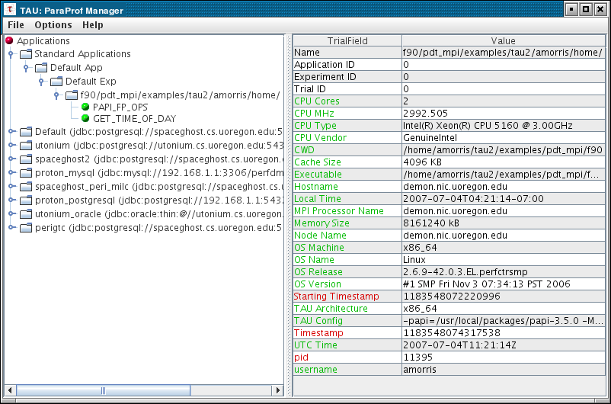
Metadata for Each Experiment
Multiple PerfDMF DBs
Notes:
We now automatically collect a variety of metadata attributes. Shown here in ParaProf, the green ones are shared among all nodes/threads. The red ones differ, but a sample is chosen to show.
186

Slide 187
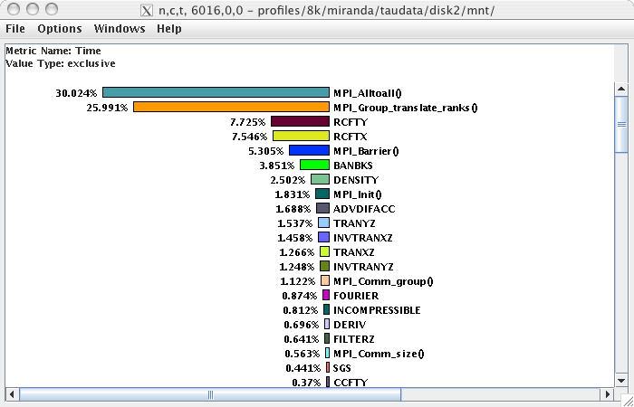
ParaProf – Flat Profile
node, context, thread
8K processors
Miranda
 hydrodynamics
 Fortran + MPI
 LLNL BG/L

Slide 188
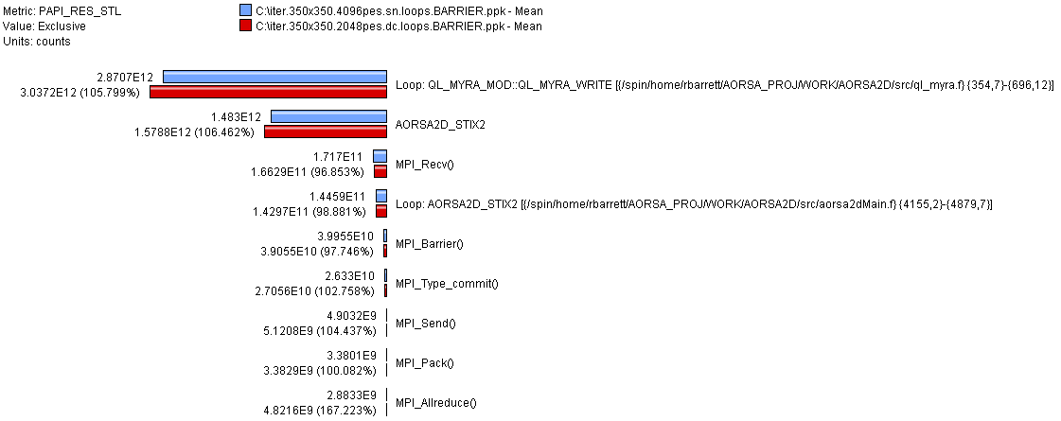
Comparing Effects of Multi-Core Processors
AORSA2D
 magnetized
plasma simulation
 Blue is single node
Red is dual core
Cray XT3 (4K cores)

Slide 189
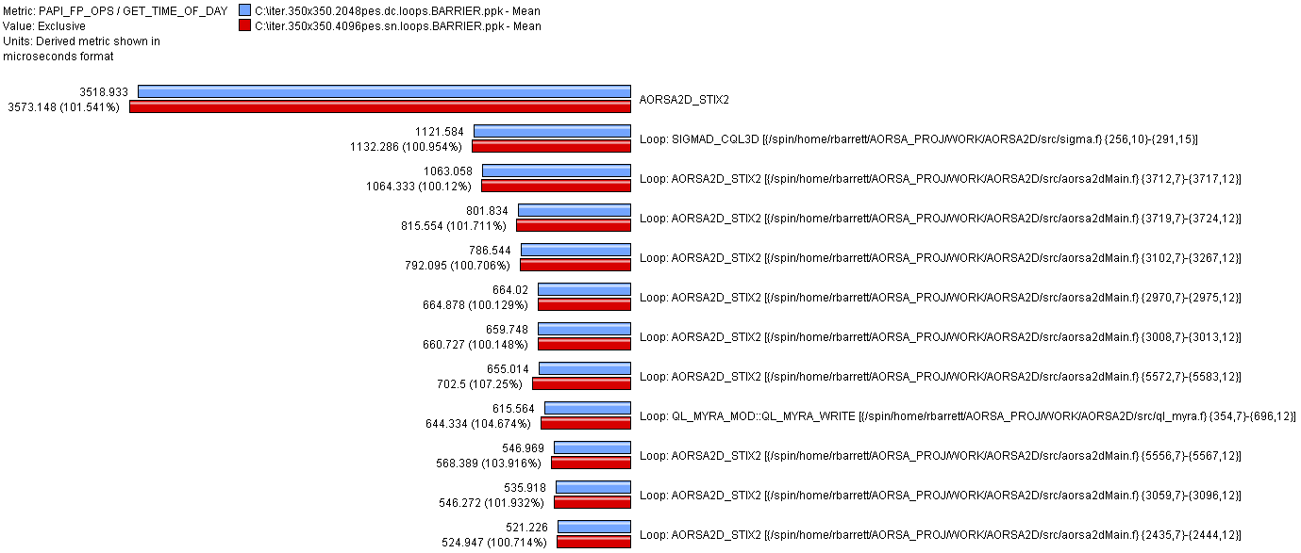
Comparing FLOPS (AORSA2D, Cray XT3)
AORSA2D
 Blue is dual core
Red is single node
Cray XT3 (4K cores)
Data generated by
Richard Barrett, ORNL

Slide 190
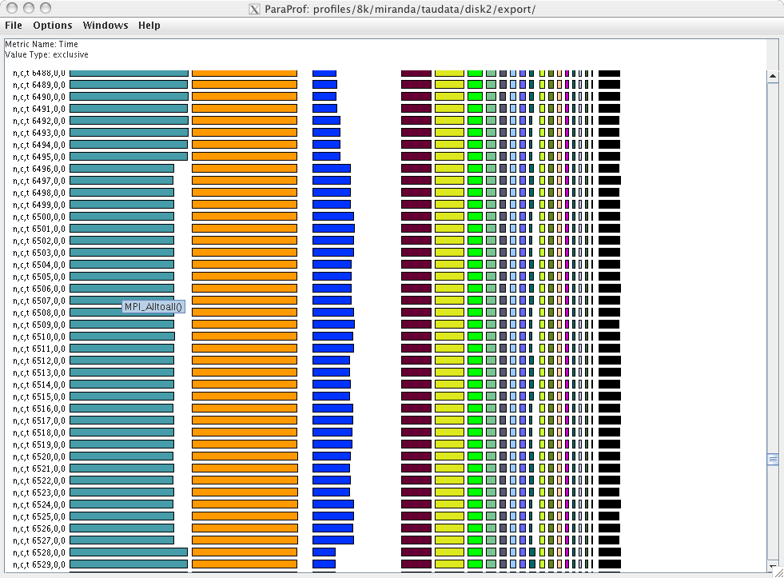
ParaProf – Stacked View

Slide 191
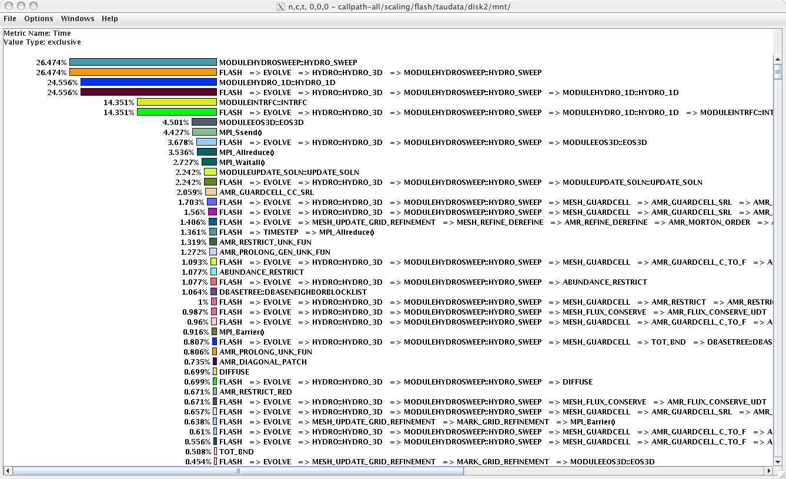
ParaProf – Callpath Profile
Flash
 thermonuclear
flashes
 Fortran + MPI
 Argonne

Slide 192
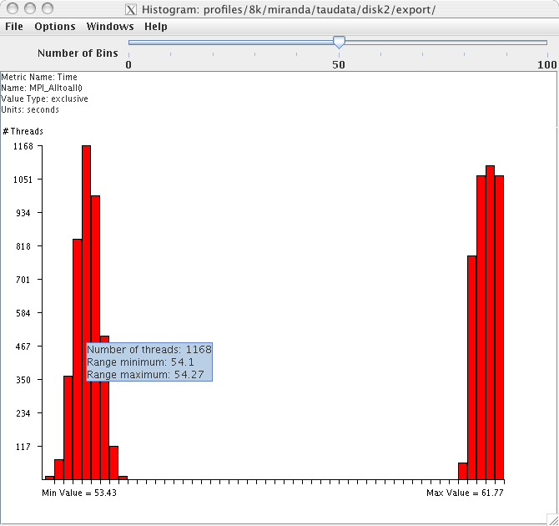
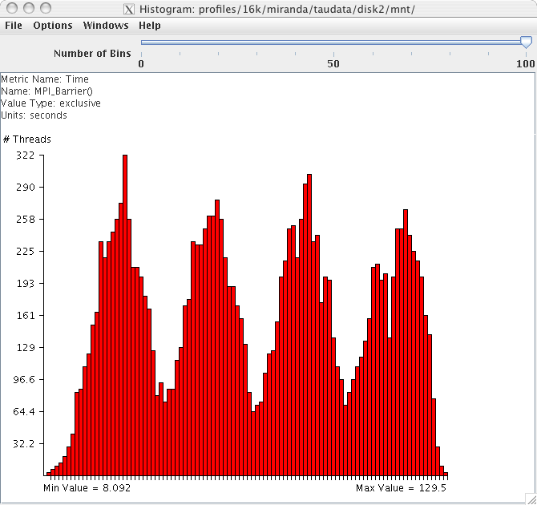
ParaProf – Scalable Histogram
8k processors
16k processors

Slide 193
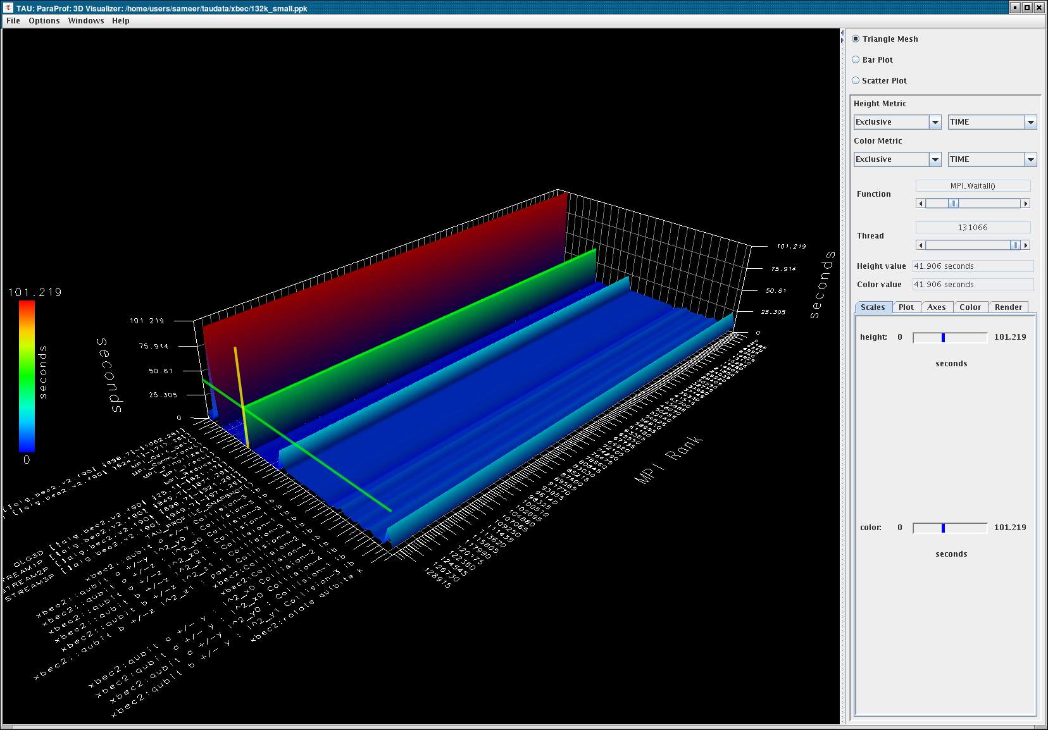
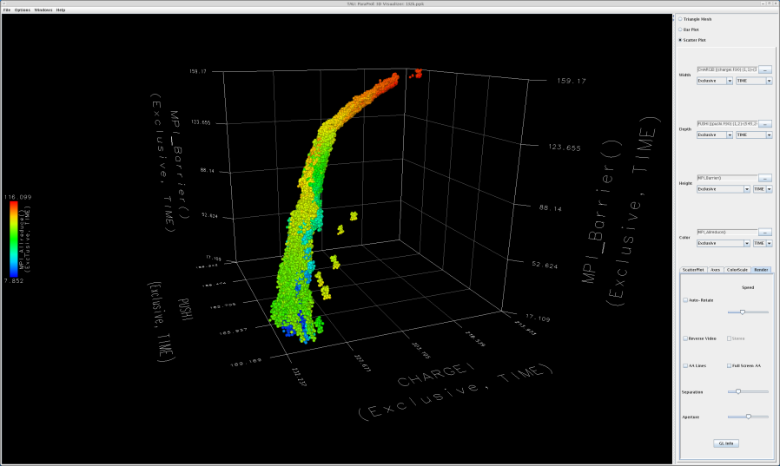
ParaProf – 3D View (Full Profile)
xbec
128k processors

Slide 194
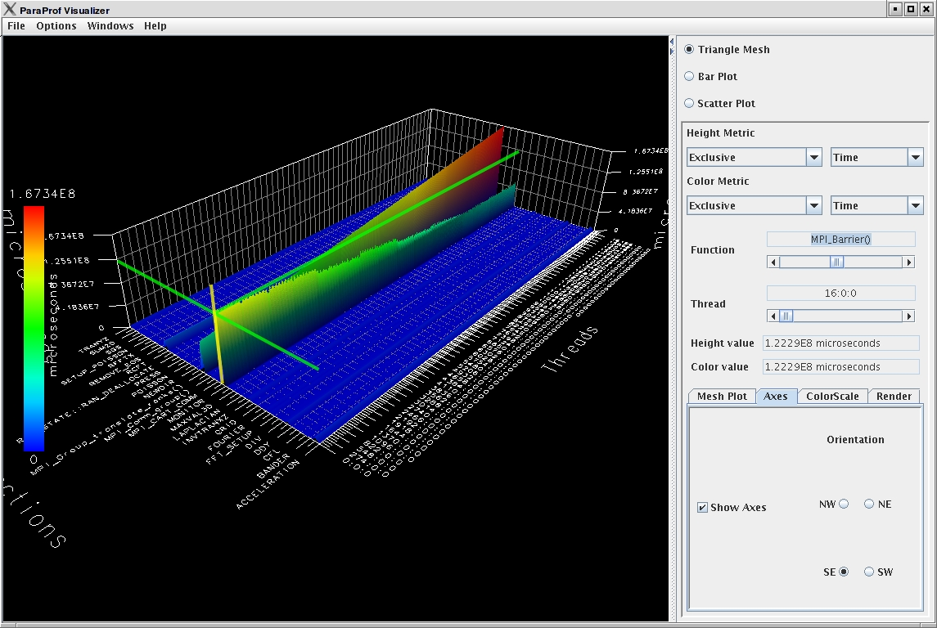
ParaProf – 3D View (Full Profile)
Miranda
16k processors

Slide 195
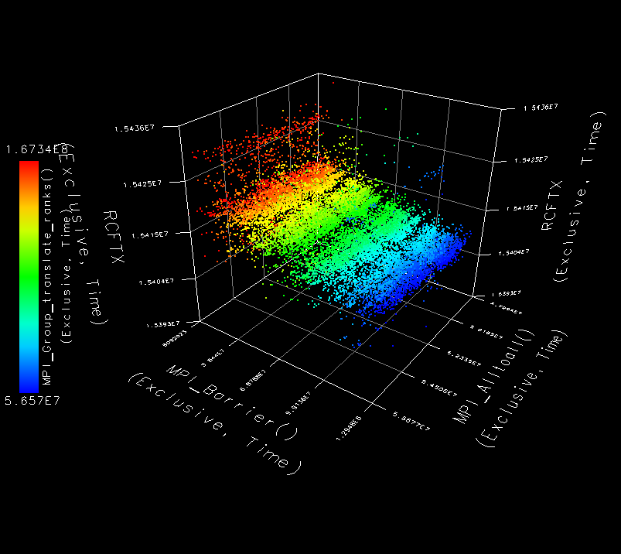
ParaProf – 3D Scatterplot
Each point is a “thread”
of execution
A total of four metrics
shown in relation
ParaProf’s
visualization
library
  JOGL
Miranda, 32k cores

Slide 196
Performance Mapping
Example: Particles distributed on cube surface
Particle* P[MAX]; /* Array of particles */
int GenerateParticles() {
/* distribute particles over all faces of the cube */
for (int face=0, last=0; face < 6; face++){
/* particles on this face */
int particles_on_this_face = num(face);
for (int i=last; i < particles_on_this_face; i++) {
/* particle properties are a function of face */ P[i] = ... f(face);
...
}
last+= particles_on_this_face;
}
}

Slide 197
Performance Mapping
int ProcessParticle(Particle *p) {
/* perform some computation on p */
}
int main() {
GenerateParticles();
/* create a list of particles */
for (int i = 0; i < N; i++)
/* iterates over the list */
ProcessParticle(P[i]);
}
work
packets
…
engine
How much time (flops) spent processing face i particles?
What is the distribution of performance among faces?

Slide 198
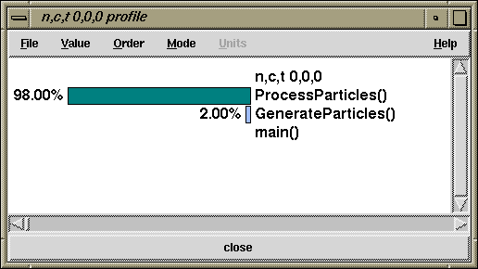

No Mapping versus Mapping
Typical performance tools report performance with respect to routines
Does not provide support for mapping
TAU’s performance mapping can observe performance with respect to scientist’s programming and problem abstractions
TAU (no mapping)
TAU (w/ mapping)

Slide 199

NAS BT – Flat Profile
Application routine names
reflect phase semantics
How is MPI_Wait()
distributed relative to
solver direction?

Slide 200


NAS BT – Phase Profile
Main phase shows nested phases and immediate events

Slide 201



Phase Profiling of HW Counters
GTC particle-in-cell simulation of fusion turbulence
Phases assigned to
iterations
Poor temporal locality for
one important data
Automatically generated
by PE2 python script
increasing phase
execution time
decreasing
flops rate
declining cache
performance
Notes:
This slide shows a four processor Flash run showing how different snapshots differ. Before the main loop beings, I write a snapshot to mark the performance data up to that point. It shows up as “Initialization”. At the end of each loop, a snapshot is written. At the end of execution, a final snapshot is written labeled “Finalization”.
I’m 99% sure the four main spikes are the checkpointing phases involving a lot of IO. The big purple color on top is “Other”. I have it limited to top 20 functions + “other”.
201

Slide 202


Profile Snapshots in ParaProf
Profile snapshots are parallel profiles recorded at runtime
Shows performance profile dynamics (all types allowed)
Initialization
Finalization
Checkpointing
Notes:
This slide shows a four processor Flash run showing how different snapshots differ. Before the main loop beings, I write a snapshot to mark the performance data up to that point. It shows up as “Initialization”. At the end of each loop, a snapshot is written. At the end of execution, a final snapshot is written labeled “Finalization”.
I’m 99% sure the four main spikes are the checkpointing phases involving a lot of IO. The big purple color on top is “Other”. I have it limited to top 20 functions + “other”.
202

Slide 203


Profile Snapshot Views
Only show main loop
Percentage breakdown
Notes:
Same view as previous slide, but I’ve filtered away initialization and finalization to better see the loop snapshots. The red at the bottom of the four spikes is MPI_Barrier, which is interesting.
203

Slide 204






Snapshot Replay in ParaProf
All windows dynamically update
Notes:
When you drag the slider, the data in all windows dynamically updates

Slide 205

PerfExplorer – Runtime Breakdown
WRITE_SAVEFILE
MPI_Waitall

Slide 206


PerfExplorer – Relative Comparisons
Total execution time
Timesteps per second
Relative efficiency
Relative efficiency per event
Relative speedup
Relative speedup per event
Group fraction of total
Runtime breakdown
Correlate events with total runtime
Relative efficiency per phase
Relative speedup per phase
Distribution visualizations

Slide 207

PerfExplorer – Correlation Analysis
Strong negative linear correlation between
CALC_CUT_BLOCK_CONTRIBUTIONS
and MPI_Barrier
Data: FLASH on BGL(LLNL), 64 nodes
Notes:
Correlation results, correlating each event to every other event. The particular example shows a strong negative linear correlation between CALC_CUT_BLOCK_CONTRIBUTIONS and MPI_Barrier.
Data: FLASH (hydro-radiation code) on BGL/LLNL, 64-1024 processors

Slide 208

PerfExplorer – Correlation Analysis
-0.995 indicates strong, negative relationship
As CALC_CUT_
BLOCK_CONTRIBUTIONS() increases in execution time, MPI_Barrier() decreases

Slide 209

PerfExplorer – Cluster Analysis

Slide 210

PerfExplorer – Cluster Analysis
Four significant events automatically selected
Clusters and correlations are visible

Slide 211

PerfExplorer – Performance Regression

Slide 212
Other Projects in TAU
TAU Portal
  Support collaborative performance study
Kernel-level system measurements (KTAU)
  Application to OS noise analysis and I/O system analysis
TAU performance monitoring
  TAUoverSupermon and TAUoverMRNet
PerfExplorer integration and expert-based analysis
  OpenUH compiler optimizations
  Computational quality of service in CCA
Eclipse CDT and PTP integration
Performance tools integration (NSF POINT project)

Slide 213
Using TAU
Install TAU
  % configure [options]; make clean install
Modify application makefile and choose TAU configuration
  Select TAU’s stub makefile
  Change name of compiler in makefile
Set environment variables
  Directory where profiles/traces are to be stored/counter selection
  TAU options
Execute application
  % mpirun –np <procs> a.out;
Analyze performance data
  paraprof, vampir, pprof, paraver …

Slide 214
Application Build Environment
Minimize impact on user’s application build procedures
Handle parsing, instrumentation, compilation, linking
Dealing with Makefiles
  Minimal change to application Makefile
  Avoid changing compilation rules in application Makefile
  No explicit inclusion of rules for process stages
Some applications do not use Makefiles
  Facilitate integration in whatever procedures used
Two techniques:
  TAU shell scripts (tau_<compiler>.sh)
    Invokes all PDT parser, TAU instrumenter, and compiler
  TAU_COMPILER

Slide 215
Configuring TAU
TAU can measure several metrics with profiling and tracing approaches
Different tools can also be invoked to instrument programs for TAU measurement
Each configuration of TAU produces a measurement library for an architecture
Each measurement configuration of TAU also creates a corresponding stub makefile that can be used to compile programs
Typically configure multiple measurement libraries

Slide 216
TAU Measurement System Configuration
configure [OPTIONS]
  {-c++=<CC>, -cc=<cc>} Specify C++ and C compilers
  -pdt=<dir> Specify location of PDT
  -opari=<dir> Specify location of Opari OpenMP tool
  -papi=<dir> Specify location of PAPI
  -vampirtrace=<dir> Specify location of VampirTrace
  -mpi[inc/lib]=<dir> Specify MPI library instrumentation
  -dyninst=<dir> Specify location of DynInst Package
  -shmem[inc/lib]=<dir> Specify PSHMEM library instrumentation
  -python[inc/lib]=<dir> Specify Python instrumentation
  -tag=<name> Specify a unique configuration name
  -epilog=<dir> Specify location of EPILOG
  -slog2 Build SLOG2/Jumpshot tracing package
  -otf=<dir> Specify location of OTF trace package
  -arch=<architecture> Specify architecture explicitly
  (bgl, xt3,x86_64,x86_64linux…)
  {-pthread, -sproc} Use pthread or SGI sproc threads
  -openmp Use OpenMP threads
  -jdk=<dir> Specify Java instrumentation (JDK)
  -fortran=[vendor] Specify Fortran compiler

Slide 217
TAU Measurement System Configuration
configure [OPTIONS]
  -TRACE Generate binary TAU traces
  -PROFILE (default) Generate profiles (summary)
  -PROFILECALLPATH Generate call path profiles
  -PROFILEPHASE Generate phase based profiles
  -PROFILEMEMORY Track heap memory for each routine
  -PROFILEHEADROOM Track memory headroom to grow
  Use hardware counters + time
  -COMPENSATE Compensate timer overhead
  -CPUTIME Use usertime+system time
  -PAPIWALLCLOCK Use PAPI’s wallclock time
  -PAPIVIRTUAL Use PAPI’s process virtual time
  -SGITIMERS Use fast IRIX timers
  -LINUXTIMERS Use fast x86 Linux timers

Slide 218
TAU Configuration – Examples
  Configure using PDT and MPI for x86_64 Linux
    ./configure –pdt=/usr/pkgs/pkgs/pdtoolkit-3.15
    -mpiinc=/usr/pkgs/mpich/include -mpilib=/usr/pkgs/mpich/lib
    -mpilibrary=‘-lmpich -L/usr/gm/lib64 -lgm -lpthread -ldl’
  Use PAPI counters (one or more) with C/C++/F90 automatic instrumentation for Cray CNL. Also instrument the MPI library. Use PGI compilers.
    ./configure -arch=craycnl -papi=/opt/xt-tools/papi/3.6.2 -mpi; make clean install
Stub makefiles
  /usr/pkgs/tau/x86_64/lib/Makefile.tau-mpi-pdt-pgi
  /usr/pkgs/tau/x86_64/lib/Makefile.tau-mpi-papi-pdt-pgi

Slide 219
Stub Makefiles Configuration Parameters
TAU scripts use stub makefiles to select performance measurements
Variables:
  TAU_CXX Specify the C++ compiler used by TAU
  TAU_CC, TAU_F90 Specify the C, F90 compilers
  TAU_DEFS Defines used by TAU (add to CFLAGS)
  TAU_LDFLAGS Linker options (add to LDFLAGS)
  TAU_INCLUDE Header files include path (add to CFLAGS)
  TAU_LIBS Statically linked TAU library (add to LIBS)
  TAU_SHLIBS Dynamically linked TAU library
  TAU_MPI_LIBS TAU’s MPI wrapper library for C/C++
  TAU_MPI_FLIBS TAU’s MPI wrapper library for F90
  TAU_FORTRANLIBS Must be linked in with C++ linker for F90
  TAU_CXXLIBS Must be linked in with F90 linker
  TAU_INCLUDE_MEMORY Use TAU’s malloc/free wrapper lib
  TAU_DISABLE TAU’s dummy F90 stub library
  TAU_COMPILER Instrument using tau_compiler.sh script

Slide 220
TAU Measurement Configuration
% cd /opt/tau-2.19.1/x86_64/lib; ls Makefile.*
  Makefile.tau-pdt
  Makefile.tau-mpi-pdt
  Makefile.tau-mpi-papi-pdt
  Makefile.tau-mpi-papi-pdt-trace
  Makefile.tau-pthread-pdt…
For an MPI+F90 application, you may want to start with:
  Makefile.tau-mpi-pdt
  Supports MPI instrumentation & PDT for automatic source instrumentation
% setenv TAU_MAKEFILE
/opt/tau-2.19.1/x86_64/lib/Makefile.tau-mpi-pdt

Slide 221
Using TAU: A brief Introduction
To instrument source code using PDT
  Choose an appropriate TAU stub makefile in <arch>/lib:
  % setenv TAU_MAKEFILE
  /opt/tau-2.19.1/x86_64/lib/Makefile.tau-mpi-pdt
  % setenv TAU_OPTIONS ‘-optVerbose …’ (see tau_compiler.sh)
  And use tau_f90.sh, tau_cxx.sh or tau_cc.sh as Fortran, C++ or C compilers:
  % mpif90 foo.f90
  changes to
  % tau_f90.sh foo.f90
Execute application and analyze performance data:
  % pprof (for text based profile display)
  % paraprof (for GUI)

Slide 222
TAU Measurement Configuration – Examples
% cd /usr/local/packages/tau-2.19.1/i386_linux/lib; ls Makefile.* on LiveDVD
Makefile.tau-pdt
Makefile.tau-mpi-pdt
Makefile.tau-papi-mpi-pdt
Makefile.tau-vampirtrace-papi-mpi-pdt
Makefile.tau-scalasca-papi-mpi-pdt
Makefile.tau-pthread-pdt
Makefile.tau-pthread-mpi-pdt
Makefile.tau-openmp-opari-pdt
Makefile.tau-openmp-opari-mpi-pdt
Makefile.tau-papi-openmp-opari-mpi-pdt
…
For an MPI+F90 application, you may want to start with:
Makefile.tau-mpi-pdt
  Supports MPI instrumentation & PDT for automatic source instrumentation
  % setenv TAU_MAKEFILE
  /usr/local/packages/tau-2.19.1/i386_linux/lib/Makefile.tau-mpi-pdt

Slide 223
-PROFILE Option
Generates flat profiles
  One for each MPI process
  It is the default option.
Uses wallclock time
  gettimeofday() sys call
Calculates exclusive, inclusive time spent in each timer and number of calls

Slide 224
Generating a Flat Profile with MPI
% setenv TAU_MAKEFILE /opt/tau-2.19.1/x86_64
/lib/Makefile.tau-mpi-pdt
% set path=(/opt/tau-2.19.1/x86_64/bin $path)
% make F90=tau_f90.sh
(Or edit Makefile and change F90=tau_f90.sh)
% qsub run.job
% paraprof -–pack app.ppk
Move the app.ppk file to your desktop.
% paraprof app.ppk

Slide 225
Generating a Loop-level Profile
% setenv TAU_MAKEFILE /opt/tau-2.19.1/x86_64
/lib/Makefile.tau-mpi-pdt
% setenv TAU_OPTIONS ‘-optTauSelectFile=select.tau –optVerbose’
% cat select.tau
BEGIN_INSTRUMENT_SECTION
loops routine=“#”
END_INSTRUMENT_SECTION
% set path=(/opt/tau-2.19.1/x86_64/bin $path)
% make F90=tau_f90.sh
(Or edit Makefile and change F90=tau_f90.sh)
% qsub run.job
% paraprof -–pack app.ppk
Move the app.ppk file to your desktop.
% paraprof app.ppk

Slide 226
Compiler-based Instrumentation
% setenv TAU_MAKEFILE /opt/tau-2.19.1/x86_64
/lib/Makefile.tau-mpi
% setenv TAU_OPTIONS ‘-optCompInst –optVerbose’
% % set path=(/opt/tau-2.19.1/x86_64/bin $path)
% make F90=tau_f90.sh
(Or edit Makefile and change F90=tau_f90.sh)
% qsub run.job
% paraprof -–pack app.ppk
Move the app.ppk file to your desktop.
% paraprof app.ppk

Slide 227
-papi Option
Instead of one metric, profile or trace with more than one metric
  Set environment variable TAU_METRICS to specify the metric
    % setenv TAU_METRICS TIME:PAPI_FP_INS:PAPI_L1_DCM...
    % setenv TAU_METRICS TIME:PAPI_NATIVE_<native_event>...
When used with tracing (TAU_TRACE=1) option, the first counter must be TIME
    % setenv TAU_METRICS TIME:PAPI_FP_INS...
    Provides a globally synchronized real time clock for tracing
-papi appears in the name of the stub Makefile
papi_avail, papi_event_chooser, and papi_native_avail are useful tools

Slide 228
Generate a PAPI profile
% setenv TAU_MAKEFILE /opt/tau-2.19.1/x86_64
/lib/Makefile.tau-papi-mpi-pdt
% setenv TAU_OPTIONS ‘-optTauSelectFile=select.tau –optVerbose’
% cat select.tau
BEGIN_INSTRUMENT_SECTION
loops routine=“#”
END_INSTRUMENT_SECTION
% set path=(/opt/tau-2.19.1/x86_64/bin $path)
% make F90=tau_f90.sh
(Or edit Makefile and change F90=tau_f90.sh)
% setenv TAU_METRICS TIME:PAPI_FP_INS
% qsub run.job
% paraprof -–pack app.ppk
Move the app.ppk file to your desktop.
% paraprof app.ppk
Choose Options -> Show Derived Panel -> Click PAPI_FP_INS, Click / , Click
TIME, Apply, choose the metric

Slide 229
-PROFILECALLPATH Option
Generates profiles that show the calling order (edges and nodes in callgraph)
  A=>B=>C shows the time spent in C when it was called by B and B was called by A
  Control the depth of callpath using TAU_CALLPATH_DEPTH environment variable
  -callpath in the name of the stub Makefile name or setting TAU_CALLPATH= 1 at runtime
  (TAU v2.18.1+)

Slide 230
-DEPTHLIMIT Option
Allows users to enable instrumentation at runtime based on the depth of a calling routine on a callstack
  Disables instrumentation in all routines a certain depth away from the root in a callgraph
TAU_DEPTH_LIMIT environment variable specifies depth
  % setenv TAU_DEPTH_LIMIT 1
  enables instrumentation in only “main”
  % setenv TAU_DEPTH_LIMIT 2
  enables instrumentation in main and routines that are directly called by main
Stub makefile has -depthlimit in its name:
  setenv TAU_MAKEFILE <taudir>/<arch>/lib/Makefile.tau-mpi-depthlimit-pdt

Slide 231
Generate a Callpath Profile
% setenv TAU_MAKEFILE /opt/tau-2.19.1/x86_64
/lib/Makefile.tau-mpi-pdt
% set path=(/opt/tau-2.19.1/x86_64/bin $path)
% make F90=tau_f90.sh
(Or edit Makefile and change F90=tau_f90.sh)
% setenv TAU_CALLPATH 1
% setenv TAU_CALLPATH_DEPTH 100
to generate the callpath profiles without any recompilation.
% qsub run.job
% paraprof -–pack app.ppk
Move the app.ppk file to your desktop.
% paraprof app.ppk
(Windows -> Thread -> Call Graph)

Slide 232
Tracing in TAU
Generates event-trace logs, rather than summary profiles
  setenv TAU_TRACE 1
Traces show when and where an event occurred in terms of location and the process that executed it
Traces from multiple processes are merged:
  % tau_treemerge.pl
    generates tau.trc and tau.edf as merged trace and event definition file
TAU traces can be converted to Vampir’s OTF/VTF3, Jumpshot SLOG2, Paraver trace formats:
  % tau2otf tau.trc tau.edf app.otf
  % tau2vtf tau.trc tau.edf app.vpt.gz
  % tau2slog2 tau.trc tau.edf -o app.slog2
  % tau_convert -paraver tau.trc tau.edf app.prv

Slide 233
Generate a Trace File
% setenv TAU_MAKEFILE /opt/tau-2.19.1/x86_64
/lib/Makefile.tau-mpi-pdt
% set path=(/opt/tau-2.19.1/x86_64/bin $path)
% make F90=tau_f90.sh
(Or edit Makefile and change F90=tau_f90.sh)
% setenv TAU_TRACE 1
% qsub run.job
% tau_treemerge.pl
(merges binary traces to create tau.trc and tau.edf files)
JUMPSHOT:
% tau2slog2 tau.trc tau.edf –o app.slog2
% jumpshot app.slog2
OR
VAMPIR:
% tau2otf tau.trc tau.edf app.otf –n 4 –z
(4 streams, compressed output trace)
% vampir app.otf
(or vng client with vngd server)

Slide 234
Instrumentation Specification
% tau_instrumentor
Usage : tau_instrumentor <pdbfile> <sourcefile> [-o <outputfile>] [-noinline] [-g groupname] [-i headerfile] [-c|-c++|-fortran] [-f <instr_req_file> ]
For selective instrumentation, use –f option
% tau_instrumentor foo.pdb foo.cpp –o foo.inst.cpp –f selective.dat
% cat selective.dat
# Selective instrumentation: Specify an exclude/include list of routines/files.
BEGIN_EXCLUDE_LIST
void quicksort(int *, int, int)
void sort_5elements(int *)
void interchange(int *, int *)
END_EXCLUDE_LIST
BEGIN_FILE_INCLUDE_LIST
Main.cpp
Foo?.c
*.C
END_FILE_INCLUDE_LIST
# Instruments routines in Main.cpp, Foo?.c and *.C files only
# Use BEGIN_[FILE]_INCLUDE_LIST with END_[FILE]_INCLUDE_LIST

Slide 235
Outer Loop Level Instrumentation
BEGIN_INSTRUMENT_SECTION
loops file="loop_test.cpp" routine="multiply"
# it also understands # as the wildcard in routine name
# and * and ? wildcards in file name.
# You can also specify the full
# name of the routine as is found in profile files.
#loops file="loop_test.cpp" routine="double multiply#"
END_INSTRUMENT_SECTION
% pprof
NODE 0;CONTEXT 0;THREAD 0:
---------------------------------------------------------------------------------------
%Time Exclusive Inclusive #Call #Subrs Inclusive Name
msec total msec usec/call
---------------------------------------------------------------------------------------
100.0 0.12 25,162 1 1 25162827 int main(int, char **)
100.0 0.175 25,162 1 4 25162707 double multiply()
90.5 22,778 22,778 1 0 22778959 Loop: double multiply()[ file = <loop_test.cpp> line,col = <23,3> to <30,3> ]
9.3 2,345 2,345 1 0 2345823 Loop: double multiply()[ file = <loop_test.cpp> line,col = <38,3> to <46,7> ]
0.1 33 33 1 0 33964 Loop: double
multiply()[ file = <loop_test.cpp> line,col = <16,10> to <21,12> ]

Slide 236
Using TAU: A brief Introduction
To instrument source code using PDT
  Choose an appropriate TAU stub makefile in <arch>/lib:
  % setenv TAU_MAKEFILE
  /opt/tau-2.19.1/x86_64/lib/Makefile.tau-mpi-pdt
  % setenv TAU_OPTIONS ‘-optVerbose …’ (see tau_compiler.sh)
  And use tau_f90.sh, tau_cxx.sh or tau_cc.sh as Fortran, C++ or C compilers:
  % mpif90 foo.f90
  changes to
  % tau_f90.sh foo.f90
Execute application and analyze performance data:
  % pprof (for text based profile display)
  % paraprof (for GUI)

Slide 237

Usage Scenarios: Routine Level Profile
Goal: What routines account for the most time? How much?

Slide 238
Solution: Generating a flat profile with MPI
% setenv TAU_MAKEFILE /opt/tau-2.19.1/x86_64
/lib/Makefile.tau-mpi-pdt
% set path=(/opt/tau-2.19.1/x86_64/bin $path)
Or
% module load tau
% make F90=tau_f90.sh
Or
% tau_f90.sh matmult.f90 –o matmult
(Or edit Makefile and change F90=tau_f90.sh)
% qsub run.job
% paraprof
To view. To view the data locally on the workstation,
% paraprof -–pack app.ppk
Move the app.ppk file to your desktop.
% paraprof app.ppk

Slide 239

Usage Scenarios: Loop Level Instrumentation
Goal: What loops account for the most time? How much?
Flat profile with wallclock time with loop instrumentation:

Slide 240
Solution: Generating a loop level profile
% setenv TAU_MAKEFILE /opt/tau-2.19.1/x86_64
/lib/Makefile.tau-mpi-pdt
% setenv TAU_OPTIONS ‘-optTauSelectFile=select.tau –optVerbose’
% cat select.tau
BEGIN_INSTRUMENT_SECTION
loops routine=“#”
END_INSTRUMENT_SECTION
% module load tau
% make F90=tau_f90.sh
(Or edit Makefile and change F90=tau_f90.sh)
% qsub run.job
% paraprof -–pack app.ppk
Move the app.ppk file to your desktop.
% paraprof app.ppk

Slide 241

Usage Scenarios: MFlops in Loops
Goal: What execution rate do my application loops get in mflops?
Flat profile with PAPI_FP_INS/OPS and time (-papi) with loop instrumentation:

Slide 242
Generate a PAPI profile with 2 or more counters
% setenv TAU_MAKEFILE /opt/tau-2.19.1/x86_64
/lib/Makefile.tau-papi-mpi-pdt
% setenv TAU_OPTIONS ‘-optTauSelectFile=select.tau –optVerbose’
% cat select.tau
BEGIN_INSTRUMENT_SECTION
loops routine=“#”
END_INSTRUMENT_SECTION
% make F90=tau_f90.sh
(Or edit Makefile and change F90=tau_f90.sh)
% setenv TAU_METRICS TIME:PAPI_FP_INS
% qsub run.job
% paraprof -–pack app.ppk
Move the app.ppk file to your desktop.
% paraprof app.ppk
Choose Options -> Show Derived Panel -> Arg 1 = PAPI_FP_INS,
Arg 2 = GET_TIME_OF_DAY, Operation = Divide -> Apply, choose.

Slide 243

Usage Scenarios: Compiler-based Instrumentation
Goal: Easily generate routine level performance data using the compiler instead of PDT for parsing the source code
Notes:
243

Slide 244
Use Compiler-Based Instrumentation
% setenv TAU_MAKEFILE /opt/tau-2.19.1/x86_64
/lib/Makefile.tau-mpi-pdt
% setenv TAU_OPTIONS ‘-optCompInst –optVerbose’
% module load tau
% make F90=tau_f90.sh
(Or edit Makefile and change F90=tau_f90.sh)
% qsub run.job
% paraprof -–pack app.ppk
Move the app.ppk file to your desktop.
% paraprof app.ppk
Notes:
244

Slide 245
Generate a Callpath Profile

Slide 246

Callpath Profile
Generates program callgraph

Slide 247
Generate a Callpath Profile
% setenv TAU_MAKEFILE /opt/tau-2.19.1/x86_64
/lib/Makefile.tau-mpi-pdt
% set path=(/opt/tau-2.19.1/x86_64/bin $path)
% make F90=tau_f90.sh
(Or edit Makefile and change F90=tau_f90.sh)
% setenv TAU_CALLPATH 1
% setenv TAU_CALLPATH_DEPTH 100
% qsub run.job
% paraprof -–pack app.ppk
Move the app.ppk file to your desktop.
% paraprof app.ppk
(Windows -> Thread -> Call Graph)

Slide 248

Usage Scenario: Detect Memory Leaks
Notes:
248

Slide 249
Detect Memory Leaks
% setenv TAU_MAKEFILE /opt/tau-2.19.1/x86_64 /lib/Makefile.tau-mpi-pdt
% setenv TAU_OPTIONS ‘-optDetectMemoryLeaks -optVerbose’
% module load tau
% make F90=tau_f90.sh
(Or edit Makefile and change F90=tau_f90.sh)
% setenv TAU_CALLPATH_DEPTH 100
% qsub run.job
% paraprof -–pack app.ppk
Move the app.ppk file to your desktop.
% paraprof app.ppk
(Windows -> Thread -> Context Event Window -> Select thread -> select... expand tree)
(Windows -> Thread -> User Event Bar Chart -> right click LEAK
-> Show User Event Bar Chart)
NOTE: setenv TAU_TRACK_HEAP 1 and setenv TAU_TRACK_HEADROOM 1 may be used to track
heap and headroom utilization at the entry and exit of each routine.
TAU_CALLPATH_DEPTH=1 shows just the routine name, and 0 shows just one event for the
entire program.
Notes:
249

Slide 250

Interval Events, Atomic Events in TAU
Interval event
e.g., routines
(start/stop)
Atomic events
(trigger with
value)
% setenv TAU_CALLPATH_DEPTH 0
% setenv TAU_TRACK_HEAP 1

Slide 251

Atomic Events, Context Events
Atomic event
Context event
= atomic event
+ executing
context
% setenv TAU_CALLPATH_DEPTH 1
% setenv TAU_TRACK_HEAP 1

Slide 252

Context Events (default)
Context event
= atomic event
+ executing
context
% setenv TAU_CALLPATH_DEPTH 2
% setenv TAU_TRACK_HEAP 1

Slide 253
Environment Variables in TAU
Environment Variable | Default | Description
TAU_TRACE | 0 | Setting to 1 turns on tracing
TAU_CALLPATH | 0 | Setting to 1 turns on callpath profiling
TAU_TRACK_HEAP or TAU_TRACK_HEADROOM | 0 | Setting to 1 turns on tracking heap memory/headroom at routine entry & exit using context events (e.g., Heap at Entry: main=>foo=>bar)
TAU_CALLPATH_DEPTH | 2 | Specifies depth of callpath. Setting to 0 generates no callpath or routine information, setting to 1 generates flat profile and context events have just parent information (e.g., Heap Entry: foo)
TAU_SYNCHRONIZE_CLOCKS | 1 | Synchronize clocks across nodes to correct timestamps in traces
TAU_COMM_MATRIX | 0 | Setting to 1 generates communication matrix display using context events
TAU_THROTTLE | 1 | Setting to 0 turns off throttling. Enabled by default to remove instrumentation in lightweight routines that are called frequently
TAU_THROTTLE_NUMCALLS | 100000 | Specifies the number of calls before testing for throttling
TAU_THROTTLE_PERCALL | 10 | Specifies value in microseconds. Throttle a routine if it is called over 100000 times and takes less than 10 usec of inclusive time per call
TAU_COMPENSATE | 0 | Setting to 1 enables runtime compensation of instrumentation overhead
TAU_PROFILE_FORMAT | Profile | Setting to “merged” generates a single file. “snapshot” generates xml format
TAU_METRICS | TIME | Setting to a comma separted list generates other metrics. (e.g., TIME:linuxtimers:PAPI_FP_OPS:PAPI_NATIVE_<event>)

Slide 254
Compile-Time Environment Variables
Optional parameters for TAU_OPTIONS: [tau_compiler.sh –help]
  -optVerbose Turn on verbose debugging messages
  -optCompInst Use compiler based instrumentation
  -optDetectMemoryLeaks Turn on debugging memory allocations/de-allocations to track leaks
  -optKeepFiles Does not remove intermediate .pdb and .inst.* files
  -optPreProcess Preprocess Fortran sources before instrumentation
  -optTauSelectFile="" Specify selective instrumentation file for tau_instrumentor
  -optLinking="" Options passed to the linker. Typically
  $(TAU_MPI_FLIBS) $(TAU_LIBS) $(TAU_CXXLIBS)
  -optCompile="" Options passed to the compiler. Typically
  $(TAU_MPI_INCLUDE) $(TAU_INCLUDE) $(TAU_DEFS)
  -optTauSelectFile="" Specify selective instrumentation file for tau_instrumentor
  -optNoCompInst Do not revert to compiler-based instrumentation if source instrumentation fails
  -optPdtF95Opts="" Add options for Fortran parser in PDT (f95parse/gfparse)
  -optPdtF95Reset="" Reset options for Fortran parser in PDT (f95parse/gfparse)
  -optPdtCOpts="" Options for C parser in PDT (cparse). Typically
  $(TAU_MPI_INCLUDE) $(TAU_INCLUDE) $(TAU_DEFS)
  -optPdtCxxOpts="" Options for C++ parser in PDT (cxxparse). Typically
  $(TAU_MPI_INCLUDE) $(TAU_INCLUDE) $(TAU_DEFS)
  ...

Slide 255

Measuring Performance of PGI Accelerator Code

Slide 256

Usage Scenarios: Mixed Python+F90+C+pyMPI
Goal: Generate multi-level instrumentation for Python+MPI+C+F90+C++ ...

Slide 257
Generate a Multi-Language Profile w/ Python
% setenv TAU_MAKEFILE /opt/tau-2.19.1/x86_64
/lib/Makefile.tau-python-mpi-pdt
% set path=(/opt/tau-2.19.1/x86_64/bin $path)
% setenv TAU_OPTIONS ‘-optShared -optVerbose…’
(Python needs shared object based TAU library)
% make F90=tau_f90.sh CXX=tau_cxx.sh CC=tau_cc.sh (build pyMPI w/TAU)
% cat wrapper.py
import tau
def OurMain():
import App
tau.run(‘OurMain()’)
Uninstrumented:
% poe <dir>/pyMPI-2.4b4/bin/pyMPI ./App.py –procs 4
Instrumented:
% setenv PYTHONPATH <taudir>/x86_64/lib/bindings-python-mpi-pdt-pgi
(same options string as TAU_MAKEFILE)
setenv LD_LIBRARY_PATH <taudir>/x86_64/lib/bindings-icpc-python-mpi-pdt-pgi\:$LD_LIBRARY_PATH
% poe <dir>/pyMPI-2.5b0-TAU/bin/pyMPI ./wrapper.py –procs 4
(Instrumented pyMPI with wrapper.py)

Slide 258

Usage Scenarios: Evaluate Scalability
Goal: How does my application scale? What bottlenecks at what cpu counts?
Load profiles in PerfDMF database and examine with PerfExplorer

Slide 259

Usage Scenarios: Evaluate Scalability
Notes:
259

Slide 260

Performance Regression Testing
Notes:
260

Slide 261
Evaluate Scalability using PerfExplorer Charts
% setenv TAU_MAKEFILE /opt/tau-2.19.1/x86_64
/lib/Makefile.tau-mpi-pdt
% set path=(/opt/tau-2.19.1/x86_64/bin $path)
% make F90=tau_f90.sh
(Or edit Makefile and change F90=tau_f90.sh)
% qsub run1p.job
% paraprof -–pack 1p.ppk
% qsub run2p.job …
% paraprof -–pack 2p.ppk … and so on.
On your client:
% perfdmf_configure
(Choose derby, blank user/passwd, yes to save passwd, defaults)
% perfexplorer_configure
(Yes to load schema, defaults)
% paraprof
(load each trial: DB -> Add Trial -> Type (Paraprof Packed Profile) -> OK, OR use perfdmf_loadtrial on the commandline)
% perfexplorer
(Charts -> Speedup)

Slide 262


Communication Matrix Display
Goal: What is the volume of inter-process communication? Along which calling path?
Notes:
262

Slide 263
Evaluate Scalability using PerfExplorer Charts
% setenv TAU_MAKEFILE $TAU/Makefile.tau-mpi-pdt
% set path=(/usr/local/packages/tau-2.19.1/x86_64/bin $path)
% make F90=tau_f90.sh
(Or edit Makefile and change F90=tau_f90.sh)
% setenv TAU_COMM_MATRIX 1
% qsub run.job (setting the environment variables)
% paraprof
(Windows -> Communication Matrix)
(Windows -> 3D Communication Matrix)
Notes:
263

Slide 264
TAU Integration with IDEs
High performance software development environments
  Tools may be complicated to use
  Interfaces and mechanisms differ between platforms / OS
Integrated development environments
  Consistent development environment
  Numerous enhancements to development process
  Standard in industrial software development
Integrated performance analysis
  Tools limited to single platform or programming language
  Rarely compatible with 3rd party analysis tools
  Little or no support for parallel projects

Slide 265

TAU and Eclipse
Provide an interface for configuring TAU’s automatic instrumentation within Eclipse’s build system
Manage runtime configuration settings and environment variables for execution of TAU instrumented programs
Add or modify
an Eclipse build
configuration w/ TAU
C/C++/Fortran
Project in Eclipse
Temporary copy
of instrumented code
TAU instrumented
libraries
Compilation/linking
with TAU libraries
Performance
data
Program
execution
Program
output

Slide 266

TAU and Eclipse
PerfDMF

Slide 267

Choosing PAPI Counters with TAU in Eclipse
% /usr/local/packages/eclipse/eclipse

Slide 268
VAMPIRTRACE & VAMPIR
INTRODUCTION AND OVERVIEW
Sameer Shende
Performance Research Laboratory
University of Oregon

Slide 269
Overview
Introduction
Event Trace Visualization
Vampir & VampirServer
The Vampir Displays
  Timeline
  Process Timeline with Performance Counters
  Summary Display
  Message Statistics
VampirTrace
  Instrumentation & Run-Time Measurement
Conclusions

Slide 270

VampirServer Architecture
Parallel Program
File System
Analysis Server
Monitor System
Merged
Traces
Worker 1
Master
Classic Analysis:
Trace 1
Worker 2
Trace 2
Trace 3
Trace N
Worker m
Event Streams
Parallel I/O
Message Passing
Process
Internet
Visualization Client
Timeline with
16 Traces visible
Segment Indicator
768 Processes Thumbnail View

Slide 271
Vampir Displays
The main displays of Vampir:
Global Timeline
Process Timeline w/o Counters
Statistic Summary
Summary Timeline
Message Statistics
Collective Operation Statistics
Counter Timeline
Call Tree

Slide 272









Vampir Global Timeline Display

Slide 273










Process Timeline Display

Slide 274





Process Timeline with Counters

Slide 275






Statistic Summary Display

Slide 276

Vampir and VampirTraces are
available at http://www.vampir.eu and
http://www.tu-dresden.de/zih/vampirtrace/ ,
get support via vampirsupport@zih.tu-dresden.de
Notes:
276

Slide 277
Jumpshot
http://www-unix.mcs.anl.gov/perfvis/software/viewers/index.htm
Developed at Argonne National Laboratory as part of the MPICH project
  Also works with other MPI implementations
  Installed on IBM BG/P
  Jumpshot is bundled with the TAU package
Java-based tracefile visualization tool for postmortem performance analysis of MPI programs
Latest version is Jumpshot-4 for SLOG-2 format
  Scalable level of detail support
  Timeline and histogram views
  Scrolling and zooming
  Search/scan facility

Slide 278

Jumpshot

Slide 279













Support Acknowledgements
Department of Energy (DOE)
  Office of Science
    MICS, Argonne National Lab
  ASC/NNSA
    University of Utah ASC/NNSA Level 1
    ASC/NNSA, Lawrence Livermore National Lab
Department of Defense (DoD)
  HPC Modernization Office (HPCMO)
NSF Software Development for Cyberinfrastructure (SDCI)
Research Centre Juelich
ANL, NASA Ames, LANL, SNL
TU Dresden
ParaTools, Inc.

Slide 280
For more information
TAU Website:
http://tau.uoregon.edu
  Software
  Release notes
  Documentation

Slide 281

Scalable performance analysis of large-scale parallel applications
David Cronk and Shirley Moore
Innovative Computing Laboratory
University of Tennessee, Knoxville
Brian J. N. Wylie and Markus Geimer
Jülich Supercomputing Centre

Slide 282
Performance analysis, tools & techniques
Profile analysis
  Summary of aggregated metrics
    per function/call-path and/or per process/thread
  Most tools (can) generate and/or present such profiles
    but they do so in very different ways, often from event traces!
  e.g., mpiP, ompP, TAU, PerfSuite, Scalasca, Sun Studio, Vampir, ...
Time-line analysis
  Visual representation of the space/time sequence of events
  Requires an execution trace
  e.g., Vampir, Paraver, Sun Studio Performance Analyzer, ...
Pattern analysis
  Search for characteristic event sequences in event traces
  Can be done manually, e.g., via visual time-line analysis
  Can be done automatically, e.g., KOJAK, Scalasca

Slide 283
Automatic trace analysis
Idea
  Automatic search for patterns of inefficient behaviour
  Classification of behaviour & quantification of significance
  Guaranteed to cover the entire event trace
  Quicker than manual/visual trace analysis
  Parallel replay analysis exploits memory & processors
  to deliver scalability
Low-level
event trace
Call
path
Analysis
High-level
result
≡
Property
Location

Slide 284
The Scalasca project
Overview
  Helmholtz Initiative & Networking Fund project started in 2006
  Headed by Prof. Felix Wolf (RWTH Aachen University & JSC)
  Follow-up to pioneering KOJAK project (started 1998)
    Automatic pattern-based trace analysis
Objective
  Development of a scalable performance analysis toolset
  Specifically targeting large-scale parallel applications
    such as those running on BlueGene/P or Cray XT
    with 10,000s to 100,000s of processes
  Latest release in February 2010: Scalasca v1.3
    Tutorial Live-DVD

Slide 285
Scalasca features
Open source, New BSD license
Portable
  BG/P, BG/L, IBM SP & blade clusters, Cray XT, SGI Altix, NEC SX, Solaris & Linux clusters, ...
Supports parallel programming paradigms & languages
  MPI, OpenMP & hybrid OpenMP/MPI
  Fortran, C, C++
Integrated measurement & analysis toolset
  Runtime summarization (aka profiling)
  Automatic event trace analysis

Slide 286
Scalasca 1.3 functionality
Automatic function instrumentation (and filtering)
  GCC, IBM, Intel, PathScale & PGI compilers
MPI measurement & analyses
  scalable runtime summarization & event tracing
  only requires application executable re-linking
  MPI File I/O operation analysis
  Full MPI 2.2 support
  MPI-2 RMA analysis
OpenMP measurement & analysis
  requires (automatic) application source instrumentation
  runtime summaries include OpenMP metrics
  serial event trace analysis (of merged traces)
Hybrid OpenMP/MPI measurement & analysis
  combined requirements/capabilities
  parallel trace analysis requires uniform thread teams

Slide 287
Generic MPI application build & run
program
sources
Application code compiled & linked into executable using MPICC/CXX/FC
Launched with MPIEXEC
Application processes interact via MPI library
compiler
executable
application + MPI library
application+EPIK
application+EPIK
application+EPIK

Slide 288
Application instrumentation
program
sources
Automatic/manual
code instrumentor
Program sources
processed to add instrumentation and measurement library into application executable
Exploits MPI standard profiling interface (PMPI) to acquire MPI events
compiler
instrumenter
instrumented executable
application + measurement lib
application+EPIK
application+EPIK
application+EPIK

Slide 289
Measurement runtime summarization
program
sources
Measurement library manages threads
& events produced
by instrumentation
Measurements summarized by
thread & call-path during execution
Analysis report unified & collated at finalization
Presentation of summary analysis
compiler
instrumenter
instrumented executable
expt config
application + measurement lib
application+EPIK
application+EPIK
application+EPIK
summary
analysis
analysis report examiner

Slide 290
Measurement event tracing & analysis
program
sources
During measurement
time-stamped
events buffered
for each thread
Flushed to files along with unified definitions & maps at finalization
Follow-up analysis replays events and produces extended analysis report
Presentation of analysis report
compiler
instrumenter
instrumented executable
expt config
application + measurement lib
application+EPIK
application+EPIK
application+EPIK
unified
defs+maps
trace 1
trace 2
trace ..
trace N
parallel trace analyzer
SCOUT
SCOUT
SCOUT
trace
analysis
analysis report examiner

Slide 291
Generic parallel tools architecture
program
sources
Automatic/manual code instrumenter
Measurement library for runtime summary & event tracing
Parallel (and/or serial)
event trace analysis when desired
Analysis report examiner for interactive exploration of measured execution performance properties
compiler
instrumenter
instrumented executable
expt config
application + measurement lib
application+EPIK
application+EPIK
application+EPIK
unified
defs+maps
trace 1
trace 2
trace ..
trace N
parallel trace analyzer
SCOUT
SCOUT
SCOUT
summary
analysis
trace
analysis
analysis report examiner

Slide 292
Scalasca toolset components
program
sources
Scalasca instrumenter
= SKIN
Scalasca measurement
collector & analyzer
= SCAN
Scalasca analysis
report examiner
= SQUARE
compiler
instrumenter
instrumented executable
expt config
application + measurement lib
application+EPIK
application+EPIK
application+EPIK
unified
defs+maps
trace 1
trace 2
trace ..
trace N
parallel trace analyzer
SCOUT
SCOUT
SCOUT
summary
analysis
trace
analysis
analysis report examiner

Slide 293
EPIK
Measurement & analysis runtime system
  Manages runtime configuration and parallel execution
  Configuration specified via EPIK.CONF file or environment
    epik_conf reports current measurement configuration
  Creates experiment archive (directory): epik_<title>
  Optional runtime summarization report
  Optional event trace generation (for later analysis)
  Optional filtering of (compiler instrumentation) events
  Optional incorporation of HWC measurements with events
    via PAPI library, using PAPI preset or native counter names
Experiment archive directory
  Contains (single) measurement & associated files (e.g., logs)
  Contains (subsequent) analysis reports

Slide 294
scalasca
One command for everything
  % scalasca
  Scalasca 1.3
  Toolset for scalable performance analysis of large-scale apps
  usage: scalasca [-v][-n] {action}
  1. prepare application objects and executable for measurement:
  scalasca -instrument <compile-or-link-command> # skin
  2. run application under control of measurement system:
  scalasca -analyze <application-launch-command> # scan
  3. interactively explore measurement analysis report:
  scalasca -examine <experiment-archive|report> # square
  [-h] show quick reference guide (only)

Slide 295
scalasca actions
One command for everything
  % scalasca -usage
  % scalasca -instrument [options] <compile-or-link-command>
  % scalasca -analyze [options] <application-launch-command>
  % scalasca -examine [options] <experiment-archive|report>
... that does nothing!
  simply a shell script wrapper for action commands:
  % skin [options] <compile-or-link-command>
    prepare application objects and executable for measurement
  % scan [options] <application-launch-command>
    run application under control of measurement system
  % square [options] <experiment-archive|report>
    interactively explore measurement analysis report

Slide 296
OPARI
Automatic instrumentation of OpenMP & POMP directives via source pre-processor
  Parallel regions, worksharing, synchronization
  Currently limited to OpenMP 2.5
    No special handling of guards, dynamic or nested thread teams
  Configurable to disable instrumentation of locks, etc.
  Typically invoked internally by instrumentation tools
Used by Scalasca/Kojak, ompP, TAU, VampirTrace, etc.
  Provided with Scalasca, but also available separately
    OPARI 1.1 (October 2001)
    OPARI 2.0 currently in development

Slide 297
CUBE3
Parallel program analysis report exploration tools
  Libraries for XML report reading & writing
  Algebra utilities for report processing
  GUI for interactive analysis exploration
    requires Qt4 or wxGTK widgets library
    can be installed independently of Scalasca instrumentor and measurement collector/analyzer, e.g., on laptop or desktop
Used by Scalasca/Kojak, Marmot, ompP, PerfSuite, etc.
  Provided with Scalasca, but also available separately
    CUBE 3.3 (February 2010)

Slide 298
Analysis presentation and exploration
Representation of values (severity matrix)
on three hierarchical axes
  Performance property (metric)
  Call-tree path (program location)
  System location (process/thread)
Three coupled tree browsers
CUBE3 displays severities
  As value: for precise comparison
  As colour: for easy identification of hotspots
  Inclusive value when closed & exclusive value when expanded
  Customizable via display mode
Call
path
Property
Location

Slide 299

Scalasca analysis report explorer (summary)
What kind of
performance
problem?
How is it
distributed across
the processes?
Where is it in the
source code?
In what context?

Slide 300


Scalasca analysis report explorer (trace)
Additional
metrics
determined
from trace

Slide 301
ZeusMP2/JUMP case study
Computational astrophysics
  (magneto-)hydrodynamic simulations on 1-, 2- & 3-D grids
  part of SPEC MPI2007 1.0 benchmark suite (132.zeusmp2)
  developed by UCSD/LLNL
  >44,000 lines Fortran 90 (in 106 source modules)
  provided configuration scales to 512 MPI processes
Run with 512 processes on JUMP
  IBM p690+ eServer cluster with HPS at JSC
Scalasca summary and trace measurements
  ~5% measurement dilation (full instrumentation, no filtering)
  2 GB trace analysis in 19 seconds
  application’s 8x8x8 grid topology automatically captured from MPI Cartesian

Slide 302
Scalasca summary analysis: zeusmp2 on jump
12.8% of time spent in MPI point-to-point communication
45.0% of which is on program callpath transprt/ct/hsmoc
With 23.2% std dev over 512 processes
Lowest values in 3rd
and 4th planes of the Cartesian grid

Slide 303
Scalasca trace analysis: zeusmp2 on jump
MPI point-to-point communication time separated into transport and Late Sender fractions
Late Sender situations dominate (57%)
Distribution of transport time (43%) indicates congestion in interior of grid

Slide 304
Understanding Application Performance with POINT:
Application Case Study
Nick Nystrom, Phil Blood, Raghu Reddy, and Mahin Mahmoodi
Pittsburgh Supercomputing Center

Slide 305
Code Development and Optimization Process
Choice of algorithm most important consideration (serial and parallel)
Measurement may reveal need for new algorithm or completely different implementation rather than optimization
Check compiler optimizations and MPI tuning parameters before code optimizations
Serial performance should be checked/optimized before major parallel effort

Slide 306





Applying Performance Tools to Improve Parallel Performance of the UNRES MD code
The UNRES molecular dynamics (MD) code utilizes a carefully-derived mesoscopic protein force field to study and predict protein folding pathways by means of molecular dynamics simulations.
http://www.chem.cornell.edu/has5/
http://cbsu.tc.cornell.edu/software/protarch/index.htm

Slide 307
Structure of UNRES
Two issues
  Master/Slave code
  Significant startup time: must remove from profiling
    Setup time: 300 sec
    MD Time: 1 sec/step
    Only MD time is significant for production runs, which consist of millions of steps
    For measurement -- could run for 30,000 steps to amortize startup!
if (myrank==0)
MD=>...=>EELEC
else
ERGASTULUM=>...=>EELEC
endif

Slide 308
Performance Engineering: Procedure
Serial
  Assess overall serial performance (percent of peak)
  Identify functions where code spends most time
  Instrument those functions
  Measure code performance using hardware counters
  Identify inefficient regions of source code and cause of inefficiencies
Parallel
  Assess overall parallel performance (scaling)
  Identify functions where code spends most time (this may change at high core counts)
  Instrument those functions
  Identify load balancing issues, serial regions
  Identify communication bottlenecks--use tracing to help identify cause and effect

Slide 309
Is There a Performance Problem?
  What does it mean for a code to perform “poorly”?
  HPL on 4K cores can take a couple of hrs
  Quantum calculations involving a few atoms may take a week
  Depends on the work being done
Where does performance need to be improved?
  Serial performance problem?
  Parallel performance problem?

Slide 310
Detecting Performance Problems
Serial Performance: Fraction of Peak
  20% peak (overall) is usually decent; After that you decide how much effort it is worth
  80:20 rule
Parallel Performance: Scalability
  Does run time decrease by 2x when I use 2x cores?
    Strong scalability
  Does run time remain the same when I keep the amount of work per core the same?
    Weak scalability

Slide 311
PerfSuite
Great for getting overall picture of application performance
  Easy: no need to recompile
  Minimal overhead
  Provides function-level information
  Works with OpenMP
  Available on x86, x86-64, em64t, and ia64 architectures
http://perfsuite.ncsa.uiuc.edu/

Slide 312
PerfSuite Mechanics
% set PSDIR=/opt/perfsuite
% source $PSDIR/bin/psenv.csh
# Use psrun on your program to generate the data,
# then use psprocess to produce an output file (default is plain text)
# First run: this will give you a summary of performance information over total program execution (e.g. MFLOPS)
% psrun myprog
% psprocess myprog.12345.xml > myprog.txt
# Second run: this will break down cycles spent in each function
% psrun –C -c papi_profile_cycles.xml myprog
% psprocess -e myprog myprog.67890.xml > myprog_functions.txt

Slide 313
UNRES: Serial Performance
Processor and System Information (abbreviated output from PerfSuite)
===========================================================
Node CPUs : 768
Vendor : Intel
Family : Itanium 2
Clock (MHz) : 1669.001
Statistics
==========================================================
Floating point operations per cycle.................................... 0.597
MFLOPS (cycles)........................................................ 995.801
CPU time (seconds)..................................................... 1404.675
Theoretical peak on Itanium2: 4 FLOP/cycle *1669 MHz = 6676 MFLOPS
UNRES getting 15% of peak on Itanium--needs serial optimization on Itanium
Much better on Bigben (x86_64): 1720 MFLOPS, 33% peak
Make sure compiler is inlining (-ipo needed for ifort, –Minline=reshape needed for pgf90)

Slide 314
UNRES: Parallel Performance

Slide 315
Performance Engineering: Procedure
Serial
  Assess overall serial performance (percent of peak)
  Identify functions where code spends most time
  Instrument those functions
  Measure code performance using hardware counters
  Identify inefficient regions of source code and cause of inefficiencies
Parallel
  Assess overall parallel performance (scaling)
  Identify functions where code spends most time (this may change at high core counts)
  Instrument those functions
  Identify load balancing issues, serial regions
  Identify communication bottlenecks--use tracing to help identify cause and effect

Slide 316
Which Functions are Important?
Often a handful of functions account for 90% of the execution time
Make sure you are measuring the production part of your code (make sure startup time, etc. is eliminated or insignificant)
For parallel apps, measure at high core counts – insignificant functions become significant!

Slide 317
PerfSuite Function Summary
Function Summary
-----------------------------------------------------------
Samples Self % Total % Function
2905589 51.98% 51.98% eelecij
827023 14.79% 66.77% egb
634107 11.34% 78.11% setup_md_matrices
247353 4.42% 82.54% escp
220089 3.94% 86.48% etrbk3
183492 3.28% 89.76% einvit
144851 2.59% 92.35% banach
132058 2.36% 94.71% ginv_mult
66182 1.18% 95.89% multibody_hb
39495 0.71% 96.60% etred3
38111 0.68% 97.28% eelec
Short runs include some startup functions amongst top functions
To eliminate startup, perform a full production run with PerfSuite
Can use PerfSuite during production runs due to low overhead—essentially no impact on application performance

Slide 318
Performance Engineering: Procedure
Serial
  Assess overall serial performance (percent of peak)
  Identify functions where code spends most time
  Instrument key functions
  Measure code performance using hardware counters
  Identify inefficient regions of source code and cause of inefficiencies
Parallel
  Assess overall parallel performance (scaling)
  Identify functions where code spends most time (this may change at high core counts)
  Instrument key functions
  Identify load balancing issues, serial regions
  Identify communication bottlenecks--use tracing to help identify cause and effect

Slide 319
Instrument Key Functions
Instrumentation: insert functions into source code to measure performance
Pro: Gives precise information about where things happen
Con: High overhead and perturbation of application performance
Thus essential to only instrument important functions

Slide 320
TAU: Tuning and Analysis Utilities
Useful for a more detailed analysis
  Routine level
  Loop level
  Performance counters
  Communication performance
A more sophisticated tool
  Performance analysis of Fortran, C, C++, Java, and Python
  Portable: Tested on all major platforms
  Steeper learning curve, must recompile code
  http://www.cs.uoregon.edu/research/tau/home.php

Slide 321
General Instructions for TAU
Use a TAU Makefile stub (even if you don’t use makefiles for your compilation)
Use TAU scripts for compiling (tau_cc.sh tau_f90.sh)
Example (most basic usage):
Excellent “Cheat Sheet”!
  Everything you need to know?! (Almost)
http://www.psc.edu/general/software/packages/tau/TAU-quickref.pdf
module load tau
setenv TAU_MAKEFILE <path>/Makefile.tau-papi-pdt-pgi
setenv TAU_OPTIONS "-optVerbose -optKeepFiles“
tau_f90.sh -o hello hello_mpi.f90

Slide 322
Using TAU with Makefiles
Fairly simple to use with well written makefiles:
setenv TAU_MAKEFILE <path>/Makefile.tau-papi-mpi-pdt-pgi
setenv TAU_OPTIONS "-optVerbose –optKeepFiles –optPreProcess”
make FC=tau_f90.sh
  run code as normal
  run pprof (text) or paraprof (GUI) to get results
  paraprof --pack file.ppk (packs all of the profile files into one file, easy to copy back to local workstation)
Example scenarios
  Typically you can do cut and paste from here:
http://www.cs.uoregon.edu/research/tau/docs/scenario/index.html

Slide 323
Tiny Routines: High Overhead
Before:
double precision function scalar(u,v)
double precision u(3),v(3)
scalar=u(1)*v(1)+u(2)*v(2)+u(3)*v(3)
return
end
After:
double precision function scalar(u,v)
double precision u(3),v(3)
call TAU_PROFILE_TIMER(profiler, 'SCALAR […]')
call TAU_PROFILE_START(profiler)
scalar=u(1)*v(1)+u(2)*v(2)+u(3)*v(3)
call TAU_PROFILE_STOP(profiler)
return
call TAU_PROFILE_STOP(profiler)
end

Slide 324

Reducing Overhead
Overhead (time in sec):
MD steps base: 51.4 seconds
MD steps with TAU:
315 seconds
Must reduce overhead to get meaningful results:
In paraprof go to “File” and select “Create Selective Instrumentation File”

Slide 325

Selective Instrumentation File
TAU automatically generates a list of routines that you can save to a selective instrumentation file

Slide 326
Selective Instrumentation File
Automatically generated file essentially eliminates overhead in instrumented UNRES
In addition to eliminating overhead, use this to specify:
  Files to include/exclude
  Routines to include/exclude
  Directives for loop instrumentation
  Phase definitions
Specify the file in TAU_OPTIONS and recompile:
setenv TAU_OPTIONS "-optVerbose –optKeepFiles
–optPreProcess -optTauSelectFile=select .tau“
http://www.cs.uoregon.edu/research/tau/docs/newguide/bk03ch01.html

Slide 327

Key UNRES Functions in TAU (with Startup Time)

Slide 328
Phase Profiling: Isolate regions of code execution
Eliminated overhead, now we need to deal with startup time
  Choose a region of the code of interest: e.g. the main computational kernel
  Determine where in the code that region begins and ends (call path can be helpful)
  Then put something like this in selective instrumentation file:
static phase name="foo1_bar“ file="foo.c“ line=26 to line=27
  Recompile and rerun

Slide 329

Key UNRES Functions (MD Time Only)

Slide 330
Performance Engineering: Procedure
Serial
  Assess overall serial performance (percent of peak)
  Identify functions where code spends most time
  Instrument those functions
  Measure code performance using hardware counters
  Identify inefficient regions of source code and cause of inefficiencies
Parallel
  Assess overall parallel performance (scaling)
  Identify functions where code spends most time (this may change at high core counts)
  Instrument those functions
  Identify load balancing issues, serial regions
  Identify communication bottlenecks--use tracing to help identify cause and effect

Slide 331
Getting Performance Counter Information
Compile with TAU as described before
  With selective instrumentation (to eliminate overhead)
  With phases designated (defining your region of interest)
At run time:
Requires that PAPI be installed on your system
Run ‘papi_avail’ or ‘papi_native_avail’ on compute nodes to get names of PAPI counters
setenv TAU_METRICS GET_TIME_OF_DAY:PAPI_FP_OPS:PAPI_TOT_CYC

Slide 332

Example: Measuring FLOP/cycle (peak is 2)
Most important UNRES routines perform well

Slide 333
Performance Engineering: Procedure
Serial
  Assess overall serial performance (percent of peak)
  Identify functions where code spends most time
  Instrument those functions
  Measure code performance using hardware counters
  Identify inefficient regions of source code and cause of inefficiencies
Parallel
  Assess overall parallel performance (scaling)
  Identify functions where code spends most time (this may change at high core counts)
  Instrument those functions
  Identify load balancing issues, serial regions
  Identify communication bottlenecks--use tracing to help identify cause and effect

Slide 334
Detecting Parallel Performance Issues:
Serial Bottlenecks
To identify scaling bottlenecks, do the following for each run in a scaling study (e.g. 2-64 cores):
  In Paraprof manager right-click “Default Exp” and select “Add Trial”. Find packed profile file and add it.
  If you defined a phase, from main paraprof window select: Windows -> Function Legend-> Filter->Advanced Filtering
  Type in the name of the phase you defined, and click ‘OK’
  Return to Paraprof manager, right-click the name of the trial, and select “Add to Mean Comparison Window”
Compare functions across increasing core counts

Slide 335

Serial Bottleneck Detection in UNRES
Examine timings of functions in your region of interest as you scale up
Identify functions that do not scale well or that need to be parallelized
Find communication routines that are starting to dominate runtime
Caution: Looking at mean execution time will not reveal some scaling problems (load imbalance)
Serial function begins to dominate runtime

Slide 336
Detecting Parallel Performance Issues:
Load Imbalance
Examine timings of functions in your region of interest
  If you defined a phase, from paraprof window, right-click on phase name and select: ‘Show profile for this phase’
To look at load imbalance in a particular function:
  Left-click on function name to look at timings across all processors
To look at load imbalance across all functions:
  In Paraprof window go to ‘Options’
  Uncheck ‘Normalize’ and ‘Stack Bars Together’

Slide 337

Load Imbalance Detection in UNRES
Only looking at time spent in the important MD phase
In this case: Developers unaware that chosen algorithm would create load imbalance
Reexamined available algorithms and found one with much better load balance – also faster in serial!
Also parallelized serial function causing bottleneck
Observe multiple causes of load imbalance, as well as the serial bottleneck

Slide 338

Major Serial Bottleneck and Load Imbalance in UNRES Eliminated
Due to 4x faster serial algorithm the balance between computation and communication has shifted – communication must be more efficient to scale well
Code is undergoing another round of profiling and optimization

Slide 339


Next Iteration of Performance Engineering with Optimized Code
Load imbalance on one processor apparently causing other processors to idle in MPI_Barrier

Slide 340
Performance Engineering: Procedure
Serial
  Assess overall serial performance (percent of peak)
  Identify functions where code spends most time
  Instrument those functions
  Measure code performance using hardware counters
  Identify inefficient regions of source code and cause of inefficiencies
Parallel
  Assess overall parallel performance (scaling)
  Identify functions where code spends most time (this may change at high core counts)
  Instrument those functions
  Identify load balancing issues, serial regions
  Identify communication bottlenecks--use tracing to help identify cause and effect

Slide 341
Getting a Call Path with TAU
Why do I need this?
  To optimize a routine, you often need to know what is above and below it
  e.g. Determine which routines make significant MPI calls
To get callpath info, do the following at runtime:
  setenv TAU_CALLPATH 1 (this enables callpath)
  setenv TAU_CALLPATH_DEPTH 50 (defines depth)

Slide 342

Use Call Path Information
Use call path information to find routines from which key MPI calls are made. Include these routines in tracing experiment.
To show source locations select:
File -> Preferences

Slide 343
Generating a Trace
Creating TAU trace and analyzing in Vampir
  At runtime: setenv TAU_TRACE 1
  After the run, in the trace directory do:
tau_treemerge.pl
tau2otf tau.trc tau.edf mytrace.otf
  Creates three files: .otf, .def, .events
  Run Vampir in the same directory:
    vampir mytrace.otf
Insight into causes of communication bottlenecks
  Duration of individual MPI calls
  Unnecessary use of blocking calls
  Posting MPI calls too early or too late
  Opportunities to overlap computation and communication

Slide 344

TAU Trace of UNRES Timesteps in Vampir
Repeating pattern for each timestep

Slide 345

Time Resolved Examination of
Load Imbalance
Focus on “problem” functions:
MPI_Barrier (green) and Multibody_HB (yellow)
As observed in profile, last process is taking longer in Multibody_HB
In addition, trace reveals that Multibody_HB always starts early on process 0 and late on the last process

Slide 346
Issues with Tracing
At high processor counts the amount of data becomes overwhelming
Very selective instrumentation is critical to manage data
Also need to isolate the computational kernel and trace for minimum number of iterations to see patterns
Complexity of manually analyzing traces on thousands of processors is an issue
SCALASCA does automated analysis of traces to determine communication problems

Slide 347
Some Take-Home Points
Good choices for algorithms (serial and parallel) are most important
Performance measurement can help you determine if algorithm and implementation is good
Do compiler and MPI parameter optimizations first
Check/optimize serial performance before investing a lot of time in improving scaling
Choose the right tool for the job
Know when to stop: 80:20 rule
PSC staff and tool developers collaborate with code developers to help with performance engineering of parallel codes

Slide 348

Additional Resources:
Obtaining Advanced Support
Advanced Support Program (ASP)
  associates one or more staff members at an
  agreed-upon level of effort with a research
  project for a sustained period of collaboration
  can be requested with all types of resource allocations
  http://www.teragrid.org/userinfo/asp.php
NSF Resource Providers & other HPC centers
  intermediate to advanced workshops address system-specific optimizations
  computational science staff
POINT Application Engagement
  Contact the POINT team at point@nic.uoregon.edu

