Slide 1

A taste of Verse
Lennart Augustsson, Koen Claessen,
Simon Peyton Jones, Tim Sweeney, Jan Vitek
Epic Games
June 2026

Slide 2
The language-design universe
Java
C
C++
Python

Slide 3


The language design universe: zoom out
C
Java
C++
Python
ML
Earth
OCaml
Haskell
Mars

Slide 4

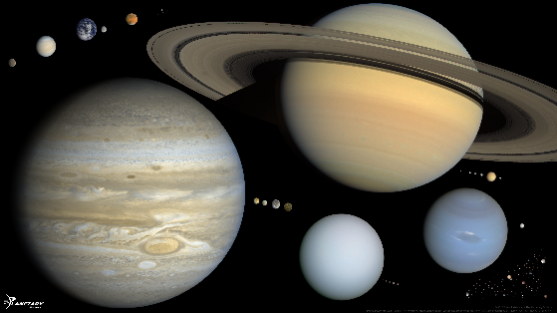
The language design universe: zoom out again
C
Java
Haskell
C++
Python
ML
OCaml
Verse
Solar system
Alpha Centuri

Slide 5

Verse
Effect system
Functional logic
Concurrency
Types
Mutable state
Transactions
Classes, objects
Verification
Tim Sweeney
Starship Captain

Slide 6

MaxVerse collaborators
Simon PJ, Lennart Augustsson, Koen Claessen, Ranjit Jhala, Stephanie Weirich, Guy Steele...
Verse

Slide 7

Verse

Slide 8
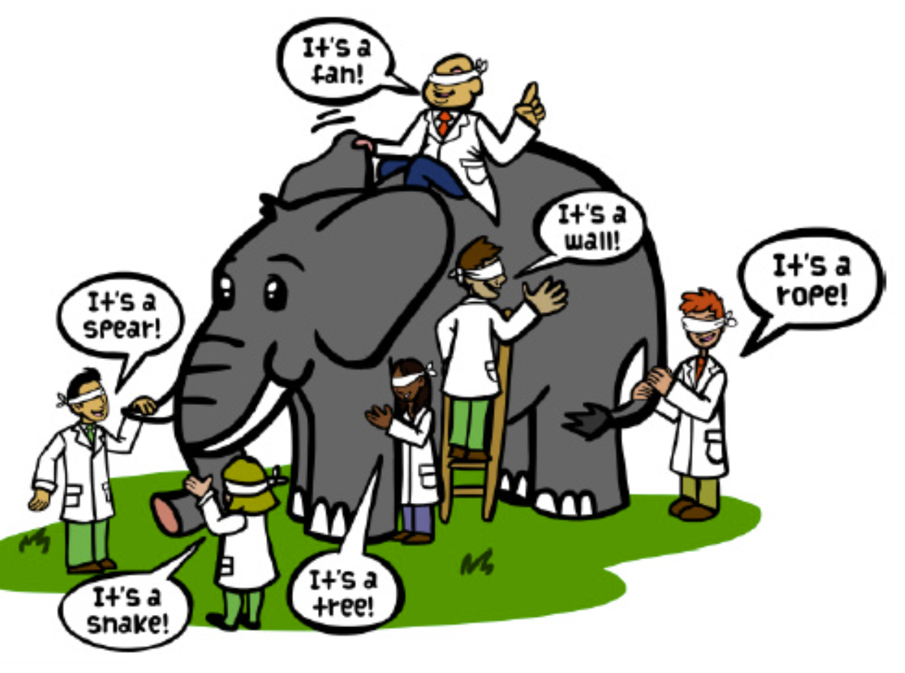

Slide 9
Galactic view
Verse is a declarative language: a variable names a single value, not a cell whose value changes over time.
Verse unifies expressions and patterns.
Verse is a functional logic language (like Curry or Mercury).
Verse has an unusual static type system that unifies types and expressions.
Verse is lenient but not strict:
  Like strict: everything gets evaluated in the end
  Like lazy: functions can be called before the argument has a value
Verse has an effect system, rather than using monads.

Slide 10
At first sight, pretty conventional
Despite the “:=“ notation,
f is not mutable!
x:=e1; e2
is like
let x=e1 in e2
Typed function declaration
f(x:int) := x+1;
f[7] + f[8]
“;” for sequencing
Function call (square brackets)

Slide 11
At first sight, pretty conventional
Of course, Verse has a lambda form too:
All three do the same thing
f1(x:int) := x+1;
f2 := function(x:int)<succeeds>{x+1}
f3 := (x:int) => x+1

Slide 12
Choice is part of the fabric of computation in Verse

Slide 13
Choice and failure
An expression can
  fail, without a value
  succeed, returning a value
  iterate, returning several values
Forward reference
Choice is NOT commutative
5 and then 6
fail # Fails
5 # Succeeds, returning 5
5 | 6 # Iterates, returning 5 then 6
5 | fail # Succeeds, returning 5
fail| 5 # Succeeds, returning 5
4..8 # Returns 4 then 5 … 8
4|5|6|7|8 # Same

Slide 14
Conditionals: no booleans
An old idea: [SNOBOL, Icon, 1979]
if(e){ e1 }else{ e2 }
Returns e1 if e succeeds
  “Succeeds” = returns one or more values
Returns e2 if e fails
  “Fails” = returns zero values
(x>20) succeeds if x>20, returning x,
fails if x<=20
No Boolean type
“Fails” is not a Bad Thing; it’s like False in Haskell or ML
if(x>20){ e1 }else{ e2 }
Exercise
What does this do?
(0 < x < 20)
NB: ‘<‘ is right associative
Most predicates do this: they are partial identity functions

Slide 15
Choice and sequencing
Sequencing takes Cartesian product.
Like list comprehensions in Haskell
x:=(5|1); y:=(1|4); x+y
# Returns 6 then 9 then 2 then 5
Filtering
x>2 fails when x<=2
x:=(5|1); y:=(1|4); x>2; x+y
# Returns 6 then 9
x:=(5|1); y:=(1|4); x=y; x+y
# Returns 2
Verse uses “=“ for equality
Fails when not equal.
Often called “unification”!

Slide 16
Cute but useful
if(x>3 | x<0){ e1 }else{ e2 }
Choice: effect is disjunction (“or”)
if(x>3 ; x<100){ e1 }else{ e2 }
Tuple: effect is conjunction (“and”)

Slide 17
Tuples / arrays

Slide 18
Arrays (aka tuple)
Arrays and tuples are the same thing in Verse
Literally no difference
(4,2,7) # An array of 3 elements
a := (4,2,7); # Bind a to (4,2,7)
a[0] # Index into a, returning 4
Arrays and choice
(4,(1|2),7)
(4, fail, 7)
((5|4), (1|2), 7)

Slide 19
Arrays and choice
(4,2,7) # An array of 3 elements
a := (4,2,7) # Bind (4,2,7) to a
a[0] # Index into a
Arrays and choice
Just cartesian product, like list comprehensions in Haskell
(4,(1|2),7) # (4,1,7) | (4,2,7)
(4, fail, 7) # fail
((5|4), (1|2), 7) # (5,1,7) | (5,2,7) |
# (4,1,7) | (4,2,7)

Slide 20
Creating arrays: for turns choice into data
for{4|2|7} # The array (4,2,7)
for{1..10} # The array (1,2,3,.., 10)
for{x:=1..10; x*x} # The array (1,4,9, .., 100)
for{x:=1..10; even[x]} # The array (2,4,..10)
for{fail} # The array ()
‘for’ takes a choice of values and makes an array of all those values
Always returns exactly one array
Consequence: choice is not commutative

Slide 21
From choice to arrays and back: for and (:)
for{4|2|7} Succeeds returning array (4,2,7)
:(4,2,7) Behaves like 4|2|7
Forward reference
:
Tuple
Choice
for

Slide 22
Creating arrays: for turns choice into data
Making new arrays from old ones
Here is a nicer way to say the same thing (forward reference)
for{i:=0..Length[a]-1; a[i]+7} # Add 7 to each
# element of a
for{x:a; x+7}

Slide 23
Two-armed ‘for’
Variables bound in e1 scope over e2
for(e1){e2}
Iterate over the N (non-failing) choices in the domain e1
Form the N-tuple from the value(s) of range e2
for(i:=1..3){i*i} = ( (i:=1; i*i)
, (i:=2; i*i)
, (i:=3; i*i) )

Slide 24
Why bother?
for(e1){e2}
Iterate over the N (non-failing) choices in the domain e1
Form the N-tuple from the value(s) of range e2
for{i:=1..3; i*i} = (1,4,9)
for(i:=1..3){i*i} = (1,4,9)

Slide 25
e2 can fail
How can we ask if every element of an array a is even?
(In Haskell: all even a)
Clumsy way: find all even elements and see if the array changes:
a:=(62,4,7,2)
for{x:a; even[x]} = a
LHS is (62,4,2)
LHS is (62,4,7,2)

Slide 26
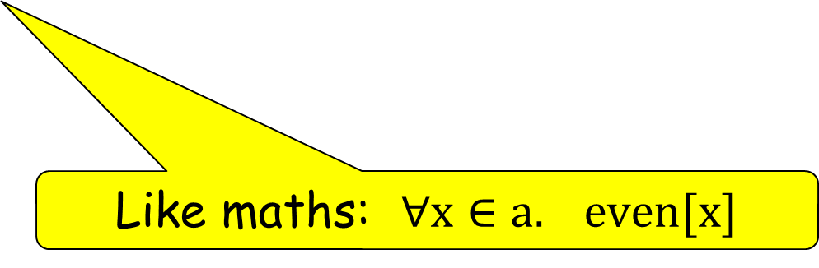
e2 can fail
How can we ask if every element of an array a is even?
(In Haskell: all even a)
Nicer, using two-armed ‘for’
If any of these fail,
the entire 3-tuple fails
a:=(4,1,2)
for(x:a){even[x]}
= ( (x:=4; even[x])
, (x:=1; even[x])
, (x:=2; even[x] )
Like maths: $∀x∈a. even[x]$

Slide 27
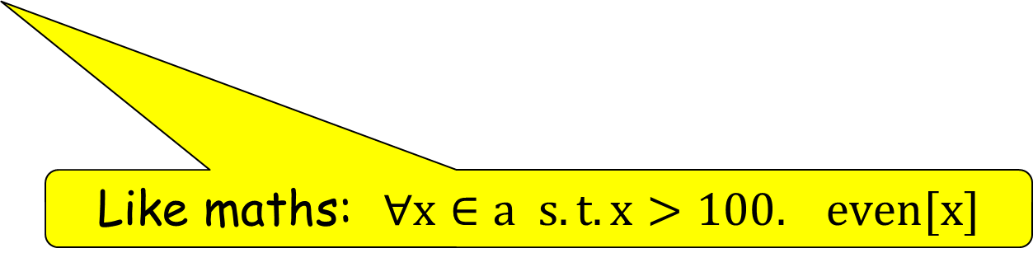
e2 can fail
How can we ask if every large element of an array a is even?
(In Haskell: all (\x -> x<=100 || even x) a
The domain limits what we test in the range
a:=(4,1,2)
for(x:a; x>100){even[x]}
Like maths: $∀x∈a s.t. x>100. even[x]$

Slide 28
e2 can have choice
Of course, this works if e2 has choice in it:
for(1..3){0|1} = ( (0|1), (0|1), (0|1) )
= (0,0,0) | (0,0,1) | (0,1,0)
| ... | (1,1,1)
All 3-bit binary numbers

Slide 29
Functions with finite domains

Slide 30
Arrays are finite functions
(4,2,7) # An array of 3 elements
a := (4,2,7) # Bind (4,2,7) to a
a[0] # Index into a
a[5] # Fail – index out of range
`a’ is a function with domain {0,1,2}
Idea: an array is a function with a finite domain
Array indexing is a function call; it is not overloaded notation
(This is why function call is f[x] is written with square brackets.)
If you call a (closed) function outside its domain, it fails
“Closed” is a forward reference

Slide 31
Array bound checks
a[5] # Fail – index out of range
How can we test for out of bounds?
if(a[5]){“Yes”}else{“No”} # Test out of bounds
How can use the value?
a := (5,2,99);
if(x:=a[1]){x+1}else{0} # Returns 3
x is bound in the predicate
x is in scope here...
...but not here

Slide 32
Closed functions with finite domains
If you call any (closed) function, even one with an infinite domain, outside its domain, it fails
a:=(4,2,7) # An array of 3 elements
a[5] # Fail – index out of range
f(x:int):=x+1 # A function whose domain is int
f[ “wombat” ] # Fails – argument outside domain
Not a type error

Slide 33
Functions with finite domains
Round parens: f(e) asks the verifier to check that f(e) cannot fail
An array is a function with a finite domain
Array indexing is a function call; it is not overloaded notation
If you call a (closed) function outside its domain, it fails
a:=(4,2,7) # An array of 3 elements
a[5] # Fail – index out of range
a(i) # Should not fail; verifier checks this
f(x:int):=x+1 # A function whose domain is int
f[ “wombat” ] # Fails – argument outside domain
f(i) # Should not fail; verifier checks this

Slide 34
Side note: the verifier
Verifier makes static checks on a Verse program
Rejects “bad” programs
Like any type system it may reject perfectly fine programs too
“Bad” means
  Fails when should not: a:=(4,1); a(7)
  Result has wrong type: f(x:int):int := “wombat”
  Result has wrong effects: f(x:int)<succeeds>:int := x>3
  Gets stuck: x:int; x = x*x
Undecidable
<succeeds> is a forward reference

Slide 35
Finite functions can do narrowing
New: i:int brings i into scope without giving it a value
as:=(3,7,4);
i:int; as[i]
A term from functional logic
You can think of i:int as bringing a new existential variable into scope
What values can i take? Clearly just 0,1,2!
So expand as[i] to those three choices
This is called “narrowing” in the functional logic literature
as:=(3,7,4);
i:int; as[i] + 1
=
as:=(3,7,4);
i:int; ((i=0; a[i]+1) |
(i=1; a[i]+1) |
(i=2; a[i]+1))
=
4 | 8 | 5

Slide 36
Narrowing in action
as:=(3,7,4);
i:int; i>0; as[i]+1
= 8 | 5
This cuts out the choice i=0

Slide 37
Narrowing in action
Forward reference: this is a slight lie
:as is shorthand for
i:int; as[i]
Enumerates the range of as
as:=(3,7,4)
i:int; as[i]
= i:int; (i=0; as[i])| (i=1; as[1] |
(i=2; as[i])
= 3 | 7 | 4
:as
= 3 | 7 | 4
:
Tuple
Choice
for

Slide 38

for as forall
for{x:as; x+7} # Add 7 to each element of a
Reads like maths $∀x∈as. blah$
But how does it work?
x:t is short for x := (:t)
for{x := :as; x+7}
Not a lie!
Simply syntactic sugar
Choice of all the elements of as

Slide 39
Some functions on arrays
[]int is the syntax of the type of arrays of ints
Fails on empty tuple
head(xs:[]int)<decides> := xs[0]
tail(xs:[]int))<decides> := { xs[0]; for{i:int; i>0; xs[i]} }
cons(x:int,xs:[]int) := for{x | :xs }
snoc(xs:[]int,x:int) := for{:xs | x}
append(xs&ys:[]int) := for{:xs | :ys}
map(f(:int):int,xs:[]int):= for{f[:xs]}

Slide 40
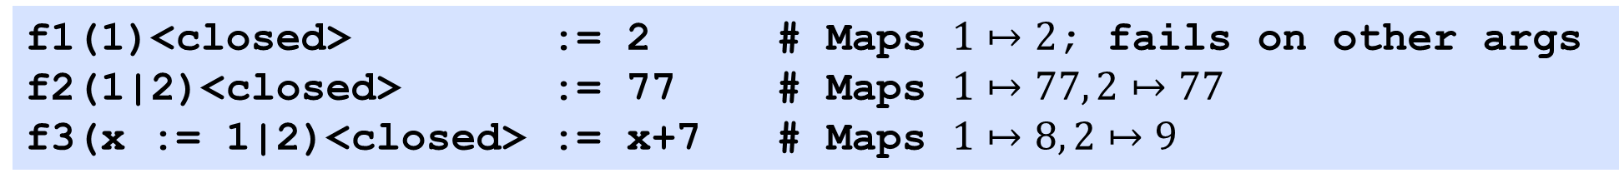
It’s not just arrays that have finite domain!
f1(1)<closed> := 2 # Maps $1↦2$; fails on other args
f2(1|2)<closed> := 77 # Maps $1↦77, 2↦77$
f3(x := 1|2)<closed> := x+7 # Maps $1↦8, 2↦9$
Outside the domain, the function fails.
Thus f2[7] fails
And narrowing works too
for{ f2[ x:int ]; x } # Returns (1,2)

Slide 41
Side note: Binding
x+1 # An occurrence of x
3=x # An occurrence of x
x=3 # An occurrence of x
x:=3 # A binding of x, equal to 3
x:int # A binding of x
In general,
  (x:e) or (x:=e), and only those two, bring x into scope,
  throughout the current block
  plain x is an occurrence of x
for{ y:=x+1; x:=3; (z | 2*y) }
desugar
for{ ∃x y. y=x+1; x=3; (z | 2*y) }

Slide 42
Binding
x:=3; f1(x:int) := x+1
x:=3; f2(x) := x+1
In f1, the (x:int) binds x, shadowing the outer binding for x.
f1 is the successor function
In f2, the (x) is an occurrence of x.
f2 has domain {3} and returns 4.
So “patterns” can contain a mixture of binding occurrences and bound occurrences
The binding occurrences are signalled with “:”.

Slide 43
Types are expressions

Slide 44
Types in Verse
In Verse, a “type” is simply a (partial) function
  Function fails (returns zero values) on values outside (the domain of) that type
  E.g. The type int is a function that fails on strings, floats;
  and is the identity function on integers.
  e.g int[4] = 4, but int[“wombat”] fails
A function applies its parameter type to its argument value:
A “type” is not necessarily an identity function
(x:int) => e
desugars to
λi. x:=int[i]; e
(x:abs) => e
desugars to
λi. x:=abs[i]; e

Slide 45
Types in Verse
A call to this function fails if the argument x is not a natural number
It is easy to define your own “types”
nat(x:int)<closed><decides>
:= (x>=0)
oneOrTwo(x:=1|2)<closed> := x
The type that contains 1 or 2

Slide 46
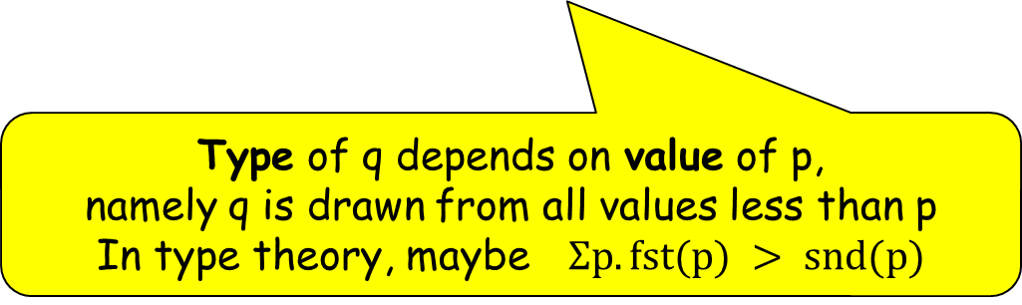
Types in Verse
Types can easily be “dependent”
grPair(p:int,q:int)<closed><decides>
:= p>q; (p,q)
Type of q depends on value of p,
namely q is drawn from all values less than p
In type theory, maybe $Σp. fst(p) > snd(p)$

Slide 47
Types in Verse
Functions can be polymorphic
swap(t:type,x:t,y:t)<closed> := (y,x)
Succeeds on (partial) identity functions
swap[int,3,7]

Slide 48
type{e} makes a new type
oneOrTwo := type{1|2} # The type containing 1 and 2
f(x:oneOrTwo):= x+1
Precisely equivalent to
In general, “type{t}” is just syntactic sugar:
oneOrTwo(x := (1|2)) := x
f(x:oneOrTwo):= x+1
type{t} means function(x:=t)<closed>{x}

Slide 49
Types in Verse
Curried function definition
User defined type constructors
pair(t1:type, t2:type)(x:any)<closed><decides>
:= { (x1,x2):= x; (t1[x1],t2[x2]) }
Entire function fails if either t1[x1] or t2[x2] fails
array(t:type)(a:any)<closed><decides>
:= { isArray[a]; for(x:a){t[x]} }
Two-armed ‘for’ is critical

Slide 50
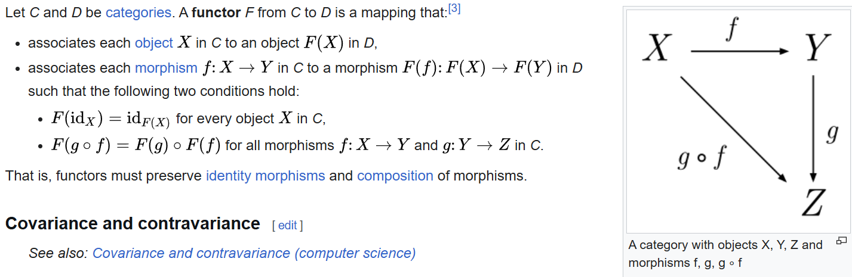
Functors
Two uses of “F”
One on objects, one on morphisms
Wikipedia
In Haskell
instance Functor Array where
fmap f a = listArray (bounds a) (map f (elems a))
-- (Array, fmap @Array) is a functor

Slide 51
Functors
Two uses of “F”
One on objects, one on morphisms
In Verse, the type constructor ‘array’ and the mapping function are the same thing.
Not “two uses of F”. Just one F that does both jobs!
Same for pairs where we get a bi-functor

Slide 52
Patterns are expressions

Slide 53
Another Big Idea in Verse
The same Verse term can describe
  An ordinary expression.
  A type.
  A pattern. Not \x.expr, nor \pat.expr, just
  function(expr){expr}
One semantics for expressions, types, and patterns.
Far-reaching consequences

Slide 54
Patterns and expressions
Typically
An expression, given the values of its free variables, returns a value
A pattern, given an input argument to match, may fail,
or may return a set of bindings
The big question: how do we “match” an argument against an expression, creating bindings?

Slide 55
Patterns and expressions
The big question: how do we “match” an argument against an expression?
function(e1){e2} = λi. i~>e1; e2
New language construct x~>e, matches x against the “pattern” e
Neither λx.e nor x~>e are part of the source language, but they are very useful as an intermediate

Slide 56
Patterns and expressions
The big question: how do we “match” an argument against an expression?
Example:
function(e1){e2} = λi. i~>e1; e2
Bindings in the pattern (aka domain) e1 scope over the body (aka range) e2
function(x:int){x+1} = λi. i~>(x:int); x+1

Slide 57
How does matching work?
The big question: how do we “match” an argument against an expression?
i~>(x:int)
x:t is short for x := (:t)
i~>(x:int) = i ~> (x := (:int))
i ~> (x:=t) = x := (i~>t)
i~>(x:int) = i ~> (x := (:int))
= x := (i ~> :int)

Slide 58
How does matching work?
The big question: how do we “match” an argument against an expression?
i~>(x:int) = i ~> (x := (:int))
= x := (i ~> :int)
i~>(:t) = t[i]
i~>(x:int) = i ~> (x := (:int))
= x := (i ~> :int)
= x := int[i]
The magic colon in action

Slide 59
More matching
This is just what we wanted
function(x:int){x+1}
= λi. i~>(x:int); x+1
= λi. x := int[i]; x+1

Slide 60
More matching
This is just what we wanted
function(x:int){x+1}
= λi. i~>(x:int); x+1
= λi. x := int[i]; x+1
function(x:abs){x+1}
= λi. i~>(x:abs); x+1
= λi. x := abs[i]; x+1
‘abs’ is a (partial) idempotent function, but not identity.
Works just fine!

Slide 61
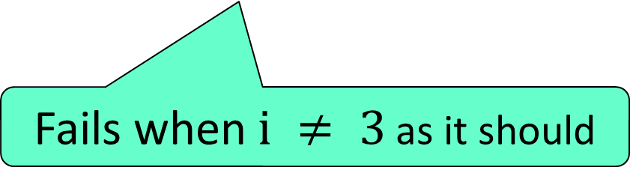
More matching
function(x:=3){x+1}
= λi. i~>(x:=3); x+1
= λi. x := i~>3; x+1
= λi. x := i=3; x+1
i~>k = i=k
Fails when $i ≠ 3$ as it should

Slide 62
Matching tuples
function(3,x:int){x+1}
= λi. i~>(3,x:int); x+1
= λi.∃jk. i=(j,k); j~>3; k~>x:int; x+1
= λi.∃jk. i=(j,k); j=3; x:=int[k]; x+1
i~>(e1,e2) = ∃jk. i=(j,k); j~>e1; k~>e2

Slide 63
Matching on “non-value” expressions
function(x:=(3|4)){x+1}
= λi. x := i~>(3|4); x+1
= λi. x := (i~>3)|(i~>4);
x+1
= λi. x := (i=3)|(i=4); x+1
i~>(e1|e2)
= (i~>e1) | (i~>e2)
This will automatically do narrowing at the call site, as it should

Slide 64
Matching on “non-values”
i~>(e1;e2)
= ∃j.(j~>e1); (i~>e2)
i~>f[x] = i=f[x]
function(x>7; x:int){x+1}
≡ function(x>7; x:int){x+1}
≡ λi. i~>(x>7; x:int); x+1
≡ λi.∃j.j~>(x>7); i~>(x:int); x+1
≡ λi.∃j.j=(x>7); x:=int[i]; x+1
Domain is ints that are >7

Slide 65
‘where’: a convenience
function(x:int where x>7){x+1}
i~>(e1 where e2)
= ∃j.(i~>e1); (j~>e2)
function(x:int, y:int where x>y){x+1}

Slide 66
if and for
function(if(x>7){:int}{:float}){…}
Conditionals in the domain
function( for(1..3){:int}){…}
This…
…behaves likes this
function(:int, :int, :int){…}

Slide 67
The big deal: functions!
f( function(1){3} ) := 7
A “pattern” that is a function!!!
Presumably the domain of f is (only) the function that maps 1=>3.
But do we really want to match on functions??

Slide 68
The big deal: functions!
f := function( g(:int):nat ){g[2]}
Wow! This is a pattern that somehow constrains the argument to f to (int->nat) function
x:t is short for x := (:t)
f(at):=bt is short for f := function(at){bt}
f := function( g := function(:int){:nat} ){g[2]}

Slide 69
How do function “patterns” behave?
Applies ‘abs’ to the argument, possibly failing, and transforming the argument
f := function( x := :abs ){x+2}
f := function( g := function(:int){:nat} ){g[2]}
Somehow applies ‘function(:int){:nat}’ to the argument, possibly failing, and
transforming the argument

Slide 70
The big deal: functions!
function(g:= function(:int){:nat} ){g[2]}
≡ λgg. gg ~> (g:= function(:int){:nat} ); g[2]
≡ λgg. g := gg ~> function(:int){:nat}; g[2]
Now what? What is (gg ~> function(at){bt}) ?

Slide 71
The big deal: functions!
function(g:= function(:int){:nat} ){g[2]}
≡ λgg. gg ~> (g:= function(:int){:nat} ); g[2]
≡ λgg. g := gg ~> function(:int){:nat}; g[2]
It has to be this:
≡ λgg. g := \i. p := int[i]; q = gg[p]; nat[q]
Standard Findler/Felleisen wrapping for Scheme contracts
c.f. gradual types

Slide 72
But wait
≡ λgg. g := \i. p := int[i]; q = gg[p]; nat[q]
Where does that lambda fail if ‘gg’ is not an (int->nat) function?
The above transforms correctly, but fails only later when ‘g’ is called. (Hence all the gradual types stuff about blame.)
Answer, just like f(e), the verifier makes a static check, and (conservatively) rejects the program if the check is not guaranteed to succeed, because the runtime cannot test it.

Slide 73
But wait
f1(x:int):int:=x+1; f1[“wombat”]
f2(g(:int):nat)):=g[3]; f2[f1]
Call f1[“wombat”] passes verification, but fails at runtime
Call f2[f1] should likewise pass verification and fail at runtime,
but the runtime can’t do that.
So call f2[f1] is rejected by the verifier.

Slide 74
Wrapping up

Slide 75
Other parts of the elephant
An operational semantics via term-rewriting (like lambda calculus)
A rather unusual set-based denotational semantics
Effects <decides>, <succeeds>, <fails>; and I/O etc.
“Open functions” and overloading
Classes and structs
Transactional memory

Slide 76
Verse occupies a very unusual part of the design space
We are actually doing all this crazy stuff
Functions with explicit domain and range
Terms and types are the same thing.
  With a necessarily-conservative verifier (= type checker)
Patterns and expressions are the same thing.
Functional logic – but only a sprinkling.
Intriguing, unusual, very challenging to figure out, but very cool

Slide 77
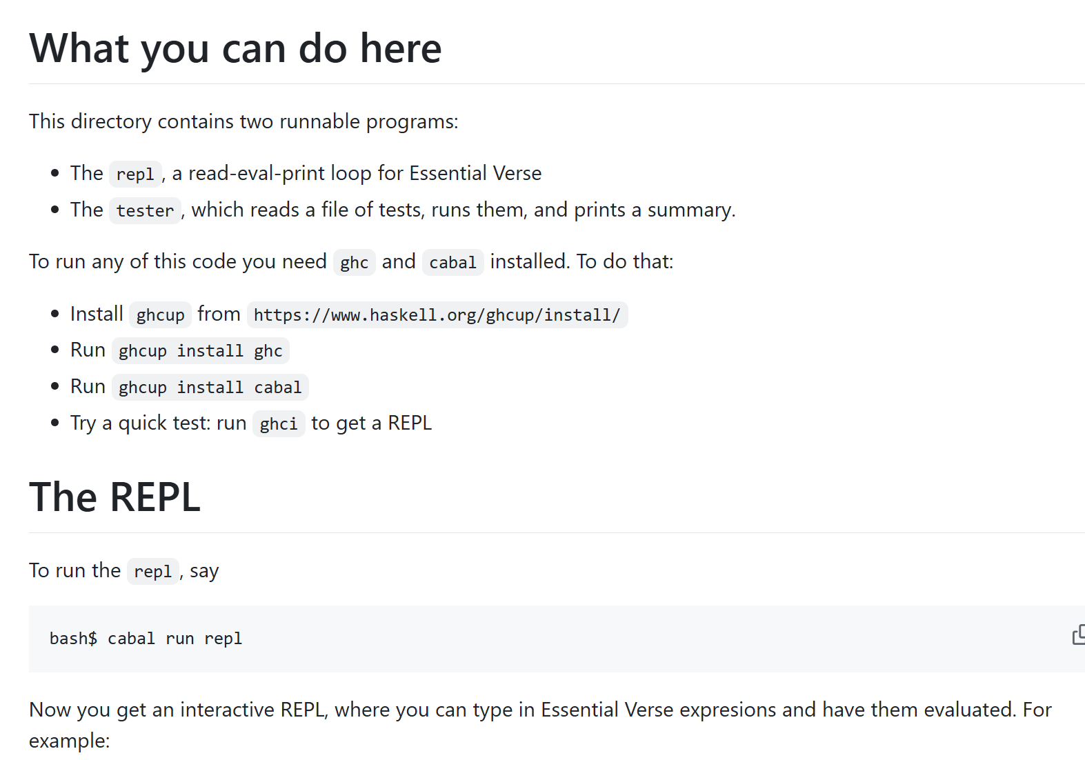
Prototype REPL
https://github.com/augustss/verse-semantics

