Slide 1

Towards a
denotational semantics for Verse
Lennart Augustsson, Koen Claessen, Simon Peyton Jones, Tim Sweeney
Epic Games 2026

Slide 2
Figuring out Verse
Programmer’s eye view
Operational semantics
Denotational semantics
Verification

Slide 3

The water gets deep quickly
Me: paddling in shallow water
Koen Claessen, Stephanie Weirich: swimming
Jon Stirling, Neel Khrisnaswami, Bob Harper, Martin Hyland, Alex Kavvos etc: fully aquatic
Conor McBride: hard to classify

Slide 4
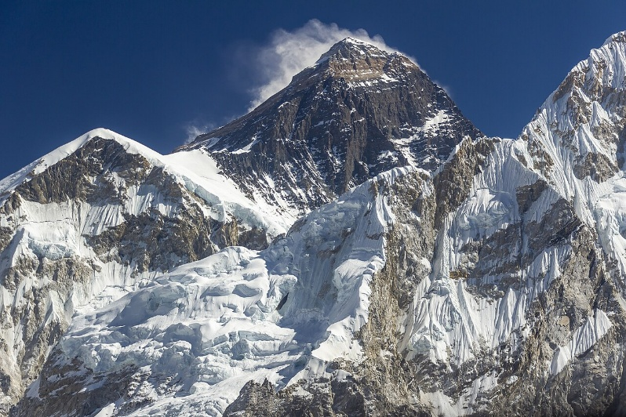
Denotational semantics
A rewrite semantics is very operational: this is how a program executes.
A denotational semantics complements that: it says what value(s) the program returns, or “denotes”.
Three big challenges
  The cardinality problem for untyped
  languages: V = V->V
  Patterns, expressions, and types are
  all the same thing
  Parametricity: usually depends critically
  on types, but Verse is not typed in a
  traditional way.

Slide 5
Challenge 1
Cardinality

Slide 6
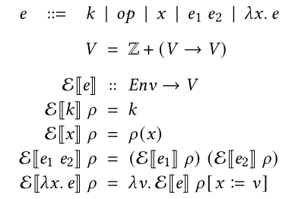

Untyped lambda calculus
Problem: what is V? There is no set satisfying
$V=V→V$
It is too big!
Answer (Scott et al): domain theory.
LHS: syntax trees
RHS: domain theory

Slide 7
Domain theory: problems
Maths behind domain theory is hard: monotonicity, continuity, limits and fixpoints.
Used to be canonical; but now
  Graph models
  Step-indexed models
  Type theory
Unification is not continuous
Non-termination and bottom deeply built in; but we want to explore terminating subsets and proofs.
(This is a choice.)

Slide 8
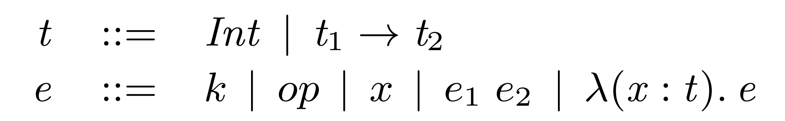
Today’s standard answer: use types
If untyped lambda calculus is the answer, you are probably asking the wrong question
Use a typed caclculus
For example, Simply Typed Lambda Calculus (STLC)

Slide 9
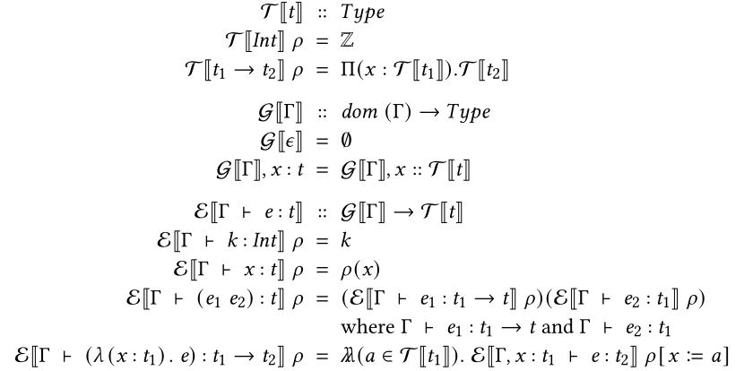
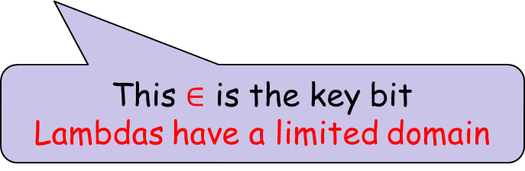
Today’s standard answer: use types
LHS: syntax
RHS: Martin-Lof type theory
Now very standard
But MLTT is itself quite a big theory
Big assumption: well typed terms only. E’s argument is really a typing derivation!
This $∈$ is the key bit
Lambdas have a limited domain
MLTT lambda
(apparently no consensus on notation)
Big problem for Verse

Slide 10
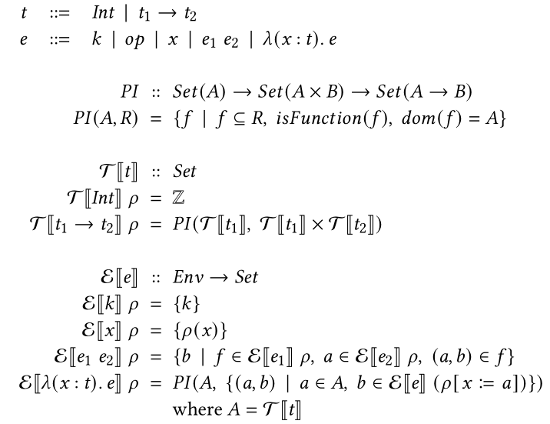
Our alternative plan
Still STLC
Still STLC; only semantics differs
LHS: syntax
RHS: ZF set theory (only)
Semantics does not depend on well-typed-ness
Indeed there is no type system.

Slide 11
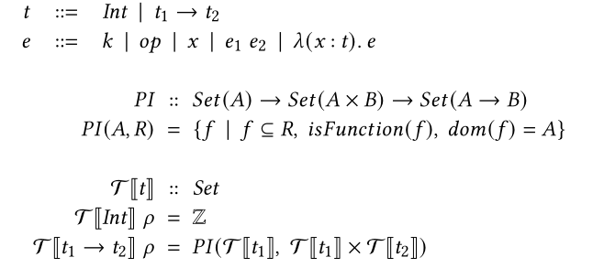
Types
PI :: Set -> Set -> Set
Functions are often infinite sets of pairs
Denotation of a type T[t] is an (infinite) set of values that inhabit that type
Set theory: a function is just a set of pairs. E.g {(0,1), (1,2), (2,3), …} is successor.
Given domain (a set) and a set of pairs, PI returns all the functions (sets of pairs)
PI: If the inputs are sets, the output is a set.
Z = {0,1,2…} = { {}, {{}}, {{}, {{}}}, …} (!)

Slide 12
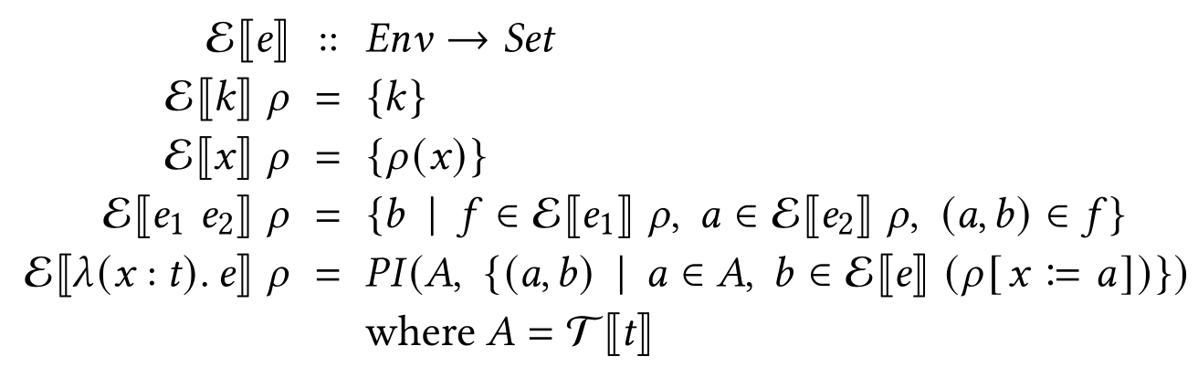
Terms
Denotation of a term is a set of values; always empty or singleton.
Every term (ill-typed or not) has a denotation, maybe {}
Empty-set means “ill typed term”; e.g. (3 4).
But not vice versa: some “ill typed terms” have non-empty denotations
  (λ(y:int).ifzero y 3 (9 5)) denotes {f} where f={(0,3)}

Slide 13
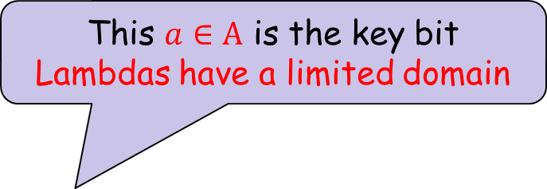
Terms
This $a∈A$ is the key bit
Lambdas have a limited domain
What makes this work? How do we avoid the cardinality problem?
Key point: the type on a lambda binders limits the values that the binder can take on. That is what keeps us in set.
But no type system! Lambda binders have a type, but THAT IS ALL

Slide 14
Surprise
Surprisingly simple.
Remarkably: does not threaten the set-based semantics.
Non-termination yields empty set.
Does not find the least fixpoint, rather all fixpoints.
BUT: STLC is still nowhere near expressive enough!

Slide 15
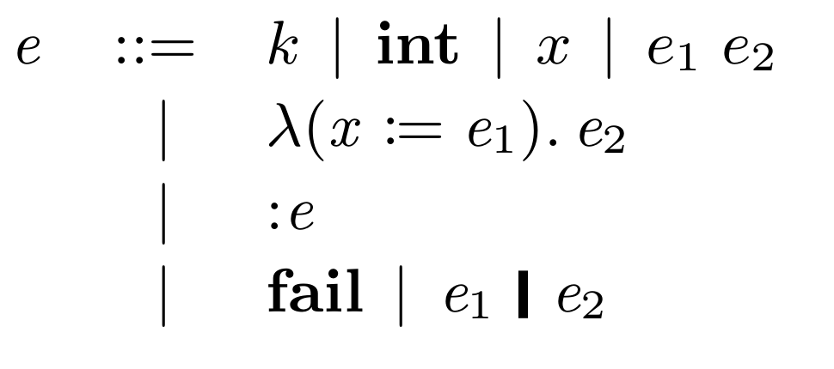
Towards Verse: Timbda 0
Terms and types are same thing
  STLC: λ(x : t). e
  Timbda-0: λ(x := e₁). e₂
λ(x := :int). x+1
Just like Verse
Unlike (say) the lambda cube, there is still only one lambda!
  Builds (dependent) function types
  Builds ordinary functions

Slide 16
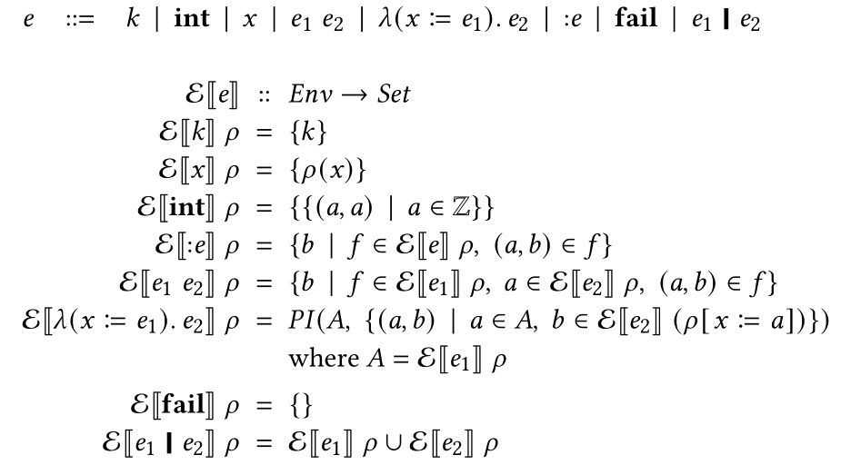
Towards Verse: Timbda 0
An expression denotes a set of values, like STLC
We need a set of results to express a type
λ(x := (3|4|5)). e
So now the set is definitely NOT always a singleton or empty! It may have many (incl infinte) elts.
Still just ZF set theory

Slide 17
Towards Verse: Timbda 0
A function is set of pairs

Slide 18
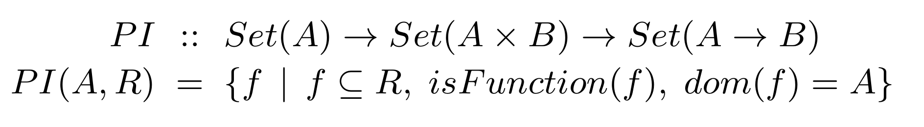

Slide 19
Towards Verse: Timbda 0
Remarkably simple – even simpler than STLC (just E, no T)!
Still just ZF set theory. No problems with cardinality.
No type system: every term has a denotation.
“Ill typed” terms simply denote the empty set, e.g. (3 4)

Slide 20

Lambda
λ(x:int). <some set of int>
Usually
  one function, that takes
  and int and returns a set
In T0 and Verse
  A set of functions
Remarkably: only one lambda!
  $ℇ[(x :=(:int)).x+1] = \{succ\}$
  $ℇ[(x :=(:int)). (:int)] = \{all functions from int to int\}$
Term-like
Type-like
f( g := function(:int){:int} ) := g[3]

Slide 21
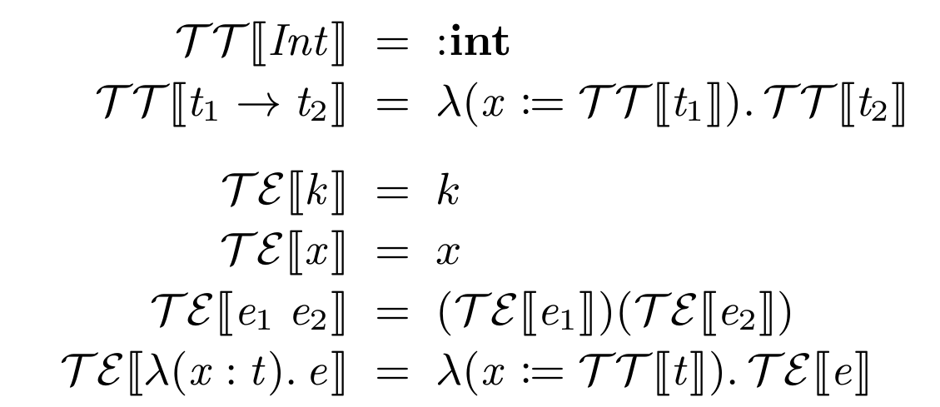
Timbda-0 is super expressive
E.g we can translate any STLC term into Timbda-0
You can see very clearly how the same lambda is used for function “types” and for function “terms”

Slide 22

any
Can we embed the untyped lambda calculus?
Surely not! But why not?
We would need a new constant ‘any’ so that we could write
TE[ λ x.e ] = λ(x := :any). e ?
But what is the denotation of ‘any’?
Maybe
  $U_{0}= \{v | e∈Expr, v∈ℇ[e]ε\}$
  $ℇ\left[any\right]={\{\{ (a,a) | a ∈U}_{0}\}\}$
Leads to a kind of stratified-universe semantics
All expressions not mentioning any
This is an enumerable set

Slide 23
Lots more to do
Operational semantics
  Untyped lambda calculus has a simple operational semantics (rewriting)
  But (embarrassingly) Timbda-0 does not.
  We know what to do: Timbda-1, Timbda-2…
Exploring relational semantics and parameteric polymorphism.

Slide 24
Challenge 2
Patterns vs expressions

Slide 25
A Big Idea in Verse
The same Verse term can describe
  An ordinary expression.
  A type.
  A pattern. Not \x.expr, nor \pat.expr, just
  fun(expr){expr}
One semantics for expressions, types, and patterns.
Far-reaching consequences

Slide 26

Patterns and expressions
Typically
An expression, given the values of its free variables, returns a value
A pattern, given an input argument to match, may fail,
or may return a set of bindings
So the denotation of every Verse expression must do all of these things:
    Take an input value
    Fail or succeed
    Return an output value
    Return a bunch of bindings
Denotational semantics must be compositional:
$$E⟦fun\left(e_{1}\right)\left\{e_{2}\right\}⟧=…E⟦e_{1}⟧….E⟦e_{2}⟧….$$

Slide 27
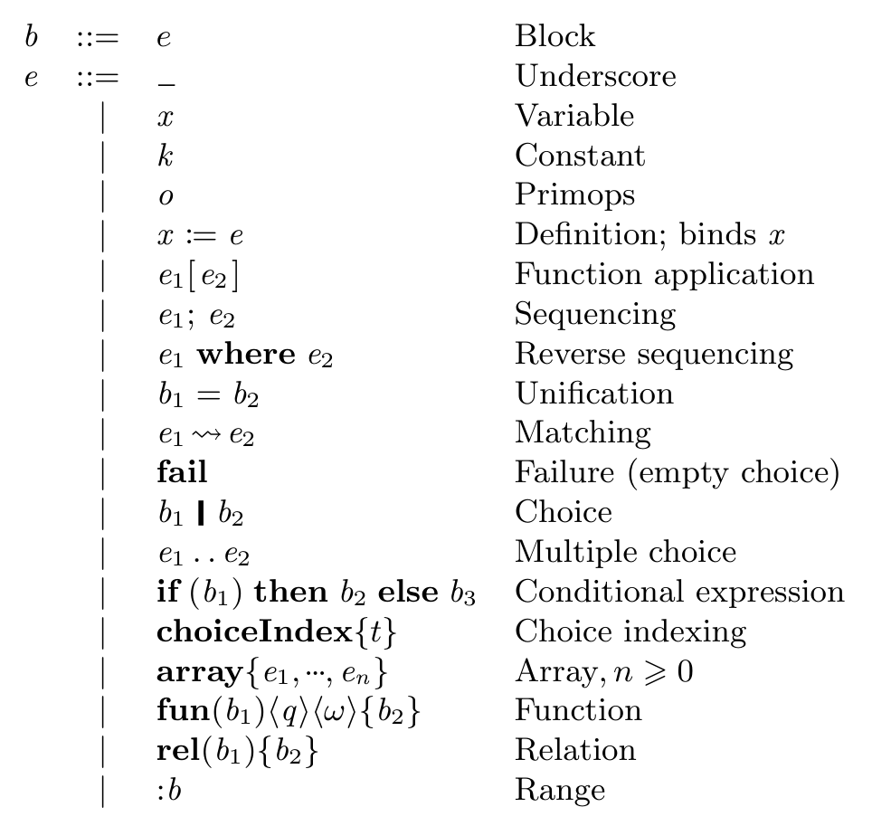
The colon rule
x:e or x:=e
brings x into scope in the enclosing block; nothing else does
In fact
x:e means x := (:e)
Scoping rules
fun(b1){b2} variables bound in e1 scope over b2
if(b1)then{b2}else{b3} variables bound in b1 scope over b2 but not b3

Slide 28

The conventional way (expression oriented)
Domains:
$Env=Ident↪Val$
$Val=Z+(Val→Val)$
Denotations:
$E\left[e\right]:Env →Val$
$E\left[e\right] ρ= …$
Each variable is brought into scope with a known value, e.g.
$E\left[λx.e\right]ρ=λy. E\left[e\right](ρ\left[x≔y\right])$
Not a good fit with the “pattern” part
  How does it “take an input argument”, or
  “return a bunch of bindings”?

Slide 29

Existentials
But what about
$E\left[∃x. e\right]ρ= ???$
There is no value to bind x to!
One idea: iterate over all possible values of x, and combine the results somehow.
  $$E\left[∃x.e\right]ρ= ∪_{\left\{y∈Val\right\}}E\left[e\right](ρ\left[x≔y\right])$$
Maybe this is fine;
  but it’s not directly implementable
  what exactly does $∪$ mean?
We have been exploring an alternative that seems a better fit with functional logic.

Slide 30

An alternative path for Verse
(setting aside the cardinality challenge)
Totally ignoring the cardinality problems here
Domains:
    $$Val=I\left(Z\right)+F\left( Fun \right)$$
    $Env=Ident →Val$ NB: total function
    $$ENV=Set\left( Env\right)$$
    $$Fun = Val →Val$$
  Denotations
    $$E\left[e\right] :Seq( Set( Env × Val))$$
    $E\left[k\right]=$ $\left[ \left\{ \left(ρ,I\left(k\right)\right) \right| ρ∈Env \right\} ]$
    $E\left[x\right]=$ $\left[ \left\{ \left(ρ,ρ(x)\right) \right| ρ∈Env \right\} ]$
Seq expresses the (ordered) choices
A massive (infinite) set of Envs

Slide 31

Encoding the result in the ENV
  Before:
    $$E\left[e\right]:Seq\left(ENV×Val\right)$$
    $E\left[k\right]=$ $\left[ \left\{ \left(ρ,I\left(k\right)\right) \right| ρ∈Env \right\} ]$
    $E\left[x\right]=$ $\left[ \left\{ \left(ρ,ρ(x)\right) \right| ρ∈Env \right\} ]$
After:
    $$E\left[e\right]:Ident→Seq\left(ENV\right)$$
    $E\left[k\right]v=$ $\left[ \left\{ρ \right| ρ∈Env, ρ\left(v\right)=I(k) \right\} ]$
    $E\left[x\right]v=$ $\left[ \left\{ ρ \right| ρ∈Env, ρ\left(v\right)=ρ\left(x\right) \right\} ]$
The “result variable”
This bit is simpler

Slide 32
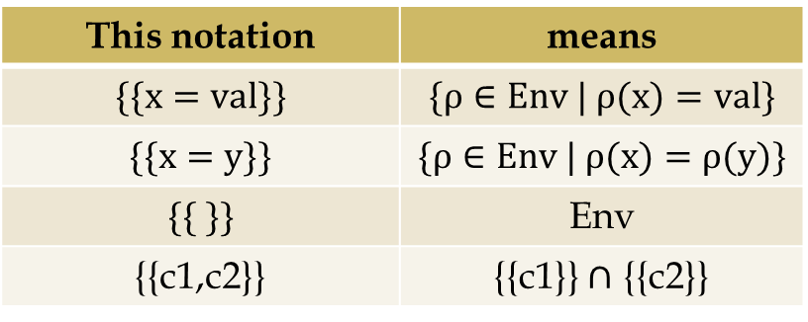

Some notation for ENV
This notation | means
$$\{\{x=val\}\}$$ | $$\{ρ∈Env | ρ(x)=val\}$$
$$\{\{x=y\}\}$$ | $$\{ρ∈Env | ρ(x)=ρ(y)\}$$
$$\{\{ \}\}$$ | Env
{{c1,c2}} | {{c1}} $∩$ {{c2}}
Before:
    $$E\left[e\right]:Ident→Seq\left(ENV\right)$$
    $E\left[k\right]v=$ $\left[ \left\{ρ \right| ρ∈Env, ρ\left(v\right)=I(k) \right\} ]$
    $E\left[x\right]v=$ $\left[ \left\{ ρ \right| ρ∈Env, ρ\left(v\right)=ρ\left(x\right) \right\} ]$
After:
    $$E\left[e\right]:Ident→Seq\left(ENV\right) \\ E\left[k\right]v=\left[ \{\{ v=I\left(k\right)\}\} \right] \\ E\left[x\right]v=\left[ \{\{ v=x \}\} \right]$$
    $$E⟦_⟧v=\left[ \{\{ \}\} \right]$$
Key idea
ENV = Set(Env)
describes a collection of constraints
The denotation of E[e] is a collection of constraints over
the free variables of e and its output variable

Slide 33

Choice
    $$E⟦e⟧:Ident→Seq\left(ENV\right) \\ E⟦k⟧v=\left[ \{\{ v=I\left(k\right)\}\} \right] \\ E⟦x⟧v=\left[ \{\{ v=x \}\} \right]$$
    $$E⟦e_{1} | e_{2}⟧v=E⟦e_{1}⟧v + E⟦e_{2}⟧v$$
    $$E⟦fail⟧v =[]$$
e.g. $E⟦3 | 7⟧v=\left[ \{\{v=3\}\}, \{\{v=7\}\} \right]$
List append

Slide 34

Unification
    $$E⟦e⟧:Ident→Seq\left(ENV\right) \\ E⟦k⟧v=\left[ \{\{ v=I\left(k\right)\}\} \right] \\ E⟦x⟧v=\left[ \{\{ v=x \}\} \right]$$
    $$E⟦e_{1} | e_{2}⟧v=E⟦e_{1}⟧v + E⟦e_{2}⟧v$$
    $$E⟦fail⟧v=[]$$
    $$E⟦e_{1}=e_{2}⟧v=E⟦e_{1}⟧v ⊛ E⟦e_{2}⟧v$$
    where
    $$\left(⊛\right)∷Seq\left(ENV\right)→Seq\left(ENV\right)→Seq\left(ENV\right)$$
    $$s_{1}⊛s_{2}=\left[Δ_{1}∩Δ_{2} | { Δ}_{1}∈s_{1},Δ_{2}∈s_{2}\right]$$
Output variable is the same
Output is the same
Cartesian product of choices from s1, s2
Set-intersection

Slide 35

Unification
    $$E⟦e_{1}=e_{2}⟧v=E⟦e_{1}⟧v ⊛ E⟦e_{2}⟧v$$
e.g. $E⟦x=3⟧v$
$$=E⟦x⟧v⊛E⟦3⟧v$$
$$=\left[\{\{x=v\}\}\right]⊛\left[\{\{v=3\}\}\right]$$
$$=\left[\{\{x=v\}\}∩\{\{v=3\}\}\right]$$
$$= [ \{\{ x=v=3 \}\} ]$$
    $$\left(⊛\right)∷Seq\left(ENV\right)→Seq\left(ENV\right)→Seq\left(ENV\right)$$
    $$s_{1}⊛s_{2}=\left[Δ_{1}∩Δ_{2} | { Δ}_{1}∈s_{1},Δ_{2}∈s_{2}\right]$$

Slide 36
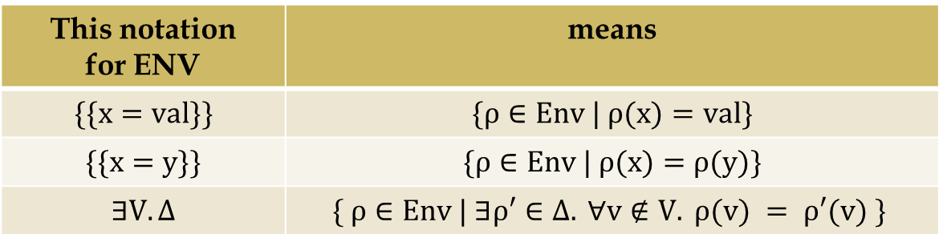

Sequencing
Cartesian product of choices from e1, e2
    $E⟦e_{1};e_{2}⟧v=(E⟦e_{1}⟧q \backslash \backslash \{q\}) ⊛ E⟦e_{2}⟧v$ $q∉fv\left(e_{1}\right)$
    $$(\backslash \backslash )∷Seq\left(ENV\right)→Set\left(Ident\right)→Seq\left(ENV\right)$$
    $$s \backslash \backslash V = [ ∃V. Δ | Δ ∈ s ]$$
This notation for ENV | means
$$\{\{x=val\}\}$$ | $$\{ρ∈Env | ρ(x)=val\}$$
$$\{\{x=y\}\}$$ | $$\{ρ∈Env | ρ(x)=ρ(y)\}$$
$$∃V. Δ$$ | $$\{ ρ∈Env | ∃ρ′∈Δ. ∀v∉V. ρ(v) = ρ′(v) \}$$

Slide 37

Existentials
    $$E⟦∃x.e ⟧v=E⟦e⟧v \backslash \backslash \{x\}$$
This notation for ENV | means
$$\{\{x=val\}\}$$ | $$\{ρ∈Env | ρ(x)=val\}$$
$$\{\{x=y\}\}$$ | $$\{ρ∈Env | ρ(x)=ρ(y)\}$$
$$∃V. Δ$$ | $$\{ ρ∈Env | ∃ρ′∈Δ. ∀v∉V. ρ(v) = ρ′(v) \}$$

Slide 38

The “:=” operator
    $$E⟦x:=e ⟧v=\left[\{\{x=v\}\}\right]⊛E⟦e⟧v$$
This is how an expression “produces bindings”
e.g. fun( x := :int ){ x+1 }
Simply constrain x to be the same as v

Slide 39
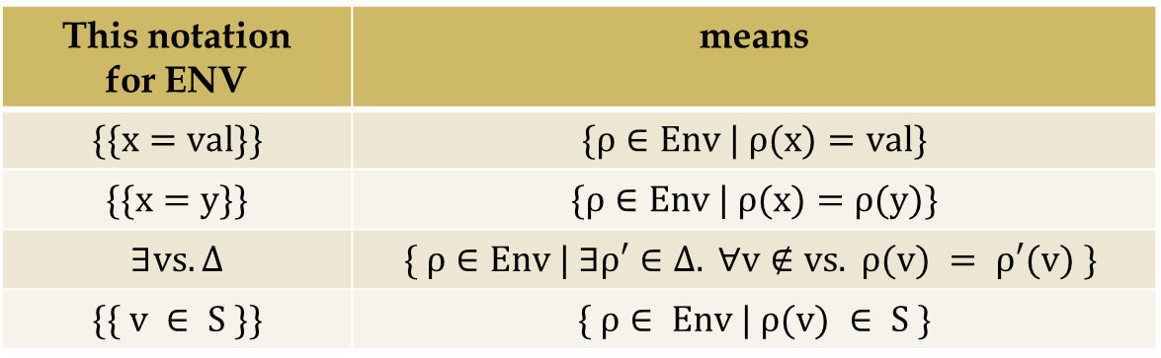

The “:” operator
    $$E⟦:int ⟧v=[ \{\{v ∈𝒵\}\} ]$$
Constrains the result v to be an integer
This notation for ENV | means
$$\{\{x=val\}\}$$ | $$\{ρ∈Env | ρ(x)=val\}$$
$$\{\{x=y\}\}$$ | $$\{ρ∈Env | ρ(x)=ρ(y)\}$$
$$∃vs. Δ$$ | $$\{ ρ∈Env | ∃ρ′∈Δ. ∀v∉vs. ρ(v) = ρ′(v) \}$$
$$\{\{ v ∈ S \}\}$$ | $$\{ ρ∈ Env | ρ(v) ∈ S \}$$

Slide 40

x:e is short for x := (:e)
$$E⟦x:=e ⟧v=\left[\{\{x=v\}\}\right]⊛E⟦e⟧v$$
$$E⟦:int ⟧v=[ \{\{v ∈𝒵\}\} ]$$
$$E⟦x:int⟧v$$
$$=E⟦x≔ (:int)⟧v$$
$$=\left[ \{\{x=v\}\} \right]⊛E⟦:int⟧v$$
$$=\left[\{\{x=v\}\}\right]⊛\left[\{\{v∈𝒵\}\}\right]$$
$$=\left[\{\{x=v,v∈𝒵\}\}\right]$$

Slide 41

Primops
$$E⟦e_{1}<e_{2}⟧v=E⟦e_{1}⟧v⊛E⟦e_{2}⟧v_{2} ⊛\left[\{\{ v<v_{2}\}\}\right]$$
Example:
    $$E⟦x:nat;x<2⟧v = \left[\{\{x=v, v∈𝒩, v<2\}\}\right]$$
This expression is un-runnable by itself; but some other part of the pgroam might tell us x, and hence filter out the other members of the set.
A more interesting set of environments

Slide 42

What about patterns?
In patterns, fun(e1){e2}, the pattern matches some incoming value. How does that show up in the denotational semantics?
Answer: think of Verse term as a transformer
  It transforms an input value into an output value
  While also producing some bindings
$$E⟦e⟧uv$$
Input u
x := :int
Output v
Binding for x

Slide 43

What about patterns though?
    $$E⟦e⟧:Ident→Seq\left(ENV\right)$$
    $$E⟦_⟧v=\left[ \{\{ \}\} \right]$$
    $$E⟦k⟧v=\left[ \{\{ v=I\left(k\right)\}\} \right] \\ E⟦x⟧v=\left[ \{\{ v=x \}\} \right]$$
    $$E⟦e_{1} | e_{2}⟧v=E⟦e_{1}⟧v + E⟦e_{2}⟧v$$
    $$E⟦fail⟧v=[]$$
    $$E⟦e_{1}=e_{2}⟧v=E⟦e_{1}⟧v ⊛ E⟦e_{2}⟧v$$
    $$E⟦e_{1};e_{2}⟧v=(E⟦e_{1}⟧q \backslash \backslash \{q\}) ⊛ E⟦e_{2}⟧v$$
    $$E⟦x:=e ⟧v=\left[\{\{x=v\}\}\right]⊛E⟦e⟧v$$
    $$E⟦:int ⟧v=[ \{\{v ∈𝒵\}\} ]$$

Slide 44

What about patterns though?
    $$E⟦e⟧:Ident ×Ident→Seq\left(ENV\right) \\ E⟦_⟧uv=\left[ \{\{ u=v\}\} \right]$$
    $$E⟦k⟧uv=\left[ \{\{ u=v=I\left(k\right)\}\} \right] \\ E⟦x⟧uv=\left[ \{\{ u=v=x \}\} \right]$$
    $$E⟦e_{1} | e_{2}⟧uv=E⟦e_{1}⟧uv + E⟦e_{2}⟧uv$$
    $$E⟦fail⟧uv=[]$$
    $$E⟦e_{1}=e_{2}⟧uv=E⟦e_{1}⟧uv ⊛ E⟦e_{2}⟧uv$$
    $$E⟦e_{1};e_{2}⟧uv=(E⟦e_{1}⟧pq \backslash \backslash \{p,q\}) ⊛ E⟦e_{2}⟧uv$$
    $$E⟦x:=e ⟧uv=\left[\{\{x=v\}\}\right]⊛E⟦e⟧uv$$
    $$E⟦:int ⟧uv=[ \{\{u=v, v ∈𝒵\}\} ]$$

Slide 45


What about patterns though?
But
Q1: When is $u ≠ v$ ?
Q2: What about functions and function application?
    $$E⟦e⟧:Ident ×Ident→Seq\left(ENV\right) \\ E⟦k⟧uv=\left[ \{\{ u=v=I\left(k\right)\}\} \right] \\ E⟦x⟧uv=\left[ \{\{ u=v=x \}\} \right]$$
    $$E⟦e_{1} | e_{2}⟧uv=E⟦e_{1}⟧uv + E⟦e_{2}⟧uv$$
    $$E⟦fail⟧uv=[]$$
    $$E⟦e_{1}=e_{2}⟧uv=E⟦e_{1}⟧uv ⊛ E⟦e_{2}⟧uv$$
    $$E⟦e_{1};e_{2}⟧uv=(E⟦e_{1}⟧pq \backslash \backslash \{p,q\}) ⊛ E⟦e_{2}⟧uv$$
    $$E⟦x:=e ⟧uv=\left[\{\{x=v\}\}\right]⊛E⟦e⟧uv$$
    $$E⟦:int ⟧uv=[ \{\{u=v, v ∈𝒵\}\} ]$$

Slide 46
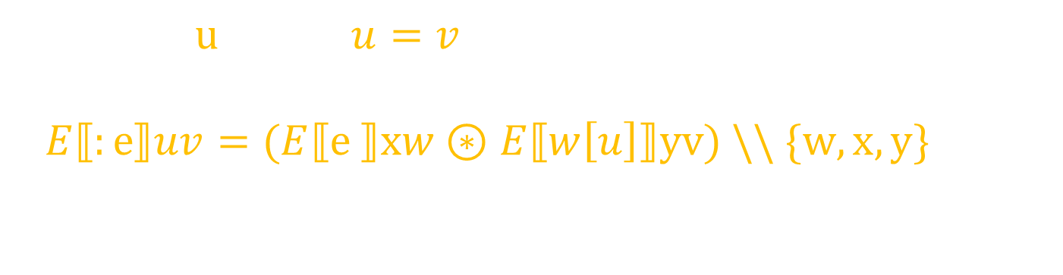
Q1: Generalising :e
  $$E⟦:int ⟧uv=\left[\{\{u=v,v∈𝒵\}\}\right]$$
$$E⟦:e⟧uv=(E⟦e ⟧xw⊛E⟦w\left[u\right]⟧yv) \backslash \backslash \{w,x,y\}$$
Compute e into w
Apply function w to argument u, to give output v

Slide 47
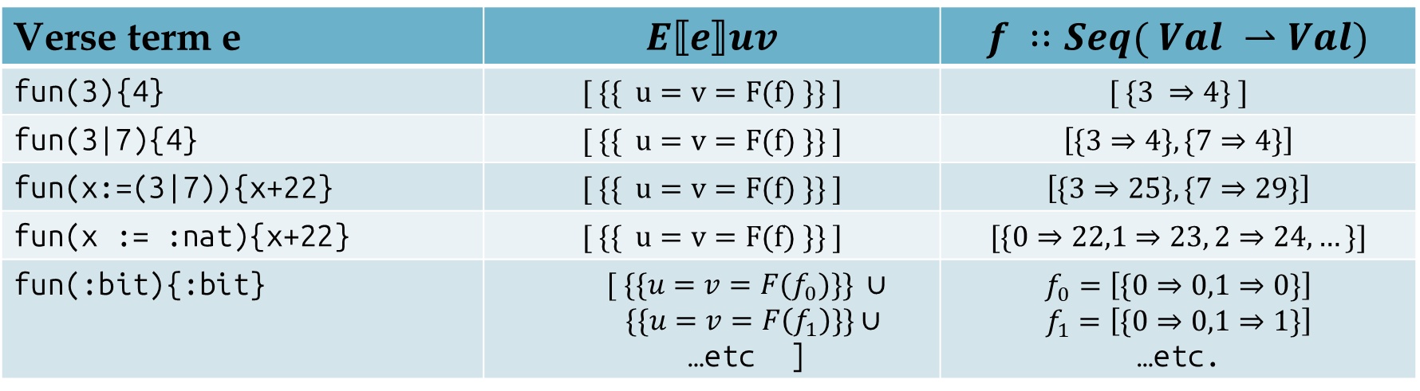

Q2: Functions
Domains:
    $$Val=I\left(Z\right)+F\left( Fun \right) \\ Env=Ident →Val$$
    $$ENV=Set\left( Env\right)$$
    $$Fun = Seq( Val ⇀ Val)$$
Verse term e | $$E⟦e⟧uv$$ | $$f ∷Seq( Val ⇀Val)$$
fun(3){4} | $$[ \{\{ u=v=F(f) \}\} ]$$ | $$[ \{3 ⇒4\} ]$$
fun(3|7){4} | $$[ \{\{ u=v=F(f) \}\} ]$$ | $$\left[\{3⇒4\}, \{7⇒4\}\right]$$
fun(x:=(3|7)){x+22} | $$[ \{\{ u=v=F(f) \}\} ]$$ | $$\left[\{3⇒25\}, \{7⇒29\}\right]$$
fun(x := :nat){x+22} | $$[ \{\{ u=v=F(f) \}\} ]$$ | $$[\{0⇒22,1⇒23, 2⇒24, …\}]$$
fun(:bit){:bit} | $$[ \{\{u=v=F(f_{0})\}\} ∪$$ $\{\{u=v=F\left(f_{1}\right)\}\}∪$ …etc ] | $$f_{0}=\left[\{0⇒0,1⇒0\}\right]$$ $$f_{1}=\left[\{0⇒0,1⇒1\}\right]$$ …etc.

Slide 48

Function application
Domains:
    $$Val=I\left(Z\right)+F\left( Fun \right) \\ Env=Ident →Val$$
    $$ENV=Set\left( Env\right)$$
    $$Fun = Seq( Val ⇀ Val)$$
$$E⟦e_{1}\left[e_{2}\right]⟧uv=(\left[\{\{u=v\}\}\right] ⊛E⟦e_{1}⟧fg⊛E⟦e_{2}⟧pq$$
$$⊛apply(g,q,v) ) \backslash \backslash \{f,g,p,q\}$$
$$apply(g,q,v)= unionS \{ ap\left(gs\right) | gs∈Fun \}$$
  $$where$$
    $$ap : Seq(Val⇀Val) →Seq(ENV)$$
    $ap(gs) = [ \{ρ∈Env | ρ(g)=F(gs)$ , $ρ(v)=gn(ρ(q)) \}$
$\left| gn←gs\right]$
$$unionS:Set\left(Seq\left(ENV\right)\right)→Seq\left(ENV\right)$$

Slide 49

Function definition
Domains:
    $$Val=I\left(Z\right)+F\left( Fun \right) \\ Env=Ident →Val$$
    $$ENV=Set\left( Env\right)$$
    $$Fun = Seq( Val ⇀ Val)$$
$$E⟦{ fun(e}_{1})\{ e_{2}\} ⟧uv= …even more wild…$$
$$unionS:Set\left(Seq\left(ENV\right)\right)→Seq\left(ENV\right)$$

Slide 50
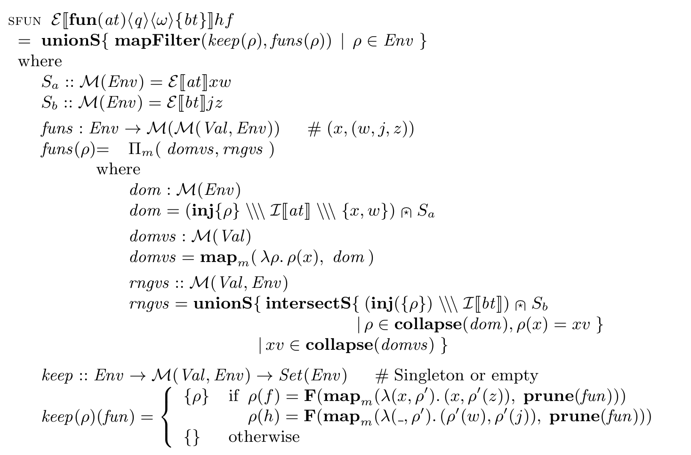

Slide 51
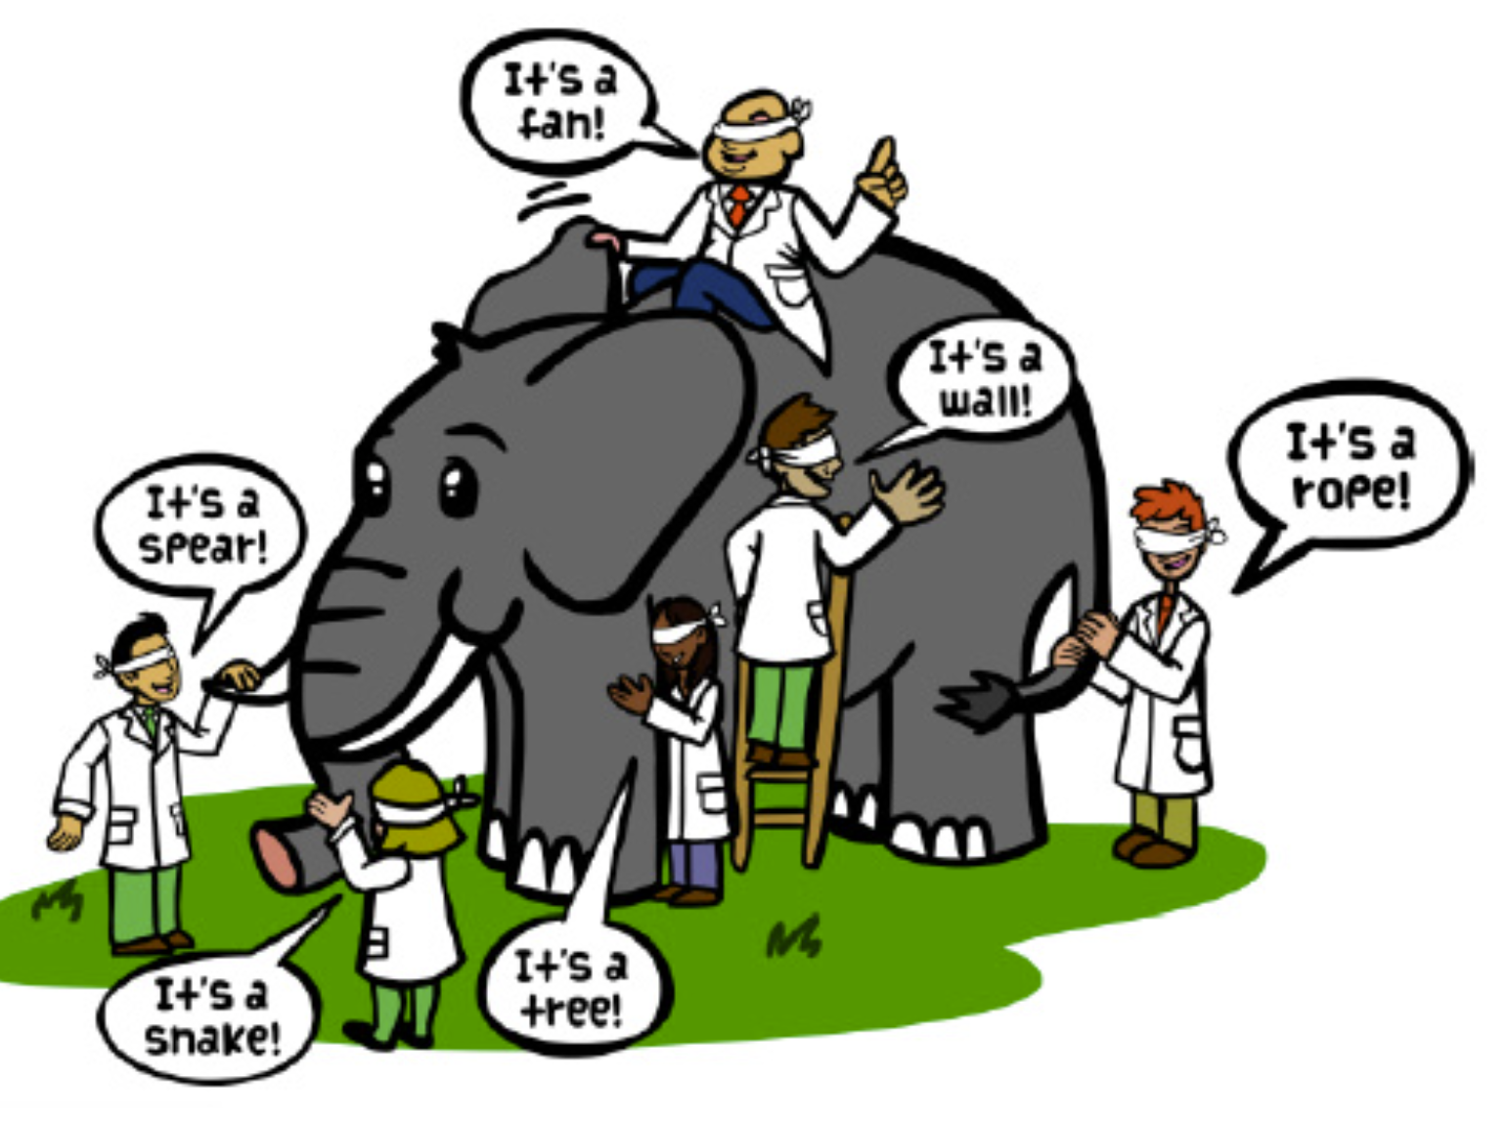

There is more. A lot more.
<succeeds> and <decides> functions
<open> and <closed> functions
Relations as well as functions
Matching and $↝$
“Wrapping” a la Findler/Felleisen
For-loops, arrays, tuples
Duality between :e and type{e}
Functor laws
Verification!!

Slide 52

Function application
$fun\left(e_{1}\right)e_{2}\left[arg\right]=arg↝e_{1};e_{2}$ (almost)
$E\left[e_{1}{↝e}_{2}\right]uv=\left(E⟦e_{1}⟧up⊛E⟦e_{2}⟧pv\right) \backslash \backslash \{p\}$
Just composition at the “uv” level
Notice that E[e1]up can
  fail (pattern match fails) or
  succeed in multiple ways (narrowing)
p
Input u
e1
e2
Output v
Bindings

