Slide 1

Verse rewriting semantics
Lennart Augustsson, Koen Claessen,
Simon Peyton Jones, Tim Sweeney, Jan Vitek
Epic Games
June 2026

Slide 2
Figuring out Verse
Programmer’s eye view
Operational semantics
Denotational semantics
Verification

Slide 3
Operational semantics
What does it mean to run a Verse program?
Plausible approaches
  Implement a compiler (or interpreter)
  Translate into code for some abstract machine, and run that
  Rewrite semantics

Slide 4
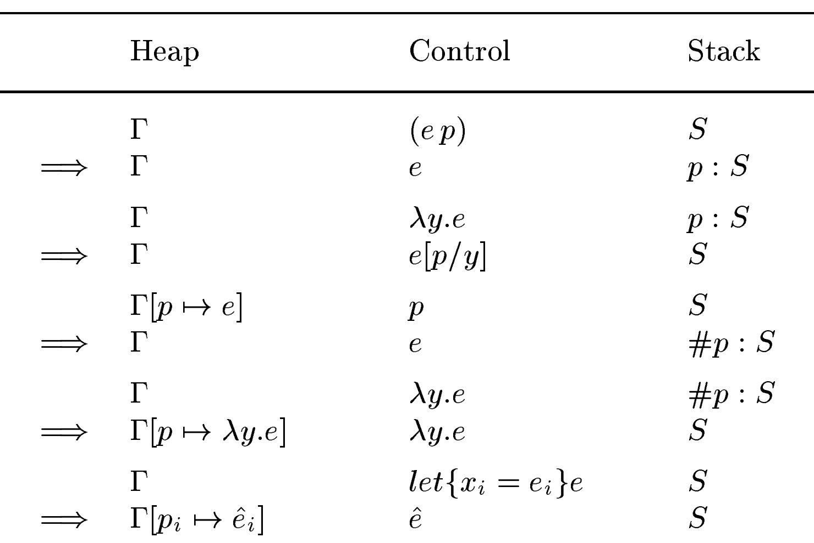
Operational semantics (small step)
(Heap, Expression, Stack) → (Heap, Expression, Stack)
[Sestoft 1997]
Abstract machine
Too low level for programmers to reason about their code
For Verse: unification, backtracking, etc. Abstract machine is quite a bit more complicated

Slide 5
Rewrite semantics
Idea: follow the lambda calculus and use a rewrite semantics
This is how we often explain the semantics of functional programs to users (e.g. Scheme, Haskell, etc)
Free of operational details (stacks, heaps, registers, environments)

Slide 6
Rewrite semantics
foo x = x*x + 1
foo (3+2)
let x=3+2 in x*x + 1
foo 5
(3+2)*(3+2) + 1
foo 5
let x=5
in x*x + 1
5*5 + 1
5*5 + 1
5*(3+2) + 1
5*(3+2) + 1
(3+2)*5 + 1
25 + 1
25 + 1
5*5 + 1
5*5 + 1
26
26

Slide 7
Rewriting: key ideas
To answer "what does this program do, or what does it mean?“
just apply the rewrite rules
Rewrite rules are things like
  Add/multiply constants
  Replace a function call with a copy of the function's RHS, making substitutions
  Substitute for a let-binding
You can apply any rewrite rule, anywhere, anytime
  They should all lead to the same answer (“confluence”)
Good as a way to explain to a programmer: just source-to-source rewrites
Good for compilers, when optimising/transforming the program
Not good as a final execution mechanism (too slow)

Slide 8
How can we give rewrite semantics to Verse?
Especially: how to express unification and iteration with rewriting?
x:=6; y:int; r:=(y,y); y>5; y=x+3; r
x
6
Heap

Slide 9
How can we give rewrite semantics to Verse?
Especially: how to express unification and iteration with rewriting?
x:=6; y:int; r:=(y,y); y>5; y=x+3; r
x
6
Heap
An empty, un-filled-in unification variable
y

Slide 10
How can we give rewrite semantics to Verse?
Especially: how to express unification and iteration with rewriting?
x:=6; y:int; r:=(y,y); y>5; y=x+3; r
x
6
r
( •, •)
Heap
An empty, un-filled-in unification variable
y

Slide 11
How can we give rewrite semantics to Verse?
Especially: how to express unification and iteration with rewriting?
x:=6; y:int; r:=(y,77); y>5; y=x+3; r
x
6
r
( •, •)
Heap
How do we deal with that y:int?
How do we deal with y>5
When can we return?
y
9

Slide 12
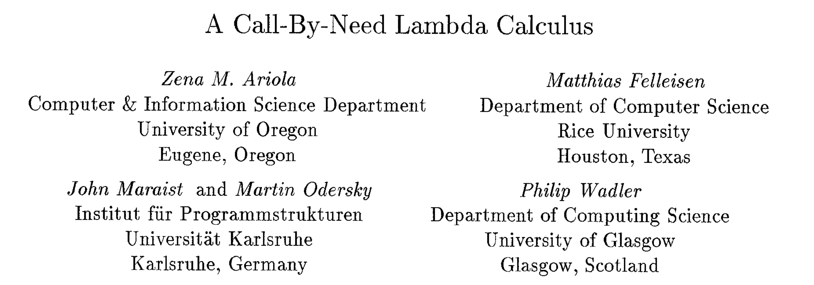

How can we give rewrite semantics Verse?
Especially: how to express unification and iteration with rewriting?
Inspiration: “A call by need lambda calculus”
[Ariola et al 1995]
  $\left(λx.e_{1}\right) e_{2} → e_{1}\{e_{2}/x\}$ Call by name
  $\left(λx.e_{1}\right) v → e_{1}\{v/x\}$ Call by value
How to do call by need? Seems to
need a “heap” with “thunks” and “update”
Answer: add let
  $let x=v in e → e\{v/x\}$ Call by need

Slide 13
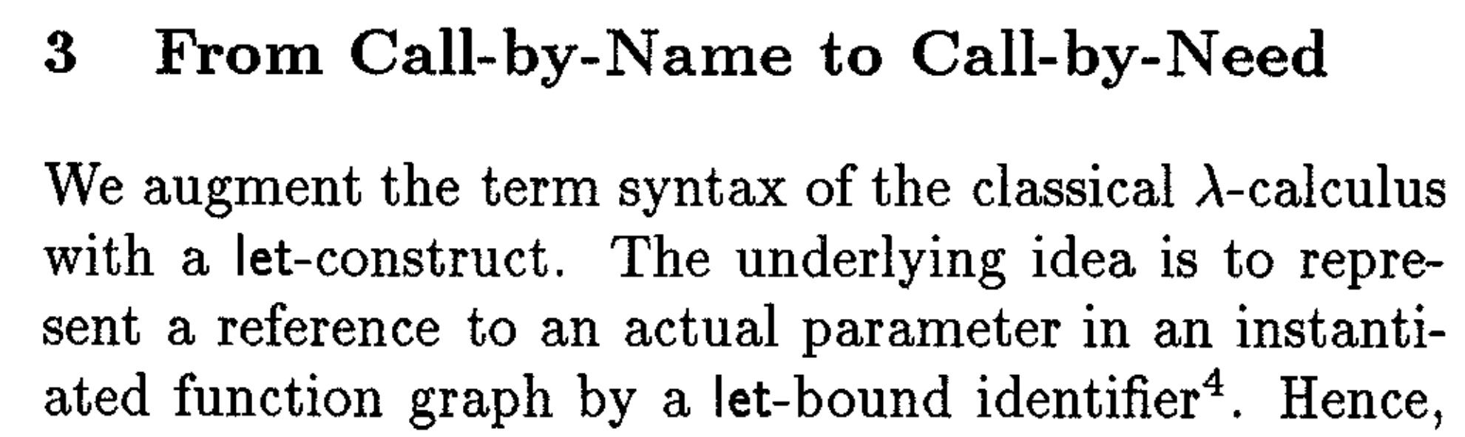
Key idea
• * •
In short: reify the heap in the term,
in the form of let-bindings.
let x = y+1 in x*x
x
y+1

Slide 14
How can we reify all that in the expression?
∃xyr{}. x=6; isInt[y]; r=(y,77); y>5; y=x+3; r
∃xyr{x$←$6}. 6; isInt[y]; r=(y,77); y>5; y=x+3; r
Promote x=6 into the “heap”
Aka unification

Slide 15
How can we reify all that in the expression?
∃xyr{}. x=6; isInt[y]; r=(y,77); y>5; y=x+3; r
∃xyr{x$←$6}. 6; isInt[y]; r=(y,77); y>5; y=x+3; r
∃xyr{x$←$6}. isInt[y]; r=(y,77); y>5; y=x+3; r
∃xyr{x$←$6,r$←$(y,77)}. isInt[y]; (y,77); y>5; y=x+3; r
∃xyr{x$←$6,r$←$(y,77)}. isInt[y]; y>5; y=x+3; r
∃xyr{x$←$6,r$←$(y,77)}. isInt[y]; y>5; y=6+3; r
Substitute for x
Aka “follow the indirection”

Slide 16
How can we reify all that in the expression?
∃xyr{}. x=6; isInt[y]; r=(y,77); y>5; y=x+3; r
∃xyr{x$←$6}. 6; isInt[y]; r=(y,77); y>5; y=x+3; r
Garbage collect the x-binding in the heap
∃xyr{x$←$6}. isInt[y]; r=(y,77); y>5; y=x+3; r
∃xyr{x$←$6,r$←$(y,77)}. isInt[y]; (y,77); y>5; y=x+3; r
∃xyr{x$←$6,r$←$(y,77)}. isInt[y]; y>5; y=x+3; r
∃xyr{x$←$6,r$←$(y,77)}. isInt[y]; y>5; y=6+3; r
∃yr{r$←$(y,77)}. isInt[y]; y>5; y=6+3; r

Slide 17
How can we reify all that in the expression?
∃yr{r$←$(y,77)}. isInt[y]; y>5; y=6+3; r
∃yr{r$←$(y,77)}. isInt[y]; y>5; y=9; r
∃yr{r$←$(9,77),y$←$9}. isInt[y]; y>5; 9; r
∃yr{r$←$(9,77),y$←$9}. isInt[y]; y>5; r
∃yr{r$←$(9,77),y$←$9}. isInt[9]; y>5; r
∃yr{r$←$(9,77),y$←$9}. 9; y>5; r

Slide 18
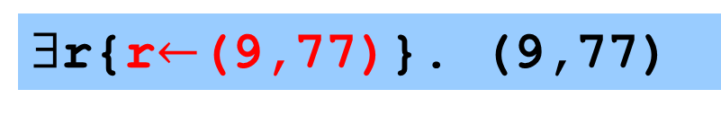
How can we reify all that in the expression?
∃yr{r$←$(9,77),y$←$9}. 9; y>5; r
∃yr{r$←$(9,77),y$←$9}. y>5; r
∃yr{r$←$(9,77),y$←$9}. 9>5; r
∃r{r$←$(9,77)}. 9>5; r
∃r{r$←$(9,77)}. 9; r
∃r{r$←$(9,77)}. r
∃r{r$←$(9,77)}. (9,77)
∃{}. (9,77)

Slide 19
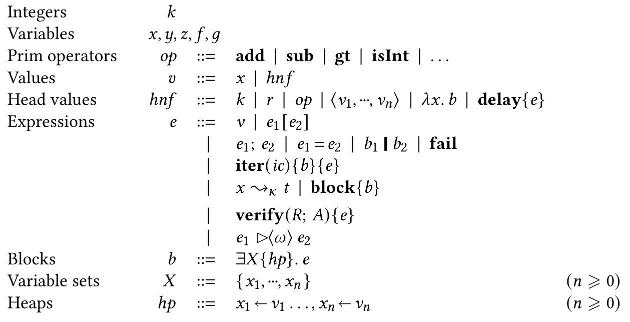

Slide 20
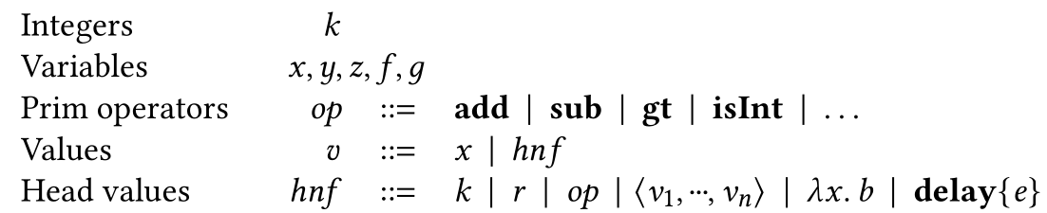

A naked variable ‘x’ is a value (unusual)
Tuples/arrays have values “all the way down”
delay{e} is the same as (λx.e), where $x∉e$
‘b’ is a “block”; coming next

Slide 21
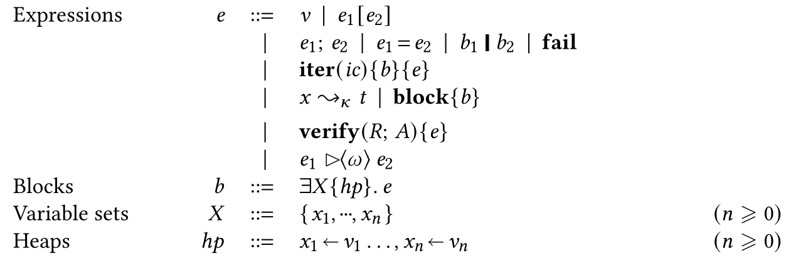
Blocks, b
Blocks play the role of ‘let’
A block ‘b’
  brings existential variables ‘X’ into scope,
  over the heap ‘hp’ and body ‘e’
  gives values to some of them via ‘hp’
Order in ‘X’ and ‘hp’ is immaterial
∃x,y{x←3}. y=x+1
Heap binds values only
Should really be add[ <x,1> ]
This heap gives a value to x but not to y

Slide 22
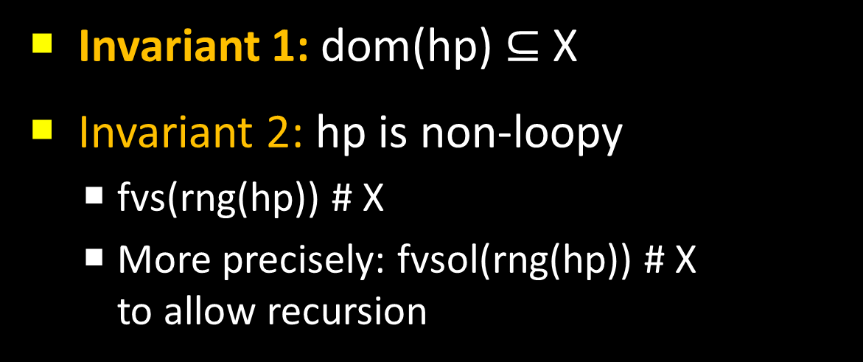
Blocks, b
∃x,y{x←3}. y=x+1
Invariant 1: dom(hp) $⊆$ X
Invariant 2: hp is non-loopy
  fvs(rng(hp)) # X
  More precisely: fvsol(rng(hp)) # X
  to allow recursion
fvs(fng(hp)) = free vars of the range of hp
“#” means “disjoint from”
“fvsol” means “free vars outside lambda”
∃fac{fac←\n. ...fac...}. fac[3]

Slide 23
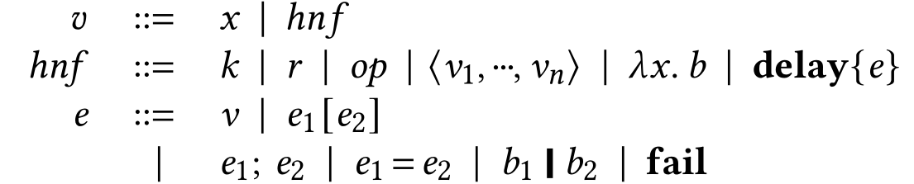
Expressions, e
“=“ is equality, aka unification
“;” is sequencing
e1[e2] is function application
The body of a lambda, and the arms of a choice are blocks.

Slide 24
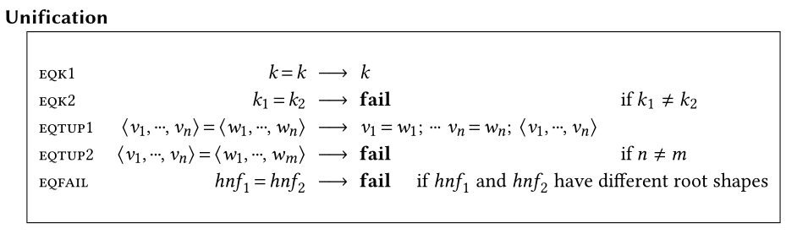
Rewrite rules: unification
No lambda – (λx.e1)=(λ y.e2) is stuck
“Stuck” is our version of “goes wrong”; should not happen.
So (slightly surprisingly) no rule for (x=x) either. That too is stuck until x gets a value.

Slide 25
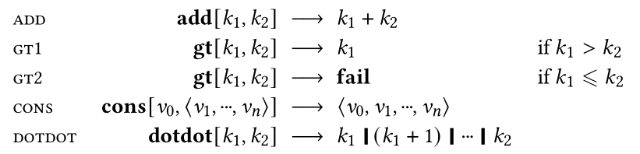
Rewrite rules: primops
No surprises.
Result of (4 > 1) is the left hand argument, 4.
Stuck outside domain e.g. (3 + “wombat”)

Slide 26
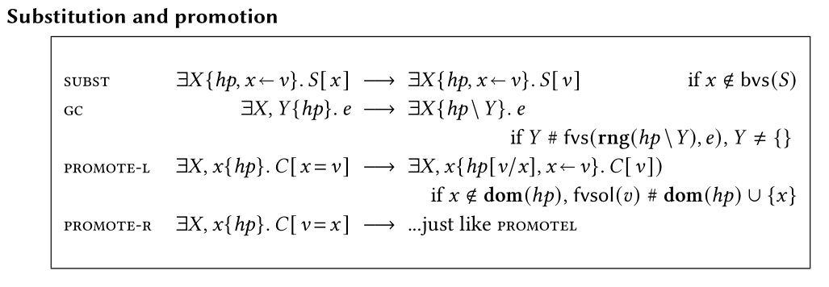
Promotion: how things get into a heap
PROMOTE-L promotes an equality out of the term, into its enclosing heap.
Contexts C used in the standard way
  C is just standard BNF for a syntax tree with a single “hole”
  C[e] is the context C with the hole filled in with ‘e’
  If you have seen context before, this is the same thing
  If not, this will be useful to you elsewhere
Side conditions guarantee the heap invariants of the RHS

Slide 27

Promotion: how things get into a heap
PROMOTE-R does the same as PROMOTE-L but
with the the variable on the right
Could have SWAP $v=x → x =v$ instead of PROMOTE-R;
but SWAP might loop on $x=y$

Slide 28
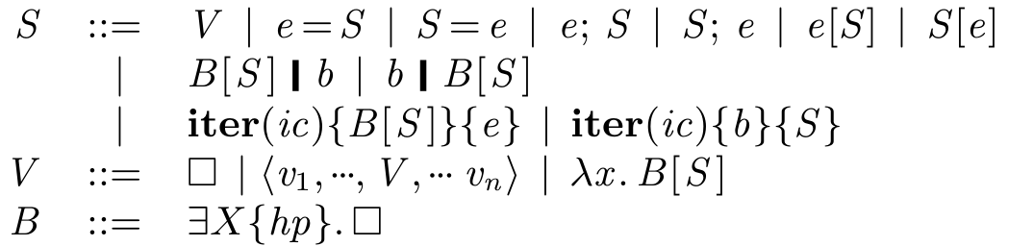

Substitution: how things get out of the heap
Given a heap binding $x ←v,$ rule SUBST replaces one occurrence of x by v.
Context S allows us to look deep in the expression, inside values (incl lambda), choice, and iter.

Slide 29

Garbage collection
Drop a strongly connected component of hp, not mentioned in e.
$∃xfg\{f←(λp.….g…),g←(λq.…f…)\}. x=3$
$→∃x.x=3$

Slide 30
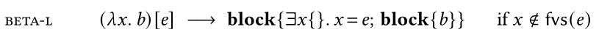
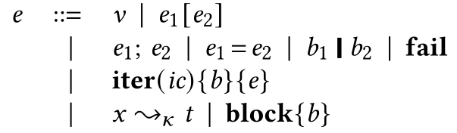
Beta reduction and block-floating
What if it isn’t?
‘block’ lets us have a block nested
inside an expression
FLOAT rule floats the block out.
Same C!
Can’t float out of choices or lambda bodies

Slide 31
Beta reduction for tuples
BETA-T does narrowing
The x=e binding simply avoids duplicating e
Empty case yields failure: <>[e] → fail
<4,1,7>[1] → (1=0; 4) | (1=1; 1) | (1=2; 7)
∃x. <4,1,7>[x]
→ ∃x.(x=0; 4) | (x=1; 1) | (x=2; 7)
→ 4 | 1 | 7

Slide 32
Choice
What happens to choice?
Answer: we fold over the choices with ‘iter’.
Roughly:
Fixed, small set of three “iteration combinators”, ic. Not a fully general fold.
  ‘if’ desugars into iter(if)
  One-armed ‘for’ desugars into iter(all)
  Two-armed ‘for’ desugars into iter(for)
iter(ic)(v1 | v2 | v3){z} = v1 `ic` v2 `ic` v3 `ic` z

Slide 33
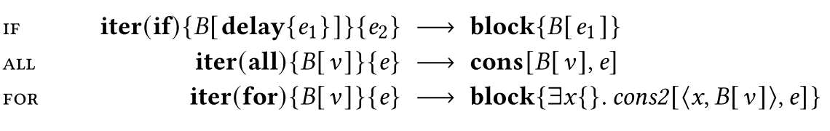
Folding over choice
for{e}
iter(all)(e){<>}
Each choice cons’s one more value onto the front of the array.
iter(all)(v1 | v2 | v3){z} = v1 `all` v2 `all` v3 `all` z

Slide 34
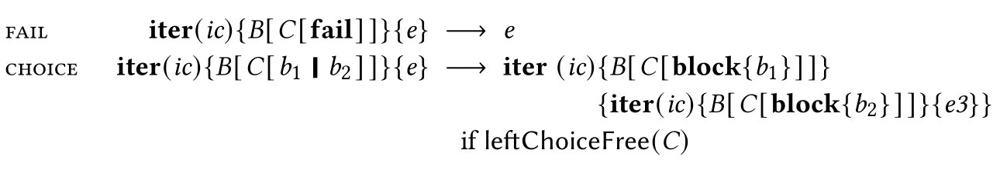
Folding over choice
for{x:=(8|2);x*x}
iter(all){∃x{}.x=(8|2); x*x}{<>}
iter(all){∃x{}.(x=8;x*x)}
{iter(all){∃x{}.(x=2; x*x)}{<>}}
Duplicates the context

Slide 35
Folding over choice
iter(all){∃x{}.(x=8;x*x)}
{iter(all){∃x{}.(x=2; x*x)}{<>}}
iter(all){∃{}.64}{iter(all){∃{}.4}{<>}}
cons[64, iter(all){∃{}.4}{<>}]
cons[64, cons[2,<>]]
<64,2>

Slide 36
Why leftChoiceFree?
Why ‘leftChoiceFree’?
iter(k)(∃xy. x=(7|8); y=(5|2) ){e}
Iterate over x first, then y

Slide 37
If
if(e1){e2}else{e3}
iter(if)(e1;delay{e2}){e3}

Slide 38

Folding over choice
if(x<7){x+1}else{3}
iter(if)(x<7;delay{x+1}){3}
x<7
$$x ≥7$$
iter(if)(delay{x+1}){3}
iter(if)(fail){3}
IF
FAIL
x+1
3

Slide 39
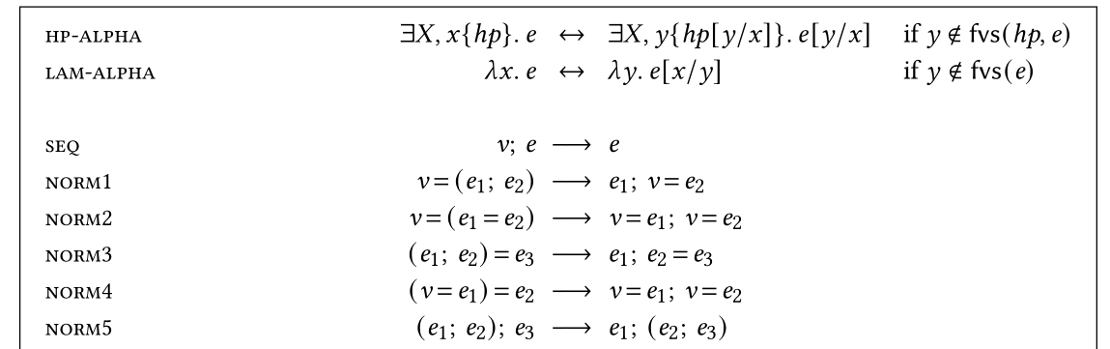
And finally...administrative reductions

Slide 40
At we can run programs!
$ git clone ...
$ cd verse
$ cabal run repl
> :set -- Shows flags
> :set trace-eval -- See step by step
> 3+4
7
>

Slide 41
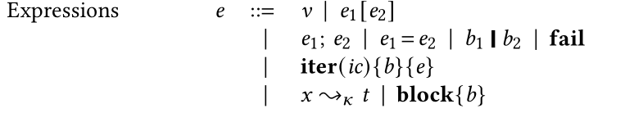
But what about functions and ~>?
Where does ~> come from?
What are its rewrite rules?

Slide 42
The big picture
Source Verse
What the programmer writes
Essential Verse
A subset of Source Verse with superficial syntactic sugar removed.
function(at){bt}, if, for
Superficial desugaring
Denotational semantics
Terms, t
Matching
Core Verse
A subset of Source Verse with superficial syntactic sugar removed
λ, ∃X{hp}.e, iter
Expressions, e

Slide 43
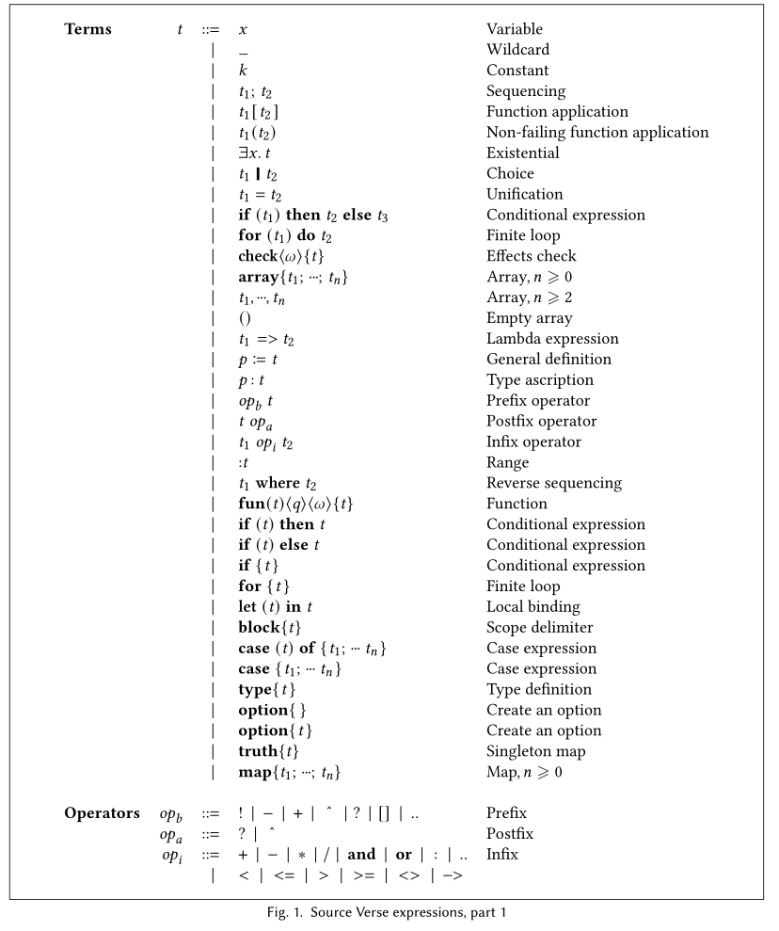
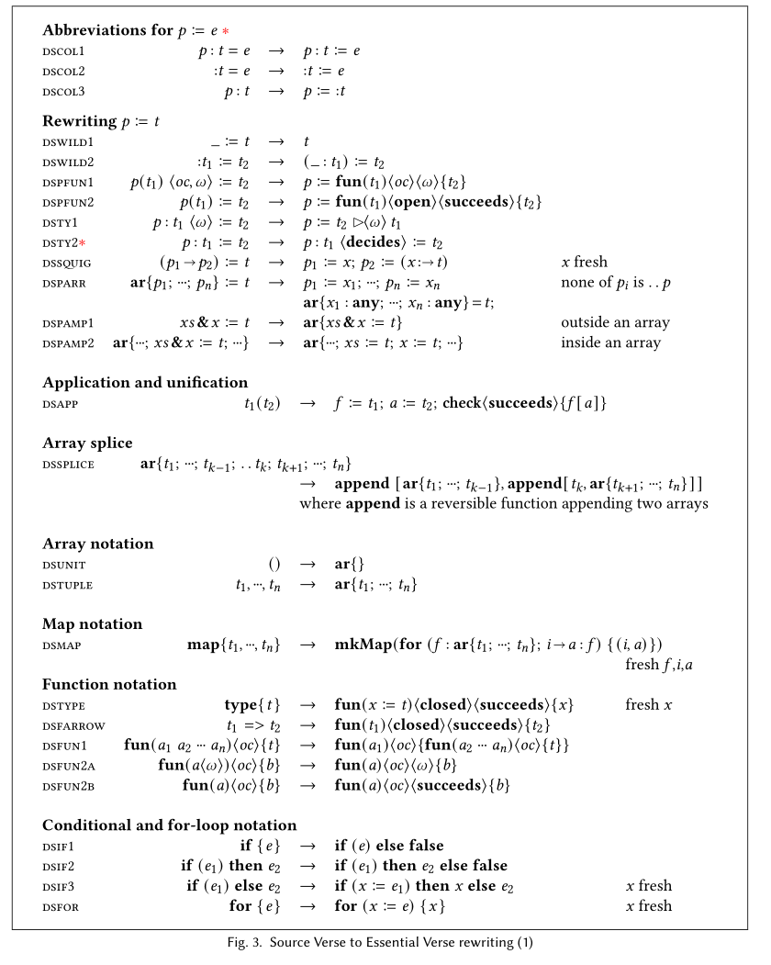
The big picture
Superficial desugaring
Source Verse
Essential Verse
Fig 1,2
Fig 3,4

Slide 44
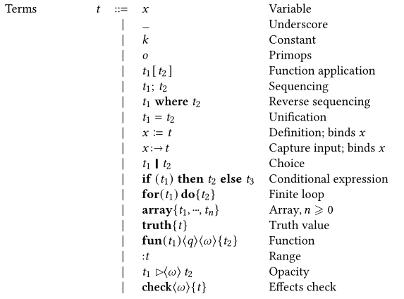
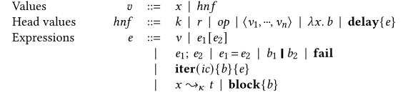
Deliberate syntax overlap
Essential Verse
A subset of Source Verse with superficial syntactic sugar removed.
function(at){bt}, if, for
Fig 5
Terms, t
Matching
Core Verse
A subset of Source Verse with superficial syntactic sugar removed
λ, ∃X{hp}.e, iter
Fig 6
Expressions, e
A term can live inside an expression

Slide 45
Where does ~> come from? First approximation
function(x:int){x+1}
Source Verse
Superficial desugaring
x:t is short for x := (:t)
function(x:=(:int)){x+1}
Essential Verse
Somehow
λu.∃{}. u~>(x:=(:int)); x+1
Core Verse
This blue bit is a term (Essential Verse)

Slide 46
The usual story
Environment
Values of free variables
e.g. x=6, y=22
Expression
e.g. x+y
Value of the expression
e.g. 28

Slide 47
The Verse story
Every Verse expression has an implicit “input value”...
Environment
Values of free variables
e.g. y=22
Input value
to match
e.g. (-5,22)
(x:abs, y)
Output value
e.g. (5,22)
...and may create bindings
Bindings
e.g.value of x
y:=22; f(x:abs,y):= x+y; f[-5,22]

Slide 48
The Verse story
Environment
Values of free variables
e.g. y=22
Input value
to match
e.g. (-5,22)
(x:abs, y)
Output value
e.g. (5,22)
Bindings
e.g.value of x
Remember, y is free, defined outside
f(x:abs,y) := x+y
Somehow
f=λu.∃x. u~>(x:abs,y); x+y := x+y
Rules for ~>
f=λu.∃pqx. u=<p,q>; x=abs[p]; q=y; x+y

Slide 49
Patterns and expressions are the same thing!
So far we have concentrated on function arguments (patterns)
But patterns and expressions are supposed to be the same thing
So the meaning of a Verse term fundamentally involves matching against some input value. All Verse terms, not just function-argument patterns.
In particular, a program is a term:
We fire up our rewrite engine by matching a fresh unification variable against it:
t
∃u. u ~> t

Slide 50
The Verse story
f(x:abs,y) := x+y
Superficial desugaring
f := function(x:abs,y){x+y}
“Somehow”
f=λu.∃x. u~>(x:abs,y); x+y := x+y
In fact
∃i. i ~> (f := function(x:abs,y){x+y})

Slide 51
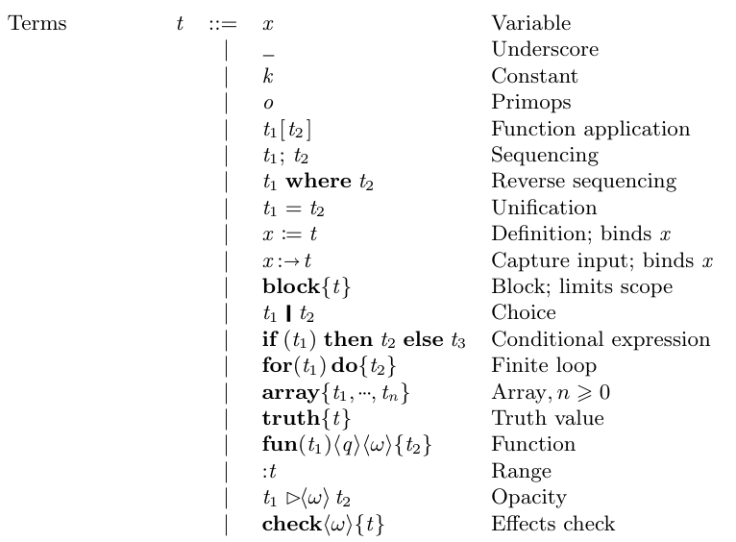
Initial expression
∃u. u ~> t

Slide 52
Rules for matching
u ~> t
u ~> (x := (:abs),22)
e.g
Match the pattern ‘t’ (an Essential Verse term)
...against the input ‘u’
...producing binding for the binders of ‘t’, written tbs(t). (E.g. ‘x’)
...but failing if ‘u’ does not match

Slide 53
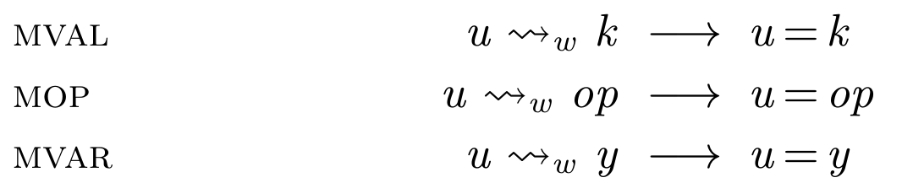
Some simple cases
Ignore subscript ‘w’ for now
For values, matching is just unification
Trivial example: to run the term
start from the initial expression
3
∃u. u ~> 3
∃u. u = 3
3
MVAL
PROMOTE, GC

Slide 54
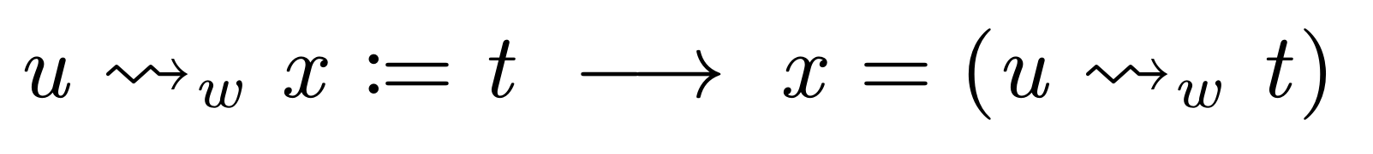
Matching :=
Push u into t, and unify x with the result
∃x. u ~> (x := 7)
∃x. x = (u ~> 7)
∃x. x = (u = 7)

Slide 55
The magic colon
function(x:int){x+1}
Superficial desugaring to EV
function(x:=(:int)){x+1}
Matching on the outer function
λu. u~>(x:=(:int)); x+1

Slide 56
The magic colon
λu.∃x. u~>(x:=(:int)); x+1
MDEF
λu.∃x. x = u~>(:int); x+1
MCOLON1
It is why ‘:t’ is a fundamental construct, not syntactic sugar
This is the key step
λu.∃x. x = int[u]; x+1

Slide 57
The magic colon
λu.∃x. u~>(x:=(:int)); x+1
MDEF
λu.∃x. x = u~>(:int); x+1
MCOLON1
λu.∃x. x = int[u]; x+1

Slide 58
Semicolon
Push u into t2 (the bit that returns value)
Push a fresh variable into t1
∃x. u ~> (x>7; x := :int)
∃x u1. u1~>(x>7); u~>(x := :int)
∃x u1. u1~>(x>7); x = u~>(:int)
∃x u1. u1=(x>7); x = int[u]

Slide 59

Application
For applications: we just evaluate the call and then unify.
D[t] matches ‘t’ against a fresh unification variable
Neither t1 nor t2 are equal to u (of course)

Slide 60
Unification and choice
MUNIF: push ‘u’ into both, and unify results.
MCHOICE: ditto. But t1,t2 define a block scope
(x:=3; x+1) | (x:=7; x*2)
These are completely different x’s
Choice in EV has implicit ‘block’
block{x:=3; x+1} | block{x:=7; x*2}

Slide 61
Block scope
‘block’ in Essential Verse
‘block’ in Core Verse
tbs(t) are the binders of the EV term t
tbs( x:int; y>x+z; y:=3 ) = {x,y}

Slide 62
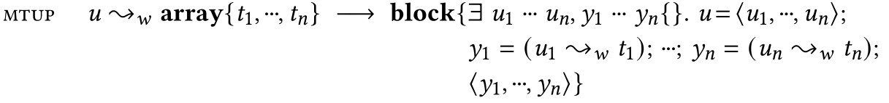
Matching tuples
Match incoming ‘u’ against ‘<u1,..,un>
Match ui against ti,
...producing yi
Tuple up the results

Slide 63
Why both ui and yi?
<3,-5> ~> (:int,:abs)
∃u1,u2,y1,y2. <3,-5> = <u1,u2>;
y1=int[u1];
y2=abs[u2];
<y1,y2>
<3,5>

Slide 64
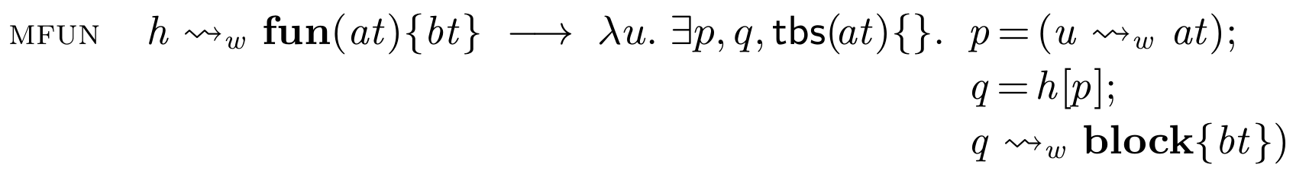

And finally, the Big Enchilada
Matching h against function(at){bt} yields a function $λu.blah$
When called, that function matches its input ‘u’ against ‘at’
Then passes the result through ‘h’
Then matches the result against ‘bt’
Transforms h into a new function
p
q
u
at
h
bt
result

Slide 65
Wrapping in action
function( g(:even):int ){g[4]}
Superficial desugaring to EV
function( g := function(:even){:int} ){g[4]}
Matching on the outer function
λgg.∃r. gg~>(g := function(:even){:int}); r=g[4]

Slide 66
Wrapping in action
λgg.∃r. gg~>(g := function(:even){:int}); r=g[4]
λgg.∃rg.g = (λu.∃pq.p=even[u];q=gg[p]; int[q]);
r=g[4]

Slide 67
First fly in ointment: verification needed
Missing: what if h does not match ‘at’.
The call should fail; but it generates a lambda anyway. Boo.
Problem: the runtime can’t do a domain test
Solution: the verifier checks that the test succeeds
p
q
u
at
h
bt
result

Slide 68
Second fly in the ointment
f := function( x:int ){x+1}; f[88]
Initialise
∃u. u ~> (f := function( x:int ){x+1}; f[88])
MSEMI
∃u uf. uf~>(f := function( x:int ){x+1}); u~>f[88]
More M rules
∃u,uf,f. f = λu2.∃xq. x=int[u2]; q=uf[x]; q=x+1
u = f[88]

Slide 69
Second fly in the ointment
∃u,uf,f. f = λu2.∃xq. x=int[u2]; q=uf[x]; q=x+1
u = f[88]
Here “wrapping” a fresh unification variable ‘uf’ is not good.
Calling ‘f’ will just get stuck.
And yet there is such a ‘uf’, namely the increment function!
It’s just that the runtime is not smart enough to find it.

Slide 70
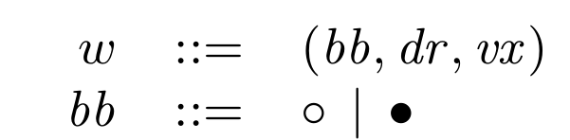
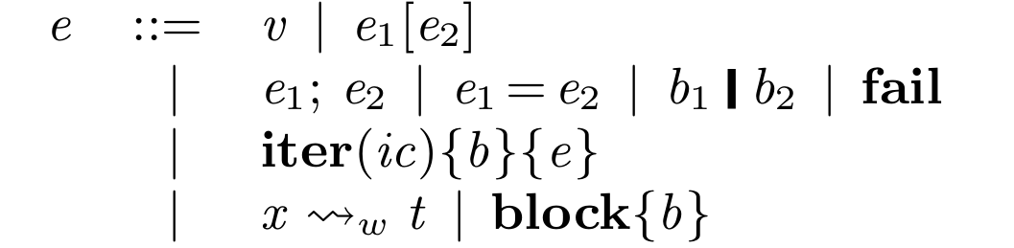
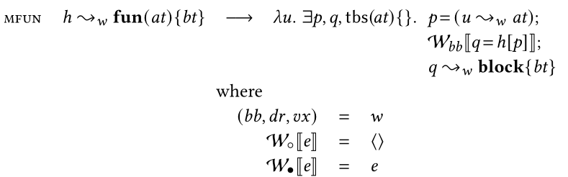

Solution
Add a flag ‘w’to ~>_{w}
The ‘bb’ component says
  $∘$ for “fresh unification var”
  • for “not”
In MFUN, generate q=h[p] only for •
Two other
uses for w in
verification!

Slide 71
Standing back
The matching rules for (u ~>t) are driven solely by the syntax of the term t
We can execute all matching statically, in advance,
by executing (~>) rules only
In the implementation use --match-first to see this
So we could present it as a pre-pass, translating EV terms into CV expressions.
But it’s very nice to see it running one step at a time

Slide 72

Criteria for a good rewrite system
Small, orthogonal, independently-understandable steps.
E.g $\left(λx.b\right)\left[e\right]→block\left(∃x.x=e;block\left(b\right)\right)$ vs
$$∃X\{hx\}.C\left[\left(λx.∃Y\{hy\}.e_{1}\right)\left[e_{2}\right]\right) →∃X,Y\{hx,hy\}.C[x=e_{2};e_{1}]$$
Sound wrt denotational semantics: does not change meaning!
Confluent
  Avoid terms that mean the same thing, but are syntactically different.
  ∃x.∃y.f[x];g[y] vs ∃y.∃x. f[x];g[y] vs ∃x. f[x]; ∃y. g[y]
  x=3; y=4; f[x,y] vs y=4; x=3; f[x,y] vs x=3; f[x,y]; y=4
Enough rules. (No rules at all certainly confluent!)

Slide 73
What we need help with
Testing confluence
  QuickCheck has already REALLY proved its worth in debugging our rules
  But the confluence tester has bit-rotted; e.g. the current evaluator picks just one redex.
Proving confluence
  A significant proof-engineering challenge because there are a lot of rules
  Don’t want to start from scratch each time we change a rule
  Tiresome problems with recursion. Maybe we need skew confluence?
Visualising rewriting would be cool

