Slide 1

Verifying Verse
Lennart Augustsson, Koen Claessen,
Simon Peyton Jones, Tim Sweeney, Jan Vitek
Epic Games
June 2026

Slide 2
Figuring out Verse
Programmer’s eye view
Operational semantics
Denotational semantics
Verification

Slide 3
What do we want to verify?
New feature:
result signatures
Ill typed functions
Reject functions that lie about their effects
f1(x:int):int := “wombat”
f2(x:string):int := x
t:int := “wombat”
 | Cardinality of results
<succeeds> | Exactly one result
<decides> | Zero or one result
<fails> | Zero results
New feature: effects on functions definitions
f3(x:int)<succeeds> := x>3
f4(x:int) := x>3
Default is <succeeds>
Hence reject f4 as well as f3

Slide 4
What do we want to verify?
Functions that know too much
Opacity is key to modular verification
All f5 knows is that, giving an int, inc5 returns some int.
Reasons:
  RHS of inc1 might be large; or recursive
  We might want to evolve inc1 without invalidating its clients
inc5(x:int):int := x+1
f5(x:int)<succeeds> := inc1(x)>x
Reject f5:
inc5 is opaque

Slide 5
What do we want to verify?
But sometimes we don’t want opacity!
Critical that the full defn of nat is available when verifying f6
..and similarly inc7 when verifying f7.
nat(x:int)<decides> := x >= 0
f6(x:nat)<succeeds>:int := x
inc7(x:int) := x+1
f7(x:int)<succeeds> := inc7(x)>x
Accept f6:
nat is transparent
Accept f7:
inc7 is transparent

Slide 6
Partial opacity
In Verse, opacity is expression-oriented, not function-oriented
f8(x:int) := (x-1, :int = (x+1))
f8 is partially opaque
Callers can see that f8(x)
returns a pair
whose first component is x-1
whose second component is some int
f8(x:int) := (x-1, (x+1) $⊳$ int )
Our notation for (:t = e)

Slide 7
What else do we want to verify?
Reject calls where the runtime can’t check the domain
f(x:int) := x+1
h(g(:int):string) := ...
f[“wombat”]
h[f]
Accepted by verifier
Fails at runtime
Domain test cannot be done by runtime
Verifier should reject

Slide 8
What do we want to verify?
Expressions that get stuck because runtime can’t figure out what value an existential should have
Clearly verify must actually RUN womble
f7() := x:int -- Stuck
f8() := { x:int; x>0; x=x*x } -- Stuck
Has exactly one solution (x=1); runtime can’t find it though
womble(x:int):= ...any Verse code...
f(x:womble)<decides>:int := x

Slide 9
Verification: a big challenge
womble(x:int):= ...arbitrary Verse code...
f(x:womble):int := x
Verifier much check that any value returned by ‘womble’ is accepted by int.
So verifier must actually RUN ‘womble’
But ‘womble’ has arbitrary Verse code….

Slide 10

Typical verification plan
Verification conditions
In a language that Z3 understands
Generate VCs
Check VCs
Program
Z3
(or whatever)b
But what if the VCs including things like
rng(womble) $⊆$ dom(int)
Definition of ‘womble’ must be in the VCs (understandable to Z3)
And hence the full execution semantics of Verse needs to be explained
to Z3 somehow.

Slide 11
Our verification plan
Probably not new, but I’d like help identifying verifiers that do this
Program
VCs
In a tiny language Z3 can understand
Some rewrites spit out a verification condition
Z3
(or whatever)
Just do rewrites
All existing rewrites continue unchanged; no duplication
A few extra rewrites for verification constructs

Slide 12
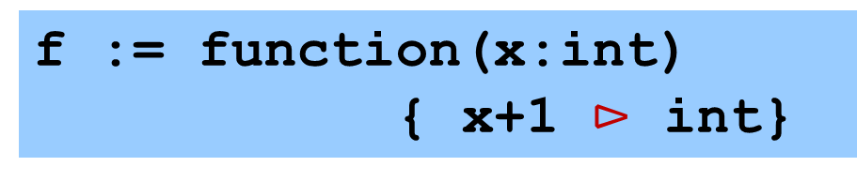
Extend CoreVerse
The (~>) matching rule for ‘function’ spits out a verify{} as well as a lambda.
That verify{} checks that the function is a function: for everything in its domain it produces one well defined result; or fails in the case of <decides> functions
f(x:int):int := x+1
Superficial syntactic sugar
f := function(x:int)
{ x+1 $⊳$ int}
Matching
f := verify(u){∃x. x=int[u];
check<succeeds>{ int[x+1] } };
\u.∃x. x=int[u]; (x+1)  int

Slide 13
Thought experiment
f := verify(u){∃x. x=int[u];
check<succeeds>{ int[x+1] } }
\u.∃x. x=int[u]; (x+1)  int
Imagine a runtime that could solve verification conditions at runtime, maybe calling a theorem prover or something.
But actually we’d like to solve the verification conditions statically, so that the runtime never comes across an unsolved one.
“Solve verification condition”
= apply rewrite rules until verify(u){e} rewrites to ().

Slide 14

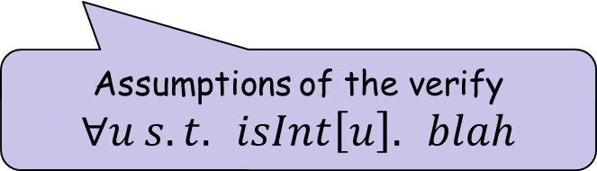
Let’s try rewriting that verify{}!
verify(u){∃x.x=int[u]; check<succeeds>{ int[x+1] }}
Immediately stuck because we don’t know what ‘u’ is.
Split into two cases:
  Either int[u] or $¬$int[u]
  In either case, verification must succeed
NB: ‘int’ is primitive, else we’d inline its definition
verify(u; isInt[u]) {∃x.x=u; check<succeeds>{ int[x+1] }};
verify(u; $¬$isInt[u]){∃x.x=fail; check<succeeds>{ int[x+1] }}
Assumptions of the verify
$$∀u s.t. isInt\left[u\right]. blah$$

Slide 15

Vacuous success
verify(u; isInt[u]) {∃x.x=u; check<succeeds>{ int[x+1] }};
verify(u; $¬$isInt[u]){∃x.x=fail; check<succeeds>{ int[x+1] }}
verify(R;A){e} rejects the program when e gets stuck
verify(R;A){fail} $⟶$ <>
It’s not stuck! It discharges the verify, vacuously.
That leaves us with...
verify(u; isInt[u]){∃x.x=u; check<succeeds>{ int[x+1] }}

Slide 16
Rewrite some more...
verify(u; isInt[u]){∃x.x=u; check<succeeds>{ int[x+1] }}
Promote, substitute, SEQ
verify(u; isInt[u]){check<succeeds>{ int[u+1] }}
Now we are stuck on that (u+1)...
Stuck on (v1+v2)
  Need int[v1] and int[v2]
  Then we can proceed

Slide 17
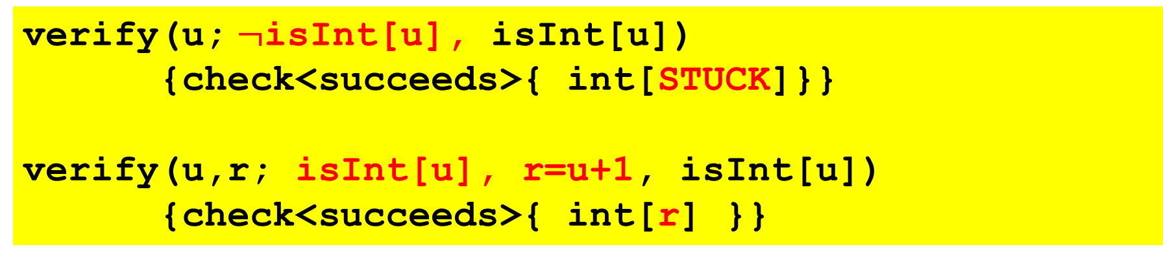
Dealing with (+)
verify(u; isInt[u]){check<succeeds>{ int[u+1]}}
Verification rule for (+)
Precondition fails
verify(u; $¬$isInt[u], isInt[u])
{check<succeeds>{ int[STUCK]}}
verify(u,r; isInt[u], r=u+1, isInt[u])
{check<succeeds>{ int[r] }}
Precondition succeeds
Fresh skolem r for result

Slide 18
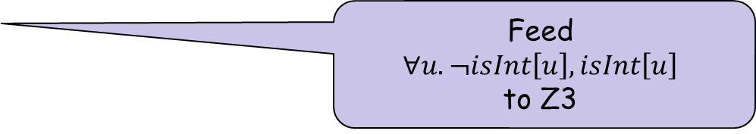
Contradiction
verify(u; ¬isInt[u], isInt[u]){check<succeeds>{ int[STUCK] }}
Assumptions are contradictory
So the verify is discharged vacuously
So verify(R; <contradiction>){e} ⟶ <>
So we are left with
Feed
$$∀u.¬isInt\left[u\right],isInt\left[u\right]$$
to Z3
This IS the interface to an external SMT solver
verify(u,r; isInt[u], r=u+1, isInt[u])
{check<succeeds>{ int[r] }}

Slide 19
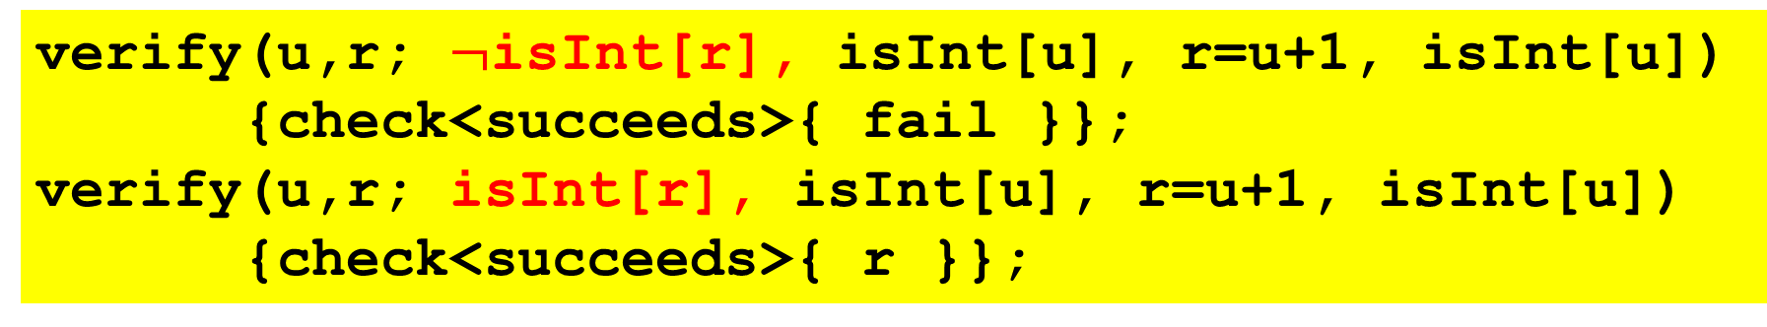
Stuck again on int[r]
verify(u,r; isInt[u], r=u+1, isInt[u])
{check<succeeds>{ int[r] }}
Same as before: split into two cases: int[r] holds or it doesn’t.
verify(u,r; $¬$isInt[r], isInt[u], r=u+1, isInt[u])
{check<succeeds>{ fail }};
verify(u,r; isInt[r], isInt[u], r=u+1, isInt[u])
{check<succeeds>{ r }};

Slide 20
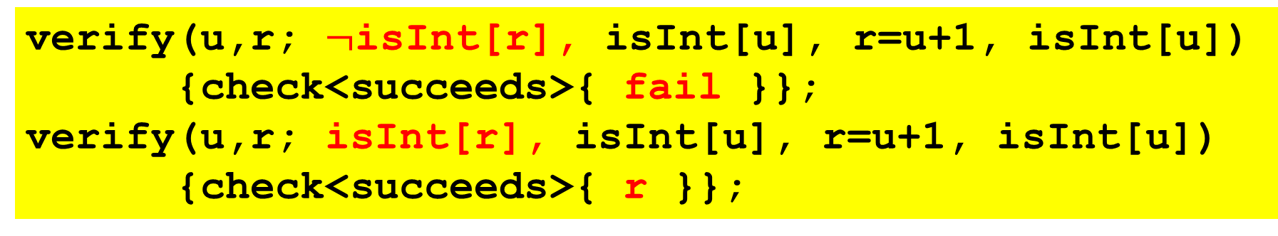
Wrap up
Contradiction
Again
verify(u,r; $¬$isInt[r], isInt[u], r=u+1, isInt[u])
{check<succeeds>{ fail }};
verify(u,r; isInt[r], isInt[u], r=u+1, isInt[u])
{check<succeeds>{ r }};
verify(u,r; isInt[r], isInt[u], r=u+1, isInt[u])
{r};
<>
Phew!

Slide 21
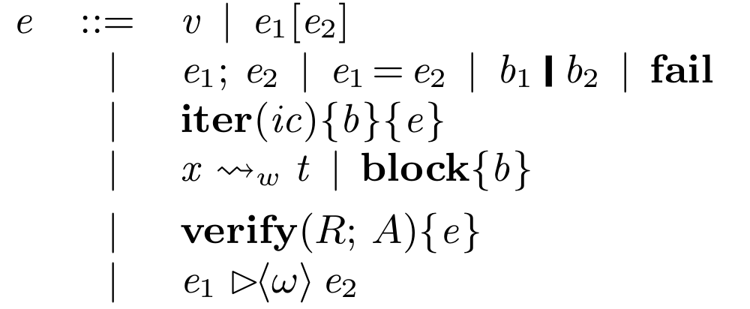
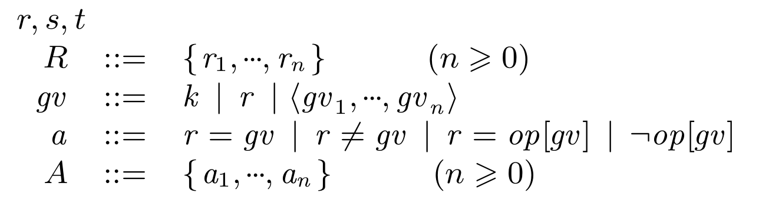
New constructs
A is assumptions
The language of assumptions A is tiny,
and directly suitable for a SMT solver
New

Slide 22
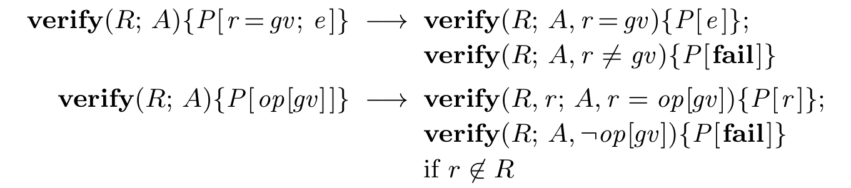
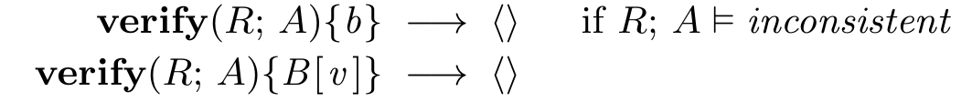
Rules for verify are rather simple
External SMT solver
Needs to understand only the super-simple language A

Slide 23
General plan
Nothing really new here (verification is well studied) but very nice separation of concerns
The (largely un-modified) rewrite engine just “executes the program”...
...until it gets stuck because it doesn’t know the value of a skolem.
Then it explores two or more alternatives, each with a different assumption about the skolem.
The language of expressions and of assumptions are very different. Assumptions are much, much simpler.
So the rewrite steamroller clanks along, sometimes emitting questions to the SMT solver. If it gets stuck, verification fails.

Slide 24
Fleshing out verification

Slide 25
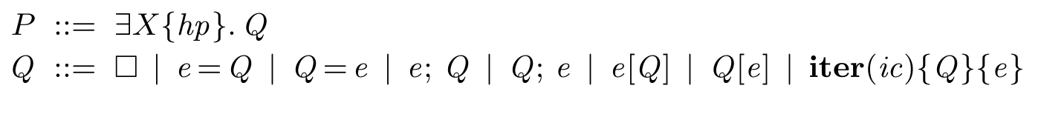
Verification contexts

Slide 26
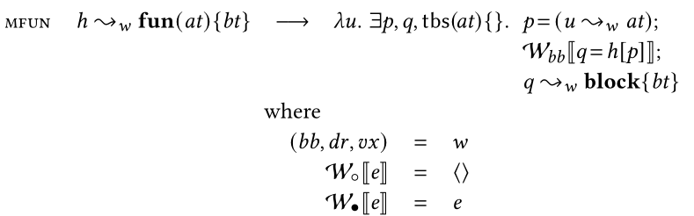
Where does verify come from?
Reminder: the matching rule for functions
Lambdas are where verification happens

Slide 27
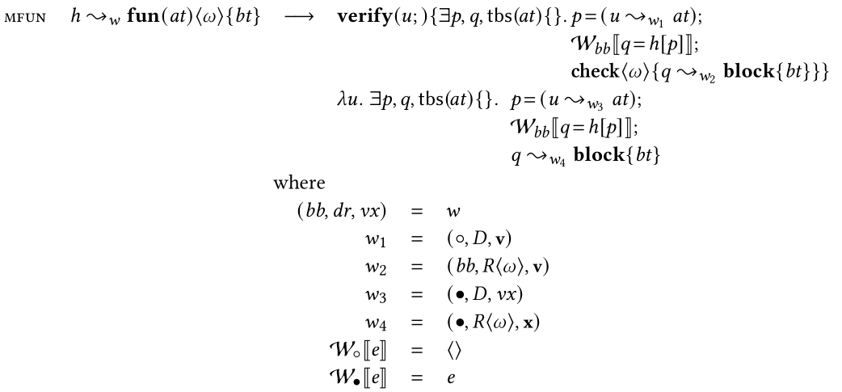
Where does verify come from?
It comes from here!

Slide 28
Modular verification
f(x:int):int := rhs
g(x:int):int := f[x] + 1
One binding for f
Superficial desugar plus matching rules
When verifying g, we know only that f returns some int
f := verify(uf){ ...stuff for f... };
\uf. x:=int[uf]; rhs  int
g := verify(ug){ .... f[x] ... ];
\ug. x:=int[ug]; ... f[x]+1 ...
When running g, we must run f, returning ‘blah’

Slide 29
Modular verification
When verifying g, we know only that f returns some int
f := verify(uf){ ...stuff for f... };
\uf. x:=int[uf]; blah  int
g := verify(ug){ .... f[x] ... ];
\ug. x:=int[ug]; ... f[x]+1 ...
When running g, we must run f, returning ‘blah’
Hence the need for ; it behaves differently under a verify
than not-under a verify.
⬥ embodies opacity

Slide 30
Modular verification with effects
f(x:int)<decides>:int := blah
g(x:int):int := f[x] + 1
e<fx>:t := rhs
→ e := rhs _{fx} t
Superficial desugar plus matching rules
When verifying g, we know that f can fail, or return some int
f := verify(uf){ ...stuff for f... };
\uf. x:=int[uf]; blah _{decides} int
g := verify(ug){ .... f[x] ... ];
\ug. x:=int[ug]; ... f[x]+1 ...

Slide 31

Rules for 
Note that (by design) the rule ignores ‘e’, the function body.
Outside verify{}, the rule is super simple:
By design ignores <w>. e1 does whatever it does
A bit annoying that this rule has a “outside verify” side condition

Slide 32
Higher order 
f( g(:int)<decides>:int )<succeeds>:int := g[3]
This should not verify. But what actually happens?
f := verify(uf){ g = uf ~> (function(:int)<decides>{:int})
; check<succeeds>{ g[3] } }
We want
f := verify(uf){ g = \i. p=int[i]; uf[p] |> int
; check<succeeds>{ g[3] } }

Slide 33
Standing back
The basic plan is great:
  Use the ordinary reduction rules to do the heavy lifting
  Plus some extra reductions for verification
  And a very clear, simple interface to a SMT solver to leverage that huge pile of cleverness. (E.g. array bounds checking.)
There are many fiddly details to get right.
Closest related work
  Higher order symbolic execution for contract verification and refutation (Nguyen, Tobin-Hochstadt, van Horn; JFP 2017)
  HALO: Haskell to logic through denotational semantics
  (Vytiniotis, Peyton Jones, Claessen, Rosen)
Please tell me about other similar work

Slide 34
Standing back
Big shortcoming: we are nowhere near a proof of soundness, or even a crisp statement of the theorem. Help please.

