Slide 1
Writing verified software for production
K. Rustan M. Leino
Senior Principal Engineer
Automated Reasoning Group (ARG), Amazon Web Services
© 2019, Amazon Web Services, Inc. or its affiliates. All rights reserved.
Evening lecture, Oregon Programming Languages Summer School
25 June 2019, Eugene, OR, USA

Slide 2
Automated Reasoning Group (ARG)
Amazon Web Services (AWS)
Amazon
Not drawn to scale

Slide 3
Automated Reasoning Group
Amazon mission: Emc³
  Earth’s most customer-centric company
Using proofs as explanations for
why things work

Slide 4
We reason about
Policies
Networks
Designs
Code
using techniques like
Type checking
Bounded exploration
Deductive verification

Slide 5
Examples

Slide 6
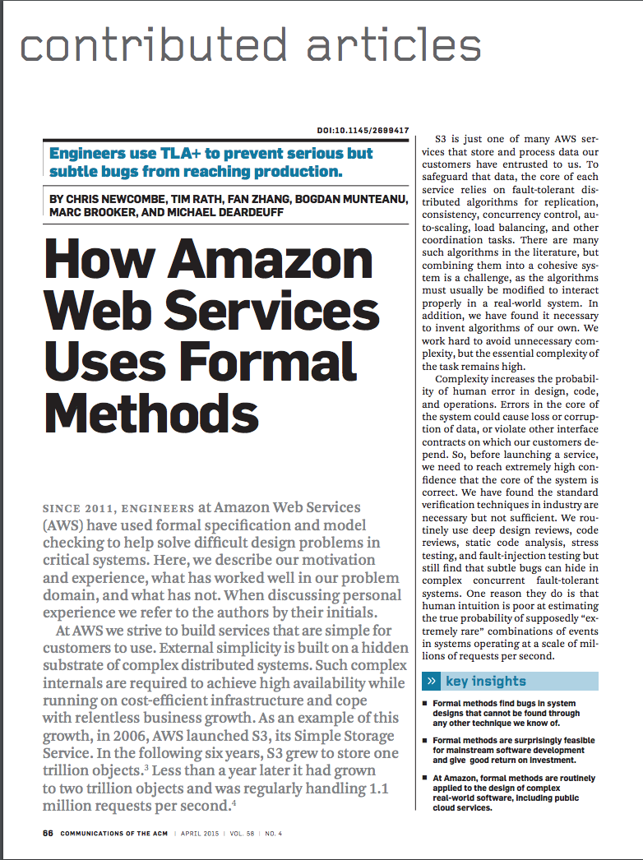
Distributed protocols: TLA+
Model checking

Slide 7
Security protocols: Quivela
EtM(e,mac) { new (e= e, mac= mac) {
enc(m) { m & em = e.enc(m) & t = mac.tag(em) & <em,t> }
dec(c) { <em,t> = c & mac.verify(em,t) & e.dec(em) }
}}
https://github.com/awslabs/quivela

Slide 8
Timing behaviors: SideTrail
for (i = 0; i < length; ++i) {
if (password[i] != input[i]) {
send("bad password");
}
}
https://aws.amazon.com/blogs/security/
how-aws-sidetrail-verifies-key-aws-cryptography-code/

Slide 9
Memory safety: CBMC
Low-level systems code written in C

Slide 10

Compliance:
Via type checking

Slide 11
Deductive verification
Pre- and postconditions, invariants, …
C
  VCC
Java
  JML + OpenJML
  Javelyn
  → Difficult to do for legacy code

Slide 12
Obtaining verified software
Legacy Code
Textbook Ideal
New Development
0. Write and test code
1. Write specifications
2. Write proofs
0. Write specifications
1. Derive code
0. Write
specifications +
code +
proofs
❌
❌
✅

Slide 13
Integrating specs + code + proofs
Or:
making specs+code+proofs into daily software engineering practice
Or:
a personal perspective of the evolution of automated verification

Slide 14
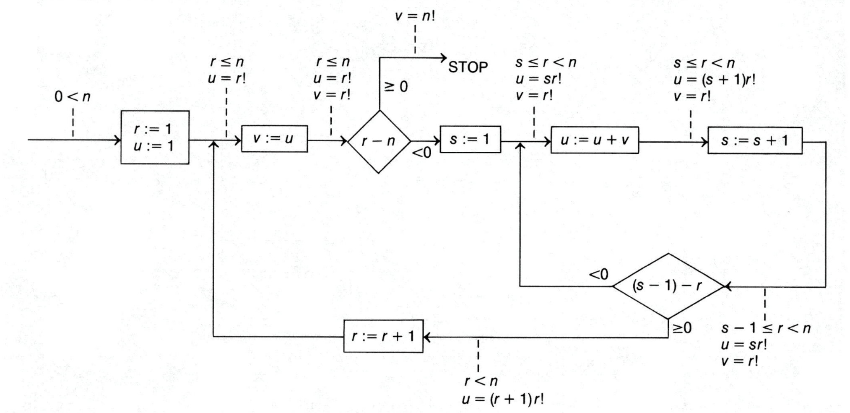
Program verification:
1949
Source: “An Early Program Proof by Alan Turing” by F.L. Morris and C.B. Jones, Annals of the History of Computing, 1984

Slide 15
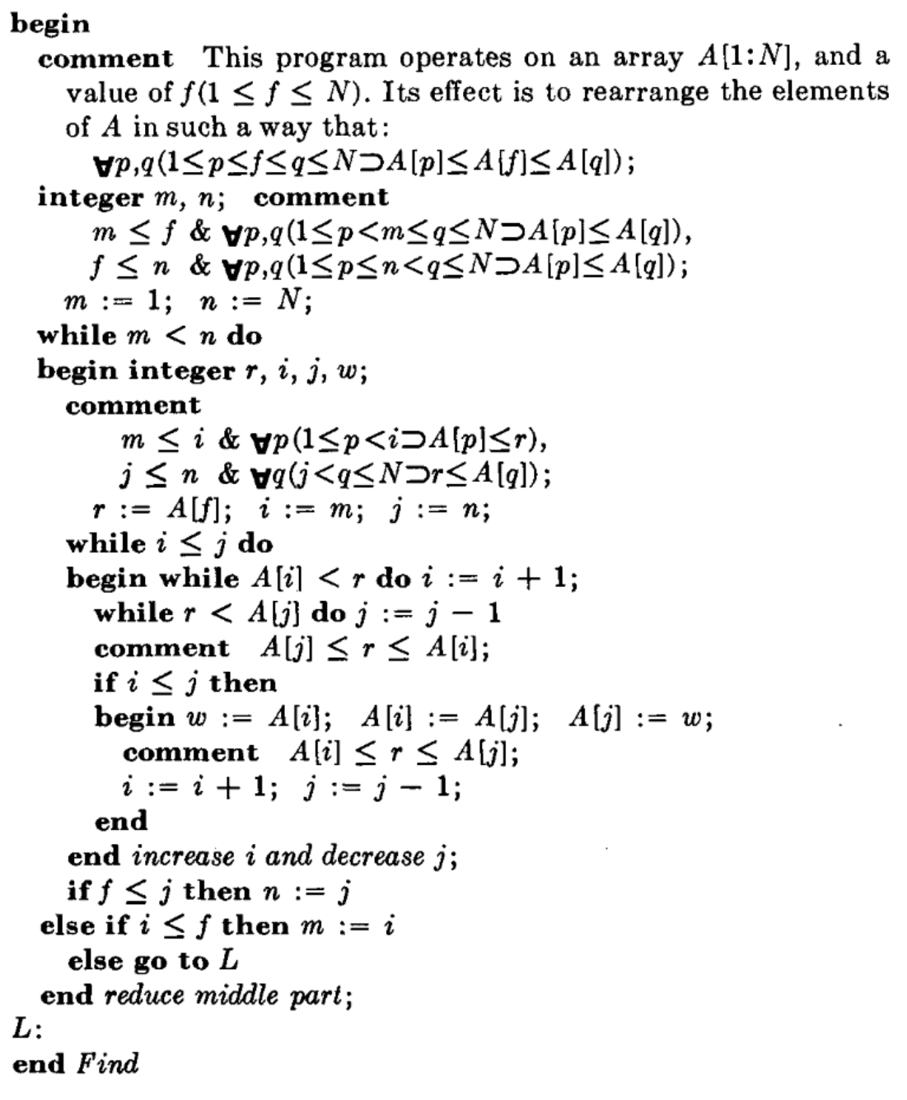
Program verification:
1971
Source: “Proof of a program: FIND” by C.A.R. Hoare, CACM, 1971

Slide 16
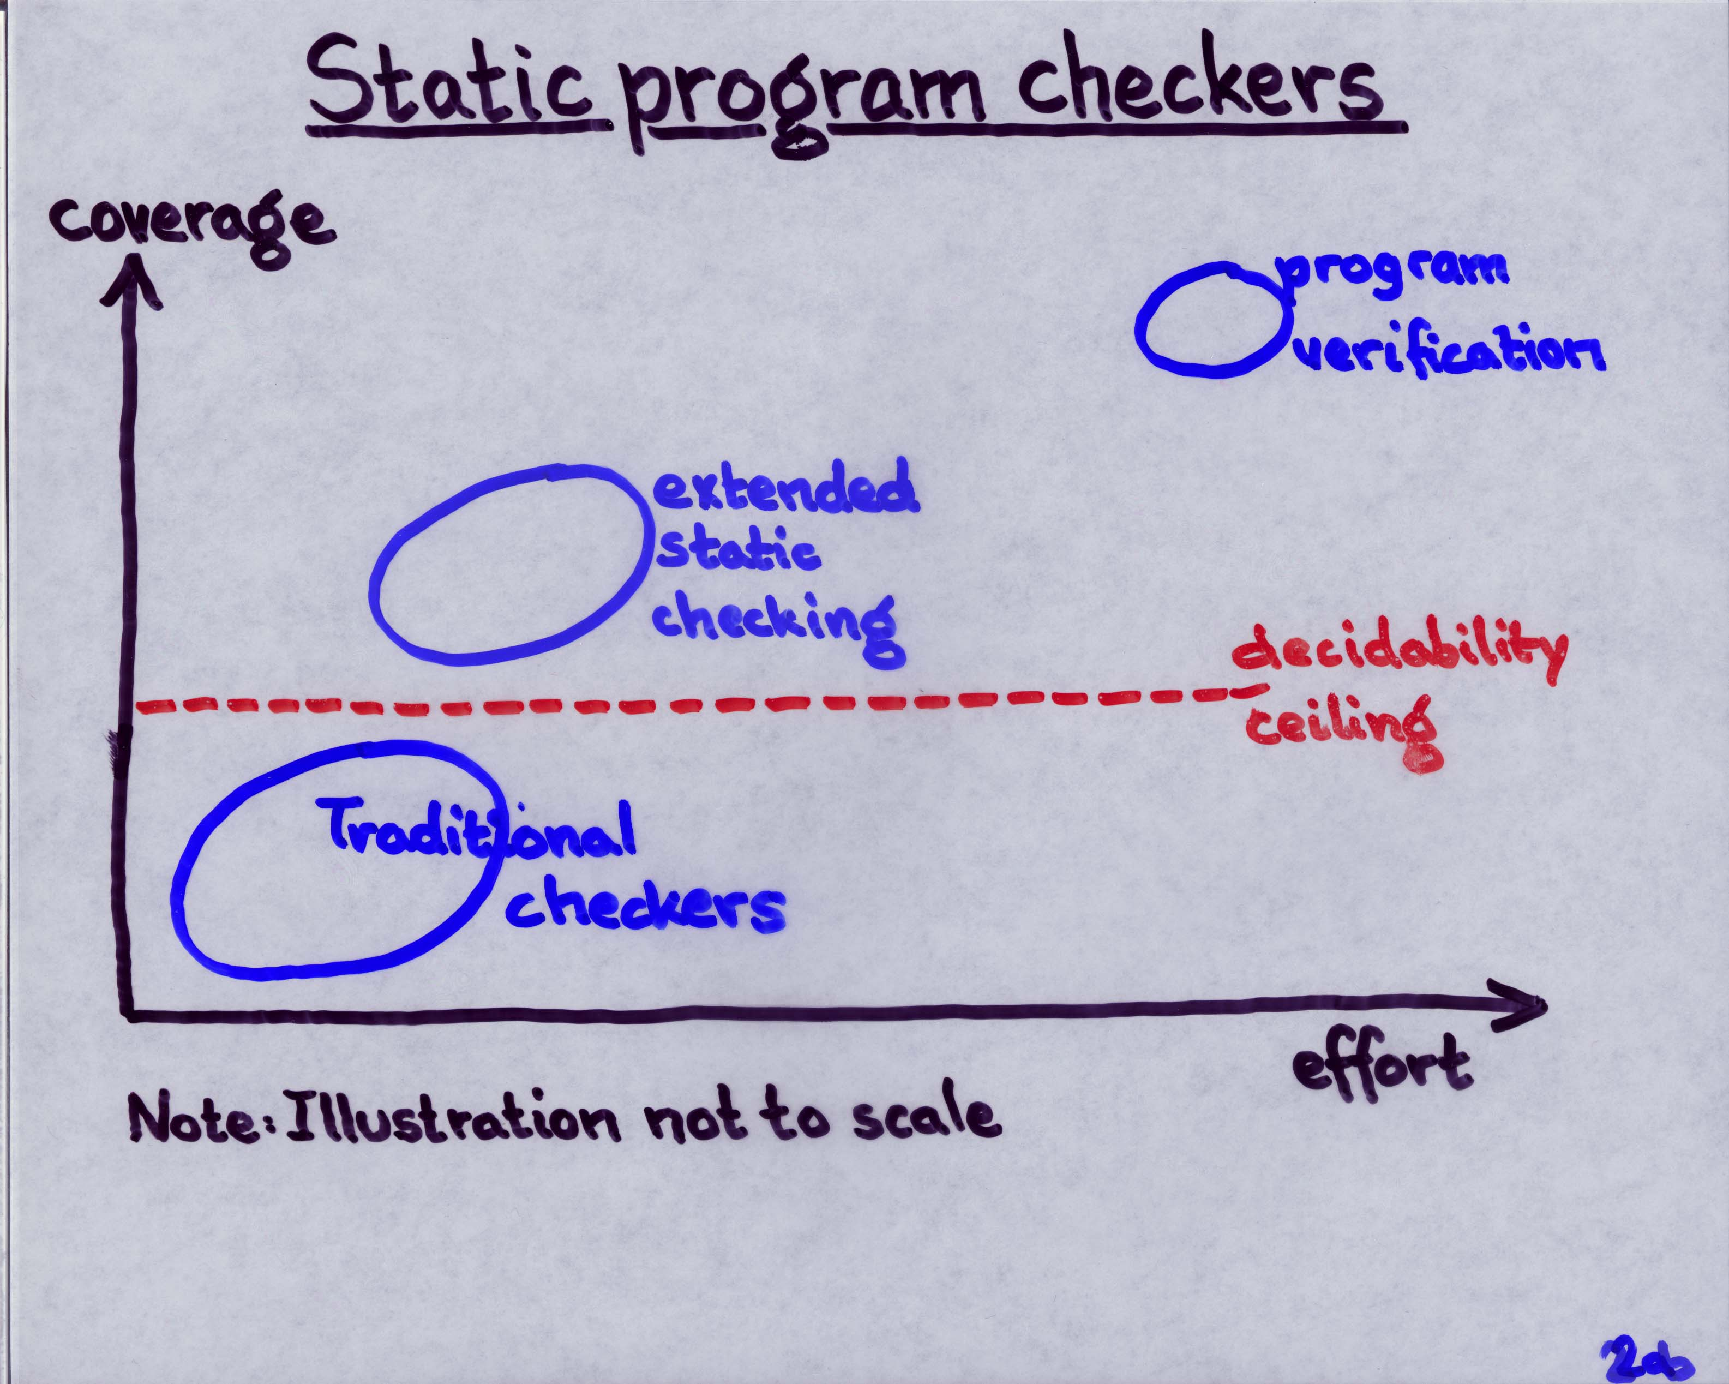
Program verification:
1998
Source: Invited talk “ESC/Java” by K.R.M. Leino at Larch User’s Group Meeting, FM’99, Toulouse, France, Sep 1999

Slide 17
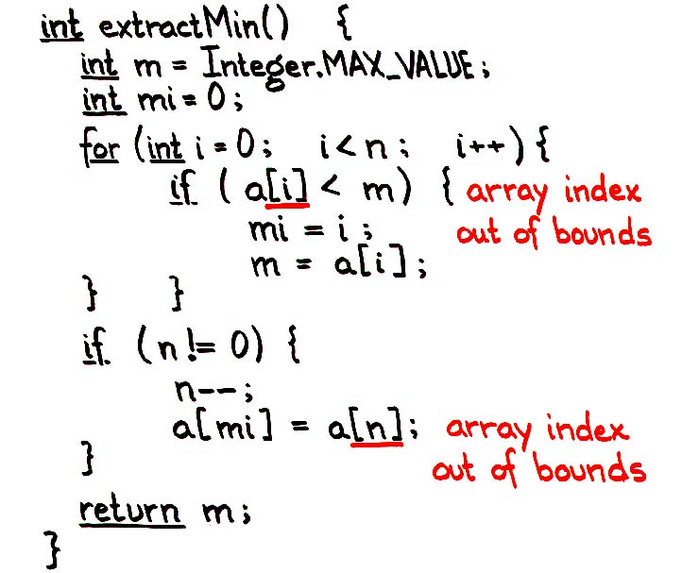
Program verification:
1998
Source: Talk and first (pre-tool) ESC/Java demo by K.R.M. Leino to Hopper et al. at DEC WRL, “Extended Static Checking for Java”, March 1998

Slide 18
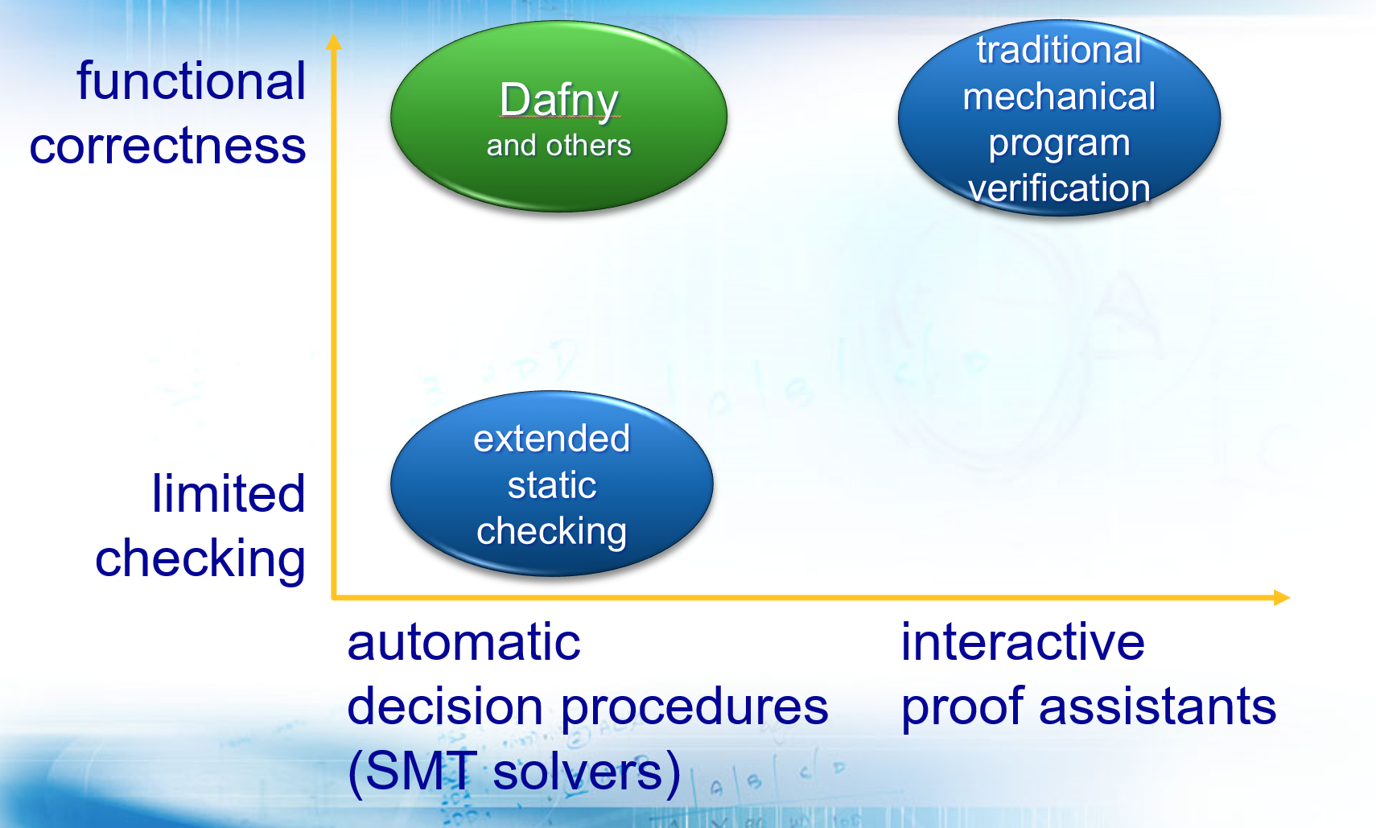
Program verification:
2008
Auto-active verification
Source: Paper presentation on Dafny by K.R.M. Leino at LPAR-16, Dakar, Senegal, April 2010

Slide 19
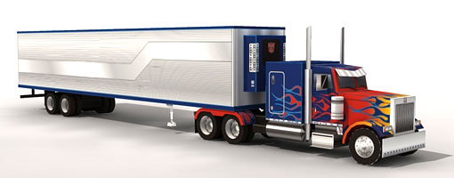
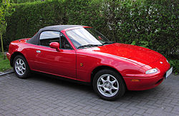
2010s
Annotated program text alone is not enough
Need ability to formalize models, state lemmas, and assist in proof authoring
This has always been possible in interactive proof assistants
  Coq, Isabelle/HOL, Agda, …
Now it has come to automated program verifiers as well
  Dafny, VeriFast, WhyML, F*, Liquid Haskell, …

Slide 20

Dafny
Put reasoning about programs first
Language aimed at reasoning
  Constructs for recording design decisions
Tool support
  Static program verifier enforces design decisions
Integrated development environment
  Tools help in reasoning process
  Verification is not an afterthought

Slide 21
Dafny
Imperative programming
  if, while, :=, class, …
Functional programming
  function, datatype, codatatype, …
Proof authoring
  lemma, calc, refines,
  inductive predicate, …

Slide 22
Imperative code
Demo: String comparison modulo hyphens
Compare two given strings for equality, ignoring hyphens.
For example:
  EqualModuloHyphens(“800-555-1212”, “8005551212”) == true
  EqualModuloHyphens(“800555-1212”, “800---5551212---”) == true
  EqualModuloHyphens(“800-abc-1212”, “800-555-1212”) == false

Slide 23
function RemoveHyphens(s: string): string {
if s == "" then s
else if s[0] == '-' then RemoveHyphens(s[1..])
else [s[0]] + RemoveHyphens(s[1..])
}
method EqualModuloHyphens(s: string, t: string) returns (eq: bool)
ensures eq <==> RemoveHyphens(s) == RemoveHyphens(t)

Slide 24
method EqualModuloHyphens(s: string, t: string) returns (eq: bool)
ensures eq <==> RemoveHyphens(s) == RemoveHyphens(t)
{
var i, j := 0, 0;
while true
invariant i <= |s| && j <= |t|
invariant RemoveHyphens(s) == RemoveHyphens(t) <==>
RemoveHyphens(s[i..]) == RemoveHyphens(t[j..])
decreases |s| + |t| - i - j
{
if i == |s| && j == |t| {
return true;
} else if i < |s| && s[i] == '-’ {
i := i + 1;
} else if j < |t| && t[j] == '-’ {
j := j + 1;
} else if i == |s| || j == |t| {
return false;
} else {
ghost var s', t' := RemoveHyphens(s[i..]), RemoveHyphens(t[j..]);
assert s'[0] == s[i] && t'[0] == t[j];
if s[i] == t[j] {
assert s'[1..] == RemoveHyphens(s[i+1..]);
assert t'[1..] == RemoveHyphens(t[j+1..]);
i, j := i + 1, j + 1;
} else {
return false;
}
}
}
}

Slide 25
Functional code
Demo: Hansel and Gretel
A path has left turns and right turns
At each turn, there is a breadcrumb
Hansel picks up the breadcrumbs for the left turns
Gretel picks up the breadcrumbs for the right turns

Slide 26
datatype List<A> = Nil | Cons(A, List<A>)
function Sum(list: List<int>): int {
match list
case Nil => 0
case Cons(x, tail) => x + Sum(tail)
}

Slide 27
datatype Path<L,R> = Stop | Left(L, Path) | Right(R, Path)
function Hansel<L,R>(p: Path): List<L> {
match p
case Stop => Nil
case Left(l, rest) => Cons(l, Hansel(rest))
case Right(_, rest) => Hansel(rest)
}
function Gretel<L,R>(p: Path): List<R> {
match p
case Stop => Nil
case Left(_, rest) => Gretel(rest)
case Right(r, rest) => Cons(r, Gretel(rest))
}

Slide 28
Proof authoring
Demo: Lemma that proves equality of two functions
function Diff(p: Path<int,int>): int {
Sum(Hansel(p)) - Sum(Gretel(p))
}
function FastDiff(p: Path<int,int>): int {
match p
case Stop => 0
case Left(l, rest) => FastDiff(rest) + l
case Right(r, rest) => FastDiff(rest) - r
}

Slide 29
function Diff(p: Path<int,int>): int {
Sum(Hansel(p)) - Sum(Gretel(p))
}
function method FastDiff(p: Path<int,int>): int {
match p
case Stop => 0
case Left(l, rest) => FastDiff(rest) + l
case Right(r, rest) => FastDiff(rest) - r
}
lemma DiffSame(p: Path<int,int>)
ensures Diff(p) == FastDiff(p)

Slide 30
lemma {:induction false} DiffSame(p: Path<int,int>)
ensures Diff(p) == FastDiff(p)
{
match p
case Stop =>
case Left(l, rest) =>
calc {
FastDiff(p);
== // def. FastDiff
FastDiff(rest) + l;
== { DiffSame(rest); }
Diff(rest) + l;
== // def. Diff
Sum(Hansel(rest)) - Sum(Gretel(rest)) + l;
== { assert Sum(Hansel(p)) == l + Sum(Hansel(rest)); }
Sum(Hansel(p)) - Sum(Gretel(rest));
== { assert Sum(Gretel(rest)) == Sum(Gretel(p)); }
Sum(Hansel(p)) - Sum(Gretel(p));
== // def. Diff
Diff(p);
}
case Right(r, rest) =>
calc {
FastDiff(p);
== // def. FastDiff
FastDiff(rest) - r;
== { DiffSame(rest); }
Diff(rest) - r;
== // def. Diff
Sum(Hansel(rest)) - Sum(Gretel(rest)) - r;
== { assert Sum(Hansel(p)) == Sum(Hansel(rest)); }
Sum(Hansel(p)) - Sum(Gretel(rest)) - r;
== { assert Sum(Gretel(rest)) + r == Sum(Gretel(p)); }
Sum(Hansel(p)) - Sum(Gretel(p));
== // def. Diff
Diff(p);
}
}

Slide 31
lemma DiffSame(p: Path<int,int>)
ensures Diff(p) == FastDiff(p)
{
// proof is done automatically by Dafny
}

Slide 32
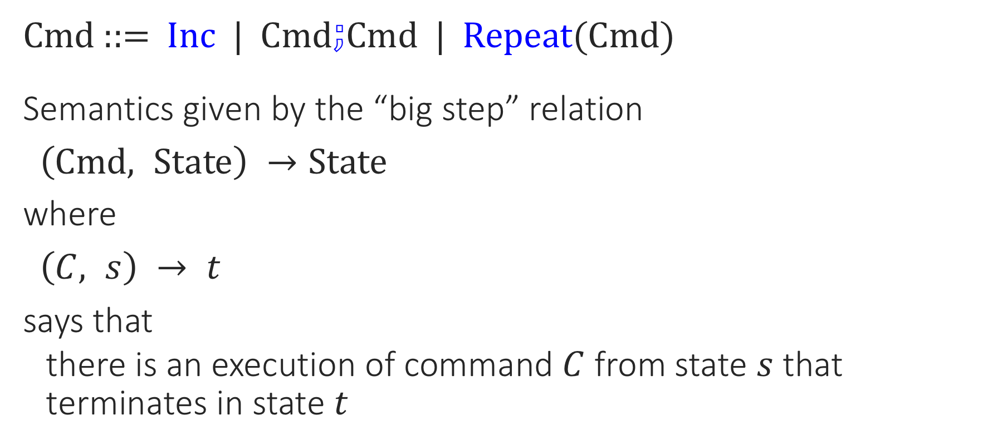
Program semantics: INC
Since we’re at OPLSS,
Cmd ::= Inc | Cmd$⨟$Cmd | Repeat(Cmd)
Semantics given by the “big step” relation
$\left(Cmd, State\right) →State$
where
$\left(C, s\right) → t$
says that
  there is an execution of command $C$ from state $s$ that terminates in state $t$

Slide 33
Semantics of INC
Cmd ::= Inc | Cmd$⨟$Cmd | Repeat(Cmd)
$\frac{t = s+1}{\left(Inc, s\right) → t}$
$\frac{\left(c0, s\right) → s^{′} \left(c1,{ s}^{′}\right) → t}{\left(c0⨟c1, s\right) → t}$
$\frac{t = s}{\left(Repeat\left(body\right), s\right) → t}$ $\frac{\left(body, s\right) →{ s}^{′} (Repeat\left(body), { s}^{′}\right) → t}{\left(Repeat\left(body\right), s\right) → t}$

Slide 34
Semantics of INC
Cmd ::= Inc | Cmd$⨟$Cmd | Repeat(Cmd)
$\frac{t = s+1}{\left(Inc, s\right) → t}$
$\frac{\text{∃}{ s}^{′}\text{.} \left(c0, s\right) → s^{′} \left(c1,{ s}^{′}\right) → t}{\left(c0⨟c1, s\right) → t}$
$\frac{t = s}{\left(Repeat\left(body\right), s\right) → t}$ $\frac{\text{∃}{ s}^{′}\text{.} \left(body, s\right) →{ s}^{′} (Repeat\left(body), { s}^{′}\right) → t}{\left(Repeat\left(body\right), s\right) → t}$

Slide 35
datatype cmd = Inc | Seq(cmd, cmd) | Repeat(cmd)
type state = int
inductive predicate BigStep(c: cmd, s: state, t: state)
{
match c
case Inc =>
t == s + 1
case Seq(c0, c1) =>
exists s' :: BigStep(c0, s, s') && BigStep(c1, s', t)
case Repeat(body) =>
s == t ||
exists s' :: BigStep(body, s, s') && BigStep(c, s', t)
}

Slide 36
inductive lemma {:induction false} Monotonic(c: cmd, s: state, t: state)
requires BigStep(c, s, t)
ensures s <= t
{
match c
case Inc =>
case Seq(c0, c1) =>
var s' :| BigStep(c0, s, s') && BigStep(c1, s', t);
Monotonic(c0, s, s’);
Monotonic(c1, s', t);
case Repeat(body) =>
if s == t{
} else {
var s' :| BigStep(body, s, s') && BigStep(c, s', t);
Monotonic(body, s, s’);
Monotonic(c, s', t);
}
}

Slide 37
inductive lemma Monotonic(c: cmd, s: state, t: state)
requires BigStep(c, s, t)
ensures s <= t
{
// proof is done automatically by Dafny
}

Slide 38
Encryption libraries
Source
Target platforms
.NET
JavaScript
Go
Java

Slide 39
ARG internships -- join us!

